Slide 1



Saarland
University
Diffusion, First Passage Processes, Reactions
H. Rieger
Center for Biophysics & Physics Department
Saarland University, Saarbrücken, Germany
ICTS program „Statistical Biological Physics: From Single Molecule to Cell“,
Bangalore, 11.-22.10.2022

Slide 2
First passage problems
Scheme of a two target
first-passage problem
Scheme of a generic
first-passage problem
Scheme of a discrete
first-passage problem
Scheme of a
first-exit problem
FPT(t) = probability density for the first-passage time,
i.e the first time the random walker hits a target
(start at position r_{s,} target at position r_{t})

Slide 3

MFPT of Brownian motion in confined geometries
$$\frac{L^{2}}{D}$$
1d
~
2d
3d
L, A, V system size (in 1,2,3d)
R initial searcher-target distance
a target size
D diffusion constant
[Condamin etal, PRL 2005]

Slide 4
Optimizing search strategies
A search strategy is simply one parameter set
for the of a stochastic process / random walk under consideration
Example:
Intermittent search
Walker / searcher alternates
stochastically between
ballistic and diffusive behavior
[Bénichou etal, PRL 2005]
Minimum!
[Loverdo etal, Nat.Phys. 2008]

Slide 5
Spatial Organization of the Cytoskeleton
Filament distribution establishes a
spatially inhomogeneous (ρ_{Ω}(r) ≠ const.) search strategy
⬇ Escape region
Mathematical idealization for spherical cells with centrosome:
& automatic switch to diffusion
at r=0 (MTOC), r=R-Δ (cortex boundary),
r=R (membrane)

Slide 6
Results: NEP – inhomogeneous strategy
MFPT with k_{opt}, k‘_{opt} from hom. str.
as function of Δ
MFPT with k‘=0 as function of k and Δ
MFPT with fixed k,k‘ vs. Δ
[Schwarz … HR, PRL 117, 068101 (2016)]

Slide 7
Results
Spatially inhomogeneous better than homogeneous search strategies
Superior strategy for 3 standard search problems:
Ballistic transport between center and the boundary plus
thin boundary layer of multidirectional transport
Similar results obtained for non-intermittent search -
persistent random walk / random velocity model
Spatial organization of the cytoskeleton represents an
efficient spatially inhomogeneous search strategy
Boundary layer = actin cortex:
Thin cortex is more efficient than thick cortex!
Actin cortex accelerates transport tangential to the boundary
Reminiscent of purely diffusive search with enhanced surface diffusion

Slide 8

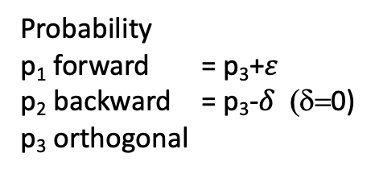
Optimizing search strategies (2)
Example: Persistent Walk
MFPT vs l_{p}
Probability
p₁ forward = p₃+$ε$
p₂ backward = p₃-$δ$ (δ=0)
p₃ orthogonal
$⇒$ persistence length l_{p} ~ 1/(1- $ε$)
l_{p}/L
Minimum!
[Tejdor etal, PRL 2012]

Slide 9
Non-Markovian random walks with n-step memory
Conditional transition probabilities:
= average first passage time to reach the target
at position r_{T} with n last directions
Backward equation for T_{n}:
n
Solution:
[Meyer, HR: PRL 2021]

Slide 10
Optimal search strategies with n-step memory
Optimal search strategies on a
2d square lattice for n = 1, 2, 3
The corresponding MFPT normalized
by the MFPT for a blind random walk
[Meyer, HR: PRL 2021]

Slide 11
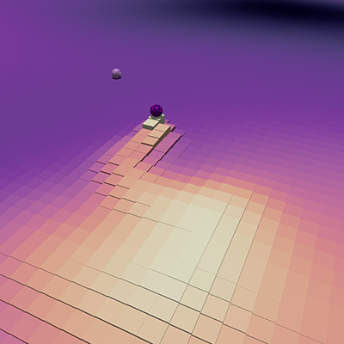
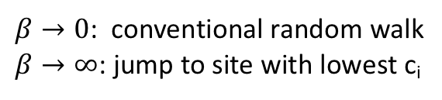
The auto-chemotactic searcher
Philosophy:
try to avoid sites already visited!
Searcher releases chemo-repulsive
diffusive cue c_{i}
Transition probabilities:
$β→0$: conventional random walk
$β→∞$: jump to site with lowest c_{i}
[Meyer, HR: PRL 2021]

Slide 12
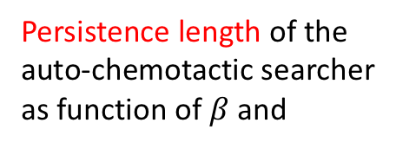
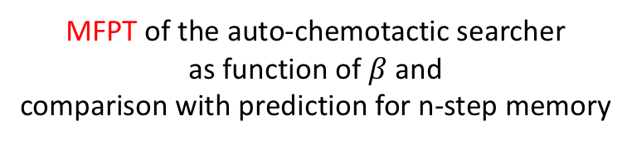
Optimal search strategy f. auto-chemotactic searcher
Persistence length of the
auto-chemotactic searcher
as function of $β$ and
MFPT of the auto-chemotactic searcher
as function of $β$ and
comparison with prediction for n-step memory
[Meyer, HR: PRL 2021]

Slide 13


N searcher / M targets
Consider confined 2d space, area A:
N independent, non-communicating random walkers, 1 target:
FPT₁(t) ~e^{-t/}$τ$ $⟹$ MFPT₁ ~ $τ$ $⟹$ MFPT_{N} ~ $τ$/N
1 random walker, M randomly distributed targets:
MFPT_{first target} ~ 1/M$β$, with $β$~1.
MFPT_{all targets} ~ cover time(A) for M/A -> 1.

Slide 14



N chemotactic searchers, 1 target
Optimal coupling $β$ to chemotactic field c
Persistence length vs. coupling $β$
optimal coupling
l_{p}($β→∞$) vs N
[Meyer, HR: t.b.p]

Slide 15
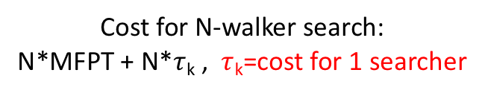
N chemotactic searchers, 1 target
Compare MFPT(N,L²) (N searcher in area L²)
with MFPT(1,L²/N) (1 searcher in area (L²/N))
Cost for N-walker search:
N*MFPT + N*$τ$_{k} , $τ$_{k}=cost for 1 searcher
worse
optimal N
better
[Meyer, HR: t.b.p]

Slide 16
Title

