Slide 1



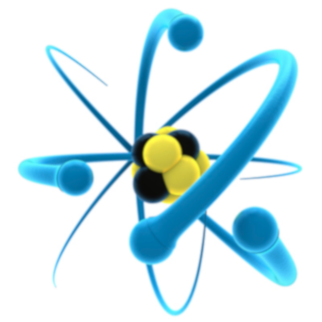
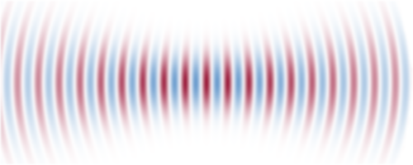

Dynamics of information in collective states of a spin ensemble
Himadri Shekhar Dhar
Department of Physics and
Center for Quantum Information Computing Science & Technology
Indian Institute of Technology Bombay
Quantum Trajectories
International Centre for Theoretical Sciences, Bengaluru
20 Jan - 07 Feb 2025

Slide 2
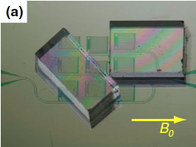
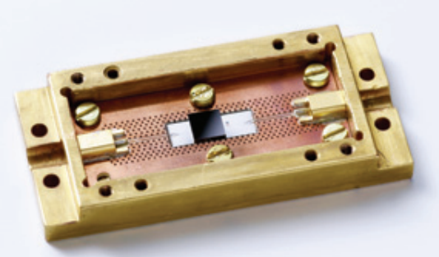
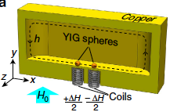
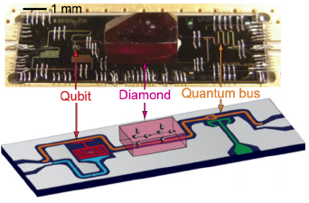
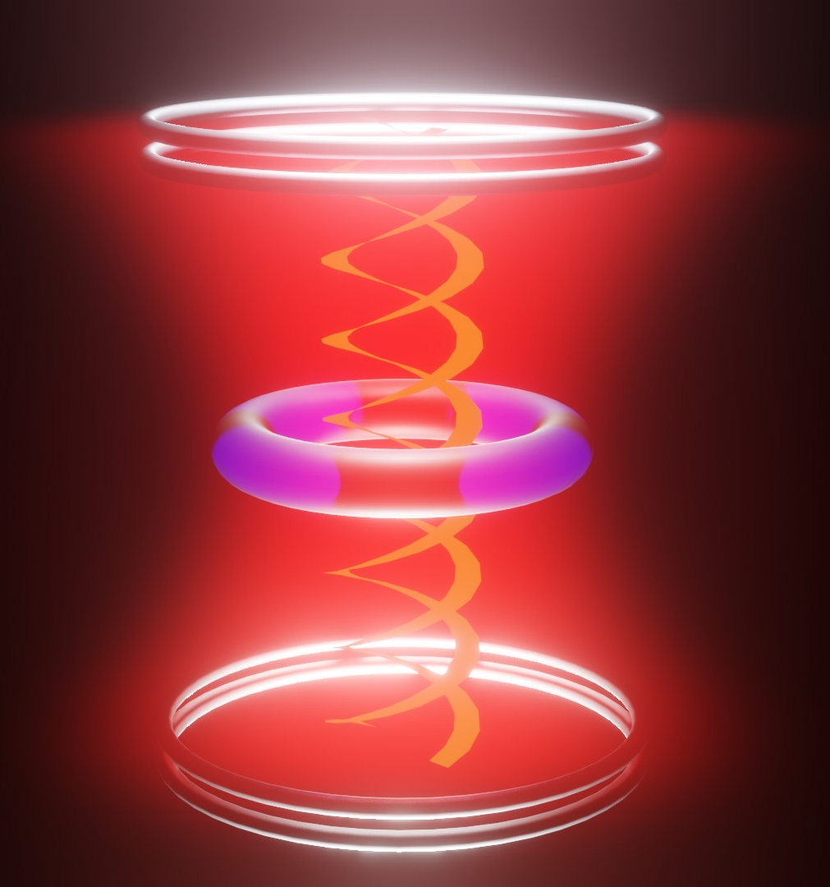
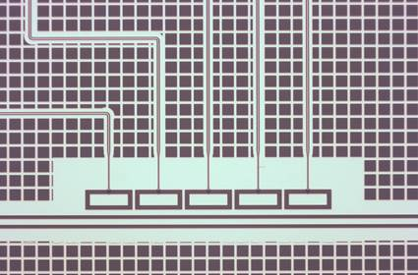
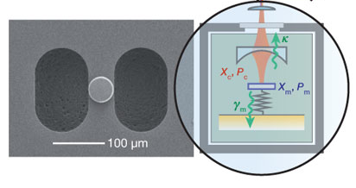
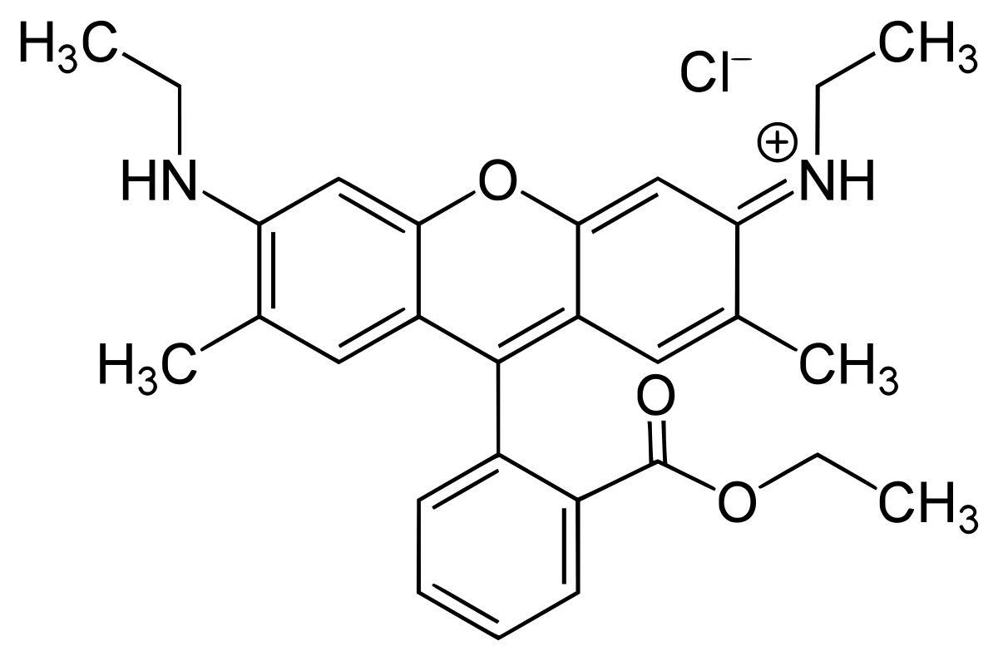
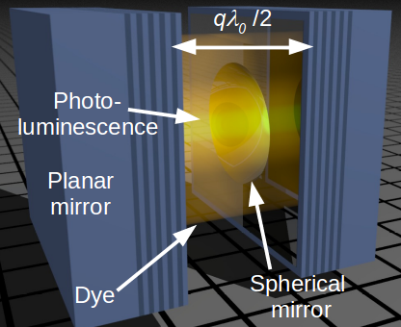
Outline – collective states
Rare earth spin ensemble
Ensemble of NV spins
with MW resonator
Magnetic structures in copper cavity
Hybrid quantum systems
Superconducting qubit
with MW resonator
BEC in a cavity
Optomechanical system
Molecules in a microcavity
Notes:
Rb atom in nanoscale photonic crystal cavity 2. Rb atom in whispering-gallery mode of a bottle microresonator 3. Quantum dot in photonic nano cavity. 4. Optamechanical resonator inside a high Q optical cavity. 5. Superconducting qubits. In our group we work on various theoretical frameworks from single atoms to collection of atoms in a cavity.
Most importantly, the strong coupling limit has also been realized not just with real atoms but also with artificial resonators, like here (strongly coupled exciton-photon system based on photonic crystal nanocavity interacting with a single quantum dot) or in optomechanics (micromechanical resonators). One important aspect of strong-coupling is that it can also be used for coherent information transfer between the electromagnetic field and such a qubit – interesting for quantum information science. The most successful artificial systems that have been realized in this context are super-conducting qubits. Super-conducting qubits are built with nano-fabricated Josephson junctions and depending on whether the charge or the phase is a good quantum number one speaks of a charge or flux qubit. One of the numerous advantages of such artificial systems is the tunability of both the coupling strength and the transition frequency.

Slide 3
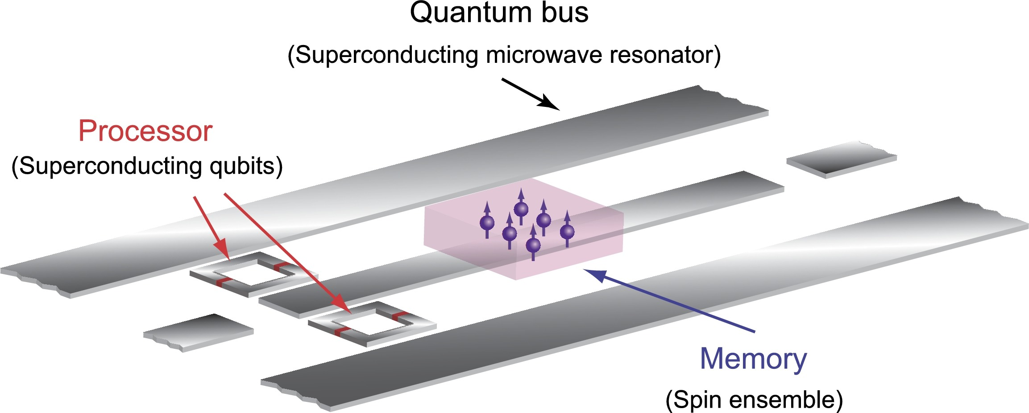
Outline – collective states
What are hybrid quantum systems?
Communicating information
Controlled information processing
Static qubit
Good coherence
C. Grezes et al., Comptes Rendus Physique (2016)

Slide 4
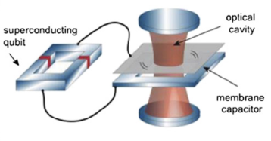
Outline – collective states
What are hybrid quantum systems?
Quantum processing/ storage
Superconducting or semiconductor qubit
NV centre based spin ensemble
Superconducting line resonator
Communication/transduction
Superconducting or semiconductor qubit
Optomechanical membrane
Optical cavity
Kurizki et al., PNAS (2015)

Slide 5
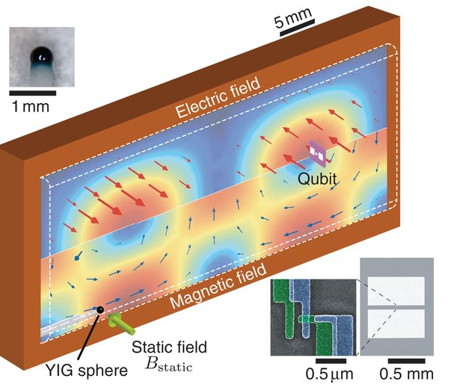
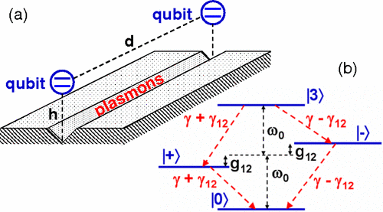
Outline – collective states
What are hybrid quantum systems?
Information processing
Superconducting qubit
Magnon (YIG sphere)
Microwave cavity
Tabuchi et al., Science (2015)
Waveguide mediated entanglement
Two Distant qubit
Plasmon waveguide
Gonzalez-Tudela et al., Phys. Rev. Lett. (2011)

Slide 6
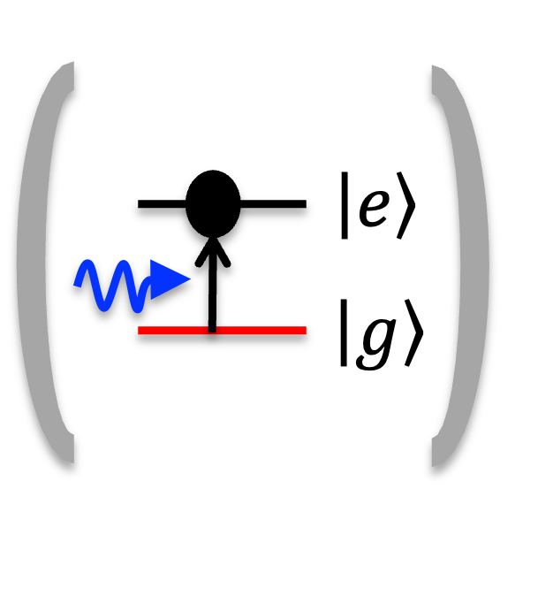
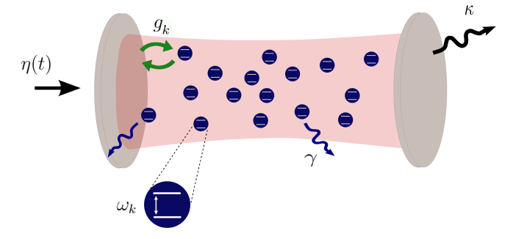
Outline – collective states
System dynamics from
single qubits to spin ensemble
Nonclassical physics
Entanglement/single-photon
Exact quantum dynamics
Hybrid quantum system
Collective phenomena
Quantum memories/ sensing
Semiclassical/mean-field
Gurizki et al., PNAS (2015)
C. Grezes et al., Comptes Rendus Physique (2016)

Slide 7
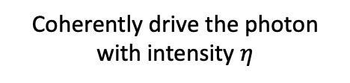
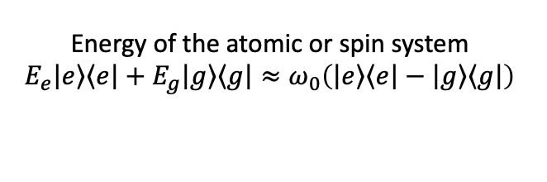
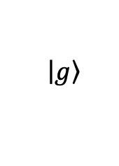
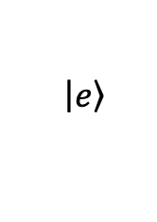

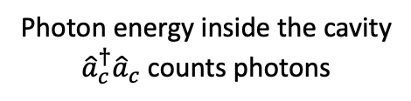
Interaction between an atom and light
Jaynes-Cummings Hamiltonian
$$\left|\left.e\right\rangle \right.$$
$$\left|\left.g\right\rangle \right.$$
A two-level atom or spin interacting with light
$$ℋ=\frac{1}{2}ω_{0}σ^{z}+ω_{c}{\hat{a}}_{c}^{†}{\hat{a}}_{c}+g\left(σ^{−}{\hat{a}}_{c}^{†}+σ^{+}{\hat{a}}_{c}\right)+ i\left(η {\hat{a}}_{c}^{†}e^{−iω_{p}t}−η^{∗}{\hat{a}}_{c}e^{iω_{p}t}\right)$$
Photon energy inside the cavity
${\hat{a}}_{c}^{†}{\hat{a}}_{c}$ counts photons
Coherently drive the photon with intensity $η$
Energy of the atomic or spin system
$$E_{e}\left|\left.e\right\rangle \right.\left\langle \left.e\right|\right.+E_{g}\left|\left.g\right\rangle \right.\left\langle \left.g\right|\right.≈ω_{0}\left(\left|\left.e\right\rangle \right.\left\langle \left.e\right|\right.−\left|\left.g\right\rangle \right.\left\langle \left.g\right|\right.\right)$$
Spin-photon coupling: $e \vec{r.}\vec{𝓔}$
keeping energy conserving terms
Other interactions – counter-rotating, optomechanical, nonlinear etc.

Slide 8
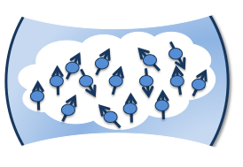
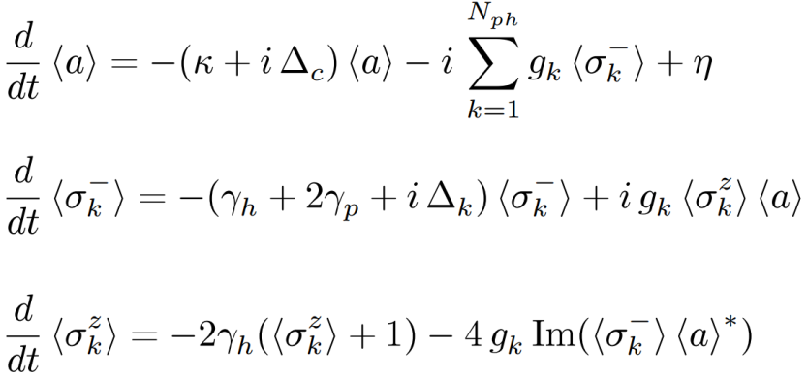
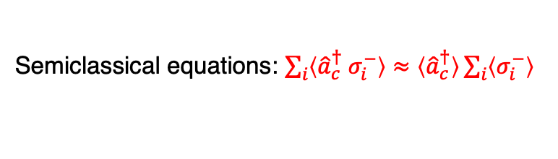
Solving collective spin cavity systems
Tavis-Cummings Hamiltonian
$$ℋ=\frac{1}{2}\sum_{k=1}^{N}{{ω^{′}}_{k}σ_{k}^{z}}+ω_{c}{\hat{a}}_{c}^{†}{\hat{a}}_{c}+\sum_{k=1}^{N}{g_{k}\left(σ_{k}^{−}{\hat{a}}_{c}^{†}+ σ_{k}^{+}{\hat{a}}_{c}\right)}+ i\left(η\left(t\right){\hat{a}}_{c}^{†}e^{−iω_{p}t}−η^{∗}\left(t\right){\hat{a}}_{c}e^{iω_{p}t}\right)$$
Lindblad equation for the open dynamics
$$η, ω_{p}$$
$$κ$$
$$γ_{k}$$
$$ω_{c}$$
Semiclassical equations: $\sum_{i}{〈{\hat{a}}_{c}^{†} σ_{i}^{−}〉}≈〈{\hat{a}}_{c}^{†}〉\sum_{i}{〈σ_{i}^{−}〉}$
For full quantum solutions for finite spins
Increase in Hilbert space
with N limits computation
(4^{N} x n_{c}⁴)
Effective Hamiltonians – low excitations
Quantum trajectories – Small spin ensemble
Permutation symmetry – identical spins, small ensemble

Slide 9
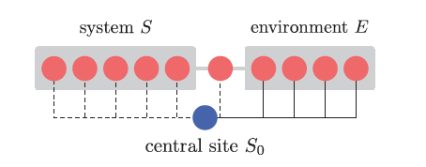
Solving collective spin cavity systems
Tavis-Cummings Hamiltonian
$$ℋ=\frac{1}{2}\sum_{k=1}^{N}{{ω^{′}}_{k}σ_{k}^{z}}+ω_{c}{\hat{a}}_{c}^{†}{\hat{a}}_{c}+\sum_{k=1}^{N}{g_{k}\left(σ_{k}^{−}{\hat{a}}_{c}^{†}+ σ_{k}^{+}{\hat{a}}_{c}\right)}+ i\left(η\left(t\right){\hat{a}}_{c}^{†}e^{−iω_{p}t}−η^{∗}\left(t\right){\hat{a}}_{c}e^{iω_{p}t}\right)$$
Lindblad equation for the open dynamics
$$η, ω_{p}$$
$$κ$$
$$γ_{k}$$
$$ω_{c}$$
For full quantum solutions for finite spins
Increase in Hilbert space
with N limits computation
(4^{N} x n_{c}⁴)
Variational renormalization methods to solve this regime

Slide 10
Variational renormalization group method
Quantum states/ Unitary dynamics
Many body quantum state
Large Hilbert space
For weakly entangled
state
Renormalized/truncated
space
Underlying principle in variational renormalization group methods
Density Matrix Renormalization Group
Matrix Product States
Tensor Network Methods

Slide 11
Variational renormalization group method
Quantum states/ Unitary dynamics
Many body quantum state
Large Hilbert space
For weakly entangled
state
Renormalized/truncated
space
Density operators/ Open dynamics
For weakly correlated
state
Large superoperator space
Renormalized/truncated
space
Zwolak and Vidal, Phys. Rev. Lett. (2004)
Datta and Vidal, Phys. Rev. Lett. (2007)

Slide 12
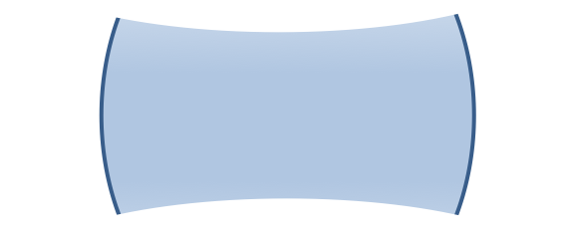
Variational renormalization group method
Total spins, N = S + E +1 Dimension 4^{N}
S
E
cavity
Renormalized
4^{S} D
Renormalized
4E D
Renormalized dimension
4^{N} 4D²
Central-body problem
$$\frac{d\left|\left.ρ\right\rangle \right.}{dt}=ℒ\left|\left.ρ\right\rangle \right.=\sum_{i=1}^{N}{ℒ_{i}}\left|\left.ρ\right\rangle \right.; ℒ_{i}=ℒ_{i,s}+\frac{1}{N}ℒ_{c}$$
HSD, M. Zens et al. Phys. Rev. Lett. (2018)

Slide 13
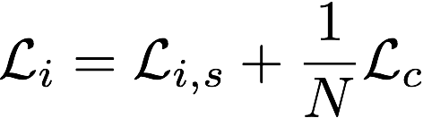

How does it work?
-
Suzuki-Trotter (ST) decomposition
$${ρ\left(t+Δt\right)=e}^{𝓛∆t}ρ(t)$$

Slide 14

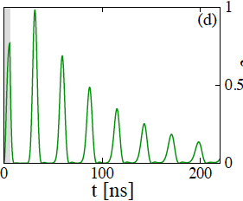
Dynamics of information in collective states
Atomic frequency comb
We want to combine the collective and nonclassical features
Multimode quantum memory
atomic frequency comb
Riedmatten et al., Nature 456, 773 (2008)
Afzelius et al., PRA 79, 052329 (2009)
Krimer, Laser & Photon. Rev. (2016)

Slide 15
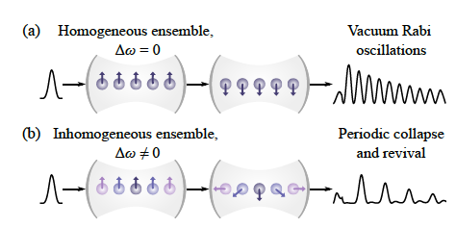
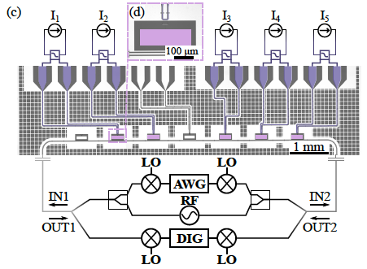
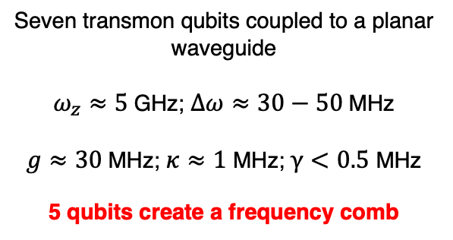
Collective effects in a superconducting AFC
Homogeneous ensemble: Rabi oscillations
AFC: Periodic revival
Seven transmon qubits coupled to a planar waveguide
$ω_{z}≈5$GHz; $∆ω≈30−50$MHz
$g≈30$MHz; $κ≈1$ MHz; $γ<0.5$ MHz
5 qubits create a frequency comb
E.S. Redchenko, M.Zens,…,HSD et al. PRL (2025)

Slide 16
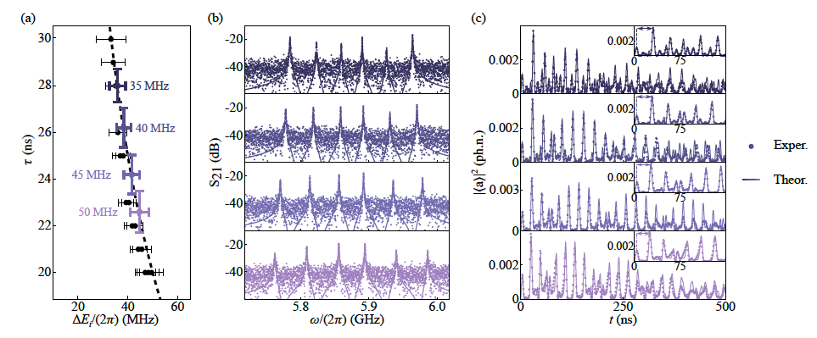
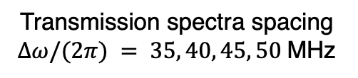
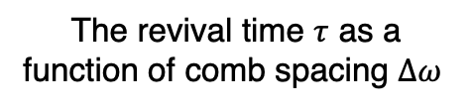
Collective effects in a superconducting AFC
The revival time $τ$ as a function of comb spacing $Δω$
Revival in the transmission
Transmission spectra spacing $Δω/(2π) = 35, 40, 45, 50$MHz

Slide 17
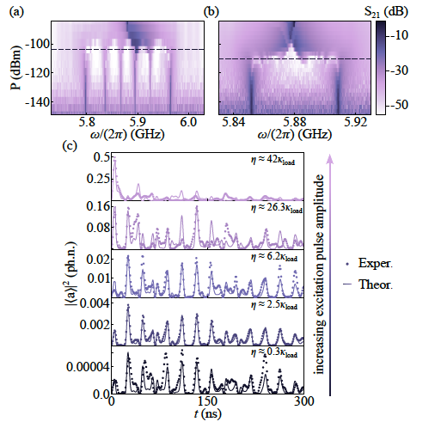
Collective effects in a superconducting AFC
Dressed states of the ensemble gets saturated at least ∼ 6 dB higher power than that a single qubit
1764 photons
38 photons
0.1 photon
High
Photon
number

Slide 18
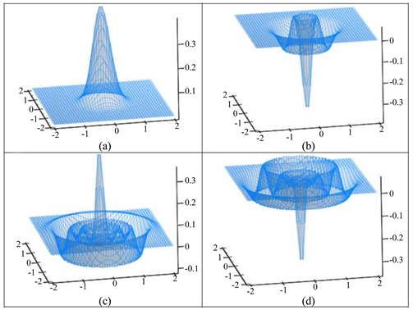

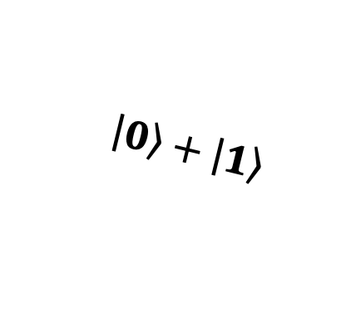
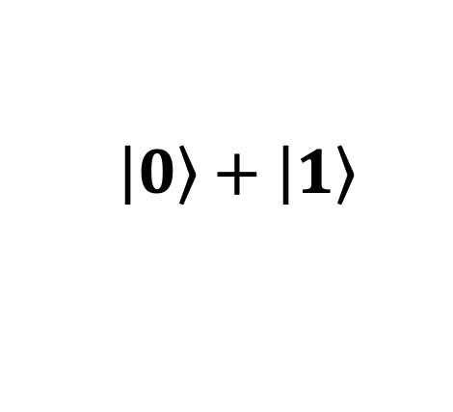
Transferring information to collective states
$$\left|\left.0\right\rangle \right.+\left|\left.1\right\rangle \right.$$
$$\left|\left.0\right\rangle \right.+\left|\left.1\right\rangle \right.$$
Atomic frequency comb
(~100 spins)
At some later time
Initial cavity state
Final cavity state

Slide 19
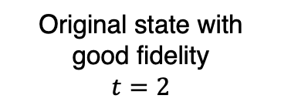
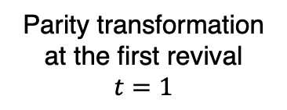
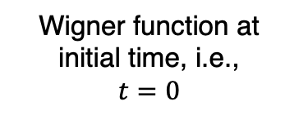
Transferring information to collective states
Wigner function at initial time, i.e.,
$$t=0$$
Parity transformation at the first revival
$$t=1$$
Original state with good fidelity
$$t=2$$

Slide 20
Transferring information to collective states
Fidelity of the revived state is dependent on the shape of the atomic frequency comb
Adjusting the coupling strength in each tooth of the comb
High fidelity at the output even at 4th revival

Slide 21
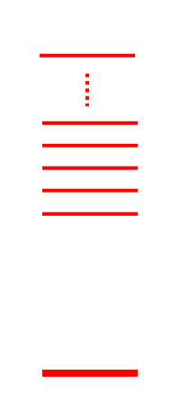

Transferring information to collective states
Fidelity of the revived state is dependent on the shape of the atomic frequency comb
$$∆E_{i}$$
M. Zens, D. Krimer, HSD et al., Phys. Rev. Lett. (2021)

Slide 22
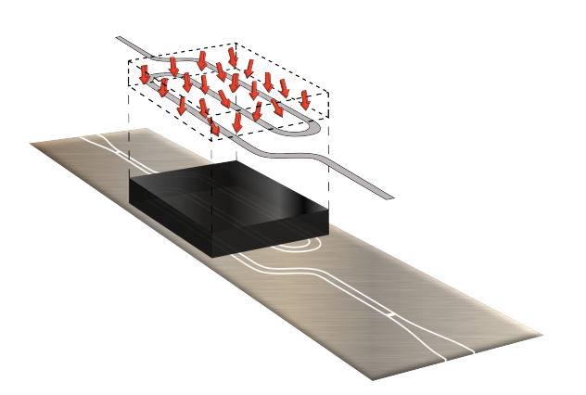
Protecting information in inhomogeneous ensemble
Inhomogeneous broadening: Spins are non-identical in an ensemble
Inhomogeneous broadening decoherence:
Krimer, Putz, Majer, Rotter, PRA (2014)

Slide 23
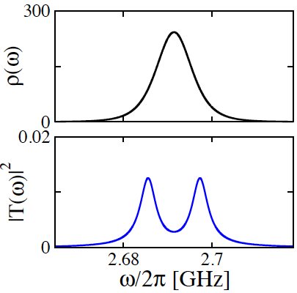
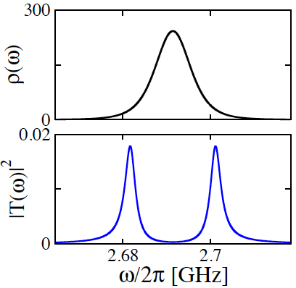
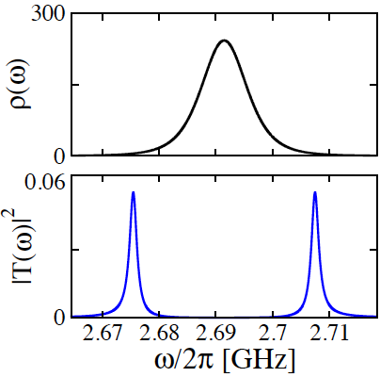


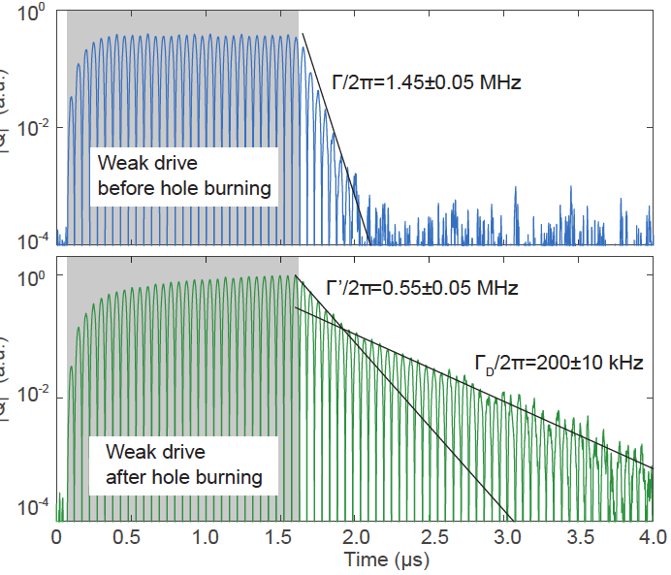
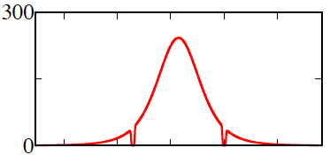
Protecting information in inhomogeneous ensemble
Inhomogeneous broadening decoherence:
Spectral hole burning
Cavity protection effect
spectral holes
Diniz et al., PRA (2011)
Putz et al., Nature Physics (2014)
Krimer et al., PRL (2015)
Putz et al., Nature Photonics (2017)

Slide 24
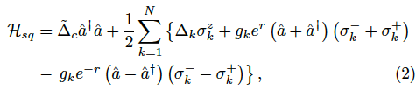


Protecting information via parametric drive
In the squeezed frame:
Dicke model
Parametric drive
S. Tiwary, H. Sharma and HSD (2024)

Slide 25


Protecting information via parametric drive
In the squeezed frame:
Dicke model
Semiclassical dynamics
$Ω=g_{k}⟶$ $g_{k}e^{r}$
Rabi oscillations with
increased effective coupling
Rate of decay decreases with increased squeezing for different width of spin distribution
S. Tiwary, H. Sharma and HSD (2024)

Slide 26










Protecting information via parametric drive
$$\frac{1}{\sqrt{2}}\left\{\left|\left.1\right\rangle \right.+\left|\left.2\right\rangle \right.\right\}$$
Encoding a quantum state:
Quantum dynamics on $N\sim 100$
$$δ=0.75 Ω$$
$$r≤1.38$$
$$r≤1.73$$
$$δ=1.5 Ω$$
S. Tiwary, H. Sharma and HSD (2024)

Slide 27




Protecting information via parametric drive
$$\frac{1}{\sqrt{2}}\left\{\left|\left.1\right\rangle \right.+\left|\left.2\right\rangle \right.\right\}$$
Encoding a quantum state:
Quantum dynamics on $N\sim 100$
Fidelity and Wigner function of the encoded quantum state
Initial state for $δ=0.75 Ω$
State at $t$, for $r=0$
State at $t$, for $r=1.75$
S. Tiwary, H. Sharma and HSD (2024)

Slide 28
In conclusion
Theoretical study of collective states and hybrid architectures offers a rich playground for design and control of quantum protocols
Information storage and protection
Quantum communication and sensing in CV systems
Error-correction for collective states!!

Slide 29










Acknowledgments
Matthias Zens
Elena Redchenko
Siddhartha Tiwary
(IIT Bombay, now at U. Berkeley)
Harsh Sharma
(IIT Bombay)
Stefan Rotter
Johannes Fink
Rahul, Sudipta, and Harsh
(IIT Bombay)

Slide 30
Thank you.

