Slide 1

Superconductor-Insulator Transition in Weakly Monitored Josephson Junction Arrays
Sumilan Banerjee
Centre for Condensed Matter Theory, Department of Physics,
Indian Institute of Science
Quantum Trajectories,
ICTS, January 22, 2025

Slide 2

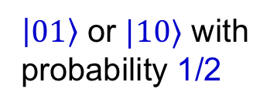
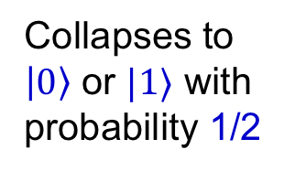
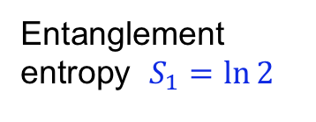
Superposition
Measurement
Collapses to
$\left|0\right\rangle$ or $|1⟩$ with
probability 1/2
$$\left|ψ\right\rangle =(|0⟩+|1⟩)/√2$$
Entanglement
Measure state
of one qubit
$\left|ψ\right\rangle =\frac{1}{\sqrt{2}}\left(|01⟩+|10⟩\right)$
Entanglement
entropy $S_{1}=\ln{2}$
$\left|01\right\rangle$ or $|10⟩$ with
probability 1/2
Unentangled product state
Can measurements change the nature of many-body systems and
induce phase transitions?
A
A
Measurements
Metal
or
Superconductor
Insulator
??

Slide 3
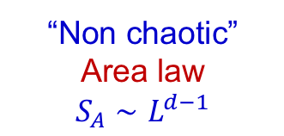
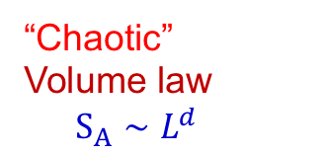
Measurement-induced phase transition (MIPT)
Random quantum circuits with non-unitary evolution
Unitary evolution + measurements
local projective or weak measurements
Tune measurement rate, measurement strength, etc., ..
Other systems – non-interacting fermions,
interacting bosons, Luttinger liquids, ..
Skinner et al. (2019), Bao et al. (2019);
Li et al. (2019), Jian et al. (2019),
Gullans et al. (2020), Nahum et al. (2021)
Sang et al. (2021), ...
“Chaotic”
Volume law
$S_{A}∼L^{d}$
“Non chaotic”
Area law ${S_{A}∼L}^{d−1}$
Transition in steady state from
volume-law to area-law
entanglement
Chaotic to non-chaotic phase transitions

Slide 4
Can measurements change the nature of many-body systems and
induce phase transitions?
Measurements
Superconductor
Insulator
??

Slide 5

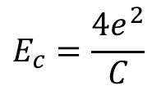
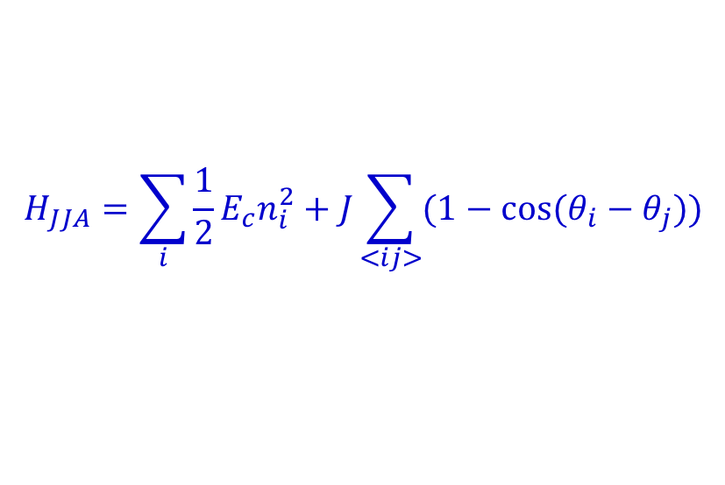
Measurement Induced Superconductor-Insulator Transitions in
Josephson Junction Array (JJA)
P. Das & SB, arXiv:2412.04556
Purnendu Das
(IISc)
$$H_{JJA}=\sum_{i}{\frac{1}{2}E_{c}n_{i}^{2}+J\sum_{<ij>}{(1−\cos{(θ_{i}−θ_{j})})}}$$
$$E_{c}=\frac{4e^{2}}{C}$$
$$\left[θ_{i},n_{j}\right]=iδ_{ij}$$
Quantum XY model

Slide 6

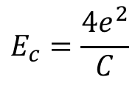
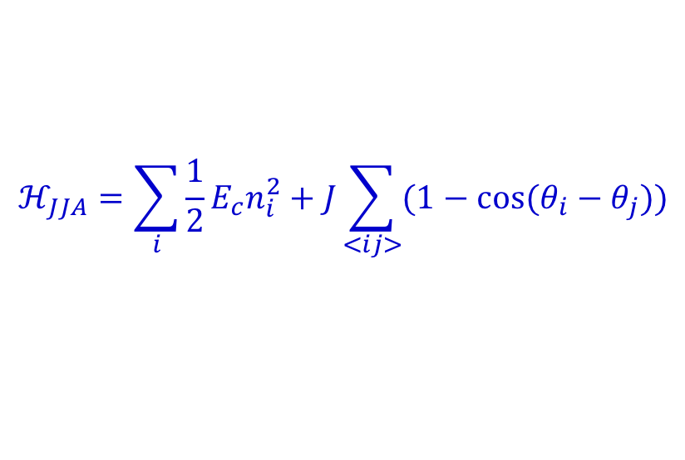
Superconductor-insulator quantum phase transitions
Josephson Junction Array (JJA)
Superconductor-insulator
transition (SIT)
H. van der Zant,
et al.
Phys. Rev. B (1996)
L. J. Geerligs, Thesis, Delft (1990)
R. Fazio & H. van der Zant,
Phys. Rep. (2001)
$$ℋ_{JJA}=\sum_{i}{\frac{1}{2}E_{c}n_{i}^{2}+J\sum_{<ij>}{(1−\cos{(θ_{i}−θ_{j})})}}$$
$$\left[θ_{i},n_{j}\right]=iδ_{ij}$$
$$E_{c}=\frac{4e^{2}}{C}$$

Slide 7
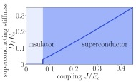
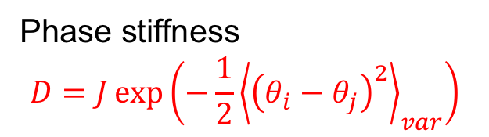

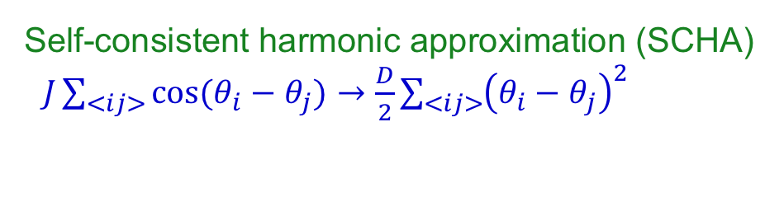
Superconductor-insulator quantum phase transitions
$$z=2d$$
Self-consistent harmonic approximation (SCHA)
$J\sum_{<ij>}{\cos{(θ_{i}−θ_{j})}}→\frac{D}{2}\sum_{<ij>}{{\left(θ_{i}−θ_{j}\right)}^{2}}$
Phase stiffness
$$D=J\exp\left(−\frac{1}{2}{\left\langle {\left(θ_{i}−θ_{j}\right)}^{2}\right\rangle }_{var}\right)$$
Typically first order transition

Slide 8
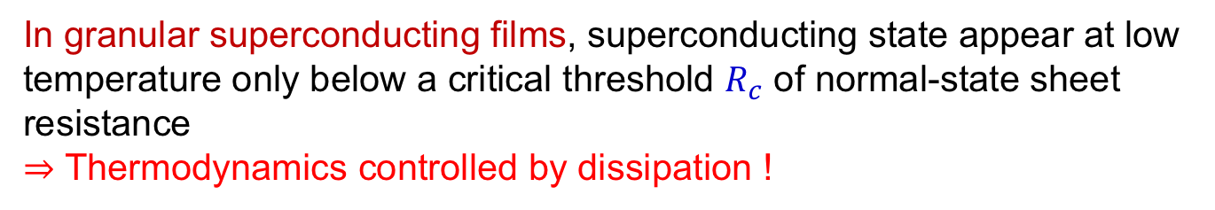
Dissipative phase transition in JJA
In granular superconducting films, superconducting state appear at low
temperature only below a critical threshold $R_{c}$ of normal-state sheet
resistance
$⇒$ Thermodynamics controlled by dissipation !
Expt. B. G. Orr et al., PRL 56 (1986)
Granular superconductors are well described by Josephson junction array
(JJA) model

Slide 9
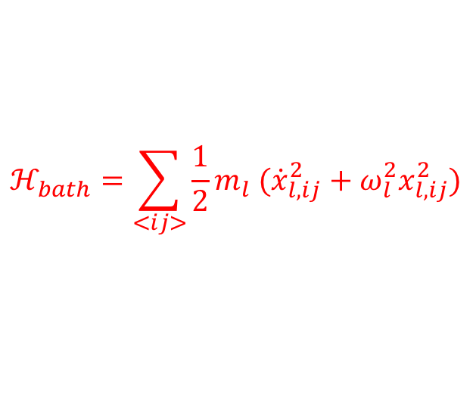
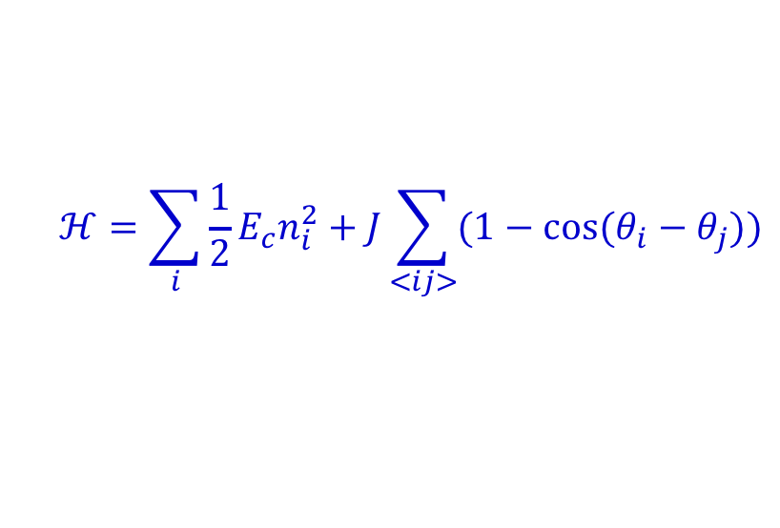
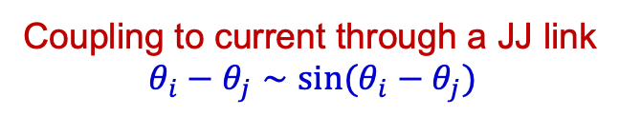



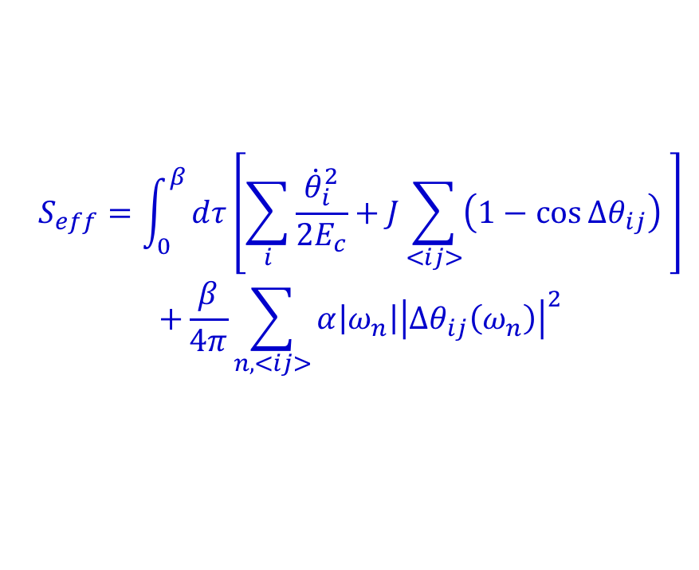
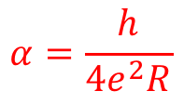
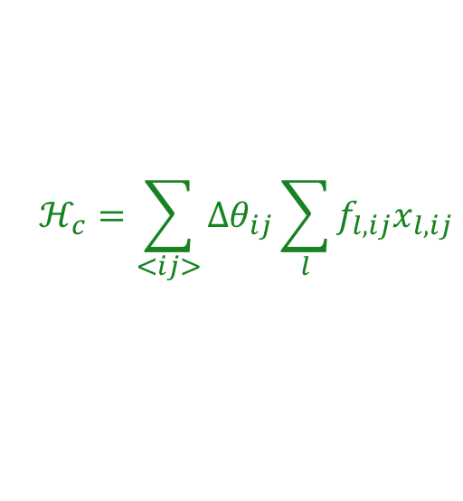
Dissipative phase transition in JJA
Ohmic heat bath
Chakravarty et al. PRL (1986), PRB (1988)
$$ℋ=ℋ_{JJA}+ℋ_{bath}+ℋ_{c}$$
$$ℋ=\sum_{i}{\frac{1}{2}E_{c}n_{i}^{2}+J\sum_{<ij>}{(1−\cos{(θ_{i}−θ_{j})})}}$$
$$ℋ_{bath}=\sum_{<ij>}{\frac{1}{2}m_{l} ({\dot{x}}_{l,ij}^{2}+ω_{l}^{2}x_{l,ij}^{2})}$$
$$Δθ_{ij}=θ_{i}−θ_{j}$$
$$ℋ_{c}=\sum_{<ij>}{Δθ_{ij}\sum_{l}{f_{l,ij}x_{l,ij}}}$$
Coupling to current through a JJ link
$$θ_{i}−θ_{j}∼\sin{(θ_{i}−θ_{j})}$$
Integrate out the bath, assume Ohmic spectral density ($∼ω$) of the bath
Imaginary-time action
$$S_{eff}=\int_{0}^{β}{dτ\left[\sum_{i}{\frac{{\dot{θ}}_{i}^{2}}{2E_{c}}+J\sum_{<ij>}{\left(1−\cos{Δθ_{ij}}\right)}} \right]}$$
$$+\frac{β}{4π}\sum_{n,<ij>}{α\left|ω_{n}\right|{\left|Δθ_{ij}\left(ω_{n}\right)\right|}^{2}}$$
$$α=\frac{h}{4e^{2}R}$$
$R$, normal-state resistance

Slide 10

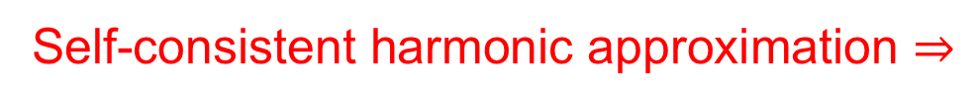
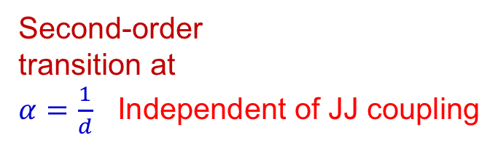
Self-consistent harmonic approximation $⇒$
First-order transition
Chakravarty et al. PRL (1986), PRB (1988)
SCHA
$$T=0$$
Second-order
transition at
$α=\frac{1}{d}$ Independent of JJ coupling

Slide 11

Monitored Josephson junction array (JJA)
Model of weak quantum measurements + feedback on JJA
Generalization of a model of weak position measurement on a single particle Caves and Milburn, Phys. Rev. A 36 (1987)
Application to measurement-induced transition in anharmonic oscillator chain
S. Ruidas & SB, Phys. Rev. Lett. 132, 030402 (2024)
$$Δθ_{ij}=θ_{i}−θ_{i+1}$$
Are the effects of dissipation and monitoring (with feedback) similar
on JJAs?

Slide 12








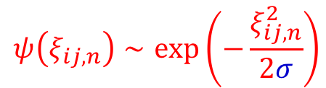
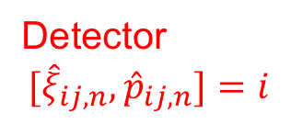

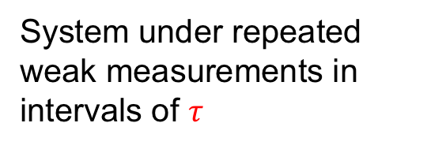

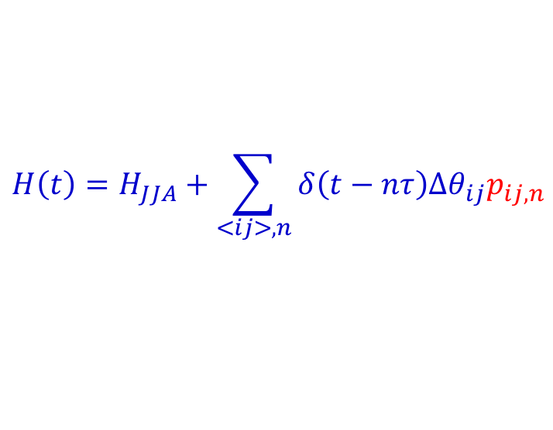

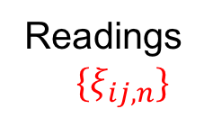





Model of weak measurements + feedback on JJA
Weak measurement of current
Detectors coupled to phase difference
junctions $<ij>$
$$sin\left(Δθ_{ij}\right)∼ Δθ_{ij}=θ_{i}−θ_{i+1}$$
$$H\left(t\right)=H_{JJA}+\sum_{<ij>,n}{δ\left(t−nτ\right)Δθ_{ij}p_{ij,n}}$$
$$t_{n}$$
System under repeated weak measurements in
intervals of $τ$
$$t_{0}$$
$$t_{n−1}$$
$$e^{−ıH_{JJA}τ/ℏ}$$
$$t_{n}=nτ$$
$$τ$$
$$ρ(\left\{ξ\right\},t_{n−1}^{+})$$
$$t_{n}^{−}$$
$$t_{n}$$
$$t_{n}^{+}$$
Detector
$${[\hat{ξ}}_{ij,n}, {\hat{p}}_{ij,n}]=i$$
Apply
$$\sum_{<ij>,n}{δ\left(t−nτ\right)Δθ_{ij}p_{ij,n}}$$
Readings
$\{ξ_{ij,n}\}$
$$ψ\left(ξ_{ij,n}\right)∼\exp\left(−\frac{ξ_{ij,n}^{2}}{2σ}\right)$$
Projective
measurements

Slide 13
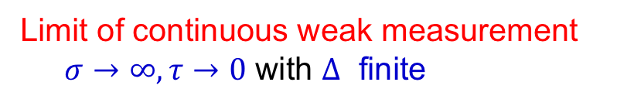


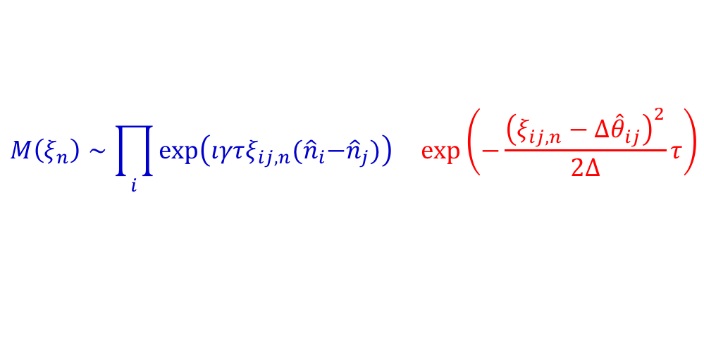

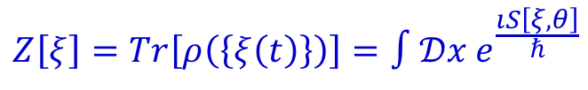
Non-unitary time evolution of JJA density matrix
$$ρ\left({\left\{ξ\right\}}_{n},t_{n}^{+}\right)=M\left(ξ_{n}\right)e^{−\frac{ıH_{JJA}τ}{ℏ}}ρ\left({\left\{ξ\right\}}_{n−1},t_{n−1}^{+}\right)e^{\frac{ıH_{JJA}τ}{ℏ}}M^{†}(ξ_{n})$$
With only measurements system heats up indefinitely
Measurement + feedback
$$M\left(ξ_{n}\right)∼\prod_{i}{\exp\left(ıγτξ_{ij,n}{(\hat{n}}_{i}−{\hat{n}}_{j})\right) \exp\left(−\frac{{\left(ξ_{ij,n}−{Δ\hat{θ}}_{ij}\right)}^{2}}{2Δ}τ\right)}$$
Caves and Milburn, Phys. Rev. A (1987)
“Feedback” $γ$, acts like dissipation
Limit of continuous weak measurement
$σ→∞, τ→0$ with $Δ$ finite
$$Δ=στ$$
Measurement strength $Δ^{−1}$
Schwinger-Keldysh path integral
$$Z\left[ξ\right]=Tr\left[ρ\left(\left\{ξ\left(t\right)\right\}\right)\right]=∫𝒟x e^{\frac{ıS\left[ξ,θ\right]}{ℏ}}$$

Slide 14
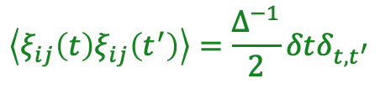
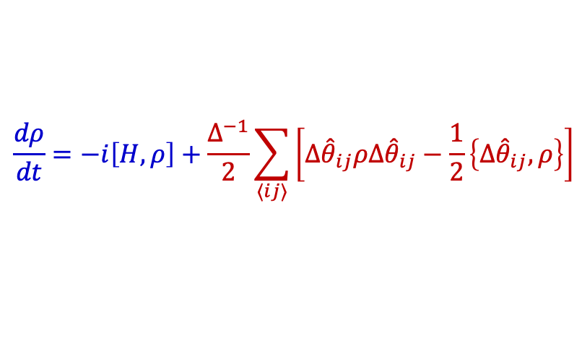
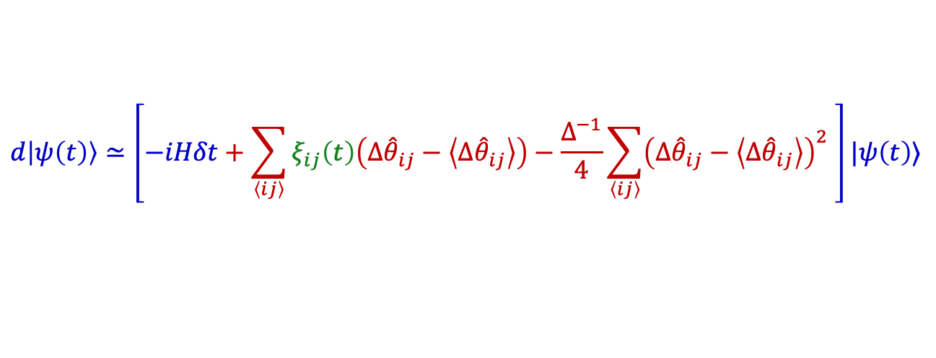
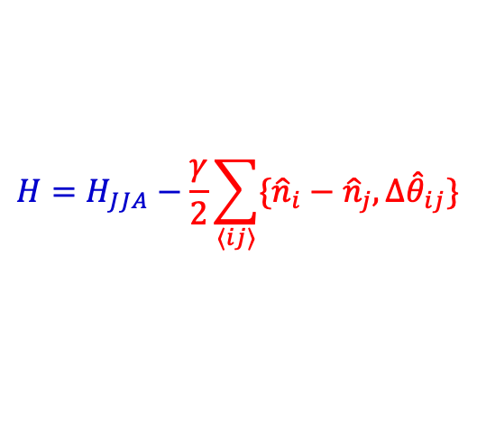
Stochastic Schrodinger equation or quantum state diffusion with feedback
$$d\left|ψ\left(t\right)\right\rangle ≃\left[−iHδt+\sum_{\left\langle ij\right\rangle }{ξ_{ij}\left(t\right)\left(Δ{\hat{θ}}_{ij}−\left\langle Δ{\hat{θ}}_{ij}\right\rangle \right)}−\frac{Δ^{−1}}{4}\sum_{\left\langle ij\right\rangle }{{\left(Δ{\hat{θ}}_{ij}−\left\langle Δ{\hat{θ}}_{ij}\right\rangle \right)}^{2}} \right]|ψ\left(t\right)⟩$$
$$\left\langle ξ_{ij}\left(t\right)ξ_{ij}\left(t^{′}\right)\right\rangle =\frac{Δ^{−1}}{2}δtδ_{t,t^{′}}$$
$$H=H_{JJA}−\frac{γ}{2}\sum_{⟨ij⟩}{\{{\hat{n}}_{i}−{\hat{n}}_{j},Δ{\hat{θ}}_{ij}\}}$$
Feedback
$→$ Also, quantum jump dynamics can be written
Dynamics of trajectory averaged density matrix $→$ Lindblad with feedback
$$\frac{dρ}{dt}=−i\left[H,ρ\right]+\frac{Δ^{−1}}{2}\sum_{⟨ij⟩}{\left[Δ{\hat{θ}}_{ij}ρΔ{\hat{θ}}_{ij}−\frac{1}{2}\left\{Δ{\hat{θ}}_{ij},ρ\right\}\right]}$$

Slide 15
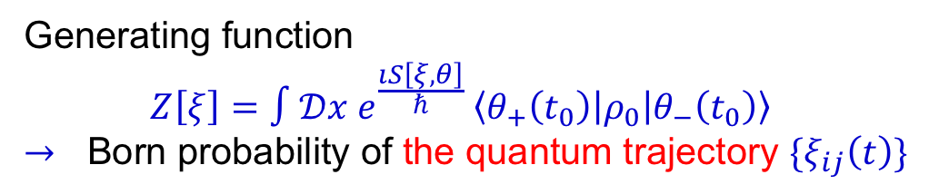



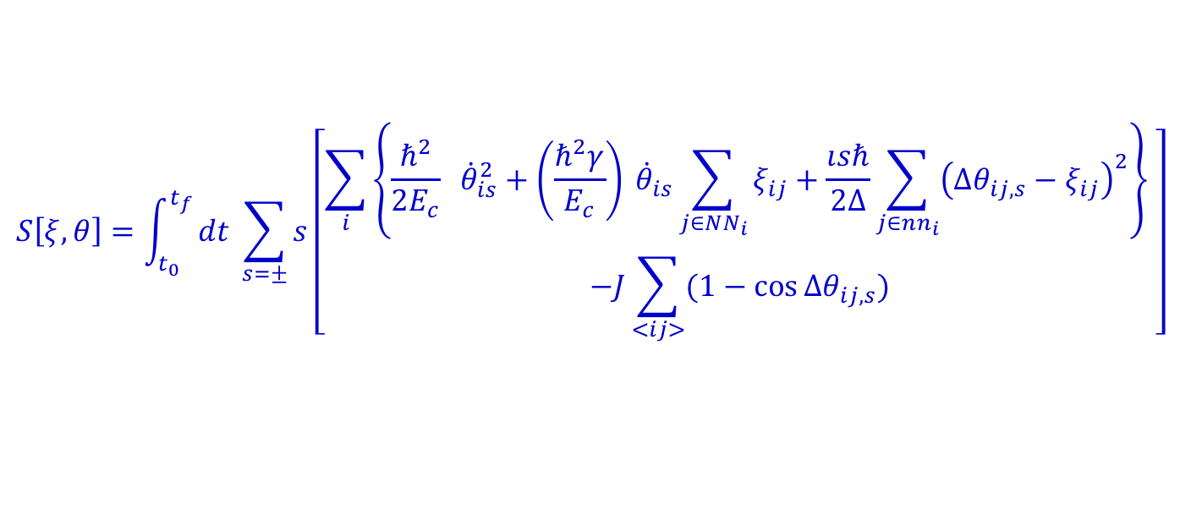
Schwinger-Keldysh path integral
$$θ_{i}−θ_{i+1}$$
Readings $\{ξ_{ij,n}\}$
Generating function
$$Z\left[ξ\right]=∫𝒟x e^{\frac{ıS\left[ξ,θ\right]}{ℏ}} \left\langle θ_{+}\left(t_{0}\right)\left|ρ_{0}\right|θ_{−}\left(t_{0}\right)\right\rangle$$
$→$ Born probability of the quantum trajectory $\{ξ_{ij}\left(t\right)\}$
Schwinger-Keldysh action
$$S\left[ξ,θ\right]=\int_{t_{0}}^{t_{f}}{dt \sum_{s=±}{s\left[\begin{aligned}\sum_{i}{\left\{\frac{ℏ^{2}}{2E_{c}} {\dot{θ}}_{is}^{2}+\left(\frac{ℏ^{2}γ}{E_{c}}\right) {\dot{θ}}_{is}\sum_{j∈NN_{i}}{ξ_{ij}}+\frac{ısℏ}{2Δ}\sum_{j∈nn_{i}}{{\left(Δθ_{ij,s}−ξ_{ij}\right)}^{2}}\right\}} \\ −J\sum_{<ij>}{(1−\cos{Δθ_{ij,s}})}\end{aligned}\right]}}$$
$$t_{f}$$
Assume long-time steady-state independent of $ρ_{0}$

Slide 16
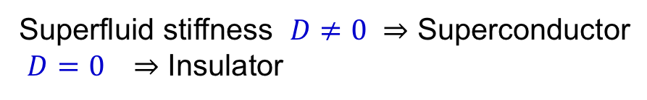

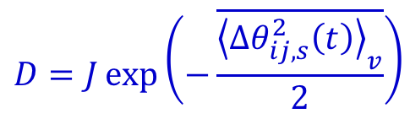
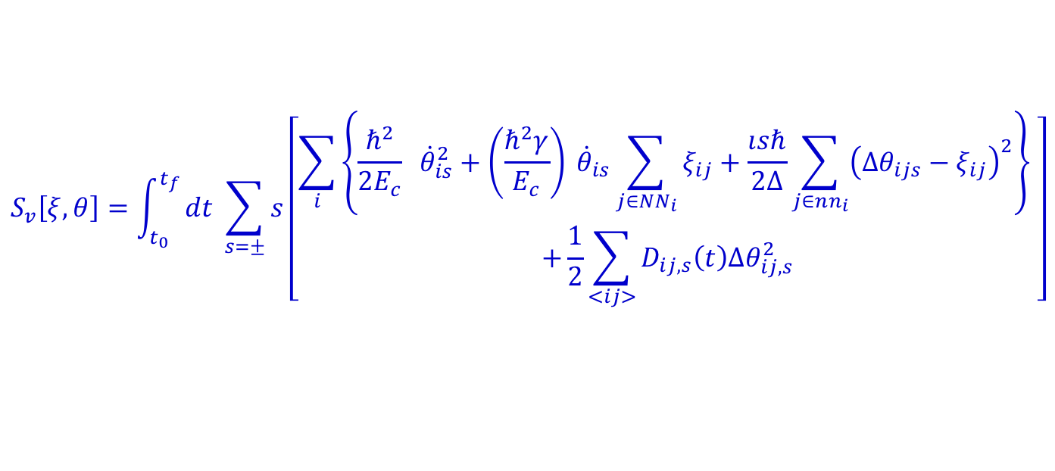
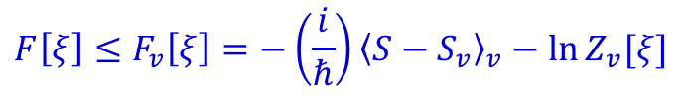
Self-consistent harmonic approximation (SCHA) for steady state
Variational harmonic action
$$S_{v}\left[ξ,θ\right]=\int_{t_{0}}^{t_{f}}{dt \sum_{s=±}{s\left[\begin{aligned}\sum_{i}{\left\{\frac{ℏ^{2}}{2E_{c}} {\dot{θ}}_{is}^{2}+\left(\frac{ℏ^{2}γ}{E_{c}}\right) {\dot{θ}}_{is}\sum_{j∈NN_{i}}{ξ_{ij}}+\frac{ısℏ}{2Δ}\sum_{j∈nn_{i}}{{\left(Δθ_{ijs}−ξ_{ij}\right)}^{2}}\right\}} \\ +\frac{1}{2}\sum_{<ij>}{D_{ij,s}\left(t\right)Δθ_{ij,s}^{2}}\end{aligned}\right]}}$$
Variational parameter $D_{ij,s}(t)$
Variational principle – Maximize Born probability $Z\left[ξ\right]=e^{−F[ξ]}$
$$F\left[ξ\right]≤F_{v}\left[ξ\right]=−\left(\frac{i}{ℏ}\right){\left\langle S−S_{v}\right\rangle }_{v}−\ln{Z_{v}[ξ]}$$
Trajectory averaged self-consistency condition $→ D_{ij,s}\left(t\right)=J \overline{⟨{\cos{Δθ_{ij,s}(t)⟩}}_{v}}$
For steady state averaged over trajectories
$$D=J\exp\left(−\frac{\overline{{\left\langle Δθ_{ij,s}^{2}\left(t\right)\right\rangle }_{v}}}{2}\right)$$
Superfluid stiffness $D≠0 ⇒$ Superconductor
$D=0 ⇒$ Insulator

Slide 17
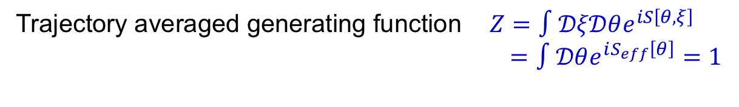

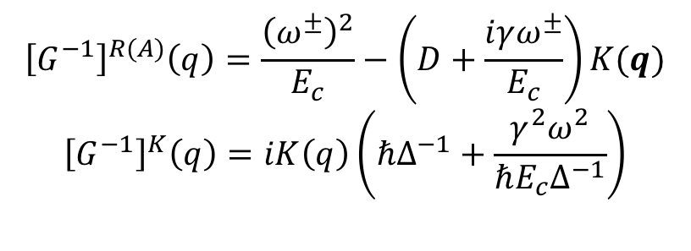
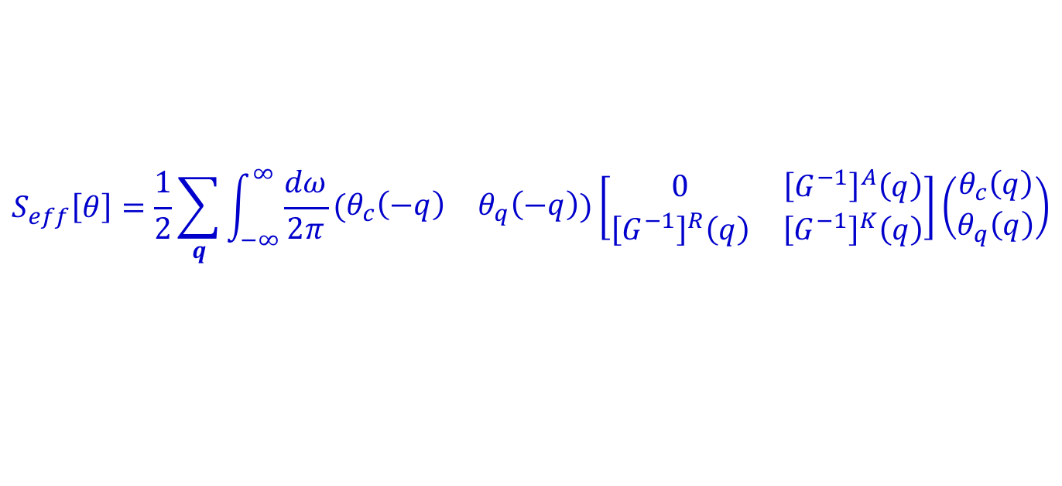
Trajectory averaged generating function $Z=∫𝒟ξ𝒟θe^{iS\left[θ,ξ\right]}$
$=∫𝒟θe^{iS_{eff}\left[θ\right]}=1$
Observables averaged over measurement outcomes or quantum trajectories
(Lindblad evolution)
$\overline{⟨A⟩}=\frac{1}{Z}∫𝒟ξ𝒟θA\left[θ\right]e^{iS[θ,ξ]}$
Effective self-consistent harmonic action in the steady state
$$S_{eff}\left[θ\right]=\frac{1}{2}\sum_{q}{\int_{−∞}^{∞}{\frac{dω}{2π}\left(\begin{matrix}θ_{c}\left(−q\right) & θ_{q}\left(−q\right)\end{matrix}\right)\left[\begin{matrix}0 & {\left[G^{−1}\right]}^{A}\left(q\right) \\ {\left[G^{−1}\right]}^{R}\left(q\right) & {\left[G^{−1}\right]}^{K}\left(q\right)\end{matrix}\right]\left(\begin{matrix}θ_{c}\left(q\right) \\ θ_{q}\left(q\right)\end{matrix}\right)}}$$
$${\left[G^{−1}\right]}^{R(A)}\left(q\right)=\frac{{\left(ω^{±}\right)}^{2}}{E_{c}}−\left(D+\frac{iγω^{±}}{E_{c}}\right)K(q)$$
$${\left[G^{−1}\right]}^{K}\left(q\right)=iK\left(q\right)\left(ℏΔ^{−1}+\frac{γ^{2}ω^{2}}{ℏE_{c}Δ^{−1}}\right)$$
Causal structure

Slide 18
SC-Insulator transition in monitored Josephson junction array
and phase diagram
Reentrant superconductor-insulator transitions

Slide 19


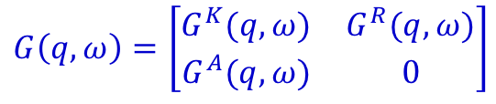
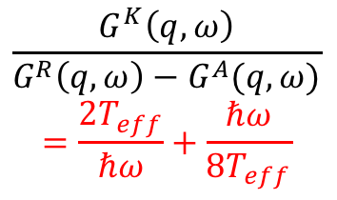
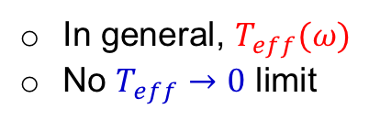
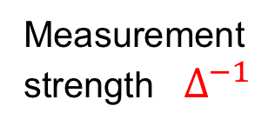
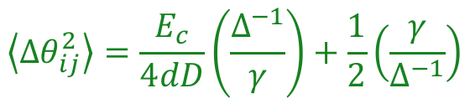
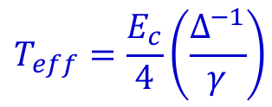
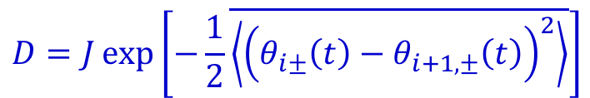





Is the monitored JJA very different from dissipative JJA?
Trajectory averaged Green’s function for non-equilibrium steady state ($t_{f}→∞$)
and effective temperature
$$G\left(q,ω\right)=\left[\begin{matrix}G^{K}(q,ω) & G^{R}(q,ω) \\ G^{A}(q,ω) & 0\end{matrix}\right]$$
Causal structure
SCHA $⇒$
$$D=J\exp\left[−\frac{1}{2}\overline{\left\langle {\left(θ_{i±}\left(t\right)−θ_{i+1,±}\left(t\right)\right)}^{2}\right\rangle }\right]$$
$$\left\langle Δθ_{ij}^{2}\right\rangle =\frac{E_{c}}{4dD}\left(\frac{Δ^{−1}}{γ}\right)+\frac{1}{2}\left(\frac{γ}{Δ^{−1}}\right)$$
Measured and dissipative JJA can be directly compared within SCHA
Measured
Dissipative
Measurement
strength $Δ^{−1}$
Feedback $γ$
$$=$$
$\frac{E_{c}α}{2π}$ Dissipation
$$\frac{G^{K}\left(q,ω\right)}{G^{R}\left(q,ω\right)−G^{A}(q,ω)}$$
$$=\frac{{2T}_{eff}}{ℏω}+\frac{ℏω}{8T_{eff}}$$
$$≡$$
$$\coth\left(\frac{ℏω}{2T}\right)≃\frac{2T}{ℏω}+\frac{ℏω}{6T}+⋯$$
Effective
temperature
$$T_{eff}=\frac{E_{c}}{4}\left(\frac{Δ^{−1}}{γ}\right)$$
In general, $T_{eff}(ω)$
No $T_{eff}→0$ limit
$ω→0$ or $ℏ$ small

Slide 20

Measured
Dissipative
$$T=0$$
Hard to compare

Slide 21



Measured
Dissipative
Very different
at low $T_{eff}$
Always
an insulator
$$⇒$$
Reentrant
transition
$T_{eff}$ or $Δ^{−1 }$
MIPT
Insulator-SC
transition
Low-temperature normal state (insulator)
$→$ high-temperature superconductor

Slide 22









Beyond self-consistent harmonic approximation (SCHA)
Semi-classical limit (high effective temperature)
SCHA $⇒$ $D=Jexp\left(−\frac{T_{eff}}{dD}\right)$
$T_{eff}$ or $Δ^{−1 }$
Same in measurement and dissipative model
$$S\left[\left\{ξ\right\},θ\right]=\int_{t_{0}}^{t_{f}}{dt \sum_{s=±}{s\left[\begin{aligned}\sum_{i}{\left\{\frac{1}{2E_{c}} {\dot{θ}}_{is}^{2}+\left(\frac{γ}{E_{c}}\right) {\dot{θ}}_{is}\sum_{j∈NN_{i}}{ξ_{ij}}\right\}} \\ +\frac{ısℏ}{4Δ}\sum_{ij∈NN_{i}}{{\left(Δθ_{ijs}−ξ_{i}\right)}^{2}}−J\sum_{<ij>}{(1−\cos{Δθ_{ijs}})}\end{aligned}\right]}}$$
Classical $(θ_{ic}≡θ_{i})$ and quantum $(x_{iq})$components
$$θ_{i±}=θ_{i}±θ_{iq}$$
Expand in $θ_{iq}$ or $ℏ$ keeping $𝒪(1)$ while scaling $Δ∼ℏ^{2}$
$⇒$ Stochastic Langevin equation
$$m=\frac{ℏ^{2}}{E_{c}}$$
$${\ddot{θ}}_{i}+γ\sum_{j∈NN_{i}}{({\dot{θ}}_{i}−{\dot{θ}}_{j})}=\frac{1}{ m} \left[−J\sum_{j∈NN_{i}}{\sin\left(θ_{i}−θ_{j}\right)}+\sum_{j∈{NN}_{i}}{η_{ij}}\right]$$
$$\left\langle η_{ij}\left(t\right)η_{kl}\left(t^{′}\right)\right\rangle =\frac{ℏ^{2}}{2Δ}δ_{ij}δ_{kl}δ(t−t′)$$
$$T_{eff}=\frac{E_{c}}{4}\left(\frac{Δ^{−1}}{γ}\right)$$
Usual thermal phase transitions,
e.g., BKT transition in 2D

Slide 23





Strong feedback and measurement limit $ℏγ,ℏΔ^{−1}≫J,E_{c}$
Dynamics is effectively classical over a time scale $≫mγ/J$
$⇒$ Fast mode $θ_{js}^{>}\left(t\right)=\int_{J/mγ}^{γ}{\frac{dω}{2π}e^{−iωt}θ_{js}(ω)}$
Slow mode $θ_{js}^{<}\left(t\right)=\int_{0}^{J/mγ}{\frac{dω}{2π}e^{−iωt}θ_{js}(ω)}$
Effective dynamics of slow modes
$${\ddot{θ}}_{i}^{<}+γ\sum_{j∈NN_{i}}{({\dot{θ}}_{i}^{<}−{\dot{θ}}_{j}^{<})}=\frac{1}{ m} \left[−J_{eff}\sum_{j∈NN_{i}}{\sin\left(θ_{i}^{<}−θ_{j}^{<}\right)}+\sum_{j∈{NN}_{i}}{η_{ij}}\right]$$
$$J_{eff}=J\left(1−\frac{\left\langle {\left(Δθ_{ij}^{c>}\right)}^{2}\right\rangle }{2}\right)$$
$≈J\left(1−\frac{γ}{4Δ^{−1}}\right)$ $γ≫Δ^{−1}$
$≈J\left(1−\left(\frac{Δ^{−1}}{4γ}\right)\left(\frac{E_{c}}{Jd}\right)\right)$ $Δ^{−1}≫γ$
Phase stiffness decreases with $γ$ or $Δ^{−1}$
$→$ Insulator for large $γ$ or $Δ^{−1}$

Slide 24





Strong feedback and measurement limit $ℏγ,ℏΔ^{−1}≫J,E_{c}$
$$J_{eff}=J\left(1−\frac{\left\langle {\left(Δθ_{ij}^{c>}\right)}^{2}\right\rangle }{2}\right)≈J\left(1−\frac{γ}{4Δ^{−1}}\right)$$
Dissipative case
$J_{eff}=J\left(1−\frac{1}{2αd}\ln\left(1+\frac{α}{2π}\right)\right)$ $α≫1$
Phase stiffness decreases with $γ$
$→$ Insulator for large $γ$
$J_{eff}→J$ for large dissipation
$→$ Superconducting for large $α$
$$T=0$$

Slide 25





Weak coupling limit $J≪E_{c}$ : Perturbative RG
Fast mode $θ_{js}^{>}\left(t\right)=\int_{ω_{c}/b}^{ω_{c}}{\frac{dω}{2π}e^{−iωt}θ_{js}(ω)}$
Slow mode $θ_{js}^{<}\left(t\right)=\int_{0}^{ω_{c}/b}{\frac{dω}{2π}e^{−iωt}θ_{js}(ω)}$
$$b=e^{δl}$$
Dissipative case
Treat the Josephson coupling $J$ perturbatively
$⇒$ RG flow equation
$$\frac{dJ}{dl}=J\left(1−\frac{1}{4πγd}\left(\frac{Δ^{−1}}{γ^{2}}+\frac{γ^{2}}{Δ^{−1}}\right)\right)$$
$$\frac{dJ}{dl}=J\left(1−\frac{1}{dα}\right)$$
SCHA
$$T=0$$
$T_{eff}$ or $Δ^{−1 }$
SCHA

Slide 26





Connection with steady-state transition in driven-dissipative systems
Manipulation of quantum states by bath engineering and dissipation
Diehl et al. Nat. Phys (2008), PRL (2010), Tomadin et al. PRB (2011), ..
Lindblad dynamics of open Bose Hubbard model
$$∂_{t}ρ=−i\left[H,ρ\right]+κ\sum_{⟨ij⟩}{\left({L_{ij}ρL}_{ij}^{†}−\frac{1}{2}\{L_{ij}^{†}L_{ij},ρ\}\right)}$$
Bose-Hubbard model $H=−J\sum_{⟨ij⟩}{\left(a_{i}^{†}a_{j}+h.c.\right)−μ\sum_{i}{n_{i}}−\frac{U}{2}\sum_{i}{n_{i}(n_{i}−1)}}$
Jump operators $L_{ij}=\left(a_{i}^{†}+a_{j}^{†}\right)\left(a_{i}−a_{j}\right)∼\left(a_{i}^{†}a_{j}−a_{j}^{†}a_{i}\right)∼$ Current
Non-interacting limit ($U=0$),
(Pure) Dark state. $\left(a_{i}^{†}+a_{j}^{†}\right)\left(a_{i}−a_{j}\right)\left|BEC\right\rangle =0, H\left|BEC\right\rangle =E_{0}|BEC⟩$
$$\left|BEC\right\rangle =a_{q=0}^{†}|0⟩$$
$$\sin{(θ_{i}−θ_{j})}|BEC⟩=0∼(θ_{i}−θ_{j})|BEC⟩=0$$
Dissipative coupling to particle current fixes phase difference to 0
Interacting case $(U≠0)$, weakly mixed condensate with effective temperature
$T_{eff}=\frac{Un}{2}$ (Single-site mean field theory )
Controlled by interaction and number density (chemical potential)

Slide 27




$T_{eff}=\frac{Un}{2}$
Diehl et al. PRL (2010)
$T_{eff}$ controlled by interaction
and chemical potential
$T_{eff}$ controlled by measurement
and feedback strength
$T_{eff}$ or $Δ^{−1 }$

Slide 28


Summary
Model of monitored JJA with weak measurement of current + feedback
$$Δθ_{ij}=θ_{i}−θ_{i+1}$$
Regime of fluctuation dissipation relation (FDR)
not accessible by dissipative bath in thermal
equilibrium
$T_{eff}$ or $Δ^{−1 }$
Measurements
Superconductor
Insulator
Thank You.

Slide 29









Dynamics of monitored JJA
$$t_{0}$$
$$t_{n−1}$$
$$t_{n}=nτ$$
$$H\left(t\right)=H_{JJA}+\sum_{<ij>,n}{δ\left(t−t_{n}\right)Δθ_{ij}p_{ij,n}}$$
$${U_{s}\left(τ\right)=e}^{−ıH_{JJA}τ/ℏ}$$
$$ρ_{0}$$
$$ρ(\left\{ξ\right\},t_{n−1}^{+})$$
$$τ$$
Density matrix of JJA+detectors before n-th measurements
$$ρ_{tot}\left(\left\{ξ_{ij}\right\},t_{n}^{−}\right)=⊗_{\left\langle ij\right\rangle }|ψ_{ij,n}⟩⟨ψ_{ij,n}|⊗U_{s}\left(τ\right)ρ\left(\left\{ξ_{ij,n}\right\},t_{n−1}^{+}\right)U_{s}^{†}(τ)$$
After interaction with the detectors and measurements on the detectors
$$ρ_{tot}\left(\left\{ξ_{ij}\right\},t_{n}^{+}\right)$$
$$=𝒫[\prod_{\left\langle ij\right\rangle }{\left(e^{−iΔθ_{ij}p_{ij,n}}\right)}⊗_{\left\langle ij\right\rangle }|ψ_{ij,n}⟩⟨ψ_{ij,n}|⊗U_{s}\left(τ\right)ρ\left(\left\{ξ_{ij,n}\right\},t_{n−1}^{+}\right)U_{s}^{†}(τ)$$
$$\prod_{⟨ij⟩}{\left(e^{iΔθ_{ij}p_{ij,n}}\right)}]𝒫$$
Projection due to measurements $𝒫=⊗_{⟨ij⟩}|ξ_{ij,n}⟩⟨ξ_{ij,n}|$
Density matrix of JJA
$$ρ\left(\left\{ξ_{ij}\right\},t_{n}^{+}\right)=tr_{D}[ρ_{tot}(\left\{ξ_{ij,n}\right\},t_{n}^{+})]$$

Slide 30





Monitored Bose-Hubbard model
$$H_{BH}=−t\sum_{⟨ij⟩}{\left(a_{i}^{†}a_{j}+a_{j}^{†}a_{i}\right)+\frac{U}{2}\sum_{i}{{\hat{n}}_{i}({\hat{n}}_{i}−1)}−μ\sum_{i}{{\hat{n}}_{i}}}$$
Weak measurement of current ${\hat{J}}_{ij}=−i(a_{i}^{†}a_{j}−a_{j}^{†}a_i)$ with feedback ${\hat{n}}_{i}−{\hat{n}}_{j}$
$$d\left|ψ\left(t\right)\right\rangle ≃\left[−iHδt+\sum_{\left\langle ij\right\rangle }{ξ_{ij}\left(t\right)\left({\hat{J}}_{ij}−\left\langle {\hat{J}}_{ij}\right\rangle \right)}−\frac{Δ^{−1}}{4}\sum_{\left\langle ij\right\rangle }{{\left({\hat{J}}_{ij}−\left\langle {\hat{J}}_{ij}\right\rangle \right)}^{2}} \right]|ψ\left(t\right)⟩$$
$$\left\langle ξ_{ij}\left(t\right)ξ_{ij}\left(t^{′}\right)\right\rangle =\frac{Δ^{−1}}{2}δtδ_{t,t^{′}}$$
$$H=H_{BH}−\frac{γ}{2}\sum_{⟨ij⟩}{\{{\hat{n}}_{i}−{\hat{n}}_{j},{\hat{J}}_{ij}\}}$$
Feedback
$→$ Also, quantum jump dynamics can be written
Dynamics of trajectory averaged density matrix $→$ Lindblad with feedback
$$\frac{dρ}{dt}=−i\left[H,ρ\right]+\frac{Δ^{−1}}{2}\sum_{⟨ij⟩}{\left[{\hat{J}}_{ij}ρ{\hat{J}}_{ij}−\frac{1}{2}\left\{{\hat{J}}_{ij},ρ\right\}\right]}$$

