Slide 1
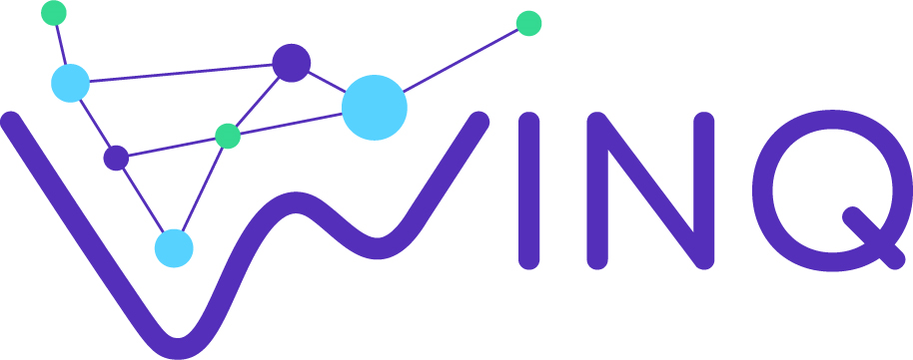

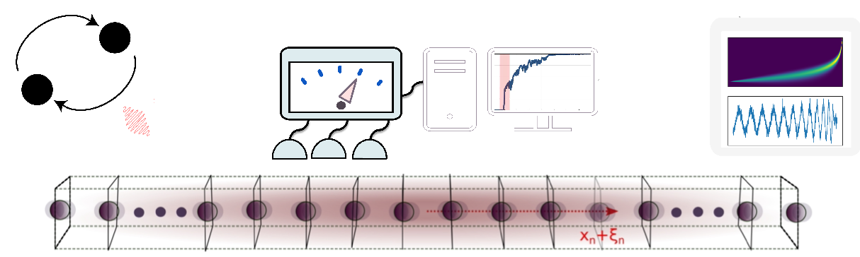
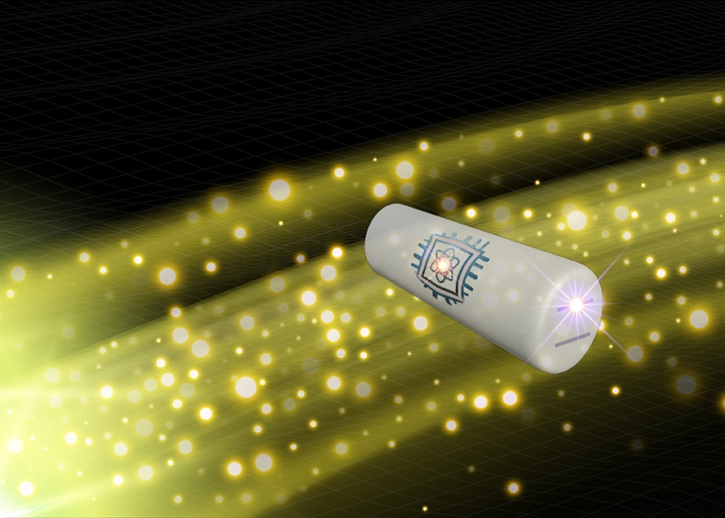






Detecting Single Gravitons and Probing their Acoherence with Continuous Quantum Sensing
Image credits: I Pikovski
Speaker: Sreenath K. Manikandan, Researcher in theoretical physics
Nordita, Stockholm University and KTH Royal Institute of Technology, Stockholm, Sweden

Slide 2
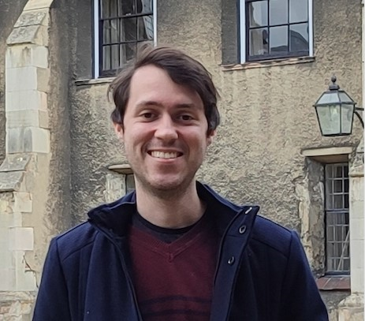
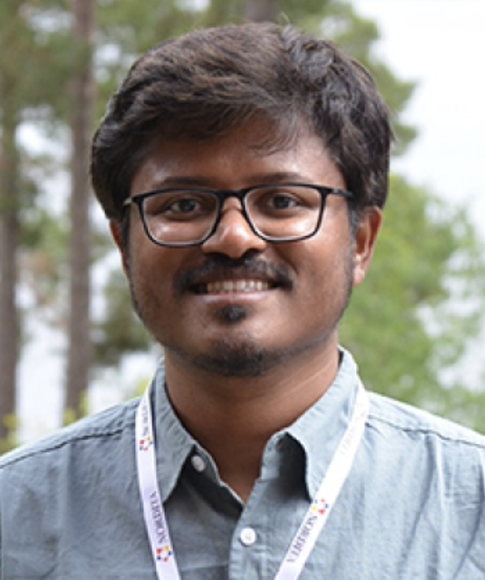


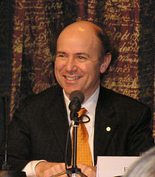
Based on the following two articles:
Germain Tobar*, Sreenath K. Manikandan*, Thomas Beitel, and Igor Pikovski. “Detecting single gravitons with quantum sensing.” Nature Communications 15, 7229 (2024).
“Detecting acoherence in radiation fields.” Sreenath K. Manikandan and Frank Wilczek. arXiv: 2409.20378 (2024).

Slide 3
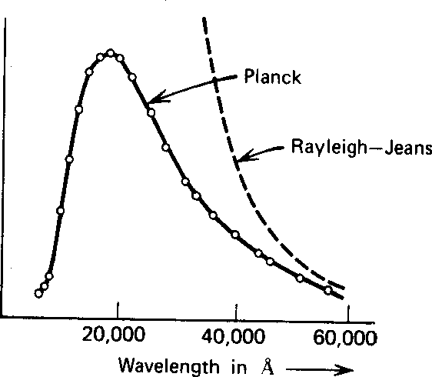
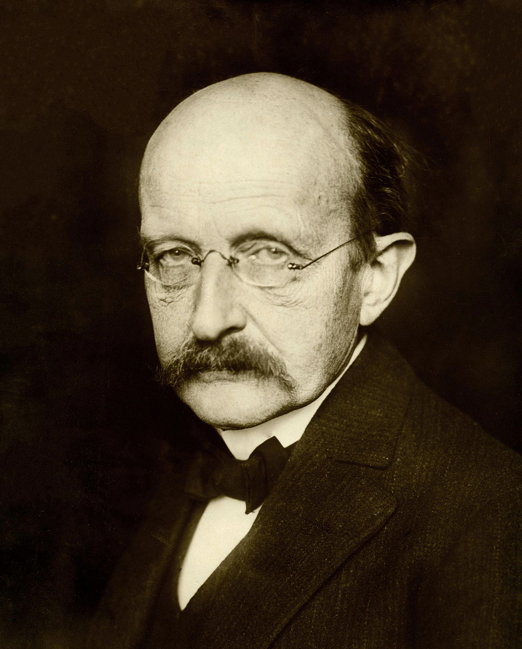
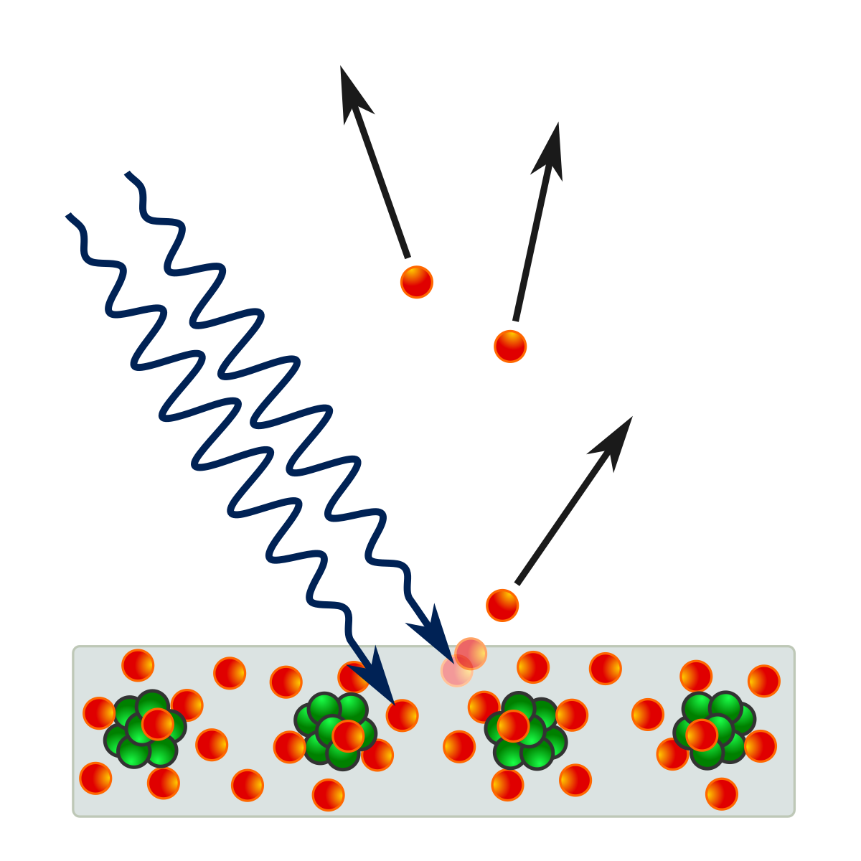
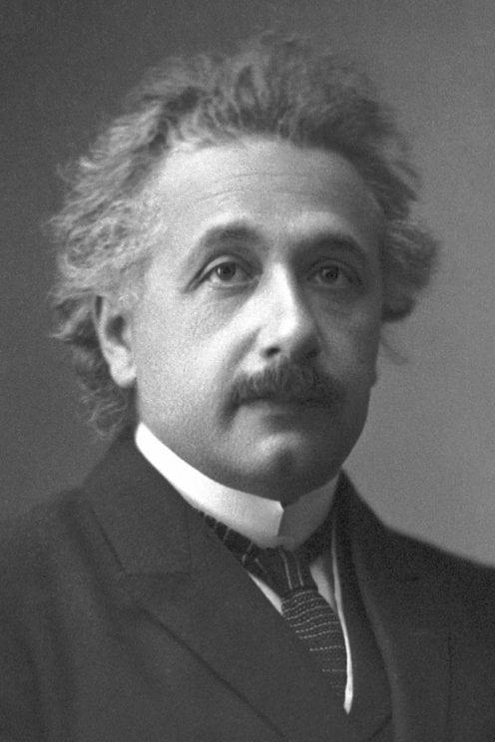
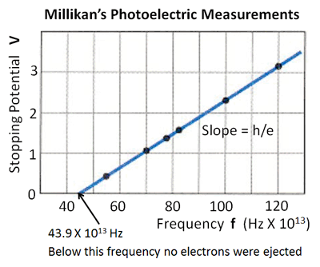
Photons as quantized packets of energy exchanged with matter
1900: Planck’s explanation for the black body radiation spectrum:
1905: Einstein’s explanation for the photoelectric effect, and the light-quantum hypothesis:
1916: Millikan experimentally tests the photoelectric effect.
Radiation Intensity
https://quantummechanics.ucsd.edu/ph130a/130_notes/node48.html
Credits: Wikipedia

Slide 4
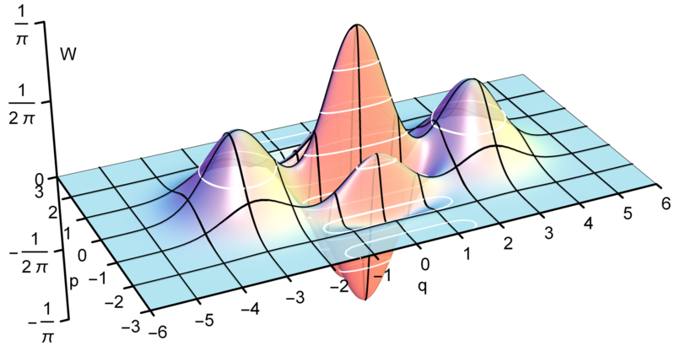
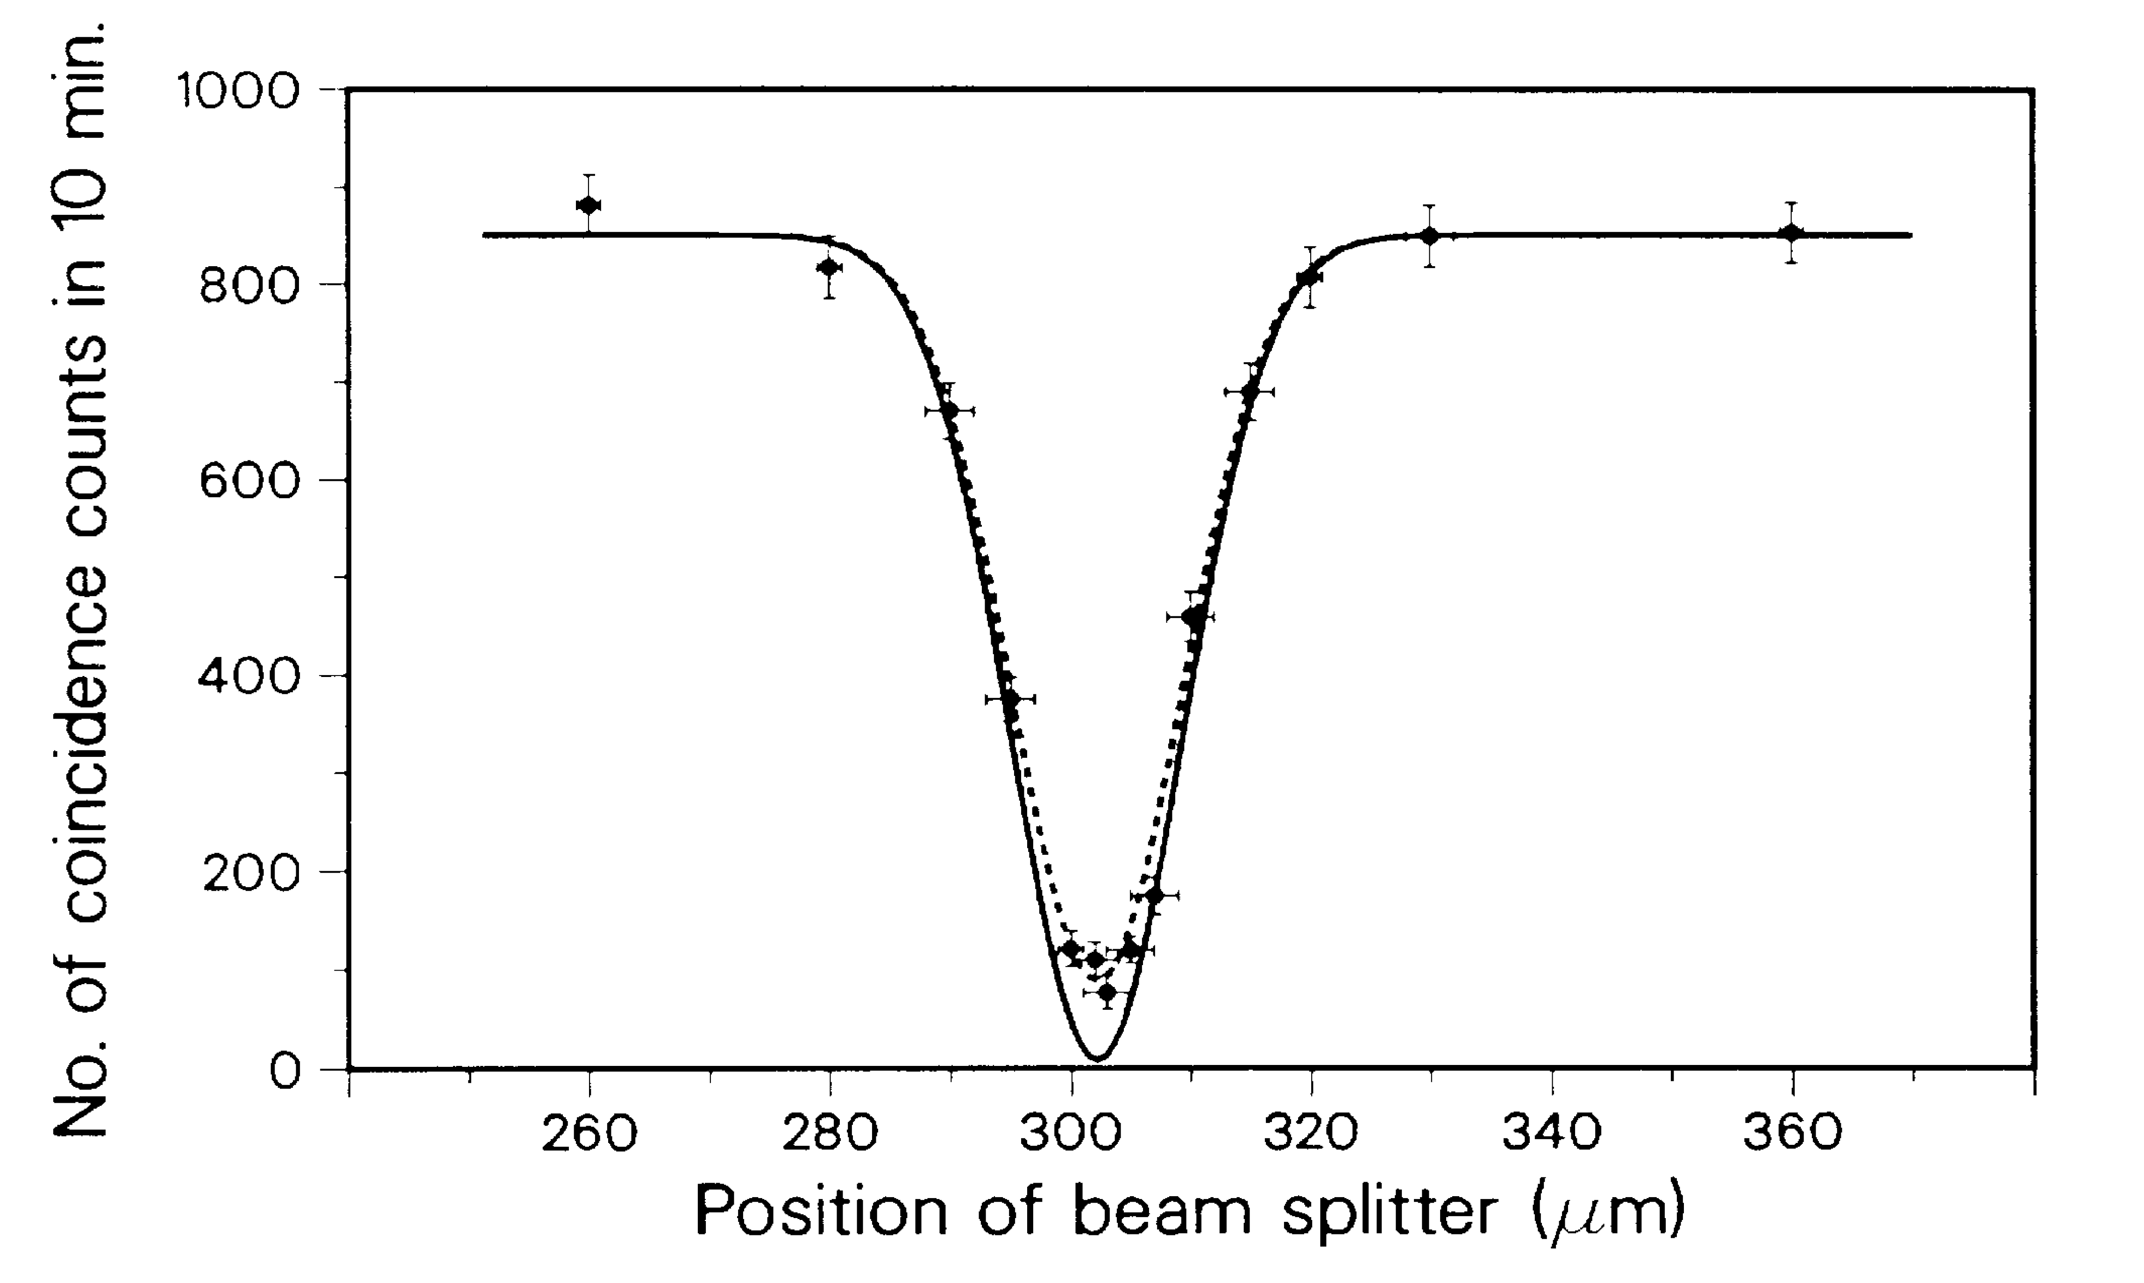
Towards modern quantum optics
Semiclassical limit of QED also works to capture some of the essential features of the photoelectric effect [Lamb Jr, W. E., & Scully, M. O. (1968).], also see [1]. The semiclassical limit of QED however is a convenient approximation, it violates energy conservation for example.
Einstein in a letter to Jakob Laub, 4th November 1910: “At present I have high hopes for solving the radiation problem and that without light-quanta. I am enormously curious how it will work out. One must renounce the energy principle in its present form.”
Einstein at the 1911 Solvay meeting: “One can choose between the [quantum] structure of radiation and the negation of an absolute validity of the energy conservation law. […] Who would have the courage to make a decision of this kind.... We will agree that the energy principle should be retained”
Bell inequality violation experiments: the only loophole free test of non-classicality
Sub-Poissonian statistics, Hong-Ou-Mandel effect, Wigner negativities, squeezing, non-classical correlations...
Credits: Wikipedia
C. K. Hong; Z. Y. Ou & L. Mandel (1987). Phys. Rev. Lett. 59 (18): 2044–2046.
[1] Scully, M. O., & Sargent, M. (1972). The concept of the photon. Physics Today, 25(3), 38-47.
Wigner function
Hong-Ou-Mandel dip

Slide 5
Observing matter and light exchanging quantum of energy (i. e., photons) was an important first step in formulating the quantum theory of light.
Can we detect a graviton, as exchange of energy in discrete units with matter?

Slide 6
Observing matter and light exchanging quantum of energy (i. e., photons) was an important first step in formulating the quantum theory of light.
Can we detect a graviton, as exchange of energy in discrete units with matter?

Slide 7
Quantum mechanics of gravitational waves
Linearized gravity, low energy regime: Bronstein 1935, Feynman 1963, Dyson 1969, Weinberg1972, Lightman 1973, Boughn & Rothman 2006. For an electron in the local inertial frame:
Boughn, S., & Rothman, T. (2006). Aspects of graviton detection: graviton emission and absorption by atomic hydrogen. Classical and Quantum Gravity, 23(20), 5839. Also see Maggiore, M. (2007). Gravitational waves: Volume 1: Theory and experiments. OUP Oxford.

Slide 8

Quantum mechanics of gravitational waves
Linearized gravity, low energy regime: Bronstein 1935, Feynman 1963, Dyson 1969, Weinberg1972, Lightman 1973, Boughn & Rothman 2006. For an electron in the local inertial frame:
GWs in TT-gauge:
$$h^{ij}=\frac{1}{\sqrt{V}}\sum_{k,λ}{e_{k,λ}^{ij}{ h}_{k,λ}{ e}^{i(k∙r−ωt)}}+cc$$
$$h^{0μ}=0, h_{ i}^{i}=0, ∂^{j}h_{ij}=0.$$
Normalization
Polarization tensor
Fourier amplitudes
Polarization
Boughn, S., & Rothman, T. (2006). Aspects of graviton detection: graviton emission and absorption by atomic hydrogen. Classical and Quantum Gravity, 23(20), 5839. Also see Maggiore, M. (2007). Gravitational waves: Volume 1: Theory and experiments. OUP Oxford.

Slide 9

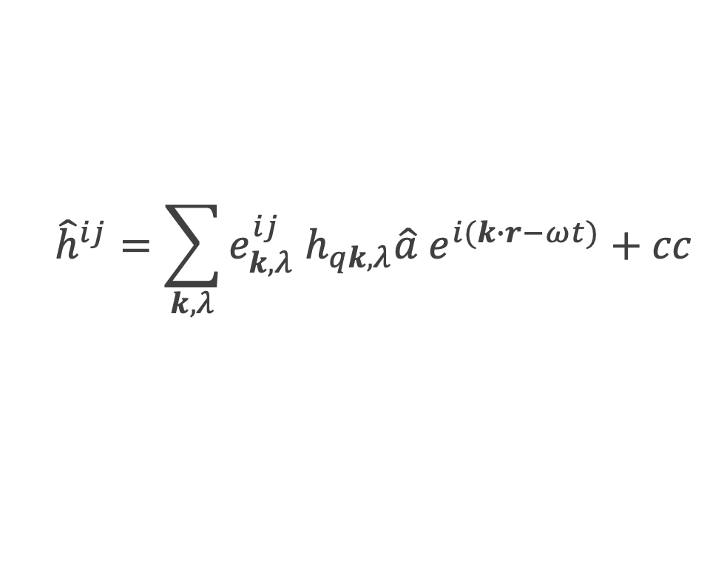
Quantum mechanics of gravitational waves
Linearized gravity, low energy regime: Bronstein 1935, Feynman 1963, Dyson 1969, Weinberg1972, Lightman 1973, Boughn & Rothman 2006. For an electron in the local inertial frame:
GWs in TT-gauge:
$$h^{ij}=\frac{1}{\sqrt{V}}\sum_{k,λ}{e_{k,λ}^{ij}{ h}_{k,λ}{ e}^{i(k∙r−ωt)}}+cc$$
$$h^{0μ}=0, h_{ i}^{i}=0, ∂^{j}h_{ij}=0.$$
Normalization
Polarization tensor
Fourier amplitudes
Polarization
$${\hat{h}}^{ij}=\sum_{k,λ}{e_{k,λ}^{ij}{ h}_{qk,λ}\hat{a}{ e}^{i(k∙r−ωt)}}+cc$$
$${ h}_{qk,λ}=\sqrt{\frac{16πGℏ}{c^{2}ν_{k}V}}$$
Quantize:
Boughn, S., & Rothman, T. (2006). Aspects of graviton detection: graviton emission and absorption by atomic hydrogen. Classical and Quantum Gravity, 23(20), 5839. Also see Maggiore, M. (2007). Gravitational waves: Volume 1: Theory and experiments. OUP Oxford.

Slide 10
Quantum mechanics of gravitational waves
Linearized gravity, low energy regime: Bronstein 1935, Feynman 1963, Dyson 1969, Weinberg1972, Lightman 1973, Boughn & Rothman 2006. For an electron in the local inertial frame:
GWs in TT-gauge:
In the local inertial frame (Fermi coordinates/proper detector frame):
$$h^{ij}=\frac{1}{\sqrt{V}}\sum_{k,λ}{e_{k,λ}^{ij}{ h}_{k,λ}{ e}^{i(k∙r−ωt)}}+cc$$
$$h^{0μ}=0, h_{ i}^{i}=0, ∂^{j}h_{ij}=0.$$
Normalization
Polarization tensor
Fourier amplitudes
Polarization
Quadrupole
$H_{int}=−\frac{1}{2}h_{μν}T^{μν}≈−\frac{1}{2}m_{e}h_{00}=\frac{1}{4}m_{e}ω^{2}h_{k,λ}{ e}^{i(k∙r−ωt)}x^{j}x^{k}e_{jk}$ + H. c.
Boughn, S., & Rothman, T. (2006). Aspects of graviton detection: graviton emission and absorption by atomic hydrogen. Classical and Quantum Gravity, 23(20), 5839. Also see Maggiore, M. (2007). Gravitational waves: Volume 1: Theory and experiments. OUP Oxford.

Slide 11
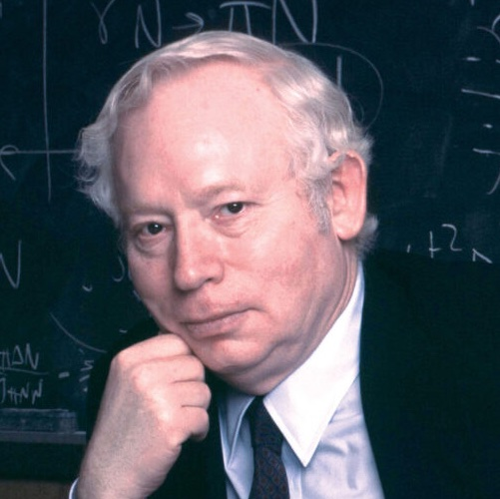

Detecting single gravitons was thought to be impossible
Weinberg computed the rate for spontaneous atomic processes involving a graviton, and obtained
$Γ≈{10}^{−44}s^{−1} (actually {10}^{−40}s^{−1})$, Boughn & Rothman 2006.
Weinberg, “Gravitation and Cosmology” 1972:
Actually $Γ=5.7×{10}^{−40} s^{−1}$
Boughn & Rothman 2006

Slide 12
Detecting single gravitons was thought to be impossible
Linearized gravity, low energy regime: Bronstein 1935, Feynman 1963, Dyson 1969, Weinberg1972, Lightman 1973, Boughn & Rothman 2006. For an electron in the local inertial frame:
$${\hat{h}}^{ij}=\sum_{k,λ}{e_{k,λ}^{ij}{ h}_{qk,λ}\hat{a}{ e}^{i(k∙r−ωt)}}+cc$$
$${ h}_{qk,λ}=\sqrt{\frac{16πGℏ}{c^{2}ν_{k}V}}$$
Quantize:
Boughn, S., & Rothman, T. (2006). Aspects of graviton detection: graviton emission and absorption by atomic hydrogen. Classical and Quantum Gravity, 23(20), 5839.; Weinberg, “Gravitation and Cosmology” 1972

Slide 13
Detecting single gravitons was thought to be impossible
Linearized gravity, low energy regime: Bronstein 1935, Feynman 1963, Dyson 1969, Weinberg1972, Lightman 1973, Boughn & Rothman 2006. For an electron in the local inertial frame:
$${\hat{h}}^{ij}=\sum_{k,λ}{e_{k,λ}^{ij}{ h}_{qk,λ}\hat{a}{ e}^{i(k∙r−ωt)}}+cc$$
$${ h}_{qk,λ}=\sqrt{\frac{16πGℏ}{c^{2}ν_{k}V}}$$
Quantize:
Graviton transition rate:
$$Γ_{atom} (3d2→1s)=\frac{2π}{ℏ}{\left|\left\langle 1s | \left\langle 1 | {\hat{H}}_{int} | 0\right\rangle | 3d2\right\rangle \right|}^{2}ρ$$
$$ρ=\frac{Vν^{2}}{2π^{2}ℏc^{3}}$$
Density of graviton states
$$≈{10}^{−40}s^{−1}$$
Boughn, S., & Rothman, T. (2006). Aspects of graviton detection: graviton emission and absorption by atomic hydrogen. Classical and Quantum Gravity, 23(20), 5839.; Weinberg, “Gravitation and Cosmology” 1972

Slide 14
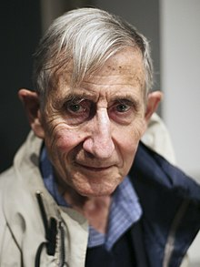
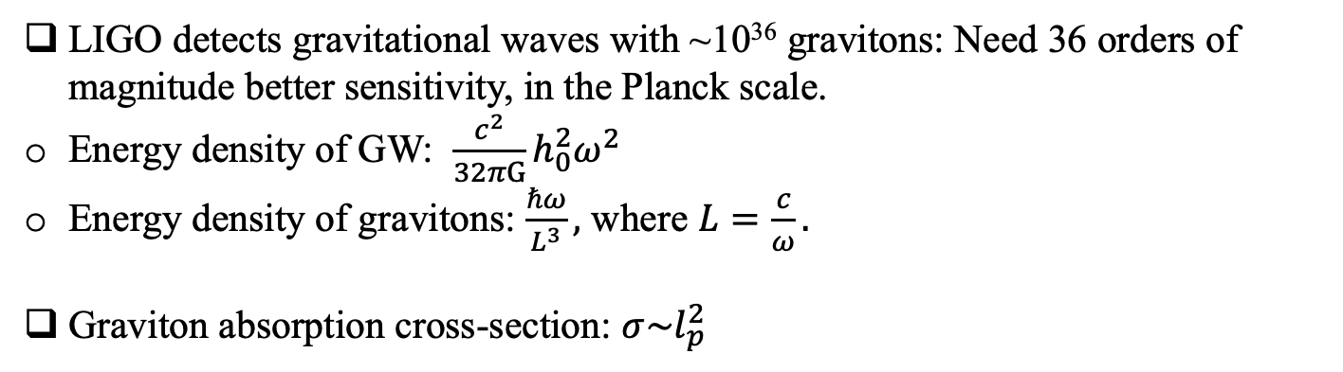
Detecting single gravitons was thought to be impossible
Dyson also looked at sensitivity required for LIGO to detect the strain amplitude corresponding to a single graviton:
LIGO detects gravitational waves with ~10³⁶ gravitons: Need 36 orders of magnitude better sensitivity, in the Planck scale.
Energy density of GW: ${\frac{c^{2}}{32πG}h}_{0}^{2}ω^{2}$
Energy density of gravitons: $\frac{ℏω}{L^{3}},$ where $L=\frac{c}{ω}.$
Graviton absorption cross-section: $σ\sim l_{p}^{2}$
Dyson, F. (2013). Is a graviton detectable?. International Journal of Modern Physics A, 28(25), 1330041.
Weinberg, “Gravitation and Cosmology” 1972
Boughn, S., & Rothman, T. (2006). Aspects of graviton detection: graviton emission and absorption by atomic hydrogen. Classical and Quantum Gravity, 23(20), 5839.

Slide 15
Single gravitons can be detected
Germain Tobar*, S. K. Manikandan*, Thomas Beitel, & Igor Pikovski, (2023). Nature Communications 15, 7229 (2024).
We do not need a single graviton to arrive (or sensitivity at the single graviton level) to infer the exchange of single quantum of energy with the matter side, just as was the case with the photo-electric effect for photons.
To infer energy exchanges we should measure quantized energy transitions on the matter side, so LIGO may not be the best detector for this purpose.
We
(1) focus on massive quantum systems, and
(2) stimulated processes in the LIGO-band (kHz frequencies)
(3) combined with quantum sensing of energy that allow us to infer single graviton exchange events

Slide 16
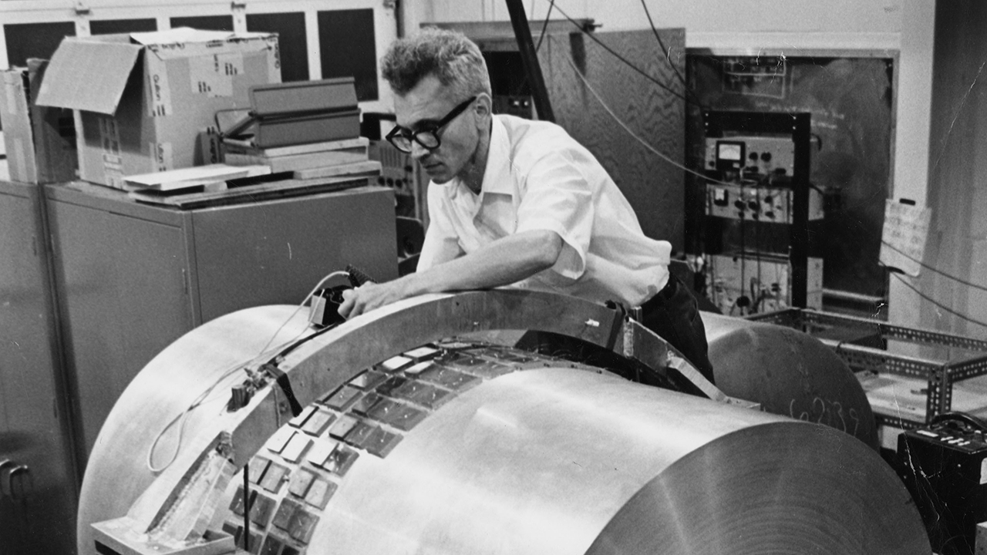
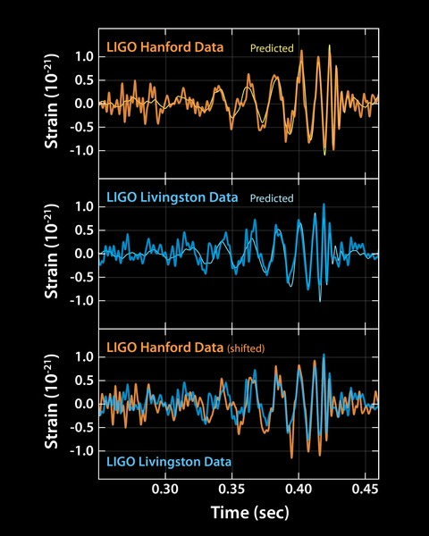
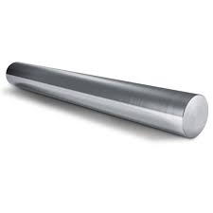
We propose to use
Weber bars with a quantum twist
Acoustic bar resonators
LIGO events
Quantum sensing
We (1) focus on massive quantum systems, and (2) stimulated processes in the LIGO-band, (3) combined with quantum sensing of energy levels that allow us to infer single graviton exchange events
We use Weber bars with a quantum twist:

Slide 17
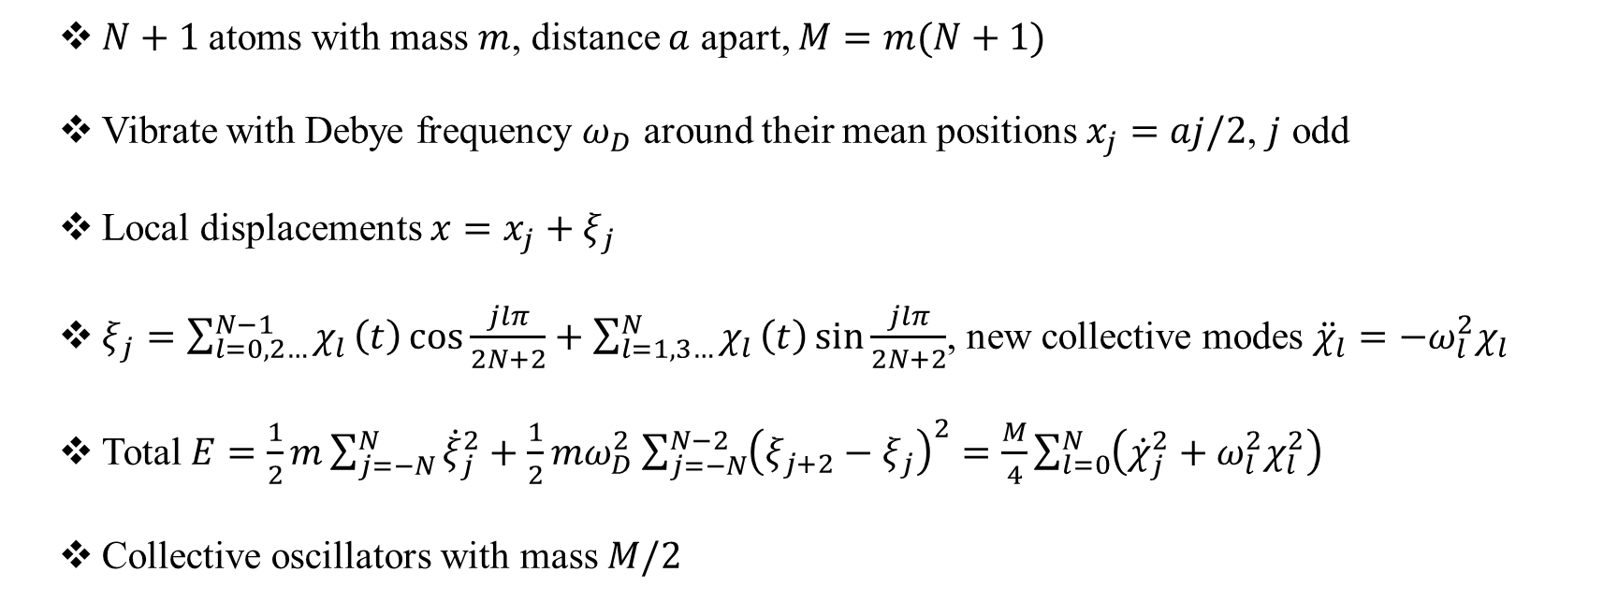
Acoustic modes of a Weber bar
$N+1$ atoms with mass $m$, distance $a$ apart, $M=m(N+1)$
Vibrate with Debye frequency $ω_{D}$ around their mean positions $x_{j}=aj/2$, $j$ odd
Local displacements $x=x_{j}+ξ_{j}$
$ξ_{j}=\sum_{l=0,2…}^{N−1}{χ_{l}}\left(t\right)\cos{\frac{jlπ}{2N+2}}+\sum_{l=1,3…}^{N}{χ_{l}}\left(t\right)\sin{\frac{jlπ}{2N+2}}$, new collective modes ${\ddot{χ}}_{l}=−ω_{l}^{2}χ_{l}$
Total $E=\frac{1}{2}m\sum_{j=−N}^{N}{{\dot{ξ}}_{j}^{2}}+\frac{1}{2}mω_{D}^{2}\sum_{j=−N}^{N−2}{{\left(ξ_{j+2}−ξ_{j}\right)}^{2}}=\frac{M}{4}\sum_{l=0}^{N}{\left({\dot{χ}}_{j}^{2}+ω_{l}^{2}χ_{l}^{2}\right)}$
Collective oscillators with mass $M/2$
Grishchuk, L. P. (1992). Quantum mechanics of a solid-state bar gravitational antenna. Physical Review D, 45(8), 2601.
Germain Tobar*, Sreenath K. Manikandan*, Thomas Beitel, and Igor Pikovski. "Detecting single gravitons with quantum sensing."
Nature Communications 15, 7229 (2024)`

Slide 18
A macroscopic interaction
$$H_{int}=−\frac{1}{2}h_{μν}T^{μν}≈−m\sum_{n}{\frac{1}{4}{\ddot{h}}_{xx}(t){(x}_{n}+ξ_{n})^{2}}≈−\frac{ML{\ddot{h}}_{xx}(t)}{π^{2}}\sum_{l=1,3,5..}{{\frac{{\left(−1\right)}^{\frac{l−1}{2}}}{l^{2}}χ}_{l}−}\frac{M{\ddot{h}}_{xx}(t)}{8}\sum_{l}{χ_{l}^{2}}.$$
Leading contribution
Sub-leading correction:
Weinberg-like effect on each atoms
The leading coupling to GW increases with the mass of the bar Weber bar as well as length of the Weber bar.
Germain Tobar*, Sreenath K. Manikandan*, Thomas Beitel, and Igor Pikovski. "Detecting single gravitons with quantum sensing."
Nature Communications 15, 7229 (2024)

Slide 19
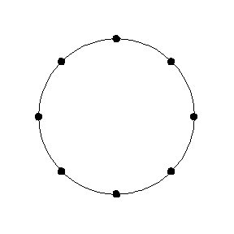


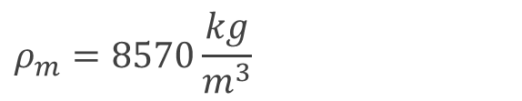



Rates for spontaneous and stimulated processes
Field in vacuum state
$$\left|0\right\rangle →\left|1\right\rangle .$$
$$ℏν$$
$ρ_{m}$: mass density
$$Γ_{spon} \left(1→0\right)=\frac{2π}{ℏ}{\left|\left\langle 1 | \left\langle 0 | {\hat{H}}_{int} | 1\right\rangle | 0\right\rangle \right|}^{2}ρ=\frac{8GML^{2}ω_{l}^{4}}{l^{4}π^{4}c^{5}}=\frac{8πGρ_{m}R^{2}v_{s}^{4}}{Lc^{5}}$$
$v_{s}=\frac{Lω_{l}}{lπ}$: sound speed,
$$Γ_{stim} \left(1→0\right)=\frac{2π}{ℏ}{\left|\left\langle 1 | \left\langle α | {\hat{H}}_{int} | α\right\rangle | 0\right\rangle \right|}^{2}ρ=\frac{{\left|α\right|}^{2}8GML^{2}ω_{l}^{4}}{l^{4}π^{4}c^{5}}$$
$${\left|α\right|}^{2}≈N=\frac{h_{0}^{2}c^{5}}{32πGℏω_{l}^{2}}$$
$$Γ_{stim} =\frac{ML^{2}ω_{l}^{2}}{4l^{4}π^{5}ℏ}h_{0}^{2}=\frac{Mv_{s}^{2}}{4l^{4}π^{3}ℏ}h_{0}^{2}$$
Spontaneous emission rate for a Niobium cylinder:
Stimulated emission rate for an aluminium cylinder:
$$ρ_{m}=8570\frac{kg}{m^{3}}$$
$$2R=L=1m$$
$$h_{0}=5×{10}^{−22}$$
$$v_{s}=5.4\frac{km}{s}$$
(GW150914)
$$M=1800 kg$$
$$Γ_{spon} ={10}^{−33}s^{−1}$$
$$Γ_{stim} =1 Hz$$
Much better than Weinberg (atom), but still small!
One graviton emitted/absorbed per second.
Tobar, Germain*, Sreenath K. Manikandan*, Thomas Beitel, and Igor Pikovski. "Detecting single gravitons with quantum sensing."
Nature Communications 15, 7229 (2024)

Slide 20




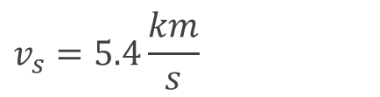


Rates for spontaneous and stimulated processes
Field in a coherent state
$$\left|α\right\rangle →\left|α\right\rangle .$$
$$ℏν$$
$$Γ_{spon} \left(1→0\right)=\frac{2π}{ℏ}{\left|\left\langle 1 | \left\langle 0 | {\hat{H}}_{int} | 1\right\rangle | 0\right\rangle \right|}^{2}ρ=\frac{8GML^{2}ω_{l}^{4}}{l^{4}π^{4}c^{5}}=\frac{8πGρ_{m}R^{2}v_{s}^{4}}{Lc^{5}}$$
$v_{s}=\frac{Lω_{l}}{lπ}$: sound speed,
$ρ_{m}$: mass density
$$Γ_{stim} \left(1→0\right)=\frac{2π}{ℏ}{\left|\left\langle 1 | \left\langle α | {\hat{H}}_{int} | α\right\rangle | 0\right\rangle \right|}^{2}ρ=\frac{{\left|α\right|}^{2}8GML^{2}ω_{l}^{4}}{l^{4}π^{4}c^{5}}$$
$${\left|α\right|}^{2}≈N=\frac{h_{0}^{2}c^{5}}{32πGℏω_{l}^{2}}$$
$$Γ_{stim} =\frac{ML^{2}ω_{l}^{2}}{4l^{4}π^{5}ℏ}h_{0}^{2}=\frac{Mv_{s}^{2}}{4l^{4}π^{3}ℏ}h_{0}^{2}$$
Spontaneous emission rate for a Niobium cylinder:
Stimulated emission rate for an aluminium cylinder:
$$ρ_{m}=8570\frac{kg}{m^{3}}$$
$$h_{0}=5×{10}^{−22}$$
$$v_{s}=5.4\frac{km}{s}$$
$$Γ_{spon} ={10}^{−33}s^{−1}$$
(GW150914)
$$2R=L=1m$$
$$M=1800 kg$$
$$Γ_{stim} =1 Hz$$
Much better than Weinberg (atom), but still small!
One graviton emitted/absorbed per second.
Tobar, Germain*, Sreenath K. Manikandan*, Thomas Beitel, and Igor Pikovski. "Detecting single gravitons with quantum sensing."
Nature Communications 15, 7229 (2024)

Slide 21
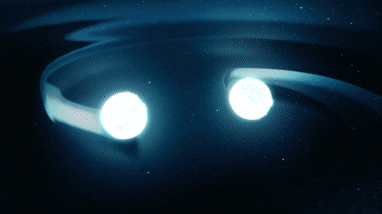

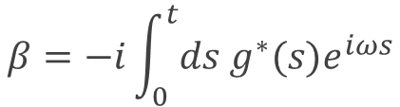

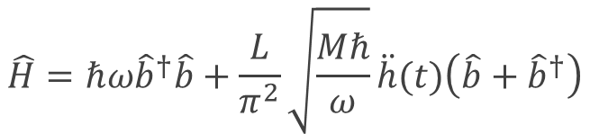
We solve the full, time-dependent problem
Interaction picture:
$$\hat{H}=ℏω{\hat{b}}^{†}\hat{b}+\frac{L}{π^{2}}\sqrt{\frac{Mℏ}{ω}}\ddot{h}(t)\left(\hat{b}+{\hat{b}}^{†}\right)$$
$${\hat{U}}_{int}=\hat{𝒯}e^{−i\int_{0}^{t}{ds\left(g\left(s\right)\hat{b}\left(s\right)+g^{∗}(s){\hat{b}}^{†}(s)\right)}}$$
NASA
$$ℏν$$
Magnus expansion or Lie algebra or other methods:
$$\hat{U}=e^{−iφ}e^{−ωt{\hat{b}}^{†}\hat{b}}\hat{D}(β)$$
$$β=−i\int_{0}^{t}{ds{ g}^{∗}(s)e^{iωs}}$$
Tobar, Germain*, Sreenath K. Manikandan*, Thomas Beitel, and Igor Pikovski. "Detecting single gravitons with quantum sensing."
Nature Communications 15, 7229 (2024)

Slide 22

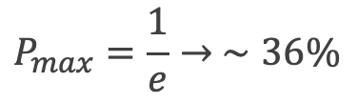
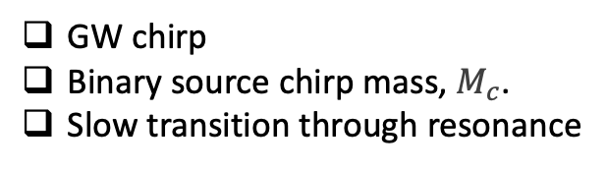
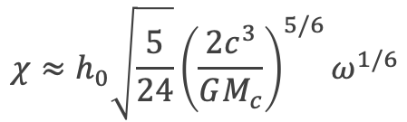


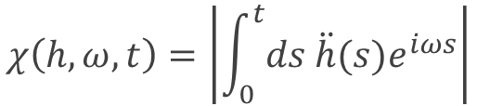
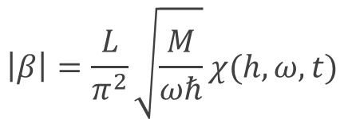
The full, time-dependent problem is solved and gives analytical predictions
$$ℏν$$
NASA
NASA
$$\left|β\right|=\frac{L}{π^{2}}\sqrt{\frac{M}{ωℏ}}χ(h,ω,t)$$
$$χ\left(h,ω,t\right)=\left|\int_{0}^{t}{ds \ddot{h}(s)e^{iωs}}\right|$$
$$\left.\left.\left|0\right.\right\rangle →\left|β(t)e^{−iωt}\right.\right\rangle$$
Single transition:
Use LIGO data, or stationary phase method, or analytic approximation:
$$P_{0→1}={\left|\left\langle 1 | βe^{−iωt}\right\rangle \right|}^{2}=e^{−{\left|β\right|}^{2}}{\left|β\right|}^{2}$$
$$χ≈h_{0}\sqrt{\frac{5}{24}}{\left(\frac{2c^{3}}{GM_{c}}\right)}^{5/6}ω^{1/6}$$
GW chirp
Binary source chirp mass, $M_{c}$.
Slow transition through resonance
$$P_{max}=\frac{1}{e}→ ∼36\%$$
$${\left|β\right|}_{max}=1$$
Tobar, Germain*, Sreenath K. Manikandan*, Thomas Beitel, and Igor Pikovski. "Detecting single gravitons with quantum sensing."
Nature Communications 15, 7229 (2024)

Slide 23
We compute the optimum mass required that maximizes the probability of single graviton exchange
NASA
NASA
$$\left.\left.\left|0\right.\right\rangle →\left|β(t)e^{−iωt}\right.\right\rangle$$
$$P_{0→1}={\left|\left\langle 1 | βe^{−iωt}\right\rangle \right|}^{2}=e^{−{\left|β\right|}^{2}}{\left|β\right|}^{2}$$
$$P_{max}=\frac{1}{e}≈0.36$$
Ideal mass, optimized for single graviton exchange:
$$M=\frac{π^{2}ℏω^{3}}{v_{s}^{2}χ\left(h,ω,t\right)}$$
$${\left|β\right|}_{max}=1$$
Tobar, Germain*, Sreenath K. Manikandan*, Thomas Beitel, and Igor Pikovski. "Detecting single gravitons with quantum sensing."
Nature Communications 15, 7229 (2024)

Slide 24
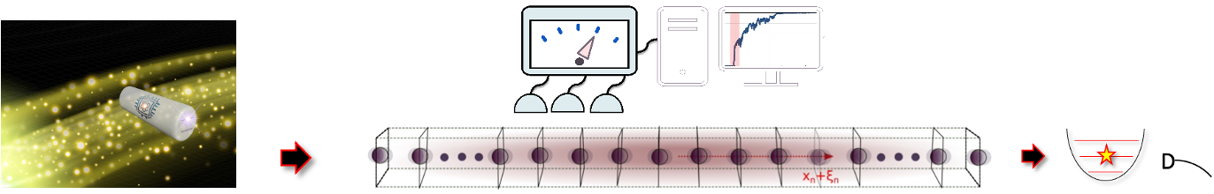
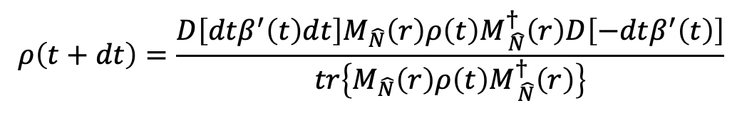
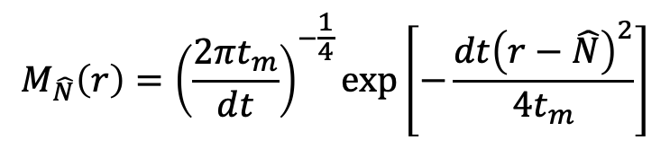

We require continuous quantum sensing of energy levels of the Weber bar
NASA
Measurement model:
$$r\left(t\right)=\left\langle \hat{N}\left(t\right)\right\rangle +\sqrt{t_{m}} ζ\left(t\right).$$
$$M_{\hat{N}}\left(r\right)={\left(\frac{2πt_{m}}{dt}\right)}^{−\frac{1}{4}}\exp\left[−\frac{dt{\left(r−\hat{N}\right)}^{2}}{4t_{m}}\right]$$
$$ρ\left(t+dt\right)=\frac{D\left[dtβ^{′}\left(t\right)dt\right]M_{\hat{N}}\left(r\right)ρ\left(t\right)M_{ \hat{N}}^{†}\left(r\right)D\left[−dtβ^{′}\left(t\right)\right]}{tr\left\{M_{\hat{N}}\left(r\right)ρ\left(t\right)M_{ \hat{N}}^{†}\left(r\right)\right\}}$$
Germain Tobar*, Sreenath K. Manikandan*, Thomas Beitel, and Igor Pikovski. "Detecting single gravitons with quantum sensing." arXiv:2308.15440 (2023).
Lectures at Quantum Trajectories, ICTS, Jan 20th – Feb 7th 2025.
Andrew N. Jordan, and Irfan A. Siddiqi. Quantum Measurement: Theory and Practice. Cambridge University Press, 2024.
Wiseman HM, Milburn GJ. Quantum Measurement and Control. Cambridge University Press; 2009.

Slide 25

Time-continuous and weak number-resolving quantum measurements of a Weber bar
Gradual collapse of the wavefunction
D
Image ref: Andrew N Jordan, Nature 502, 177 (2013)
Time-continuous energy measurement, outcomes r
Fock state probabilities
Blue dashed: re-cooling to ground state Pink: GW incidence
Germain Tobar*, Sreenath K. Manikandan*, Thomas Beitel, and Igor Pikovski. "Detecting single gravitons with quantum sensing."
Nature Communications 15, 7229 (2024)

Slide 26
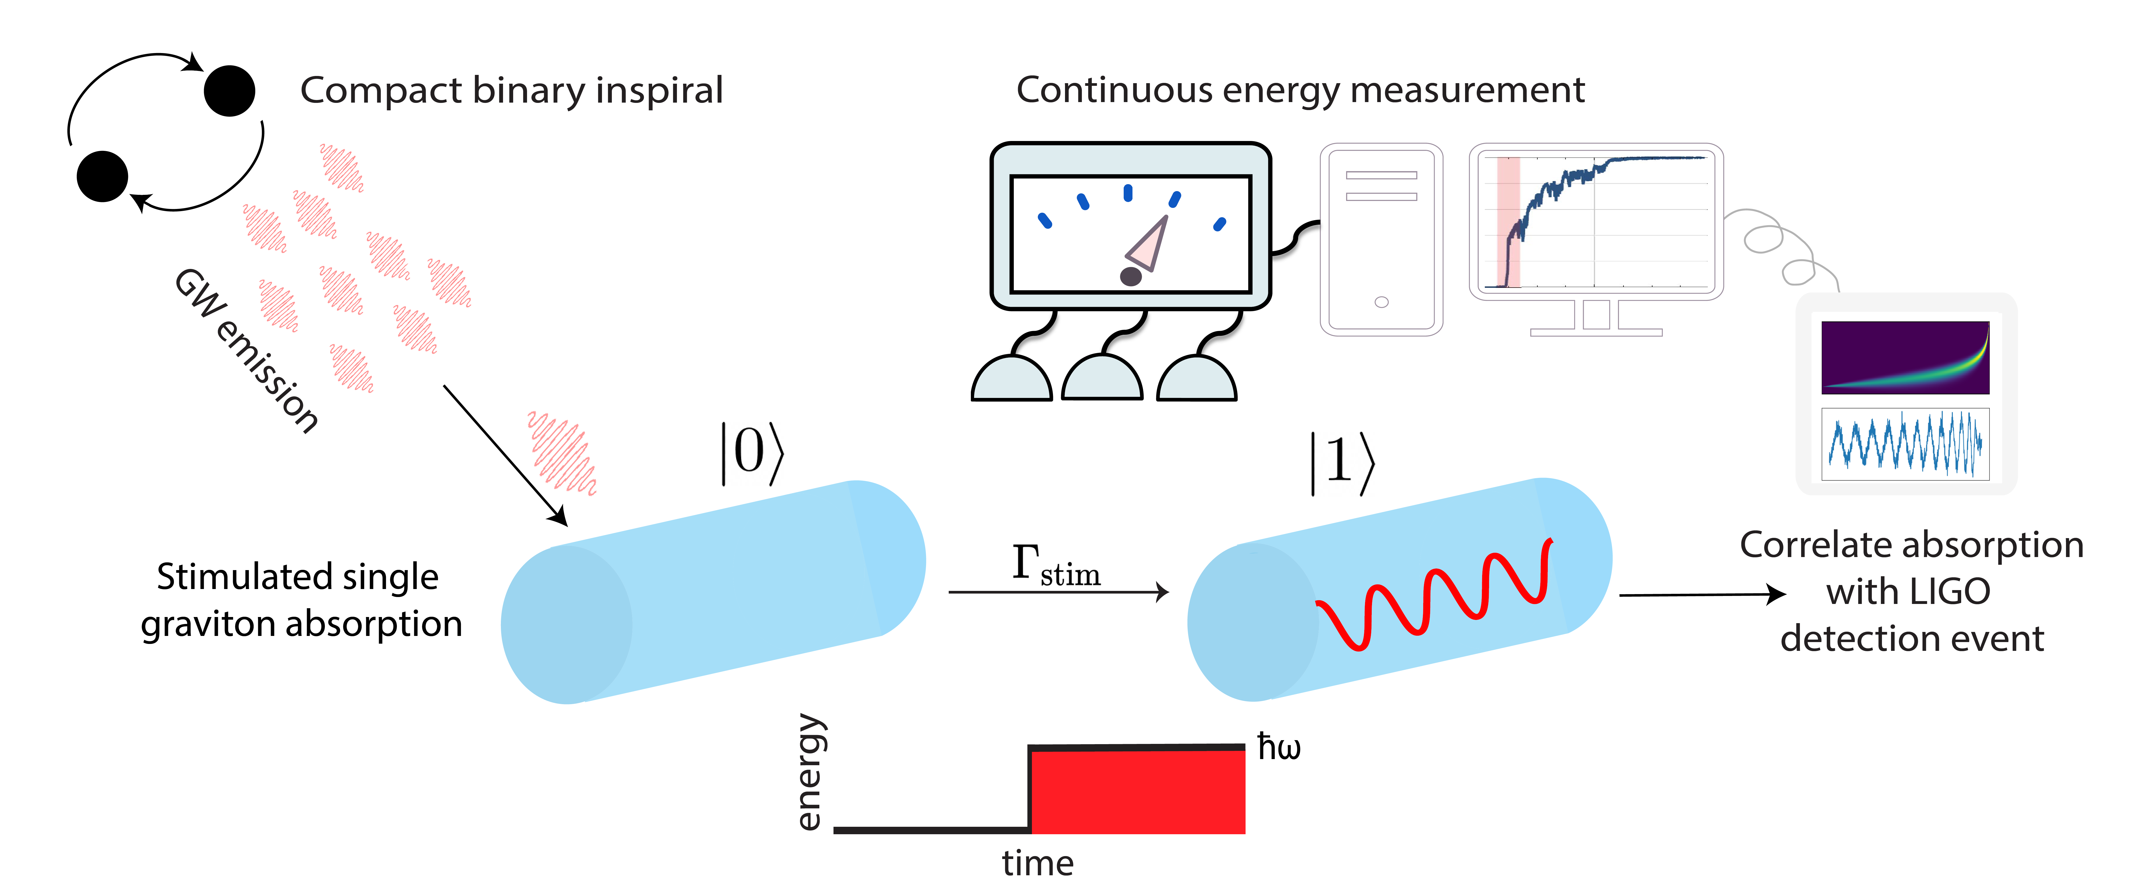
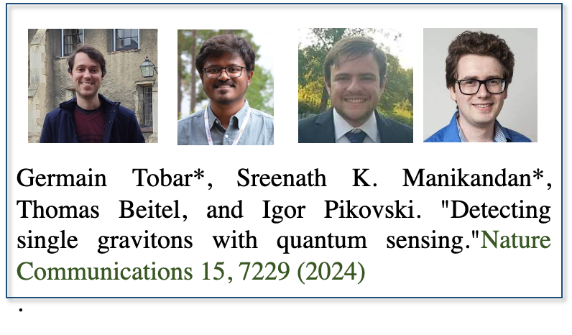
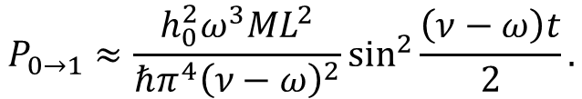
We can infer single graviton exchange events
$$P_{0→1}≈\frac{h_{0}^{2}ω^{3}ML^{2}}{{ℏπ^{4}\left(ν−ω\right)}^{2}}\sin^{2}{\frac{\left(ν−ω\right)t}{2}.}$$
Absorption happens at resonance (RWA):
Classical LIGO can tell if there was a wave chirping through the resonant frequency.
We see single excitations in the Weber bar: a gravito-phononic effect! Conservation of energy (which the conventional semi-classical limit of QED violates) suggests a quantum of energy (graviton) exchanged with the gravitational wave.
Not proof of quantum theory of gravity. But exchange of energy quanta analogous to photo-electric indication for photons.
Germain Tobar*, Sreenath K. Manikandan*, Thomas Beitel, and Igor Pikovski. "Detecting single gravitons with quantum sensing."
Nature Communications 15, 7229 (2024)

Slide 27
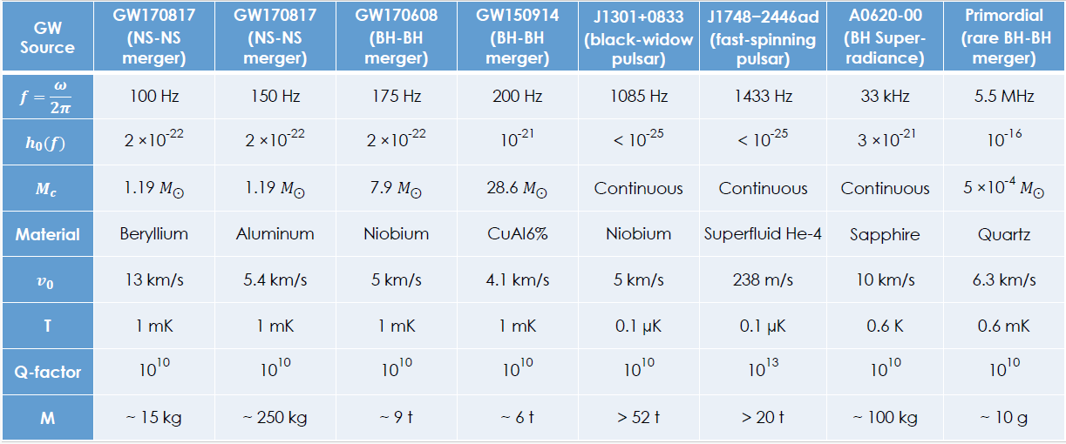
Requirements:
Germain Tobar*, Sreenath K. Manikandan*, Thomas Beitel, and Igor Pikovski. "Detecting single gravitons with quantum sensing."
Nature Communications 15, 7229 (2024)

Slide 28
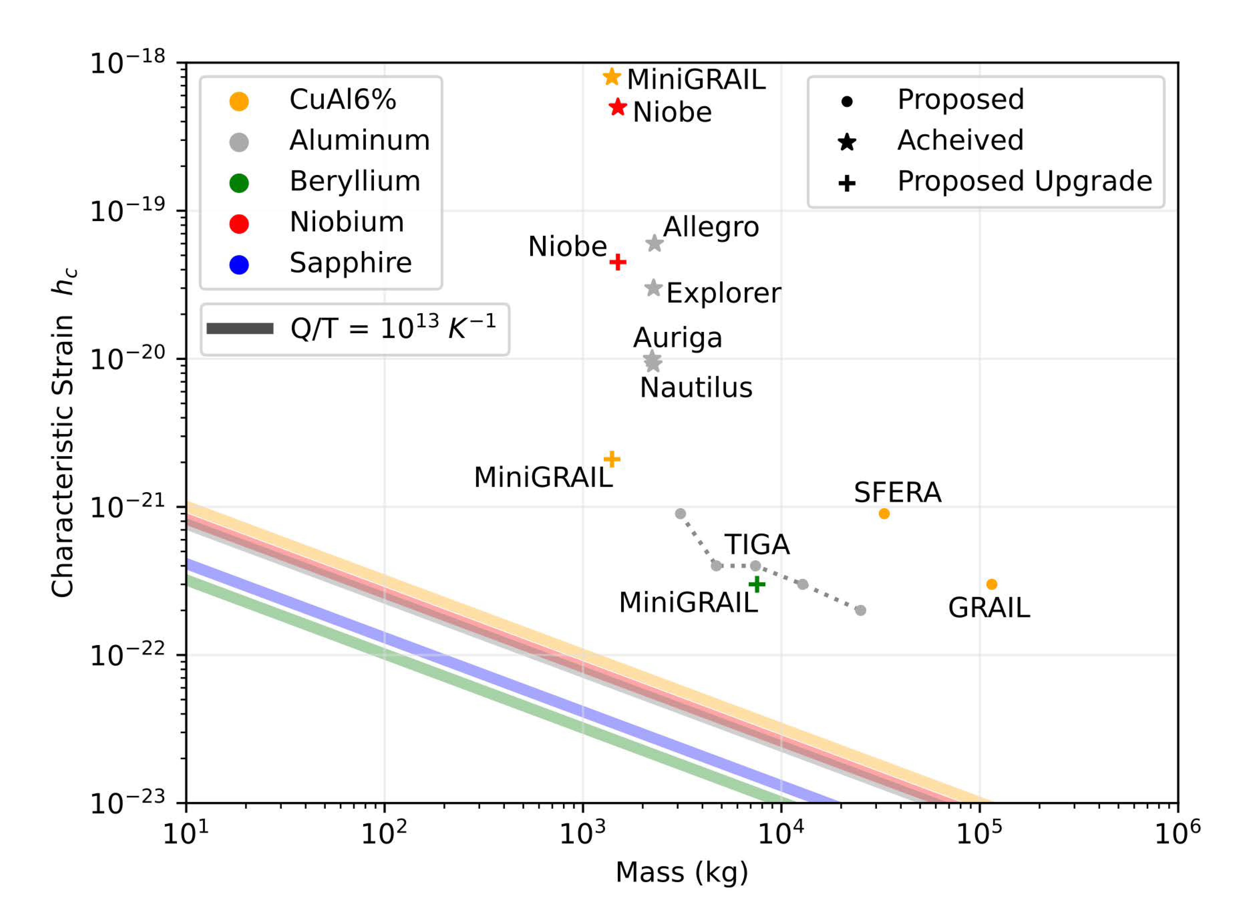

Requirements:
$$ω\overline{n}Q^{−1}≤Γ_{stim}.$$
Germain Tobar*, Sreenath K. Manikandan*, Thomas Beitel, and Igor Pikovski. "Detecting single gravitons with quantum sensing."
Nature Communications 15, 7229 (2024)

Slide 29
The Acoherence of Gravitons
“Detecting acoherence in radiation fields.” Sreenath K. Manikandan and Frank Wilczek. arXiv: 2409.20378 (2024).
Germain Tobar*, Sreenath K. Manikandan*, Thomas Beitel, & Igor Pikovski, (2023). Nature Communications 15, 7229 (2024).
Parikh, Maulik, Frank Wilczek, and George Zahariade. "Quantum mechanics of gravitational waves." Physical Review Letters 127.8 (2021): 081602.
Parikh, Maulik, Frank Wilczek, and George Zahariade. "Signatures of the quantization of gravity at gravitational wave detectors." Physical Review D 104.4 (2021): 046021.
Victoria Shenderov, Mark Suppiah, Thomas Beitel, Germain Tobar, Sreenath K. Manikandan, and Igor Pikovski. "Stimulated absorption of single gravitons: First light on quantum gravity." arXiv:2407.11929 (2024).

Slide 30
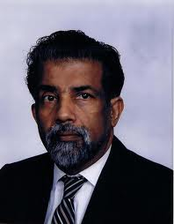
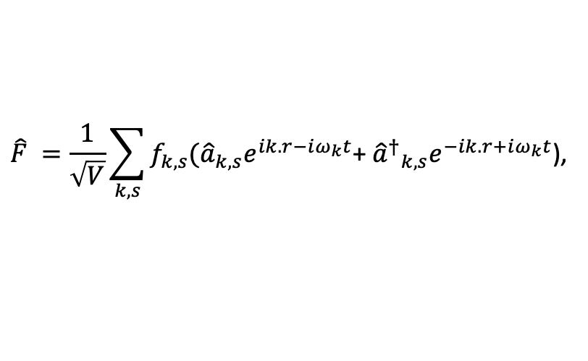
The semi-classical limit/optical equivalence
Plane waves in linearized quantum field theories (quantum optics, quantum acoustics, or linearized gravitational waves) can be decomposed generically as,
$$\hat{F} =\frac{1}{\sqrt{V}}\sum_{k,s}{f_{k,s}({\hat{a}}_{k,s}e^{ik.r−iω_{k}t}\text{+ }{{\hat{a}}^{†}}_{k,s}e^{−ik.r+iω_{k}t}\text{)}\text{,} }$$
Sudarshan, ECG. (1963). Equivalence of semiclassical and quantum mechanical descriptions of statistical light beams. Physical Review Letters, 10(7), 277.
Glauber, R. J. (1963). Coherent and incoherent states of the radiation field. Physical Review, 131(6), 2766.
Mandel L, Wolf E. Optical Coherence and Quantum Optics. Cambridge University Press; 1995.

Slide 31
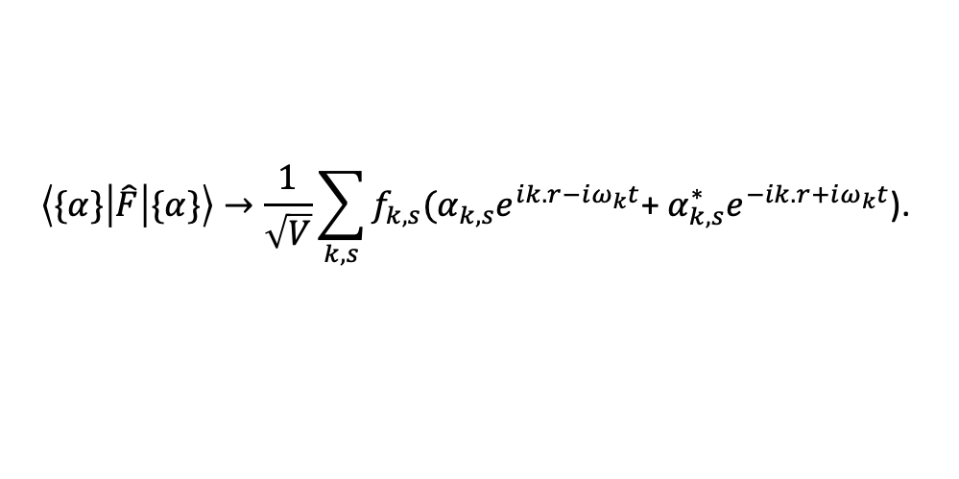
The semi-classical limit/optical equivalence
Plane waves in linearized quantum field theories (quantum optics, quantum acoustics, or linearized gravitational waves) can be decomposed generically as,
$$\hat{F} =\frac{1}{\sqrt{V}}\sum_{k,s}{f_{k,s}({\hat{a}}_{k,s}e^{ik.r−iω_{k}t}\text{+ }{{\hat{a}}^{†}}_{k,s}e^{−ik.r+iω_{k}t}\text{)}\text{,} }$$
For coherent states of the optical field we can substitute the field amplitude operators with complex field amplitudes,
$$\left\langle \{α\}\left|\hat{F}\right|\{α\}\right\rangle →\frac{1}{\sqrt{V}}\sum_{k,s}{f_{k,s}(α_{k,s}e^{ik.r−iω_{k}t}\text{+ }α_{k,s}^{∗}e^{−ik.r+iω_{k}t}\text{)}\text{.} }$$
Sudarshan, ECG. (1963). Equivalence of semiclassical and quantum mechanical descriptions of statistical light beams. Physical Review Letters, 10(7), 277.
Glauber, R. J. (1963). Coherent and incoherent states of the radiation field. Physical Review, 131(6), 2766.
Mandel L, Wolf E. Optical Coherence and Quantum Optics. Cambridge University Press; 1995.

Slide 32
The semi-classical limit/optical equivalence
Plane waves in linearized quantum field theories (quantum optics, quantum acoustics, or linearized gravitational waves) can be decomposed generically as,
$$\hat{F} =\frac{1}{\sqrt{V}}\sum_{k,s}{f_{k,s}({\hat{a}}_{k,s}e^{ik.r−iω_{k}t}\text{+ }{{\hat{a}}^{†}}_{k,s}e^{−ik.r+iω_{k}t}\text{)}\text{,} }$$
For coherent states of the optical field we can substitute the field amplitude operators with complex field amplitudes,
$$\left\langle \{α\}\left|\hat{F}\right|\{α\}\right\rangle →\frac{1}{\sqrt{V}}\sum_{k,s}{f_{k,s}(α_{k,s}e^{ik.r−iω_{k}t}\text{+ }α_{k,s}^{∗}e^{−ik.r+iω_{k}t}\text{)}\text{.} }$$
This can be done because coherent states have zero variance (noise) for the field amplitude operators,
$${\hat{a}}^{2}\left|α\right\rangle =α^{2}\left|α\right\rangle$$
$$\hat{a}\left|α\right\rangle =α\left|α\right\rangle$$
$${⟨α|\hat{a}}^{2}\left|α\right\rangle −{\left\langle α\left|a\right|α\right\rangle }^{2}=0$$
$${⟨α|\hat{a}}^{†}=α^{∗}⟨α|$$
$${{⟨α|(\hat{a}}^{†})}^{2}={{⟨α|(α}^{∗})}^{2}$$
$${{⟨α|(\hat{a}}^{†})}^{2}\left|α\right\rangle −{⟨α|\hat{a}}^{†}{\left|α\right\rangle }^{2}=0.$$
Sudarshan, ECG. (1963). Equivalence of semiclassical and quantum mechanical descriptions of statistical light beams. Physical Review Letters, 10(7), 277.
Glauber, R. J. (1963). Coherent and incoherent states of the radiation field. Physical Review, 131(6), 2766.
Mandel L, Wolf E. Optical Coherence and Quantum Optics. Cambridge University Press; 1995.

Slide 33
Quantum mechanics of a resonant harmonic detector for radiation fields
The interaction (picture) Hamiltonian in the rotating wave approximation between the detector and the radiation field can be approximated as,
$$V_{I}=ℏ\sqrt{γ_{0}}\left[d\left(t\right)a^{†}+d^{†}\left(t\right)a\right]. Assume \left[d\left(t\right),d^{†}\left(t^{′}\right)\right]=δ\left(t−t^{′}\right).$$
“Detecting acoherence in radiation fields.” Sreenath K. Manikandan and Frank Wilczek. arXiv: 2409.20378 (2024).

Slide 34
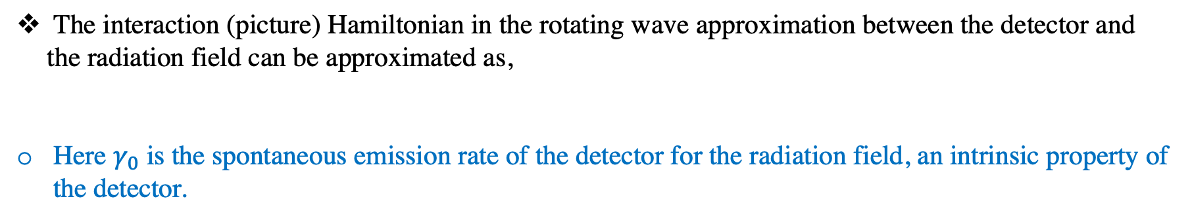
Quantum mechanics of a resonant harmonic detector for radiation fields
The interaction (picture) Hamiltonian in the rotating wave approximation between the detector and the radiation field can be approximated as,
Here $γ_{0}$ is the spontaneous emission rate of the detector for the radiation field, an intrinsic property of the detector.
$$V_{I}=ℏ\sqrt{γ_{0}}\left[d\left(t\right)a^{†}+d^{†}\left(t\right)a\right]. Assume \left[d\left(t\right),d^{†}\left(t^{′}\right)\right]=δ\left(t−t^{′}\right).$$
“Detecting acoherence in radiation fields.” Sreenath K. Manikandan and Frank Wilczek. arXiv: 2409.20378 (2024).

Slide 35
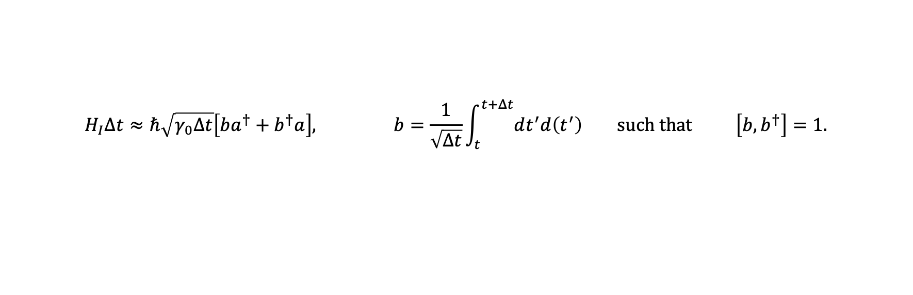
Quantum mechanics of a resonant harmonic detector for radiation fields
The interaction (picture) Hamiltonian in the rotating wave approximation between the detector and the radiation field can be approximated as,
Here $γ_{0}$ is the spontaneous emission rate of the detector for the radiation field, an intrinsic property of the detector.
$$V_{I}=ℏ\sqrt{γ_{0}}\left[d\left(t\right)a^{†}+d^{†}\left(t\right)a\right]. Assume \left[d\left(t\right),d^{†}\left(t^{′}\right)\right]=δ\left(t−t^{′}\right).$$
The time evolution operator can be approximated as $U_{I}=e^{−i/ℏ{ ∫V}_{I}\left(t^{′}\right)dt^{′}}≈e^{−\frac{i}{ℏ}H_{I}Δt}$ where,
$$H_{I}Δt≈ℏ\sqrt{γ_{0}Δt}\left[ba^{†}+b^{†}a\right], b=\frac{1}{\sqrt{Δt}}\int_{t}^{t+Δt}{dt^{′}d\left(t^{′}\right) such that \left[b,b^{†}\right]=1.}$$
“Detecting acoherence in radiation fields.” Sreenath K. Manikandan and Frank Wilczek. arXiv: 2409.20378 (2024).

Slide 36
Quantum mechanics of a resonant harmonic detector for radiation fields
The interaction (picture) Hamiltonian in the rotating wave approximation between the detector and the radiation field can be approximated as,
Here $γ_{0}$ is the spontaneous emission rate of the detector for the radiation field, an intrinsic property of the detector.
$$V_{I}=ℏ\sqrt{γ_{0}}\left[d\left(t\right)a^{†}+d^{†}\left(t\right)a\right]. Assume \left[d\left(t\right),d^{†}\left(t^{′}\right)\right]=δ\left(t−t^{′}\right).$$
The time evolution operator can be approximated as $U_{I}=e^{−i/ℏ{ ∫V}_{I}\left(t^{′}\right)dt^{′}}≈e^{−\frac{i}{ℏ}H_{I}Δt}$ where,
$$H_{I}Δt≈ℏ\sqrt{γ_{0}Δt}\left[ba^{†}+b^{†}a\right], b=\frac{1}{\sqrt{Δt}}\int_{t}^{t+Δt}{dt^{′}d\left(t^{′}\right) such that \left[b,b^{†}\right]=1.}$$
Coherent state of the field, $a\left|α\right\rangle =α\left|α\right\rangle ,$ coupled to the vacuum of the detector $b\left|0\right\rangle =0,$ evolves as,
$$e^{−\frac{i}{ℏ}H_{I}Δt}\left|α\right\rangle \left|0\right\rangle →\left|α cos\left(\sqrt{γ_{0}Δt}\right)\right\rangle |−iαsin\left(\sqrt{γ_{0}Δt}\right)⟩$$
“Detecting acoherence in radiation fields.” Sreenath K. Manikandan and Frank Wilczek. arXiv: 2409.20378 (2024).

Slide 37
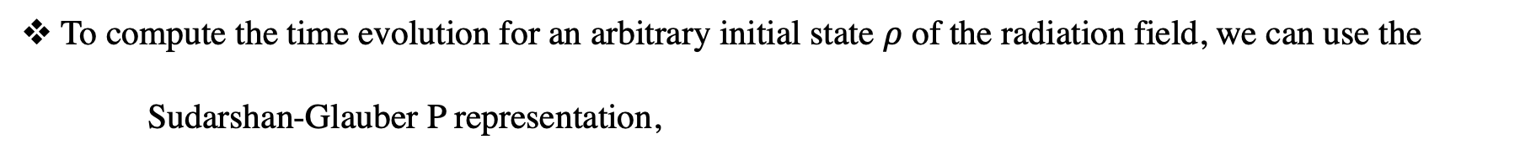
The P representation and global counting statistics
Coherent state of the field, $a\left|α\right\rangle =α\left|α\right\rangle ,$ coupled to the vacuum of the detector $b\left|0\right\rangle =0,$ evolves as,
$$e^{−\frac{i}{ℏ}H_{I}Δt}\left|α\right\rangle \left|0\right\rangle →\left|α cos\left(\sqrt{γ_{0}Δt}\right)\right\rangle |−iαsin\left(\sqrt{γ_{0}Δt}\right)⟩$$
To compute the time evolution for an arbitrary initial state $ρ$ of the radiation field, we can use the
Sudarshan-Glauber P representation,
$$ρ=∫d^{2}α P\left(α\right)\left|α\right\rangle \left\langle α\right|.$$
$U_{I}ρ⊗|0⟩⟨0|U_{I}^{†}=∫d^{2}αP(α)$ $\left|α cos\left(\sqrt{γ_{0}Δt}\right)\right\rangle ⟨α cos\left(\sqrt{γ_{0}Δt}\right)|⊗|−iαsin\left(\sqrt{γ_{0}Δt}\right)⟩⟨−iαsin\left(\sqrt{γ_{0}Δt}\right)$|
“Detecting acoherence in radiation fields.” Sreenath K. Manikandan and Frank Wilczek. arXiv: 2409.20378 (2024).

Slide 38
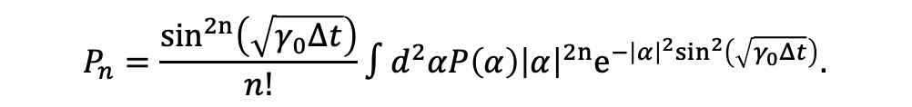
The P representation and global counting statistics
Coherent state of the field, $a\left|α\right\rangle =α\left|α\right\rangle ,$ coupled to the vacuum of the detector $b\left|0\right\rangle =0,$ evolves as,
$$e^{−\frac{i}{ℏ}H_{I}Δt}\left|α\right\rangle \left|0\right\rangle →\left|α cos\left(\sqrt{γ_{0}Δt}\right)\right\rangle |−iαsin\left(\sqrt{γ_{0}Δt}\right)⟩$$
To compute the time evolution for an arbitrary initial state $ρ$ of the radiation field, we can use the
Sudarshan-Glauber P representation,
$$ρ=∫d^{2}α P\left(α\right)\left|α\right\rangle \left\langle α\right|.$$
$U_{I}ρ⊗|0⟩⟨0|U_{I}^{†}=∫d^{2}αP(α)$ $\left|α cos\left(\sqrt{γ_{0}Δt}\right)\right\rangle ⟨α cos\left(\sqrt{γ_{0}Δt}\right)|⊗|−iαsin\left(\sqrt{γ_{0}Δt}\right)⟩⟨−iαsin\left(\sqrt{γ_{0}Δt}\right)$|
This yields the probability $P_{n}$ of seeing n quantum jumps in the detector,
$$P_{n}=\frac{\sin^{2n}\left(\sqrt{γ_{0}Δt}\right)}{n!}∫d^{2}αP\left(α\right){\left|α\right|}^{2n}e^{−{{\left|α\right|}^{2}sin}^{2}\left(\sqrt{γ_{0}Δt}\right)}.$$
“Detecting acoherence in radiation fields.” Sreenath K. Manikandan and Frank Wilczek. arXiv: 2409.20378 (2024).

Slide 39
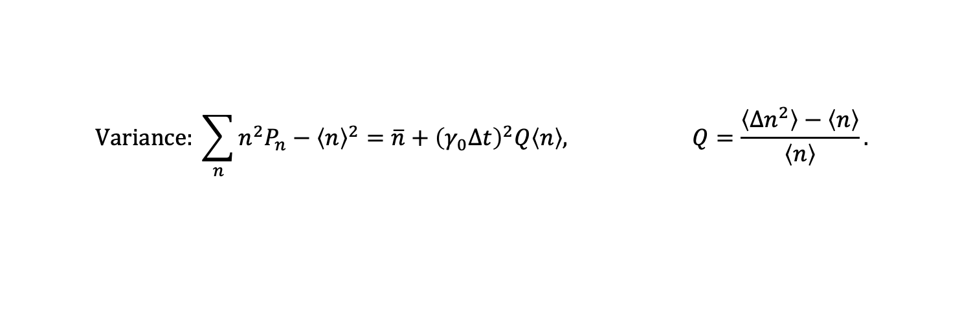
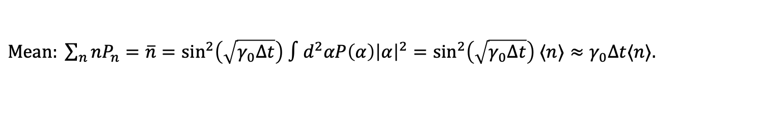

The P representation and global counting statistics
We obtain the probability $P_{n}$ of seeing n quantum jumps in the detector using the Sudarshan-Glauber P representation,
$$P_{n}=\frac{\sin^{2n}\left(\sqrt{γ_{0}Δt}\right)}{n!}∫d^{2}αP\left(α\right){\left|α\right|}^{2n}e^{−{{\left|α\right|}^{2}sin}^{2}\left(\sqrt{γ_{0}Δt}\right)}.$$
$Mean: \sum_{n}{nP_{n}}=\overline{n}=\sin^{2}\left(\sqrt{γ_{0}Δt}\right)$ $∫d^{2}αP\left(α\right){\left|α\right|}^{2}=\sin^{2}\left(\sqrt{γ_{0}Δt}\right) ⟨n⟩≈γ_{0}Δt⟨n⟩.$
$$Variance: \sum_{n}{n^{2}P_{n}−{\left\langle n\right\rangle }^{2}}=\overline{n}+{\left(γ_{0}Δt\right)}^{2}Q\left\langle n\right\rangle , Q=\frac{\left\langle Δn^{2}\right\rangle −\left\langle n\right\rangle }{\left\langle n\right\rangle }.$$
Here $γ_{0}$ is the spontaneous emission rate of the detector and Q is the Mandel’s Q parameter.
“Detecting acoherence in radiation fields.” Sreenath K. Manikandan and Frank Wilczek. arXiv: 2409.20378 (2024).

Slide 40



Global counting statistics: examples
The mean and the variance of observable quantum jumps,
For coherent states, $\left|β\right\rangle ,$ the mean equals the variance, $\left\langle n\right\rangle ={\left|β\right|}^{2}=\left\langle Δn^{2}\right\rangle .$
$P\left(α\right)=δ(α−β), \overline{n}=γ_{0}Δt{\left|β\right|}^{2}$, $\left(Δn^{2}\right)=γ_{0}Δt{\left|β\right|}^{2}, Q=0$
$Mean: \sum_{n}{nP_{n}}=\overline{n}=\sin^{2}\left(\sqrt{γ_{0}Δt}\right)$ $∫d^{2}αP\left(α\right){\left|α\right|}^{2}=\sin^{2}\left(\sqrt{γ_{0}Δt}\right) ⟨n⟩≈γ_{0}Δt⟨n⟩.$
$$Variance: \sum_{n}{n^{2}P_{n}−{\left\langle n\right\rangle }^{2}}=\overline{n}+{\left(γ_{0}Δt\right)}^{2}Q\left\langle n\right\rangle , Q=\frac{\left\langle Δn^{2}\right\rangle −\left\langle n\right\rangle }{\left\langle n\right\rangle }.$$
$$−1≤Q<0:Sub−Poissonian, Q=0:Poissonian, Q>0 super−Poissonian$$
“Detecting acoherence in radiation fields.” Sreenath K. Manikandan and Frank Wilczek. arXiv: 2409.20378 (2024).

Slide 41

Global counting statistics: examples
The mean and the variance of observable quantum jumps,
For coherent states, $\left|β\right\rangle ,$ the mean equals the variance, $\left\langle n\right\rangle ={\left|β\right|}^{2}=\left\langle Δn^{2}\right\rangle .$
$P\left(α\right)=δ(α−β), \overline{n}=γ_{0}Δt{\left|β\right|}^{2}$, $\left(Δn^{2}\right)=γ_{0}Δt{\left|β\right|}^{2}, Q=0$
For a thermal state,
$Mean: \sum_{n}{nP_{n}}=\overline{n}=\sin^{2}\left(\sqrt{γ_{0}Δt}\right)$ $∫d^{2}αP\left(α\right){\left|α\right|}^{2}=\sin^{2}\left(\sqrt{γ_{0}Δt}\right) ⟨n⟩≈γ_{0}Δt⟨n⟩.$
$$Variance: \sum_{n}{n^{2}P_{n}−{\left\langle n\right\rangle }^{2}}=\overline{n}+{\left(γ_{0}Δt\right)}^{2}Q\left\langle n\right\rangle , Q=\frac{\left\langle Δn^{2}\right\rangle −\left\langle n\right\rangle }{\left\langle n\right\rangle }.$$
$$−1≤Q<0:Sub−Poissonian, Q=0:Poissonian, Q>0 super−Poissonian$$
$P\left(α\right)=\frac{1}{πn_{th}}e^{−\frac{{\left|α\right|}^{2}}{n_{th}}}, \overline{n}=γ_{0}{Δt n}_{th}$,${. \left(Δn^{2}\right)= γ}_{0}{Δt n}_{th}+{\left(γ_{0}Δt\right)}^{2} n_{th}^{2}, Q=n_{th}$
“Detecting acoherence in radiation fields.” Sreenath K. Manikandan and Frank Wilczek. arXiv: 2409.20378 (2024).

Slide 42

Global counting statistics: examples
For coherent states, $\left|β\right\rangle ,$ the mean equals the variance, $\left\langle n\right\rangle ={\left|β\right|}^{2}=\left\langle Δn^{2}\right\rangle .$
$P\left(α\right)=δ(α−β), \overline{n}=γ_{0}Δt{\left|β\right|}^{2}$, $\left(Δn^{2}\right)=γ_{0}Δt{\left|β\right|}^{2}, Q=0$
For a thermal state,
For a highly squeezed vacuum state,
$\left|ψ_{sq}\right\rangle =\frac{1}{\sqrt{\cosh{r}}}\sum_{m}{\frac{{\left(−\tanh{r}\right)}^{m}\sqrt{2m!}}{2^{m}m!}|2m⟩}, \overline{n}=γ_{0}Δt{(sinh{r)}}^{2}$, $\left(Δn^{2}\right)=\overline{n}+\cosh{2r}{(sinh{r)}}^{2}, Q=\cosh{2r}=1+2{(sinh{r)}}^{2}=1+2\left\langle n\right\rangle ≈2⟨n⟩.$
$P\left(α\right)=\frac{1}{πn_{th}}e^{−\frac{{\left|α\right|}^{2}}{n_{th}}}, \overline{n}=γ_{0}{Δt n}_{th}$,${. \left(Δn^{2}\right)= γ}_{0}{Δt n}_{th}+{\left(γ_{0}Δt\right)}^{2} n_{th}^{2}, Q=n_{th}$
“Detecting acoherence in radiation fields.” Sreenath K. Manikandan and Frank Wilczek. arXiv: 2409.20378 (2024).

Slide 43

Global counting statistics: examples
For coherent states, $\left|β\right\rangle ,$ the mean equals the variance, $\left\langle n\right\rangle ={\left|β\right|}^{2}=\left\langle Δn^{2}\right\rangle .$
$P\left(α\right)=δ(α−β), \overline{n}=γ_{0}Δt{\left|β\right|}^{2}$, $\left(Δn^{2}\right)=γ_{0}Δt{\left|β\right|}^{2}, Q=0$
For a thermal state,
For a highly squeezed vacuum state,
$\left|ψ_{sq}\right\rangle =\frac{1}{\sqrt{\cosh{r}}}\sum_{m}{\frac{{\left(−\tanh{r}\right)}^{m}\sqrt{2m!}}{2^{m}m!}|2m⟩}, \overline{n}=γ_{0}Δt{(sinh{r)}}^{2}$, $\left(Δn^{2}\right)=\overline{n}+\cosh{2r}{(sinh{r)}}^{2}, Q=\cosh{2r}=1+2{(sinh{r)}}^{2}=1+2\left\langle n\right\rangle ≈2⟨n⟩.$
For sub-Poissonian states $−1≤Q<0$, and $Q=−1$ for Fock (number) states $|n⟩$.
$\overline{n}=γ_{0}Δt \left\langle n\right\rangle {., \left(Δn^{2}\right)= γ}_{0}Δt \left\langle n\right\rangle +{\left(γ_{0}Δt\right)}^{2}Q\left\langle n\right\rangle <\overline{n}$
$P\left(α\right)=\frac{1}{πn_{th}}e^{−\frac{{\left|α\right|}^{2}}{n_{th}}}, \overline{n}=γ_{0}{Δt n}_{th}$,${. \left(Δn^{2}\right)= γ}_{0}{Δt n}_{th}+{\left(γ_{0}Δt\right)}^{2} n_{th}^{2}, Q=n_{th}$
“Detecting acoherence in radiation fields.” Sreenath K. Manikandan and Frank Wilczek. arXiv: 2409.20378 (2024).

Slide 44




A simple ratio test for acoherence
Coherent states have Poissonian statistics, evident from their representation in the number basis, which yields Poissonian probabilities that obey rigid relations between $p\left(0\right), p\left(1\right), p\left(2\right)…$
$$\left|β\right\rangle =e^{−\frac{{\left|β\right|}^{2}}{2}}\sum_{n}{\frac{β^{n}}{\sqrt{n!}}} \left|n\right\rangle , p\left(n\right)=\frac{e^{−{\left|β\right|}^{2}}{|β|}^{2n}}{n!}.$$
For Poissonian statistics, $2p\left(0\right)p\left(2\right)=p{\left(1\right)}^{2}.$ This is also satisfied by the probability of observing the quantum jumps in a resonant detector if the field is in a coherent state, $P\left(α\right)=δ(α−β)$,
For coherent states,
$$P_{n}=\frac{\sin^{2n}\left(\sqrt{γ_{0}Δt}\right)}{n!}∫d^{2}αP\left(α\right){\left|α\right|}^{2n}e^{−{{\left|α\right|}^{2}sin}^{2}\left(\sqrt{γ_{0}Δt}\right)}.$$
$$R= \frac{{2P}_{0}P_{2}}{P_{1}^{2}}=1.$$
“Detecting acoherence in radiation fields.” Sreenath K. Manikandan and Frank Wilczek. arXiv: 2409.20378 (2024).

Slide 45



A simple ratio test for acoherence
The probability of observing the quantum jumps in a resonant detector,
For coherent states,
For thermal states,
$$P_{n}=\frac{\sin^{2n}\left(\sqrt{γ_{0}Δt}\right)}{n!}∫d^{2}αP\left(α\right){\left|α\right|}^{2n}e^{−{{\left|α\right|}^{2}sin}^{2}\left(\sqrt{γ_{0}Δt}\right)}.$$
$$R= \frac{{2P}_{0}P_{2}}{P_{1}^{2}}=1.$$
$$R= \frac{{2P}_{0}P_{2}}{P_{1}^{2}}=2.$$
“Detecting acoherence in radiation fields.” Sreenath K. Manikandan and Frank Wilczek. arXiv: 2409.20378 (2024).

Slide 46



For coherent states,
For thermal states,
For highly squeezed vacuum states,
A simple ratio test for acoherence
$$R= \frac{{2P}_{0}P_{2}}{P_{1}^{2}}=1.$$
$$R= \frac{{2P}_{0}P_{2}}{P_{1}^{2}}=2.$$
$$R= \frac{{2P}_{0}P_{2}}{P_{1}^{2}}=3.$$
“Detecting acoherence in radiation fields.” Sreenath K. Manikandan and Frank Wilczek. arXiv: 2409.20378 (2024).

Slide 47


For coherent states,
For thermal states,
For highly squeezed vacuum states,
For number states, $|n⟩$
A simple ratio test for acoherence
$$R= \frac{{2P}_{0}P_{2}}{P_{1}^{2}}=1.$$
$$R= \frac{{2P}_{0}P_{2}}{P_{1}^{2}}=2.$$
$$R= \frac{{2P}_{0}P_{2}}{P_{1}^{2}}=3.$$
$$R= \frac{{2P}_{0}P_{2}}{P_{1}^{2}}=1−\frac{1}{n}.$$
“Detecting acoherence in radiation fields.” Sreenath K. Manikandan and Frank Wilczek. arXiv: 2409.20378 (2024).

Slide 48

A simple ratio test for acoherence
For a generic quantum state,
$$R= \frac{{2P}_{0}P_{2}}{P_{1}^{2}}≈1+\frac{Q}{\left\langle n\right\rangle }.$$
“Detecting acoherence in radiation fields.” Sreenath K. Manikandan and Frank Wilczek. arXiv: 2409.20378 (2024).

Slide 49


A simple ratio test for acoherence
For a generic quantum state,
For a generic Gaussian state (Using Wigner functions, and Weyl transform),
$$R= \frac{{2P}_{0}P_{2}}{P_{1}^{2}}≈1+\frac{Q}{\left\langle n\right\rangle }.$$
$x_{0}$: the displacement, $n_{th}:$ the thermal occupation, $r:$ the degree of squeezing,
$φ:$ the angle between the displacement direction and squeezing direction.
“Detecting acoherence in radiation fields.” Sreenath K. Manikandan and Frank Wilczek. arXiv: 2409.20378 (2024).

Slide 50





Tests of acoherence for gravitational radiation
For a generic quantum state of gravitational radiation let us assume the intensity $∝\left\langle n\right\rangle ∼{10}^{36}$, high enough such that LIGO is also sensitive to the radiation field. Using our simple ratio test,
For coherent states,
For thermal states,
For highly squeezed vacuum states,
$$R= \frac{{2P}_{0}P_{2}}{P_{1}^{2}}≈1+\frac{Q}{\left\langle n\right\rangle }.$$
$$R= \frac{{2P}_{0}P_{2}}{P_{1}^{2}}=1.$$
$$R= \frac{{2P}_{0}P_{2}}{P_{1}^{2}}=2.$$
$$R= \frac{{2P}_{0}P_{2}}{P_{1}^{2}}=3.$$
“Detecting acoherence in radiation fields.” Sreenath K. Manikandan and Frank Wilczek. arXiv: 2409.20378 (2024).

Slide 51

Tests of acoherence for gravitational radiation
The spontaneous emission rate of a typical Weber bar detector for single gravitons, $γ_{0}=\frac{8GML^{2}ω^{4}}{π^{4}c^{5}}≈{10}^{−33}s^{−1}.$
Let us say, the number of gravitons in the LIGO band $\left\langle n\right\rangle ≈{10}^{36},$and the duration $Δt≈1ms={10}^{−3}s.$
“Detecting acoherence in radiation fields.” Sreenath K. Manikandan and Frank Wilczek. arXiv: 2409.20378 (2024).

Slide 52


Tests of acoherence for gravitational radiation
The spontaneous emission rate of a typical Weber bar detector for single gravitons, $γ_{0}=\frac{8GML^{2}ω^{4}}{π^{4}c^{5}}≈{10}^{−33}s^{−1}.$
For a thermal state,
Let us say, the number of gravitons in the LIGO band $\left\langle n\right\rangle ≈{10}^{36},$and the duration $Δt≈1ms={10}^{−3}s.$
For coherent states, $\left|β\right\rangle ,$ the mean equals the variance, $\left\langle n\right\rangle ={\left|β\right|}^{2}=\left\langle Δn^{2}\right\rangle .$
$\overline{n}=γ_{0}Δt\left\langle n\right\rangle ∼1$, $\left(Δn^{2}\right)=γ_{0}Δt\left\langle n\right\rangle ∼1, Q=0$
$P\left(α\right)=\frac{1}{πn_{th}}e^{−\frac{{\left|α\right|}^{2}}{n_{th}}}, \overline{n}=γ_{0}{Δt n}_{th}∼1$,${. \left(Δn^{2}\right)= γ}_{0}{Δt n}_{th}+{\left(γ_{0}Δt\right)}^{2} n_{th}^{2}∼2, Q=n_{th}$
“Detecting acoherence in radiation fields.” Sreenath K. Manikandan and Frank Wilczek. arXiv: 2409.20378 (2024).

Slide 53

Tests of acoherence for gravitational radiation
The spontaneous emission rate of a typical Weber bar detector for single gravitons, $γ_{0}=\frac{8GML^{2}ω^{4}}{π^{4}c^{5}}≈{10}^{−33}s^{−1}.$
For a thermal state,
For a highly squeezed vacuum state,
$$\left|ψ_{sq}\right\rangle =\frac{1}{\sqrt{\cosh{r}}}\sum_{m}{\frac{{\left(−\tanh{r}\right)}^{m}\sqrt{2m!}}{2^{m}m!}|2m⟩}, Q=\cosh{2r}=1+2{(sinh{r)}}^{2}=1+2\left\langle n\right\rangle ≈2⟨n⟩.$$
Let us say, the number of gravitons in the LIGO band $\left\langle n\right\rangle ≈{10}^{36},$and the duration $Δt≈1ms={10}^{−3}s.$
For coherent states, $\left|β\right\rangle ,$ the mean equals the variance, $\left\langle n\right\rangle ={\left|β\right|}^{2}=\left\langle Δn^{2}\right\rangle .$
$\overline{n}=γ_{0}Δt\left\langle n\right\rangle ∼1$, $\left(Δn^{2}\right)=γ_{0}Δt\left\langle n\right\rangle ∼1, Q=0$
$P\left(α\right)=\frac{1}{πn_{th}}e^{−\frac{{\left|α\right|}^{2}}{n_{th}}}, \overline{n}=γ_{0}{Δt n}_{th}∼1$,${. \left(Δn^{2}\right)= γ}_{0}{Δt n}_{th}+{\left(γ_{0}Δt\right)}^{2} n_{th}^{2}∼2, Q=n_{th}$
$\overline{n}=γ_{0}Δt{(sinh{r)}}^{2}∼1$, $\left(Δn^{2}\right)=\overline{n}+{\left(γ_{0}Δt\right)}^{2}Q{(sinh{r)}}^{2}∼3.$
“Detecting acoherence in radiation fields.” Sreenath K. Manikandan and Frank Wilczek. arXiv: 2409.20378 (2024).

Slide 54
Conclusions
Single gravitons can be detected:
Macroscopic quantum resonators (quantum Weber bars)
Stimulated single absorption
Time-continuous quantum sensing of quantum jumps
Weak interaction helps. Gives reasonable single graviton regime
Can be achieved with “realistic” parameters
Need quantum measurement at macro-level
Ground-state cooling of Weber bars
Correlation with LIGO or new sources
The gravito-phononic effect
Exchange of energy quanta analogous to photo-electric indication for photons.
Quantum acoherence: deviations from a coherent state description for the radiation field.
Even in the seemingly classical limit (large ⟨𝑛⟩), thermal states and highly squeezed vacuum states can be distinguished from a coherent state using the tests proposed. The same class of states are expected to induce observable noise of gravitons in LIGO (Parikh, Wilzcek, and Zahariade, 2021).
How our results connect to early studies of quantum mechanics and photons:
Victoria Shenderov, Mark Suppiah, Thomas Beitel, Germain Tobar, Sreenath K. Manikandan, and Igor Pikovski. "Stimulated absorption of single gravitons: First light on quantum gravity." arXiv:2407.11929 (2024). [Honorable mention award by the GRF essay competition 2024.]

Slide 55

Thank you
$$R=\frac{2P_{0}P_{2}}{P_{1}^{2}}≈1+\frac{Q}{\left\langle n\right\rangle }.$$
Germain Tobar*, Sreenath K. Manikandan*, Thomas Beitel, and Igor Pikovski. “Detecting single gravitons with quantum sensing.” Nature Communications 15, 7229 (2024).
We thank Shimon Kolkowitz, Avi Loeb, Stefan Pabst, Michael Tobar, Frank Wilczek, and Ting Yu for discussions. GT thanks the 2022 Research Internship Program at Okinawa Institute of Science and Technology (OIST) for hospitality during the development of this work. This research has made use of data or software obtained from the Gravitational Wave Open Science Center (gwosc.org), a service of the LIGO Scientific Collaboration, the Virgo Collaboration, and KAGRA. This material is based upon work supported by the National Science Foundation under Grant No. 2239498, the European Research Council under grant no. 742104, the Swedish Research Council under grant no. 2019-05615, the U.S. Department of Energy, Office of Science, ASCR under Award Number DE-SC0023291, the Branco Weiss Fellowship -- Society in Science, the General Sir John Monash Foundation, and the Wallenberg Initiative on Networks and Quantum Information (WINQ). Nordita is partially supported by Nordforsk.
“Detecting acoherence in radiation fields.” Sreenath K. Manikandan and Frank Wilczek. arXiv: 2409.20378 (2024).
FW is supported by the U.S. Department of Energy under grant Contract Number DESC0012567 and by the Swedish Research Council under Contract No. 335-2014-7424. SKM is supported in part by the Swedish Research Council under Contract No. 335-2014-7424 and in part by the Wallenberg Initiative on Networks and Quantum Information (WINQ). We thank Maulik Parikh and Igor Pikovski for stimulating conversations around these subjects.

Slide 56
Time-continuous and weak number resolving quantum measurements of a Weber bar
Gradual collapse of the wavefunction
Time-continuous energy measurement, outcomes r
Fock state probabilities
Blue dashed: re-cooling to ground state Pink: GW incidence
D
Image ref: Andrew N Jordan, Nature 502, 177 (2013)
Germain Tobar*, Sreenath K. Manikandan*, Thomas Beitel, and Igor Pikovski. "Detecting single gravitons with quantum sensing."
Nature Communications 15, 7229 (2024)

Slide 57




Near-ground state cooling of larger and larger masses: Brings opportunities for novel cooling principles and tests of fundamental physics!
Credit: Caltech/MIT/LIGO Lab
Achieves occupation numbers close to $n≈10$ for a 10kg mirror.
Sougato Bose, Ivette Fuentes, Andrew A. Geraci, Saba Mehsar Khan, Sofia Qvarfort, Markus Rademacher, Muddassar Rashid, Marko Toroš, Hendrik Ulbricht, Clara C. Wanjura “Massive quantum systems as interfaces of quantum mechanics and gravity” arXiv:2311.09218
Whittle, Chris, Evan D. Hall, Sheila Dwyer, Nergis Mavalvala, Vivishek Sudhir, R. Abbott, A. Ananyeva et al. "Approaching the motional ground state of a 10-kg object." Science 372, no. 6548 (2021): 1333-1336.
Chu, Yiwen, Prashanta Kharel, Taekwan Yoon, Luigi Frunzio, Peter T. Rakich, and Robert J. Schoelkopf. "Creation and control of multi-phonon Fock states in a bulk acoustic-wave resonator." Nature 563, no. 7733 (2018): 666-670.
Schrinski, Björn, Yu Yang, Uwe von Lüpke, Marius Bild, Yiwen Chu, Klaus Hornberger, Stefan Nimmrichter, and Matteo Fadel. "Macroscopic quantum test with bulk acoustic wave resonators." Physical Review Letters 130, no. 13 (2023): 133604.

