Slide 1

Sharp Lovász-Theta Bounds on Random Graphs
Aaron Potechin
University of Chicago
ICTS Workshop on Circuits, Communication, and Proofs
August 2026
Joint work with Jeff Xu

Slide 2
Talk Outline
The Lovász-Theta Function
Graph Matrices
Interpretation Using Graph Matrices
Behavior of Path Shapes
Initial Attempts
Our Construction

Slide 3
Part I: The Lovász-Theta Function

Slide 4


The Lovász-Theta Function
The Lovász-Theta function $θ(G)$ was introduced by László Lovász in 1979 [Lovász79] to analyze the Shannon capacity of graphs.
Image from Wikipedia (https://en.wikipedia.org/wiki/ László_Lovász)
By Európa Pont - https://www.flickr.com/photos/europapont/33228165300/, CC BY 2.0, https://commons.wikimedia.org/w/index.php?curid=110966497

Slide 5
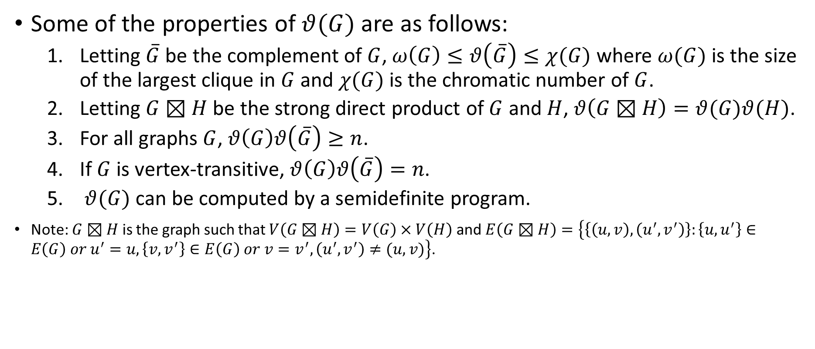
Properties of the Lovász-Theta Function
Some of the properties of $θ(G)$ are as follows:
  Letting $\overline{G}$ be the complement of $G$, $ω\left(G\right)≤θ\left(\overline{G}\right)≤χ(G)$ where $ω(G)$ is the size of the largest clique in $G$ and $χ(G)$ is the chromatic number of $G$.
  Letting $G⊠H$ be the strong direct product of $G$ and $H$, $θ\left(G⊠H\right)=θ(G)θ(H)$.
  For all graphs $G$, $θ\left(G\right)θ\left(\overline{G}\right)≥n$.
  If $G$ is vertex-transitive, $θ\left(G\right)θ\left(\overline{G}\right)=n$.
  $θ(G)$ can be computed by a semidefinite program.
Note: $G⊠H$ is the graph such that $V\left(G⊠H\right)=V\left(G\right)×V\left(H\right)$ and $E\left(G⊠H\right)=\left\{\left\{\left(u,v\right),\left(u^{′},v^{′}\right)\right\}:\left\{u,u^{′}\right\}∈E\left(G\right) or u^{′}=u,\left\{v,v^{′}\right\}∈E\left(G\right) or v=v^{′}, \left(u^{′},v^{′}\right)≠(u,v)\right\}$.

Slide 6
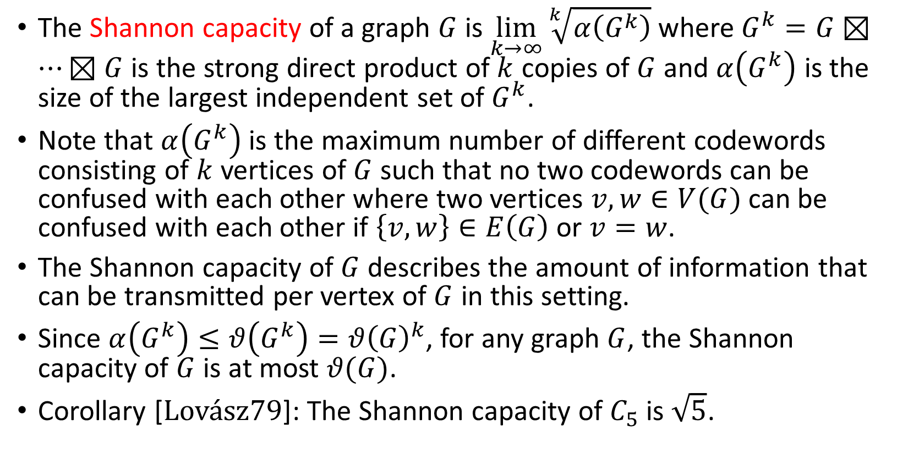
Shannon Capacity of a Graph
The Shannon capacity of a graph $G$ is $\lim_{k→∞}{\sqrt[k]{α\left(G^{k}\right)}}$ where $G^{k}=G⊠…⊠G$ is the strong direct product of $k$ copies of $G$ and $α\left(G^{k}\right)$ is the size of the largest independent set of $G^{k}$.
Note that $α\left(G^{k}\right)$ is the maximum number of different codewords consisting of $k$ vertices of $G$ such that no two codewords can be confused with each other where two vertices $v,w∈V(G)$ can be confused with each other if $\left\{v,w\right\}∈E\left(G\right)$ or $v=w$.
The Shannon capacity of $G$ describes the amount of information that can be transmitted per vertex of $G$ in this setting.
Since $α\left(G^{k}\right)≤θ\left(G^{k}\right)=θ{\left(G\right)}^{k}$, for any graph $G$, the Shannon capacity of $G$ is at most $θ(G)$.
Corollary [Lovász79]: The Shannon capacity of $C_{5}$ is $\sqrt{5}$.

Slide 7
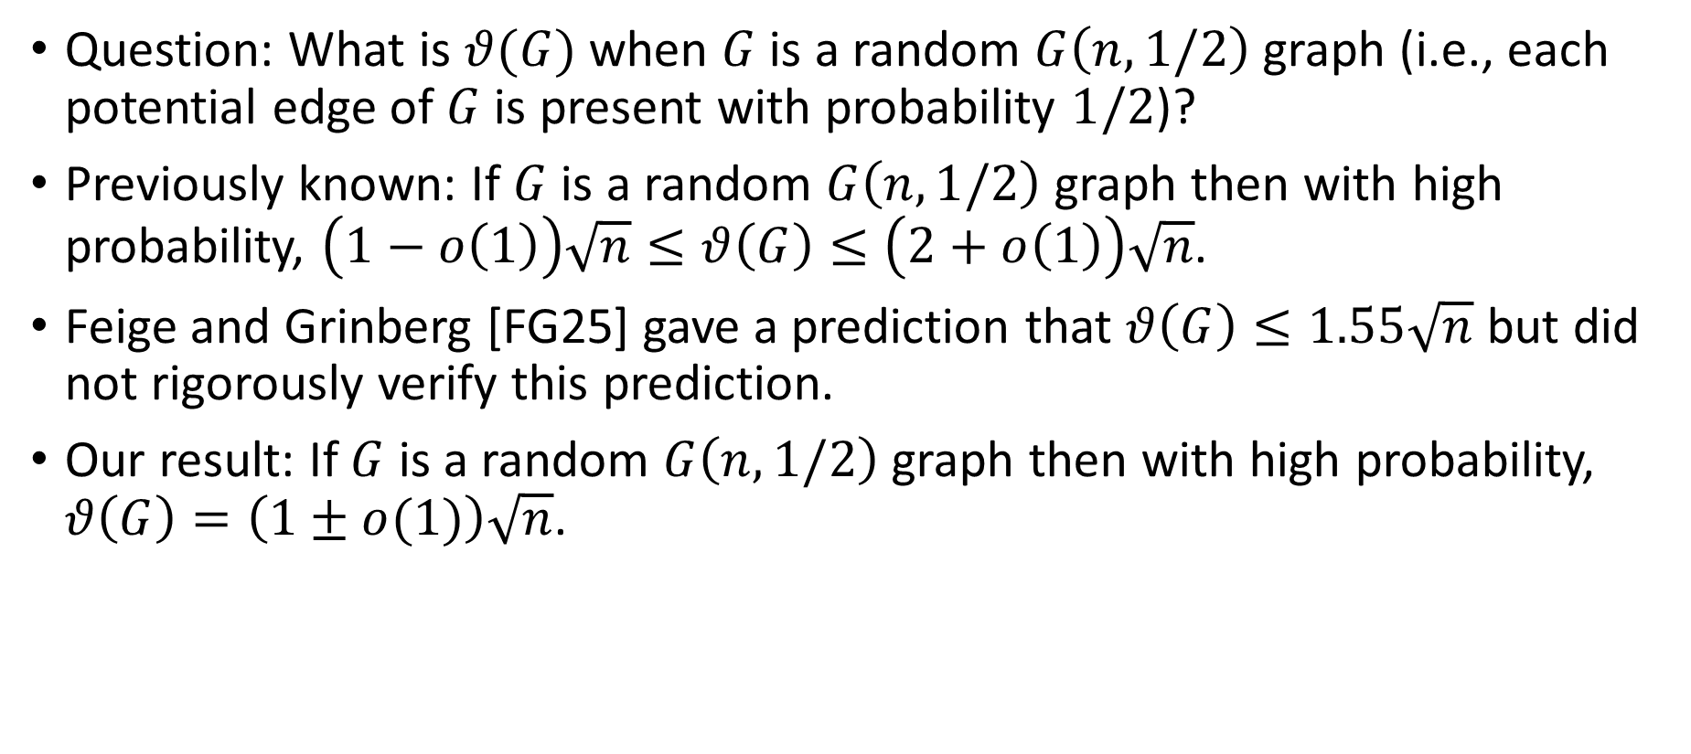
Our Results
Question: What is $θ(G)$ when $G$ is a random $G\left(n,1/2\right)$ graph (i.e., each potential edge of $G$ is present with probability $1/2$)?
Previously known: If $G$ is a random $G\left(n,1/2\right)$ graph then with high probability, $\left(1−o\left(1\right)\right)\sqrt{n}≤θ\left(G\right)≤\left(2+o\left(1\right)\right)\sqrt{n}$.
Feige and Grinberg [FG25] gave a prediction that $θ\left(G\right)≤1.55\sqrt{n}$ but did not rigorously verify this prediction.
Our result: If $G$ is a random $G\left(n,1/2\right)$ graph then with high probability, $θ\left(G\right)=\left(1±o(1)\right)\sqrt{n}$.

Slide 8
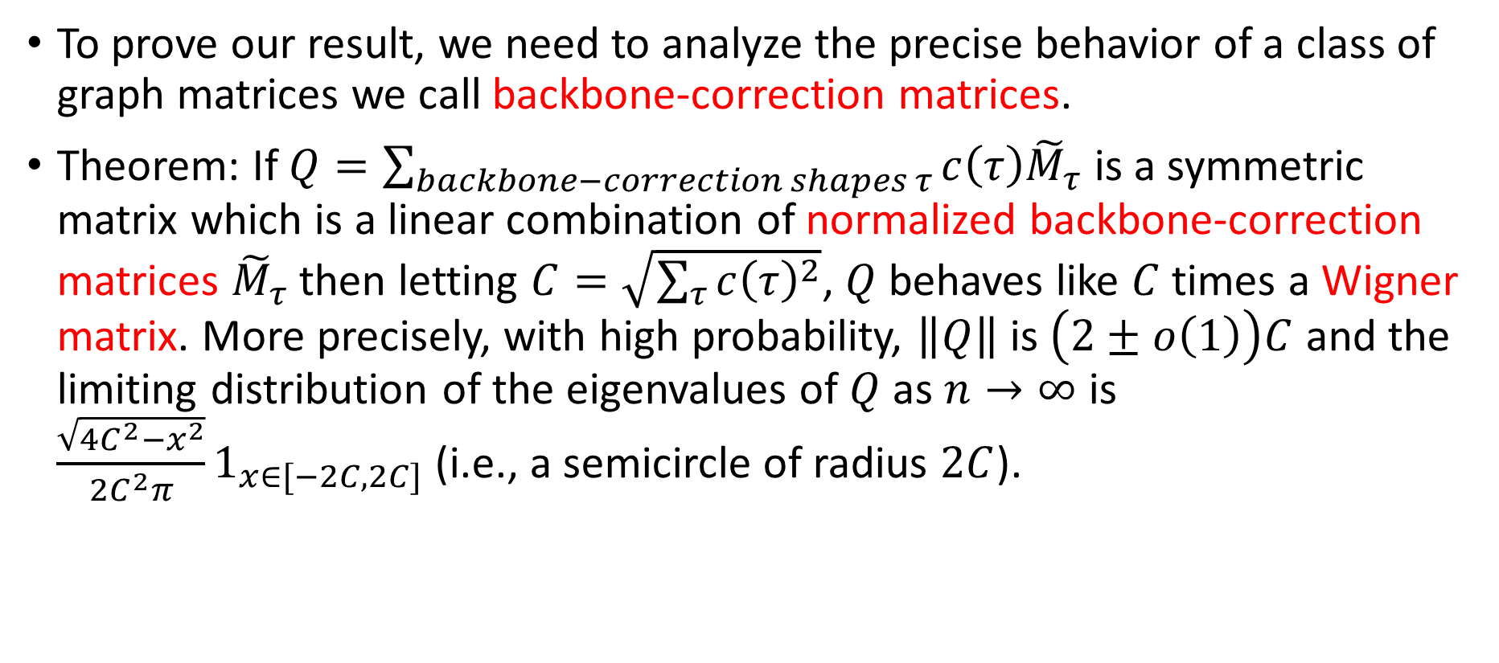
Our Results
To prove our result, we need to analyze the precise behavior of a class of graph matrices we call backbone-correction matrices.
Theorem: If $Q=\sum_{backbone−correction shapes τ}{c\left(τ\right){\tilde{M}}_{τ}}$ is a symmetric matrix which is a linear combination of normalized backbone-correction matrices ${\tilde{M}}_{τ}$ then letting $C=\sqrt{\sum_{τ}{c{\left(τ\right)}^{2}}}$, $Q$ behaves like $C$ times a Wigner matrix. More precisely, with high probability, $\left\|Q\right\|$ is $\left(2±o\left(1\right)\right)C$ and the limiting distribution of the eigenvalues of $Q$ as $n→∞$ is $\frac{\sqrt{4C^{2}−x^{2}}}{2C^{2}π}1_{x∈[−2C,2C]}$ (i.e., a semicircle of radius $2C$).

Slide 9
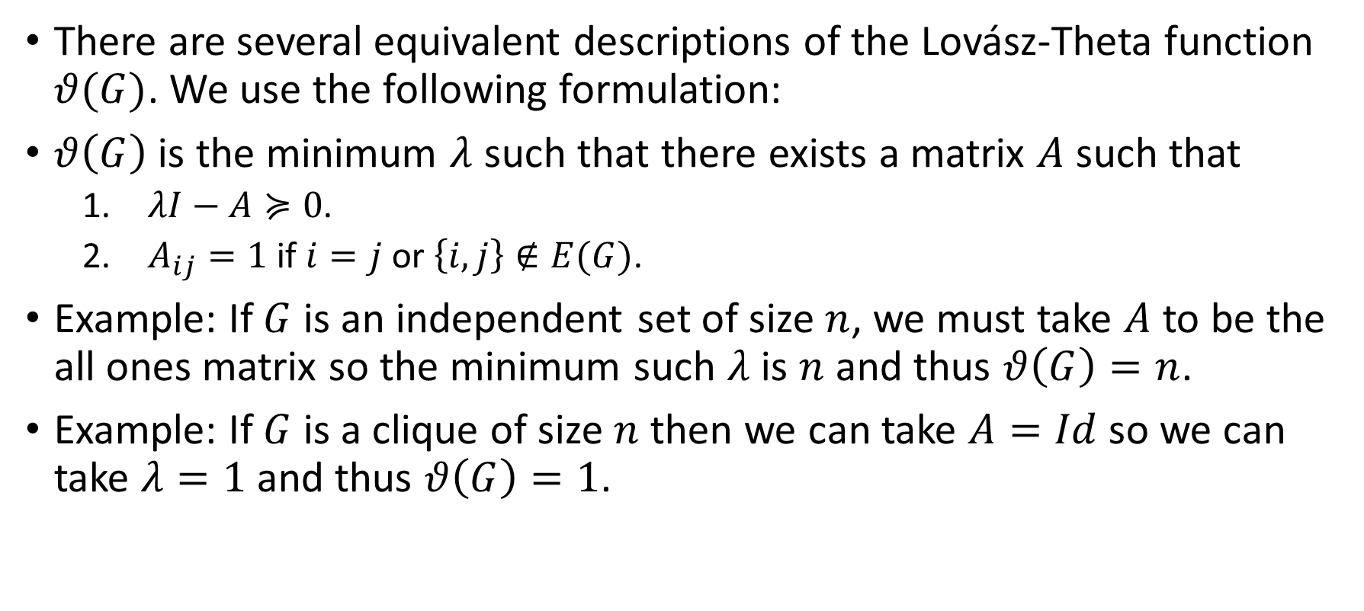
One Definition of the Lovász-Theta Function
There are several equivalent descriptions of the Lovász-Theta function $θ(G)$. We use the following formulation:
$θ\left(G\right)$ is the minimum $λ$ such that there exists a matrix $A$ such that
  $λI−A≽0$.
  $A_{ij}=1$ if $i=j$ or $\left\{i,j\right\}∉E(G)$.
Example: If $G$ is an independent set of size $n$, we must take $A$ to be the all ones matrix so the minimum such $λ$ is $n$ and thus $θ\left(G\right)=n$.
Example: If $G$ is a clique of size $n$ then we can take $A=Id$ so we can take $λ=1$ and thus $θ\left(G\right)=1$.

Slide 10
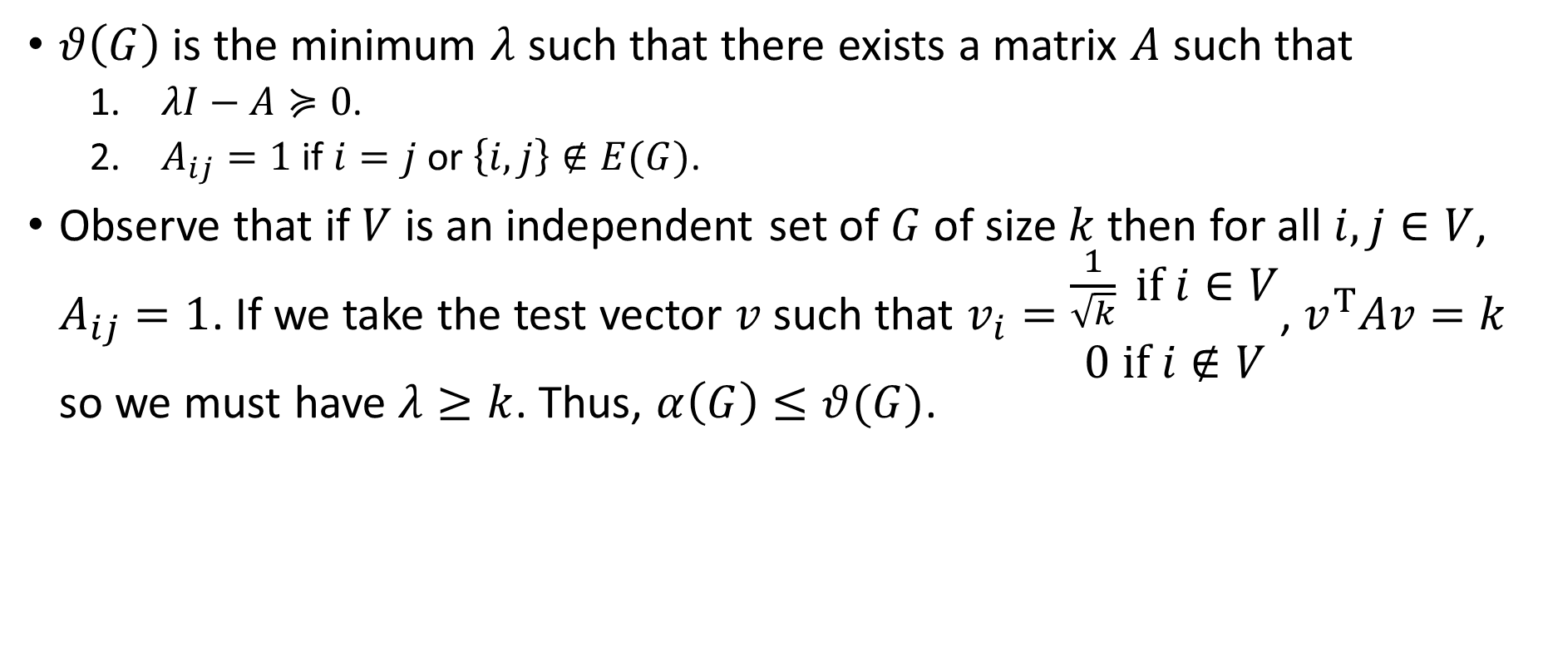

Reason Why $α\left(G\right)≤θ(G)$
$θ\left(G\right)$ is the minimum $λ$ such that there exists a matrix $A$ such that
  $λI−A≽0$.
  $A_{ij}=1$ if $i=j$ or $\left\{i,j\right\}∉E(G)$.
Observe that if $V$ is an independent set of $G$ of size $k$ then for all $i,j∈V$, $A_{ij}=1$. If we take the test vector $v$ such that $v_{i}=\begin{aligned}\frac{1}{\sqrt{k}} if i∈V \\ &0 if i∉V\end{aligned}$, $v^{T}Av=k$ so we must have $λ≥k$. Thus, $α\left(G\right)≤θ(G)$.

Slide 11
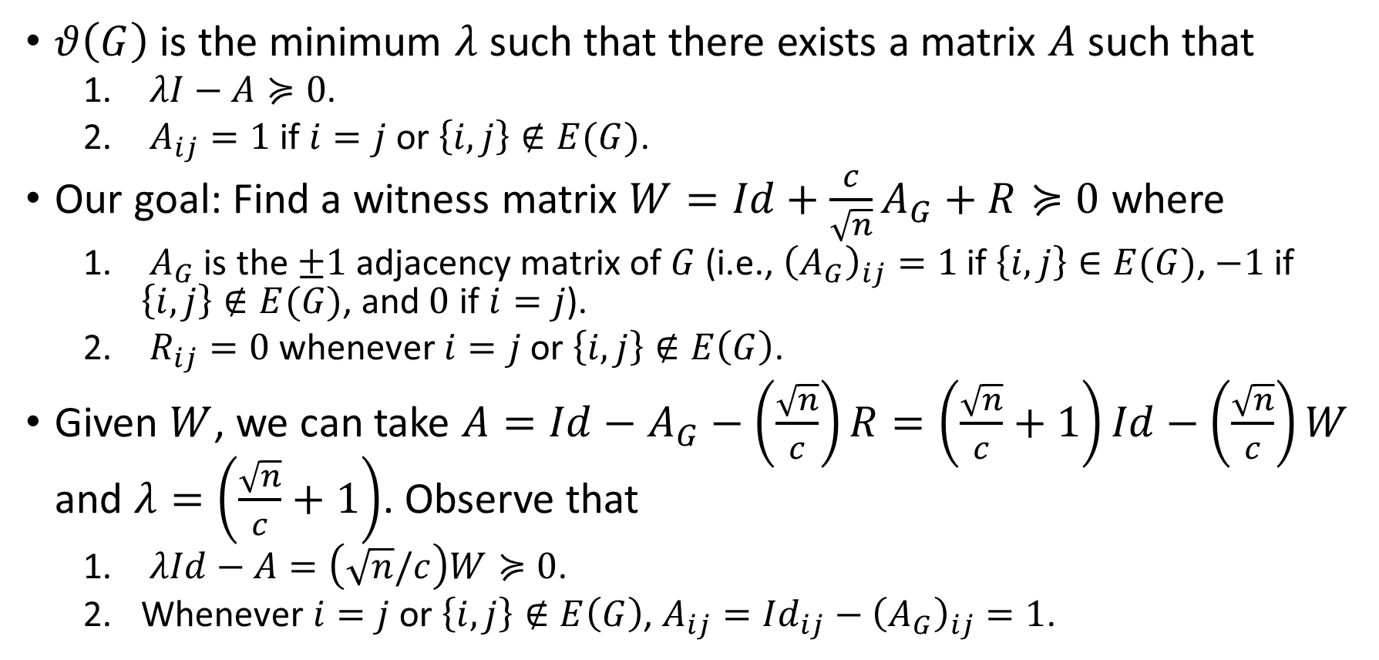
Our Goal: A Witness Matrix W
$θ\left(G\right)$ is the minimum $λ$ such that there exists a matrix $A$ such that
  $λI−A≽0$.
  $A_{ij}=1$ if $i=j$ or $\left\{i,j\right\}∉E(G)$.
Our goal: Find a witness matrix $W=Id+\frac{c}{\sqrt{n}}A_{G}+R≽0$ where
  $A_{G}$ is the $±1$ adjacency matrix of $G$ (i.e., ${\left(A_{G}\right)}_{ij}=1$ if $\left\{i,j\right\}∈E(G)$, $−1$ if $\left\{i,j\right\}∉E(G)$, and $0$ if $i=j$).
  $R_{ij}=0$ whenever $i=j$ or $\left\{i,j\right\}∉E\left(G\right)$.
Given $W$, we can take $A=Id−A_{G}−\left(\frac{\sqrt{n}}{c}\right)R=\left(\frac{\sqrt{n}}{c}+1\right)Id−\left(\frac{\sqrt{n}}{c}\right)W$ and $λ=\left(\frac{\sqrt{n}}{c}+1\right)$. Observe that
  $λId−A=\left(\sqrt{n}/c\right)W≽0$.
  Whenever $i=j$ or $\left\{i,j\right\}∉E\left(G\right)$, $A_{ij}=Id_{ij}−{\left(A_{G}\right)}_{ij}=1$.

Slide 12
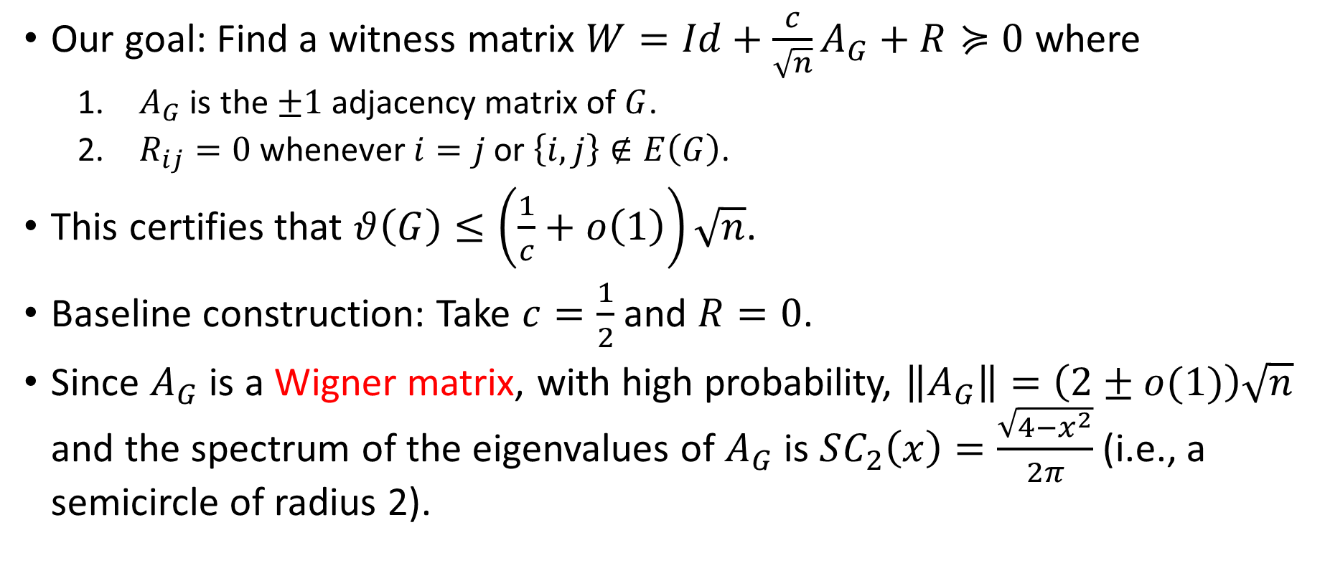
Baseline Construction
Our goal: Find a witness matrix $W=Id+\frac{c}{\sqrt{n}}A_{G}+R≽0$ where
  $A_{G}$ is the $±1$ adjacency matrix of $G$.
  $R_{ij}=0$ whenever $i=j$ or $\left\{i,j\right\}∉E\left(G\right)$.
This certifies that $θ\left(G\right)≤\left(\frac{1}{c}+o\left(1\right)\right)\sqrt{n}$.
Baseline construction: Take $c=\frac{1}{2}$ and $R=0$.
Since $A_{G}$ is a Wigner matrix, with high probability, $\left\|A_{G}\right\|=\left(2±o(1)\right)\sqrt{n}$ and the spectrum of the eigenvalues of $A_{G}$ is $SC_{2}\left(x\right)=\frac{\sqrt{4−x^{2}}}{2π}$ (i.e., a semicircle of radius 2).

Slide 13
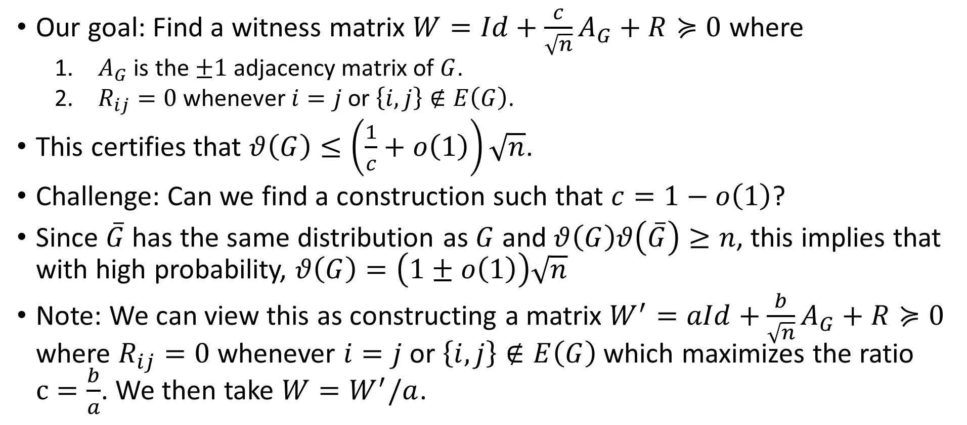
Summary of the Problem
Our goal: Find a witness matrix $W=Id+\frac{c}{\sqrt{n}}A_{G}+R≽0$ where
  $A_{G}$ is the $±1$ adjacency matrix of $G$.
  $R_{ij}=0$ whenever $i=j$ or $\left\{i,j\right\}∉E\left(G\right)$.
This certifies that $θ\left(G\right)≤\left(\frac{1}{c}+o\left(1\right)\right)\sqrt{n}$.
Challenge: Can we find a construction such that $c=1−o\left(1\right)$?
Since $\overline{G}$ has the same distribution as $G$ and $θ\left(G\right)θ\left(\overline{G}\right)≥n$, this implies that with high probability, $θ\left(G\right)=\left(1±o\left(1\right)\right)\sqrt{n}$
Note: We can view this as constructing a matrix $W^{′}=aId+\frac{b}{\sqrt{n}}A_{G}+R≽0$ where $R_{ij}=0$ whenever $i=j$ or $\left\{i,j\right\}∉E\left(G\right)$ which maximizes the ratio $c=\frac{b}{a}$. We then take $W=W^{′}/a$.

Slide 14
Part II: Graph Matrices

Slide 15
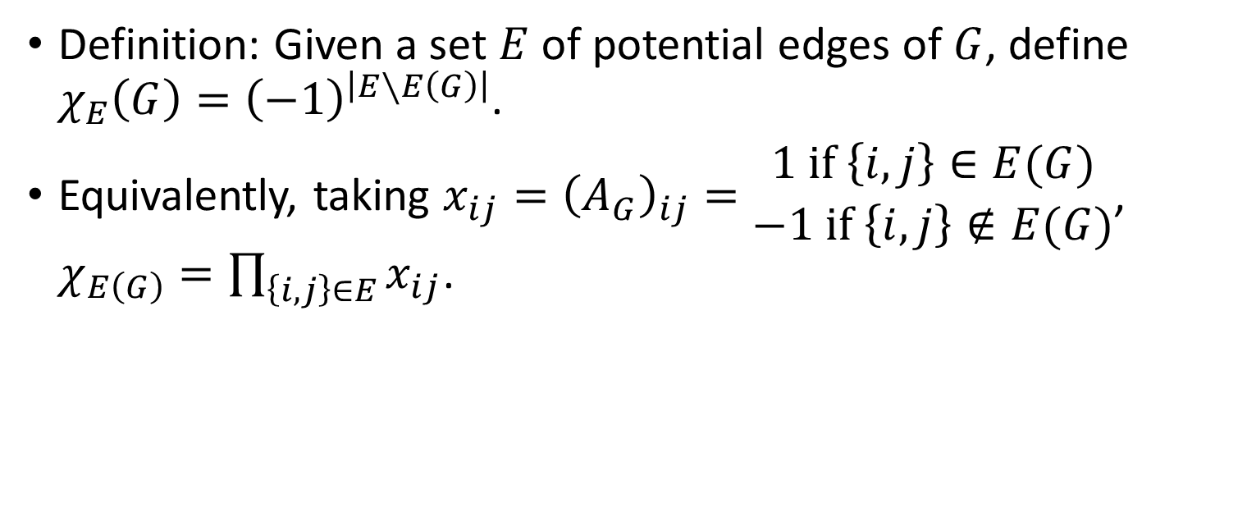
Fourier Characters
Definition: Given a set $E$ of potential edges of $G$, define $χ_{E}\left(G\right)={\left(−1\right)}^{\left|E∖E\left(G\right)\right|}$.
Equivalently, taking $x_{ij}={\left(A_{G}\right)}_{ij}=\begin{aligned}1 if \left\{i,j\right\}∈E(G) \\ &−1 if \left\{i,j\right\}∉E(G)\end{aligned}$, $χ_{E\left(G\right)}=\prod_{\left\{i,j\right\}∈E}{x_{ij}}$.

Slide 16









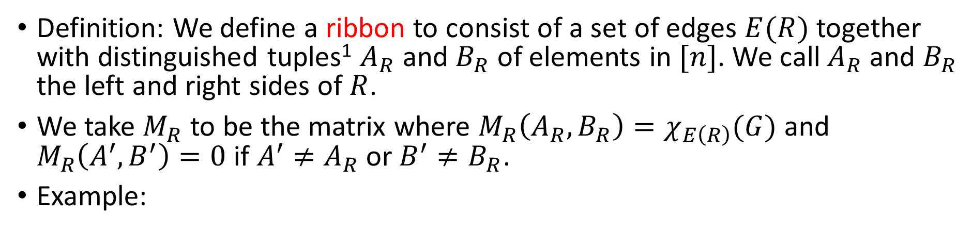














Ribbons
Definition: We define a ribbon to consist of a set of edges $E(R)$ together with distinguished tuples¹ $A_{R}$ and $B_{R}$ of elements in $[n]$. We call $A_{R}$ and $B_{R}$ the left and right sides of $R$.
We take $M_{R}$ to be the matrix where $M_{R}\left(A_{R},B_{R}\right)=χ_{E\left(R\right)}(G)$ and $M_{R}\left(A^{′},B^{′}\right)=0$ if $A^{′}≠A_{R}$ or $B^{′}≠B_{R}$.
Example:
$$M_{R}\left(\left(2,4\right),\left(3,5\right)\right)=−1$$
$$1$$
$$1$$
$$2$$
$$3$$
$$2$$
$$3$$
$$2$$
$$3$$
In $G$
$$4$$
$$5$$
Not in $G$
$$4$$
$$5$$
$$4$$
$$5$$
$$A_{R}$$
$$R$$
$$B_{R}$$
$$G$$
$$A_{R}$$
$$B_{R}$$
¹We take $A$ and $B$ to be tuples rather than sets for technical reasons.

Slide 17





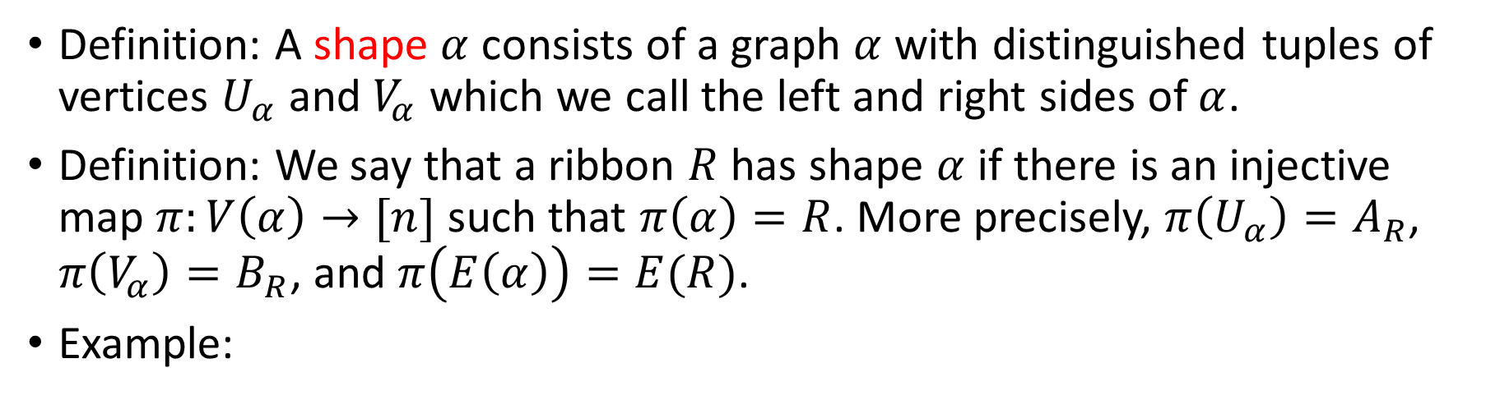









Shapes
Definition: A shape $α$ consists of a graph $α$ with distinguished tuples of vertices $U_{α}$ and $V_{α}$ which we call the left and right sides of $α$.
Definition: We say that a ribbon $R$ has shape $α$ if there is an injective map $π:V\left(α\right)→[n]$ such that $π\left(α\right)=R$. More precisely, $π\left(U_{α}\right)=A_{R}$, $π\left(V_{α}\right)=B_{R}$, and $π\left(E\left(α\right)\right)=E(R)$.
Example:
$$2$$
$$3$$
$$u_{1}$$
$$v_{1}$$
has shape
$$4$$
$$5$$
$$u_{2}$$
$$v_{2}$$
$$A_{R}$$
$$R$$
$$B_{R}$$
$$U_{α_{Z}}$$
$$α_{Z}$$
$$V_{α_{Z}}$$

Slide 18
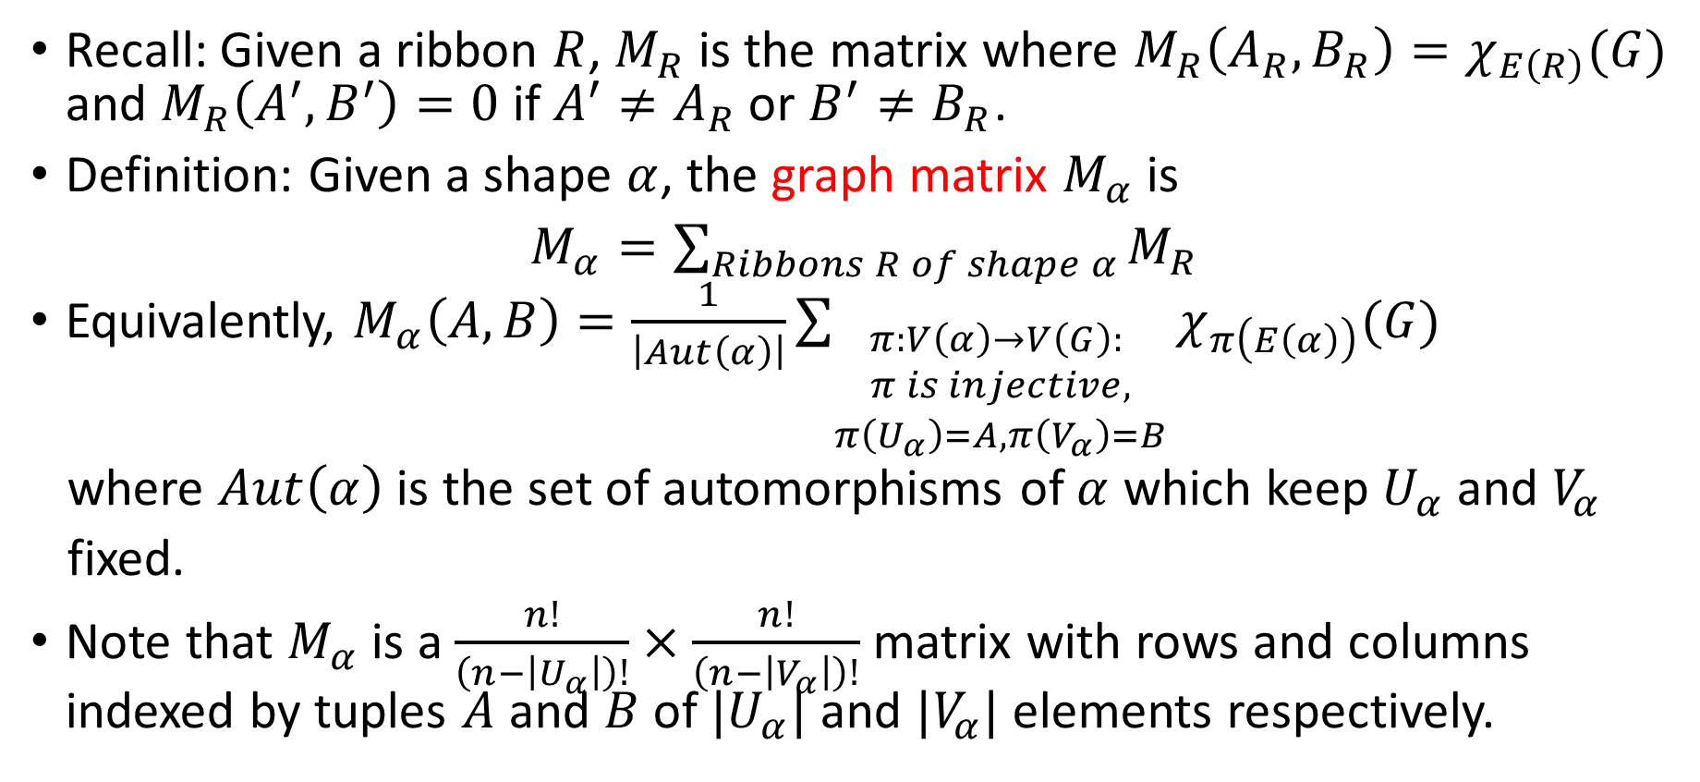
Graph Matrices
Recall: Given a ribbon $R$, $M_{R}$ is the matrix where $M_{R}\left(A_{R},B_{R}\right)=χ_{E\left(R\right)}(G)$ and $M_{R}\left(A^{′},B^{′}\right)=0$ if $A^{′}≠A_{R}$ or $B^{′}≠B_{R}$.
Definition: Given a shape $α$, the graph matrix $M_{α}$ is
$M_{α}=\sum_{Ribbons R of shape α}{M_{R}}$
Equivalently, $M_{α}\left(A,B\right)=\frac{1}{\left|Aut\left(α\right)\right|}\sum_{\begin{aligned}π:V\left(α\right)→V\left(G\right): \\ π is injective, \\ π\left(U_{α}\right)=A,π\left(V_{α}\right)=B\end{aligned}}{χ_{π\left(E\left(α\right)\right)}(G)}$
where $Aut\left(α\right)$ is the set of automorphisms of $α$ which keep $U_{α}$and $V_{α}$
fixed.
Note that $M_{α}$ is a $\frac{n!}{\left(n−\left|U_{α}\right|\right)!}×\frac{n!}{\left(n−\left|V_{α}\right|\right)!}$ matrix with rows and columns indexed by tuples $A$ and $B$ of $|U_{α}|$ and $|V_{α}|$ elements respectively.

Slide 19






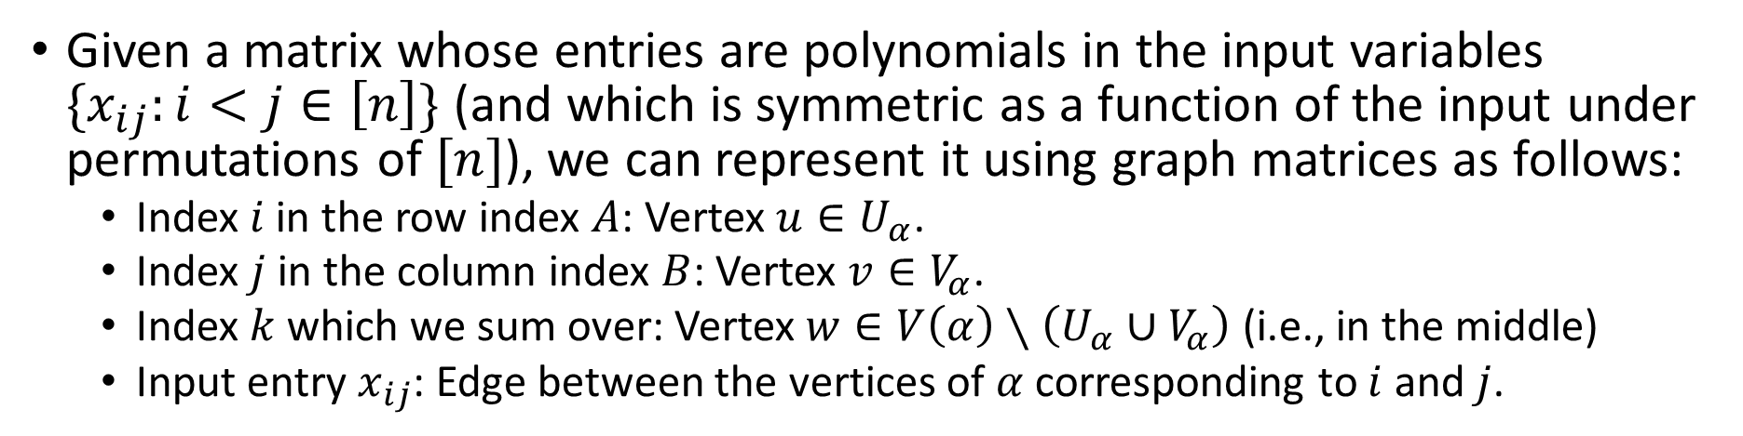


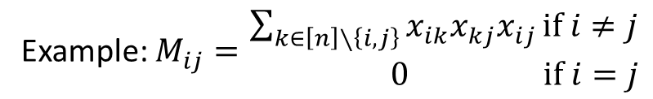






Summary
Given a matrix whose entries are polynomials in the input variables $\{x_{ij}:i<j∈\left[n\right]\}$ (and which is symmetric as a function of the input under permutations of $[n]$), we can represent it using graph matrices as follows:
  Index $i$ in the row index $A$: Vertex $u∈U_{α}$.
  Index $j$ in the column index $B$: Vertex $v∈V_{α}$.
  Index $k$ which we sum over: Vertex $w∈V\left(α\right)∖\left(U_{α}∪V_{α}\right)$ (i.e., in the middle)
  Input entry $x_{ij}$: Edge between the vertices of $α$ corresponding to $i$ and $j$.
Example: $M\left(\left(i,j\right),\left(k,l\right)\right)=$ $\begin{aligned}x_{ik}x_{jk}x_{jl} if i,j,k,l are distinct \\ &0 otherwise\end{aligned}$
Example: $M_{ij}=\begin{aligned}\sum_{k∈\left[n\right]∖\left\{i,j\right\}}{x_{ik}x_{kj}x_{ij}}if i≠j \\ & 0 if i=j\end{aligned}$
$$i$$
$$k$$
Corresponding shape:
Corresponding shape:
v
$$i$$
$$k$$
$$j$$
$$j$$
$$l$$
$$U_{{\overline{P}}_{2}}$$
$${\overline{P}}_{2}$$
$$V_{{\overline{P}}_{2}}$$
$$U_{α_{Z}}$$
$$α_{Z}$$
$$V_{α_{Z}}$$

Slide 20
Part III: Interpretation Using Graph Matrices

Slide 21
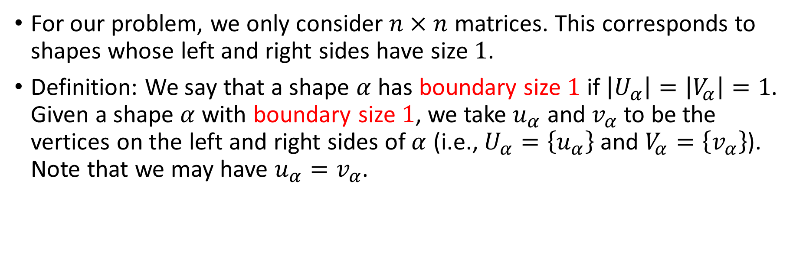

Restriction on Graph Matrices: Boundary Size $1$
For our problem, we only consider $n×n$ matrices. This corresponds to shapes whose left and right sides have size $1$.
Definition: We say that a shape $α$ has boundary size $1$ if $\left|U_{α}\right|=\left|V_{α}\right|=1$. Given a shape $α$ with boundary size $1$, we take $u_{α}$ and $v_{α}$ to be the vertices on the left and right sides of $α$ (i.e., $U_{α}=\left\{u_{α}\right\}$ and $V_{α}=\left\{v_{α}\right\}$). Note that we may have $u_{α}=v_{α}$.

Slide 22

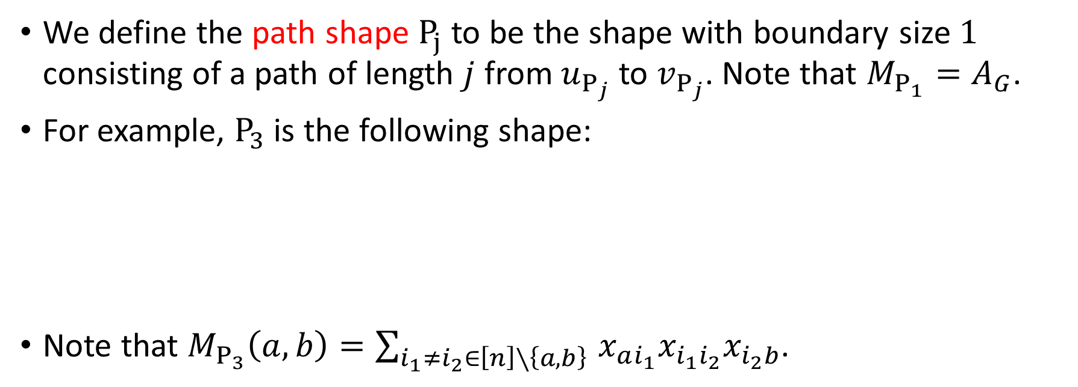


Path Shapes
We define the path shape $P_{j}$ to be the shape with boundary size $1$ consisting of a path of length $j$ from $u_{P_{j}}$ to $v_{P_{j}}$. Note that $M_{P_{1}}=A_{G}$.
For example, $P_{3}$ is the following shape:
Note that $M_{P_{3}}\left(a,b\right)=\sum_{i_{1}≠i_{2}∈\left[n\right]∖\left\{a,b\right\} }{x_{ai_{1}}x_{i_{1}i_{2}}x_{i_{2}b}}$.
$$u_{P_{3}}$$
$$v_{P_{3}}$$
$$P_{3}$$

Slide 23
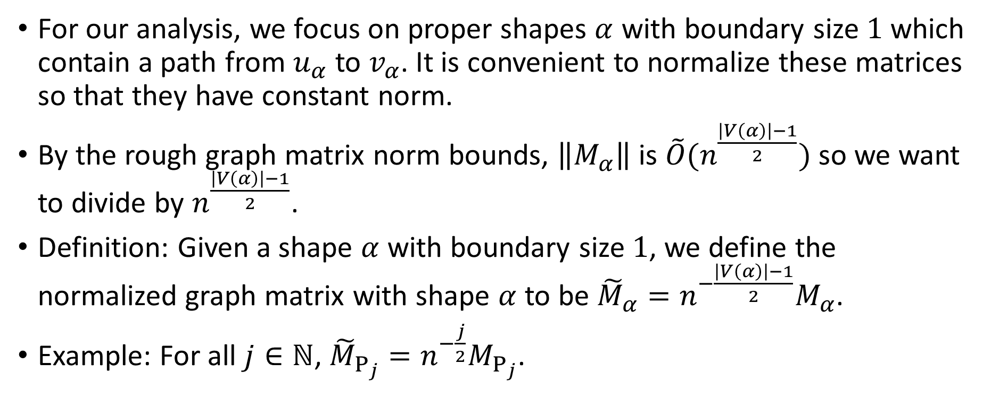
Normalized Graph Matrices
For our analysis, we focus on proper shapes $α$ with boundary size $1$ which contain a path from $u_{α}$ to $v_{α}$. It is convenient to normalize these matrices so that they have constant norm.
By the rough graph matrix norm bounds, $\left\|M_{α}\right\|$ is $\tilde{O}(n^{\frac{\left|V\left(α\right)\right|−1}{2}})$ so we want to divide by $n^{\frac{\left|V\left(α\right)\right|−1}{2}}$.
Definition: Given a shape $α$ with boundary size $1$, we define the normalized graph matrix with shape $α$ to be ${\tilde{M}}_{α}=n^{−\frac{\left|V\left(α\right)\right|−1}{2}}M_{α}$.
Example: For all $j∈ℕ$, ${\tilde{M}}_{P_{j}}=n^{−\frac{j}{2}}M_{P_{j}}$.

Slide 24
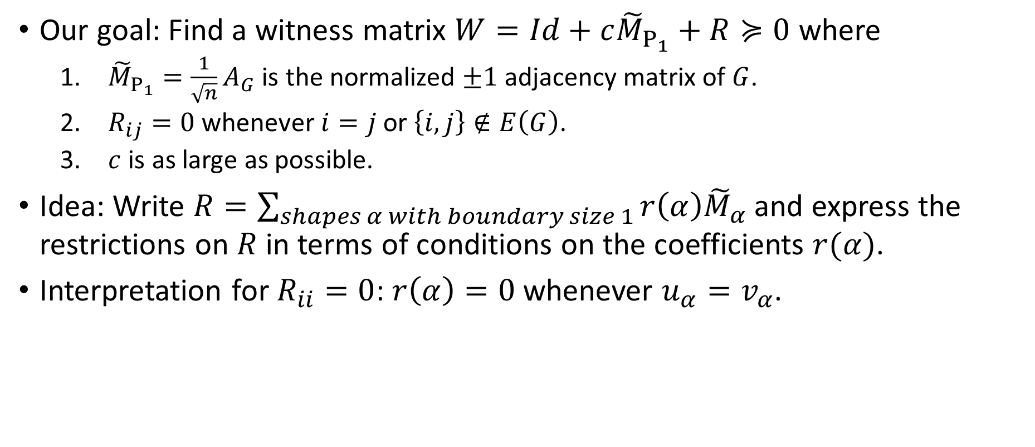

Restrictions on $R$
Our goal: Find a witness matrix $W=Id+c{\tilde{M}}_{P_{1}}+R≽0$ where
  ${\tilde{M}}_{P_{1}}{=\frac{1}{\sqrt{n}}A}_{G}$ is the normalized $±1$ adjacency matrix of $G$.
  $R_{ij}=0$ whenever $i=j$ or $\left\{i,j\right\}∉E\left(G\right)$.
  $c$ is as large as possible.
Idea: Write $R=\sum_{shapes α with boundary size 1}{r\left(α\right){\tilde{M}}_{α}}$ and express the restrictions on $R$ in terms of conditions on the coefficients $r(α)$.
Interpretation for $R_{ii}=0$: $r\left(α\right)=0$ whenever $u_{α}=v_{α}$.

Slide 25

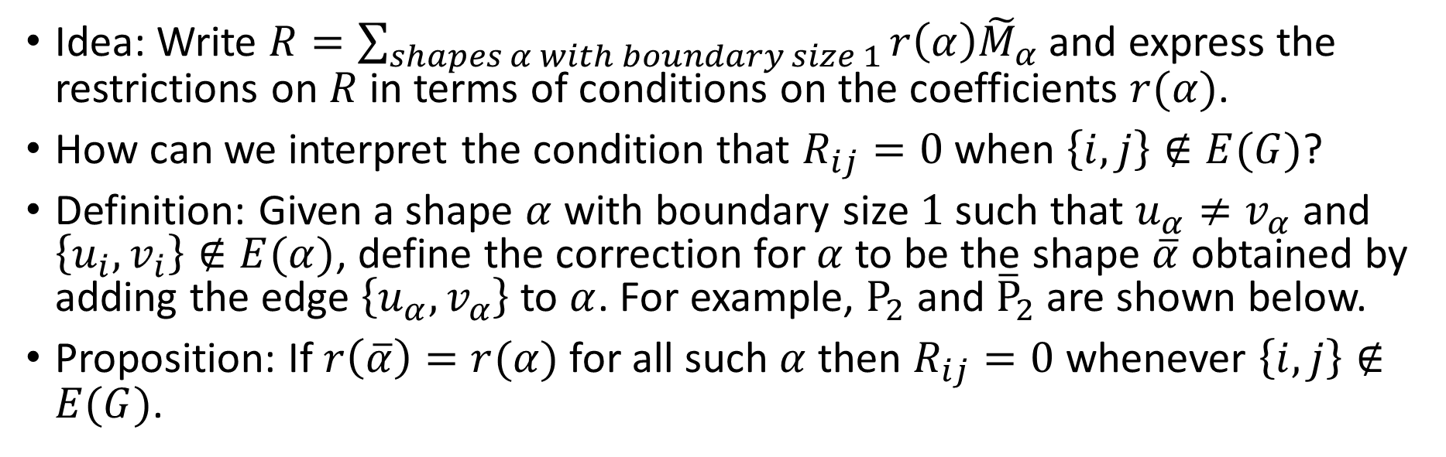





Restrictions on $R$
Idea: Write $R=\sum_{shapes α with boundary size 1}{r\left(α\right){\tilde{M}}_{α}}$ and express the restrictions on $R$ in terms of conditions on the coefficients $r(α)$.
How can we interpret the condition that $R_{ij}=0$ when $\left\{i,j\right\}∉E(G)$?
Definition: Given a shape $α$ with boundary size $1$ such that $u_{α}≠v_{α}$ and $\left\{u_{i},v_{i}\right\}∉E(α)$, define the correction for $α$ to be the shape $\overline{α}$ obtained by adding the edge $\left\{u_{α},v_{α}\right\}$ to $α$. For example, $P_{2}$ and ${\overline{P}}_{2}$ are shown below.
Proposition: If $r\left(\overline{α}\right)=r(α)$ for all such $α$ then $R_{ij}=0$ whenever $\left\{i,j\right\}∉E(G)$.
v
v
$$u_{P_{2}}$$
$$v_{P_{2}}$$
$$u_{{\overline{P}}_{2}}$$
$$v_{{\overline{P}}_{2}}$$
$$P_{2}$$
$${\overline{P}}_{2}$$

Slide 26
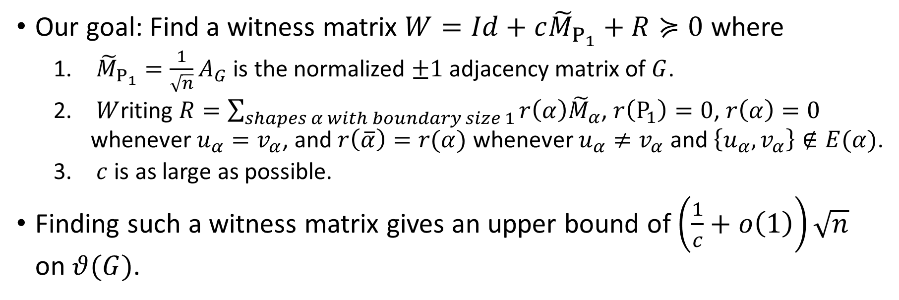
Problem Reformulation
Our goal: Find a witness matrix $W=Id+c{\tilde{M}}_{P_{1}}+R≽0$ where
  ${\tilde{M}}_{P_{1}}{=\frac{1}{\sqrt{n}}A}_{G}$ is the normalized $±1$ adjacency matrix of $G$.
  $W$riting $R=\sum_{shapes α with boundary size 1}{r\left(α\right){\tilde{M}}_{α}}$, $r\left(P_{1}\right)=0$, $r\left(α\right)=0$ whenever $u_{α}=v_{α}$, and $r\left(\overline{α}\right)=r(α)$ whenever $u_{α}≠v_{α}$ and $\left\{u_{α},v_{α}\right\}∉E(α)$.
  $c$ is as large as possible.
Finding such a witness matrix gives an upper bound of $\left(\frac{1}{c}+o\left(1\right)\right)\sqrt{n}$ on $θ(G)$.

Slide 27
Part IV: Behavior of Path Shapes

Slide 28


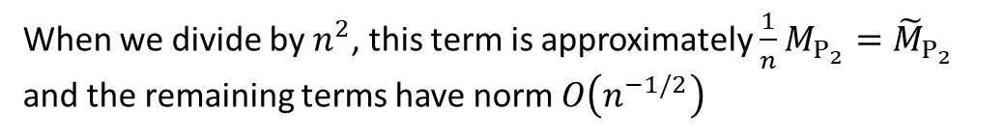
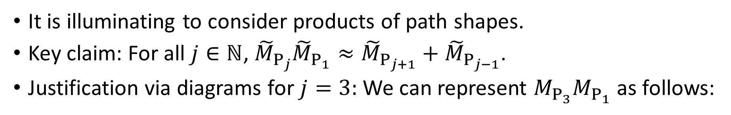



Products of Path Shapes
It is illuminating to consider products of path shapes.
Key claim: For all $j∈ℕ$, ${\tilde{M}}_{P_{j}}{\tilde{M}}_{P_{1}}≈{\tilde{M}}_{P_{j+1}}+{\tilde{M}}_{P_{j−1}}$.
Justification via diagrams for $j=3:$ We can represent $M_{P_{3}}M_{P_{1}}$ as follows:
$$×$$
$$=$$
Note that
$$+$$
$$+$$
$=$ $(n−3)$
When we divide by $n^{2}$, this term is approximately $\frac{1}{n}M_{P_{2}}={\tilde{M}}_{P_{2}}$ and the remaining terms have norm $O\left(n^{−1/2}\right)$
$$+$$

Slide 29
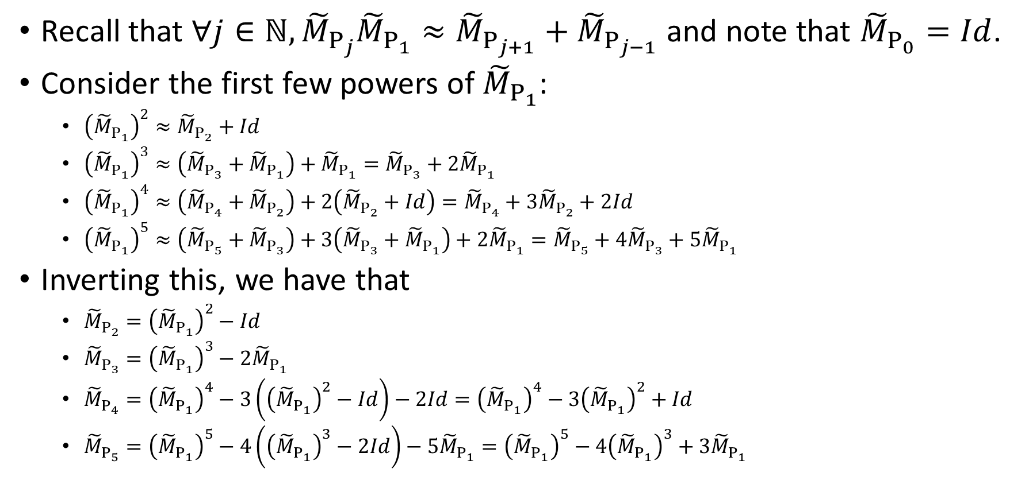

Approximating ${\tilde{M}}_{P_{j}}$ as a Polynomial of ${\tilde{M}}_{P_{1}}$
Recall that $∀j∈ℕ,{\tilde{M}}_{P_{j}}{\tilde{M}}_{P_{1}}≈{\tilde{M}}_{P_{j+1}}+{\tilde{M}}_{P_{j−1}}$ and note that ${\tilde{M}}_{P_{0}}=Id$.
Consider the first few powers of ${\tilde{M}}_{P_{1}}$:
  ${\left({\tilde{M}}_{P_{1}}\right)}^{2}≈{\tilde{M}}_{P_{2}}+Id$
  ${\left({\tilde{M}}_{P_{1}}\right)}^{3}≈\left({\tilde{M}}_{P_{3}}+{\tilde{M}}_{P_{1}}\right)+{\tilde{M}}_{P_{1}}={\tilde{M}}_{P_{3}}+2{\tilde{M}}_{P_{1}}$
  ${\left({\tilde{M}}_{P_{1}}\right)}^{4}≈\left({\tilde{M}}_{P_{4}}+{\tilde{M}}_{P_{2}}\right)+2\left({\tilde{M}}_{P_{2}}+Id\right)={\tilde{M}}_{P_{4}}+3{\tilde{M}}_{P_{2}}+2Id$
  ${\left({\tilde{M}}_{P_{1}}\right)}^{5}≈\left({\tilde{M}}_{P_{5}}+{\tilde{M}}_{P_{3}}\right)+3\left({\tilde{M}}_{P_{3}}+{\tilde{M}}_{P_{1}}\right)+2{\tilde{M}}_{P_{1}}={\tilde{M}}_{P_{5}}+4{\tilde{M}}_{P_{3}}+5{\tilde{M}}_{P_{1}}$
Inverting this, we have that
  ${\tilde{M}}_{P_{2}}={\left({\tilde{M}}_{P_{1}}\right)}^{2}−Id$
  ${\tilde{M}}_{P_{3}}={\left({\tilde{M}}_{P_{1}}\right)}^{3}−2{\tilde{M}}_{P_{1}}$
  ${\tilde{M}}_{P_{4}}={\left({\tilde{M}}_{P_{1}}\right)}^{4}−3\left({\left({\tilde{M}}_{P_{1}}\right)}^{2}−Id\right)−2Id={\left({\tilde{M}}_{P_{1}}\right)}^{4}−3{\left({\tilde{M}}_{P_{1}}\right)}^{2}+Id$
  ${\tilde{M}}_{P_{5}}={\left({\tilde{M}}_{P_{1}}\right)}^{5}−4\left({\left({\tilde{M}}_{P_{1}}\right)}^{3}−2Id\right)−5{\tilde{M}}_{P_{1}}={\left({\tilde{M}}_{P_{1}}\right)}^{5}−4{\left({\tilde{M}}_{P_{1}}\right)}^{3}+3{\tilde{M}}_{P_{1}}$

Slide 30
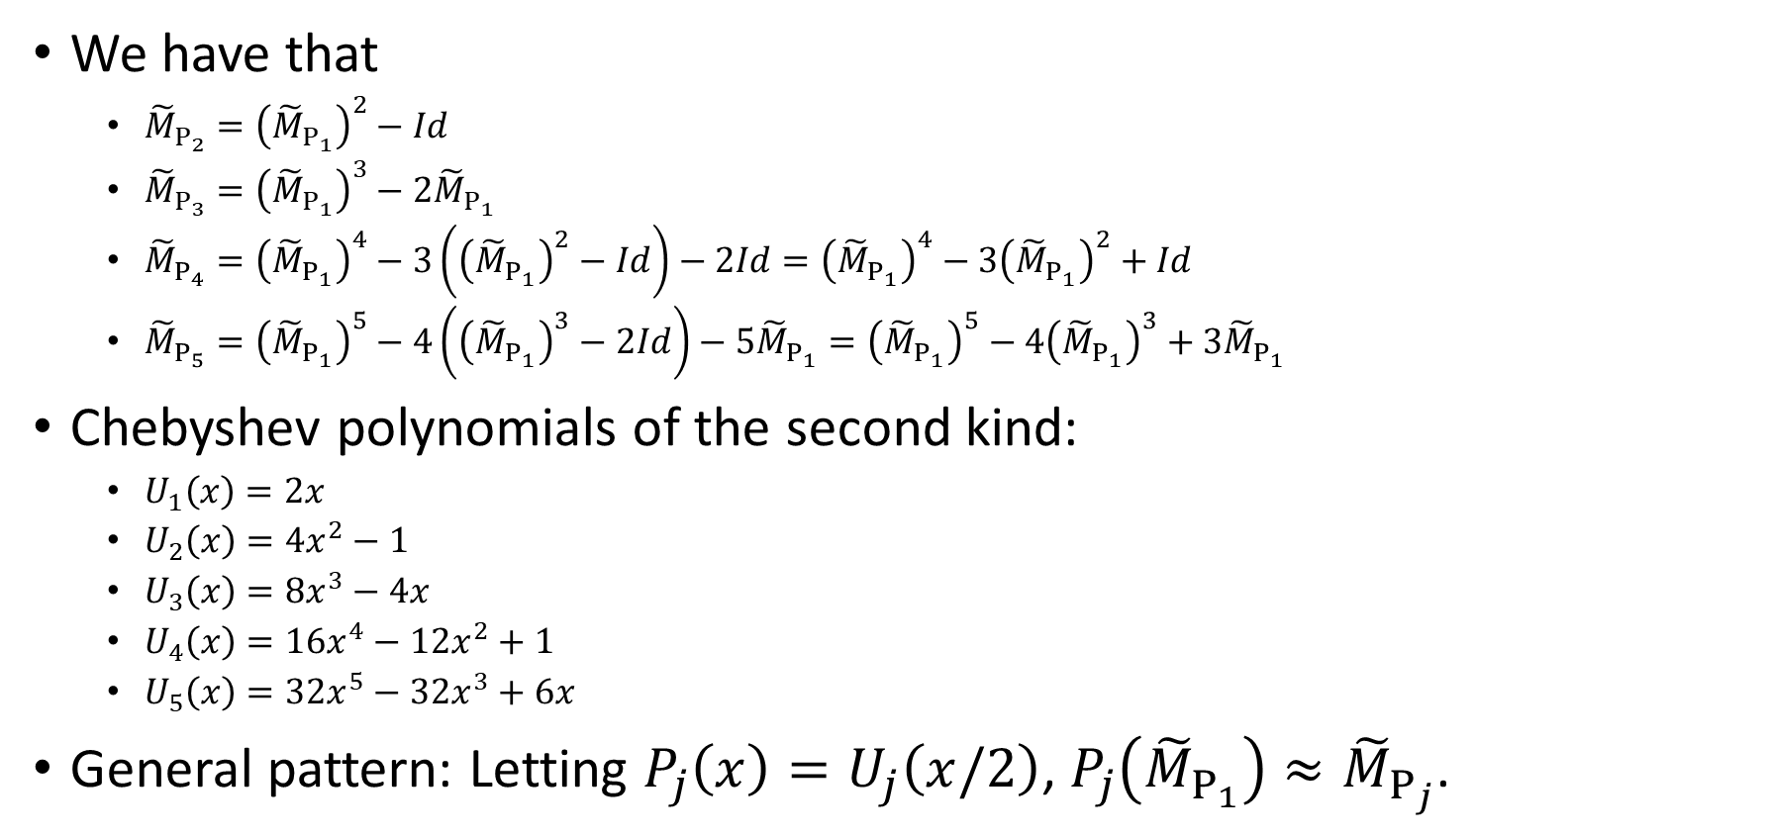
Approximating ${\tilde{M}}_{P_{j}}$ as a Polynomial of ${\tilde{M}}_{P_{1}}$
We have that
  ${\tilde{M}}_{P_{2}}={\left({\tilde{M}}_{P_{1}}\right)}^{2}−Id$
  ${\tilde{M}}_{P_{3}}={\left({\tilde{M}}_{P_{1}}\right)}^{3}−2{\tilde{M}}_{P_{1}}$
  ${\tilde{M}}_{P_{4}}={\left({\tilde{M}}_{P_{1}}\right)}^{4}−3\left({\left({\tilde{M}}_{P_{1}}\right)}^{2}−Id\right)−2Id={\left({\tilde{M}}_{P_{1}}\right)}^{4}−3{\left({\tilde{M}}_{P_{1}}\right)}^{2}+Id$
  ${\tilde{M}}_{P_{5}}={\left({\tilde{M}}_{P_{1}}\right)}^{5}−4\left({\left({\tilde{M}}_{P_{1}}\right)}^{3}−2Id\right)−5{\tilde{M}}_{P_{1}}={\left({\tilde{M}}_{P_{1}}\right)}^{5}−4{\left({\tilde{M}}_{P_{1}}\right)}^{3}+3{\tilde{M}}_{P_{1}}$
Chebyshev polynomials of the second kind:
  $U_{1}\left(x\right)=2x$
  $U_{2}\left(x\right)=4x^{2}−1$
  $U_{3}\left(x\right)=8x^{3}−4x$
  $U_{4}\left(x\right)=16x^{4}−12x^{2}+1$
  $U_{5}\left(x\right)=32x^{5}−32x^{3}+6x$
General pattern: Letting $P_{j}\left(x\right)=U_{j}\left(x/2\right)$, $P_{j}\left({\tilde{M}}_{P_{1}}\right)≈{\tilde{M}}_{P_{j}}$.

Slide 31
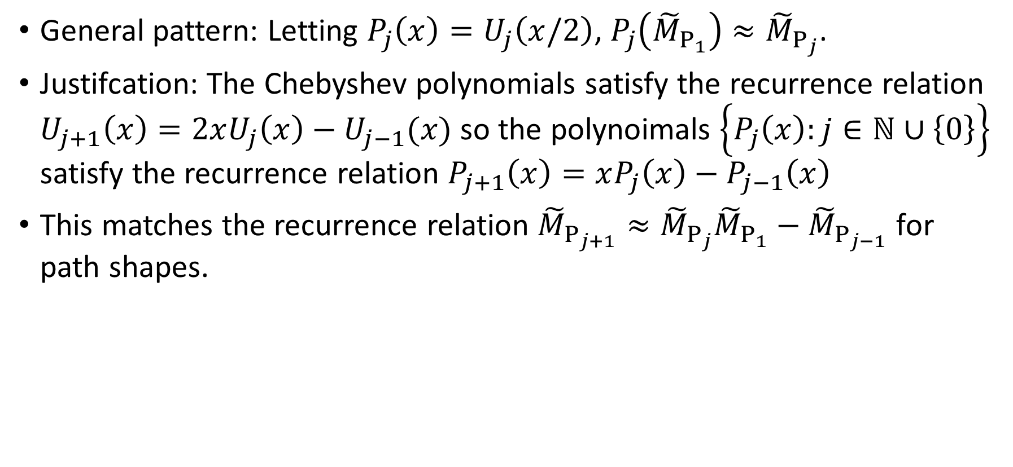
Pattern Justification
General pattern: Letting $P_{j}\left(x\right)=U_{j}\left(x/2\right)$, $P_{j}\left({\tilde{M}}_{P_{1}}\right)≈{\tilde{M}}_{P_{j}}$.
Justifcation: The Chebyshev polynomials satisfy the recurrence relation $U_{j+1}\left(x\right)=2xU_{j}\left(x\right)−U_{j−1}(x)$ so the polynoimals $\left\{P_{j}\left(x\right):j∈ℕ∪\left\{0\right\}\right\}$ satisfy the recurrence relation $P_{j+1}\left(x\right)=xP_{j}\left(x\right)−P_{j−1}\left(x\right)$
This matches the recurrence relation ${\tilde{M}}_{P_{j+1}}≈{\tilde{M}}_{P_{j}}{\tilde{M}}_{P_{1}}−{\tilde{M}}_{P_{j−1}}$ for path shapes.

Slide 32
Part V: Initial Attempts

Slide 33
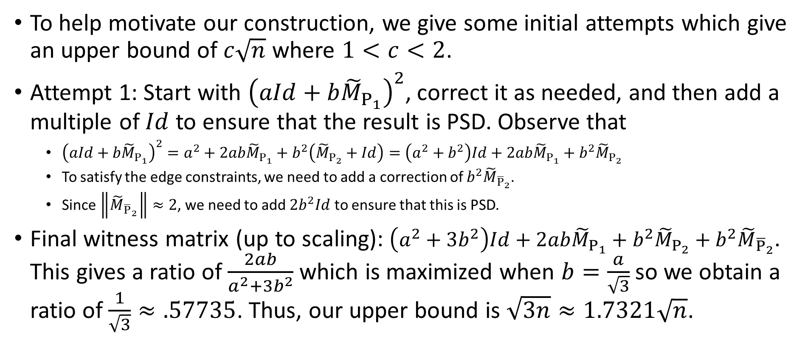
Attempt 1: Direct Construction
To help motivate our construction, we give some initial attempts which give an upper bound of $c\sqrt{n}$ where $1<c<2$.
Attempt 1: Start with ${\left(aId+b{\tilde{M}}_{P_{1}}\right)}^{2}$, correct it as needed, and then add a multiple of $Id$ to ensure that the result is PSD. Observe that
  ${\left(aId+b{\tilde{M}}_{P_{1}}\right)}^{2}=a^{2}+2ab{\tilde{M}}_{P_{1}}+b^{2}\left({\tilde{M}}_{P_{2}}+Id\right)=\left(a^{2}+b^{2}\right)Id+2ab{\tilde{M}}_{P_{1}}+b^{2}{\tilde{M}}_{P_{2}}$
  To satisfy the edge constraints, we need to add a correction of $b^{2}{\tilde{M}}_{{\overline{P}}_{2}}$.
  Since $\left\|{\tilde{M}}_{{\overline{P}}_{2}}\right\|≈2$, we need to add $2b^{2}Id$ to ensure that this is PSD.
Final witness matrix (up to scaling): $\left(a^{2}+3b^{2}\right)Id+2ab{\tilde{M}}_{P_{1}}+b^{2}{\tilde{M}}_{P_{2}}+b^{2}{\tilde{M}}_{{\overline{P}}_{2}}$. This gives a ratio of $\frac{2ab}{a^{2}+3b^{2}}$ which is maximized when $b=\frac{a}{\sqrt{3}}$ so we obtain a ratio of $\frac{1}{\sqrt{3}}≈.57735$. Thus, our upper bound is $\sqrt{3n}≈1.7321\sqrt{n}$.

Slide 34
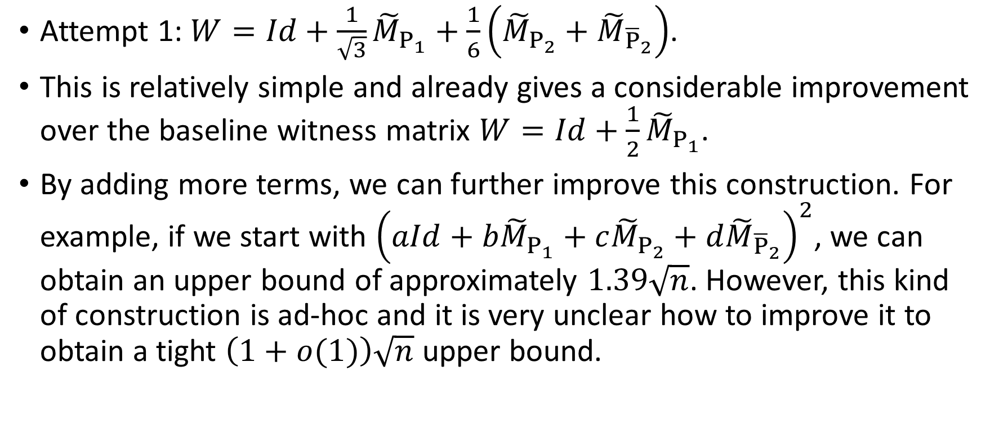
Attempt 1 Summary
Attempt 1: $W=Id+\frac{1}{\sqrt{3}}{\tilde{M}}_{P_{1}}+\frac{1}{6}\left({\tilde{M}}_{P_{2}}+{\tilde{M}}_{{\overline{P}}_{2}}\right)$.
This is relatively simple and already gives a considerable improvement over the baseline witness matrix $W=Id+\frac{1}{2}{\tilde{M}}_{P_{1}}$.
By adding more terms, we can further improve this construction. For example, if we start with ${\left(aId+b{\tilde{M}}_{P_{1}}+c{\tilde{M}}_{P_{2}}+d{\tilde{M}}_{{\overline{P}}_{2}}\right)}^{2}$, we can obtain an upper bound of approximately $1.39\sqrt{n}$. However, this kind of construction is ad-hoc and it is very unclear how to improve it to obtain a tight $\left(1+o(1)\right)\sqrt{n}$ upper bound.

Slide 35
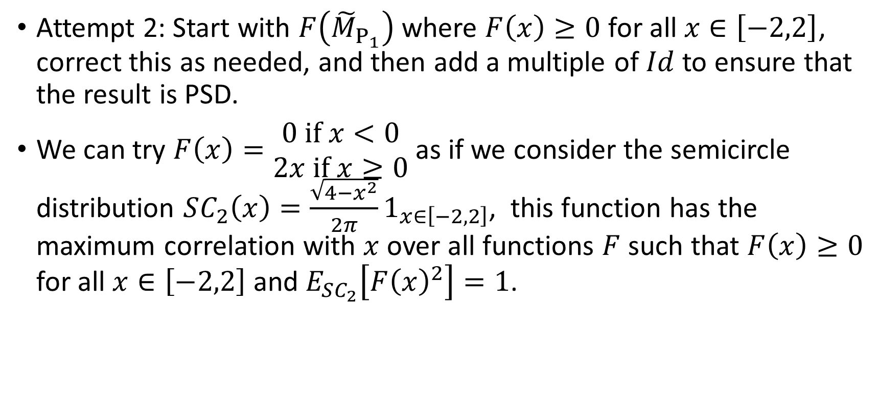

Attempt 2: Applying a function $F\left(x\right)$ to ${\tilde{M}}_{P_{1}}$
Attempt 2: Start with $F\left({\tilde{M}}_{P_{1}}\right)$ where $F\left(x\right)≥0$ for all $x∈\left[−2,2\right]$, correct this as needed, and then add a multiple of $Id$ to ensure that the result is PSD.
We can try $F\left(x\right)=\begin{aligned}0 if x<0 \\ &2x if x≥0\end{aligned}$ as if we consider the semicircle distribution $SC_{2}\left(x\right)=\frac{\sqrt{4−x^{2}}}{2π}1_{x∈\left[−2,2\right]}$, this function has the maximum correlation with $x$ over all functions $F$ such that $F\left(x\right)≥0$ for all $x∈\left[−2,2\right]$ and $E_{SC_{2}}\left[F{\left(x\right)}^{2}\right]=1$.

Slide 36
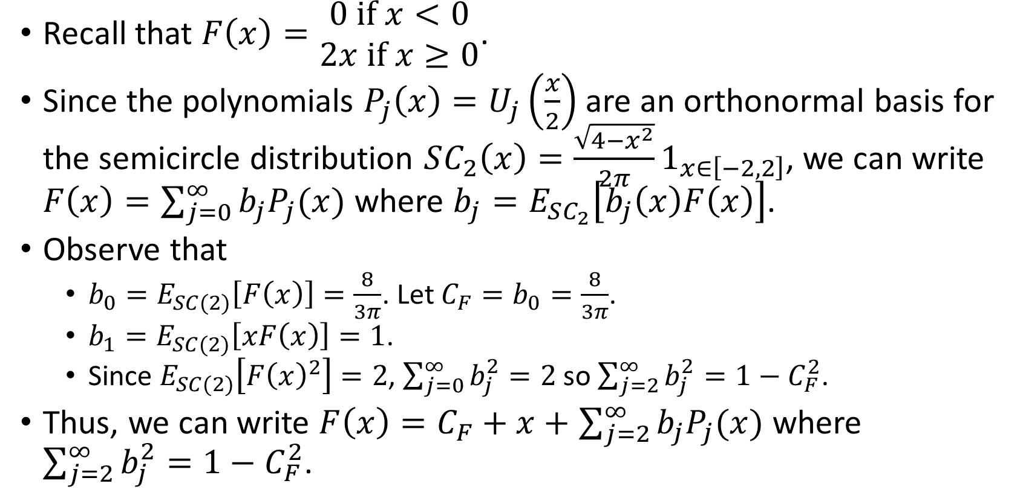

Decomposing $F\left(x\right)$ Into Chebyshev Polynomials
Recall that $F\left(x\right)=\begin{aligned}0 if x<0 \\ &2x if x≥0\end{aligned}$.
Since the polynomials $P_{j}\left(x\right)=U_{j}\left(\frac{x}{2}\right)$ are an orthonormal basis for the semicircle distribution $SC_{2}\left(x\right)=\frac{\sqrt{4−x^{2}}}{2π}1_{x∈\left[−2,2\right]}$, we can write $F\left(x\right)=\sum_{j=0}^{∞}{b_{j}P_{j}(x)}$ where $b_{j}=E_{SC_{2}}\left[b_{j}\left(x\right)F\left(x\right)\right]$.
Observe that
  $b_{0}=E_{SC(2)}\left[F\left(x\right)\right]=\frac{8}{3π}$. Let $C_{F}=b_{0}=\frac{8}{3π}$.
  $b_{1}=E_{SC(2)}\left[xF\left(x\right)\right]=1$.
  Since $E_{SC(2)}\left[F{\left(x\right)}^{2}\right]=2$, $\sum_{j=0}^{∞}{b_{j}^{2}}=2$ so $\sum_{j=2}^{∞}{b_{j}^{2}}=1−C_{F}^{2}$.
Thus, we can write $F\left(x\right)=C_{F}+x+$ $\sum_{j=2}^{∞}{b_{j}P_{j}(x)}$ where $\sum_{j=2}^{∞}{b_{j}^{2}}=1−C_{F}^{2}$.

Slide 37
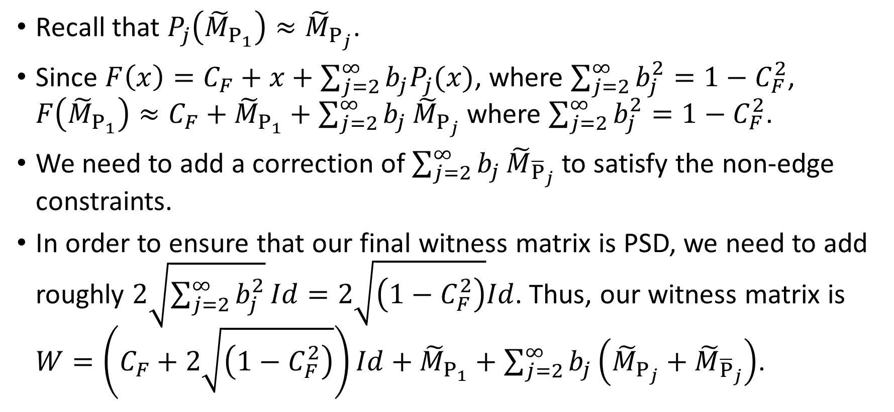

Attempt 2: Applying $F\left(x\right)$ to ${\tilde{M}}_{P_{1}}$
Recall that $P_{j}\left({\tilde{M}}_{P_{1}}\right)≈{\tilde{M}}_{P_{j}}$.
Since $F\left(x\right)=C_{F}+x+$ $\sum_{j=2}^{∞}{b_{j}P_{j}(x)}$, where $\sum_{j=2}^{∞}{b_{j}^{2}}=1−C_{F}^{2}$, $F\left({\tilde{M}}_{P_{1}}\right)≈C_{F}+{\tilde{M}}_{P_{1}}+$ $\sum_{j=2}^{∞}{b_{j}}{\tilde{M}}_{P_{j}}$ where $\sum_{j=2}^{∞}{b_{j}^{2}}=1−C_{F}^{2}$.
We need to add a correction of $\sum_{j=2}^{∞}{b_{j}}{\tilde{M}}_{{\overline{P}}_{j}}$ to satisfy the non-edge constraints.
In order to ensure that our final witness matrix is PSD, we need to add roughly $2\sqrt{\sum_{j=2}^{∞}{b_{j}^{2}}}Id=2\sqrt{\left(1−C_{F}^{2}\right)}Id$. Thus, our witness matrix is $W=\left(C_{F}+2\sqrt{\left(1−C_{F}^{2}\right)}\right)Id+{\tilde{M}}_{P_{1}}+\sum_{j=2}^{∞}{b_{j}\left({\tilde{M}}_{P_{j}}+{\tilde{M}}_{{\overline{P}}_{j}}\right)}$.

Slide 38
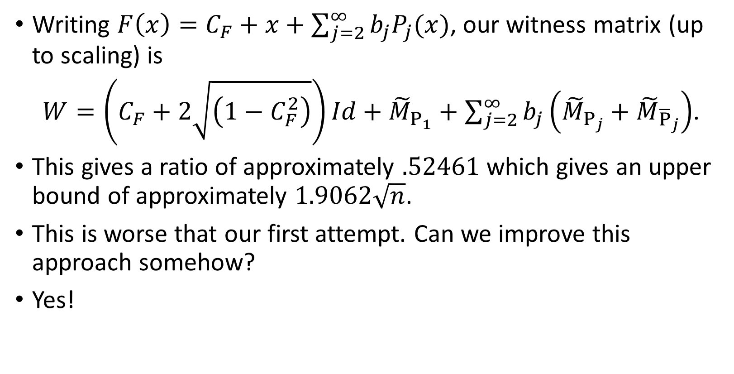
Attempt 2: Applying $F\left(x\right)$ to ${\tilde{M}}_{P_{1}}$
Writing $F\left(x\right)=C_{F}+x+$ $\sum_{j=2}^{∞}{b_{j}P_{j}(x)}$, our witness matrix (up to scaling) is
$W=\left(C_{F}+2\sqrt{\left(1−C_{F}^{2}\right)}\right)Id+{\tilde{M}}_{P_{1}}+\sum_{j=2}^{∞}{b_{j}\left({\tilde{M}}_{P_{j}}+{\tilde{M}}_{{\overline{P}}_{j}}\right)}$.
This gives a ratio of approximately $.52461$ which gives an upper bound of approximately $1.9062\sqrt{n}$.
This is worse that our first attempt. Can we improve this approach somehow?
Yes!

Slide 39
Part VI: Our Construction

Slide 40
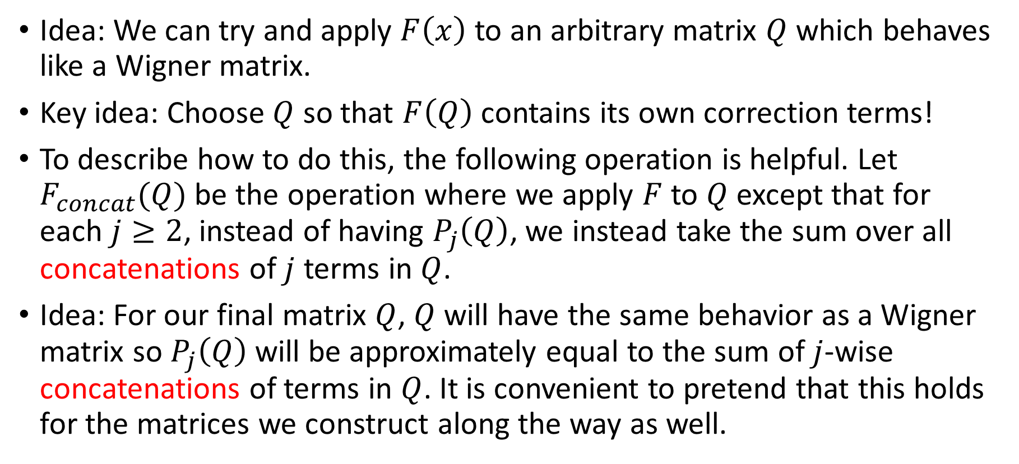
Key Idea
Idea: We can try and apply $F\left(x\right)$ to an arbitrary matrix $Q$ which behaves like a Wigner matrix.
Key idea: Choose $Q$ so that $F\left(Q\right)$ contains its own correction terms!
To describe how to do this, the following operation is helpful. Let $F_{concat}(Q)$ be the operation where we apply $F$ to $Q$ except that for each $j≥2$, instead of having $P_{j}\left(Q\right)$, we instead take the sum over all concatenations of $j$ terms in $Q$.
Idea: For our final matrix $Q$, $Q$ will have the same behavior as a Wigner matrix so $P_{j}\left(Q\right)$ will be approximately equal to the sum of $j$-wise concatenations of terms in $Q$. It is convenient to pretend that this holds for the matrices we construct along the way as well.

Slide 41

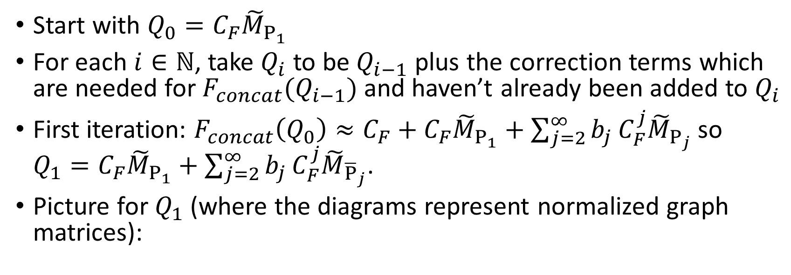



Iterative Construction
Start with $Q_{0}=C_{F}{\tilde{M}}_{P_{1}}$
For each $i∈ℕ$, take $Q_{i}$ to be $Q_{i−1}$ plus the correction terms which are needed for $F_{concat}(Q_{i−1})$ and haven’t already been added to $Q_{i}$
First iteration: $F_{concat}\left(Q_{0}\right)≈C_{F}+C_{F}{\tilde{M}}_{P_{1}}+\sum_{j=2}^{∞}{b_{j}}C_{F}^{j}{\tilde{M}}_{P_{j}}$ so $Q_{1}=C_{F}{\tilde{M}}_{P_{1}}+\sum_{j=2}^{∞}{b_{j}}C_{F}^{j}{\tilde{M}}_{{\overline{P}}_{j}}$.
Picture for $Q_{1}$ (where the diagrams represent normalized graph matrices):
$$C_{F}$$
v
$$+b_{3}C_{F}^{3}$$
$$+…$$
$$+b_{2}C_{F}^{2}$$

Slide 42








Some New Terms in $Q_{2}$
Picture for $Q_{1}=C_{F}{\tilde{M}}_{P_{1}}+\sum_{j=2}^{∞}{b_{j}}C_{F}^{j}{\tilde{M}}_{{\overline{P}}_{j}}$:
Some new terms in $Q_{2}$:
$$C_{F}$$
v
$$+b_{3}C_{F}^{3}$$
$$+b_{2}C_{F}^{2}$$
$$+…$$
$$b_{2}\left(b_{2}C_{F}^{2}\right)\left(b_{4}C_{F}^{4}\right)$$
v
$$b_{4}C_{F}\left(b_{2}C_{F}^{2}\right)C_{F}^{2}$$
v

Slide 43
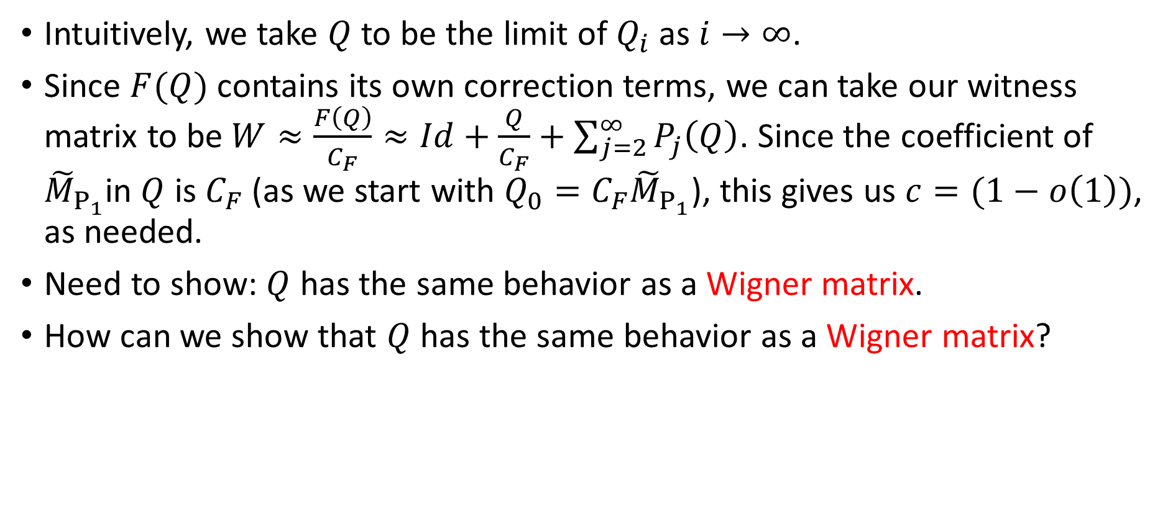
Punchline
Intuitively, we take $Q$ to be the limit of $Q_{i}$ as $i→∞$.
Since $F(Q)$ contains its own correction terms, we can take our witness matrix to be $W≈\frac{F\left(Q\right)}{C_{F}}≈Id+\frac{Q}{C_{F}}+\sum_{j=2}^{∞}{P_{j}\left(Q\right)}$. Since the coefficient of ${\tilde{M}}_{P_{1}}$in $Q$ is $C_{F}$ (as we start with $Q_{0}=C_{F}{\tilde{M}}_{P_{1}}$), this gives us $c=(1−o\left(1\right))$, as needed.
Need to show: $Q$ has the same behavior as a Wigner matrix.
How can we show that $Q$ has the same behavior as a Wigner matrix?

Slide 44
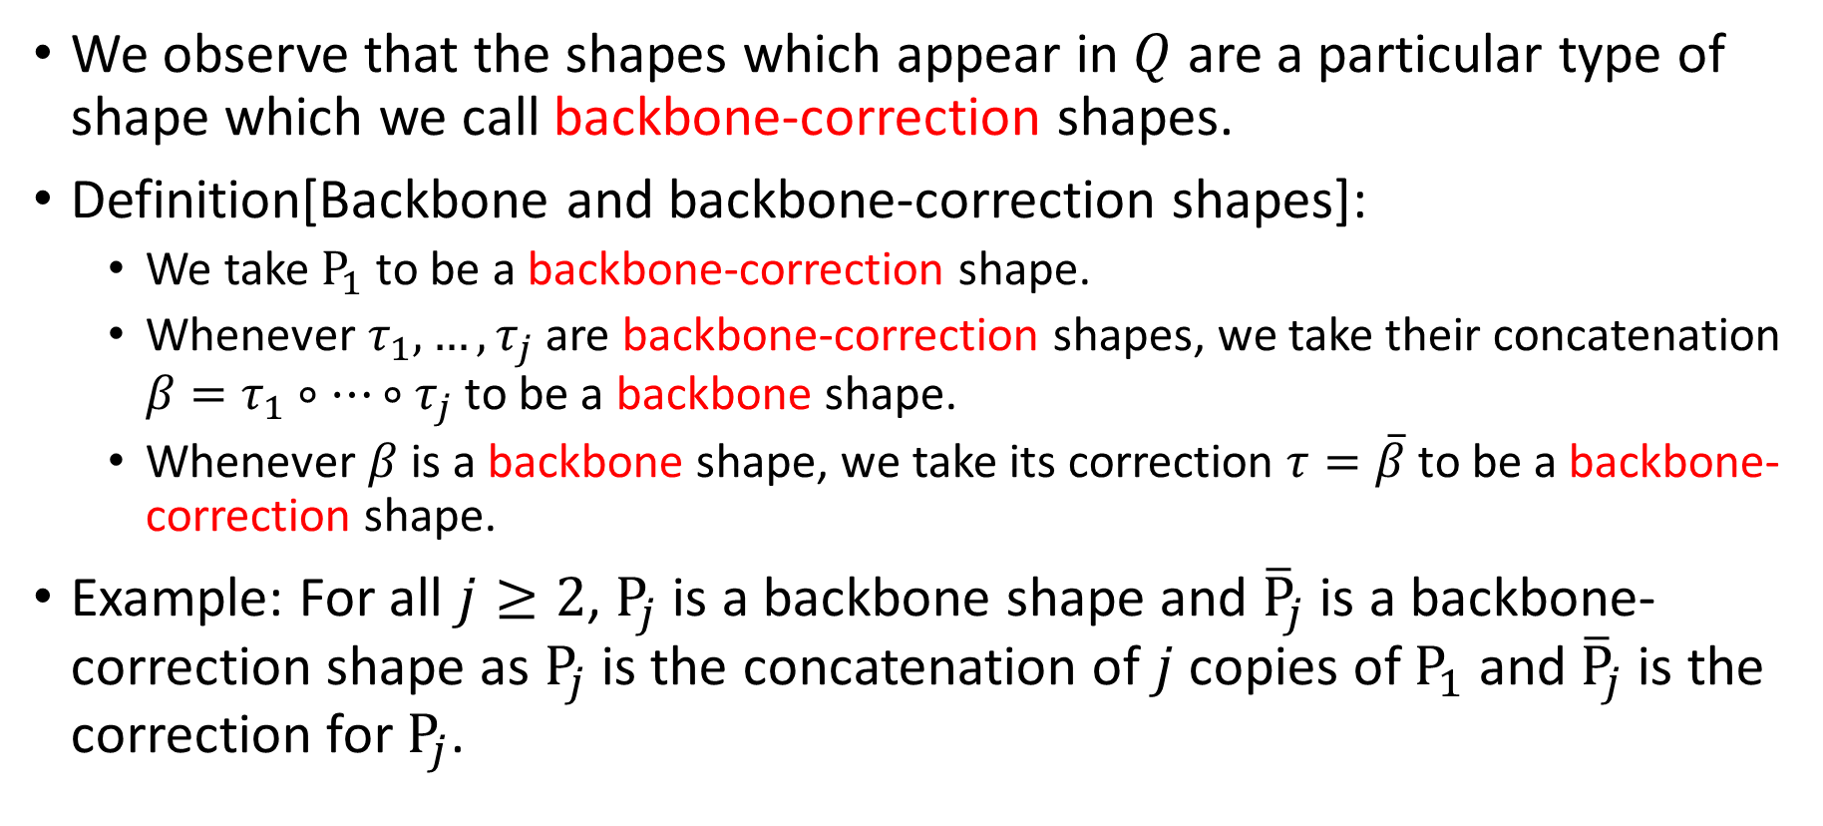
Backbone and Backbone-Correction Shapes
We observe that the shapes which appear in $Q$ are a particular type of shape which we call backbone-correction shapes.
Definition[Backbone and backbone-correction shapes]:
  We take $P_{1}$ to be a backbone-correction shape.
  Whenever $τ_{1},…,τ_{j}$ are backbone-correction shapes, we take their concatenation $β=τ_{1}∘…∘τ_{j}$ to be a backbone shape.
  Whenever $β$ is a backbone shape, we take its correction $τ=\overline{β}$ to be a backbone-correction shape.
Example: For all $j≥2$, $P_{j}$ is a backbone shape and ${\overline{P}}_{j}$ is a backbone-correction shape as $P_{j}$ is the concatenation of $j$ copies of $P_{1}$ and ${\overline{P}}_{j}$ is the correction for $P_{j}$.

Slide 45
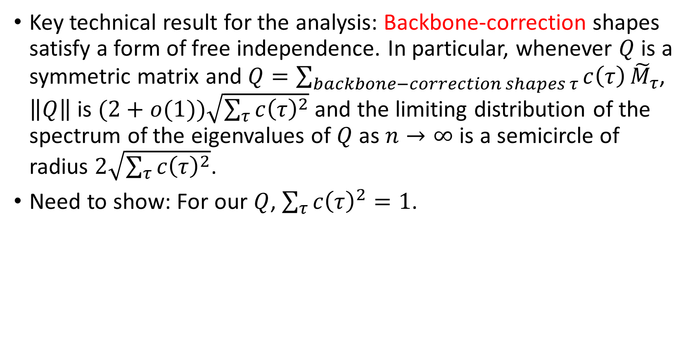
Key Technical Result
Key technical result for the analysis: Backbone-correction shapes satisfy a form of free independence. In particular, whenever $Q$ is a symmetric matrix and $Q=\sum_{backbone−correction shapes τ}{c\left(τ\right)}{\tilde{M}}_{τ}$, $\left\|Q\right\|$ is $(2+o(1))\sqrt{\sum_{τ}{c{\left(τ\right)}^{2}}}$ and the limiting distribution of the spectrum of the eigenvalues of $Q$ as $n→∞$ is a semicircle of radius $2\sqrt{\sum_{τ}{c{\left(τ\right)}^{2}}}$.
Need to show: For our $Q$, $\sum_{τ}{c{\left(τ\right)}^{2}}=1$.

Slide 46
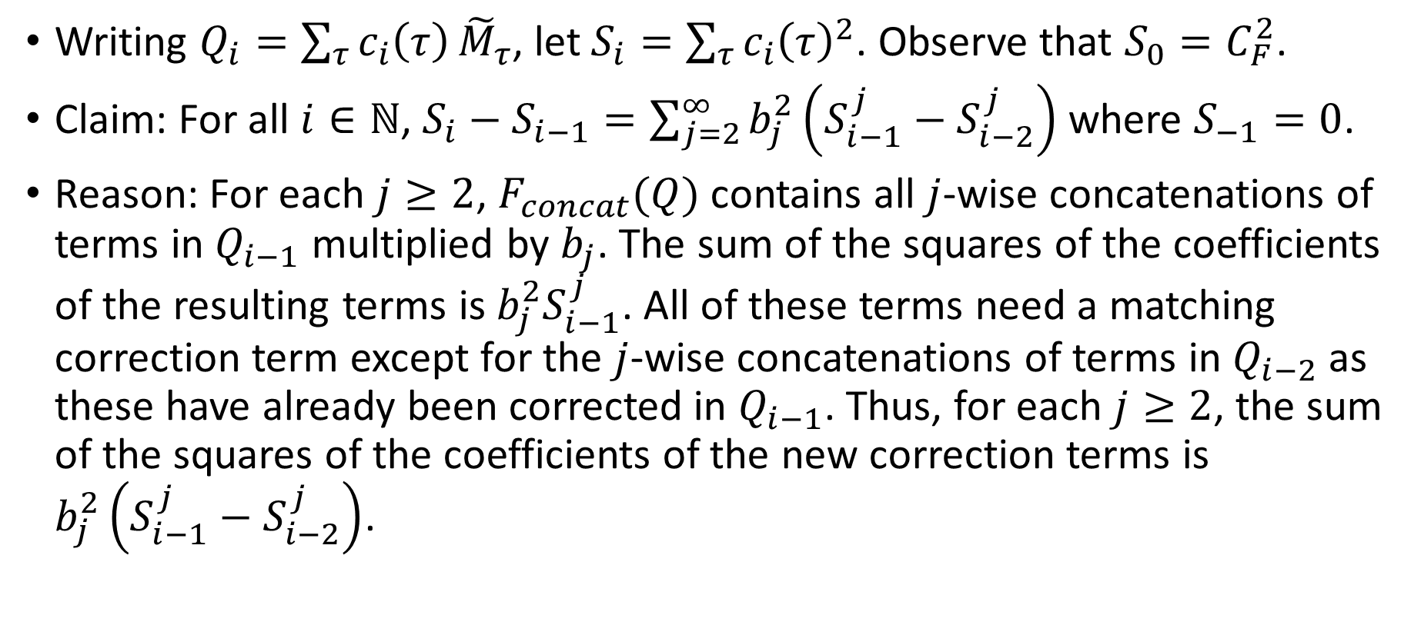

Justification for Why $\sum_{τ}{c{\left(τ\right)}^{2}}=1$
Writing $Q_{i}=\sum_{τ}{c_{i}\left(τ\right)}{\tilde{M}}_{τ}$, let $S_{i}=\sum_{τ}{c_{i}{\left(τ\right)}^{2}}$. Observe that $S_{0}=C_{F}^{2}$.
Claim: For all $i∈ℕ$, $S_{i}−S_{i−1}=\sum_{j=2}^{∞}{b_{j}^{2}\left(S_{i−1}^{j}−S_{i−2}^{j}\right)}$ where $S_{−1}=0$.
Reason: For each $j≥2$, $F_{concat}(Q)$ contains all $j$-wise concatenations of terms in $Q_{i−1}$ multiplied by $b_{j}$. The sum of the squares of the coefficients of the resulting terms is $b_{j}^{2}S_{i−1}^{j}$. All of these terms need a matching correction term except for the $j$-wise concatenations of terms in $Q_{i−2}$ as these have already been corrected in $Q_{i−1}$. Thus, for each $j≥2$, the sum of the squares of the coefficients of the new correction terms is $b_{j}^{2}\left(S_{i−1}^{j}−S_{i−2}^{j}\right)$.

Slide 47
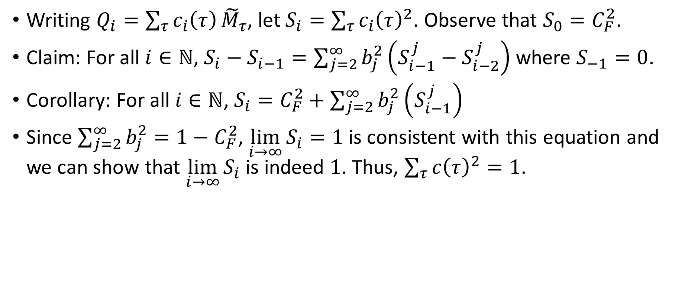
Justification for Why $\sum_{τ}{c{\left(τ\right)}^{2}}=1$
Writing $Q_{i}=\sum_{τ}{c_{i}\left(τ\right)}{\tilde{M}}_{τ}$, let $S_{i}=\sum_{τ}{c_{i}{\left(τ\right)}^{2}}$. Observe that $S_{0}=C_{F}^{2}$.
Claim: For all $i∈ℕ$, $S_{i}−S_{i−1}=\sum_{j=2}^{∞}{b_{j}^{2}\left(S_{i−1}^{j}−S_{i−2}^{j}\right)}$ where $S_{−1}=0$.
Corollary: For all $i∈ℕ$, $S_{i}=C_{F}^{2}+\sum_{j=2}^{∞}{b_{j}^{2}\left(S_{i−1}^{j}\right)}$
Since $\sum_{j=2}^{∞}{b_{j}^{2}}=1−C_{F}^{2}$, $\lim_{i→∞}{S_{i}}=1$ is consistent with this equation and we can show that $\lim_{i→∞}{S_{i}}$ is indeed $1$. Thus, $\sum_{τ}{c{\left(τ\right)}^{2}}=1$.

Slide 48
Thank you!

Slide 49
References
[FG25] U. Feige and V. Grinberg. Upper bounds on the theta function of random graphs. arXiv 2506.02952. 2025
[Lovász79] L. Lovász. On the Shannon Capacity of a Graph. IEEE Transactions on Information Theory, Vol. IT-25, No.1 p. 1-7. 1979.

