Slide 1
Sum of Squares Lower Bounds for Average Case Problems
Aaron Potechin
University of Chicago
ICTS Workshop on Circuits, Communication, and Proofs
August 2026

Slide 2

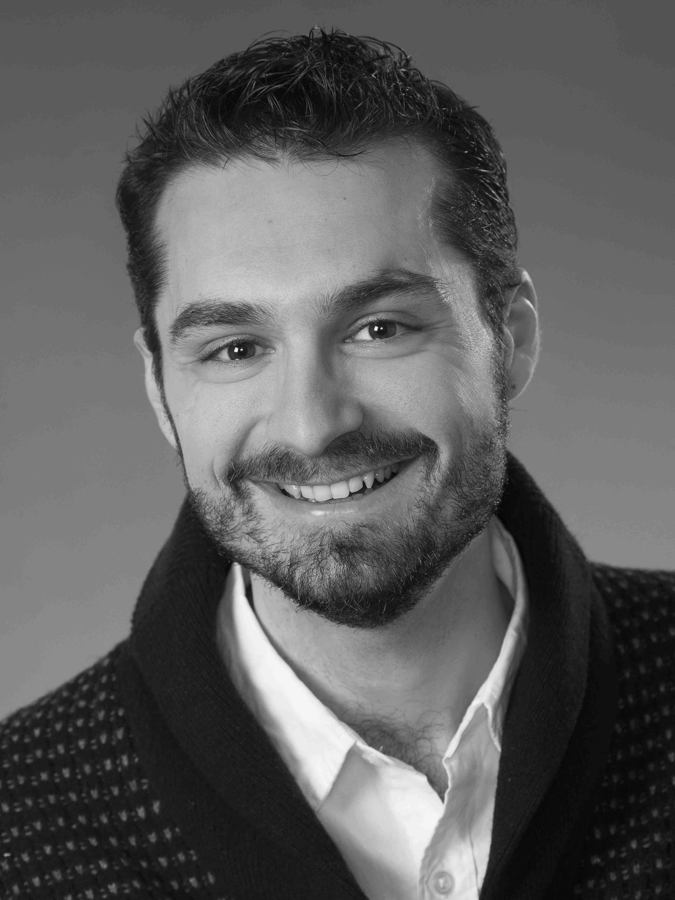

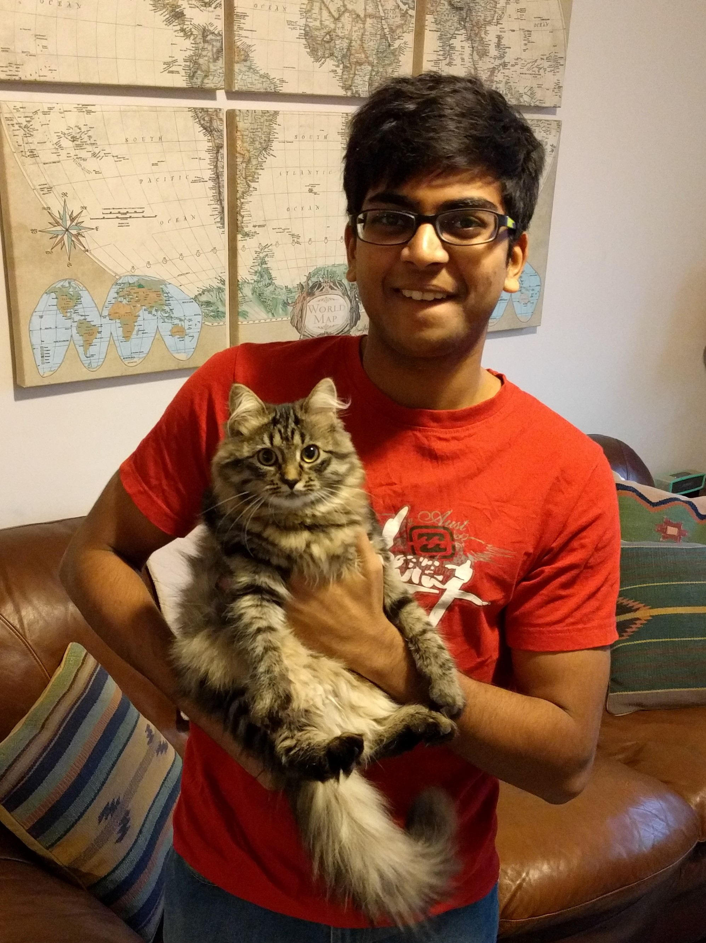

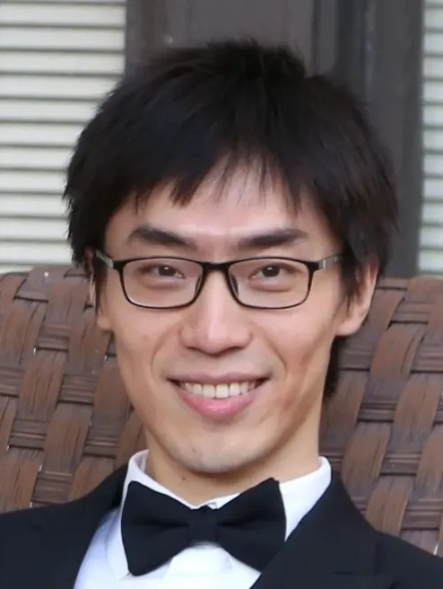


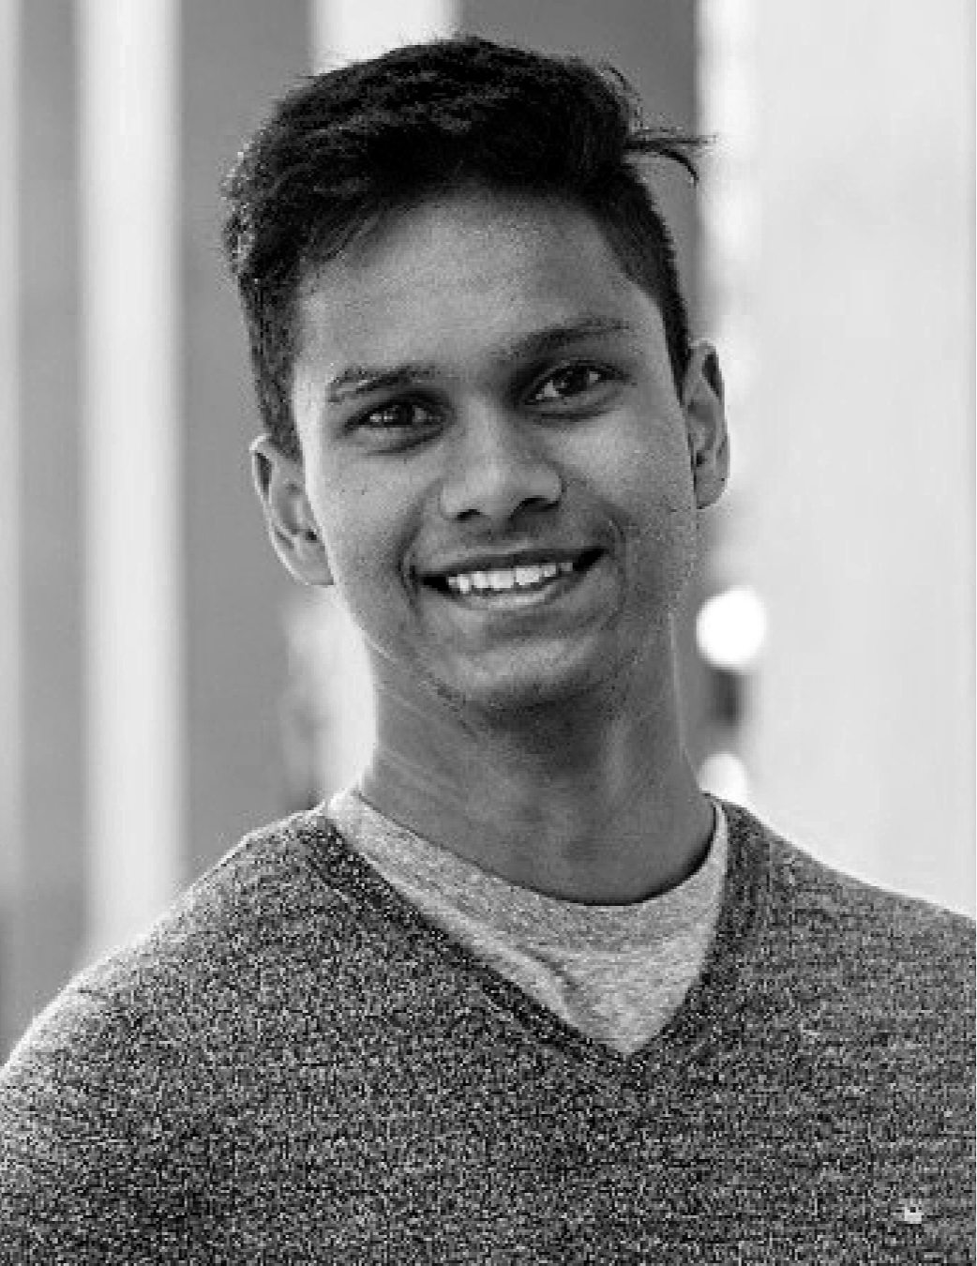
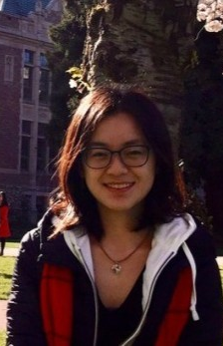


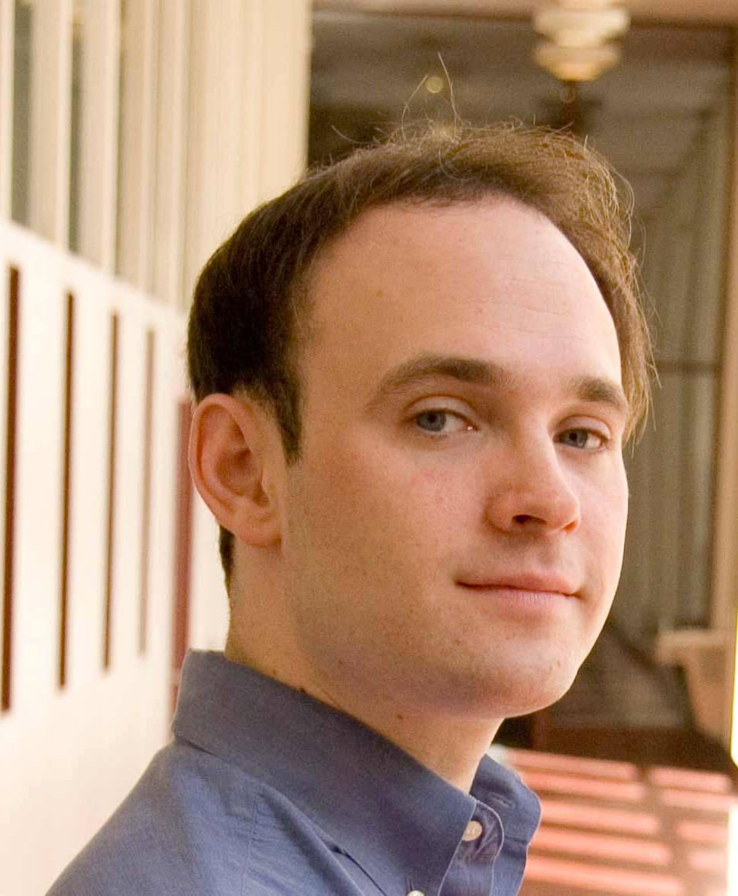


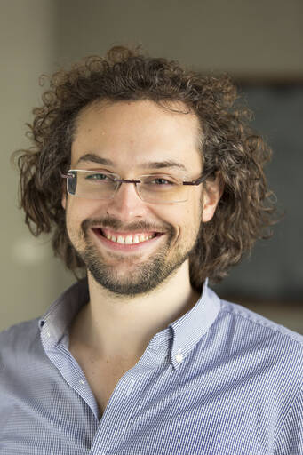


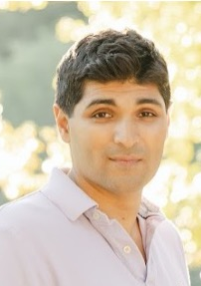
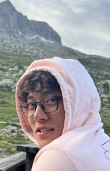
Collaborators for Average Case SoS Lower Bounds and Analyzing Graph Matrices
Madhur Tulsiani
Ilias Diakonikolas
Chris Jones
Goutham Rajendran
Jeff Xu
Shuo Pang
Sushrut Karmalkar
Pravesh Kothari
Dhruv Medarametla
Wenjun Cai
Fernando Granha
Jeronimo
Mrinalkanti Ghosh
Jonathan Kelner
Sam Hopkins
Boaz Barak
David Steurer
Tselil Schramm
Prasad Raghavendra
Ankur Moitra
Kwangjun Ahn

Slide 3
Common Theme of This Talk and the Next Talk
Common question discussed in this talk and the next talk: Given an SDP (semidefinite program) over a random input, how can we construct candidate solutions for this SDP and analyze them?
Common technical tool: Graph matrices are a powerful tool for analyzing problems with random inputs.

Slide 4
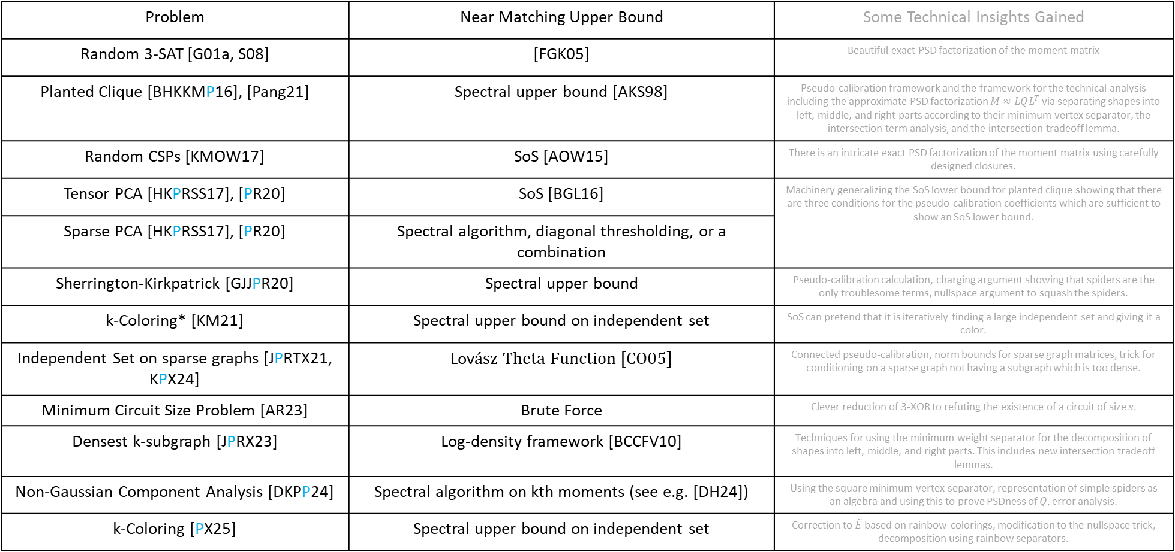
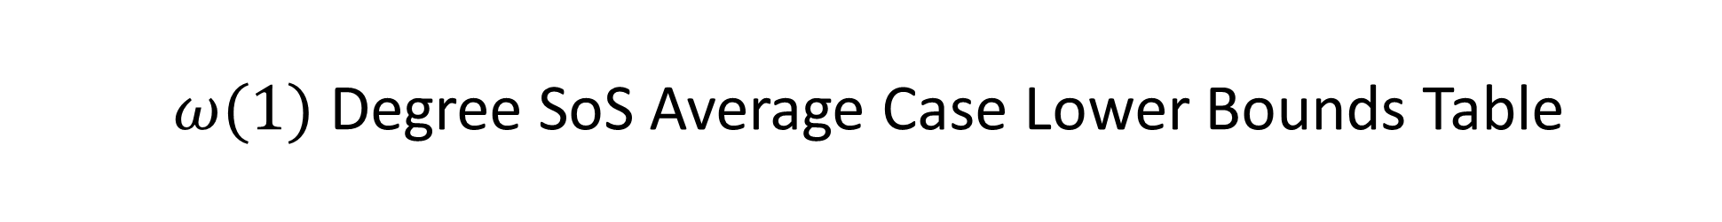
$ω(1)$ Degree SoS Average Case Lower Bounds Table
Problem | Near Matching Upper Bound | Some Technical Insights Gained
Random 3-SAT [G01a, S08] | [FGK05] | Beautiful exact PSD factorization of the moment matrix
Planted Clique [BHKKMP16], [Pang21] | Spectral upper bound [AKS98] | Pseudo-calibration framework and the framework for the technical analysis including the approximate PSD factorization $M≈LQL^{T}$ via separating shapes into left, middle, and right parts according to their minimum vertex separator, the intersection term analysis, and the intersection tradeoff lemma.
Random CSPs [KMOW17] | SoS [AOW15] | There is an intricate exact PSD factorization of the moment matrix using carefully designed closures.
Tensor PCA [HKPRSS17], [PR20] | SoS [BGL16] | Machinery generalizing the SoS lower bound for planted clique showing that there are three conditions for the pseudo-calibration coefficients which are sufficient to show an SoS lower bound.
Sparse PCA [HKPRSS17], [PR20] | Spectral algorithm, diagonal thresholding, or a combination
Sherrington-Kirkpatrick [GJJPR20] | Spectral upper bound | Pseudo-calibration calculation, charging argument showing that spiders are the only troublesome terms, nullspace argument to squash the spiders.
k-Coloring* [KM21] | Spectral upper bound on independent set | SoS can pretend that it is iteratively finding a large independent set and giving it a color.
Independent Set on sparse graphs [JPRTX21, KPX24] | Lovász Theta Function [CO05] | Connected pseudo-calibration, norm bounds for sparse graph matrices, trick for conditioning on a sparse graph not having a subgraph which is too dense.
Minimum Circuit Size Problem [AR23] | Brute Force | Clever reduction of 3-XOR to refuting the existence of a circuit of size $s$.
Densest k-subgraph [JPRX23] | Log-density framework [BCCFV10] | Techniques for using the minimum weight separator for the decomposition of shapes into left, middle, and right parts. This includes new intersection tradeoff lemmas.
Non-Gaussian Component Analysis [DKPP24] | Spectral algorithm on kth moments (see e.g. [DH24]) | Using the square minimum vertex separator, representation of simple spiders as an algebra and using this to prove PSDness of $Q$, error analysis.
k-Coloring [PX25] | Spectral upper bound on independent set | Correction to $\tilde{E}$ based on rainbow-colorings, modification to the nullspace trick, decomposition using rainbow separators.

Slide 5
Goals for this Talk
In this talk, I will describe the following three key ideas which were pioneered by the paper “A Nearly Tight Sum-of-Squares Lower Bound for the Planted Clique Problem” [BHKKMP16] and are used (sometimes with modifications) in most SoS lower bounds for average case problems:
  The pseudo-calibration technique for designing pseudo-expectation values.
  Decomposing the moment matrix using graph matrices.
  Decomposing shapes into left, middle, and right parts based on their leftmost and rightmost minimum vertex separators.
After describing these ideas, if there is time, I will give a brief summary of progress since then and some open problems.
Red or blue: Key terms
Grey: Either a lot of work was done here which I won’t try to describe or these are details I’m sweeping under the rug.

Slide 6
Outline
The Sum of Squares Hierarchy
Planted clique and First Candidate Pseudo-expectation Values
Pseudo-calibration
Graph Matrices
Brief Sketch for the PSDness Analyses
Recent Progress and Open Problems

Slide 7
Part I: The Sum of Squares Hierarchy

Slide 8
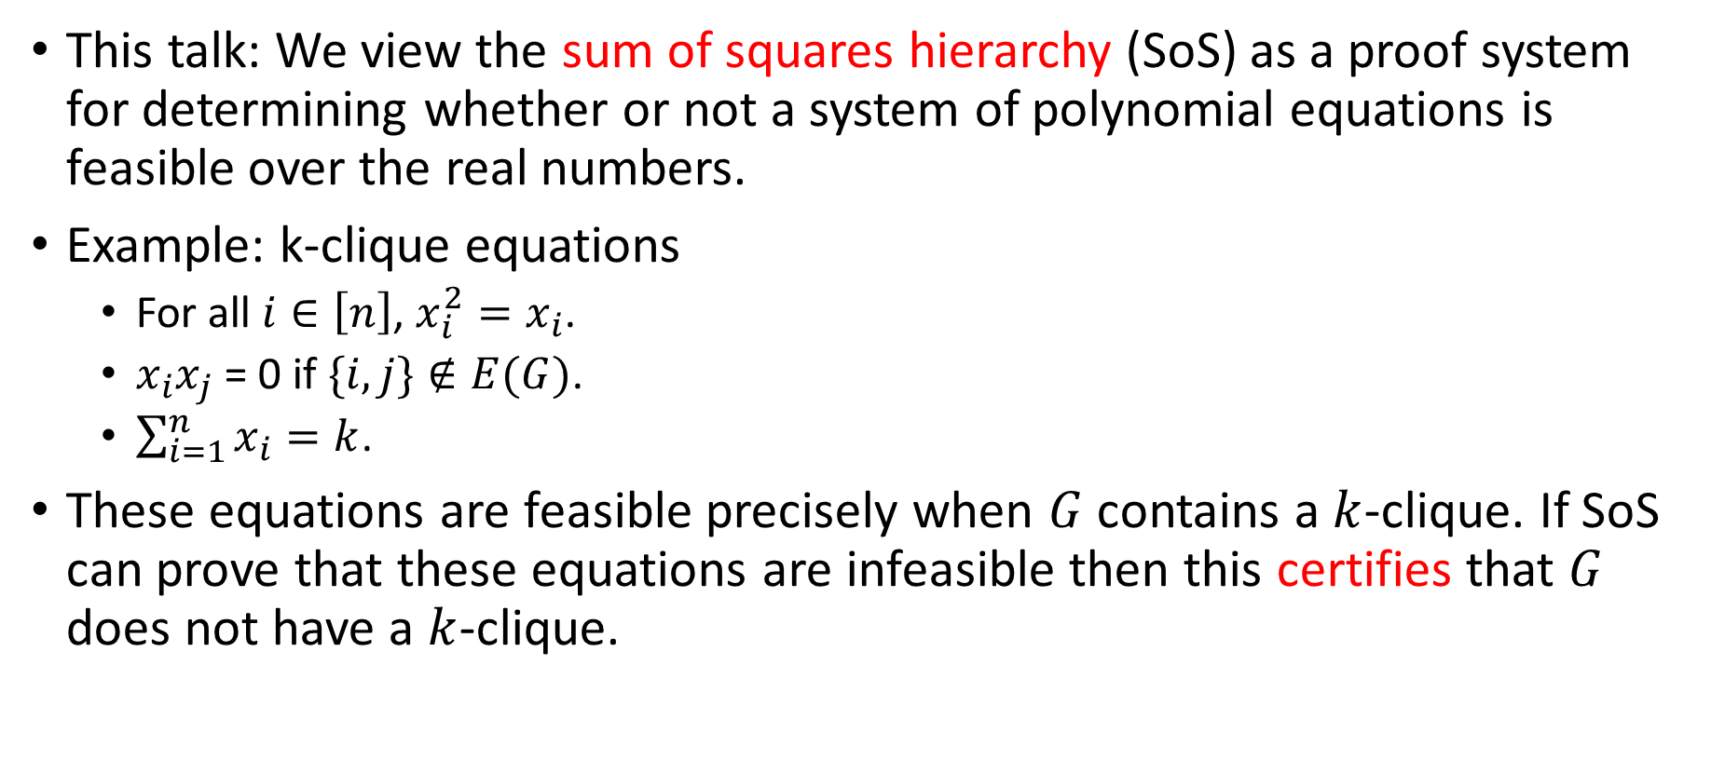
Setup for the Sum of Squares Hierarchy
This talk: We view the sum of squares hierarchy (SoS) as a proof system for determining whether or not a system of polynomial equations is feasible over the real numbers.
Example: k-clique equations
  For all $i∈\left[n\right]$, $x_{i}^{2}=x_{i}$.
  $x_{i}x_{j}$ = 0 if $\{i,j\}∉E(G)$.
  $\sum_{i=1}^{n}{x_{i}}=k$.
These equations are feasible precisely when $G$ contains a $k$-clique. If SoS can prove that these equations are infeasible then this certifies that $G$ does not have a $k$-clique.

Slide 9
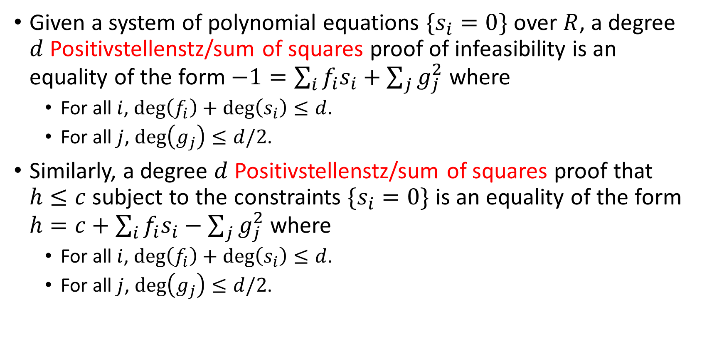
Positivstellensatz/Sum of Squares Proofs
Given a system of polynomial equations $\{s_{i}=0\}$ over $R$, a degree $d$ Positivstellenstz/sum of squares proof of infeasibility is an equality of the form $−1=\sum_{i}{f_{i}s_{i}}+\sum_{j}{g_{j}^{2}}$ where
  For all $i$, $\deg\left(f_{i}\right)+\deg\left(s_{i}\right)≤d$.
  For all $j$, $\deg\left(g_{j}\right)≤d/2$.
Similarly, a degree $d$ Positivstellenstz/sum of squares proof that $h≤c$ subject to the constraints $\{s_{i}=0\}$ is an equality of the form $h=c+\sum_{i}{f_{i}s_{i}}−\sum_{j}{g_{j}^{2}}$ where
  For all $i$, $\deg\left(f_{i}\right)+\deg\left(s_{i}\right)≤d$.
  For all $j$, $\deg\left(g_{j}\right)≤d/2$.

Slide 10
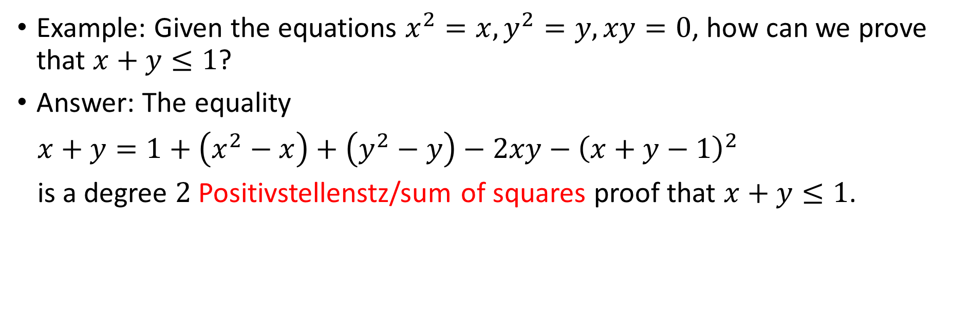
Positivstellensatz/Sum of Squares Proof Example
Example: Given the equations $x^{2}=x,y^{2}=y, xy=0$, how can we prove that $x+y≤1$?
Answer: The equality
$x+y=1+\left(x^{2}−x\right)+\left(y^{2}−y\right)−2xy−{\left(x+y−1\right)}^{2}$
is a degree $2$ Positivstellenstz/sum of squares proof that $x+y≤1$.

Slide 11

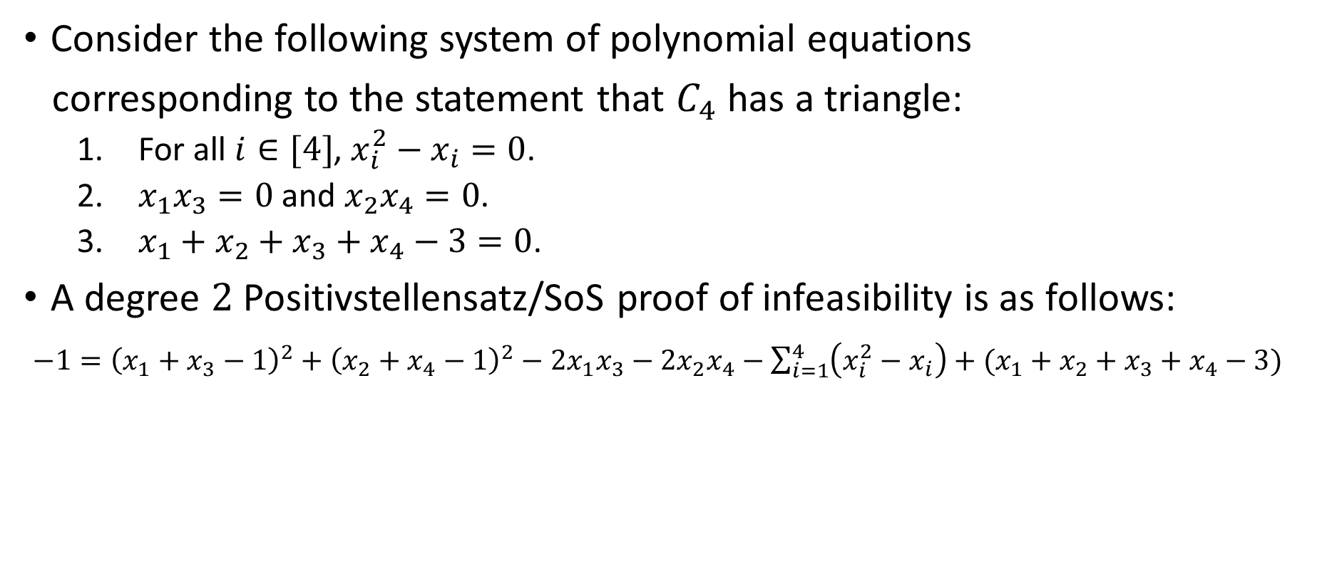



Another Positivstellensatz/Sum of Squares Proof Example
Consider the following system of polynomial equations
corresponding to the statement that $C_{4}$ has a triangle:
  For all $i∈[4]$, $x_{i}^{2}−x_{i}=0$.
  $x_{1}x_{3}=0$ and $x_{2}x_{4}=0$.
  $x_{1}+x_{2}+x_{3}+x_{4}−3=0$.
A degree $2$ Positivstellensatz/SoS proof of infeasibility is as follows:
$−1={\left(x_{1}+x_{3}−1\right)}^{2}+{\left(x_{2}+x_{4}−1\right)}^{2}−2x_{1}x_{3}−2x_{2}x_{4}−\sum_{i=1}^{4}{\left(x_{i}^{2}−x_{i}\right)}+(x_{1}+x_{2}+x_{3}+x_{4}−3)$
$$x_{1}$$
$$x_{2}$$
$$x_{4}$$
$$x_{3}$$

Slide 12
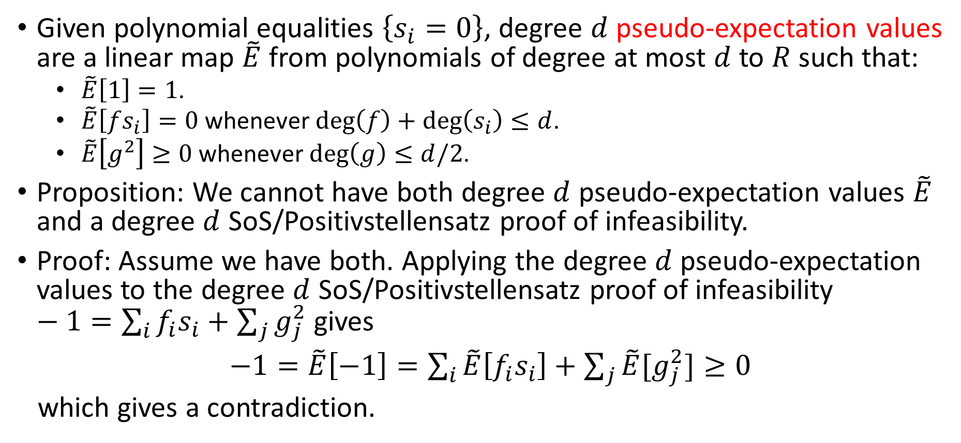
Pseudo-expectation Values
Given polynomial equalities $\left\{s_{i}=0\right\}$, degree $d$ pseudo-expectation values are a linear map $\tilde{E}$ from polynomials of degree at most $d$ to $R$ such that:
  $\tilde{E}\left[1\right]=1$.
  $\tilde{E}\left[fs_{i}\right]=0$ whenever $\deg\left(f\right)+\deg\left(s_{i}\right)≤d$.
  $\tilde{E}\left[g^{2}\right]≥0$ whenever $\deg\left(g\right)≤d/2$.
Proposition: We cannot have both degree $d$ pseudo-expectation values $\tilde{E}$ and a degree $d$ SoS/Positivstellensatz proof of infeasibility.
Proof: Assume we have both. Applying the degree $d$ pseudo-expectation values to the degree $d$ SoS/Positivstellensatz proof of infeasibility $−1=\sum_{i}{f_{i}s_{i}}+\sum_{j}{g_{j}^{2}}$gives
$−1=\tilde{E}\left[−1\right]=\sum_{i}{\tilde{E}\left[f_{i}s_{i}\right]}+\sum_{j}{\tilde{E}[g_{j}^{2}]≥0}$
which gives a contradiction.

Slide 13
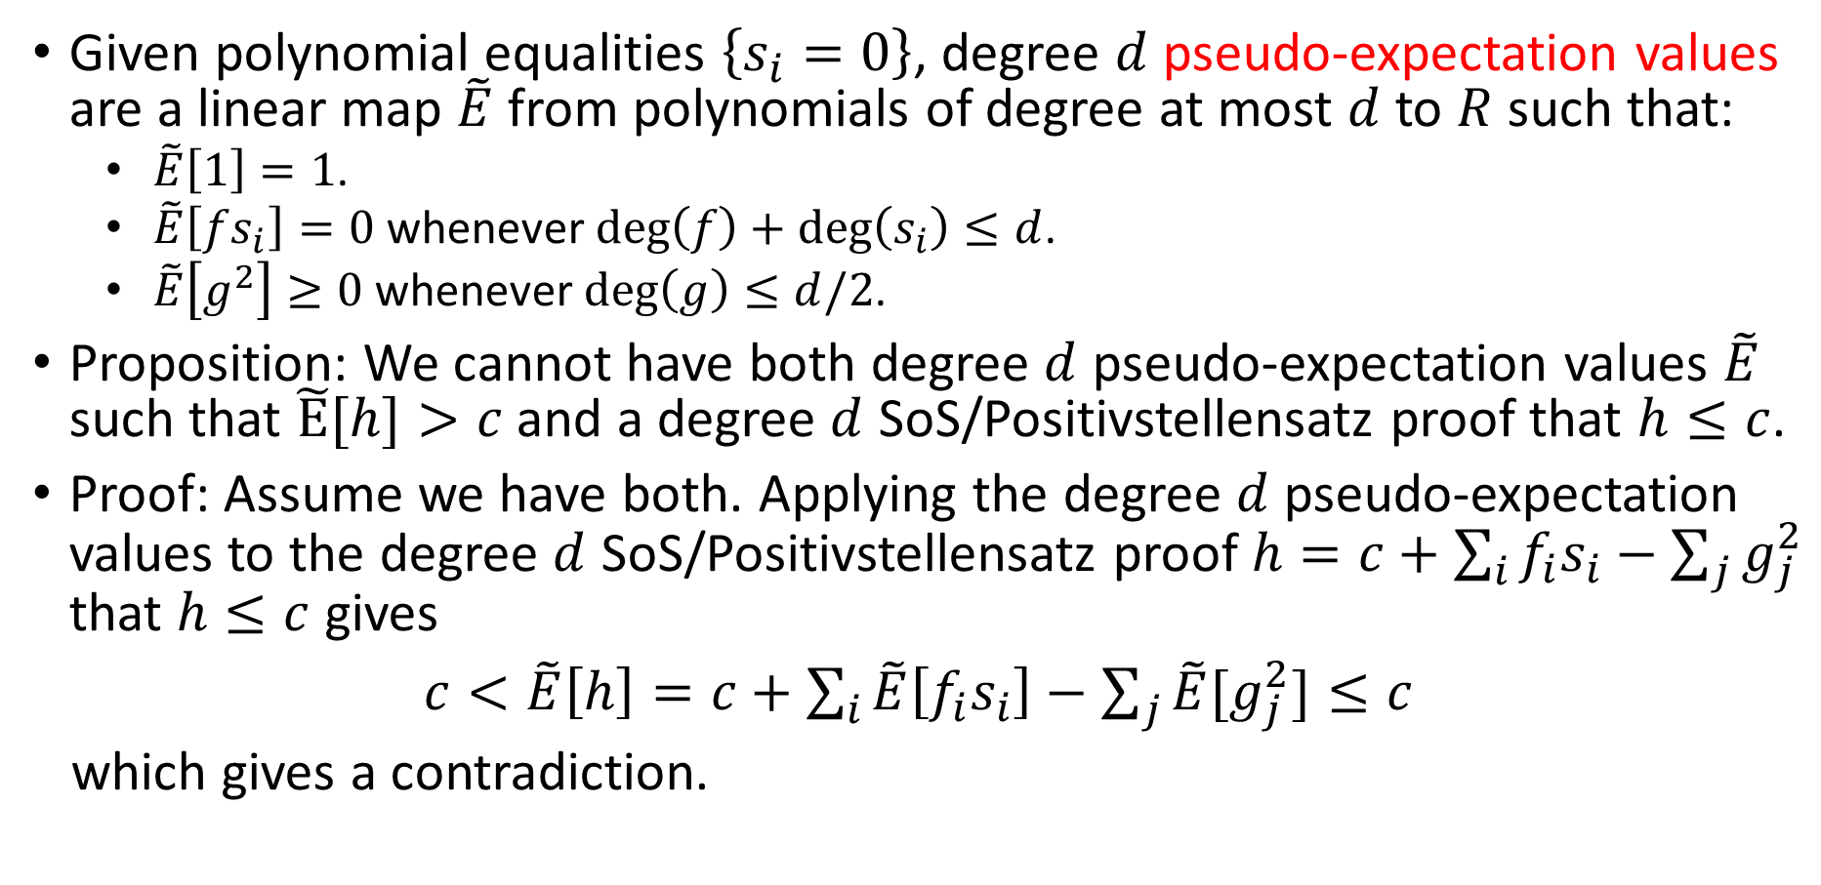
Pseudo-expectation Values
Given polynomial equalities $\left\{s_{i}=0\right\}$, degree $d$ pseudo-expectation values are a linear map $\tilde{E}$ from polynomials of degree at most $d$ to $R$ such that:
  $\tilde{E}\left[1\right]=1$.
  $\tilde{E}\left[fs_{i}\right]=0$ whenever $\deg\left(f\right)+\deg\left(s_{i}\right)≤d$.
  $\tilde{E}\left[g^{2}\right]≥0$ whenever $\deg\left(g\right)≤d/2$.
Proposition: We cannot have both degree $d$ pseudo-expectation values $\tilde{E}$ such that $\tilde{E}[h]>c$ and a degree $d$ SoS/Positivstellensatz proof that $h≤c$.
Proof: Assume we have both. Applying the degree $d$ pseudo-expectation values to the degree $d$ SoS/Positivstellensatz proof $h=c+\sum_{i}{f_{i}s_{i}}−\sum_{j}{g_{j}^{2}}$ that $h≤c$ gives
$c<\tilde{E}\left[h\right]=c+\sum_{i}{\tilde{E}\left[f_{i}s_{i}\right]}−\sum_{j}{\tilde{E}[g_{j}^{2}]≤c}$
which gives a contradiction.

Slide 14

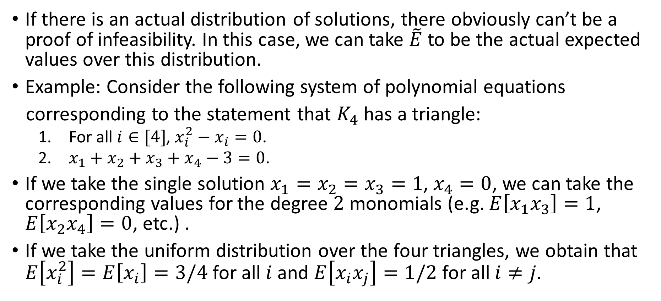



Distributions of Solutions Give Pseudo-expectation Values
If there is an actual distribution of solutions, there obviously can’t be a proof of infeasibility. In this case, we can take $\tilde{E}$ to be the actual expected values over this distribution.
Example: Consider the following system of polynomial equations
corresponding to the statement that $K_{4}$ has a triangle:
  For all $i∈[4]$, $x_{i}^{2}−x_{i}=0$.
  $x_{1}+x_{2}+x_{3}+x_{4}−3=0$.
If we take the single solution $x_{1}=x_{2}=x_{3}=1$, $x_{4}=0$, we can take the corresponding values for the degree $2$ monomials (e.g. $E\left[x_{1}x_{3}\right]=1$, $E\left[x_{2}x_{4}\right]=0$, etc.) .
If we take the uniform distribution over the four triangles, we obtain that $E\left[x_{i}^{2}\right]=E\left[x_{i}\right]=3/4$ for all $i$ and $E\left[x_{i}x_{j}\right]=1/2$ for all $i≠j$.
$$x_{1}$$
$$x_{2}$$
$$x_{4}$$
$$x_{3}$$

Slide 15
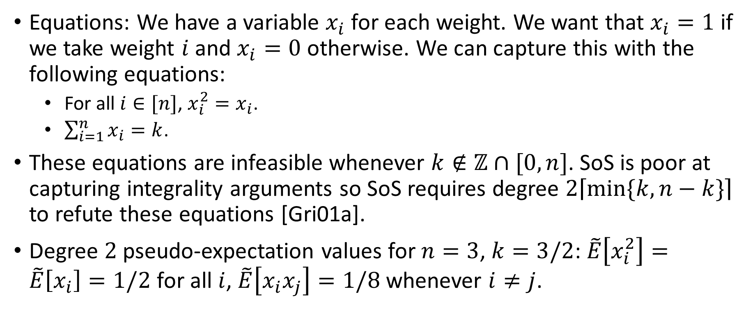
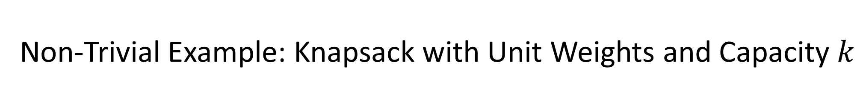
Non-Trivial Example: Knapsack with Unit Weights and Capacity $k$
Equations: We have a variable $x_{i}$ for each weight. We want that $x_{i}=1$ if we take weight $i$ and $x_{i}=0$ otherwise. We can capture this with the following equations:
  For all $i∈[n]$, $x_{i}^{2}=x_{i}$.
  $\sum_{i=1}^{n}{x_{i}}=k$.
These equations are infeasible whenever $k∉ℤ∩[0,n]$. SoS is poor at capturing integrality arguments so SoS requires degree $2\left\lceil min⁡\{k,n−k\}\right\rceil$ to refute these equations [Gri01a].
Degree $2$ pseudo-expectation values for $n=3$, $k=3/2$: $\tilde{E}\left[x_{i}^{2}\right]=\tilde{E}\left[x_{i}\right]=1/2$ for all $i$, $\tilde{E}\left[x_{i}x_{j}\right]=1/8$ whenever $i≠j$.

Slide 16
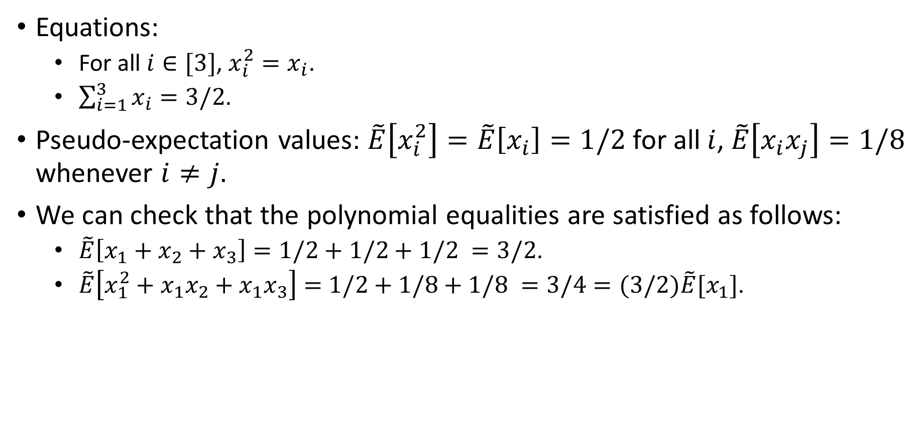
Checking the Pseudo-expectation Values
Equations:
  For all $i∈[3]$, $x_{i}^{2}=x_{i}$.
  $\sum_{i=1}^{3}{x_{i}}=3/2$.
Pseudo-expectation values: $\tilde{E}\left[x_{i}^{2}\right]=\tilde{E}\left[x_{i}\right]=1/2$ for all $i$, $\tilde{E}\left[x_{i}x_{j}\right]=1/8$ whenever $i≠j$.
We can check that the polynomial equalities are satisfied as follows:
  $\tilde{E}\left[x_{1}+x_{2}+x_{3}\right]=1/2+1/2+1/2 =3/2$.
  $\tilde{E}\left[x_{1}^{2}+x_{1}x_{2}+x_{1}x_{3}\right]=$ $1/2+1/8+1/8 =3/4=(3/2)\tilde{E}[x_{1}]$.

Slide 17

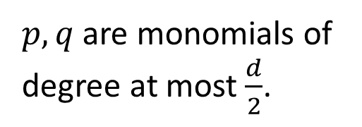
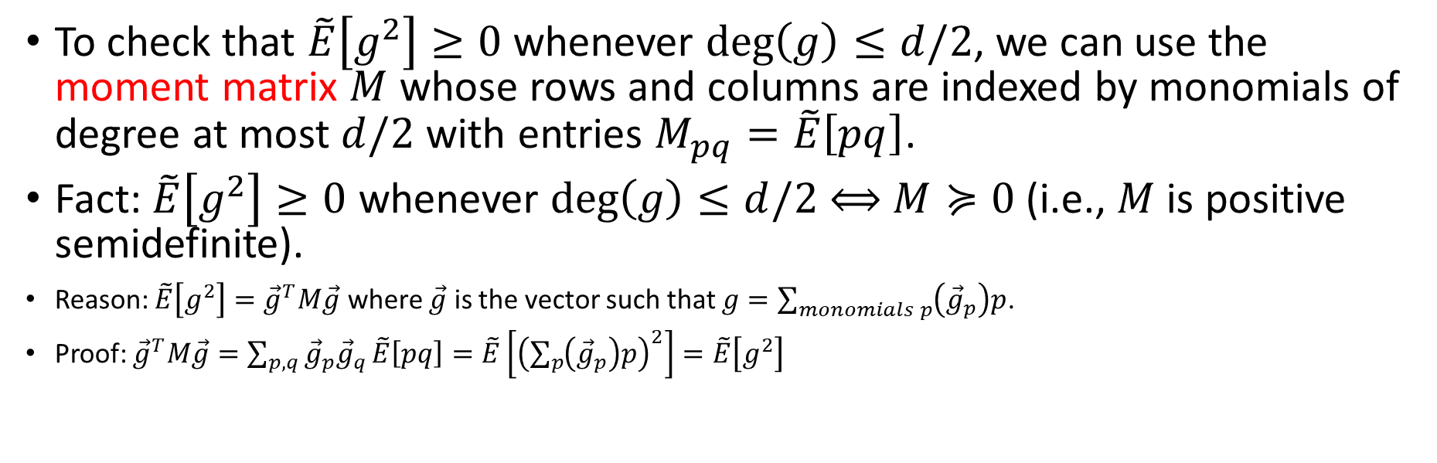



The Moment Matrix
To check that $\tilde{E}\left[g^{2}\right]≥0$ whenever $\deg\left(g\right)≤d/2$, we can use the moment matrix $M$ whose rows and columns are indexed by monomials of degree at most $d/2$ with entries $M_{pq}=\tilde{E}\left[pq\right]$.
Fact: $\tilde{E}\left[g^{2}\right]≥0$ whenever $\deg\left(g\right)≤d/2$ $⟺$ $M≽0$ (i.e., $M$ is positive semidefinite).
Reason: $\tilde{E}\left[g^{2}\right]={\vec{g}}^{T}M\vec{g}$ where $\vec{g}$ is the vector such that $g=\sum_{monomials p}{\left({\vec{g}}_{p}\right)p}$.
Proof: ${\vec{g}}^{T}M\vec{g}=\sum_{p,q}{{\vec{g}}_{p}{\vec{g}}_{q}}\tilde{E}\left[pq\right]=\tilde{E}\left[{\left(\sum_{p}{\left({\vec{g}}_{p}\right)p}\right)}^{2}\right]=\tilde{E}\left[g^{2}\right]$
$$q$$
$p,q$ are monomials of degree at most $\frac{d}{2}$.
$$p$$
$$\tilde{E}\left[pq\right]$$
$$M$$

Slide 18
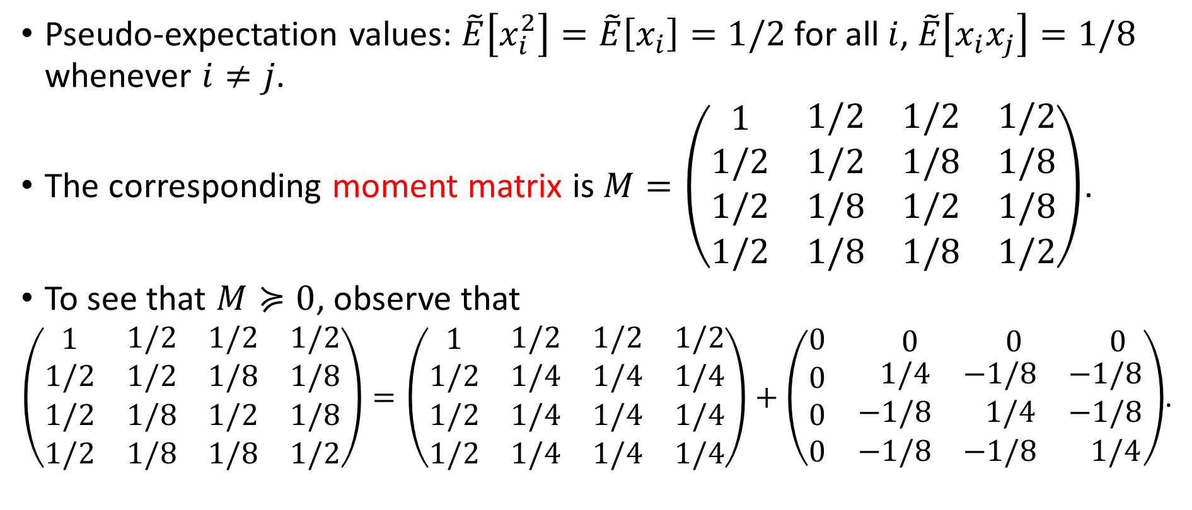

Checking $M≽0$
Pseudo-expectation values: $\tilde{E}\left[x_{i}^{2}\right]=\tilde{E}\left[x_{i}\right]=1/2$ for all $i$, $\tilde{E}\left[x_{i}x_{j}\right]=1/8$ whenever $i≠j$.
The corresponding moment matrix is $M=\left(\begin{matrix}1 & \begin{matrix}1/2 & 1/2 & 1/2\end{matrix} \\ \begin{matrix}1/2 \\ 1/2 \\ 1/2\end{matrix} & \begin{matrix}1/2 & 1/8 & 1/8 \\ 1/8 & 1/2 & 1/8 \\ 1/8 & 1/8 & 1/2\end{matrix}\end{matrix}\right)$.
To see that $M≽0$, observe that
$\left(\begin{matrix}1 & \begin{matrix}1/2 & 1/2 & 1/2\end{matrix} \\ \begin{matrix}1/2 \\ 1/2 \\ 1/2\end{matrix} & \begin{matrix}1/2 & 1/8 & 1/8 \\ 1/8 & 1/2 & 1/8 \\ 1/8 & 1/8 & 1/2\end{matrix}\end{matrix}\right)=\left(\begin{matrix}1 & \begin{matrix}1/2 & 1/2 & 1/2\end{matrix} \\ \begin{matrix}1/2 \\ 1/2 \\ 1/2\end{matrix} & \begin{matrix}1/4 & 1/4 & 1/4 \\ 1/4 & 1/4 & 1/4 \\ 1/4 & 1/4 & 1/4\end{matrix}\end{matrix}\right)+\left(\begin{matrix}0 & \begin{matrix} 0 & 0 & 0 \end{matrix} \\ \begin{matrix}0 \\ 0 \\ 0\end{matrix} & \begin{matrix} 1/4 & −1/8 & −1/8 \\ −1/8 & 1/4 & −1/8 \\ −1/8 & −1/8 & 1/4\end{matrix}\end{matrix}\right)$.

Slide 19

SoS Lower Bounds
Summary: To prove a degree $d$ SoS lower bound, we generally need to
  Construct candidate degree $d$ pseudo-expectation values $\tilde{E}$.
  Show that $\tilde{E}$ gives valid degree $d$ pseudo-expectation values. The most difficult condition to check is that the moment matrix $M$ is PSD (positive semidefinite).

Slide 20
Part II: Planted Clique and First Candidate Pseudo-expectation Values

Slide 21
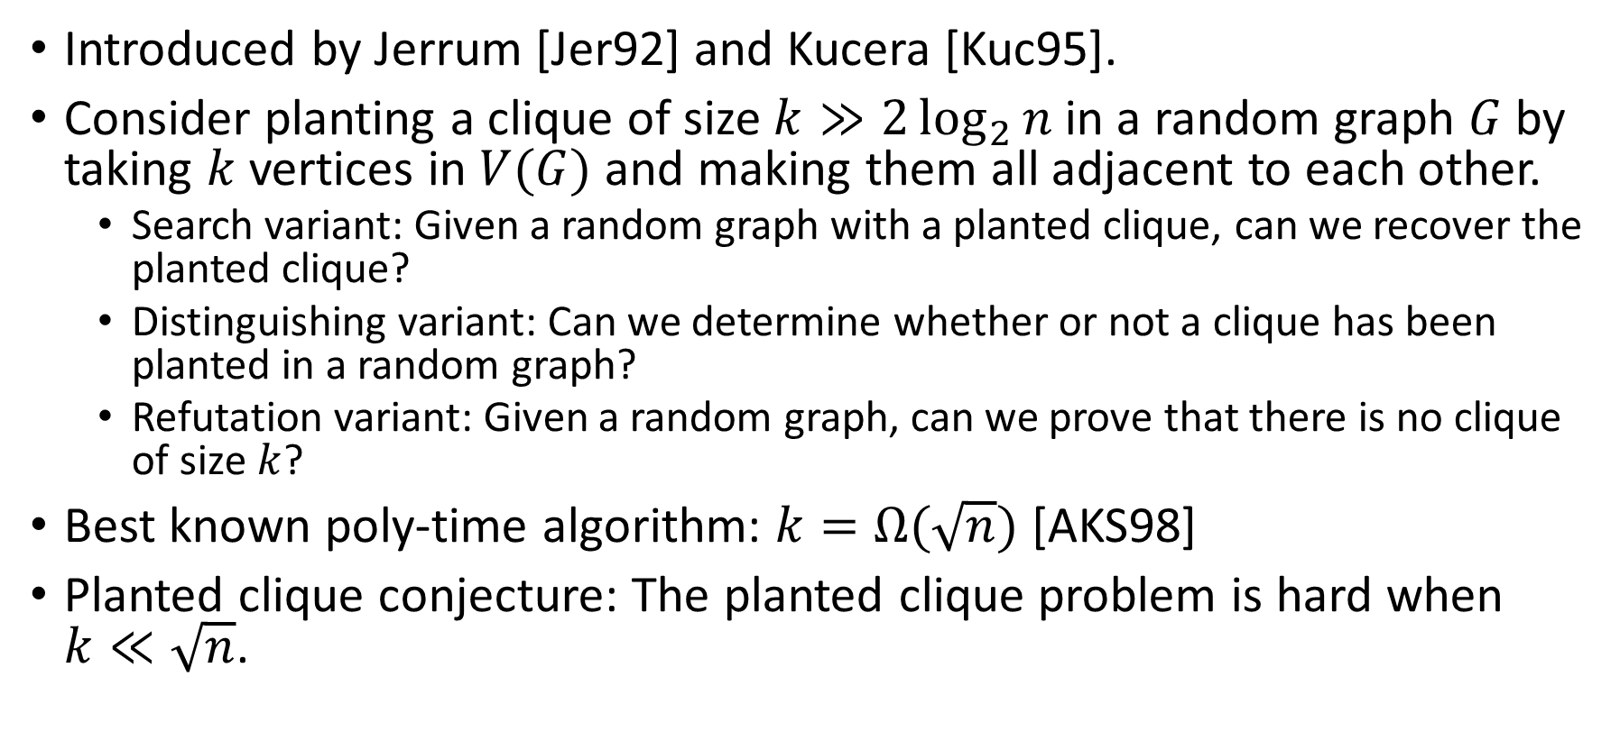
Planted Clique
Introduced by Jerrum [Jer92] and Kucera [Kuc95].
Consider planting a clique of size $k≫2\log_{2}{n}$ in a random graph $G$ by taking $k$ vertices in $V(G)$ and making them all adjacent to each other.
  Search variant: Given a random graph with a planted clique, can we recover the planted clique?
  Distinguishing variant: Can we determine whether or not a clique has been planted in a random graph?
  Refutation variant: Given a random graph, can we prove that there is no clique of size $k$?
Best known poly-time algorithm: $k=Ω(\sqrt{n})$ [AKS98]
Planted clique conjecture: The planted clique problem is hard when $k≪\sqrt{n}$.

Slide 22
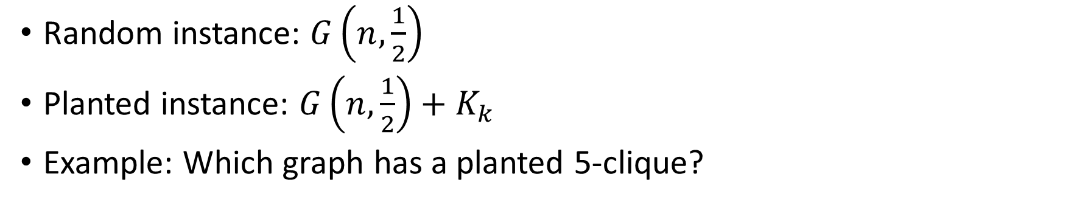
Planted Clique Example
Random instance: $G\left(n,\frac{1}{2}\right)$
Planted instance: $G\left(n,\frac{1}{2}\right)+K_{k}$
Example: Which graph has a planted 5-clique?
a
b
a
b
j
c
j
c
i
d
i
d
h
e
h
e
g
f
g
f

Slide 23
Planted Clique Example
Random instance: $G\left(n,\frac{1}{2}\right)$
Planted instance: $G\left(n,\frac{1}{2}\right)+K_{k}$
Example: Which graph has a planted 5-clique?
a
b
a
b
j
c
j
c
i
d
i
d
h
e
h
e
g
f
g
f

Slide 24
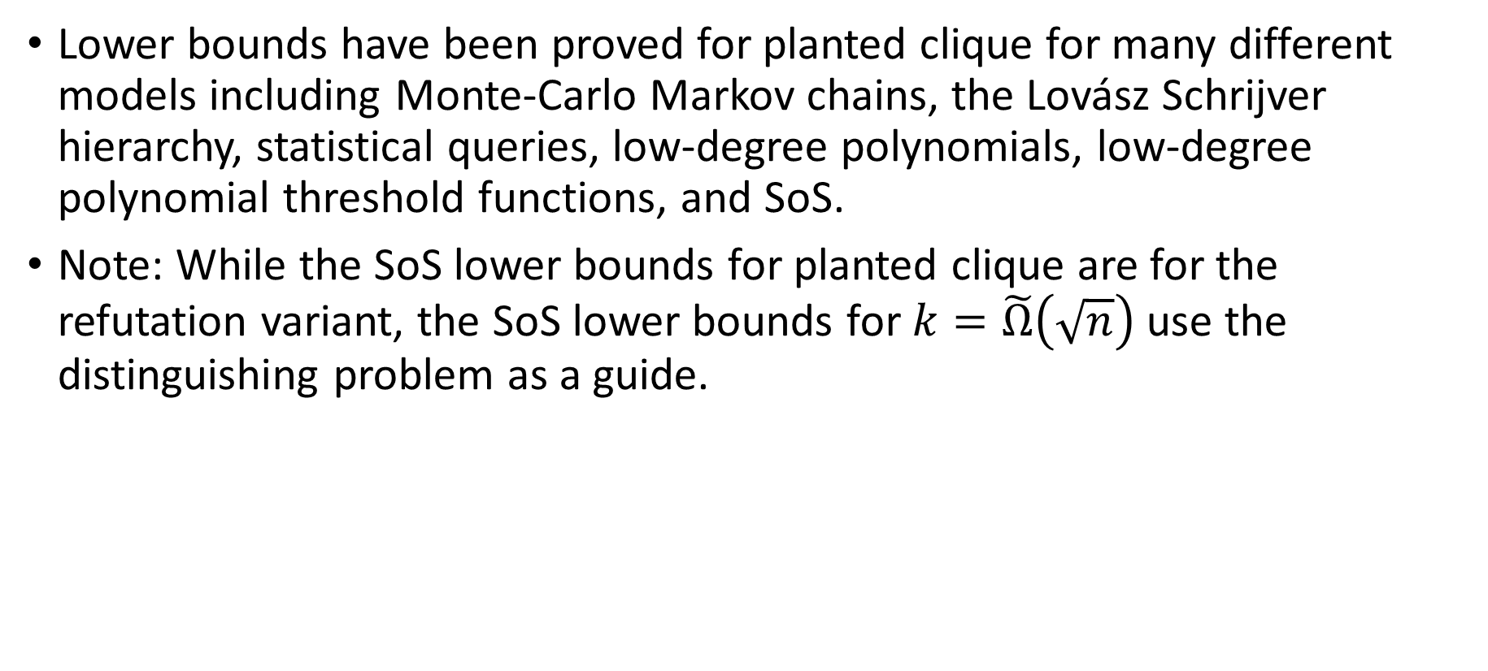
Lower Bounds for Planted Clique
Lower bounds have been proved for planted clique for many different models including Monte-Carlo Markov chains, the Lovász Schrijver hierarchy, statistical queries, low-degree polynomials, low-degree polynomial threshold functions, and SoS.
Note: While the SoS lower bounds for planted clique are for the refutation variant, the SoS lower bounds for $k=\tilde{Ω}\left(\sqrt{n}\right)$ use the distinguishing problem as a guide.

Slide 25
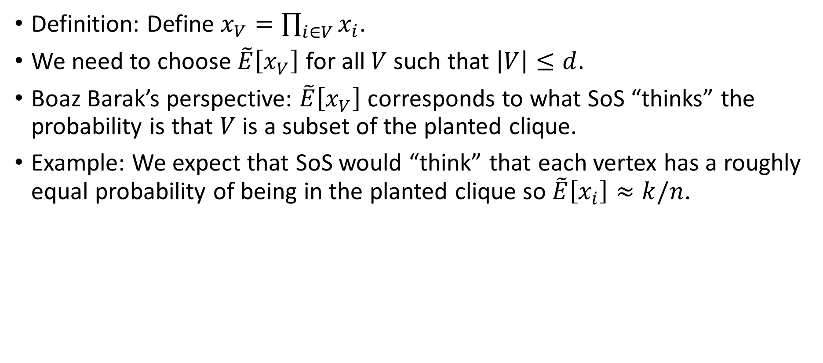
Designing Pseudo-expectation Values
Definition: Define $x_{V}=\prod_{i∈V}{x_{i}}$.
We need to choose $\tilde{E}\left[x_{V}\right]$ for all $V$ such that $\left|V\right|≤d$.
Boaz Barak’s perspective: $\tilde{E}\left[x_{V}\right]$ corresponds to what SoS “thinks” the probability is that $V$ is a subset of the planted clique.
Example: We expect that SoS would “think” that each vertex has a roughly equal probability of being in the planted clique so $\tilde{E}\left[x_{i}\right]≈k/n$.

Slide 26
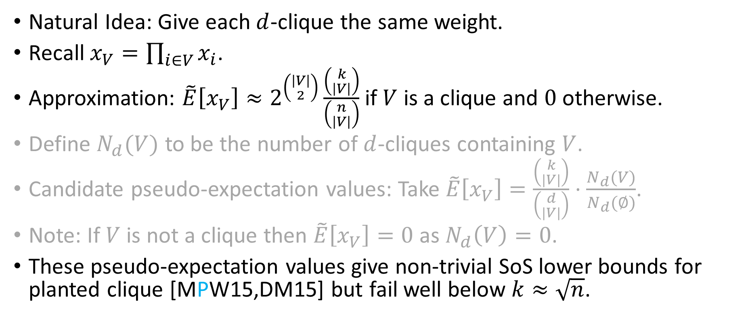
First Candidate Pseudo-expectation Values
Natural Idea: Give each $d$-clique the same weight.
Recall $x_{V}=\prod_{i∈V}{x_{i}}$.
Approximation: $\tilde{E}\left[x_{V}\right]≈2^{\left({\left|V\right| \atop 2}\right)}\frac{\left({k \atop \left|V\right|}\right)}{\left({n \atop \left|V\right|}\right)}$ if $V$ is a clique and $0$ otherwise.
Define $N_{d}(V)$ to be the number of $d$-cliques containing $V$.
Candidate pseudo-expectation values: Take $\tilde{E}\left[x_{V}\right]=\frac{\left({k \atop |V|}\right)}{\left({d \atop |V|}\right)}⋅\frac{N_{d}(V)}{N_{d}(∅)}$.
Note: If $V$ is not a clique then $\tilde{E}\left[x_{V}\right]=0$ as $N_{d}\left(V\right)=0$.
These pseudo-expectation values give non-trivial SoS lower bounds for planted clique [MPW15,DM15] but fail well below $k≈\sqrt{n}$.

Slide 27
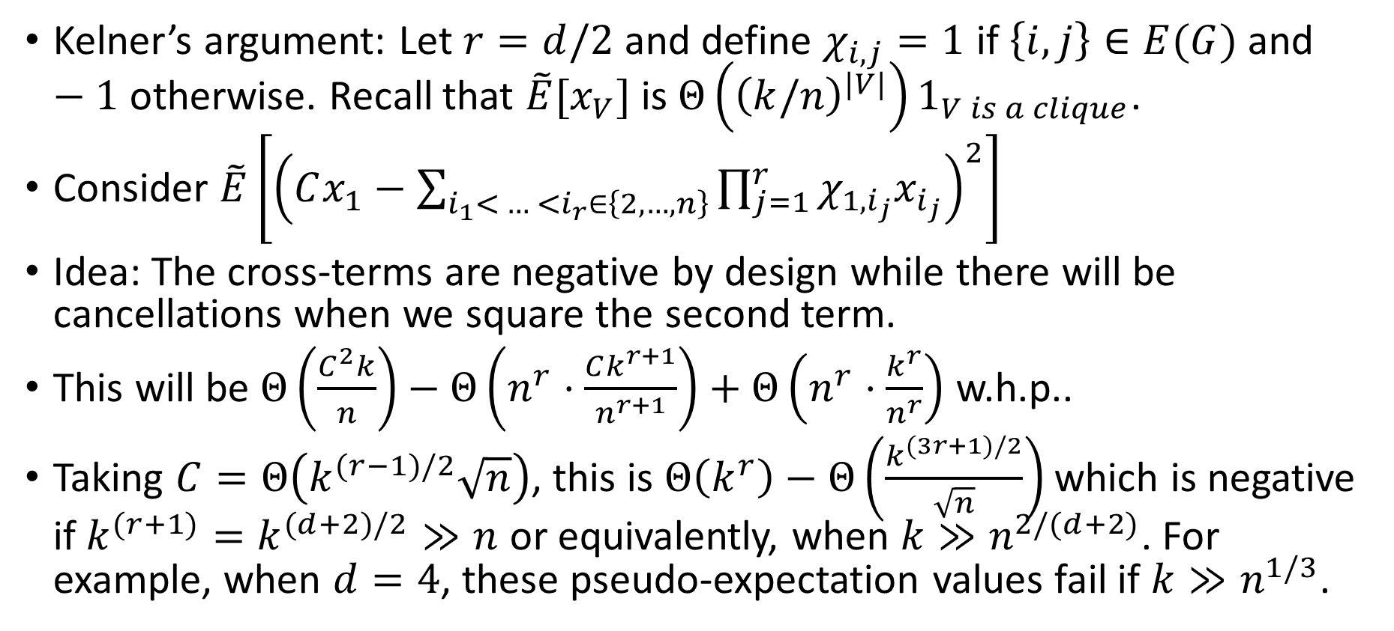
Failure of the First Candidate Pseudo-expectation Values
Kelner’s argument: Let $r=d/2$ and define $χ_{i,j}=1$ if $\left\{i,j\right\}∈E(G)$ and $−1$ otherwise. Recall that $\tilde{E}[x_{V}]$ is $Θ\left({\left(k/n\right)}^{|V|}\right)1_{V is a clique}$.
Consider $\tilde{E}\left[{\left(Cx_{1}−\sum_{i_{1}< … <i_{r}∈\left\{2,…,n\right\}}{\prod_{j=1}^{r}{χ_{1,i_{j}}x_{i_{j}}}}\right)}^{2}\right]$
Idea: The cross-terms are negative by design while there will be cancellations when we square the second term.
This will be $Θ\left(\frac{C^{2}k}{n}\right)−Θ\left(n^{r}⋅\frac{Ck^{r+1}}{n^{r+1}}\right)+Θ\left(n^{r}⋅\frac{k^{r}}{n^{r}}\right)$ w.h.p..
Taking $C=Θ\left(k^{(r−1)/2}\sqrt{n}\right)$, this is $Θ\left(k^{r}\right)−Θ\left(\frac{k^{(3r+1)/2}}{\sqrt{n}}\right)$ which is negative if $k^{(r+1)}=k^{(d+2)/2}≫n$ or equivalently, when $k≫n^{2/(d+2)}$. For example, when $d=4$, these pseudo-expectation values fail if $k≫n^{1/3}$.

Slide 28

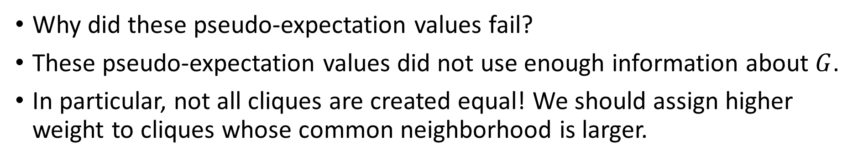
What Went Wrong?
Why did these pseudo-expectation values fail?
These pseudo-expectation values did not use enough information about $G$.
In particular, not all cliques are created equal! We should assign higher weight to cliques whose common neighborhood is larger.
$$≠$$

Slide 29
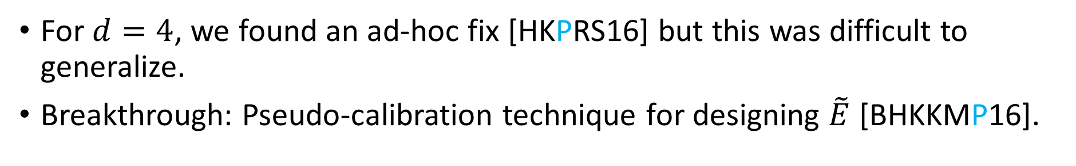
Modifying the Pseudo-expectation Values
For $d=4$, we found an ad-hoc fix [HKPRS16] but this was difficult to generalize.
Breakthrough: Pseudo-calibration technique for designing $\tilde{E}$ [BHKKMP16].

Slide 30
Part II: Pseudo-calibration

Slide 31
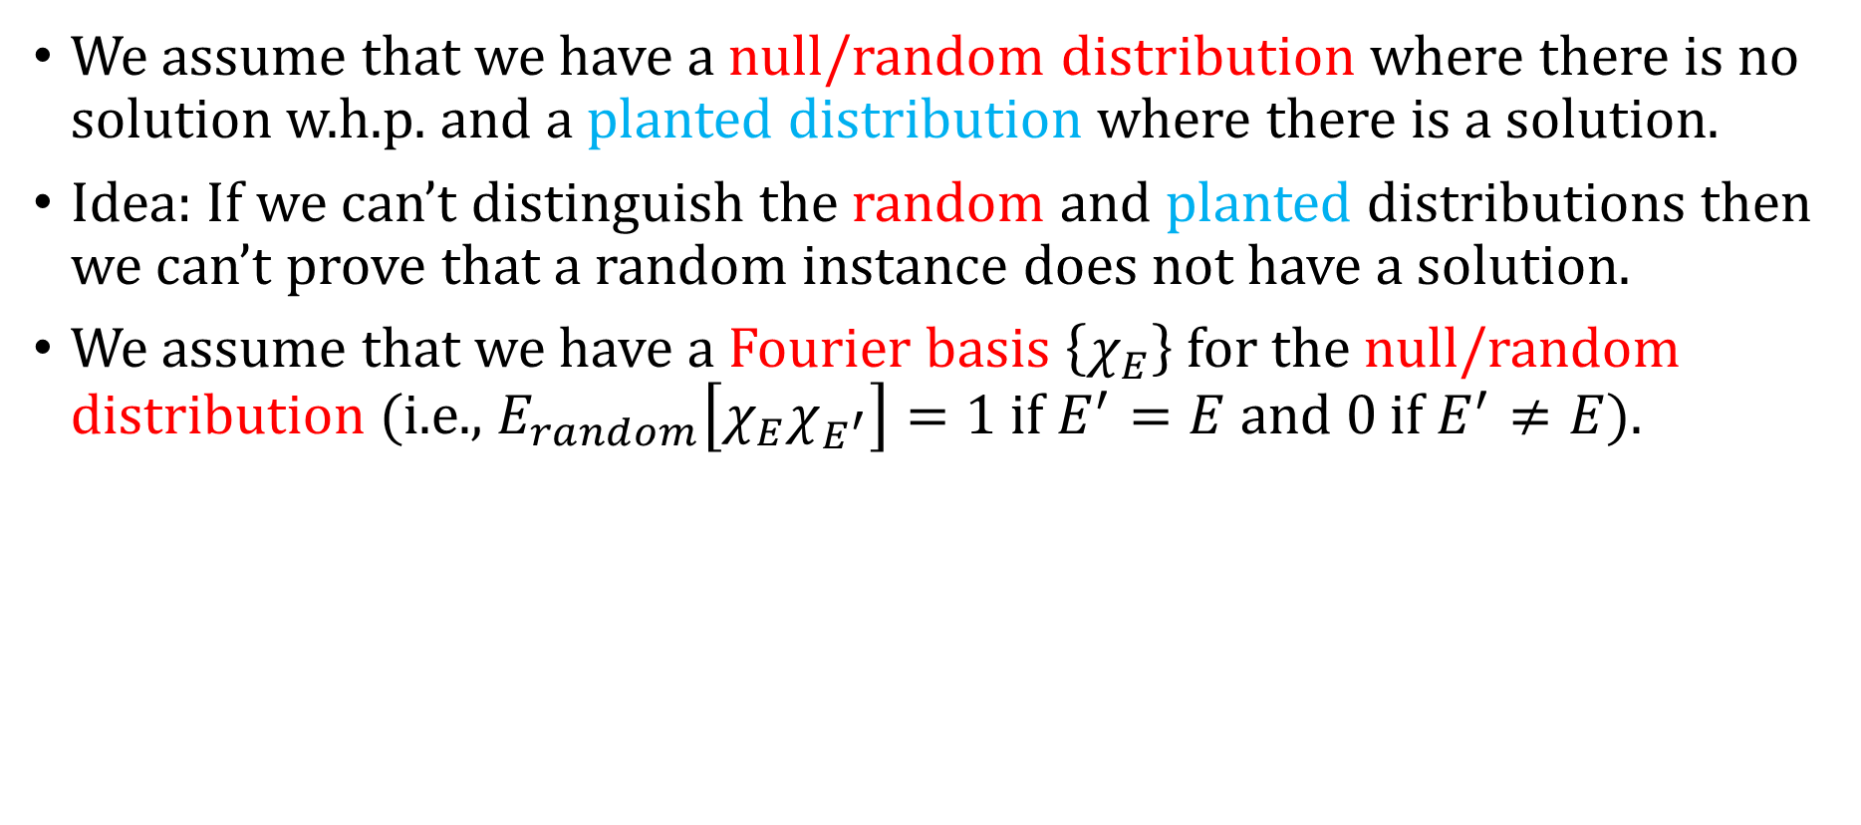
Setup
We assume that we have a null/random distribution where there is no solution w.h.p. and a planted distribution where there is a solution.
Idea: If we can’t distinguish the random and planted distributions then we can’t prove that a random instance does not have a solution.
We assume that we have a Fourier basis $\left\{χ_{E}\right\}$for the null/random distribution (i.e., $E_{random}\left[χ_{E}χ_{E^{′}}\right]=1$ if $E^{′}=E$ and $0$ if $E^{′}≠E$).

Slide 32
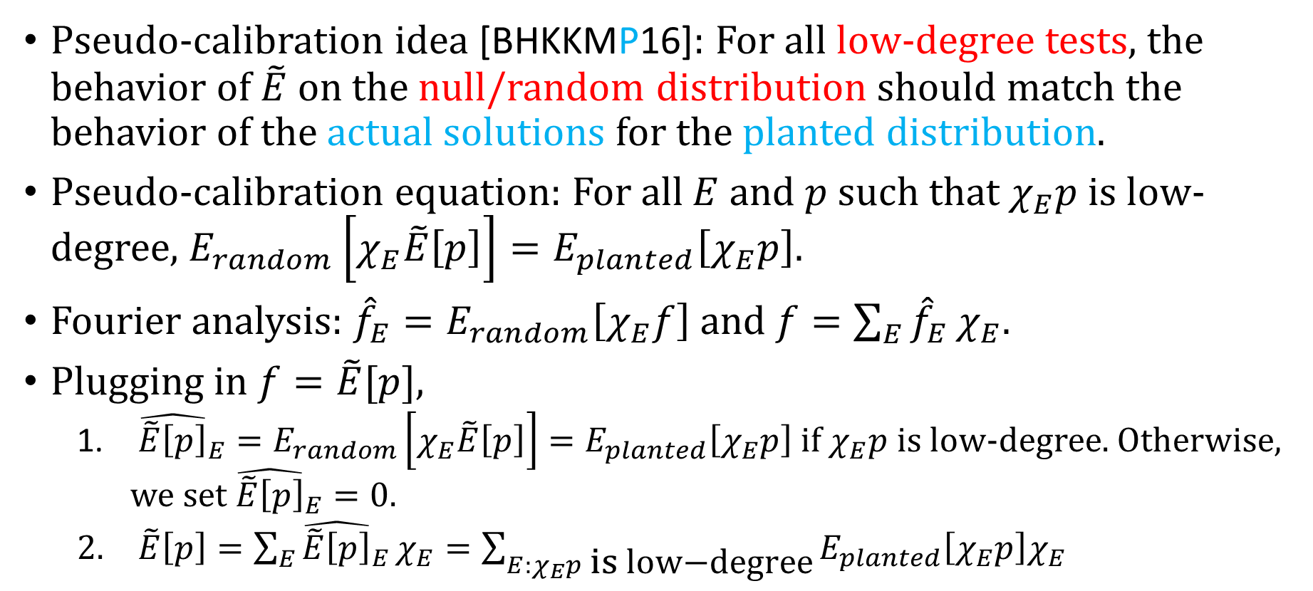
Pseudo-calibration
Pseudo-calibration idea [BHKKMP16]: For all low-degree tests, the behavior of $\tilde{E}$ on the null/random distribution should match the behavior of the actual solutions for the planted distribution.
Pseudo-calibration equation: For all $E$ and $p$ such that $χ_{E}p$ is low-degree, $E_{random}\left[χ_{E}\tilde{E}\left[p\right]\right]=E_{planted}\left[χ_{E}p\right]$.
Fourier analysis: ${\hat{f}}_{E}=E_{random}\left[χ_{E}f\right]$ and $f=\sum_{E}{{\hat{f}}_{E}}χ_{E}$.
Plugging in $f=\tilde{E}[p]$,
  ${\hat{\tilde{E}\left[p\right]}}_{E}=E_{random}\left[χ_{E}\tilde{E}\left[p\right]\right]=E_{planted}\left[χ_{E}p\right]$ if $χ_{E}p$ is low-degree. Otherwise, we set ${\hat{\tilde{E}\left[p\right]}}_{E}=0$.
  $\tilde{E}\left[p\right]=\sum_{E}{{\hat{\tilde{E}\left[p\right]}}_{E}}χ_{E}=\sum_{E:χ_{E}p \text{is} \text{low}\text{−}\text{degree}}{E_{planted}\left[χ_{E}p\right]χ_{E}}$

Slide 33


Fourier Basis for $G\left(n,1/2\right)$
Definition: Define $χ_{E}\left(G\right)={\left(−1\right)}^{|E∖E(G)|}=\prod_{e∈E}{χ_{\left\{e\right\}}(G)}$ where $χ_{\{e\}(G)}=1$ if $e∈E\left(G\right)$ and $−1$ if $e∉E(G)$.
Proposition: $E_{G∼G\left(n,1/2\right)}\left[χ_{E}\left(G\right)χ_{E^{′}}\left(G\right)\right]=1$ if $E^{′}=E$ and $0$ otherwise.
This is essentially Fourier analysis over the Boolean hypercube where we have a variable for each potential edge.

Slide 34
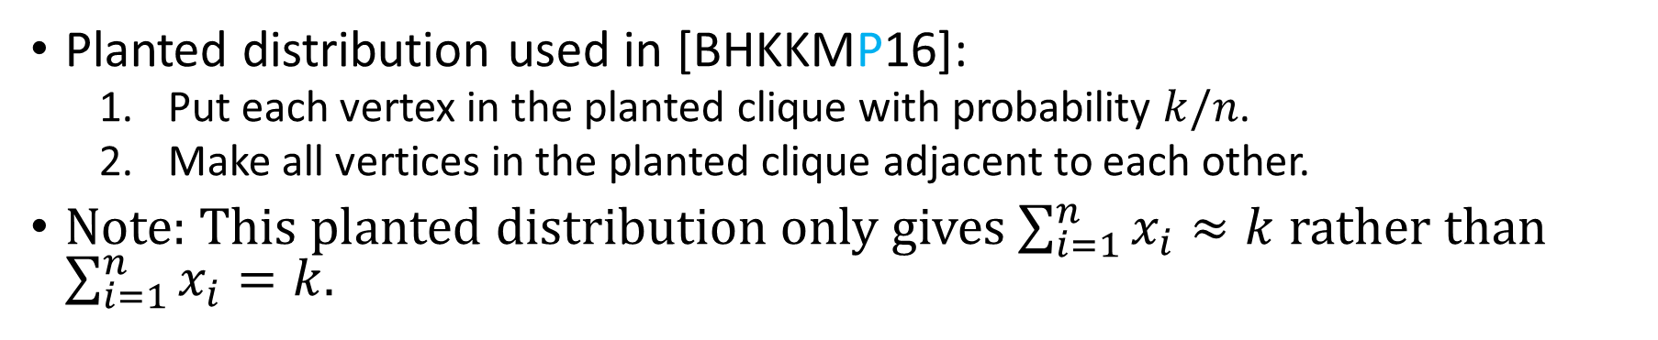
Planted Distribution for Planted Clique
Planted distribution used in [BHKKMP16]:
  Put each vertex in the planted clique with probability $k/n$.
  Make all vertices in the planted clique adjacent to each other.
Note: This planted distribution only gives $\sum_{i=1}^{n}{x_{i}}≈k$ rather than $\sum_{i=1}^{n}{x_{i}}=k$.
a
b
j
c
i
d
h
e
g
f

Slide 35
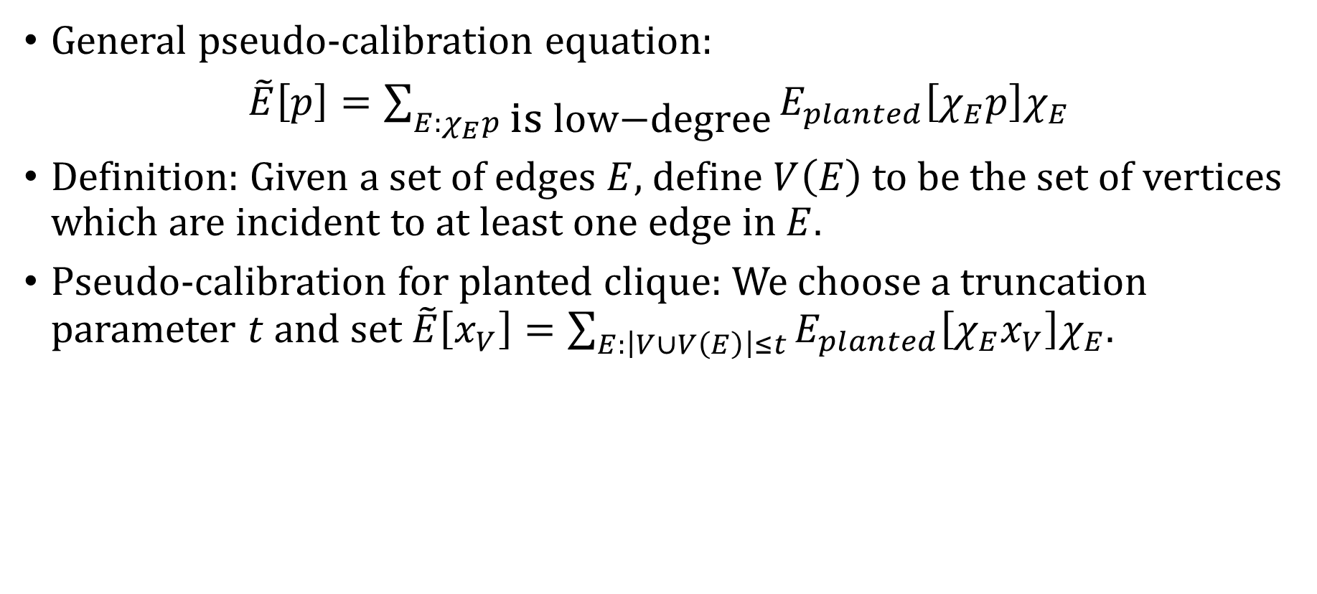
Pseudo-calibration for Planted Clique
General pseudo-calibration equation:
$\tilde{E}\left[p\right]=\sum_{E:χ_{E}p \text{is} \text{low}\text{−}\text{degree}}{E_{planted}\left[χ_{E}p\right]χ_{E}}$
Definition: Given a set of edges $E$, define $V\left(E\right)$ to be the set of vertices which are incident to at least one edge in $E$.
Pseudo-calibration for planted clique: We choose a truncation parameter $t$ and set $\tilde{E}\left[x_{V}\right]=\sum_{E:\left|V∪V\left(E\right)\right|≤t}{E_{planted}\left[χ_{E}x_{V}\right]χ_{E}}$.

Slide 36

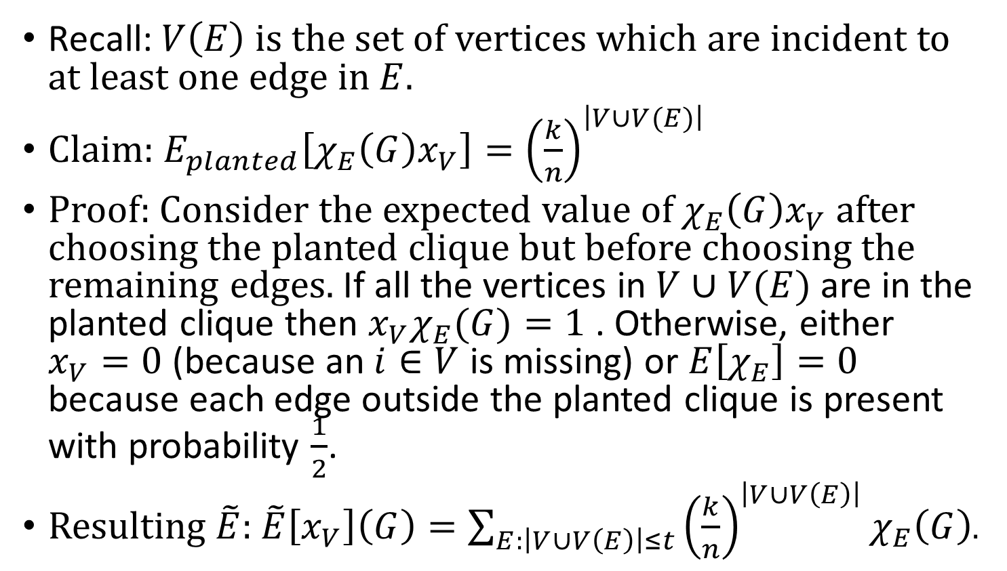

Pseudo-calibration Calculation for Planted Clique
Recall: $V\left(E\right)$ is the set of vertices which are incident to at least one edge in $E$.
Claim: $E_{planted}\left[χ_{E}\left(G\right)x_{V}\right]={\left(\frac{k}{n}\right)}^{\left|V∪V(E)\right|}$
Proof: Consider the expected value of $χ_{E}\left(G\right)x_{V}$ after choosing the planted clique but before choosing the remaining edges. If all the vertices in $V∪V(E)$ are in the planted clique then $x_{V}χ_{E}(G)=1$ . Otherwise, either $x_{V}=0$ (because an $i∈V$ is missing) or $E\left[χ_{E}\right]=0$ because each edge outside the planted clique is present with probability $\frac{1}{2}$.
Resulting $\tilde{E}$: $\tilde{E}\left[x_{V}\right]\left(G\right)=\sum_{E:\left|V∪V\left(E\right)\right|≤t}{{\left(\frac{k}{n}\right)}^{\left|V∪V\left(E\right)\right|}χ_{E}\left(G\right)}$.
$$E$$
$$V$$

Slide 37
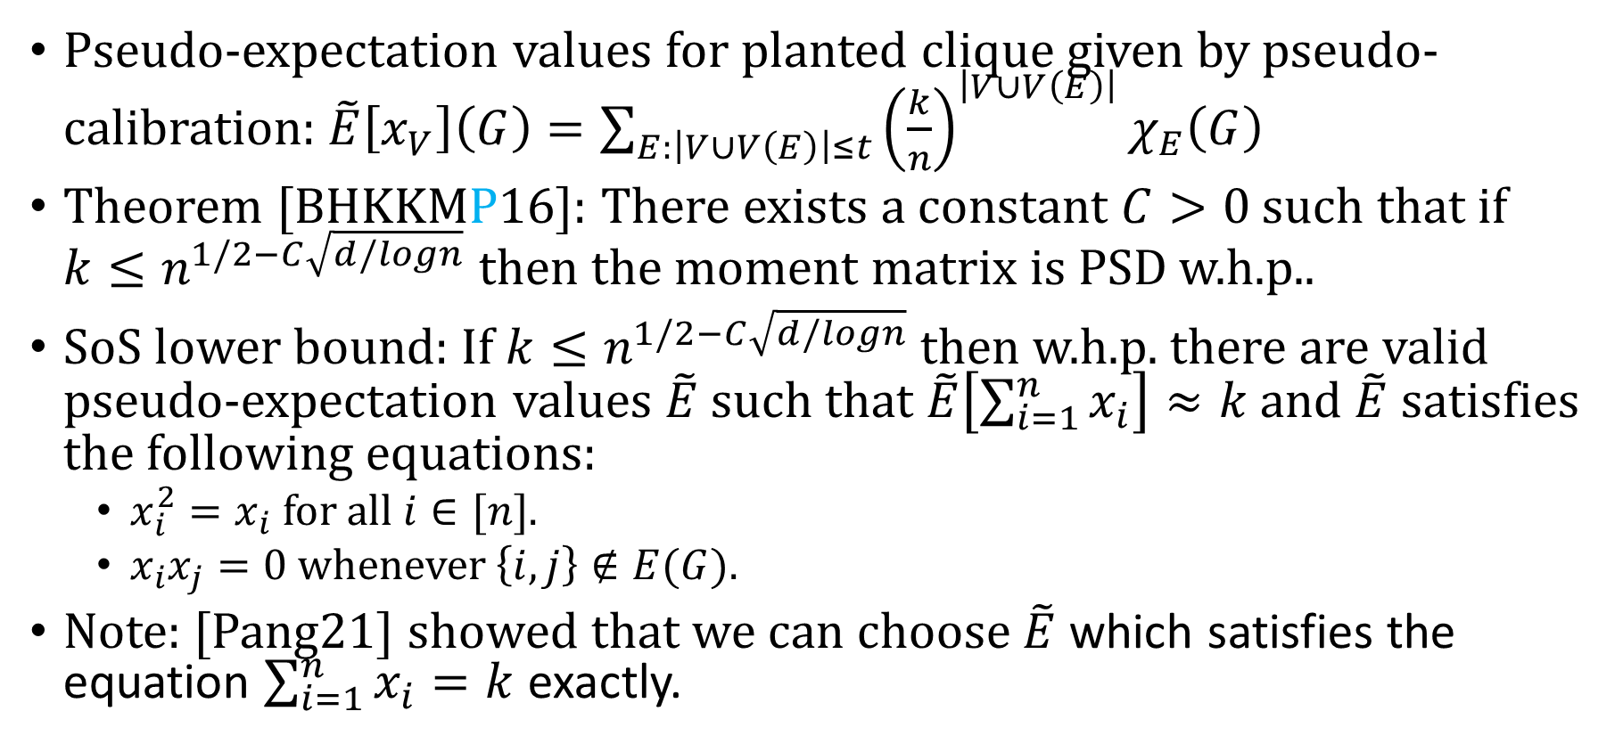
SoS Lower Bound for Planted Clique
Pseudo-expectation values for planted clique given by pseudo-calibration: $\tilde{E}\left[x_{V}\right]\left(G\right)=\sum_{E:\left|V∪V\left(E\right)\right|≤t}{{\left(\frac{k}{n}\right)}^{\left|V∪V\left(E\right)\right|}χ_{E}\left(G\right)}$
Theorem [BHKKMP16]: There exists a constant $C>0$ such that if $k≤n^{1/2−C\sqrt{d/logn}}$ then the moment matrix is PSD w.h.p..
SoS lower bound: If $k≤n^{1/2−C\sqrt{d/logn}}$ then w.h.p. there are valid pseudo-expectation values $\tilde{E}$ such that $\tilde{E}\left[\sum_{i=1}^{n}{x_{i}}\right]≈k$ and $\tilde{E}$ satisfies the following equations:
  $x_{i}^{2}=x_{i}$ for all $i∈[n]$.
  $x_{i}x_{j}=0$ whenever $\left\{i,j\right\}∉E(G)$.
Note: [Pang21] showed that we can choose $\tilde{E}$ which satisfies the equation $\sum_{i=1}^{n}{x_{i}}=k$ exactly.

Slide 38
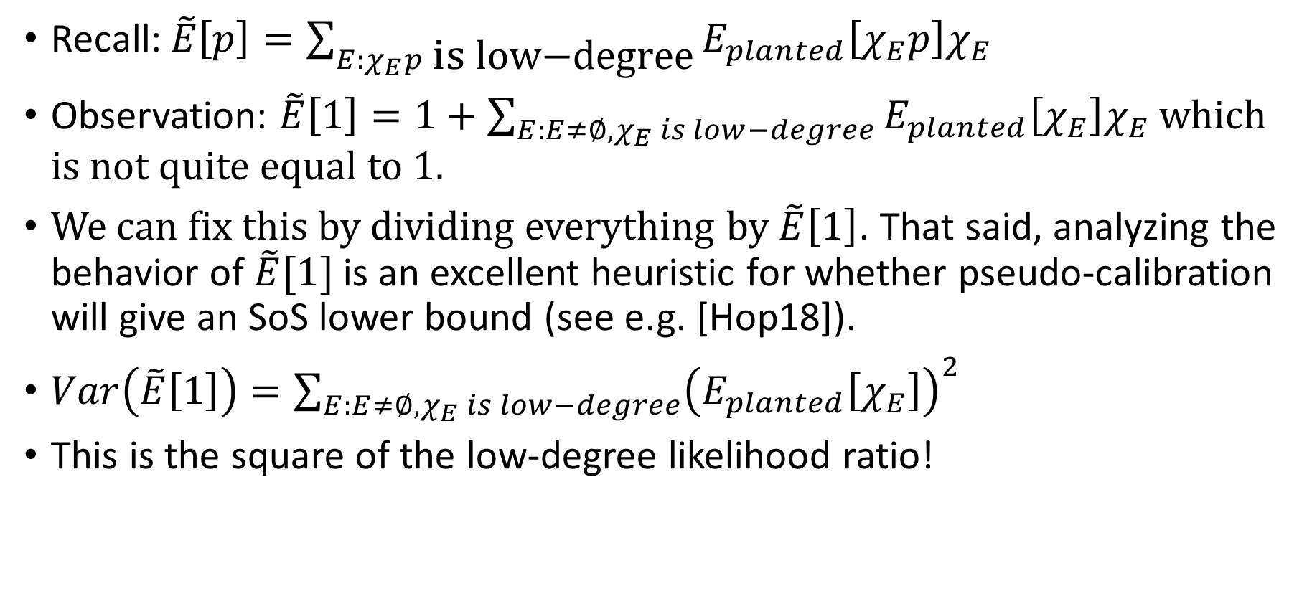

Shouldn’t $\tilde{E}[1]$ be 1?
Recall: $\tilde{E}\left[p\right]=\sum_{E:χ_{E}p \text{is} \text{low}\text{−}\text{degree}}{E_{planted}\left[χ_{E}p\right]χ_{E}}$
Observation: $\tilde{E}\left[1\right]=1+\sum_{E:E≠∅, χ_{E} is low−degree}{E_{planted}\left[χ_{E}\right]χ_{E}}$ which is not quite equal to $1$.
We can fix this by dividing everything by $\tilde{E}\left[1\right]$. That said, analyzing the behavior of $\tilde{E}[1]$is an excellent heuristic for whether pseudo-calibration will give an SoS lower bound (see e.g. [Hop18]).
$Var\left(\tilde{E}\left[1\right]\right)=\sum_{E:E≠∅,χ_{E} is low−degree}{{\left(E_{planted}\left[χ_{E}\right]\right)}^{2}}$
This is the square of the low-degree likelihood ratio!

Slide 39

Analyzing the Resulting Moment Matrix
Pseuodo-expectation values: $\tilde{E}\left[x_{V}\right]=\sum_{E:\left|V∪V\left(E\right)\right|≤t}{{\left(\frac{k}{n}\right)}^{|V∪V(E)|}χ_{E}}$
This is very complicated as $\tilde{E}\left[x_{V}\right]$ has a significant dependence on the entire input graph $G$. How can we analyze this?
We can analyze the resulting moment matrix using graph matrices.

Slide 40
Part III: Graph Matrices

Slide 41
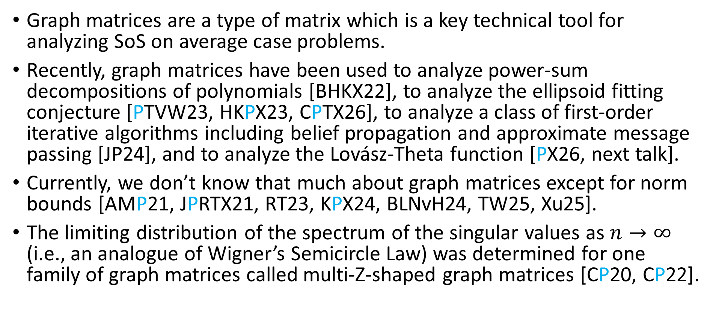
Background on Graph Matrices
Graph matrices are a type of matrix which is a key technical tool for analyzing SoS on average case problems.
Recently, graph matrices have been used to analyze power-sum decompositions of polynomials [BHKX22], to analyze the ellipsoid fitting conjecture [PTVW23, HKPX23, CPTX26], to analyze a class of first-order iterative algorithms including belief propagation and approximate message passing [JP24], and to analyze the Lovász-Theta function [PX26, next talk].
Currently, we don’t know that much about graph matrices except for norm bounds [AMP21, JPRTX21, RT23, KPX24, BLNvH24, TW25, Xu25].
The limiting distribution of the spectrum of the singular values as $n→∞$ (i.e., an analogue of Wigner’s Semicircle Law) was determined for one family of graph matrices called multi-Z-shaped graph matrices [CP20, CP22].

Slide 42









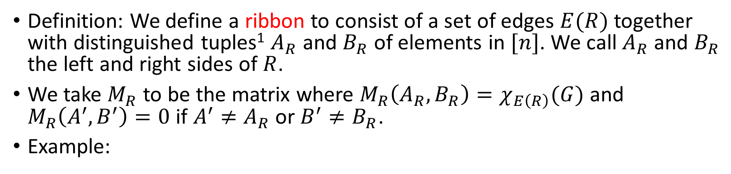














Ribbons
Definition: We define a ribbon to consist of a set of edges $E(R)$ together with distinguished tuples¹ $A_{R}$ and $B_{R}$ of elements in $[n]$. We call $A_{R}$ and $B_{R}$ the left and right sides of $R$.
We take $M_{R}$ to be the matrix where $M_{R}\left(A_{R},B_{R}\right)=χ_{E\left(R\right)}(G)$ and $M_{R}\left(A^{′},B^{′}\right)=0$ if $A^{′}≠A_{R}$ or $B^{′}≠B_{R}$.
Example:
$$M_{R}\left(\left(2,4\right),\left(3,5\right)\right)=−1$$
$$1$$
$$1$$
$$2$$
$$3$$
$$2$$
$$3$$
$$2$$
$$3$$
In $G$
$$4$$
$$5$$
Not in $G$
$$4$$
$$5$$
$$4$$
$$5$$
$$A_{R}$$
$$R$$
$$B_{R}$$
$$G$$
$$A_{R}$$
$$B_{R}$$
¹We take $A$ and $B$ to be tuples rather than sets for technical reasons.

Slide 43





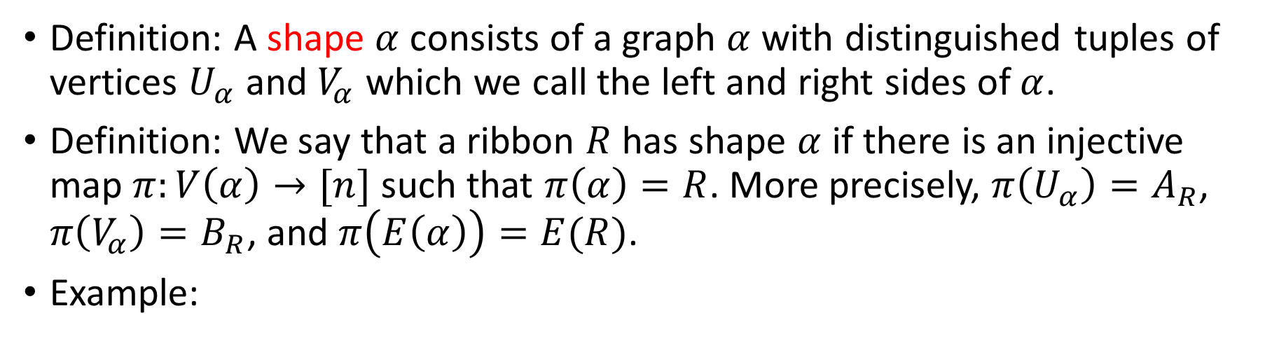









Shapes
Definition: A shape $α$ consists of a graph $α$ with distinguished tuples of vertices $U_{α}$ and $V_{α}$ which we call the left and right sides of $α$.
Definition: We say that a ribbon $R$ has shape $α$ if there is an injective map $π:V\left(α\right)→[n]$ such that $π\left(α\right)=R$. More precisely, $π\left(U_{α}\right)=A_{R}$, $π\left(V_{α}\right)=B_{R}$, and $π\left(E\left(α\right)\right)=E(R)$.
Example:
$$2$$
$$3$$
$$u_{1}$$
$$v_{1}$$
has shape
$$4$$
$$5$$
$$u_{2}$$
$$v_{2}$$
$$A_{R}$$
$$R$$
$$B_{R}$$
$$U_{α_{Z}}$$
$$α_{Z}$$
$$V_{α_{Z}}$$

Slide 44
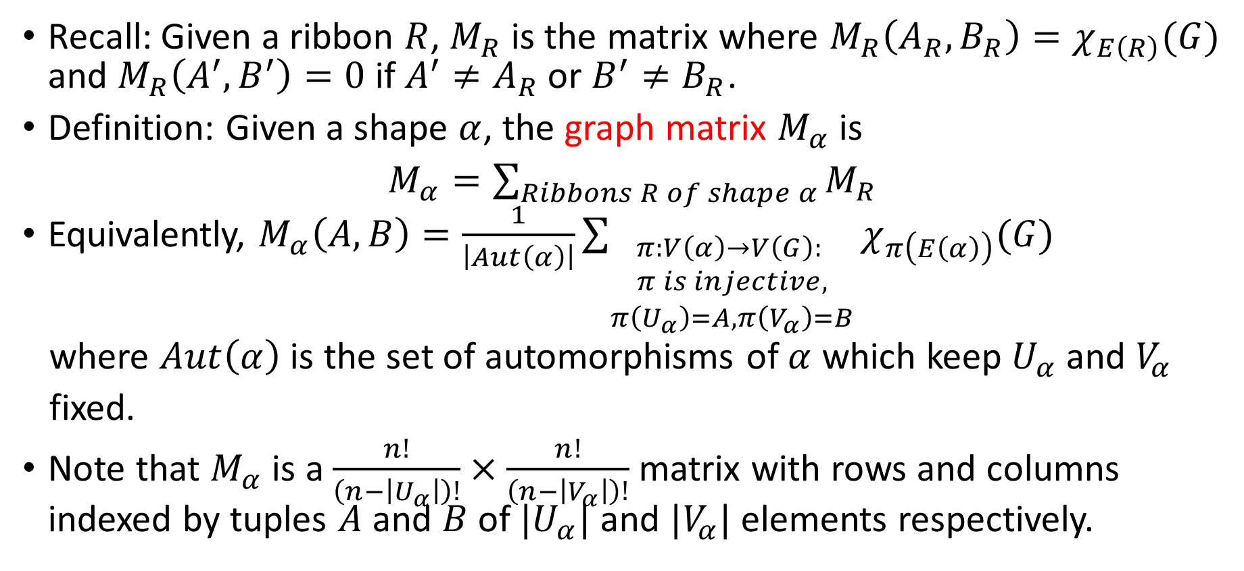
Graph Matrices
Recall: Given a ribbon $R$, $M_{R}$ is the matrix where $M_{R}\left(A_{R},B_{R}\right)=χ_{E\left(R\right)}(G)$ and $M_{R}\left(A^{′},B^{′}\right)=0$ if $A^{′}≠A_{R}$ or $B^{′}≠B_{R}$.
Definition: Given a shape $α$, the graph matrix $M_{α}$ is
$M_{α}=\sum_{Ribbons R of shape α}{M_{R}}$
Equivalently, $M_{α}\left(A,B\right)=\frac{1}{\left|Aut\left(α\right)\right|}\sum_{\begin{aligned}π:V\left(α\right)→V\left(G\right): \\ π is injective, \\ π\left(U_{α}\right)=A,π\left(V_{α}\right)=B\end{aligned}}{χ_{π\left(E\left(α\right)\right)}(G)}$
where $Aut\left(α\right)$ is the set of automorphisms of $α$ which keep $U_{α}$and $V_{α}$
fixed.
Note that $M_{α}$ is a $\frac{n!}{\left(n−\left|U_{α}\right|\right)!}×\frac{n!}{\left(n−\left|V_{α}\right|\right)!}$ matrix with rows and columns indexed by tuples $A$ and $B$ of $|U_{α}|$ and $|V_{α}|$ elements respectively.

Slide 45






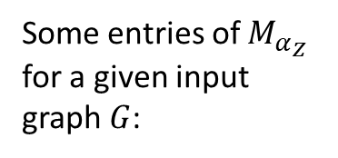





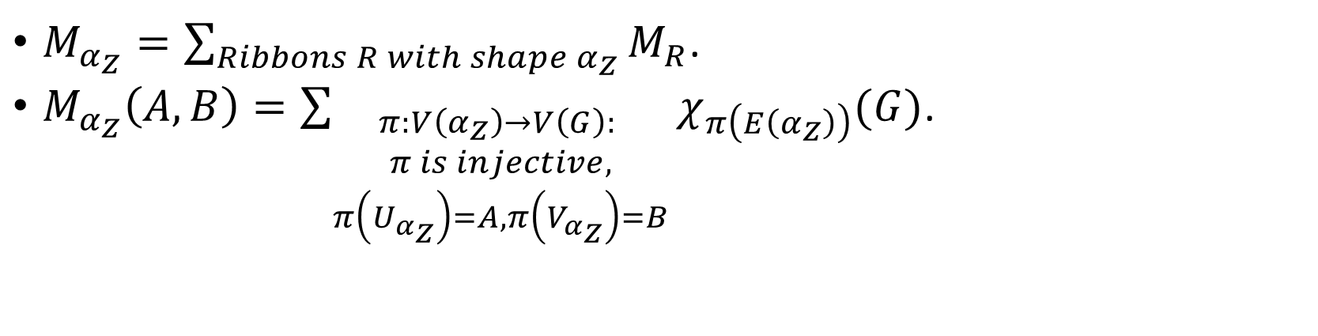




















Example: Z-Shaped Graph Matrix
$M_{α_{Z}}=\sum_{Ribbons R with shape α_{Z}}{M_{R}}$.
$M_{α_{Z}}\left(A,B\right)=\sum_{\begin{aligned}π:V\left(α_{Z}\right)→V\left(G\right): \\ π is injective, \\ π\left(U_{α_{Z}}\right)=A, π\left(V_{α_{Z}}\right)=B\end{aligned}}{χ_{π\left(E\left(α_{Z}\right)\right)}(G)}$.
In $G$
Not in $G$
$$M_{α_{Z}}\left(\left(1,2\right),\left(3,4\right)\right)=1$$
$$M_{α_{Z}}\left(\left(2,4\right),\left(3,5\right)\right)=−1$$
$$1$$
$$1$$
$$1$$
$$u_{1}$$
$$v_{1}$$
$$2$$
$$3$$
$$2$$
$$3$$
$$2$$
$$3$$
Some entries of $M_{α_{Z}}$ for a given input graph $G$:
$$A$$
$$u_{2}$$
$$v_{2}$$
$$4$$
$$5$$
$$4$$
$$5$$
$$4$$
$$5$$
$$U_{α_{Z}}$$
$$α_{Z}$$
$$V_{α_{Z}}$$
$$G$$
$$B$$
$$A$$
$$B$$

Slide 46






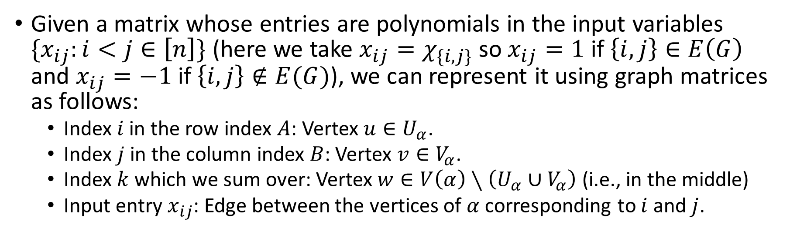


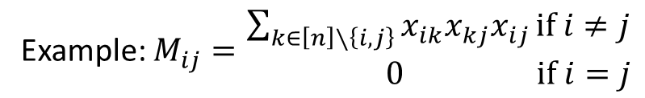






Summary
Given a matrix whose entries are polynomials in the input variables $\{x_{ij}:i<j∈\left[n\right]\}$ (here we take $x_{ij}=χ_{\{i,j\}}$ so $x_{ij}=1$ if $\left\{i,j\right\}∈E\left(G\right)$ and $x_{ij}=−1$ if $\left\{i,j\right\}∉E(G)$), we can represent it using graph matrices as follows:
  Index $i$ in the row index $A$: Vertex $u∈U_{α}$.
  Index $j$ in the column index $B$: Vertex $v∈V_{α}$.
  Index $k$ which we sum over: Vertex $w∈V\left(α\right)∖\left(U_{α}∪V_{α}\right)$ (i.e., in the middle)
  Input entry $x_{ij}$: Edge between the vertices of $α$ corresponding to $i$ and $j$.
Example: $M\left(\left(i,j\right),\left(k,l\right)\right)=$ $\begin{aligned}x_{ik}x_{jk}x_{jl} if i,j,k,l are distinct \\ &0 otherwise\end{aligned}$
Example: $M_{ij}=\begin{aligned}\sum_{k∈\left[n\right]∖\left\{i,j\right\}}{x_{ik}x_{kj}x_{ij}}if i≠j \\ & 0 if i=j\end{aligned}$
$$i$$
$$k$$
Corresponding shape:
Corresponding shape:
v
$$i$$
$$k$$
$$j$$
$$j$$
$$l$$
$$U_{{\overline{P}}_{2}}$$
$${\overline{P}}_{2}$$
$$V_{{\overline{P}}_{2}}$$
$$U_{α_{Z}}$$
$$α_{Z}$$
$$V_{α_{Z}}$$

Slide 47

















More Graph Matrix Examples
Graph matrix examples (for these examples, $V\left(α\right)=U_{α}∪V_{α}$):
  If $α$ is the shape with $U_{α}=\left(u_{1}\right)$, $V_{α}=\left(v_{1}\right)$, and $E\left(α\right)=\left\{\left\{u_{1},v_{1}\right\}\right\}$ then $M_{α}$ is a symmetric random matrix with $±1$ entries and $0$s on the diagonal.
  If $α$ is the shape with $U_{α}=\left(u_{1}\right)$, $V_{α}=\left(v_{1}\right)$, and $E\left(α\right)=\{\}$ then $M_{α}=J−Id$ where $J$ is the all ones matrix.
  If $α$ is the shape with $U_{α}=V_{α}=\left(u_{1}\right)$, and $E\left(α\right)=\{\}$ then $M_{α}=Id$
$$\left(\begin{matrix}\begin{matrix}0 & ±1 \\ ±1 & 0\end{matrix} & \begin{matrix}±1 & ±1 \\ ±1 & ±1\end{matrix} \\ \begin{matrix}±1 & ±1 \\ ±1 & ±1\end{matrix} & \begin{matrix}0 & ±1 \\ ±1 & 0\end{matrix}\end{matrix}\right)$$
$$\left(\begin{matrix}\begin{matrix}0 & 1 \\ 1 & 0\end{matrix} & \begin{matrix}1 & 1 \\ 1 & 1\end{matrix} \\ \begin{matrix}1 & 1 \\ 1 & 1\end{matrix} & \begin{matrix}0 & 1 \\ 1 & 0\end{matrix}\end{matrix}\right)$$
$$\left(\begin{matrix}\begin{matrix}1 & 0 \\ 0 & 1\end{matrix} & \begin{matrix}0 & 0 \\ 0 & 0\end{matrix} \\ \begin{matrix}0 & 0 \\ 0 & 0\end{matrix} & \begin{matrix}1 & 0 \\ 0 & 1\end{matrix}\end{matrix}\right)$$
$$u_{1}$$
$$v_{1}$$
$$u_{1}$$
$$v_{1}$$
$$α$$
$$u_{1}$$
$$U_{α}$$
$$α$$
$$V_{α}$$
$$U_{α}$$
$$α$$
$$V_{α}$$
$$U_{α}=V_{α}$$

Slide 48








Example: Decomposing a Clique Indicator Matrix
Let $M$ be the $n\left(n−1\right)×n(n−1)$ clique indicator matrix with entries $M\left(\left(a,b\right),\left(c,d\right)\right)=1$ if $\left\{a,b,c,d\right\}$ is a 4-clique and $0$ otherwise.
Using graph matrices, we can decompose the clique indicator $M$ as follows.
$M=\frac{1}{2^{6}}\sum_{\begin{aligned}α:U_{α}=\left(u_{1},u_{2}\right), \\ V_{α}=\left(v_{1},v_{2}\right), \\ V\left(α\right)=U_{α}∪V_{α}\end{aligned}}{M_{α}}$
Idea: If $A∪B$ is a 4-clique then for all of these shapes $α$, $M_{α}\left(A,B\right)=1$. If $A∪B$ is missing an edge then there is perfect cancellation between the shapes $α$ which have the corresponding edge and the shapes which do not.
$$u_{1}$$
$$v_{1}$$
$$u_{2}$$
$$v_{2}$$
$$U_{α}$$
$$α$$
$$V_{α}$$

Slide 49


















Graph Matrix Norm Bounds
Theorem [AMP21, RT23, BLNvH24]: For all shapes $α$ with no isolated vertices outside of $U_{α}∪V_{α}$, letting $S_{α}$ be a minimum vertex separator between $U_{α}$ and $V_{α}$, with high probability $\left\|M_{α}\right\|$ is $\tilde{O}(n^{\frac{\left|V\left(α\right)\right|−|S_{α}|}{2}})$.
Examples: With high probability,
$$u_{1}$$
$$v_{1}$$
$$u_{1}$$
$$v_{1}$$
$\left\|M_{α_{Z}}\right\|$ is $\tilde{O}\left(n^{\frac{4−2}{2}}\right)=\tilde{O}\left(n\right)$
$$w_{1}$$
$\left\|M_{α_{spider}}\right\|$ is $\tilde{O}\left(n^{\frac{5−1}{2}}\right)=\tilde{O}\left(n^{2}\right)$
$$u_{2}$$
$$v_{2}$$
$$u_{2}$$
$$v_{2}$$
$$U_{α_{Z}}$$
$$α_{Z}$$
$$V_{α_{Z}}$$
$$U_{α_{spider }}$$
$$V_{α_{spider}}$$
$$α_{spider}$$
One minimum vertex separator is shown in red.

Slide 50

Pseudo-calibration and Graph Matrices
Graph matrices are a natural way to represent the moment matrix $M$ given by pseudo-calibration.
Recall: For planted clique, $\tilde{E}\left[x_{V}\right]=\sum_{E:\left|V∪V\left(E\right)\right|≤t}{{\left(\frac{k}{n}\right)}^{|V∪V(E)|}χ_{E}}$.
Define $λ_{α}={\left(\frac{k}{n}\right)}^{|V(α)|}$.
Decomposition of the moment matrix $M$ using graph matrices:
$M=\sum_{α:\left|V\left(α\right)\right|≤t}{λ_{α}M_{α}}$.

Slide 51
Part IV: PSDness Analysis Sketch

Slide 52














Naïve Hope: Norm Bounds are Sufficient
We might hope that the dominant term is the identity and we can use norm bounds to handle the other terms.
Unfortunately, this is not true so a more sophisticated analysis is needed.
Example: For the part of $M$ where $\left|U_{α}\right|=\left|V_{α}\right|=2$, we have ${\left(\frac{k}{n}\right)}^{2}Id$ but the spider shape times its coefficient has a larger norm when $k≫n^{1/3}$.
$$u_{1}$$
$$v_{1}$$
$$u_{1}$$
${\left(\frac{k}{n}\right)}^{5}\left\|M_{α}\right\|$ is $\tilde{Θ}\left({\left(\frac{k}{n}\right)}^{5}n^{\frac{5−1}{2}}\right)=\tilde{Θ}\left(k^{5}/n^{3}\right)≫k^{2}/n^{2}$
$${\left(\frac{k}{n}\right)}^{2}Id$$
$$w_{1}$$
$$u_{2}$$
$$v_{2}$$
$$u_{2}$$
$$U_{α}$$
$$α$$
$$V_{α}$$
$$U=V$$

Slide 53







Decomposition via Minimum Vertex Separators
Key idea: Decompose each $α$ into left, middle, and right parts $σ,τ,σ^{′T}$ based on the leftmost and rightmost minimum vertex separators $S$ and $T$ of $α$.
$$τ$$
$$σ$$
S
T
$$U_{α}$$
$$α$$
$$σ^{′T}$$
$$V_{α}$$

Slide 54

















$$≈$$
Intuition:
$$S$$
$$T$$
$$U_{α}$$
$$M_{α}$$
$$V_{α}$$
Warning: Several
subtleties are being swept under the rug
$$×$$
$$×$$
$$S$$
$$S$$
$$M_{τ}$$
$$T$$
$$T$$
$$U_{α}$$
$$M_{σ}$$
$$M_{σ^{′^{T}}}$$
$$V_{α}$$

Slide 55

Usefulness of the Decomposition
Key idea: Decomposing shapes into left, middle, and right parts allows us to find an approximate decomposition $M≈LQL^{T}$ of $M$ where:
  $L$ consists of left shapes $σ$ (i.e., shapes $σ$ where $V_{σ}$ is the unique minimum vertex separator of $σ$ and every vertex is connected to $U_{σ}$).
  $Q$ consists of proper middle shapes $τ$ (i.e., shapes $τ$ where $U_{τ}$ and $V_{τ}$ are the leftmost and rightmost minimum vertex separators of $τ$ and $τ$ has no isolated vertices outside of $U_{τ}∪V_{τ}$).
  $L^{T}$consists of right shapes ${σ^{′}}^{T}$ (i.e., shapes ${σ^{′}}^{T}$ where $U_{{σ^{′}}^{T}}$ is the unique minimum vertex separator of ${σ^{′}}^{T}$and every vertex is connected to $V_{{σ^{′}}^{T}}$).
Intuition: Instead of comparing $λ_{Id}Id$ to $λ_{α}M_{α}$ for all shapes $α$, we need to compare $λ_{Id}Id$ to $λ_{τ}M_{τ}$ for proper middle shapes $τ$.
Warning: There are many additional technical details which need to be handled, especially intersection terms.

Slide 56


Analyzing Proper Middle Shapes $τ$
Definition: We say that $τ$ is a proper middle shape if $U_{τ}$ and $V_{τ}$ are the leftmost and rightmost minimum vertex separators of $τ$ and $τ$ has no isolated vertices outside of $U_{τ}∪V_{τ}$.
Observation: If $τ$ is a proper middle shape such that $\left|U_{τ}\right|=\left|V_{τ}\right|=r$ then ${\left(\frac{k}{n}\right)}^{\left|V\left(τ\right)\right|−r}\left\|M_{τ}\right\|$ is $\tilde{O}\left({\left(\frac{k}{n}\right)}^{\left|V\left(τ\right)\right|−r}n^{\frac{\left|V\left(τ\right)\right|−r}{2}}\right)=\tilde{O}\left({\left(\frac{k}{\sqrt{n}}\right)}^{\left|V\left(τ\right)\right|−r}\right)$.
This implies that $Id$ is the dominant part of $Q$ as the contributions from other shapes have smaller norm¹.
¹Actually, any $τ$ such that $V\left(τ\right)=\left|U_{τ}\right|=\left|V_{τ}\right|=r$ has the same coefficient and norm as $Id$ . This can be handled by either grouping these $τ$ into a clique indicator or restricting $τ$ to have no edges inside of $U_{τ}$ or $V_{τ}$.

Slide 57

Summary of the PSDness Analysis
We proved our SoS lower bound for planted clique [BHKKMP16] as follows:
  Construct candidate pseudo-expectation values using pseudo-calibration.
  Decompose the resulting moment matrix using graph matrices (note: [BHKKMP16] used ribbons and only shifted to graph matrices for the norm bounds).
  Obtain an approximate factorization $M≈LQ_{0}L^{T}$ of the moment matrix $M$ by decomposing ribbons/shapes based on their leftmost and rightmost minimum vertex separator.
  Show that $Q_{0}$ is PSD w.h.p. by showing that $Id$ is the dominant term of $Q_{0}$.
  Iteratively refine the factorization of $M$ to handle intersection terms. This gives a factorization $M=LQL^{T}+truncation error$.
  Bound the norms of the intersection terms in $Q$ using an intersection tradeoff lemma.
  Bound the truncation error (which will be extremely small).
  Show that $L$ is not too badly conditioned so $LQL^{T}$ is positive definite.

Slide 58
Part V: Recent Progress and Open Problems

Slide 59
Progress Since [BHKKMP16]
Since [BHKKMP16], lower bounds have been shown for many other fundamental average case problems including tensor PCA, sparse PCA, random CSPs, Sherrington-Kirkpatrick, independent set on sparse graphs, densest k-subgraph, the minimum circuit size problem, non-Gaussian component analysis, and k-coloring.
These SoS lower bounds required quite a bit of work and many technical innovations which I won’t try to describe here. For a summary, see the table on the next slide.
While we’ve made quite a bit of progress in analyzing SoS on average case problems, there are still several open problems and unresolved issues.

Slide 60

$ω(1)$ Degree SoS Average Case Lower Bounds Table
Problem | Near Matching Upper Bound | Some Technical Insights Gained
Random 3-SAT [G01a, S08] | [FGK05] | Beautiful exact PSD factorization of the moment matrix
Planted Clique [BHKKMP16], [Pang21] | Spectral upper bound [AKS98] | Pseudo-calibration framework and the framework for the technical analysis including the approximate PSD factorization $M≈LQL^{T}$ via separating shapes into left, middle, and right parts according to their minimum vertex separator, the intersection term analysis, and the intersection tradeoff lemma.
Random CSPs [KMOW17] | SoS [AOW15] | There is an intricate exact PSD factorization of the moment matrix using carefully designed closures.
Tensor PCA [HKPRS17], [PR20] | SoS [BGL16] | Machinery generalizing the SoS lower bound for planted clique showing that there are three conditions for the pseudo-calibration coefficients which are sufficient to show an SoS lower bound.
Sparse PCA [HKPRS17], [PR20] | Spectral algorithm, diagonal thresholding, or a combination
Sherrington-Kirkpatrick [GJJPR20] | Spectral upper bound | Pseudo-calibration calculation, charging argument showing that spiders are the only troublesome terms, nullspace argument to squash the spiders.
k-Coloring* [KM21] | Spectral upper bound on independent set | SoS can pretend that it is iteratively finding a large independent set and giving it a color.
Independent Set on sparse graphs [JPRTX21, KPX24] | Lovász Theta Function [CO05] | Connected pseudo-calibration, norm bounds for sparse graph matrices, trick for conditioning on a sparse graph not having a subgraph which is too dense.
Minimum Circuit Size Problem [AR23] | Brute Force | Clever reduction of 3-XOR to refuting the existence of a circuit of size $s$.
Densest k-subgraph [JPRX23] | Log-density framework [BCCFV10] | Techniques for using the minimum weight separator for the decomposition of shapes into left, middle, and right parts. This includes new intersection tradeoff lemmas.
Non-Gaussian Component Analysis [DKPP24] | Spectral algorithm on kth moments (see e.g. [DH24]) | Using the square minimum vertex separator, representation of simple spiders as an algebra and using this to prove PSDness of $Q$, error analysis.
k-Coloring [PX25] | Spectral upper bound on independent set | Correction to $\tilde{E}$ based on rainbow-colorings, modification to the nullspace trick, decomposition using rainbow separators.

Slide 61

Analyzing Independent Set on Sparse Graphs
Q: Given a sparse graph $G$ with average degree $≈d$, does it have an independent set of size $≈k=\frac{n}{d^{1/2+ε}}$?
Random Distribution: Random $G\left(n,\frac{d}{n}\right)$ graph
Naïve Planted Distribution: Start with a random $G\left(n,\frac{d}{n}\right)$ graph and put each vertex in the independent set with probability $\frac{k}{n}$.
Problem: It is easy to distinguish these distributions! In fact, counting the number of edges is sufficient. This can be fixed by starting with a $G\left(n,\frac{d^{′}}{n}\right)$ graph instead of a $G\left(n,\frac{d}{n}\right)$graph for $d^{′}=d\left(\frac{n^{2}}{n^{2}−k^{2}}\right)$, but then counting the number of triangles is still sufficient.
What can we do?

Slide 62

Analyzing Independent Set on Sparse Graphs
Low-Degree polynomial lower bound for recovery [SW20]: Even though it is easy to distinguish the random and planted distributions, there is no low-degree polynomial which distinguishes whether a given vertex $i$ is in the independent set or not.
SoS certification lower bounds [JPR+21, KPX24, Xu25]: We can tweak the pseudo-expectation values given by pseudo-calibration to show an SoS lower bound on the certification problem of proving that a $G\left(n,\frac{d}{n}\right)$ graph does not have an independent set of size $≈k$.
To do this, we ignore all shapes $α$ which have a component which is disconnected from $U_{α}∪V_{α}$, which corresponds to ignoring all of the global distinguishers.

Slide 63

Analyzing Independent Set on Sparse Graphs
Technical challenge: Graph matrices behave differently on sparse inputs.
Fourier characters for $G\left(n,p\right)$:
  $χ_{\left\{e\right\}}=\begin{aligned}\sqrt{\frac{1−p}{p}} if e∈E(G) \\ &−\sqrt{\frac{p}{1−p}} if e∉E(G)\end{aligned}$
  $χ_{E}=\prod_{e∈E}{χ_{\left\{e\right\}}}$
The norms of graph matrices are now determined by their sparse minimum vertex separators.
Sparse minimum vertex separators: If $p≈n^{−β}$, a sparse minimum vertex separator of a shape $α$ is a set of vertices $S$ separating $U_{α}$ from $V_{α}$ which minimizes $\left|S\right|−β\left|E\left(S\right)\right|$ rather than $|S|$

Slide 64

SoS Version of the Low-Degree Conjecture
Open problem: Are there nice conditions under which a low-degree polynomial lower bound implies an SoS lower bound?
Recall the low degree polynomial framework for distinguishing problems: Find a low-degree polynomial $p$ such that
  $E_{planted}\left[p\right]≥C$ for some large $C$
  $E_{random}\left[p\right]=0$ and $E_{planted}\left[p^{2}\right]=1$
Low-degree conjecture (see [Hop18], [HW21]): If there is no low-degree distinguisher for a symmetric distinguishing problem then there is no polynomial time algorithm which solves a noisy version of the problem.
SoS version of the low-degree conjecture: If there is a low-degree polynomial lower bound for a symmetric distinguishing problem then there is an SoS lower bound for a noisy version of the problem.

Slide 65

SoS Version of the Low-Degree Conjecture Continued
Recently, Buhai, Hsieh, Jain, and Kothari [BHJK25] refuted the version of low-degree conjecture proposed by [Hop18], [HW21] (though the algorithm requires quasi-polynomial time rather than polynomial time). We can still hope that an SoS version of the low-degree conjecture holds for two reasons:
  Low-degree SoS is likely unable to implement the list decoding for noisy polynomial interpolation in [BHJK25].
  It’s possible that more noise is needed (say 99% or $\left(1−\frac{1}{polylog(n)}\right)$ noise rather than $ε$ noise).

Slide 66
Further Research on Graph Matrices
Further research on graph matrices: There are many mathematical questions to explore about graph matrices including the following:
  Can we find analogues of Wigner's Semicircle Law [Wig58] for more graph matrices? In other words, can we determine the spectrum of the singular values for more graph matrices?
  Can we find analogues of Girko’s Circular Law [Gir85] for graph matrices? In other words, can we determine the spectrum of the eigenvalues of graph matrices?
  Can we tighten the norm bounds on graph matrices? More ambitiously, can we find analogues of the Tracy-Widom distribution [TW94] for graph matrices?
  Can we prove that graph matrices are non-singular with high probability unless there is a reason why they must be singular?
  If we generalize graph matrices to tensors, can we prove almost tight norm bounds on these tensors?

Slide 67

Handling Global Constraints
We have considerable difficulty handling global constraints such as having a bisection or having a clique of size exactly $k$.
Kothari, O’Donnell, and Schramm [KOS19] handled global constraints by implementing them using local constraints but this is somewhat ad-hoc.
Still open: If we apply pseudo-calibration with the planted distribution where the planted clique has size exactly $k$ (which gives the pseudo-expectation values $\tilde{E}\left[x_{V}\right]=\sum_{E:\left|V∪V\left(E\right)\right|≤t}{\frac{\left({k \atop \left|V∪V\left(E\right)\right|}\right)}{\left({n \atop \left|V∪V\left(E\right)\right|}\right)}χ_{E}}$), can we show that the resulting moment matrix is PSD with high probability?
Note: Shuo Pang proves his SoS lower bound [Pang21] by modifying $\tilde{E}$.

Slide 68
Quiet Plantings
For problems such as independent set on sparse graphs or k-coloring where it is easy to distinguish the random distribution from the natural planted distribution, can we find an alternative planted distribution which is hard to distinguish from the random distribution?
This would allow us to apply pseudo-calibration without modifications.

Slide 69
How Do We Know Which Minimum Vertex Separators to Use?
When decomposing shapes into left, middle, and right parts, we used different kinds of minimum vertex separators for different problems:
  Planted clique, independent set on sparse graphs: Minimum size vertex separators.
  Tensor PCA, Sparse PCA: Minimum weight vertex separators.
  Densest k-subgraph: Sparse minimum vertex separators.
  Non-Gaussian Component Analysis: Minimum square vertex separators.
  k-coloring: Minimum rainbow vertex separators.
I don’t have a much better explanation for why we choose a given kind of separator for a given problem other than that it works.

Slide 70

Going Beyond Product Distributions
Currently, most of our techniques are tailored to the setting where the input is a product distribution. Can we handle other inputs such as random $d$-regular graphs and pseudo-random inputs?
Tim Kunisky and Xifan Yu [KY23] proved degree 4 SoS lower bounds against bounding the size of the largest clique of Paley graphs [KY23].
Recently, Jeff Xu [Xu25] proved graph matrix norms bounds when the input is a random $d$-regular graph rather than $G\left(n,\frac{d}{n}\right)$ and showed that this allows us to prove an SoS lower bound for independent set on $d$-regular graphs.

Slide 71
Thank you!

Slide 72
References
[AMP20] K. Ahn, D. Medarametla, and A. Potechin. Graph Matrices: Norm Bounds and Applications. arXiv 1604.03423. 2020
[AKS98] N. Alon, M. Krivelevich, and B. Sudakov. Finding a large hidden clique in a random graph. Random Struct. Algorithms, 13(3-4):457–466, 1998.
[AR23] P. Austrin and K. Risse. Sum-of-Squares Lower Bounds for the Minimum Circuit Size Problem. CCC 2023
[BHKX22] M. Bafna, J. T. Hsieh, P. Kothari, and J. Xu. Polynomial-Time Power-Sum Decomposition of Polynomials. FOCS 2022
[BLNvH24] A.S Bandeira, K. Lucca, P. Nizić-Nikolac, and R. van Handel. Matrix Chaos Inequalities and Chaos of Combinatorial Type. arXiv 2412.18468. 2024
[BHKKMP16] B. Barak, S. Hopkins, J. Kelner, P. Kothari, A. Moitra, and A. Potechin. A Nearly Tight Sum-of-Squares Lower Bound for the Planted Clique Problem. SIAM Journal on Computing Vol. 48, Issue 2, p.687-735. 2019
[BHJK25] R. Buhai, J. Hsieh, A. Jain, and P. Kothari. The Quasi-Polynomial Low-Degree Conjecture is False. arXiv 2505.17360
[CP20] W. Cai and A. Potechin. The Spectrum of the Singular Values of Z-Shaped Graph Matrices. arXiv 2006.14144. 2020
[CP22] W. Cai and A. Potechin. On Mixing Distributions Via Random Orthogonal Matrices and the Spectrum of the Singular Values of Multi-Z Shaped Graph Matrices. arXiv 2206.02224. 2022
[CPTX26] Sofia de la Cerda, Aaron Potechin, Madhur Tulsiani, and Jeff Xu. Sharp Phase Transition for Ellipsoid Fitting. arxiv 2008.02269. 2026

Slide 73
References
[DM15] Y. Deshpande and A. Montanari, Improved sum-of-squares lower bounds for hidden clique and hidden submatrix problems, COLT 2015.
[GJJPR20] M. Ghosh, F. G. Jeronimo, C. Jones, A. Potechin, and G. Rajendran. Sum-of-Squares Lower Bounds for Sherrington-Kirkpatrick via Planted Affine Planes. FOCS 2020
[Gir85] V. L. Girko. Theory of Probability & Its Applications. Vol. 29, No. 4, p. 694-706. 1985
[Gri01] D. Grigoriev. Linear lower bound on degrees of Positivstellensatz calculus proofs for the parity. Theor. Comput. Sci., 259(1-2), p. 613–622. 2001
[HW21] J. Holmgren and A. S. Wein. Counterexamples to the Low-Degree Conjecture. ITCS 2021
[Hop18] S. Hopkins. Statistical Inference and the Sum of Squares Method. PhD thesis, Cornell University. 2018
[HKPRS16] S. Hopkins, P. Kothari, A. Potechin, P. Raghavendra, T. Schramm. Tight Lower Bounds for Planted Clique in the Degree-4 SOS Program. SODA 2016.
[HKPRSS17] S. Hopkins, P. Kothari, A. Potechin. P. Raghavendra, T. Schramm, and D. Steurer. The Power of Sum-of-Squares for Detecting Hidden Structures. FOCS 2017
[HS17] S. Hopkins and D. Steurer. Efficient Bayesian estimation from few samples: community detection and related problems. FOCS 2017
[HKPX23] J. Hsieh, P. Kothari, A. Potechin, and J. Xu. Ellipsoid Fitting Up to a Constant. ICALP 2023

Slide 74
References
[Jer92] M. Jerrum. Large cliques elude the metropolis process. Random Struct. Algorithms, 3(4):347–360. 1992
[JP24] C. Jones and L. Pesenti. Diagram analysis of iterative algorithms. arXiv 2404.07881. 2024
[JPRTX21] C. Jones, A. Potechin, G. Rajendran, M. Tulsiani, J. Xu. Sum-of-Squares Lower Bounds for Sparse Independent Set. FOCS 2021
[JPRX23] C. Jones, A. Potechin, G. Rajendran, J. Xu. Sum-of-Squares Lower Bounds for Densest k-Subgraph. STOC 2023
[KM21] P. Kothari and P. Manohar. A Stress-Free Sum-Of-Squares Lower Bound for Coloring. CCC 2021
[KMOW17] P. Kothari, R. Mori, R. O’Donnell, and D. Witmer. Sum of squares lower bounds for refuting any CSP. STOC 2017
[KOS19] P. Kothari, R. O’Donnell, and T. Schramm. SOS Lower Bounds with Hard Constraints: Think Global, Act Local. ITCS 2019
[KPX24] P. Kothari, A. Potechin, and J. Xu. Sum-of-Squares Lower Bounds for Independent Set on Ultra-Sparse Random Graphs. STOC 2024
[Kuc95] L. Kucera. Expected complexity of graph partitioning problems. Discrete Applied Mathematics, 57(2-3):193–212, 1995
[KWB22] D. Kunisky, A. S. Wein, and A. S. Bandeira. Notes on computational hardness of hypothesis testing: Predictions using the low-degree likelihood ratio. ISAAC 2022
[KY23] D. Kunisky, X. Yu. A degree 4 sum-of-squares lower bound for the clique number of the Paley graph. CCC 2023
[Pang21] S. Pang. SOS lower bound for exact planted clique. CCC 2021

Slide 75
References
[PR20] A. Potechin and G. Rajendran. Machinery for Proving Sum-of-Squares Lower Bounds on Certification Problems. arXiv 2011.04253, 2020. Note: A version of this paper appeared in NeurIPS 2022 with the title “Sub-exponential time Sum-of-Squares lower bounds for Principal Components Analysis”
[PTVW23] A. Potechin, P. Turner, P. Venkat, and A. Wein. Near-optimal fitting of ellipsoids to random points. COLT 2023
[PX25] A. Potechin and J. Xu. Sum-of-Squares Lower Bounds for Coloring Random Graphs. STOC 2025
[PX26] A. Potechin and J. Xu. Sharp Lovász-Theta Bounds on Random Graphs. FOCS 2026
[RT23] G. Rajendran and M. Tulsiani. Concentration of polynomial random matrices via Efron-Stein inequalities. SODA 2023
[SW22] T. Schramm and A. S. Wein. Computational Barriers to Estimation from Low-Degree Polynomials. The Annals of Statistics, Vol. 50, Issue 3, p.1833-1858. 2022
[TW94] C. Tracy, H. Widom. Level-spacing distributions and the Airy kernel. Communications in Mathematical Physics. Vol 159, p.151-174. 1994.
[TW25] M. Tulsiani and J. Wu. Simple Norm Bounds for Polynomial Random Matrices via Decoupling. ITCS 2025
[Wig55] E. Wigner. Characteristic Vectors of Bordered Matrices with Infinite Dimensions. Ann. of Math. 62, p. 548-564. 1955
[Wig58] E. Wigner. On the Distribution of the Roots of Certain Symmetric Matrices. Ann. of Math. 67, p. 325-328, 1958.
[Xu25] J. Xu. Switching Graph Matrix Norm Bounds: from i.i.d. to Random Regular Graphs. CCC 2025

