Slide 1
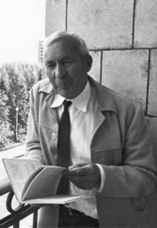


High Dimensional Expanders (HDXs)
Prahladh Harsha
ICTS-Kolmogorov Symposium 2023

Slide 2
Expander Graphs
Graphs which are very well connected
First studied
[Barzdin-Kolmogorov ’67]
[Pinksker ’73]

Slide 3
Expander Graphs
Graphs which are very well connected
Combinatorial Expansion:
∀S⊆V, If |S|≤|V|/2 then |N(S)|≥A|S|.

Slide 4
Expander Graphs
Graphs which are very well connected
Spectral Expansion:
λ := max{ λ₂, |λ_{n}| } ≤ 1−μ < 1
(eigenvalues of normalized adjacency matrix)

Slide 5
Expander Graphs
Graphs which are very well connected
Random Walk: Walk mixes well
∥J/n−A∥≤λ,
(J = all 1’s matrix and A - normalized adjacency matrix)

Slide 6
Expander Graphs
Graphs which are very well connected
Gold Standard of connectivity:
Complete Graph
Theorem:
There exist explicit constant degree expander graphs

Slide 7
Expander Graphs
Applications:
Metric Embeddings
Telephone Networking
Random Walks and Mixing times
Time-space tradeoffs
Byzantive Agreement
Error-Correcting Coding
Derandomization
Logspace algorithm for undirected-connectivity [Reingold ‘05]
Proof of the PCP Theorem [Dinur ‘05]
…..

Slide 8
Expander Graphs
Coding Theory Applications
Constant rate, linear distance binary codes [Gallager]
Distance Amplification in codes
[Alon-Bruck-Naor-Naor-Roth]
Linear time (unique) decodable codes
[Sipser-Spielman]
Linear time list-decodable codes
[Guruswami-Indyk]

Slide 9
Higher Dimension Analogues
What about expansion in hypergraphs?
Edge – hyperedges (contain more than 2 vertices)

Slide 10
Higher Dimension Analogues
Several Candidate Definitions
Computer Science perspective:
[Louis, Yoshida, Soma-Yoshida]
Extend Spectral / Laplacian viewpoint
Math perspective:
[Linial-Meshulam, Gromov, ...]
topological expanders
cohomological expanders
co-boundary expanders
Link expanders [Dinur-Kaufman ‘18]
Random walk analogues [Dikstein-Dinur-Filmus-Harsha ’18, Kaufman-Oppenheim ‘18]

Slide 11
High Dimensional Expanders (HDXs)
Gold Standard of connectivity in graphs:
Complete Graph
Gold Standard of connectivity in hypergraphs:
k-uniform Complete Graph

Slide 12

Simplicial Complex Viewpoint
X(3)
Triangles
X(2)
Edges
X(1)
Given k-uniform hypergraph X, down close it
Vertices
X(0)
$$φ −empty set$$
Empty Set

Slide 13
Random Walk Definition of HDX
X(3)
Triangles
Consider two types of walk on each layer X(i), 0 < i < k
Up-Down walk
Down-up walk
X(2)
Edges
X(1)
Vertices
X(0)
$$φ −empty set$$
Empty Set

Slide 14
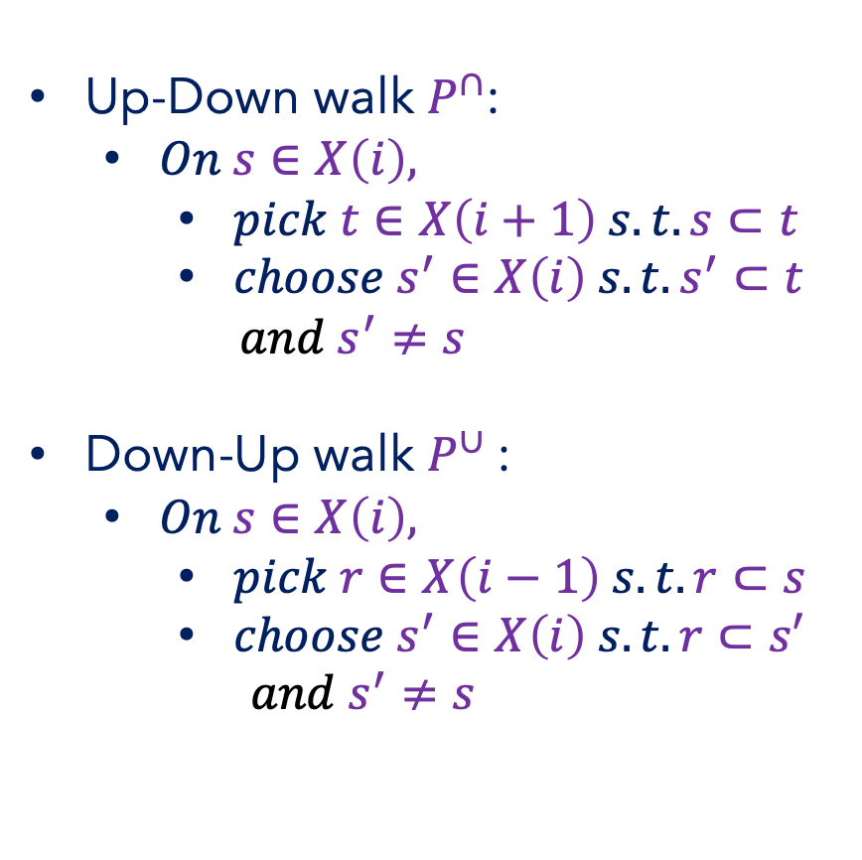
Random Walk Definition of HDX
X(i+1)
Up-Down walk $P^{∩}$:
$On s∈X\left(i\right),$
$pick t∈X\left(i+1\right) s.t. s⊂t$
$choose s^{′}∈X\left(i\right) s.t. s^{′}⊂t$
${and s}^{′}≠s$
Down-Up walk $P^{∪}$:
$On s∈X\left(i\right),$
$pick r∈X\left(i−1\right) s.t. r⊂s$
$choose s^{′}∈X\left(i\right) s.t. r⊂s′$
$${and s}^{′}≠s$$
X(i)
X(i-1)

Slide 15
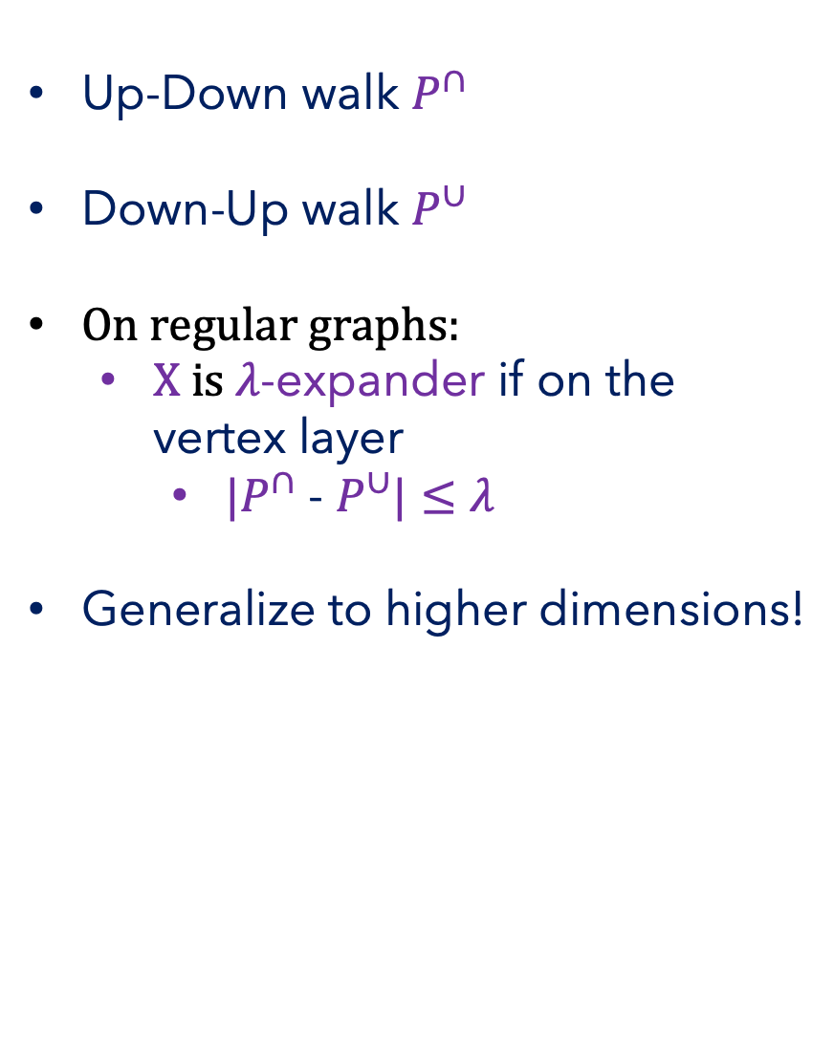
Random Walk Definition of HDX
X(i+1)
Up-Down walk $P^{∩}$
Down-Up walk $P^{∪}$
On regular graphs:
X is $λ$-expander if on the vertex layer
$|P^{∩}$ - $P^{∪}|≤λ$
Generalize to higher dimensions!
X(i)
X(i-1)

Slide 16


Random Walk Definition of HDX
X(i+1)
Up-Down walk $P^{∩}$
Down-Up walk $P^{∪}$
X(i)
Clearly, complete k-uniform hypergraph is a 0-HDX
Random Walk Definition of HDX:
If for each layer i, 0 < i < k
$|P^{∩}$ - $P^{∪}|≤λ$
Then X is $λ$-HDX
X(i-1)

Slide 17
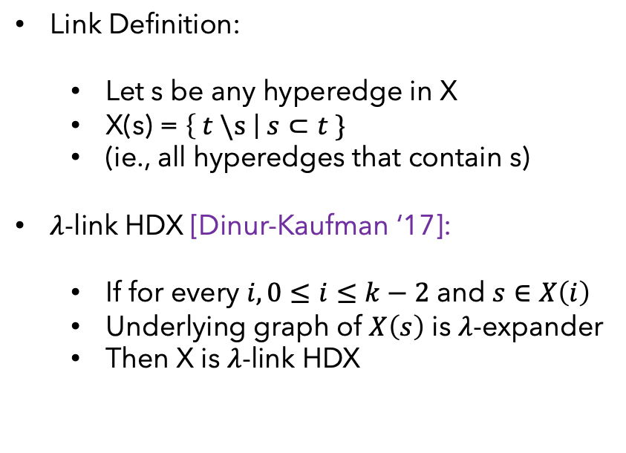
Definition via Link expansion
X(3)
Triangles
Underlying Graph
X(2)
Link Definition:
Let s be any hyperedge in X
X(s) = $\left\{ t \backslash s \right| s⊂t \}$
(ie., all hyperedges that contain s)
$λ$-link HDX [Dinur-Kaufman ‘17]:
If for every $i, 0≤i≤k−2$ and $s∈X\left(i\right)$
Underlying graph of $X\left(s\right)$ is $λ$-expander
Then X is $λ$-link HDX
Edges
X(1)
Vertices
X(0)
$$φ −empty set$$
Empty Set

Slide 18
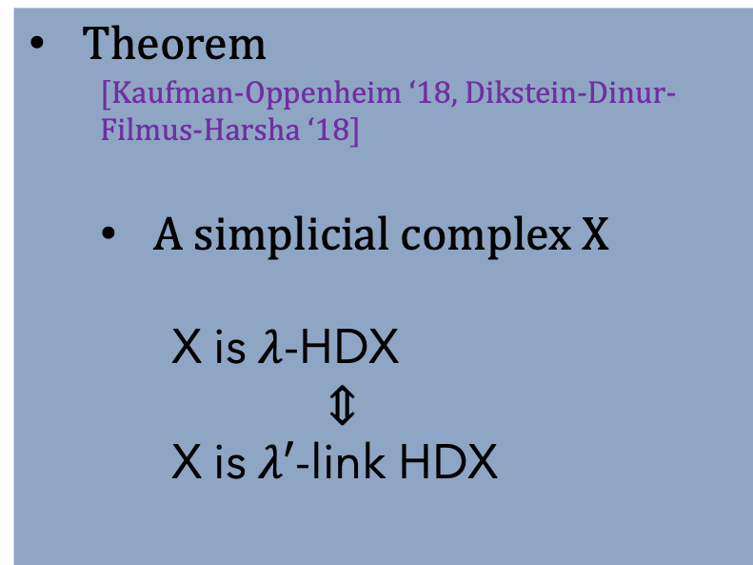
Equivalence of definitions
X(3)
Triangles
X(2)
Theorem
[Kaufman-Oppenheim ‘18, Dikstein-Dinur-Filmus-Harsha ‘18]
A simplicial complex X
X is $λ$-HDX
$⇕$
X is $λ′$-link HDX
Edges
X(1)
Vertices
X(0)
$$φ −empty set$$
Empty Set

Slide 19
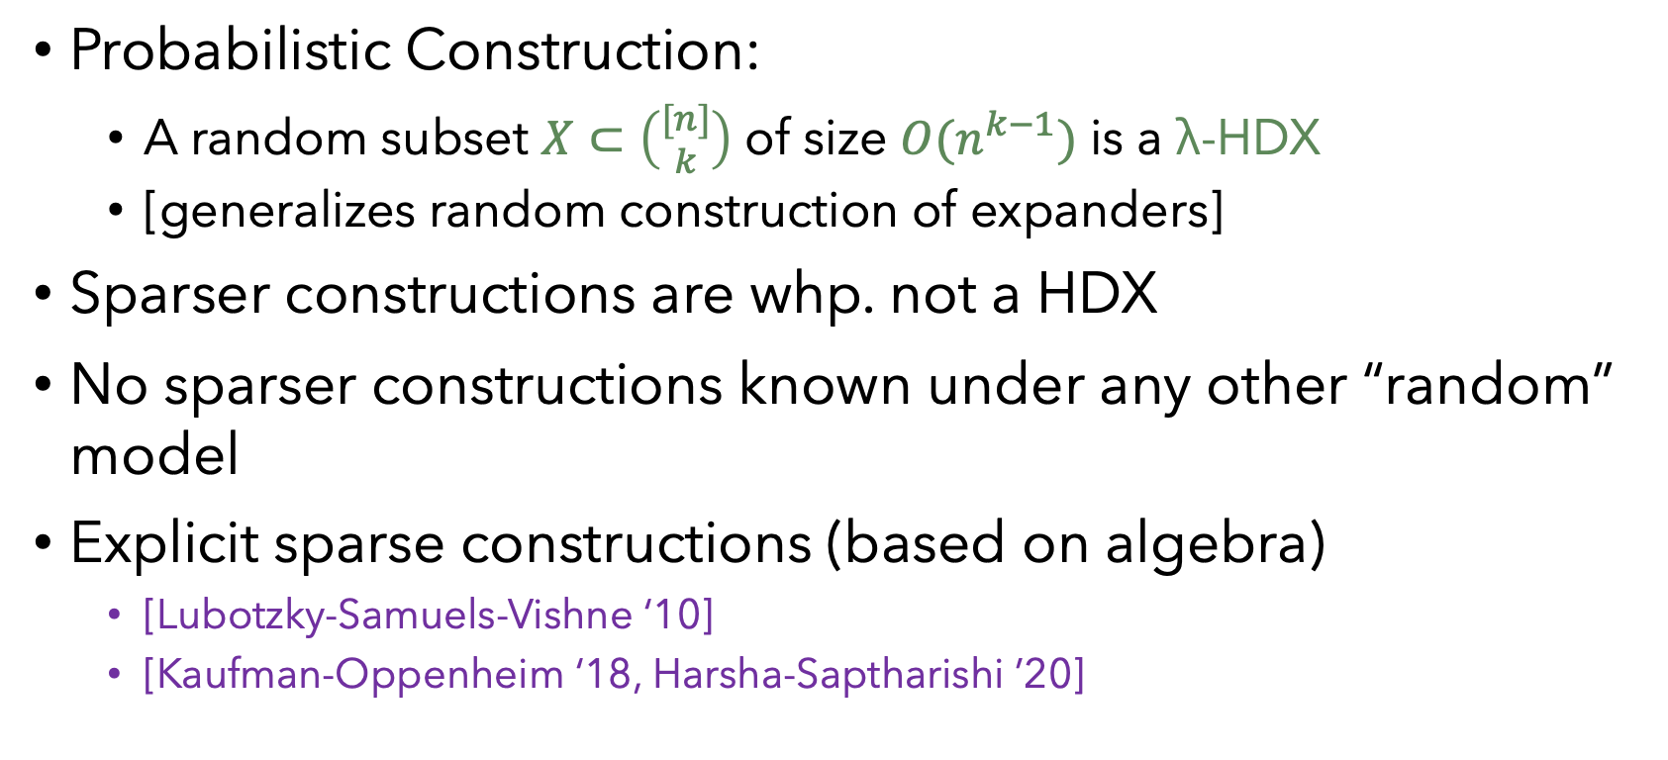
Sparse HDXs
Probabilistic Construction:
A random subset $X⊂\left({[n] \atop k}\right)$ of size $O(n^{k−1})$ is a λ-HDX
[generalizes random construction of expanders]
Sparser constructions are whp. not a HDX
No sparser constructions known under any other “random” model
Explicit sparse constructions (based on algebra)
[Lubotzky-Samuels-Vishne ‘10]
[Kaufman-Oppenheim ‘18, Harsha-Saptharishi ’20]

Slide 20
Applications of HDXs

Slide 21
HDX Applications to TCS
Local-to-Global Testing
Property testing, agreement testing [Dinur-Kaufman ‘17]
Coding Theory
Efficient list-decodable codes [Dinur-Harsha-Kaufman-Livni-RonZewi-TaShma ’19, Alev-Jeranimo-Tulsiani ‘19]
Locally testable codes [Dikstein-Dinur-Harsha-RonZewi-Kaufman ‘19, Dikstein-Dinur-Harsha-RonZewi ’20,
Constant query locally testable codes with constant rate and constant fractional distance [Dinur-Evra-Livne-Lubotzky-Mozes ’22, Panteleev-Kalachev ‘22]
Approximate Sampling/Counting
Sampling/Counting bases of matroid [Anari-Liu-Gharan-Vinzent ‘19, Alev-Lau ‘20]

Slide 22
Application: Sampling bases of Matroid
Example: sample a random spanning tree in a given graph [Anari-Liu-Gharan-Vinzent ‘19]

Slide 23
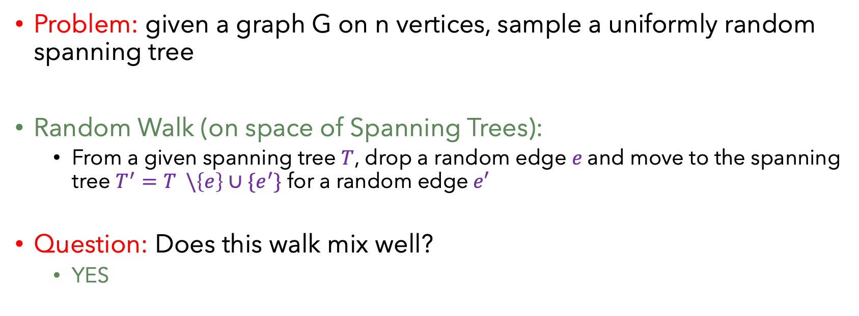
Sampling a random spanning tree
Problem: given a graph G on n vertices, sample a uniformly random spanning tree
Random Walk (on space of Spanning Trees):
From a given spanning tree $T$, drop a random edge $e$and move to the spanning tree $T^{′}=T \backslash \left\{e\right\}∪\{e^{′}\}$ for a random edge$e′$
Question: Does this walk mix well?
YES

Slide 24
Question:
Is this simplicial complex a HDX?
[Anari-Liu-Gharan-Vinzent ‘19]
Yes, it is a link-HDX
[Kaufman-Oppenheim ‘18, Dikstein-Dinur-Filmus-Harsha ‘18]
Hence, it is a HDX
Complete the Simplicial Complex of forests

Slide 25
Summarizing …
A new object called high-dimensional expander
Which generalizes expander graphs to hypergraphs
Applications
Sampling bases of matroids (spanning trees)
Coding Theory
….?

Slide 26
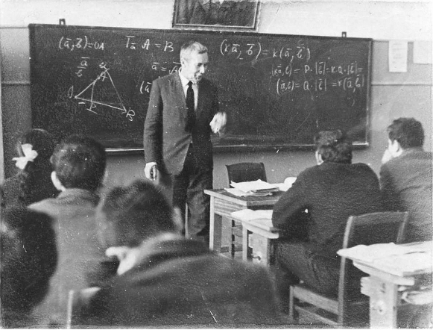
High Dimensional Expanders (HDXs)
Thank You

