Slide 1
Interacting Graphene at ν=0
Ankur Das, Ribhu Kaul, and Ganpathy Murthy
University of Kentucky
ICTS, Bangalore, 2021

Slide 2
Outline
Graphene basics.
Landau levels in graphene.
An experimental puzzle in ν=0 graphene.
Lattice and continuum Hartree-Fock.
Speculations and open questions.

Slide 3
Zero-B-Field Graphene

Slide 4
Interactions: Alicea & Fisher PRB 74, 075422 (2006)

Slide 5
Continuum Limit B -> 0

Slide 6
The ZLL Manifold and Edges

Slide 7
Noninteracting ground state
Should be fully spin polarized.
Should have a pair of counterpropagating edge modes of opposite spin at each edge. Abanin, Lee, Levitov PRL 96, 176803 (2006).
Coulomb interactions do not change the physical picture of the Helical Luttinger liquid edge. Brey and Fertig, PRL 97, 116805 (2006)

Slide 8
Two-Terminal Transport Young et al, Nature 505, 528 (2014)

Slide 9
The meaning of the experiment

Slide 10
Recall Alicea & Fisher PRB 74, 075422 (2006)

Slide 11
Kharitonov’s HF Phase Diagram Kharitonov, PRB 85, 155439 (2012)
Kharitonov assumes ultra-short
range interactions, with range much smaller than the magnetic length.

Slide 12
With a small Zeeman coupling

Slide 13
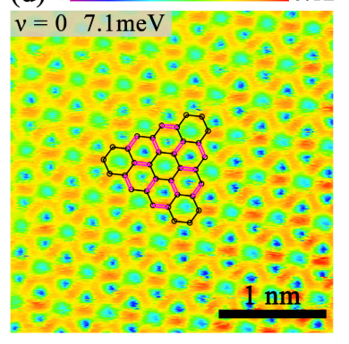
Experimentally, what is the phase?
The Young et al experiment sees a continuous phase transition from the phase at perpendicular B to the fully polarized state at large Zeeman, consistent with CAF -> F.
Wei et al Science 362, 229 (2018) (Yacoby group) see magnon transmission through the putative CAF at energy greater than Zeeman, also consistent with CAF -> F.
Li et al, PRB 100, 085437 (2019) do STM and find bond order. This is inconsistent with Kharitonov’s phase diagram.

Slide 14
Possibilities
Most obvious possibility is co-existence of bond and CAF order.
In the continuum, the only way to obtain this is to relax the ultra-short-range assumption. In fact, one needs structure in the interaction functions on the scale of the magnetic length.
Qualitatively, one can get this kind of structure by integrating out higher n Landau levels.

Slide 15
Hartree-Fock in the Continuum

Slide 16
Ankur Das,
Ribhu Kaul,
& GM,
in preparation

Slide 19
Lattice Hartree-Fock
For 1/q (q integer) quanta of flux per original unit cell, we
Choose a gauge.
Choose a magnetic unit cell so that we have two commuting translations.
Hamiltonian has nearest-neighbor hopping, on-site Hubbard, and nearest-neighbor spin-spin interactions.
Carry out iterative Hartree-Fock until it converges.

Slide 20
Previous Work on the phase diagram
The vast majority of work is in the continuum limit, either in the n=0 manifold (Kharitonov + many others) or including a few Landau levels around it (Feshami+Fertig PRB 94, 245435 (2016)). FF found only F, CDW, and SDW.
The lattice problem was first addressed by Jung + MacDonald, PRB 80, 235417 (2009). Their model has the long-range Coulomb and a Hubbard interaction. They found the F, CDW and SDW states.
A spinless model with a nearest-neighbor repulsion was studied at various q by Mishra et al, PRB 95, 035140 (2017). They found various phases with broken translations.

Slide 24
Phase diagram for q=12
Zeeman=0

Slide 25
Kharitonov’s HF Phase Diagram for comparison Kharitonov, PRB 85, 155439 (2012)

Slide 26
Some general observations
There is always a (very tiny) gapless Dirac phase close to the origin of U and g.
Bond order seems to be ubiquitous. It co-exists with all other kinds of order throughout the phase diagram except for ferromagnetic order.
As q changes lots of phases pop up in small regions of the phase diagram. Some of these persist in large regions over all the q that we have studied.
All phase boundaries are first order for Zeeman=0.

Slide 27
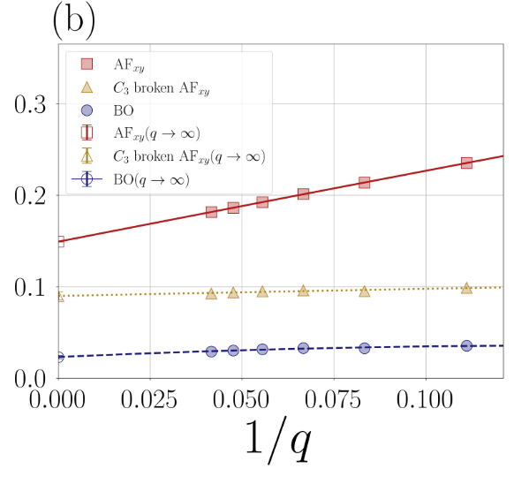
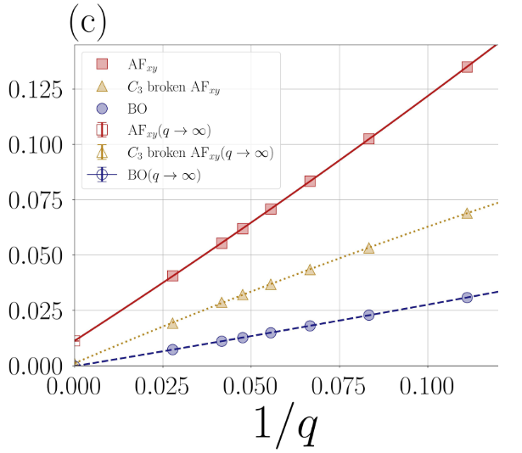
Varying Zeeman
Ankur Das,
Ribhu Kaul,
and GM,
In preparation

Slide 28
Conclusions
The lattice calculations always have a co-existence of AF and bond order at vanishing Zeeman.
As Zeeman increases, in the q-> infinity limit, there are two second-order transitions, the first to phase with only CAF, and then to the fully polarized phase. Unfortunately, the first two phases are insulating, so there is no transport signature.
Disorder breaks translation invariance, and will expand the domain of the bond-ordered phases.

Slide 29
Open questions
Hartree-Fock generically tends to overestimate order. It is not clear that all the phases seen in the lattice HF will survive in an exact calculation.
The ultra-short-range assumption is suspect. The phase diagram for bilayer graphene needs to be revisited.
Similar questions will arise in Weyl semimetals with interactions.

Slide 30
Cubic lattice WSM with orbital flux Faruk Abdulla, Ankur Das, Sumathi Rao, & GM, arxiv:2108.03196
Phase transition points are more susceptible to interactions!

Slide 33
Phase H: FM

Slide 35
Phase B: Antiferromagnetic SDW + BO

Slide 37
Phase D: BO, Nonuniform flux

Slide 39
Phase C: CDW + BO

Slide 41
Bond Order II and nonuniform flux

Slide 43
Phase I: FM + BO III

Slide 45
Phase E: BO and nonuniform flux

Slide 47
Phase J: SDW + BO

Slide 49
Phase F: SDW + BO

Slide 50
Conclusions
Noninteracting graphene in the Hofstadter regime is already interesting. Bands with large Chern numbers exist away from the central two bands.
Dirac touchings in the two central bands are protected by a combination of lattice and chiral symmetries. Can be broken to either C=-1 or large C Chern bands by breaking the symmetry in different ways.
A plethora of phases in the interacting problem for q=3. Many different types of spin order/bond order and sometimes co-existence.
Transitions from the central gapless region are second-order, but all other transitions are first-order.

Slide 51
Open questions
Can we somehow make use of the large Chern numbers to get exotic phases?
What are the Chern numbers and collective modes for the various gapped phases we see in the interacting problem? Are there gapless collective modes?
In Bilayer Graphene, in the zero-field limit, and with only nearest-neighbor hopping, there are quadratic band touchings at K and K’. What is their fate in the Hofstadter regime?
Moire + Hofstadter?

