Slide 1

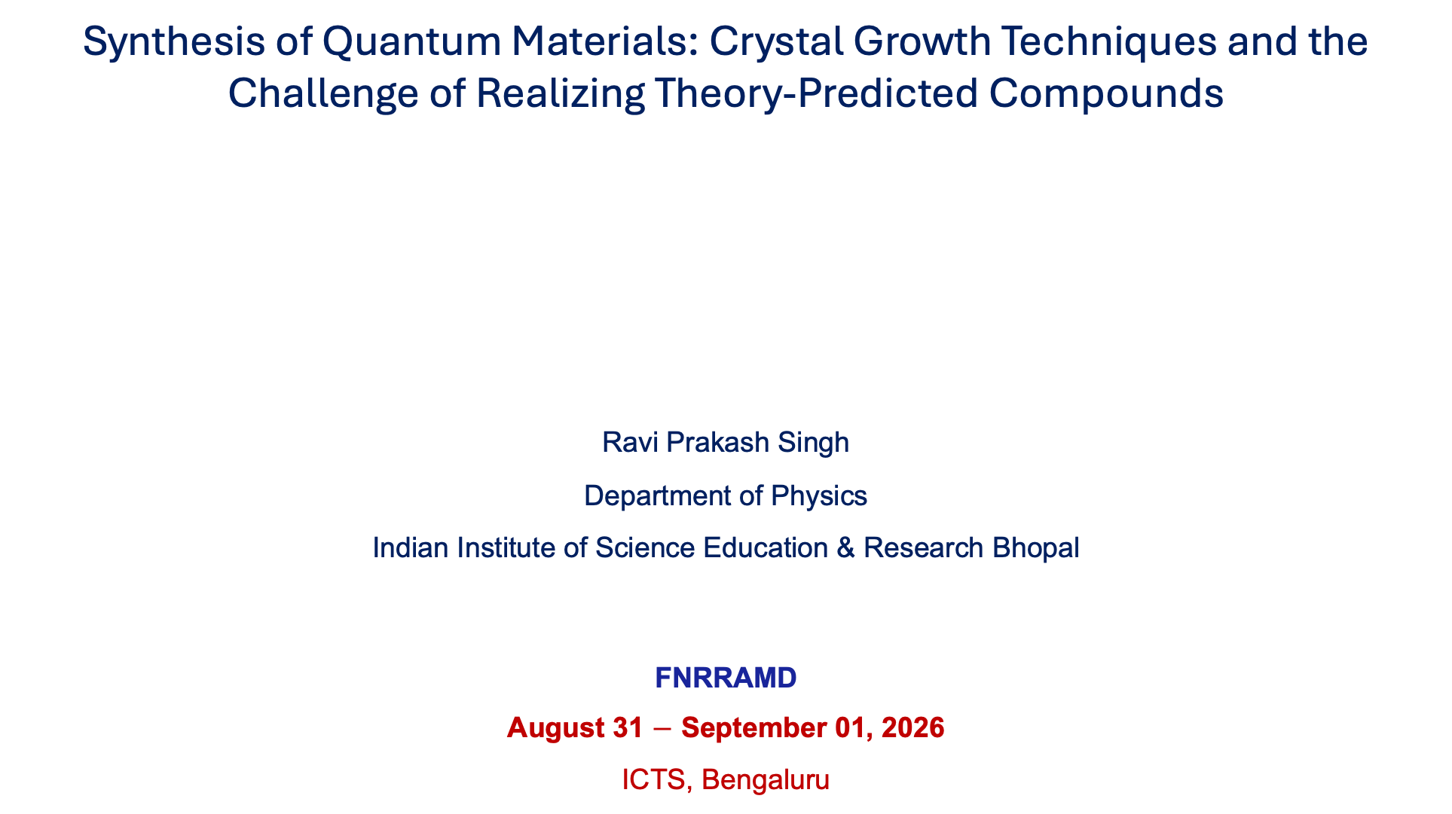
Synthesis of Quantum Materials: Crystal Growth Techniques and the Challenge of Realizing Theory-Predicted Compounds
Ravi Prakash Singh
Department of Physics
Indian Institute of Science Education & Research Bhopal
FNRRAMD
August 31 $−$ September 01, 2026
ICTS, Bengaluru
rpsingh@iiserb.ac.in
https://home.iiserb.ac.in/~rpsingh/

Slide 2
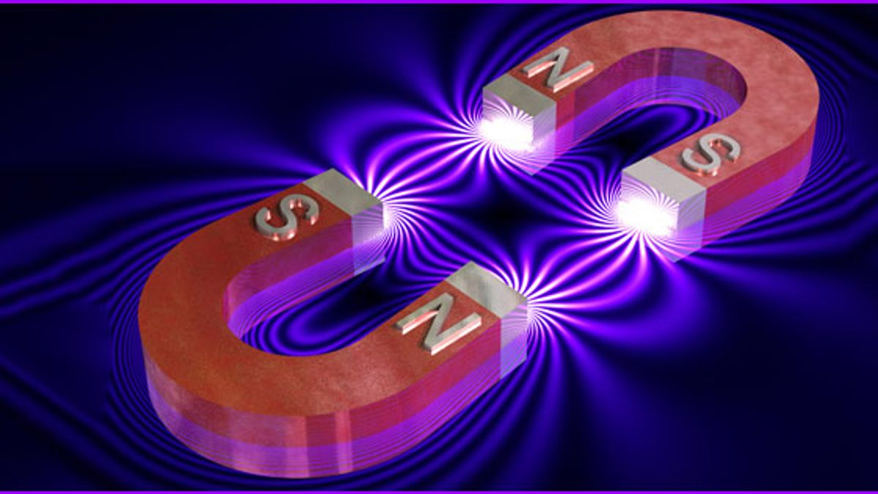
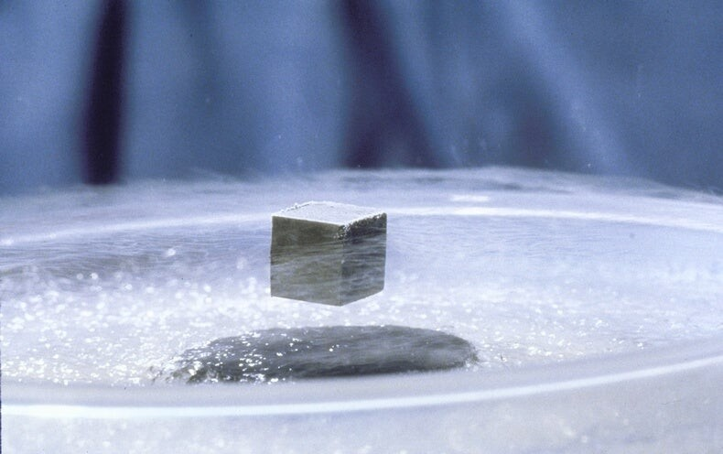
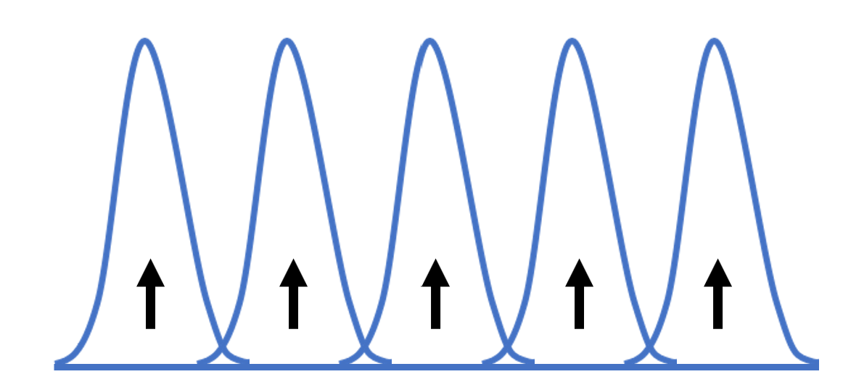
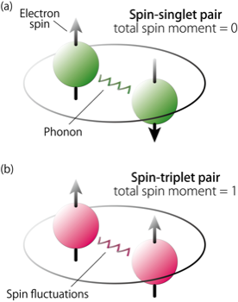

Unconventional Superconductors
Superconductivity and Magnetism are Largely Incompatible
Very few materials have singlet superconductivity coexisting with magnetism- usually exists just before superconductivity disappears
Why We Need Coexistence of Superconductivity and Magnetism?
Superconducting materials more robust to the effect of external magnetic field
Spin polarised supercurrents – spin triplet superconductors
Efficient spin injection – Spintronic devices
Superconducting switch-voltage controlled switching of superconductivity
Needed for non Abelian excitations

Slide 3
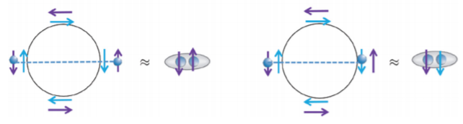
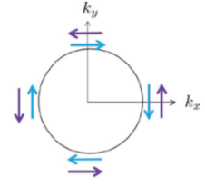
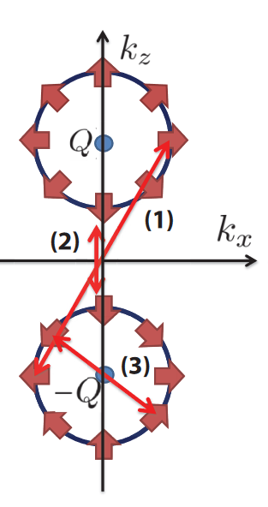
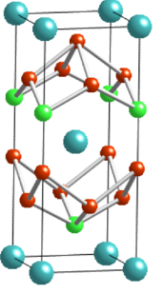
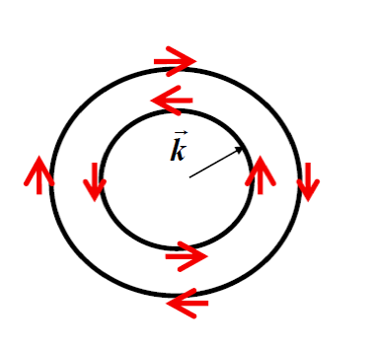
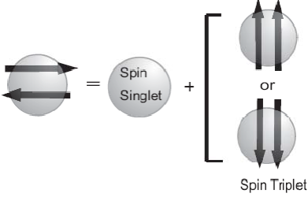
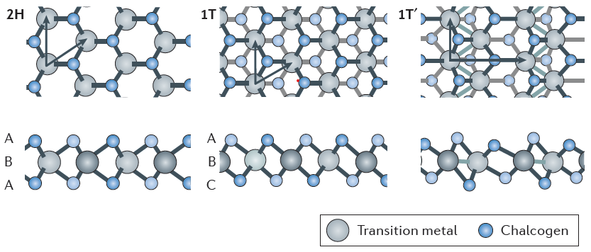
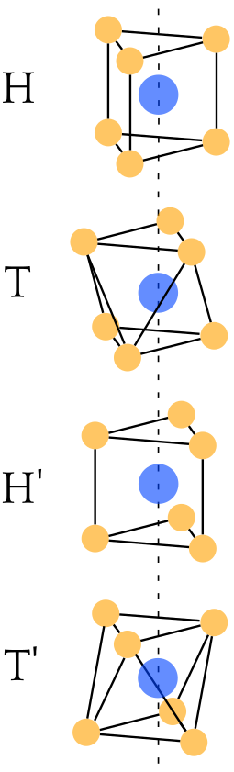
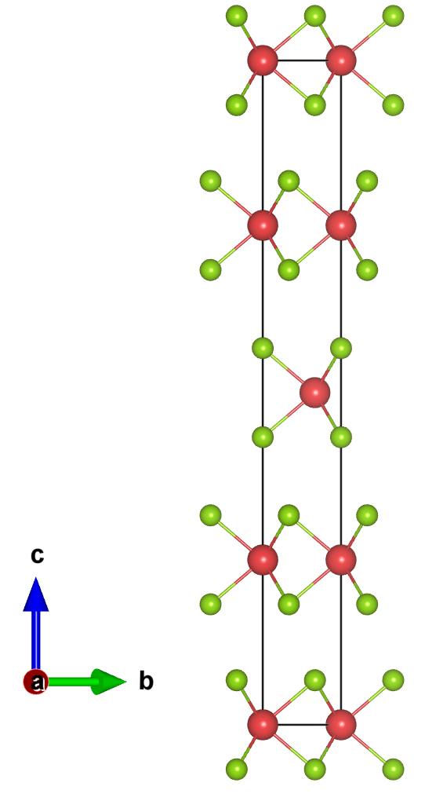
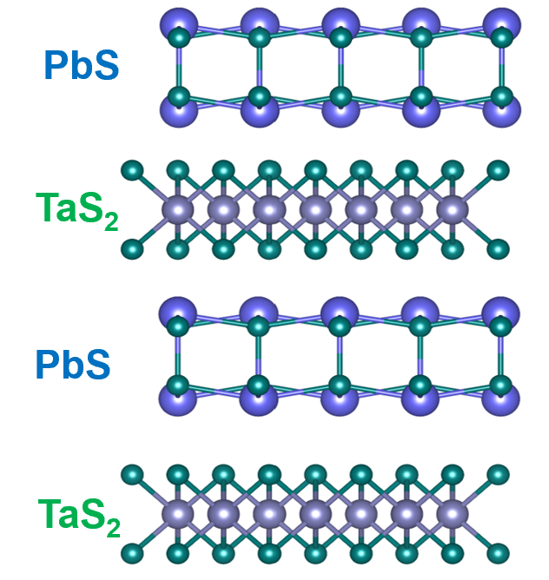
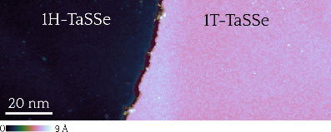
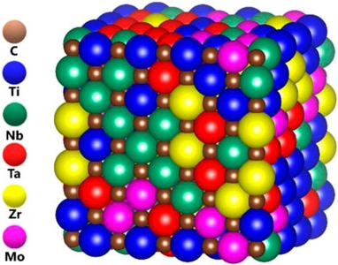
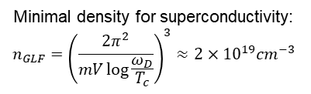




Unconventional Superconductivity Research @ IISER Bhopal
Non-centrosymmetric Superconductors
Topological Materials
Antisymmetric spin-orbit coupling mixes singlet and triplet pairing channels. Signatures include high Hc2, gap nodes, and non-trivial topological band structure.
Superconductors with unconventional pairing and non-trivial topology - candidates for topological superconductivity.
Non-uniform Lattice Potential
Intra band pairing
Inter band pairing
Layered Chalcogenides, Natural Heterostructure/Misfit Compounds
Most TMDCs host competing CDW and superconducting phases, tied together by electron-phonon coupling. Doping or disorder can suppress CDW while preserving this coupling — a route to isolating its role in Cooper pairing
4H-TaSeS
4H-NbSe₂
Misfit
Superconductivity in Low Carrier Materials
High Entropy Alloys
The density of states depend on the density of carriers:
$$N\left(0\right)=\frac{mk_{F}}{2π^{2}}∝n^{\frac{1}{3}}$$
$$T_{C}=ω_{D}e^{−\frac{1}{N\left(0\right)V}}$$
Chemical disorder in HEAs disrupts the regular phonon spectrum BCS theory assumes, offering a testbed for how superconductivity survives — or is modified — under extreme structural disorder.
$V−$ local interaction
$ω_{D} −$Debye frequency
$N\left(0\right)−$density of states
$$m=m_{e}$$
$$T_{c}=1 K$$
$$ω_{D}=500 K$$
$$V=10 eVa^{3}$$
$$a^{3}=6×{10}^{23}{cm}^{3}$$
Minimal density for superconductivity:
$$n_{GLF}={\left(\frac{2π^{2}}{mV\log{\frac{ω_{D}}{T_{c}}}}\right)}^{3}≈2×{10}^{19}{cm}^{−3}$$
Lower density of state put bound on superconductivity

Slide 4
Superconducting Ground States of Non-Centrosymmetric, High-SOC, and Topological Materials Probed by Our Group.
 | Compound | T_{C} (K) | TRSB | Reference
1 | Re₆Zr | 6.75 K | Y | Phys. Rev. Lett. 112, 107002 (2014)
2 | La₇Ir₃ | 2.25 K | Y | Phys. Rev. Lett. 115, 267001 (2015)
3 | Re₆Hf | 5.98 K | Y | Phys. Rev. B 94, 054515 (2016) Phys. Rev. B 96, 180501(R) (2017)
4 | Re₆Ti | 6.0 K | Y | Phys. Rev. B 97, 100505(R) (2018)
5 | LaPtGe | 3.05 K | Y/N | Phys. Rev. B 98, 214505 (2018)
6 | NbOs₂ | 2.7 K | N | Phys. Rev. B 99, 014516 (2019)
7 | BeAu | 3.2 K | N | Phys. Rev. B 99, 134509 (2019)
8 | Zr₃Ir | 2.3 K | Y/N | Phys. Rev. Mater. 3, 104802 (2019)
9 | La₇Rh₃ | 2.65 K | Y | Phys. Rev. B 102, 134511 (2020)
10 | Re_{5.5}Ta | 8.0 K | Y/SF | Phys. Rev. B 101, 144508 (2020)
11 | LaMSi (M=Ni, Pt) | 1.25, 3.45 K | SF/? | Phys. Rev. B 102, 094515 (2020)
12 | La₇Ni₃ | 2.3 K | Y | Phys. Rev. B 103, 174502 (2021)
13 | Re₇B₃, Re₃B | 3.2, 5.2 K | N | Phys. Rev. B 103, 104507 (2021)
14 | Ti₃X (X=Ir, Sb) | 4.3, 6.7 K | N | Phys. Rev. B 103, 054501 (2021)
15 | Zr₂Ir | 7.4 K | N | Phys. Rev. B 104, 054509 (2021)
16 | Pd₂Pb | 3.0 K | N | Phys. Rev. B 103, 184506 (2021)
17 | (Hf/ZrNb)_{0.10}(MoReRu)_{0.90} | 5.2 K, 5.5 K | N | Phys. Rev. B 104, 094515 (2021)
18 | IrGe | 4.7 K | N | Phys. Rev. B 105, 054517 (2022)
19 | Nb₆₀Re₁₀Zr₁₀Hf₁₀Ti₁₀ | 5.7 K | N | Phys. Rev. B 105, 144501 (2022)
 | Compound | T_{C} (K) | TRSB | Reference
20 | NbReSi | 5.3 K | N | Phys. Rev. B 105, 094523 (2022)
21 | Re₂Hf/ | 5.8 K | Y | Phys. Rev. B 105, 094513 (2022)
22 | ScS | 5.1 K | Y | Phys. Rev. B 106, L020504 (2022)
23 | La₃Os₄Ge₁₃ | 3.0 K | Y | Phys. Rev. B 107, L100506 (2023)
24 | AgSnSe₂ | 4.9 K | N | Phys. Rev. B 107, 174517 (2023)
25 | TaRu/ReSi | 4.0 K, 5.32 K | Y/N | Phys. Rev. B 108, 144510 (2023)
26 | Y₃Ru₄Ge₁₃ | 1.3 K | Y | Phys. Rev. B 108, 214512 (2023)
27 | Re₈NbTa | 8.1 K | Y/SF | Phys. Rev. B 108, 174518 (2024)
28 | Re₂Zr | 6.7 K | Y | Phys. Rev. B 111, 054511 (2025)
29 | HfRhGe | 1.7 K | Y | Adv. Mater. 37, 2415721 (2025)
30 | Nb-Mo-Ru-Re-Ir | 4.63 K | N | Phys. Rev. B 111, 214504 (2025)
31 | Al₁₃Os₄ | 5.47 K | N | Commun. Mater. 6, 226 (2025)
32 | MIrGe (M= Ti, Hf) | 2.24 K, 5.64 K | N/N | Adv. Sci. 12, e12434 (2025)
33 | 1T-Ti_{1-x}Ta_{x}Se₂ | 2.19 K | Y | arXiv: 2511.00605 (2025)
34 | TaPtSi | 3.64 K | Y | arXiv: 2602.22793 (2026)
35 | Ag₂Pd₃S | 1.1 K | Y | arXiv: 2606.29767 (2026)
36 | NbTaOs₂ | 2.4 K | Y | Phys. Rev. B 113, 094510 (2026)
37 | PtPb₃Bi | 3 K | N | arXiv: 2604.04653 (2026)
38 | SnAs | 3.74 K | N | Phys. Rev. B 114, 094515 (2026)
39 | YbSb₂ | 1.1 K | Y | Phys. Rev. Lett. (Accepted)

Slide 5

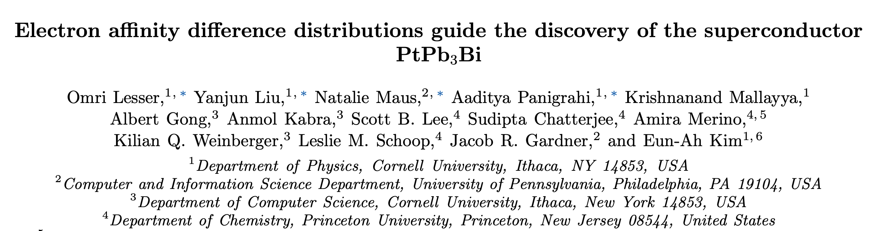
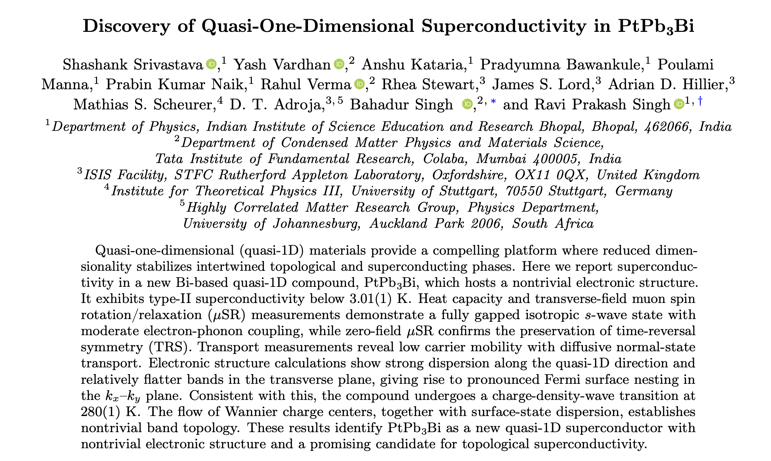
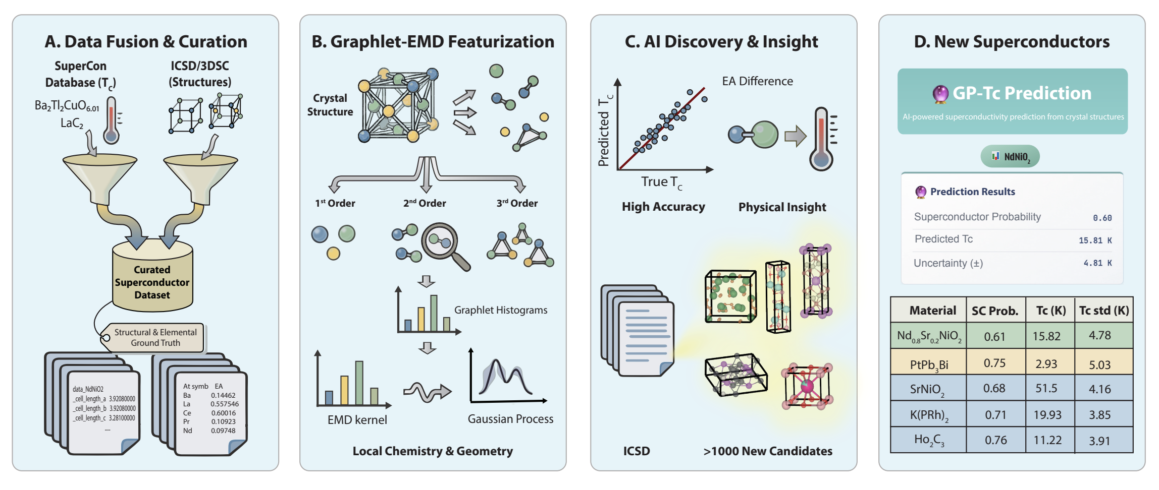
arXiv: 2510.07373v2 (2026)
arXiv: 2604.04653 (2026)

Slide 6
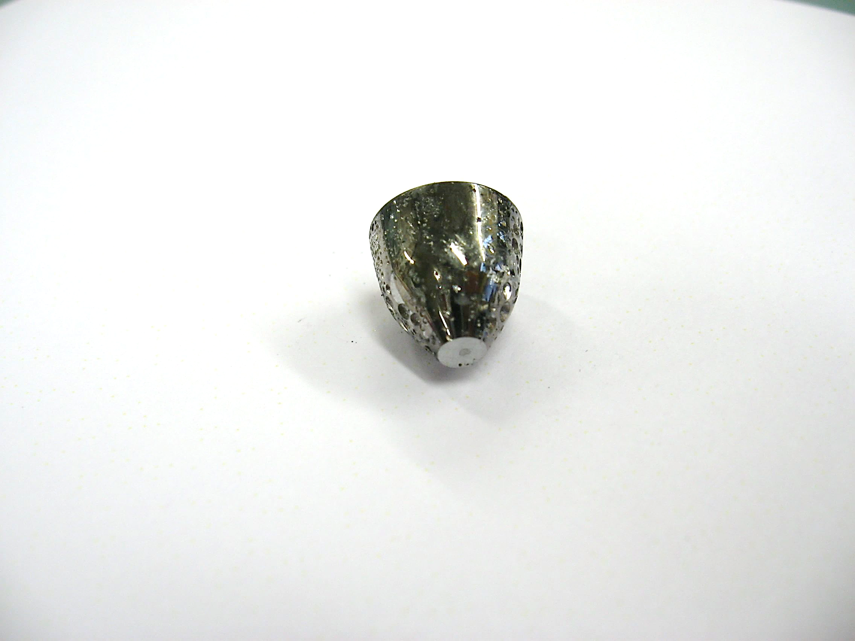
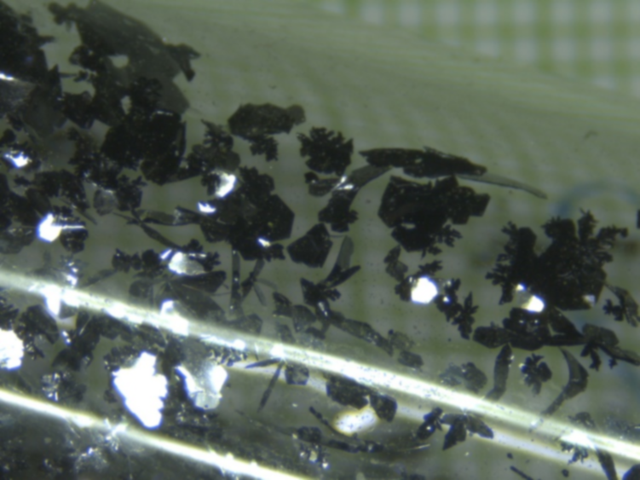
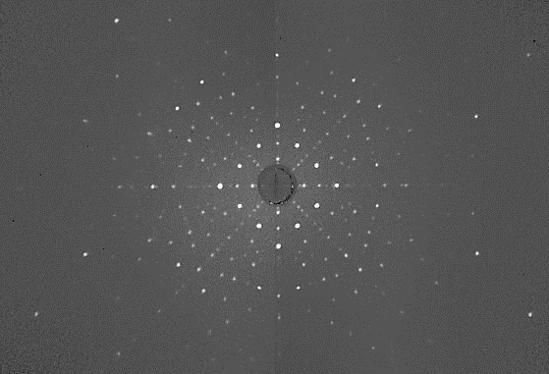
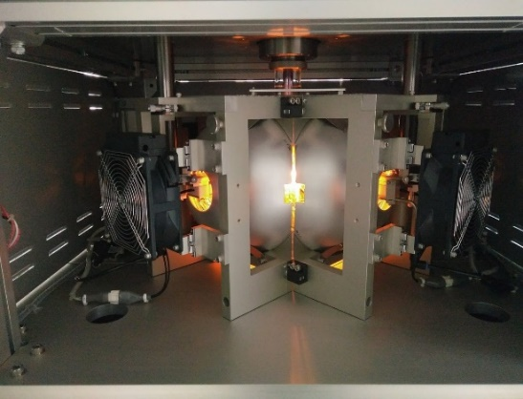


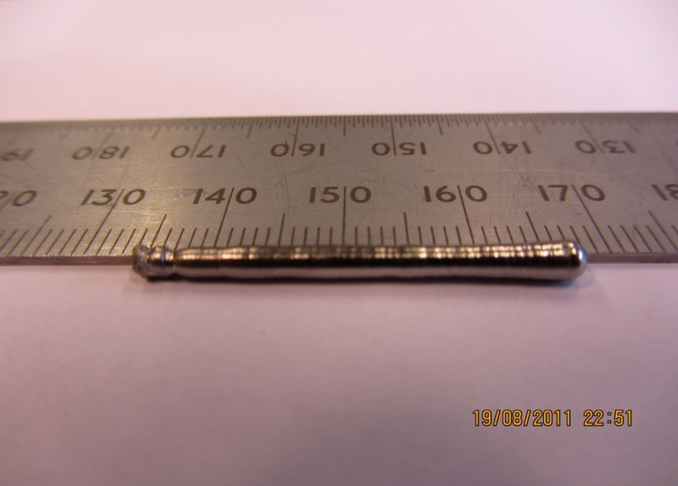
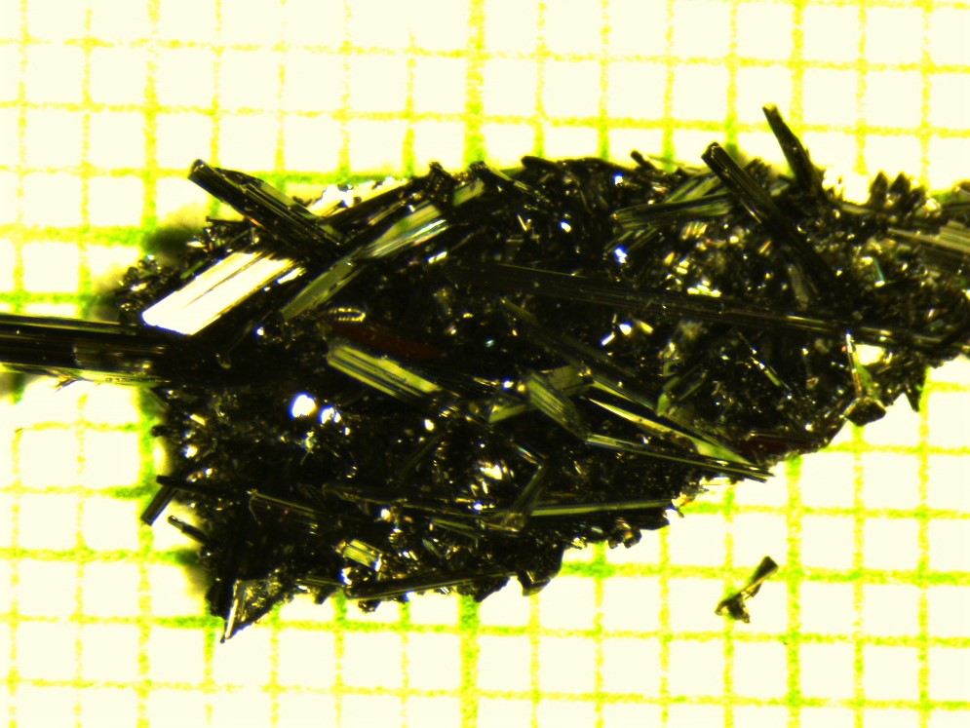
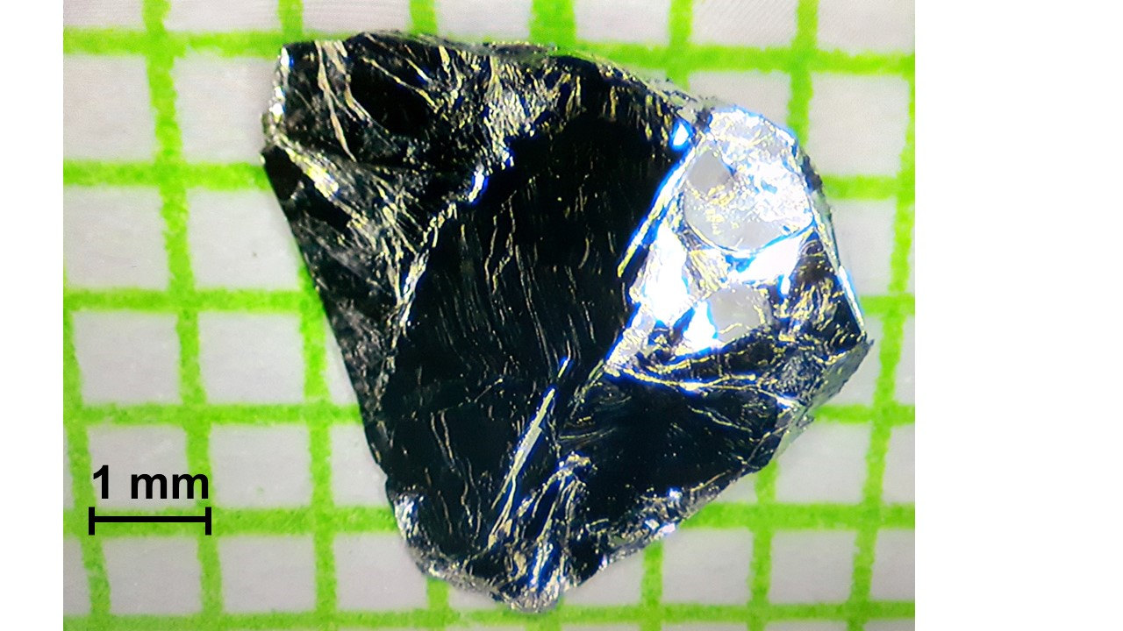
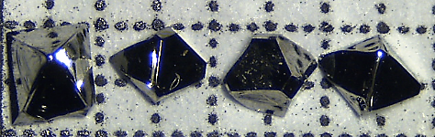
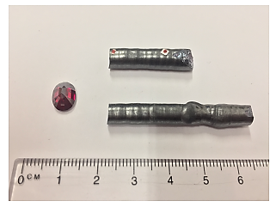

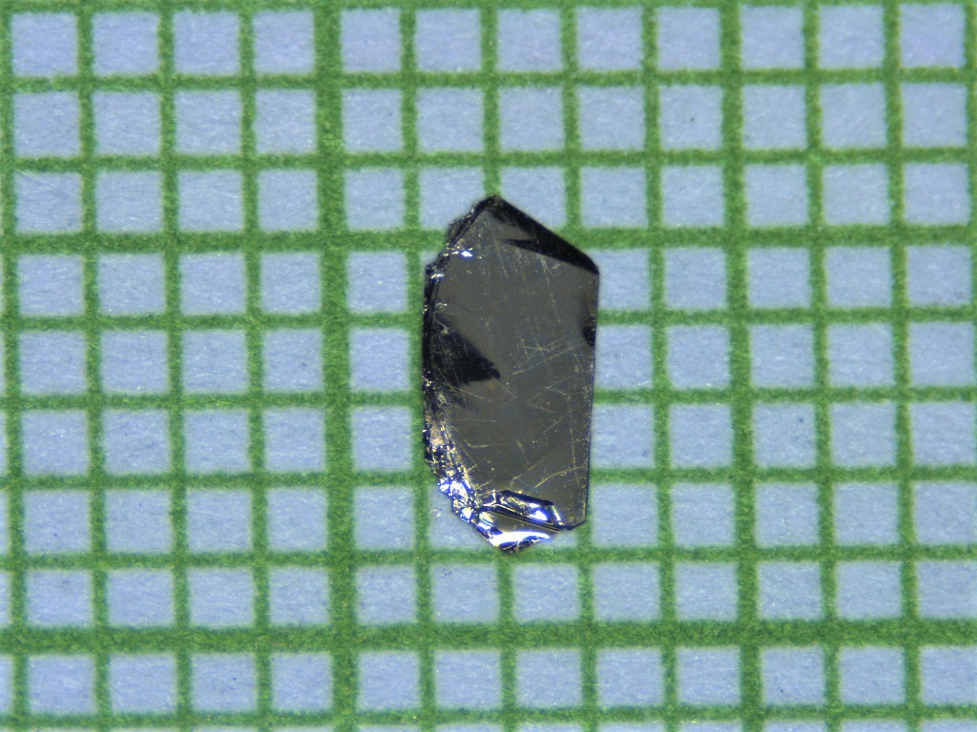

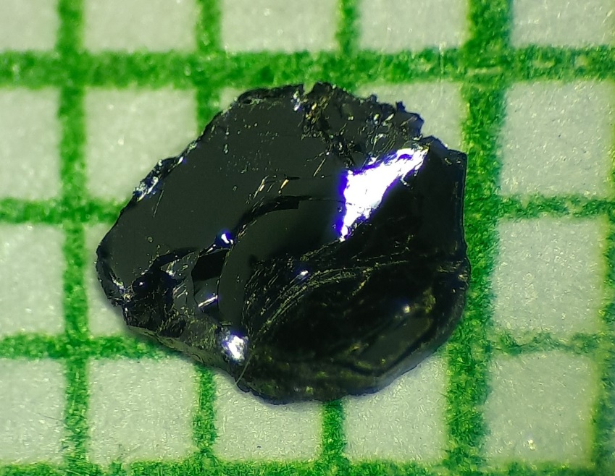
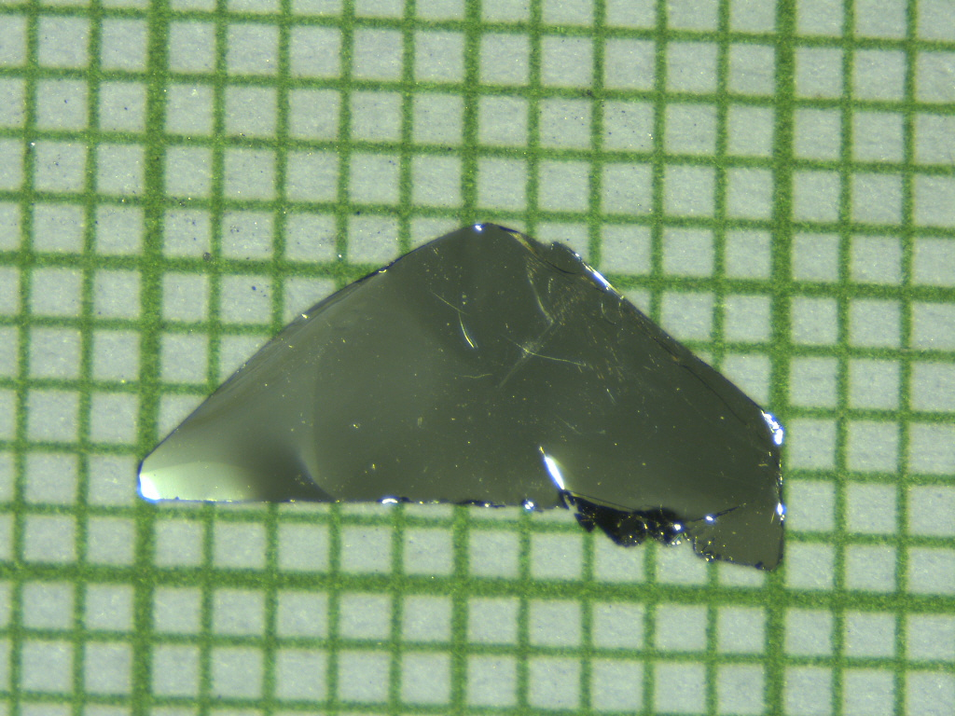
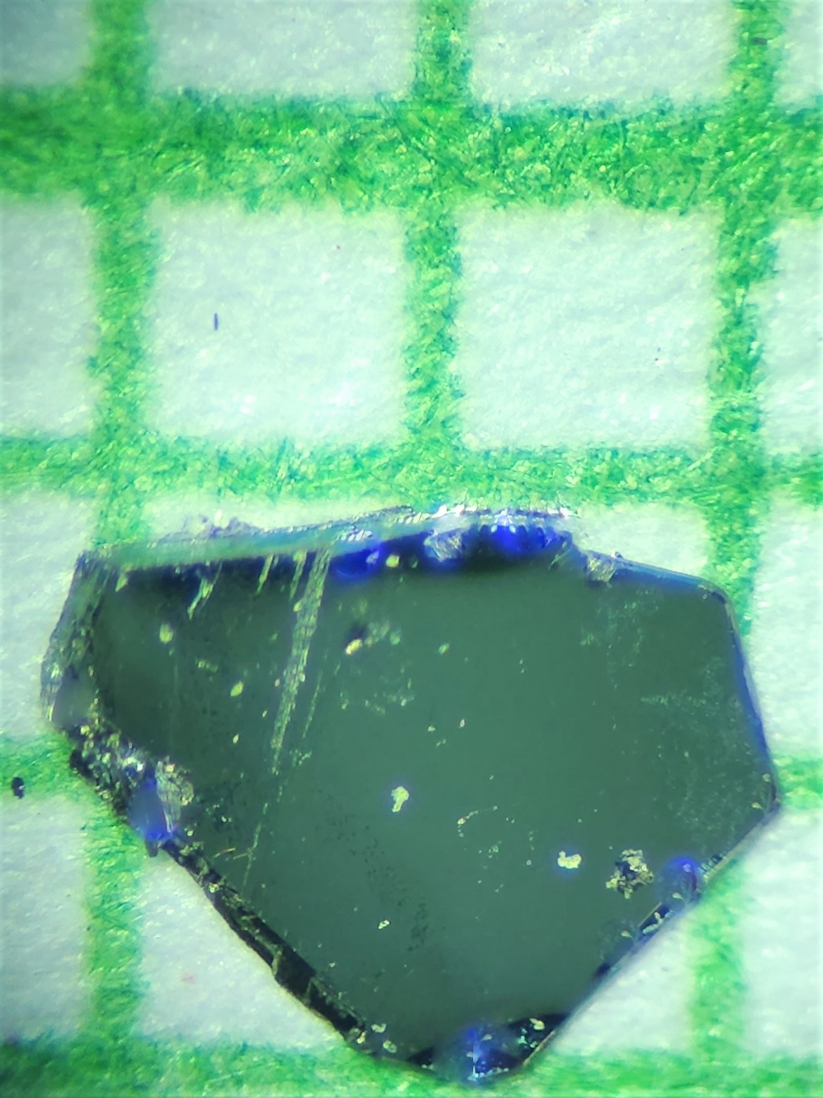
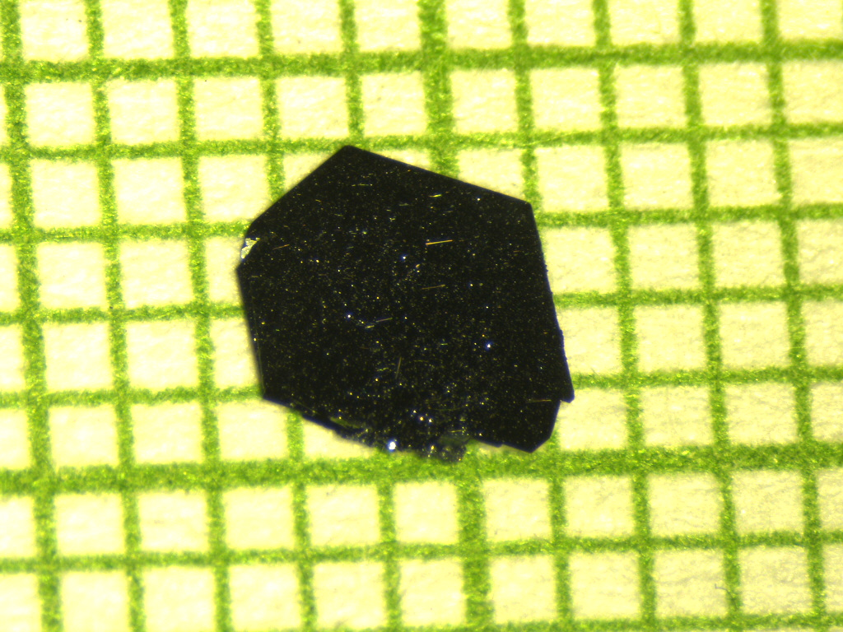
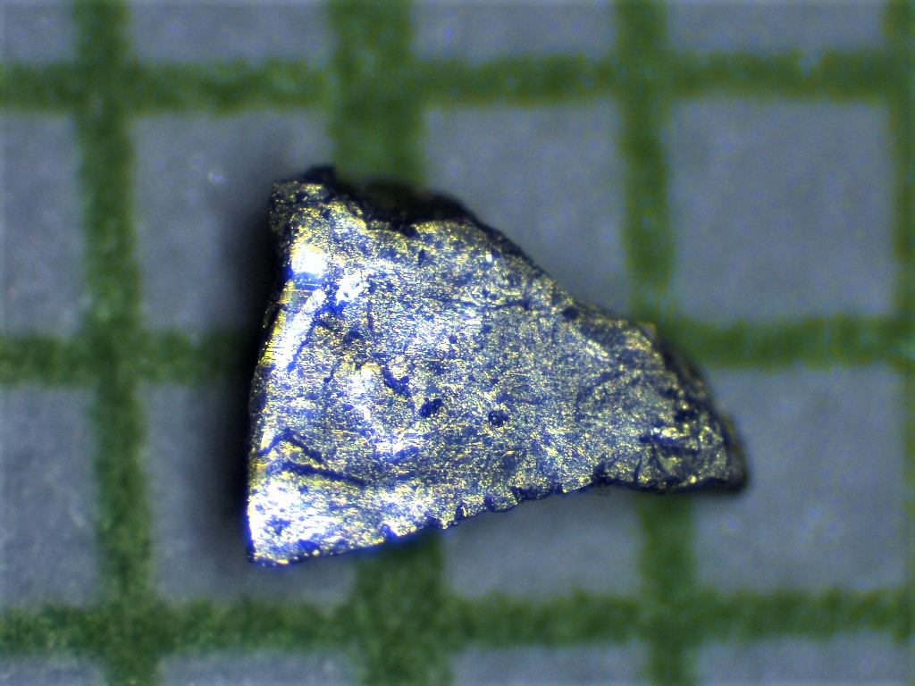
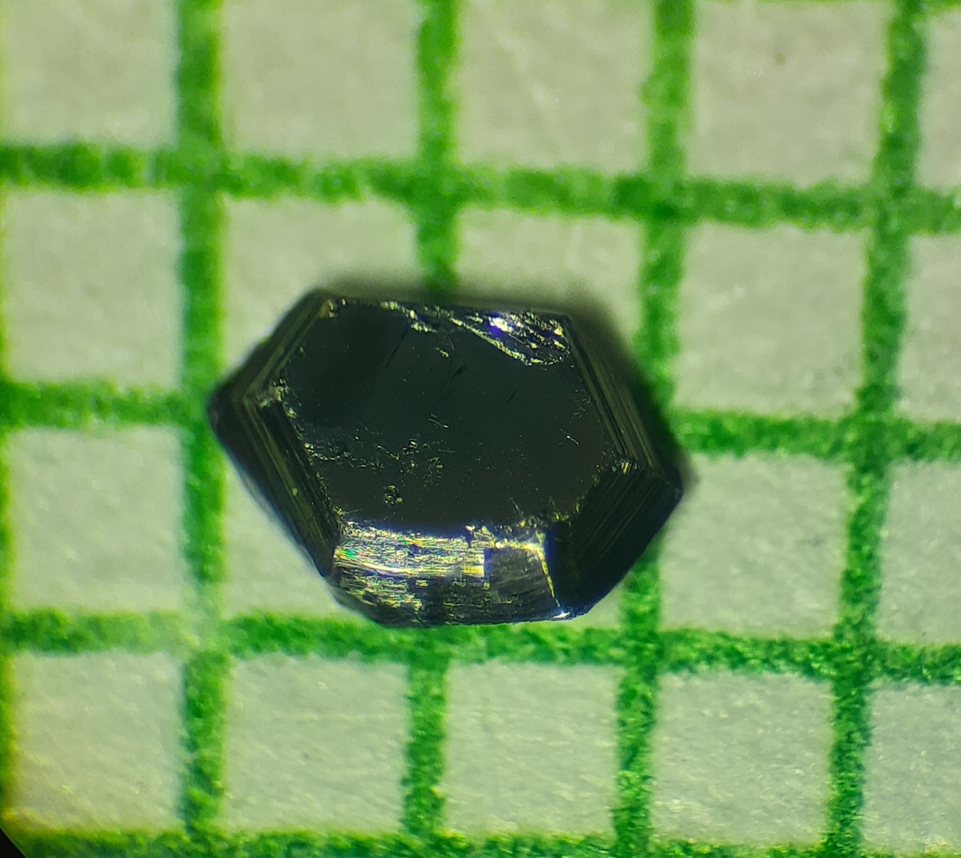
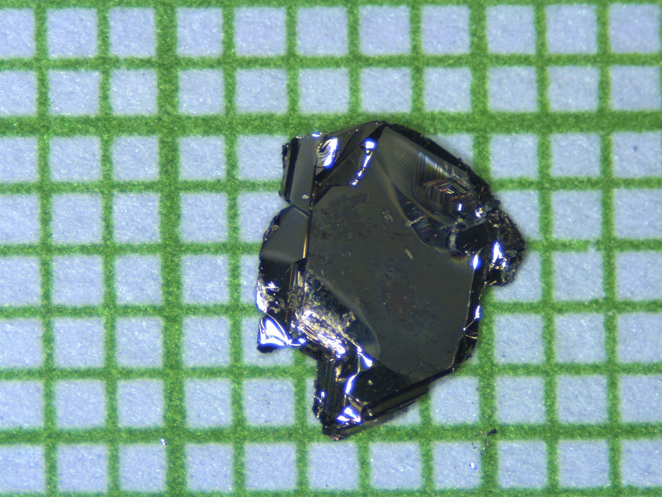
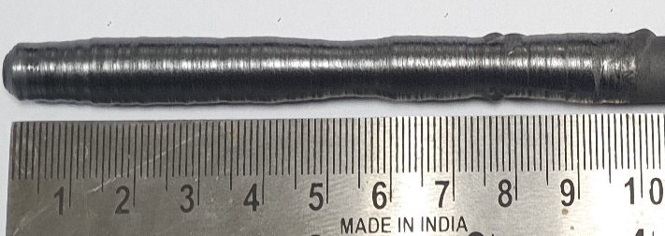
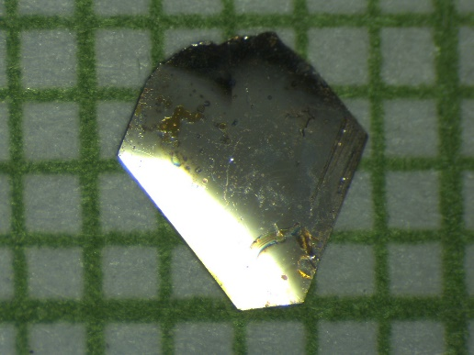
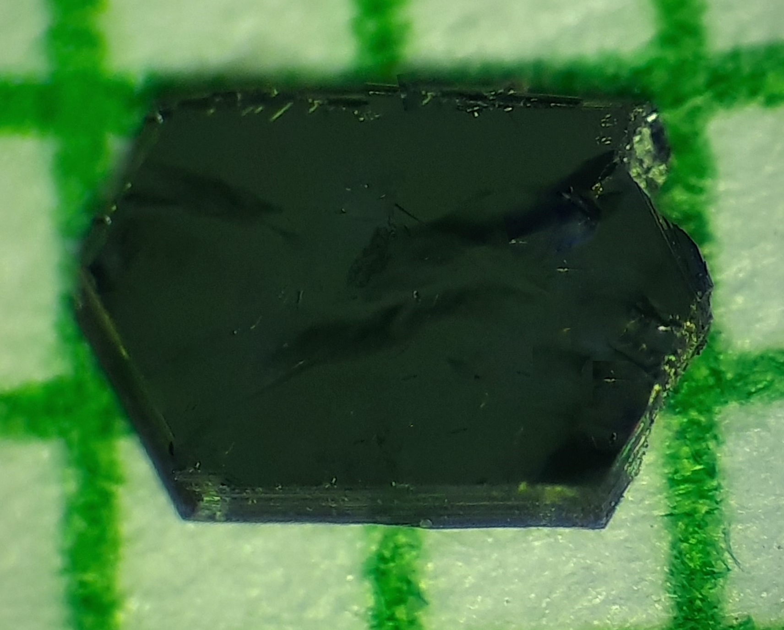
Sample Growth @ IISER Bhopal
Bridgman and Vapor transport method using a box and tubular furnaces
Optical Floating Zone Method
Czochralski Method

Slide 7
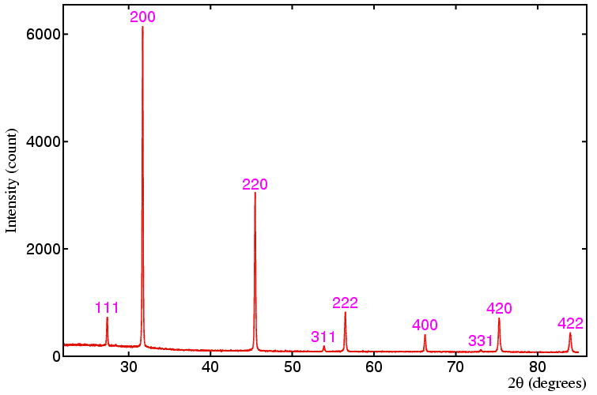
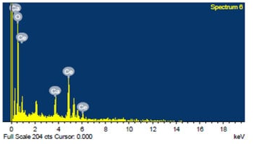
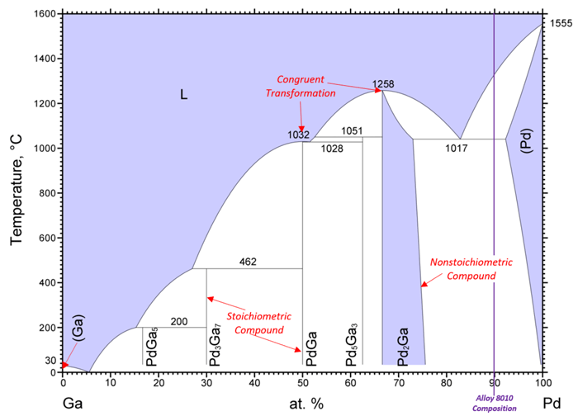
Material Synthesis Approach
Elements/Oxides
Check melting point and vapor pressure
XRD
EDAX
Analyze Phase Diagrams
Arc melting
Solid State Reaction
Polycrystal
Perform XRD and EDAX
Reevaluate the Phase Diagram
Change synthesis temperature
Optimize cooling rate
Change reaction steps and techniques
Remelting for homogeneity
Prolonged Annealing for phase stability
Some phases even get stable after single crystal growth, Proceed if possible
YES!
Pure Phase
NO! (Impure or Mixed Phase)
YES!
Single Crystal Growth
Bridgman Method
For congruently melting material
Flux Growth Technique
If material does not melt itself
Chemical Vapor Transport
Volatile element- based material
Confirm crystalline nature with Laue, SAED, and XRD
Pure Phase
NO! (Impure or Mixed Phase)
YES!
Physical Properties Measurement
Any impurity detected
Binary Phase Diagram

Slide 8
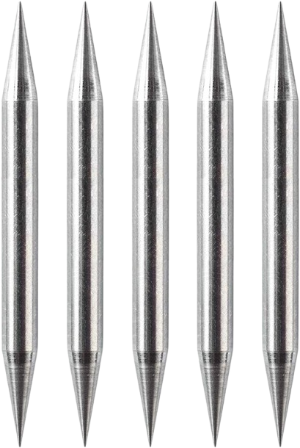
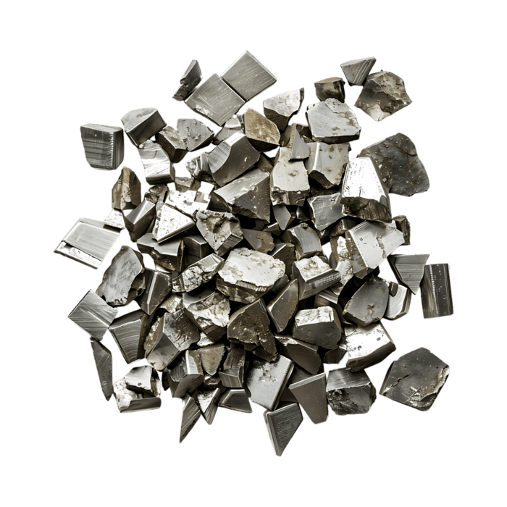
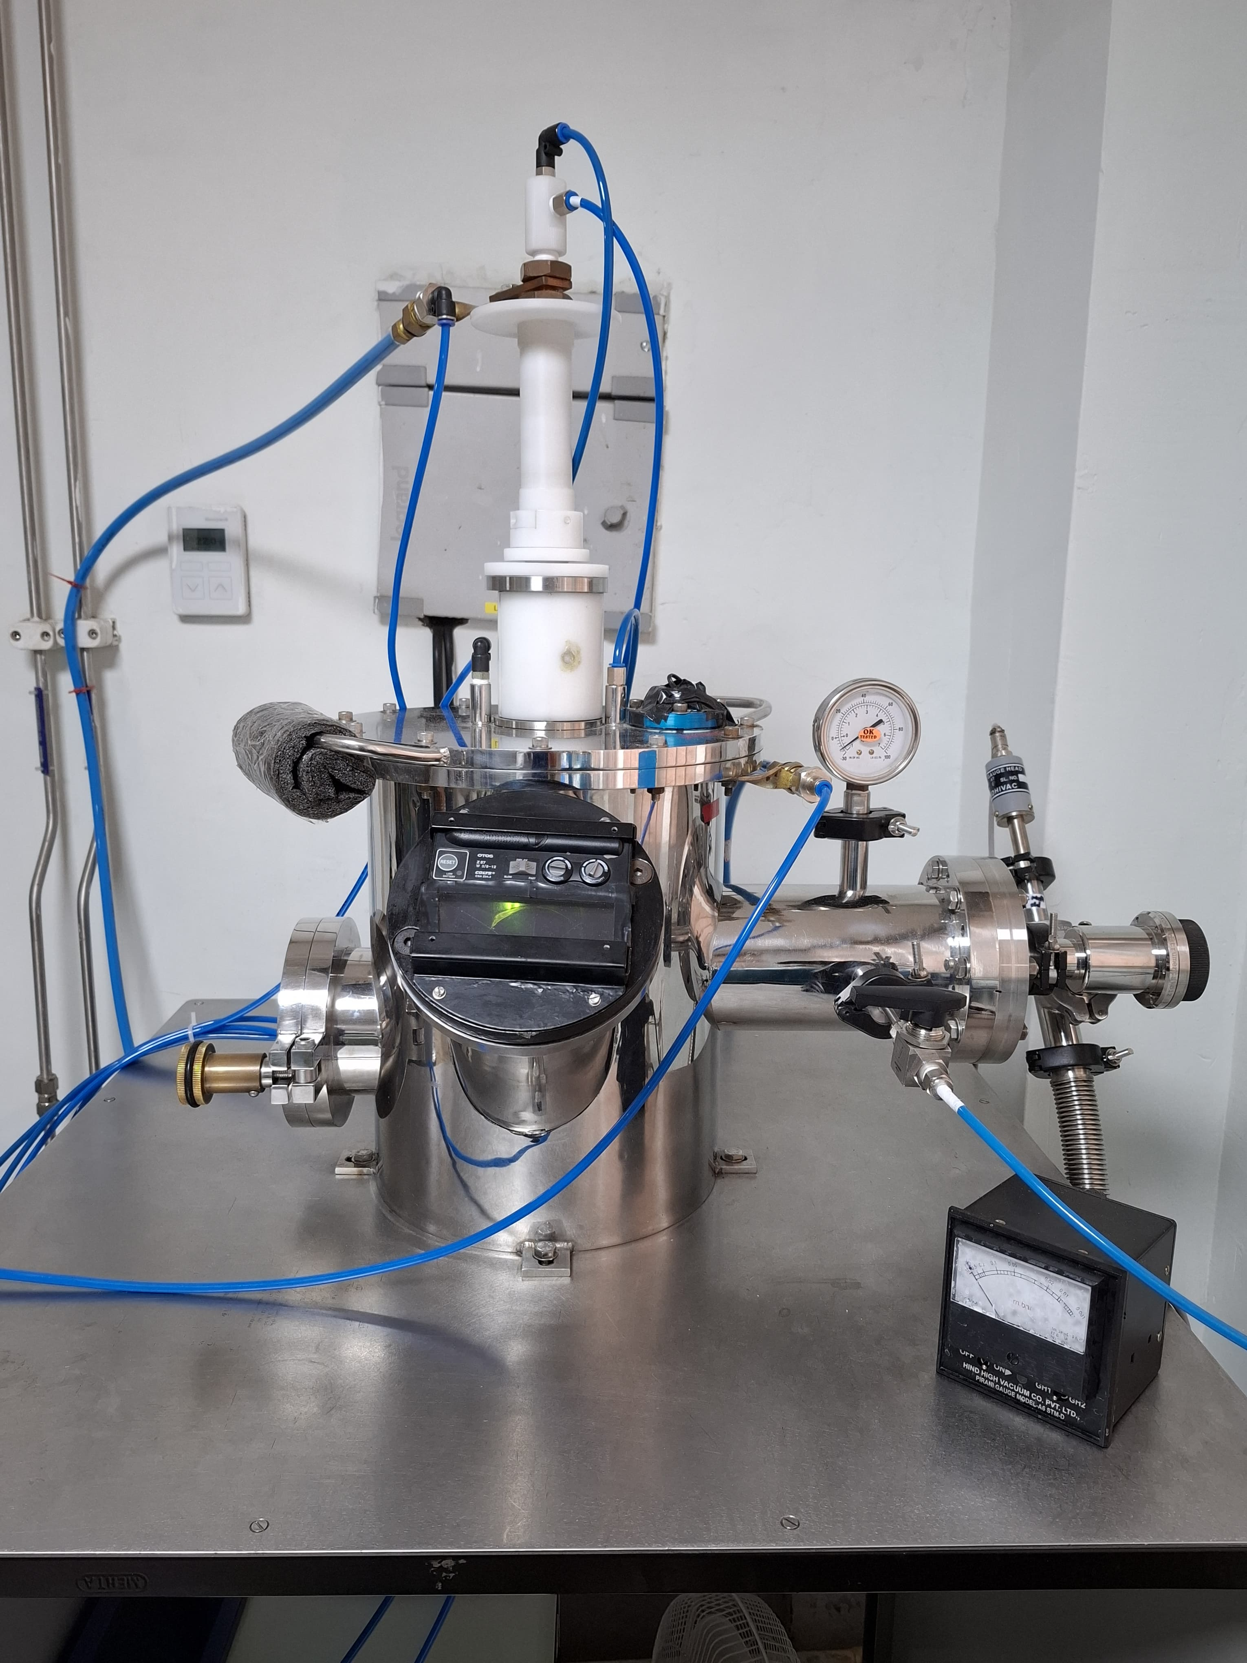
Arc Melting
Uses an electric arc using a non-consumable tungsten electrode to generate high temperature for melting samples.
Sample is melted on a water-cooled copper hearth under high-purity argon atmosphere.
Melting can be performed up to 4000°C temperature hence suitable for elements with high melting point.
Ideal for:
  Polycrystalline alloys
  Intermetallic compounds
  High purity precursor material with low vapor pressure such as Pd, Re, Ti, W etc.
Not suitable for elements with high vapor pressure.
Rod Assembly
Cu Collet
W Electrode
Electric Arc
Ti Getter
Raw Material
Cu Hearth
Chamber
Image not clear, take from phone and insert
Arc Melter

Slide 9
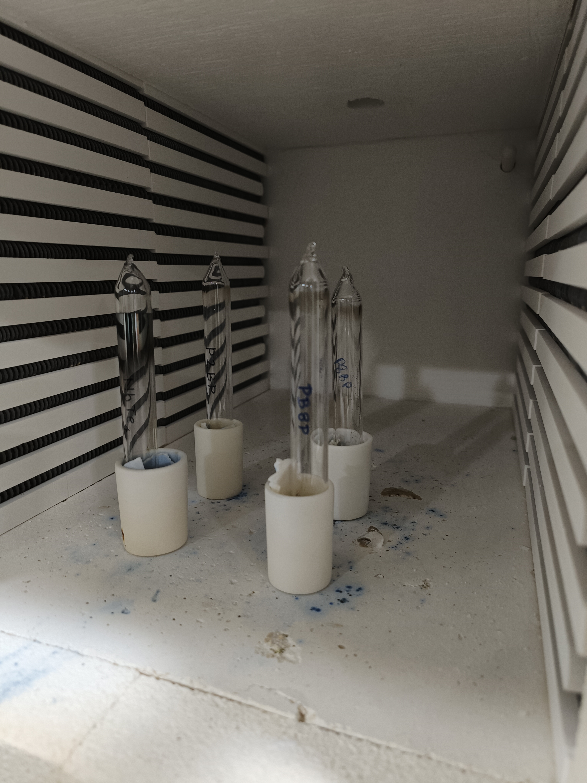

Solid State Reaction
Starting materials: High-purity elemental powders/metals or compounds in their desired stoichiometry ratio
Synthesis cycle: Grinding → Pelletizing → Ambient or vacuum-sealed in a quartz tube→ Heat treatment → Polycrystal
Ideal for: volatile intermetallic, oxides, chalcogenides, pnictides
Not suitable for the compounds with very high melting points such as intermetallic compounds
Solid State Reaction
Box Furnace

Slide 10



Bridgman Growth Technique
Basic Principle:
Crystal growth from a congruent melt under a controlled temperature gradient
Ideal for:
Single crystals of metallic and intermetallic materials with congruent melting point
Temperature Limit:
Maximum temperature up to 1800°C for single-crystal growth
Growth Process:
The solidification moves progressively along the length of the crucible
Not suitable for highly volatile materials
Pulling mechanism
Heating Furnace
Alumina Crucible
Molten Material
Grown crystal
Bridgman Furnace
Furnace Cold Zone
Crucible
Schematic diagram for crystal growth using Bridgman furnace

Slide 11


Flux Growth Technique
Suitable for binary and ternary intermetallic compounds with incongruent melting point
Low temperature flux used to melt down materials with very high melting point
Target material must dissolve in the chosen flux, and the grown single crystals must be chemically or physically separable from the flux (hot centrifugation, acid etching, etc.)
Not suitable for material which form undesirable stable secondary phases with the flux
Quartz tube
Excess flux can be separated from the grown single crystals by using a high-speed centrifuge.
Flux melt
Alumina Crucible
Grown single crystals
Schematic diagram of the single crystal growth​ via flux method
Centrifuge

Slide 12


Chemical Vapor Transport
A reversible gas-phase technique for high-purity single-crystal growth
Controlled temperature gradient
Common transport agents: I₂, SeCl₄, InCl₃ etc.
Typical working temperature range from 400°C to 1250°C, depending on the material
Ideal for:
  Volatile element-based materials including chalcogenides, halides, and pnictides
  Non-volatile solid materials
Not suitable for unstable or incongruently melting compounds
Cold Zone
Hot Zone
Three zone Tubular Furnace

Slide 13




Czochralski Method - Tetra Arc Furnace
4 Electric Arcs: Symmetrical heating between tungsten electrodes and water-cooled copper hearth in inert atmosphere.
Reaches localized melting temperatures ~ 4,000°C (allowing processing of refractory elements without crucibles).
Czochralski pulling technique for single crystal seed pulling directly from the melt.
Ideal for:
  Refractory metals: Nb, Mo, Ta, W, etc.
  Intermetallic Compounds: Rare-earth & Transition-metal systems
Not suitable for compounds with very high vapor pressure
Tetra Arc Furnace

Slide 14



Optical Floating Zone
Versatile and contamination-free technique for growing high purity single crystal
Technique ideal for producing large volume, high-quality crystals
Four mirrors used for uniform temperature profile
Principle
Surface tension supports the molten zone without crucible
Counter-rotating rods are translated to move the molten zone
Material solidifies at the lower interface to produce a single crystal
Feed rod
Molten zone
Focusing
lamp
Optical Floating Zone Furnace
Seed rod
Growth direction
Molten Zone under OFZ Furnace

Slide 15





Optical Floating Zone Furnace
Halogen Lamp
Single crystal growth system up to 2200°C under controlled sample atmosphere
Used for growing a wide range of oxides
Used for growing crystals using Bridgman for materials with sharp phase gradient
Not suitable for highly volatile materials
Xenon Lamp
High temperature single crystal growth system between 1800°C and 3500°C
Four air-cooled xenon lamps 3kW each
Suitable for crystal growth of Carbides, Borides, alloys and oxides with high melting point
Halogen based OFZ Furnace
Xenon based OFZ Furnace
LaB₆
Oxide crystals grown using OFZ
Ruby crystals

Slide 16







Measurement Techniques
Impurity phases are not always visible in structural characterization
Advanced measurement techniques are required for their detection
XRD
Dynacool with ³He
Laue Camera
Dilution Refrigerator
SEM EDAX
SQUID with iQuantum ³He

Slide 17
Bottlenecks to Synthesizing Theoretically Predicted Compounds
“Predicted-but-unmade” compounds stall for a handful of recurring reasons
The Synthesizability Gap
Theory Predicts a Formula, Not a Recipe
3. Precursor, Purity & Thermodynamic Limits
4. Missing Data & a Slow Feedback Cycle
Bottleneck 1: The Synthesizability Gap
Stability ≠ synthesizability: a DFT calculation can flag a structure as thermodynamically stable while saying nothing about whether it's reachable from real starting materials
A lower-symmetry or metastable competing phase often nucleates first and simply never converts to the predicted ground state
Many predicted compounds have several competing polymorphs; standard growth methods offer no lever to select the one that was predicted
Off-stoichiometry, doping, and defects shift which phase actually forms — none of this appears in a 0 K DFT calculation

Slide 18
Bottleneck 2: Theory Predicts a Formula, Not a Recipe
Pulling rate, atmosphere, temperature profile, and cooling rate — the actual knobs on a furnace — have no counterpart in a stability calculation
The same predicted composition can crystallize differently depending on the route chosen, and theory rarely predicts which route yields which structure
The route search is still manual - choosing among arc melting, solid-state reaction, flux growth, Bridgman, CVT, or floating-zone remains trial-and-error guided by chemist intuition
Bottleneck 3: Precursor, Purity & Thermodynamic Limits
Element availability -predicted compositions often include elements that are expensive, radioactive, or simply not available at research-lab purity
Vapor-pressure mismatch - very different vapor pressures, volatile chalcogenides against refractory metals, evaporate unevenly during melting, shifting final composition away from target
Unstable intermediate phases - reaction pathways to the target compound may pass through intermediates that react with the crucible, container, or atmosphere before the target phase can form

Slide 19
Bottleneck 4: Missing Data & a Slow Feedback Cycle
Computational and experimental databases don’t talk to each other: materials-prediction databases and experimental growth logs are built and maintained separately
Partial successes, wrong stoichiometry, right phase/poor crystallinity, are hard to encode as training data even when they are recorded
Challenges to Making the Materials Synthesis Lab Autonomous
Real-time decision-making: operators adjust pulling rate and power by eye — that tacit judgment has no written rule to automate
Sensor-action integration: in-situ cameras, Laue units, and furnace controllers exist separately; closing the loop between them remains undone
Sample handling & transfer: moving a grown ingot to XRD/PPMS without breaking vacuum or introducing contamination is a robotics problem, not just software
No standardized data logging: growth parameters and outcomes are recorded inconsistently across furnaces and users, blocking any model from learning across runs

Slide 20






THANK YOU

