Slide 1
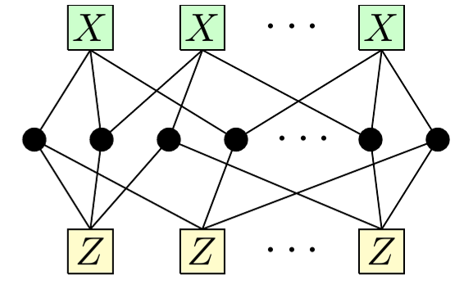














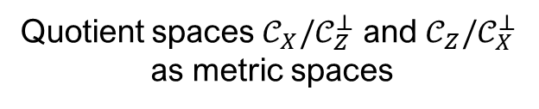

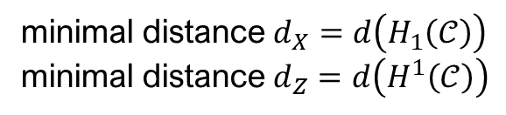
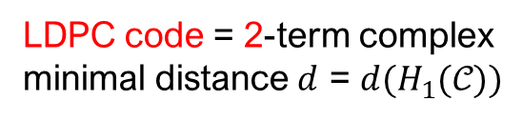
Quantum LDPC codes
Quantum (CSS) LDPC ${⟦n,k,d⟧}_{q}$ code:
A pair of classical LDPC codes $𝒞_{X},𝒞_{Z}⊆𝔽_{q}^{n}$ such that:
$$H_{X}H_{Z}^{T}=0⇔𝒞_{Z}^{⊥}⊆𝒞_{X}⇔𝒞_{X}^{⊥}⊆𝒞_{Z}$$
The parameters:
$n≔\dim{𝔽_{q}^{n}}$
$k≔\dim{𝒞_{X}/𝒞_{Z}^{⊥}}=n−rk H_{X}−rk H_{Z}$,
$d≔\min{(d_{X},d_{Z})}$, $d_{X}≔\min_{c∈𝒞_{X}\backslash 𝒞_{Z}^{⊥}}{|c|}$, $d_{Z}≔\min_{c∈𝒞_{Z}\backslash 𝒞_{X}^{⊥}}{|c|}$.
…
$$𝔽_{q}^{m_{X}}$$
…
$$∂_{1}≔H$$
$$𝔽_{q}^{n}$$
LDPC code = 2-term complex
minimal distance $d$ = $d(H_{1}(𝒞))$
Applications: future fault-tolerant quantum computers
$$𝔽_{q}^{m_{X}}$$
$$∂_{1}≔H_{X}$$
$$𝔽_{q}^{n}$$
$q^{k}$cosets
(codewords)
$$∂_{2}≔H_{Z}^{T}$$
quotient
Hamming
metric
$$𝔽_{q}^{m_{Z}}$$
$$…$$
$$…$$
qLDPC code = 3-term complex
…
$$H_{X}H_{Z}^{T}=0 ⇔∂_{1}∘∂_{2}=0$$
$$…$$
$$…$$
minimal distance $d_{X}=d\left(H_{1}\left(𝒞\right)\right)$
minimal distance $d_{Z}=d\left(H^{1}\left(𝒞\right)\right)$
Quotient spaces $𝒞_{X}/𝒞_{Z}^{⊥}$ and $𝒞_{Z}/𝒞_{X}^{⊥}$
as metric spaces

Slide 2
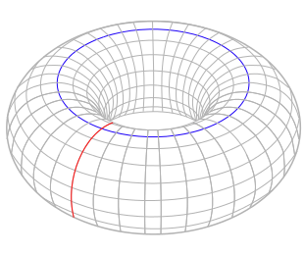
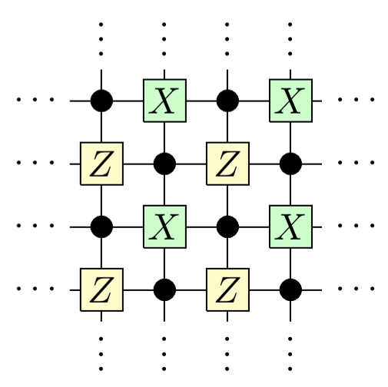






















Topological qLDPC Codes
$$∂_{i+2}$$
$$∂_{i+1}$$
$$∂_{i}$$
$$∂_{i−1}$$
$$⋯$$
$$⋯$$
$$𝒞_{i+1}$$
$$𝒞_{i}$$
$$𝒞_{i−1}$$
topological space
(finite cellulation)
$$∂_{i}∘∂_{i+1}=0$$
vertices: X-checks,
edges: qubits
squares: Z-checks
$$∂_{2}$$
$$∂_{1}$$
$$𝒞_{2}$$
$$𝒞_{1}$$
$$𝒞_{0}$$
$$=$$
$$=$$
$$=$$
$$𝔽^{S}$$
$$𝔽^{E}$$
$$𝔽^{V}$$
faces
2-chains
edges
1-chains
vertices
0-chains
Systole
(the smallest
noncontractible loop)
Kitaev's toric code
$$⟦2L^{2},2,L⟧$$

Slide 3


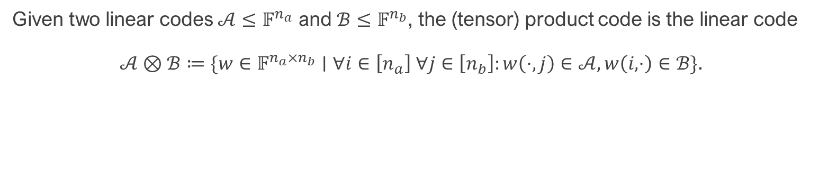

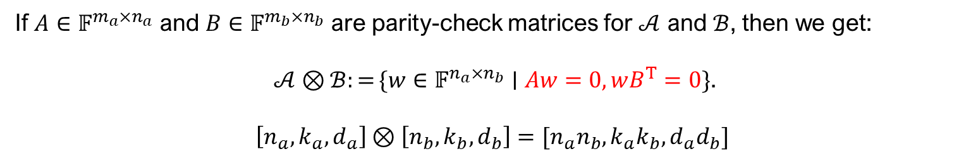






Product Codes
Given two linear codes $𝒜≤𝔽^{n_{a}}$ and $ℬ≤𝔽^{n_{b}}$, the (tensor) product code is the linear code
$𝒜⊗ℬ≔\{w∈𝔽^{n_{a}×n_{b}}∣∀i∈\left[n_{a}\right] ∀j∈\left[n_{b}\right]:w\left(⋅,j\right)∈𝒜, w\left(i,⋅\right)∈ℬ\}$.
$$n_{b}$$
$$𝒜$$
$$n_{a}$$
$$⊗$$
$$=$$
$$ℬ$$
$$𝒜$$
$$ℬ$$
$$𝒜⊗ℬ$$
If $A∈𝔽^{m_{a}×n_{a}}$ and $B∈𝔽^{m_{b}×n_{b}}$ are parity-check matrices for $𝒜$ and $ℬ$, then we get:
$𝒜⊗ℬ:=\{w∈𝔽^{n_{a}×n_{b}}∣Aw=0,wB^{T}=0\}$.
$$\left[n_{a},k_{a},d_{a}\right]⊗\left[n_{b},k_{b},d_{b}\right]=[n_{a}n_{b},k_{a}k_{b},d_{a}d_{b}]$$

Slide 4





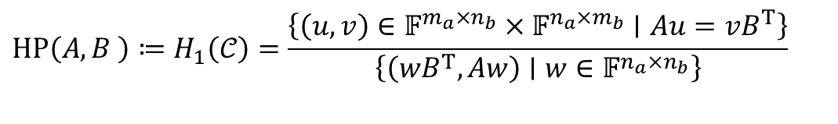
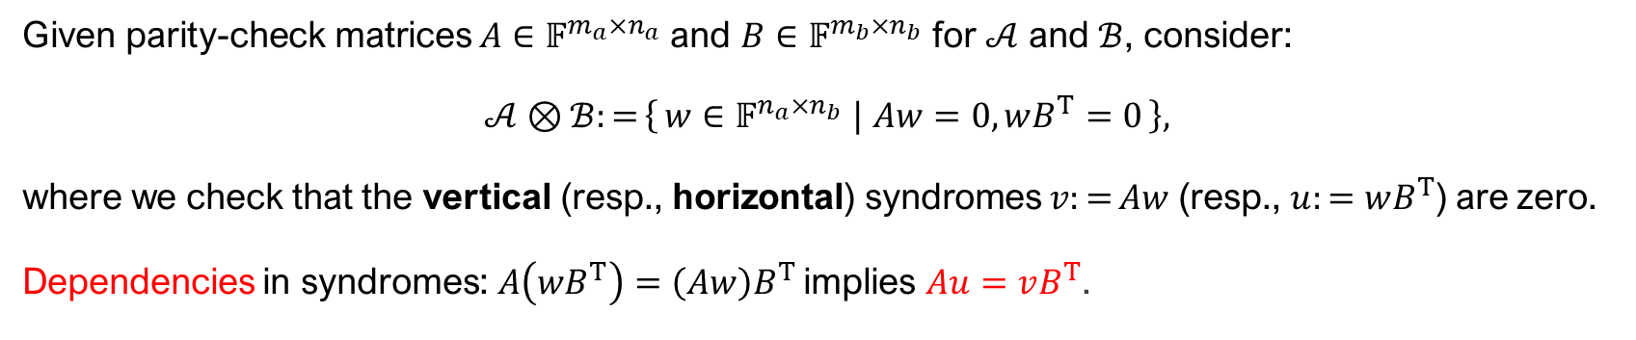







Hypergraph Product Codes
Given parity-check matrices $A∈𝔽^{m_{a}×n_{a}}$ and $B∈𝔽^{m_{b}×n_{b}}$ for $𝒜$ and $ℬ$, consider:
$𝒜⊗ℬ:=\left\{w∈𝔽^{n_{a}×n_{b}} ∣ Aw=0,wB^{T}=0\right\},$
where we check that the vertical (resp., horizontal) syndromes $v:=Aw$ (resp., $u:=wB^{T}$) are zero.
Dependencies in syndromes: $A\left(wB^{T}\right)=\left(Aw\right)B^{T}$ implies $Au=vB^{T}$.
$$u$$
$$v$$
$$𝒞≔(𝒞_{2}\underset{→}{w↦\left(wB^{T}, Aw\right)}𝒞_{1} \underset{→}{\left(u,v\right)↦Au+vB^{T}}𝒞_{0})$$
$$⋅B^{T}$$
$𝒜⊗ℬ≔H_{2}(𝒞$)
1-cycles
$$v$$
$$A⋅$$
$$A⋅$$
$$𝒞_{0}$$
$$HP\left(A,B \right)≔H_{1}\left(𝒞\right)=\frac{\left\{\left(u,v\right)∈𝔽^{m_{a}×n_{b}}×𝔽^{n_{a}×m_{b}}∣Au=vB^{T}\right\}}{\left\{\left(wB^{T},Aw\right)∣w∈𝔽^{n_{a}×n_{b}}\right\}}$$
$$⋅B^{T}$$
1-boundaries
$$w$$
$$u$$
$$𝒞_{2}$$
$$𝒞_{1}$$

Slide 5

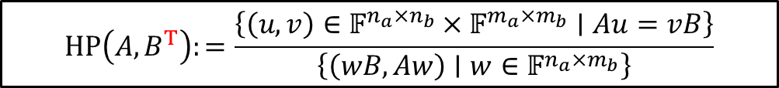


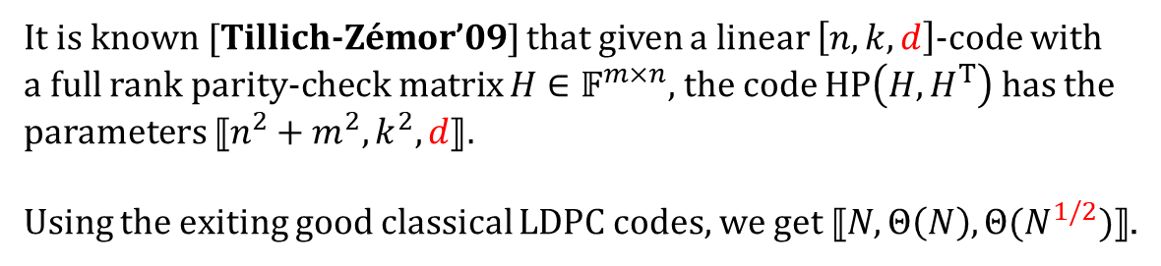




Hypergraph Product Codes
$$⋅B$$
$$v$$
$$HP\left(A,B^{T}\right):=\frac{\left\{\left(u,v\right)∈𝔽^{n_{a}×n_{b}}×𝔽^{m_{a}×m_{b}}∣Au=vB\right\}}{\left\{\left(wB,Aw\right)∣w∈𝔽^{n_{a}×m_{b}}\right\}}$$
$$A⋅$$
$$A⋅$$
$$⋅B$$
$$𝒞_{2}\underset{→}{w↦\left(wB, Aw\right)}𝒞_{1} \underset{→}{\left(u,v\right)↦Au+vB}𝒞_{0}$$
$$w$$
$$u$$
It is known [Tillich-Zémor’09] that given a linear $\left[n,k,d\right]$-code with a full rank parity-check matrix $H∈𝔽^{m×n}$, the code $HP\left(H,H^{T}\right)$ has the parameters $⟦n^{2}+m^{2},k^{2},d⟧$.
Using the exiting good classical LDPC codes, we get $⟦N,Θ\left(N\right),Θ(N^{1/2})⟧$.
Question: can we generalize HP codes to get qLDPC codes with better parameters?

Slide 6





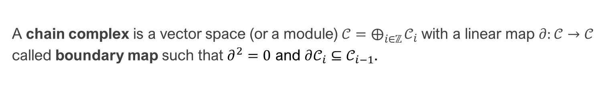











(co)Chain Complexes
A chain complex is a vector space (or a module) $𝒞=⨁_{i∈ℤ}^{​}{𝒞_{i}}$ with a linear map $∂:𝒞→𝒞$ called boundary map such that $∂^{2}=0$ and $∂𝒞_{i}⊆𝒞_{i−1}$.
$$∂_{i+2}$$
$$∂_{i+1}$$
$$∂_{i}$$
$$∂_{i−1}$$
$$∂_{2}$$
$$∂_{1}$$
$$⋯$$
$$⋯$$
$$𝒞_{2}$$
$$𝒞_{1}$$
$$𝒞_{0}$$
$$𝒞_{i+1}$$
$$𝒞_{i}$$
$$𝒞_{i−1}$$
$$=$$
$$=$$
$$=$$
$$𝔽^{S}$$
$$𝔽^{E}$$
$$𝔽^{V}$$
faces
2-chains
edges
1-chains
vertices
0-chains
$$∂_{i}∘∂_{i+1}=0, where ∂_{i}≔∂|_{𝒞_{i}}$$
$$B_{i}\left(𝒞\right)=im{∂_{i+1}}⊆Z_{i}\left(𝒞\right)=\ker{∂_{i}}$$
$i$-boundaries
$i$-cycles
$H_{i}(𝒞)≔Z_{i}\left(𝒞\right)$/$B_{i}\left(𝒞\right)$
$i$-th homology group
$$∂_{i+2}^{T}$$
$$∂_{i+1}^{T}$$
$$∂_{i}^{T}$$
$$∂_{i−1}^{T}$$
$$⋯$$
$$⋯$$
$$\dim{H_{1}\left(𝒞\right)=H^{1}\left(𝒞\right)}=2$$
$$𝒞_{i+1}$$
$$𝒞_{i}$$
$$𝒞_{i−1}$$

Slide 7
Tensor product of Chain Complexes
Tensor product: $𝒞=𝒜⊗ℬ$of chain complexes $𝒜,ℬ$.
$𝒞_{k}=⨁_{i+j=k}{𝒜_{i}⊗ℬ_{j}}$
$∂\left(a⊗b\right)≔∂a⊗b+a⊗∂b$
Cartesian product: $X×Y$
Cartesian box product: $X□Y=sk_{1} X×Y$
$$X$$
$$×$$
$$=$$
$$Y$$
$$X×Y$$
$$⋯$$
$$⋯$$
$$∂_{i}^{𝒜}$$
$$∂_{i}^{𝒜}⊗id$$
$$∂_{j}^{ℬ}$$
$$id⊗∂_{j}^{ℬ}$$
$$𝔽^{X_{i}}$$
$$⊗$$
$$⋯$$
$$⋯$$
$$=$$
$$⋯$$
$$⋯$$
$$𝔽^{Y_{i}}$$
$$𝔽^{{X_{i}×Y}_{i}}$$
$$⋯$$
$$⋯$$
$$𝒞_{k}$$

Slide 8
Lifted Product Codes

Slide 9
Lifts of Graphs, Codes, Circuits, etc.
a graph Γ with some fixed edge orientation (base graph).
a set $F$ of size $ℓ$ (fiber), typically $F=G$ is a group (e.g., $F=C_{ℓ}$)
a map $α:e∈E\left(Γ\right)↦α_{e}∈Sym F$ (lifting map, voltage assignment, …)
$$0$$
$$1$$
$$2$$
$$0$$
$$1$$
$$2$$
+
+
3-lift
+
+
+
+
+
+
$$α_{e}(x)$$
$$α_{e}$$
$ℓ$-lift
$$…$$
$$…$$
$$0$$
$$0$$
$$2$$
$$1$$
$$…$$
$$…$$
$$x$$
$$0$$
$$1$$
$$2$$
$$0$$
$$1$$
$$2$$
$$0$$
$$1$$
$$2$$
base code
lifted code
base graph $Γ$
lifted graph $Γ^{α}$
($ℓ$-fold cover of $Γ$)
$$V(Γ^{α})≔V\left(Γ\right)×F$$
$$E\left(Γ^{α}\right)≔E\left(Γ\right)×F$$
$$H=\left(\begin{matrix}1 & 1 & 0 \\ 0 & 1 & 1\end{matrix}\right)∈𝔽^{2×3}$$
$$H=\left(\begin{matrix}x^{0} & x^{2} & 0 \\ 0 & x^{0} & x^{1}\end{matrix}\right)∈R^{2×3}$$
Group $G=ℤ_{3}$
$x↦x+s (mod 3)$
$$\left(\begin{matrix}0 & 0 & 1 \\ 1 & 0 & 0 \\ 0 & 1 & 0\end{matrix}\right)$$
Lift: $𝔽→R=𝔽[G]$

Slide 10
Lifted LDPC codes
Almost all good classical LDPC are obtained as lifts of a small base code.
Question. Can we do something similar with quantum LDPC codes?
Answer. Yes (spoiler: use a lift ${\left(𝒜□ℬ\right)}^{α}$ of the product of two graphs $𝒜$ and $ℬ$)
…
$ℓ$-lift
…
…
$$g_{1}$$
…
$$g_{m}$$
base code
$$[n, k, d]$$
lifted code
$$[N=ℓn,K≥ℓk, D=Ω(ℓ)]$$
…
…
X
X
X
X
X
X
$ℓ$-lift
$$g_{1}$$
…
…
…
$$g_{m}$$
…
Z
Z
Z
Z
Z
Z
base code
$$⟦n, k, d⟧$$
lifted code
$$⟦N=ℓn,K≥ℓk,D=Ω(ℓ)⟧$$

Slide 11

Lifted Product Codes
Key idea: $𝔽→$ $R=𝔽\left[G\right]≅𝔽^{|G|}$ (group algebra). For example, $𝔽\left[C_{ℓ}\right]≅𝔽[x]/(x^{ℓ}−1)$.
Classical code (block-wise product code):
$$𝒜⊗_{R}ℬ:=\left\{w∈R^{n_{a}×n_{b}} ∣ Aw=0,wB^{T}=0\right\}$$
$=\{w∈R^{n_{a}×n_{b}}∣∀i∈\left[n_{a}\right] ∀j∈\left[n_{b}\right]:w\left(⋅,j\right)∈𝒜,w\left(i,⋅\right)∈ℬ\}$
$$⋅B$$
If $\left|G\right|=Θ(N)$, we get:
$\left[N,Θ(N),Θ(N)\right]⊗_{R}\left[N,Θ(N),Θ(N)\right]=[Θ(N),Θ(N),Θ(N)]$
$$A⋅$$
$$A⋅$$
Quantum code (block-wise hypergraph product code):
$$LP\left(A,B^{T}\right):=\frac{\{\left(u,v\right)∈R^{n_{a}×n_{b}}×R^{m_{a}×m_{b}}∣Au=vB\}}{\{\left(wB,Aw\right)∣w∈R^{n_{a}×m_{b}}\}}$$
$$⋅B$$
$$𝒞_{2}\underset{→}{w↦\left(wB, Aw\right)}𝒞_{1} \underset{→}{\left(u,v\right)↦Au+vB}𝒞_{0}$$
If $\left|G\right|=Θ(N)$, we get $⟦Θ\left(N\right),Θ\left(N\right),d= ? ⟧$
For example, if $A=B$ we get only $d=O(1)$.

Slide 12
Generalized Bicycle Codes (left-right codes)
Special case: $LP(a,b)$, where $a,b∈R=𝔽[G]$
$a=a_{1}+…+a_{Δ}$, $b=b_{1}+…+b_{Δ}$
$$v$$
$$b_{1}$$
$$X$$
$$…$$
$$LP\left(a,b\right):=\frac{\{\left(u,v\right)∈R^{2}∣au=vb\}}{\{\left(wb,aw\right)∣w∈R\}}$$
$$R\underset{→}{w↦\left(wb, aw\right)}R^{2} \underset{→}{\left(u,v\right)↦au+vb}R$$
$$b_{Δ}$$
$$a_{1}$$
$$…$$
$$a_{Δ}$$
$$a_{1}$$
$$…$$
$$a_{Δ}$$
$$b_{1}$$
Examples:
$LP(1+x,1+y)$, $G=C_{ℓ}^{2}$ – Kitaev toric codes
$LP(a,b)$, $G$ – abelian [Haah’11, KP’13, PK’19, IBM’23] (beat surface code!)
$LP(a,b)$, $G$ – non-abelian (Hastings’ left-right codes, 2014-2018)
$$…$$
$$Z$$
$$u$$
$$b_{Δ}$$
Tanner graphs for $LP(a,b)$ are left-right Cayley graphs!
arXiv:1812.02101

Slide 13
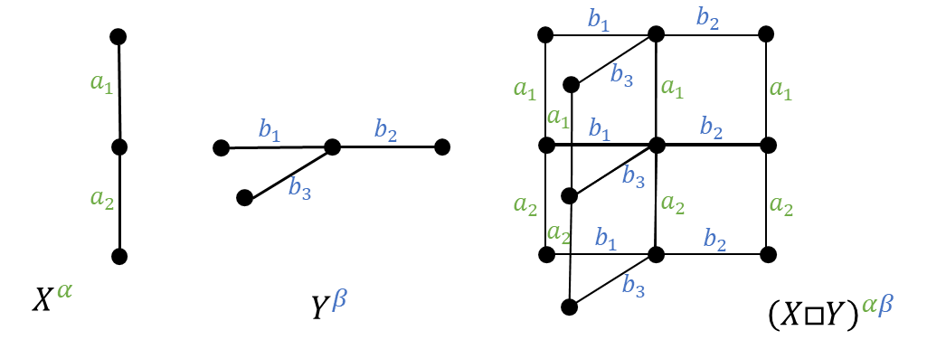
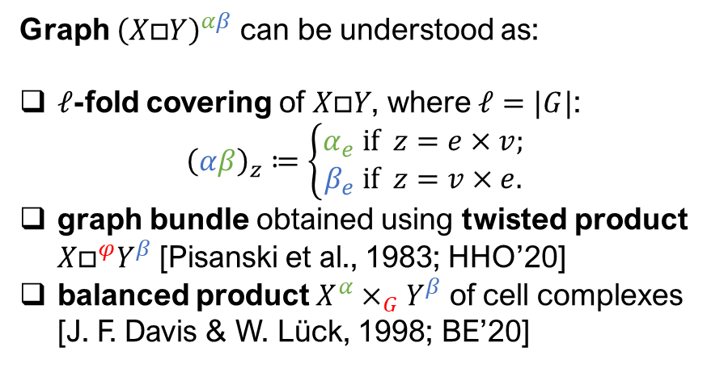
Lifted Product Complex
Graph ${\left(X□Y\right)}^{αβ}$ can be understood as:
$ℓ$-fold covering of $X□Y$, where $ℓ=|G|$: ${\left(αβ\right)}_{z}≔\left\{\begin{aligned}α_{e} if z=e×v; \\ β_{e} if z=v×e.\end{aligned}\right.$
graph bundle obtained using twisted product $X□^{φ}Y^{β}$ [Pisanski et al., 1983; HHO’20]
balanced product $X^{α}×_{G}Y^{β}$ of cell complexes [J. F. Davis & W. Lück, 1998; BE’20]

Slide 14
HDX-based Codes

Slide 15

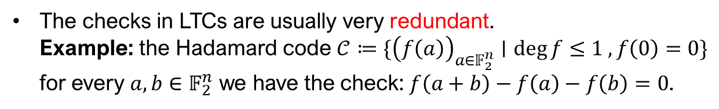
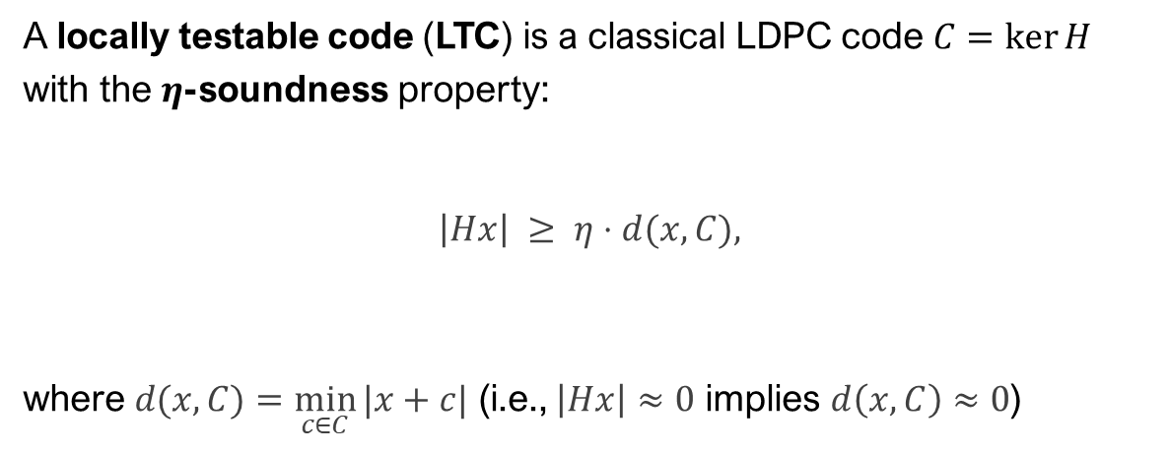








Classical LTCs
A locally testable code (LTC) is a classical LDPC code $C=\ker{H}$ with the $η$-soundness property:
$$\left|Hx\right| ≥ η⋅d(x,C),$$
where $d(x,C)=\min_{c∈C}{|x+c|}$ (i.e., $\left|Hx\right|≈0$ implies $d\left(x,C\right)≈0$)
$$d\left(x,𝒞\right)$$
$$x$$
$$𝔽^{n}$$
$$𝒞$$
syndrome weight
error
weight
$$H$$
$$Hx$$
$$\left|Hx\right|$$
$$0$$
$$𝔽^{m}$$
The checks in LTCs are usually very redundant. Example: the Hadamard code $𝒞≔\{{\left(f\left(a\right)\right)}_{a∈𝔽_{2}^{n}}∣\deg{f}≤1 ,f\left(0\right)=0\}$ for every $a,b∈𝔽_{2}^{n}$ we have the check: $f\left(a+b\right)−f\left(a\right)−f\left(b\right)=0$.
meta-checks
LTCs are used in probabilistically checkable proofs (PCPs)
…
checks
…
bits
LTC

Slide 16







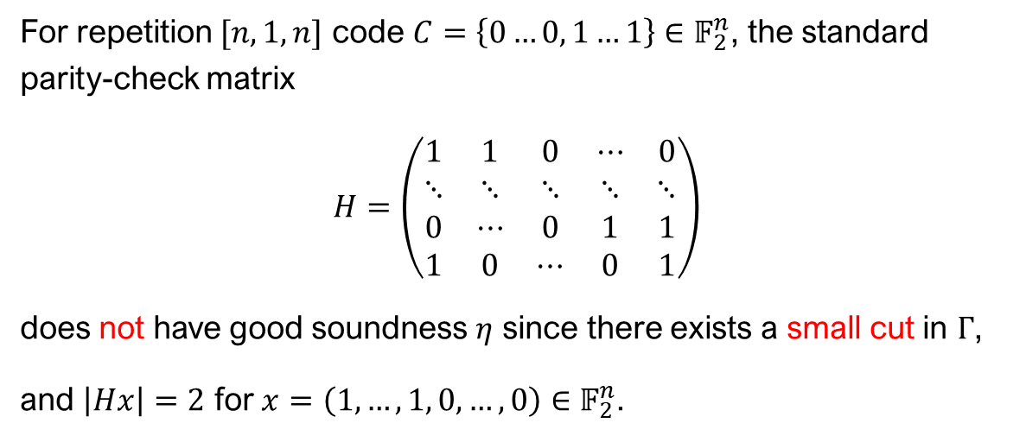













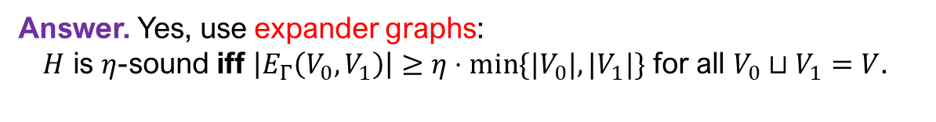
Are Repetition Codes LTCs?
For repetition $[n,1,n]$ code $C=\left\{0…0, 1…1\right\}∈𝔽_{2}^{n}$, the standard parity-check matrix
$$H=\left(\begin{matrix}1 & 1 & 0 & ⋯ & 0 \\ ⋱ & ⋱ & ⋱ & ⋱ & ⋱ \\ 0 & ⋯ & 0 & 1 & 1 \\ 1 & 0 & ⋯ & 0 & 1\end{matrix}\right)$$
does not have good soundness $η$ since there exists a small cut in $Γ$,
and $\left|Hx\right|=2$ for $x=\left(1,…,1, 0,…,0\right)∈𝔽_{2}^{n}$.
checks
$$1$$
$$1$$
$$v$$
$$1$$
bits
$$e$$
$$e′$$
$$⋯$$
$$⋯$$
$$1$$
$$1$$
$$0$$
$$0$$
$$⋯$$
$$⋯$$
$$0$$
$$0$$
The matrix $H$ is the coboundary operator $δ$ for $Γ=(V,E)$:
$𝔽_{2}^{V}\underset{→}{δ}𝔽_{2}^{E}$, where $δv=e+e′$.
$$0$$
$$V_{0}$$
Question. Can we find sparse graphs $Γ$ with only large cuts?
Answer. Yes, use expander graphs:
$H$ is $η$-sound iff $\left|E_{Γ}\left(V_{0},V_{1}\right)\right|≥η⋅\min{\{{|V}_{0}|,|V_{1}|\}}$ for all $V_{0}⊔V_{1}=V$.
syndrome
weight
error
weight
$$V_{1}$$

Slide 17







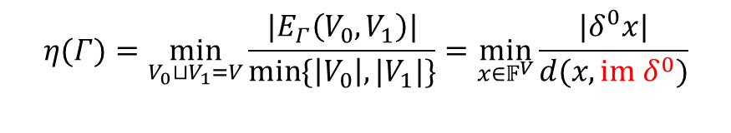

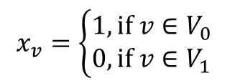



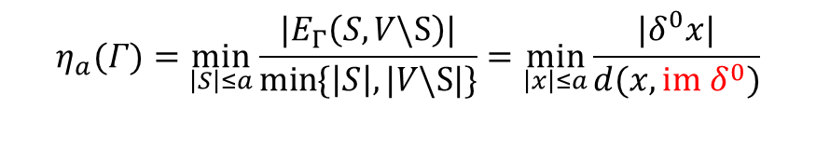
Coboundary Expansion
generator
matrix
parity-check matrix
Correspondence
$$δ^{0}$$
$$δ^{1}$$
$$x_{v}=\left\{\begin{aligned}1, if v∈V_{0} \\ 0, if v∈V_{1}\end{aligned}\right.$$
$$↔$$
$$δ^{1}∘δ^{0}=0,$$
$$V_{0}⊔V_{1}=V$$
$$𝔽_{2}$$
$$𝔽_{2}^{V}$$
$$𝔽_{2}^{E}$$
Since $im δ^{0}=\left\{1…1, 0…0\right\}$, we have:
$$η(Γ)=\min_{V_{0}⊔V_{1}=V}{\frac{|E_{Γ}\left(V_{0},V_{1}\right)|}{\min{\{\left|V_{0}\right|,|V_{1}|\}}}}=\min_{x∈𝔽^{V}}{\frac{|δ^{0}x|}{d(x,im δ^{0})}}$$
coboundary expansion of $Γ$ (Cheeger constant)
$$V_{0}$$
$$η_{a}(Γ)=\min_{\left|S\right|≤a}{\frac{|E_{Γ}\left(S,V\backslash S\right)|}{\min{\{\left|S\right|,|V\backslash S|\}}}}=\min_{\left|x\right|≤a}{\frac{|δ^{0}x|}{d(x,im δ^{0})}}$$
$$V_{1}$$
small set version

Slide 18
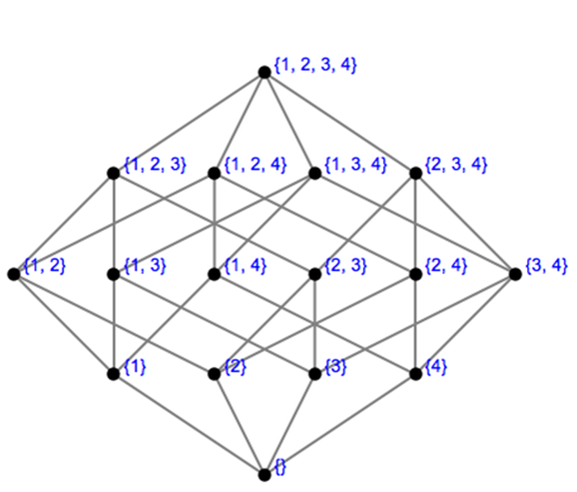


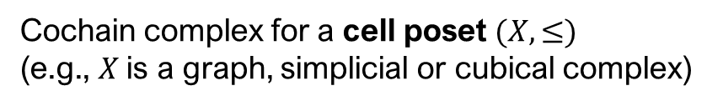
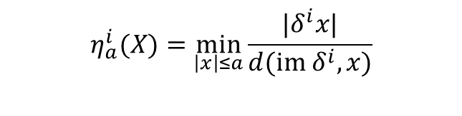







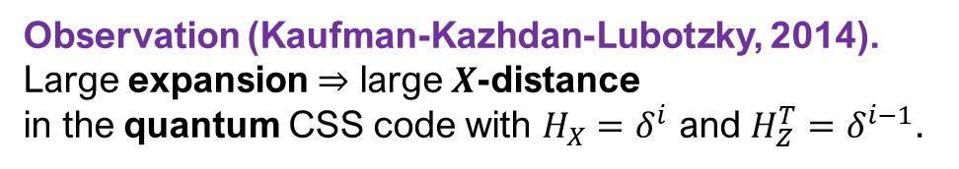




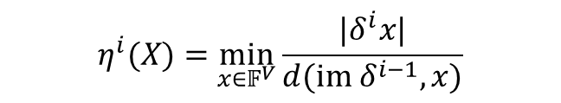




High-dimensional Expanders (HDXs)
Hasse diagram of $X$
Cochain complex for a cell poset $(X,≤)$
(e.g., $X$ is a graph, simplicial or cubical complex)
$$X(3)$$
$$δ^{i−1}$$
$$δ^{i}$$
$$X(2)$$
$$⋯$$
$$⋯$$
$$𝔽_{2}^{X(i−1)}$$
$$𝔽_{2}^{X(i)}$$
$$𝔽_{2}^{X(i+1)}$$
$$X(1)$$
$$δ^{i}∘δ^{i−1}=0$$
$$η^{i}(X)=\min_{x∈𝔽^{V}}{\frac{|δ^{i}x|}{d(im δ^{i−1}, x)}}$$
$$η_{a}^{i}(X)=\min_{\left|x\right|≤a}{\frac{|δ^{i}x|}{d(im δ^{i}, x)}}$$
$$X(0)$$
coboundary expansion in dimension $i$
small set version
($≈$ cosystolic expansion)
$$X(−1)$$
Observation (Kaufman-Lubotzky, 2014).
Large expansion $⇒$ large soundness
for the classical code with ${H=δ}^{i−1}$.
Observation (Kaufman-Kazhdan-Lubotzky, 2014).
Large expansion $⇒$ large $X$-distance in the quantum CSS code with $H_{X}=δ^{i}$ and $H_{Z}^{T}=δ^{i−1}$.
Evra-Kaufman-Zémor, 2020

Slide 19


Quantum Locally Testable Codes (qLTCs)
X
X
X-meta-checks
$\ker{H_{X}}$ is LTC
X-checks
qubits
(4D code)
Z-checks
$\ker{H_{Z}}$ is LTC
Z
Z
Z-meta-checks
qLTC
Applications: very simple linear time decoder, possibly useful for qPCPs

Slide 20



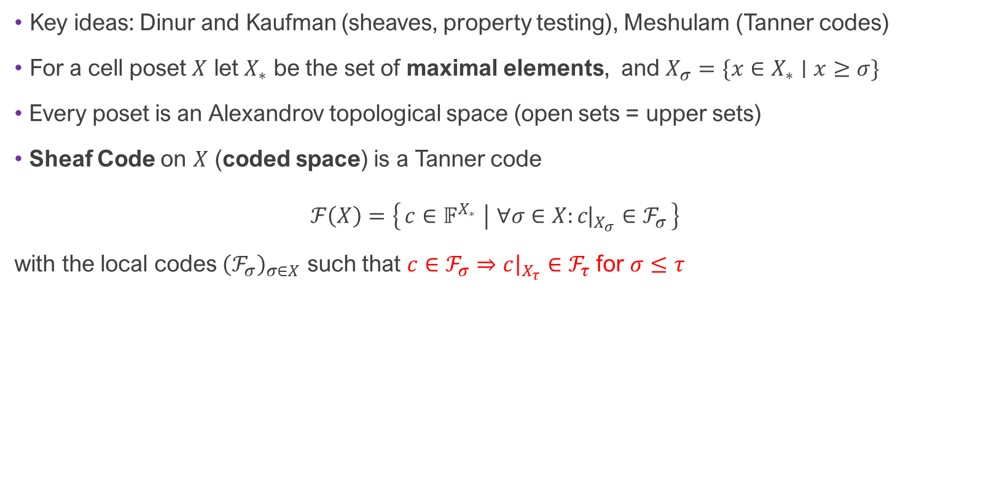




Sheaf Codes = Code + Sheaf of Linear Codes
Key ideas: Dinur and Kaufman (sheaves, property testing), Meshulam (Tanner codes)
For a cell poset $X$ let $X_{∗}$ be the set of maximal elements, and $X_{σ}=\{x∈X_{∗}∣x≥σ\}$
Every poset is an Alexandrov topological space (open sets = upper sets)
Sheaf Code on $X$ (coded space) is a Tanner code $ℱ\left(X\right)=\left\{c∈𝔽^{X_{∗}} ∣ ∀σ∈X:{c\text{|}}_{X_{σ}}∈ℱ_{σ}\right\}$
with the local codes ${\left(ℱ_{σ}\right)}_{σ∈X}$ such that $c∈ℱ_{σ}⇒c{\left.​\right|}_{X_{τ}}∈ℱ_{τ}$ for $σ≤τ$
2
$$ℱ_{σ}$$
$$U_{j}$$
(codimension)
1
$$ℱ_{τ}$$
$$U_{i}$$
0
$$𝔽^{X_{∗}}$$
$$ℱ\left(U\right)=\{c∈𝔽^{X_{U}}∣∀σ∈U:{c\text{|}}_{X_{σ}}∈ℱ_{σ}\}$$
$$𝔽^{X_{τ}}$$

Slide 21













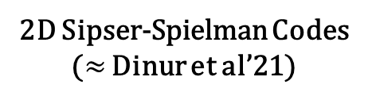


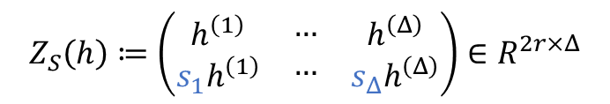





















High-dimensional Sipser-Spielman Codes
1D Sipser-Spielman Codes
(Zémor codes)
2D Sipser-Spielman Codes ($≈$ Dinur et al’21)
$$s_{1}$$
$$\ker{h_{a}}⊗\ker{h_{b}}$$
$$s_{1}$$
$$\ker{h_{a}}⊗\ker{h_{b}}$$
$$\ker{h}$$
$$…$$
$$\ker{h}$$
$$…$$
$$s_{Δ}$$
$$s_{Δ}$$
$$s_{1}$$
$$…$$
$$s_{Δ}$$
$$s_{1}$$
$$…$$
$$s_{Δ}$$
$$Z_{S}\left(h\right)≔\left(\begin{matrix}\begin{aligned}h^{\left(1\right)} \\ s_{1}h^{\left(1\right)}\end{aligned} & \begin{aligned}… \\ …\end{aligned} & \begin{aligned}h^{\left(Δ\right)} \\ s_{Δ}h^{\left(Δ\right)}\end{aligned}\end{matrix}\right)∈R^{2r×Δ}$$
$$s_{1}$$
$$…$$
$$\ker{h_{a}}⊗\ker{h_{b}}$$
$$s_{Δ}$$
$$\ker{h_{a}}⊗\ker{h_{b}}$$
Local codes satisfy: $d(\ker{h)=Ω(Δ^{\frac{1}{2}+ε}})$
Local codes satisfy: $d(\ker{h_{a},\ker{h_{b}})=Ω(Δ^{\frac{1}{2}+ε}})$
local code $ker h$
local code $\ker{h_{a}}⊗\ker{h_{b}}$
$$⋯$$
local code $𝔽$
local codes $\ker{h_{a},}\ker{h_{b}}$
$$⋯$$
$$⋯$$
local codes $𝔽$
$$⋯$$
$$⋯$$
$𝔽^{X_{1}}$ (bits are on edges, i.e., 1-cells)
$𝔽^{X_{2}}$ (bits are on 2-cells)
$$⋯$$

Slide 22
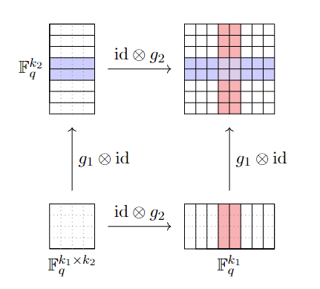

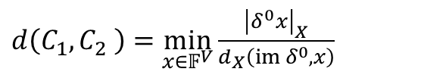


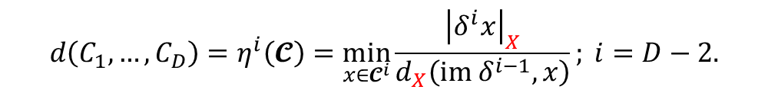


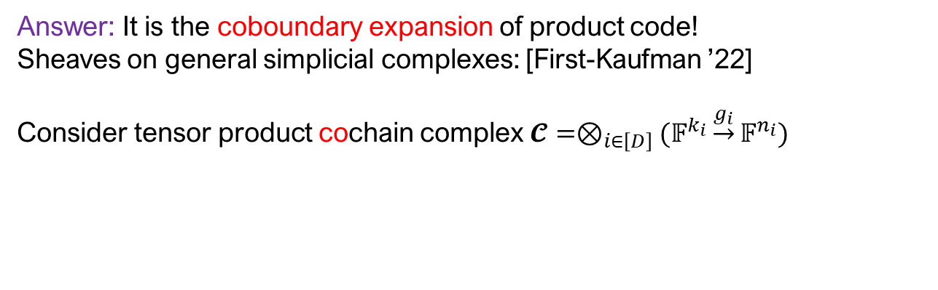

What is $d\left(C_{1},…,C_{D}\right)$?
Answer: It is the coboundary expansion of product code!
Sheaves on general simplicial complexes: [First-Kaufman ’22]
Consider tensor product cochain complex $𝓒=⊗_{i∈\left[D\right]}(𝔽^{k_{i}}\underset{→}{g_{i}}𝔽^{n_{i}})$
$${d\left(C_{1},…,C_{D}\right)=η}^{i}\left(𝓒\right)=\min_{x∈𝓒^{i}}{\frac{{\left|δ^{i}x\right|}_{X}}{d_{X}\left(im δ^{i−1}, x\right)}}; i=D−2.$$
$$𝔽$$
$$𝒞_{2}$$
$$𝒞_{1}$$
$$𝒞_{2}$$
$$𝒞_{1}$$
$$𝒞_{2}$$
Tanner code on bipartite graph
$d\left(C_{1},C_{2} \right)=$ $\min_{x∈𝔽^{V}}{\frac{{\left|δ^{0}x\right|}_{X}}{d_{X}\left(im δ^{0}, x\right)}}$

Slide 23
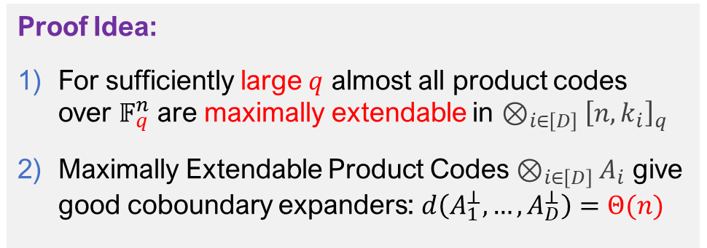
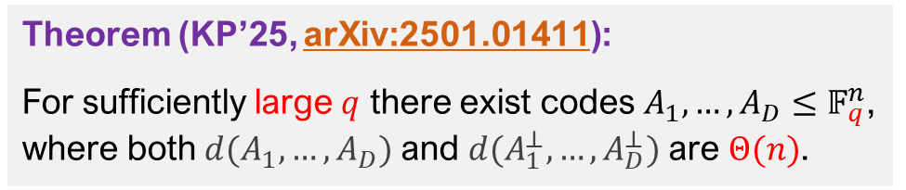


Towards Good qLTCs
(4D code)
X
X
X-meta-checks
Theorem (KP’25, arXiv:2501.01411):
For sufficiently large $q$ there exist codes $A_{1},…,A_{D}≤𝔽_{q}^{n}$, where both$d(A_{1},…,A_{D})$ and $d(A_{1}^{⊥},…,A_{D}^{⊥})$ are $Θ(n)$.
$\ker{H_{X}}$ is LTC
X-checks
qubits
Z-checks
Proof Idea:
For sufficiently large $q$ almost all product codes over $𝔽_{q}^{n}$ are maximally extendable in $⊗_{i∈\left[D\right]}{\left[n,k_{i}\right]}_{q}$
Maximally Extendable Product Codes $⊗_{i∈\left[D\right]}A_{i}$ give good coboundary expanders: $d\left(A_{1}^{⊥},…,A_{D}^{⊥}\right)=Θ(n)$
$\ker{H_{Z}}$ is LTC
Z
Z
Z-meta-checks
qLTC
Almost good qLTCs
I. Dinur, T.-C. Lin, and T. Vidick, “Expansion of higher-dimensional cubical complexes with application to quantum locally testable codes”, (2024) arXiv:2402.07476

