Slide 1
Machine Learning for HEP
Tommaso Dorigo, INFN-Padova
ICTS, November 22, 2021

Slide 2
Notes on my lecture
My slides are full of text!
this makes it harder to focus on what I actually say during the lecture...
On the other hand, they offer clarity for offline consumption / consultation
Try to pay attention to me rather than on the projected text. You will probably get the gist of it sooner.
I have way too much material
the subject is vast! We will have to skip some things (marked with * in title)
I left the slides there for possible offline use
I am (virtually) here at your service
Some of the things we will go over are highly non-intuitive, so I expect you to be confused if you have no previous understanding of a topic.
hence please ask questions if you do not understand something. You need not raise your hand, just speak up.
I will be at your service also after the school
please email me at tommaso.dorigo@gmail.com if you have nasty questions on the topics covered during the lectures, and I will do my best to answer them.

Slide 3
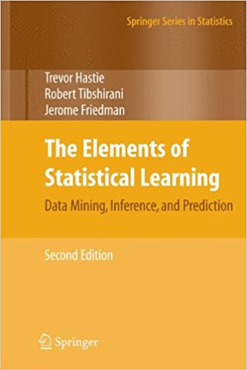
Suggested reading
This lecture is based on a number of different sources, as well as on some personal alchemy
I tried to provide references but sometimes I failed [apologies...]
A formal treatment of most of the covered material, and more in-depth than what I can go here, is offered in a couple of excellent textbooks:
Hastie, Tibshirani, Friedman:
The elements of statistical learning
→ AVAILABLE ONLINE FOR FREE!
Narsky, Porter: Statistical Analysis techniques in Particle Physics, Wiley

Slide 4
* Other credits
Besides the textbooks quoted above, the production of this lecture also benefited from perusing additional assorted material:
Trevor Hastie's lectures on Statistical Learning, Padova 2017
Some material from Michael Kagan's lectures at TASI 2017
One or two ideas from Ilya Narsky's lectures on ML with MatLab, 2018
A couple of graphs from Lorenzo Moneta's lecture at last year's school
Some slides from interesting presentations at ACAT 2019
Plus random plots / stuff I collected around

Slide 5
Contents - 1
Part 1: An introduction to Machine Learning
Introduction
Map of ML problems
Supervised and unsupervised learning
Density estimation
kNN
Divergence measures
Resampling techniques
The data
The model

Slide 6
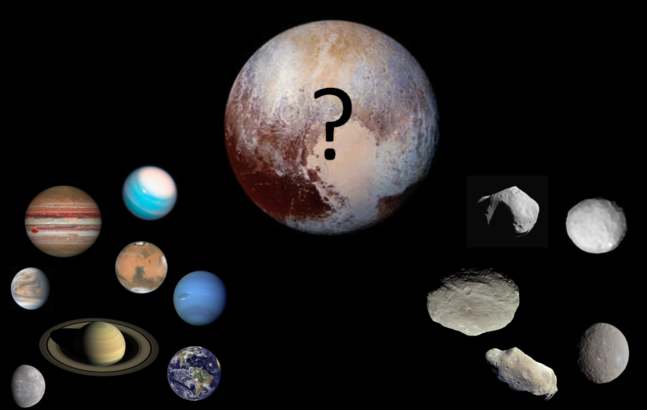
Contents - 2
Part 2: Classification and decision trees
Classification
Loss minimization
A few methods
Fisher linear discriminants
Decision trees
random forests
boosting techniques

Slide 7
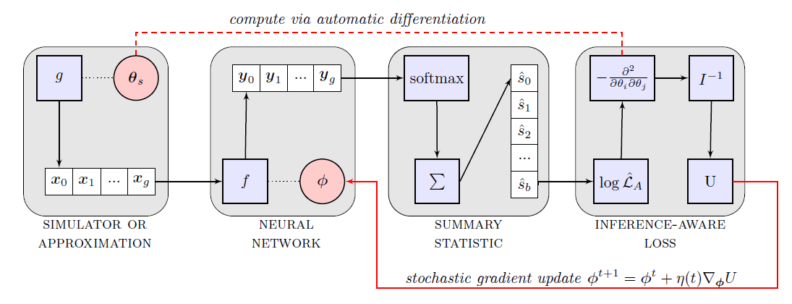
Contents - 3
Part 3: NNs and HEP applications
Neural networks
Playing with NNs
Advanced techniques
INFERNO
DNNs
Convolutional NNs
Genetic algorithms
Practical tips
Machine Learning in HEP: other examples
Generalities
kNN for H→bb
Clustering for HH theory space benchmarking
Higgs Kaggle challenge
Conclusions

Slide 8
Part 1 An introduction to Machine Learning

Slide 9
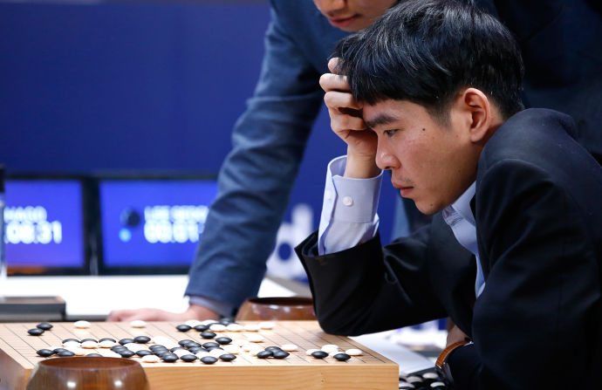
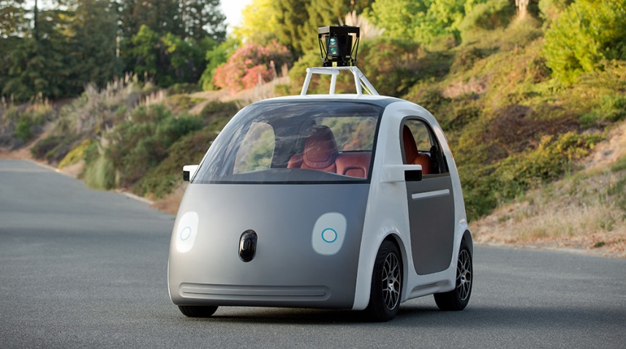
Machine Learning is all around us

Slide 10
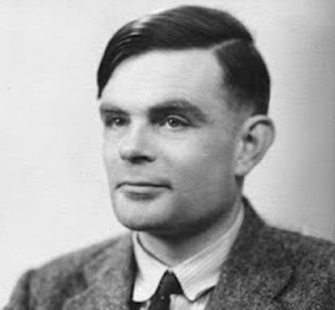
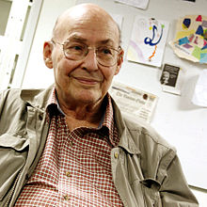
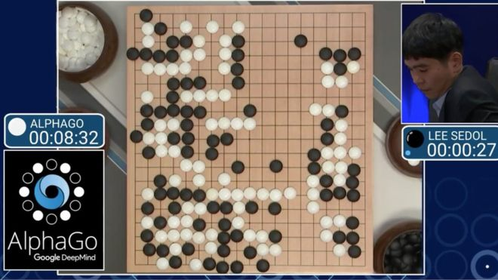
The path to Artificial Intelligence
Alan Turing: machine shuffling 0's and 1's can simulate any mathematical deduction or computation
the Turing test
Dartmouth conference, 1956 → many astonishing developments, checkers, automated theorem solvers
and funding from US defense budget
In the seventies, research effort dampened
Eighties: Expert systems
Nineties: the second AI winter
Solutions to closed system problems; deep blue → alpha zero
Development of Neural Networks
Toward AGI

Slide 11
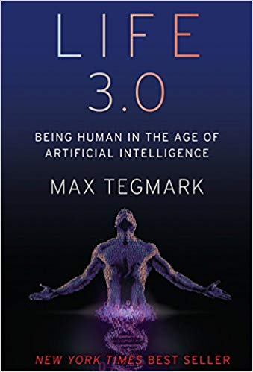
Is AI desirable?
Humanity is going to face in the next few decades the biggest "growing pain" of its history: how to deal with the explosive force of artificial intelligence
Once we create a superintelligence, there is no turning back – in terms of safeguards we have to "get it right the first time", or we risk to become extinct in a very short time
But we cannot stop AI research, no more than we could stop nuclear weapons proliferation
Interesting times ahead!

Slide 12
* Can we define Machine Learning?
No self-respected lecture on Machine Learning avoids defining ML at the very beginning
There are various options on how to define ML. Things I have heard around:
“[Machine Learning is the] field of study that gives computers the ability to learn without being explicitly programmed.” - Arthur Samuel (1959)
ok, but learning what?
Wikipedia: "A scientific discipline concerned with the design and development of algorithms that allow computers to evolve behaviors based on empirical data"
correct but slightly vague
Mitchell (1997) provides a succinct deﬁnition: “A computer program is said to learn from experience E with respect to some class of tasks T and performance measure P , if its performance at tasks in T , as measured by P , improves with experience E"
The fitting of data with complex functions
in the case of ML, we learn the parameters AND the function

Slide 13
* Can we agree on what "Learning" is?
Maybe this really is the relevant question. Not idle to answer it, as by clarifying what our goal is we take a step in the right direction
Some definitions of Learning:
the process of acquiring new, or modifying existing, knowledge, behaviors, skills, values, or preferences
the acquisition of knowledge or skills through study, experience, or being taught.
becoming aware of (something) by information or from observation.
In general: learning involves adapting our response to stimuli via a continuous inference. The inference is done by comparing new data to data already processed. How is that done? By the use of analogy.

Slide 14
* What about analogies?
Analogies: arguably the building blocks of our learning process. We learn new features in a unknown object by analogy to known features in similar known objects
This is true for language, tools, complex systems – EVERYTHING WE INTERACT WITH
... But before we even start to use analogy for inference or guesswork, we have to classify unknown elements in their equivalence class!
(Also, one has to define a metric along which analogous objects align)
In a sense, Classification is even more "fundamental" in our learning process than is Analogy.
Or maybe we should say that classification is the key ingredient in building analogies.

Slide 15
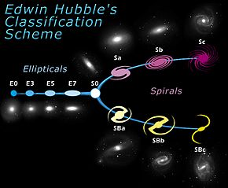
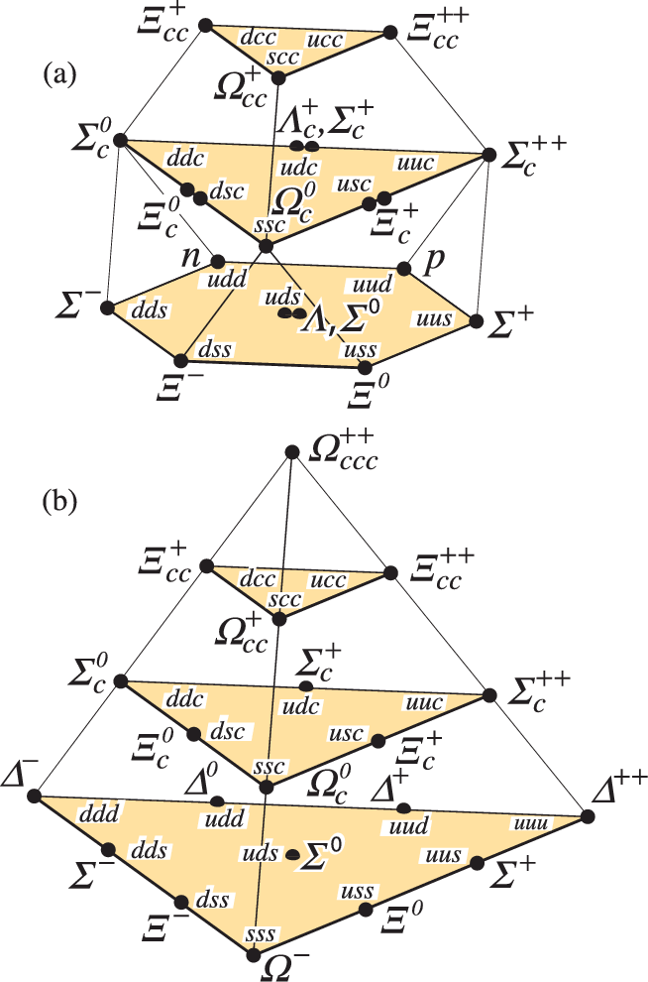
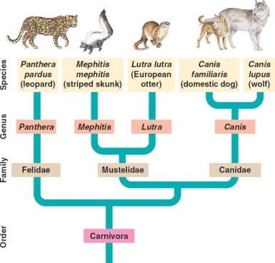
Classification and the scientific method
Countless examples may be made of how breakthroughs in the understanding of the world were brought by classifying observations
Mendeleev's table, 1869 (150 years ago!)
Galaxies: Edwin Hubble, 1926
Evolution of species: Darwin, 1859 (classification of organisms was instrumental in allowing a model of the evolution, although he used genealogy criteria rather than similarity)
Hadrons: Gell-Mann and Zweig, 1964

Slide 16
Classification is at the heart of Decision Making
Finding similarities and distinctions between elements, creating classes, looks like
an abstract task
Yet it is at the heart of our decision making process
in a game, choosing the next move entails a classification of the possible actions as
good or bad ones, as a preprocessing step before going "deep" in the analysis
an automated system driving your vehicle must constantly decide how to react to external
stimuli: it does so by classifying them (potentially dangerous → requires choice of proper
reaction; irrelevant → can be ignored)
Decisions are informed by previous experience, and by information processing
That is how we "comprehend" the world and assign it to some description
Ultimately, an important component of intelligence is the continuous processing of our
sensorial inputs, classifying them to react one way or the other to them

Slide 17
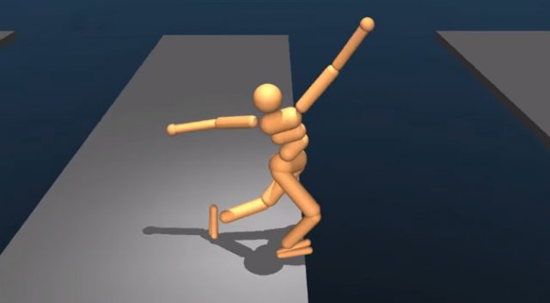
Classes of Statistical Learning algorithms
Supervised:
if we know the probability density of S and B, or if at least we can estimate it
→ E.g. we use "labeled" training events ("Signal" or "Background")
to estimate p(x|S), p(x|B) or their ratio
Semi-supervised:
it has been shown that even knowing the label for part of the data is sufficient to construct a classifier
Un-supervised:
if we lack an a-priori notion of the structure of the data, and we let an algorithm discover it without e.g. labeling classes → cluster analysis, anomaly detection, unconditional density estimation.
We may also single out:
Reinforcement learning:
the algorithm learns from the success
or failure of its own actions
→ E.g. a robot reaches its goal or fails
Active learning:
the learner chooses elements to label, asking
the user for assistance

Slide 18
A map to clarify the players role
Machine Learning
Unsupervised learning
Develop model to group and interpret data without labels
Semi-supervised Learning
Data only partly labeled
Supervised learning
Develop predictive model based on labelled data
anomaly detection
find outliers
Clustering
Learn ways to partition the data
Density Estimation
Find p(x)
Classification
The output is nominal, categorical,
unordered / ordered
Regression
The output is continuous

Slide 19
The supervised learning problem
Starting point:
A vector of n predictor measurements X (a.k.a. inputs, regressors, covariates, features, independent variables).
One has training data {(x,y)}: events (or examples, instances, observations...)
The outcome measurement Y (a.k.a. dependent variable, or response, or target)
In classification problems Y can take a discrete, unordered set of values (signal/background, index, type of class)
In regression, Y has a continuous value
Objective:
Using the data at hand, we want to predict y* given x*, when (x*,y*) does not necessarily belong to the training set.
The prediction should be accurate: |f(x*)-y*| must be small according to some useful metric (se later)
We would like to also:
understand what feature of X affects the outcome and how
assess the quality of our prediction

Slide 20
The unsupervised learning problem
Starting point:
A vector of n predictor measurements X (a.k.a. inputs, regressors, covariates, features, independent variables).
One has training data {x}: events (or examples, instances, observations...)
There is no outcome variable Y
Objective is much fuzzier:
Using the data at hand, find groups of events that behave similarly, find features that behave similarly, find linear combinations of features exhibiting largest variation
Hard to find a metric to see how well you are doing
Result can be useful as a pre-processing step for supervised learning

Slide 21
Ideal predictions, a' la Bayes
For a regression problem, the best prediction we can make for Y based on the input X=x is given by the function
f(x) = Ave (Y|X=x)
This is the conditional expectation: you just obtain the Y average for all examples having the relevant x.
It is the best predictor if we want to minimize the average squared error,
Ave (Y-f(X))².
But it is NOT the best predictor if you use other metrics. E.g., if you wish to minimize Ave |Y-f(X)| you should rather pick... Who can guess it?
f(x) = Median (Y|X=x)
If we instead are after a qualitative output Y in {1...M} (a discrete one, as in multi-class classification tasks) what we can do is to compute
P (Y=m|X=x)
for each m: conditional probability of class m at position X=x; then we take as the class prediction
C(x) = Arg max_{j} {P(Y=j|X=x)}.
The above is the majority vote classifier.
Problem solved? Let us try and see how to implement these ideas.

Slide 22
Implementation
To predict Y at X=x*, collect all pairs (x*,y) in your training data, then
For regression, get
f(x*) = Ave (y|X=x*)
For classification, get
c(x*) = Arg max_{j} {P(Y=j|X=x*)}
Alas, this would be good, but...
We usually have sparse training data, obtained by forward simulation. Our simulator gives p(x|y) but the process is stochastic. That means we cannot invert the simulator, extracting p(y|x)!
In most cases we have NO observations with X=x*.
Who you're gonna call ?
Density estimation methods!

Slide 23
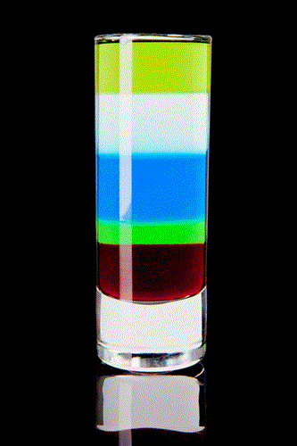
DENSITY ESTIMATION

Slide 24
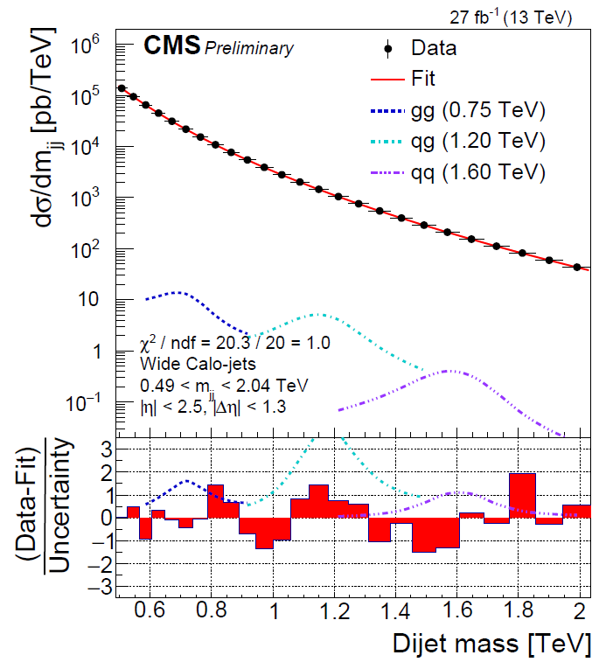
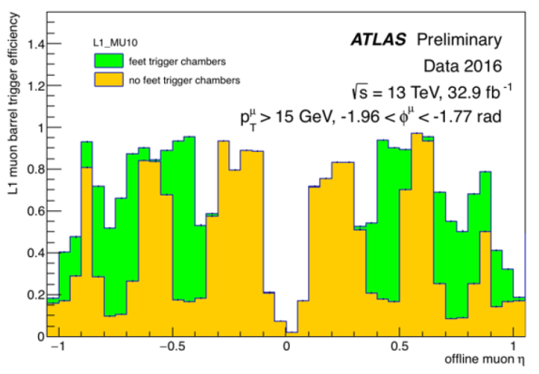
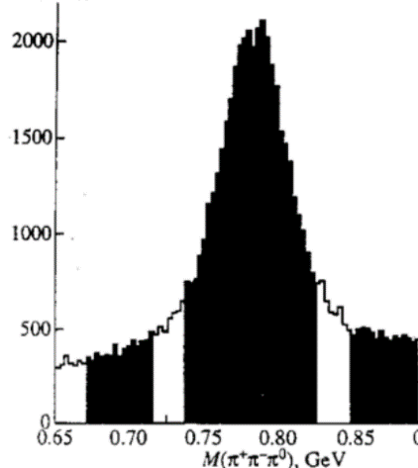
Density Estimation
Given a sample of data X, one wishes to determine their prior PDF p(X).
One can solve this with parametric or non-parametric approaches.
Parametric: find a model within a class, which fits the observed density
→ an assumption is necessary as the starting point
Non-parametric: sample-based estimators.
The most common is the histogram. NP density estimators have a number of attractive properties for experimental sciences:
are easy to use for two things dear to HEP/astro-HEP: efficiency estimates and background subtraction
lend themselves to be good inputs to unfolding methods
are an excellent visualization tool, both in 1 and 2D
S+B
B
S

Slide 25
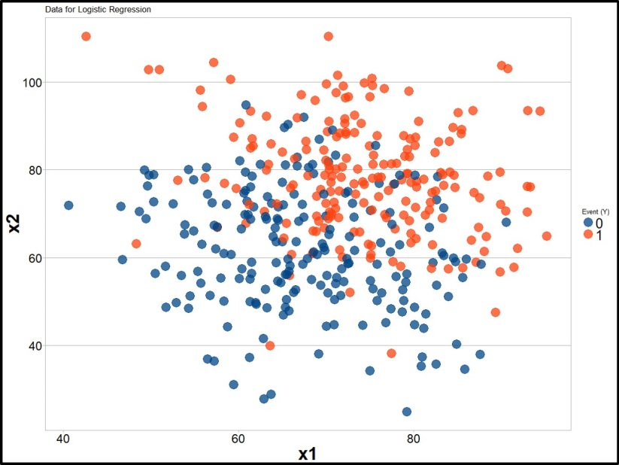
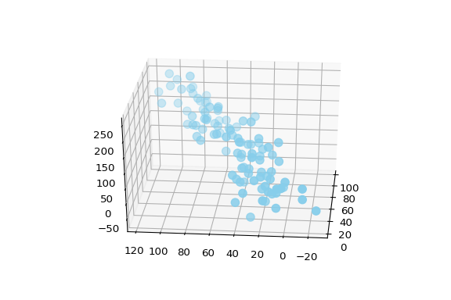
The empirical density estimate
With sparse data, the most obvious estimate of the density from which i.i.d. data {x_{i}} are drawn is called "empirical probability density function" (EPDF), which can be obtained by placing a Dirac delta function at each observation x_{i}:
$$\hat{f}\left(x\right)=\frac{1}{N}\sum_{i=1}^{N}{δ(x−x_{i})}$$
Of course, the EPDF is rarely useful in practice as a computation tool. However, it is a common way of visualizing 2D or 3D data (scatterplots)

Slide 26
Histograms
Histograms are a versatile, intuitive, ubiquitous way to get a quick density estimate from data points:
h(x) = Sum_{i=1...N} I (x-x_{i};w)
where w is the width of the bin, and I is a uniform interval function (indicator function),
I (x;w) = 1 for x in [-w/2,w/2],
= 0 otherwise
The density estimate provided by h(x) is then
f(x) = h(x)/(Nw)
Yet histograms have drawbacks:
they are discontinuous
they lose information on the true location of each data points through the use of a "regularization", the bin width w
not unique: there is a 2D infinity of histogram-based PDF estimates possible for each dataset, depending on binning and offset.
I(x;w)
w
x
x_{i}

Slide 27
* Kernel density estimation
A useful generalization of the histogram is obtained by substituting the indicator function with a suitable "kernel":
$$\hat{f}\left(x\right)=\frac{1}{N}\sum_{i=1}^{N}{k(x−x_{i};w)}$$
The kernel function k(x,w) is normalized to unity. It is typically of the form
$$k\left(x−x_{i};w\right)=\frac{1}{w}K(\frac{x−x_{i}}{w})$$
The advantage of using a kernel instead than a delta is evident: we obtain a continuous, smooth function. This comes, of course, at the cost of a modeling assumption.
A common kernel is the Gaussian distribution; the results however depend more on the smoothing parameter w than on the choice of the specific form of k.
The "kernelization" of the data can be operated in multiple dimensions too. The kernels operating in each component are identical but may have different smoothing parameters:
$$\hat{f}\left(x,y\right)=\frac{1}{Nw_{x}w_{y}}\sum_{i=1}^{N}{K(\frac{x−x_{i}}{w_{x}})K(\frac{y−y_{i}}{w_{y}}) }$$
A different extension of the KDE idea is to adapt the smoothness parameter w to reflect the precision of the local estimate of the data density → adaptive kernel estimation

Slide 28
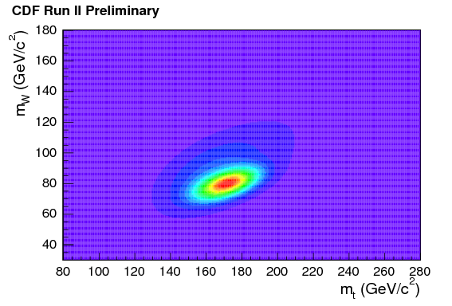
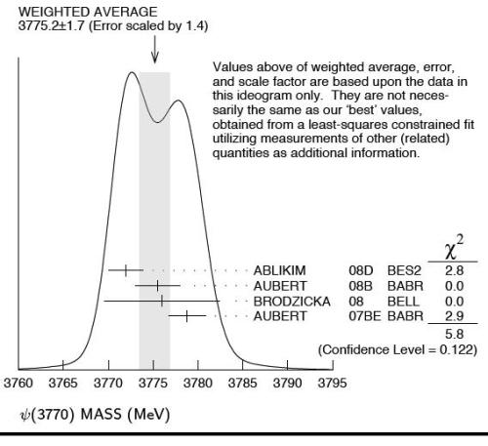
* Ideograms
A further extension of KDE is the use of different kernels for different data points → ideograms. This may be very useful if the data coordinate x comes endowed with information on its measurement precision σ. In that case we may substitute the point with a Gaussian kernel, whose smoothing parameter w is equal to the precision σ. This improves the overall density estimate
The ideogram method is sometimes used in HEP, e.g. it has been employed in top quark mass measurements.
The PDG uses it to report the PDF of a unknown parameter when the individual estimates carry different uncertainty AND there is tension between the estimates (such that the weighted average is not necessarily the whole story)

Slide 29
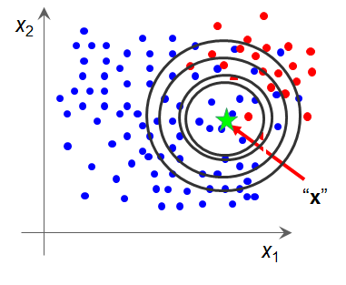
Going multi-D: K-Nearest Neighbours
The kNN algorithm tries to determine the local density
of multi-dimensional data by finding how many data points
are contained in the surroundings of every point in feature space
One usually "weighs" data points with a suitable
function of the distance from the test point
Problem: how to define the distance in an abstract space?
Also, your features might include real numbers, categories, days of the week, etcetera...
In general, it is useful to remove the dimensional nature of the features
General recipe: standardization
- for continuous variable x: find variance σ², obtain standardized variable y² = x² /σ²
for categorical variable c:
if target has large variance along c, can keep it as is (defines hyperplane, will only
use data with c*=c to estimate local density)
otherwise may still try to standardize

Slide 30
More on kNN
Once the data is properly standardized one can construct an Euclidean distance:
$$D\left(y,y^{′}\right)=\sum_{i=1}^{D}{{(y−y^{′})}^{2}}$$
kNN density estimates can be endowed with several parameters to improve their performance
Most obvious is k: how many events in the ball?
Rule of thumb: estimating a mean → if target varies a lot, can use small k; if variation small, k needs to allow precise estimate
Common to have k=20-50, but it of course depends on dimensionality D and size N of training data

Slide 31
kNN, continued
Also crucial to assess:
relative importance of variables: assign larger weight to more meaningful components in the feature space (ones along which target has largest variance)
local gradients-aware: one may try and adapt the shape of the "hyperellipsoid" to reflect how much target y(x) is variable in each direction, at test point x*
In general, kNN estimates suffer from a couple of shortcomings:
The evaluation of local density requires to use all data for each point of feature space → CPU expensive (but there are shortcuts)
The curse of dimensionality: for D>8-9, they become insensitive to local density (see next slide)

Slide 32
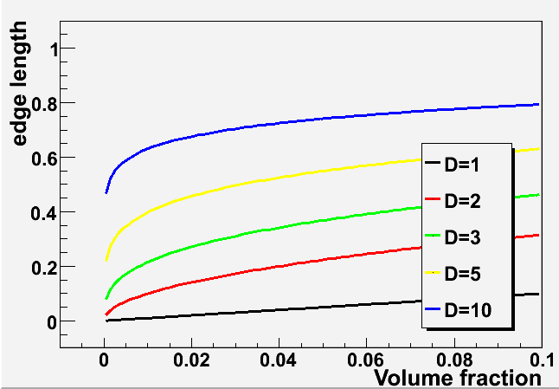
The Curse of Dimensionality
The estimate of density in a D-dimensional space is usually impossible, due to the lack of sufficient labeled data for the calculation to be meaningful. An adequate amount of data must grow exponentially with D for a good representation
For high problem dimensionality, the k "closest" events are in no way close to the point where an estimate of the density is sought:
This makes kNN impractical for D > 8-10 dimensions
In 10 dimensions, if a hypersphere captures 1% of the feature space, it has a radius of 63%
in each variable span
HEP analyses often have >10 important variables so the kNN has limited use as a generative
algorithm for S/B discrimination
But, one can apply dimensional reduction techniques to still use it, or resample subspaces

Slide 33
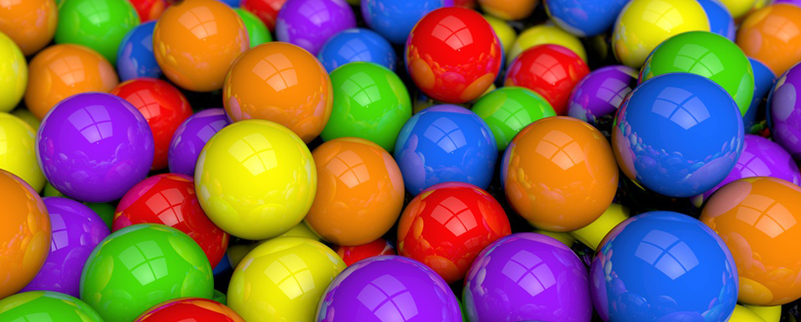
RESAMPLING TECHNIQUES

Slide 34
Resampling Techniques
Resampling techniques are pivotal for a number of ML tasks:
hypothesis testing (construction of discriminative methods)
estimation of bias and variance (optimization of predictors)
cross-validation (estimate accuracy of predictors)
Resampling allows you to avoid modeling assumptions, as you construct a non-parametric model from the data themselves. The benefits can be huge
(as measured e.g. by performance of boosting methods)
Here we only briefly flash the generalities of three basic ingredients:
permutation tests
bootstrap
jacknife
cross-validation techniques ← will treat later
The theoretical basis for resampling methods lies with their (usually very good) asymptotic properties of consistency and convergence (in probability)

Slide 35
* Permutation Sampling
A
x
B
Permutation sampling is mainly used in hypothesis tests; usually the question is: are datasets A {x₁...X_{NA}} and B {x₁...x_{NB}} sampled from the same parent PDF?
The way to answer is to form a sensitive statistic T (say: the mean of the observations) and compare quantitatively the difference between T_{A} and T_{B}
ΔT* = T_{A}-T_{B}
with what one would expect if the PDF were the same.
x
ΔT*
$$P\left(∆T^{∗}\right)=\int_{∆T^{∗}}^{∞}{∆T}$$
ΔT
The comparison requires to know how T distributes under the null hypothesis (green curve).
Here permutation comes in: we assume A=B, merge A+B=C, and sample the N_{A}+N_{B} observations creating all possible pairs of splits A', B' still of size {N_{A},N_{B}}, computing distances ΔT=T_{A'}-T_{B'}.
This provides all the information in the data about the distribution of ΔT. The permutation test makes no model assumptions, so it is called an exact test.

Slide 36
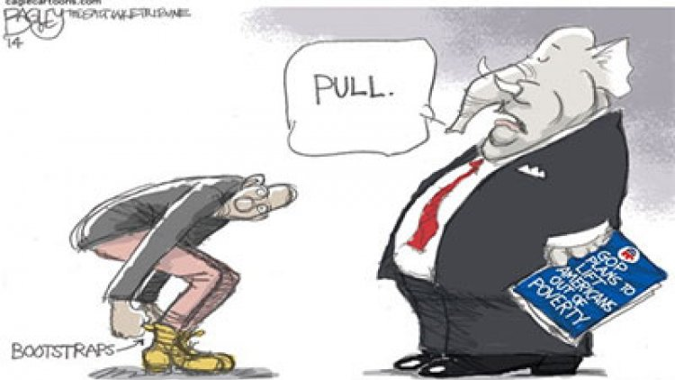
The Bootstrap
The Bootstrap (B.Efron, 1979) is called this way
because it allows to "pull oneself up from
one's own bootstraps".
Motivating problem: get the variance of an estimator $\hat{θ}(x)$ of a parameter θ, for a sample of i.i.d. observations {x₁...x_{N}}.
We may generate M replicas of the dataset X by repeatedly picking N observations at random from X, with replacement.
Then we estimate θ in each replica, and proceed to obtain a sample mean and variance with the $\hat{θ_{i}}(x)$,
$\overline{θ}=\frac{1}{M}\sum_{i=1}^{M}{θ_{i}}$
${s^{2}}_{θ}=\frac{1}{M−1}\sum_{i=1}^{M}{{({\hat{θ}}_{i}−\overline{θ})}^{2} }$
You get an estimate of variance
without assumptions of the distribution

Slide 37
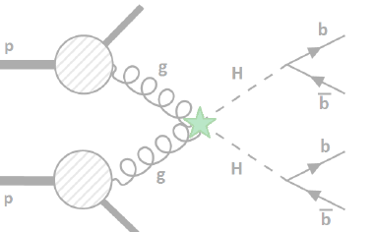
Bootstrap-cum-density estimation example: hh→bbbb CMS 2017
In the 2017 CMS search of hh→bbbb production (CMS-PAS-HIG-17-017), the background was dominated by QCD multijet production – notoriously a difficult process to model with MC simulations
In order to train a classifier, you need a good multi-D model of the features... But MC had insufficient stats
A synthetic background sample was constructed by mixing hemispheres
The idea is that QCD gives two hard quarks or gluons that scatter off one another,
and the complexity arises independently, as a combination of FSR, pileup, MI
→ can try to create models of single "halves" of the events

Slide 38
The mixing procedure
y
T axis
φ
For each event in the original sample:
Find transverse thrust axis
i.e., determine angle φ such that
is maximized
x
T = $\sum{pT}jetcos(φT−φjet)$

Slide 39
The mixing procedure
T axis
For each event in the original sample:
Find transverse thrust axis
Divide event in two halves using plane orthogonal to it
This defines two jet collections for each event (hemispheres)

Slide 40
The mixing procedure
For each event in the original sample:
Find transverse thrust axis
Divide event in two halves using plane orthogonal to it
Store resulting hemispheres in the "hemisphere library"

Slide 41
Mixing procedure - 2
y
T axis
2) Take again original sample: for each event
Find transverse thrust axis,
x

Slide 42
Mixing procedure - 2
T axis
2) Take again original sample: for each event
Find transverse thrust axis, identify the two hemispheres making it up

Slide 43
Mixing procedure - 2
T axis
2) Take again original sample: for each event
Find transverse thrust axis, identify the two hemispheres making it up
Look in hemisphere library for two SIMILAR hemispheres

Slide 44
Mixing procedure - 2
2) Take again original sample: for each event
Find transverse thrust axis, identify the two hemispheres making it up
Look in hemisphere library for two SIMILAR hemispheres
Construct an artificial event with them

Slide 45
Mixing procedure - 2
ORIGINAL DATASET
2) Take again original sample: for each event
Find transverse thrust axis, identify the two hemispheres making it up
Look in hemisphere library for two SIMILAR hemispheres
Construct an artificial event with them
The procedure creates an artificial dataset which can be used for modeling purposes
Hemisphere similarity criteria :
Number of jets (req. equal)
Number of b-tags (req. equal)
Thrust
Thrust minor
Hemisphere mass
Sum of jets p_{z} components
The 4 continuous variables are used to define a kNN distance which yields the similarity measure:
ARTIFICIAL DATASET

Slide 46
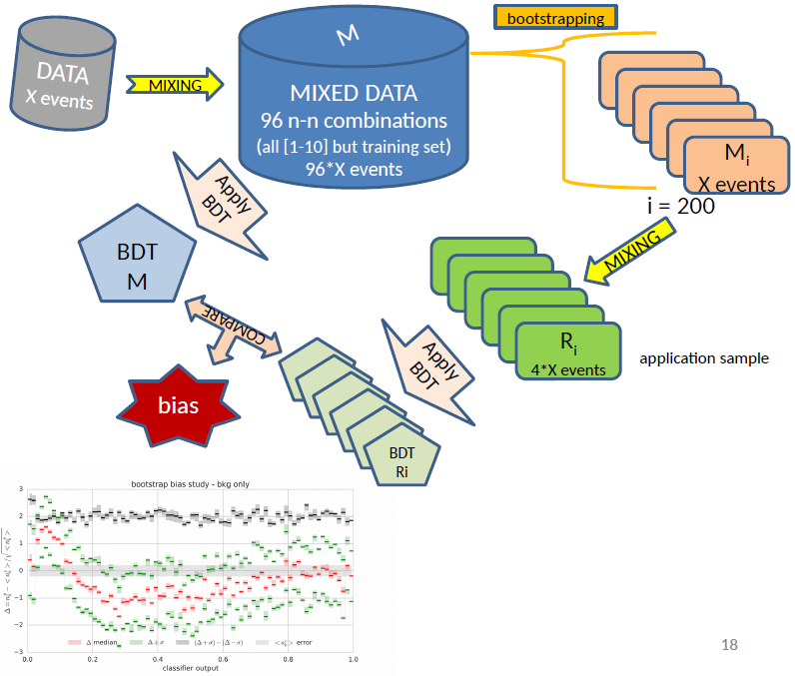
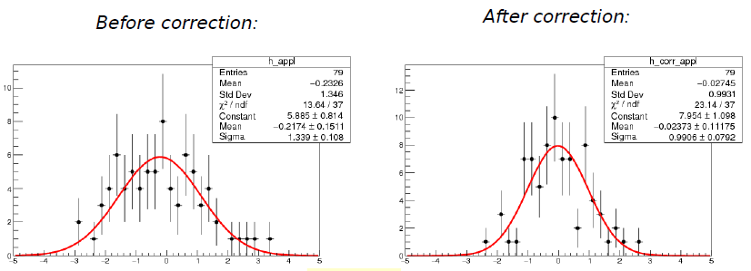
Modeling the target function
A residual bias in the modeling of the BDT distribution was suspected by studying the modeling agreement in control samples
It was then estimated by bootstrap resampling of the same data sample
This allowed to extract a bias function, which improved the model accuracy significantly
A test in a separate control sample confirmed the improvement

Slide 47
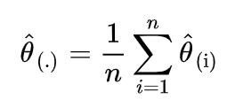
* Jackknife resampling
The jackknife is called after the large pocket knife one brings
around in an excursion – it is indeed a versatile statistics tool.
Again the most common use is determining the bias and variance of an estimator. One works out n different estimates of the estimator by leaving out in turn each one of the n i.i.d. data points {x₁...x_{n}}.
One may then get e.g. an estimate of the variance of the mean:
Given an estimator θ, we may also compute its bias in a similar way: if the jacknife average is
where ${\hat{θ}}_{(i)}$is the estimate obtained by leaving out the i-th value,
then the bias on the estimator is
What is better between bootstrap and jackknife? it depends on the problem! For smallish N
jackknife is faster; however the bootstrap uses more information with non-linear estimators.

Slide 48
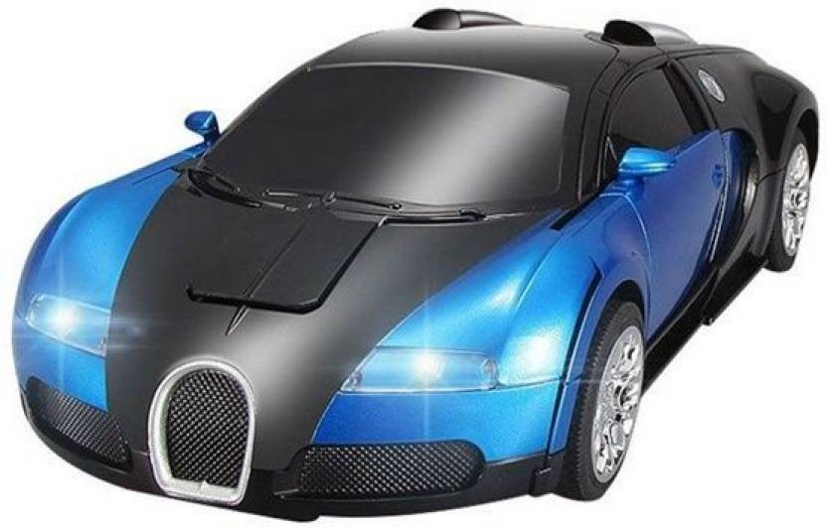
THE MODEL

Slide 49
The mathematical model
Machine learning relies on building a model of your data: a mathematical characterization of the studied system, in probabilistic terms
To build a model, you need
to understand the structure of your data
to clarify the problem you want to solve: e.g. regression, classification, clustering, ...
Based on the above inputs, you may choose the most appropriate ML method
E.g.
- for a low-D regression task, you might want to specify a family of parametric functions, and proceed to find the best choice of parameters
- for a complex classification task, you might focus on designing a proper architecture for a DNN
The method will learn the model parameters from available training data
The learned model wil allow to make predictions or inference on previously unseen data

Slide 50
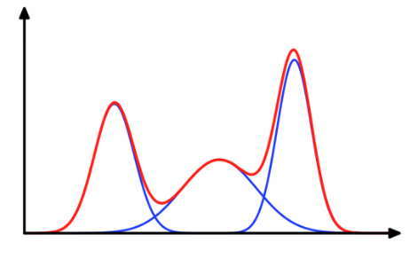
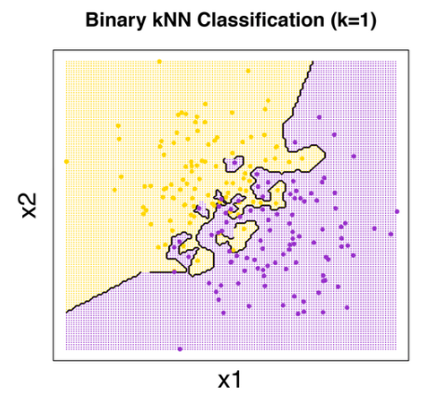
Parametric or non-parametric?
Parametric models are fully defined by a function, with a fixed set of parameters
f(x;θ) = ....
They can be a good choice when you want to retain insight in what is learned
They involve an assumption on the behaviour of the data → bias
Non-parametric models do not have a fixed set of parameters, and they may become arbitrarily more complex as you let them learn more information from training data
Assumption free (almost)
Higher variance, less bias

Slide 51
Take-away bits for part 1
Machine learning has a large overlap with statistical learning, which has been around for much longer.
Emphasis is on large-scale applications, and on prediction accuracy (as opposed to emphasis on models and their uncertainty)
Density estimation is an important ingredient of many ML methods
especially when they require pdfs as inputs
Data preprocessing may be an essential step that pays dividends in performance later on
In fundamental science we often deal with the lack of analytic likelihoods
ML methods can provide effective approximations to summary statistics to carry out the inference work

Slide 52
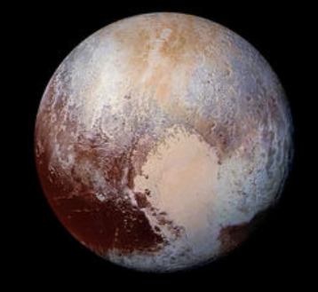
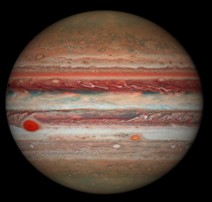
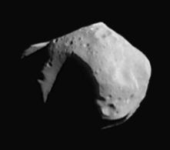
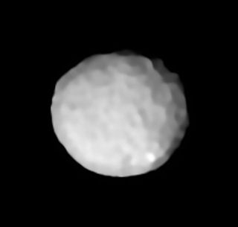
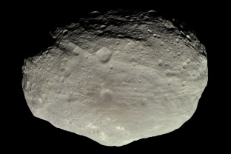
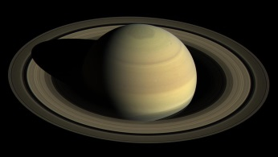
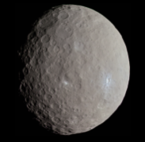
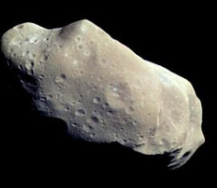
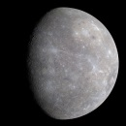
Part 2 Introduction to Classification
?

Slide 53
Binary Classification
Signal and Background: a common problem in many setups
Generally we know the characteristics of two classes of events, and we wish to use them to find the best possible distinction with a fixed rule → a "decision boundary" in the feature space of the event characteristics
A "rectangular" rule
A linear rule
Non linear rules
x₂
x₂
x₂
S
S
S
B
B
B
x₁
x₁
x₁
Low variance (stable), high bias methods
High variance, small bias methods

Slide 54
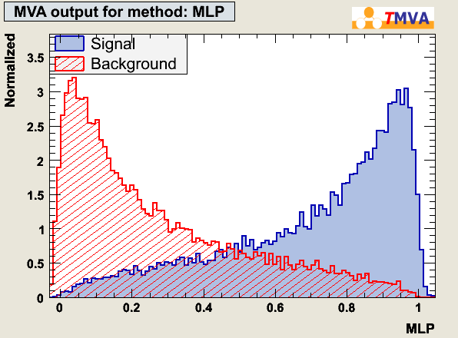
Feature Space and Output Function
Every signal or background event has “D” measured variables
Test statistic:
y(x): R^{D}→R:
y = y(x); x  R^{D}
x={x₁,….,x_{D}}: input variables
One wishes to find a map of the multi-D space of features, into a real variable that separates in a pseudo-optimal way the two classes
D-dimensional
“feature
space”
One can construct a histogram of the resulting values of y(x) taken by S and B
y(x)

Slide 55
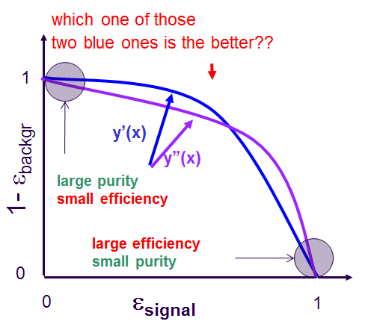
The "ROC" Curve
The ROC curve (receiver operating characteristic) is a way to summarize how well
you are doing with your estimated y(x) in the classification problem
Higher purity
y(x)
Cutting harder on y(x)
How to quantify ?
look at rejection at fixed eff
compute AUC
many other metrics available
Smaller selection efficiency

Slide 56
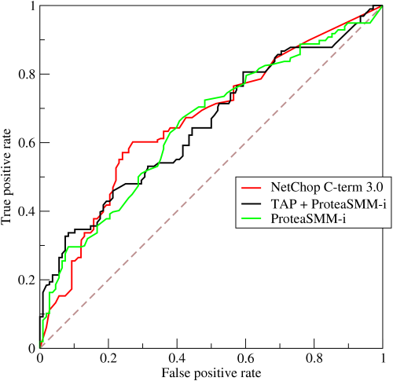
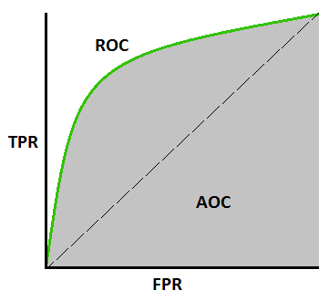
The AUC metric
In some cases it is not trivial to rank classifiers by their performance.
In particular if one does not (yet) have an estimate of the proportion of signal and background (class probabilities), one cannot decide!
A simple criterion is to compute the area under the ROC curve (AUC).
The AUC has a clean statistical interpretation: taken two events at random, one from each of the two classes, AUC is the probability that the signal event has higher score than the background event.
AUC is a coherent measure of predictive power of y(x) if we have no information on the relative misclassification cost of the two classes – i.e. if we do not know the operating point. The more we know of that, the less useful AUC is.
Which is best?
AUC

Slide 57
The Neyman-Pearson Lemma
In a 1932 paper by J. Neyman and E. S. Pearson, "On the Problem of the most Efficient Tests of Statistical Hypotheses", the following notable result is demonstrated:
Given two simple hypotheses, parametrized by densities p(x|θ₁), p(x|θ₀) that depend on specific values of a parameter, the likelihood ratio
r(x|θ₀,θ₁) = p(x|θ₁) / p(x|θ₀)
is the most powerful test statistic to discriminate between them.
The importance of this lemma cannot be overstated – it is the ultimate weapon for solving inference problems.

Slide 58
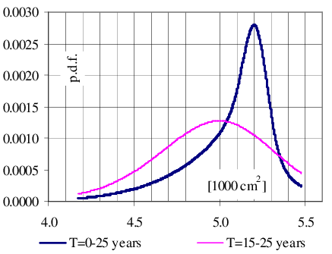
How to Build a Classifier
Because of the Neyman-Pearsons lemma, the function
r$\left(x\right)=\frac{PDF(x|S)}{PDF(x|B)}$
is the best possible classifier of S versus B → PROBLEM SOLVED! ?
...NO:
p(x|S), p(x|B) are usually not perfectly known; in typical cases of interest in HEP and astro-HEP they may be only estimated by forward simulation, affected by stochastic phenomena
hypotheses are not usually "simple vs simple" – nuisance parameters affect their determination
In general: One knows examples of S and B, but not their precise density

Slide 59
A relevant theorem
The Neyman-Pearson lemma can be used effectively in association with a
Theorem:
The likelihood ratio r(x) is invariant under a change of variable y = f(x), provided f(x) is monotonic with r(x):
$$r\left(x | θ_{0},θ_{1}\right)=\frac{p(x|θ_{0})}{p(x|θ_{1})}=\frac{p(f(x)|θ_{0})}{p(f(x)|θ_{1})}=r(y|θ_{0},θ_{1})$$
Note:
This is a strict equality, not an inequality.
The transformation does not squander information on the ratio, while reducing the dimensionality and making the problem more tractable
But information about x may be lost by f()

Slide 60
How to construct f(x)
With supervised learning we can get f(x) automagically!
we start with a binary classifier f* trained to distinguish x sampled from p(x|θ₁) from x sampled from p(x|θ₀): a Bernoulli process, modelled with Binomial pdf
the training may be achieved by minimization of cross-entropy, e.g.
$$L\left(\hat{f}\right)=−E_{p\left(x | θ\right)π\left(θ\right)}[1\left(θ=θ_{0}\right)log\hat{f}\left(x\right)+1\left(θ=θ_{1}\right)\log\left(1−\hat{f}\left(x\right)\right)]$$
The solution at minimum loss approximates the optimal classifier
$$\hat{f}\left(x\right)\sim f^{∗}\left(x\right)=\frac{p(x|θ_{1})}{p\left(x|θ_{0}\right)+p(x|θ_{1})}$$
which is monotonic with the likelihood ratio r, so
$$r\left(x | θ_{0},θ_{1}\right)\sim \hat{r}\left(x | θ_{0}{,θ}_{1}\right)=\frac{1−\hat{f}(x)}{\hat{f}(x)}$$
This proves that supervised classification is equivalent to likelihood ratio estimation, and can be effectively used for inference or discrimination

Slide 61
The loss function
The mean squared error is a sound measure of the model accuracy, but it is not necessarily the most appropriate metric for our problem
In general, the quality of a predictive model can be quantified by constructing a function l(y,f(x)), a measure of the distance between the true class label y and the predicted response f(x).
One may then define the expected distance
$$L\left(X,Y\right)=E_{X,Y}l\left(Y,f\left(X\right)\right)=\sum_{y∈Y}{\int_{X}{l\left(y,f\left(x\right)\right)P\left(x,y\right)dx}}$$
over the full space of X and Y. This can be computed empirically, using labelled data drawn from the pdf p(x,y), by averaging l(y,f(x)):
$$\hat{L}=\frac{1}{N}\sum_{n=1}^{N}{l(y_{n},f\left(x_{n}\right))}$$
Note: the empirical loss depends on the prior distribution of the two classes, P(y). This is not always what the analyzer wants

Slide 62
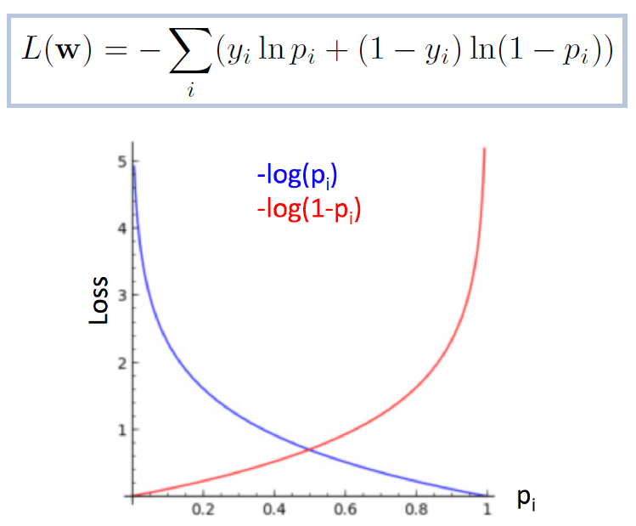
Binary Cross-Entropy
For binary classification, class assignment is modeled by a Bernoulli trial probability p following the Binomial distribution
A commonly used loss function
is correspondingly defined as
High loss for events
with low probability
of being in predicted class

Slide 63
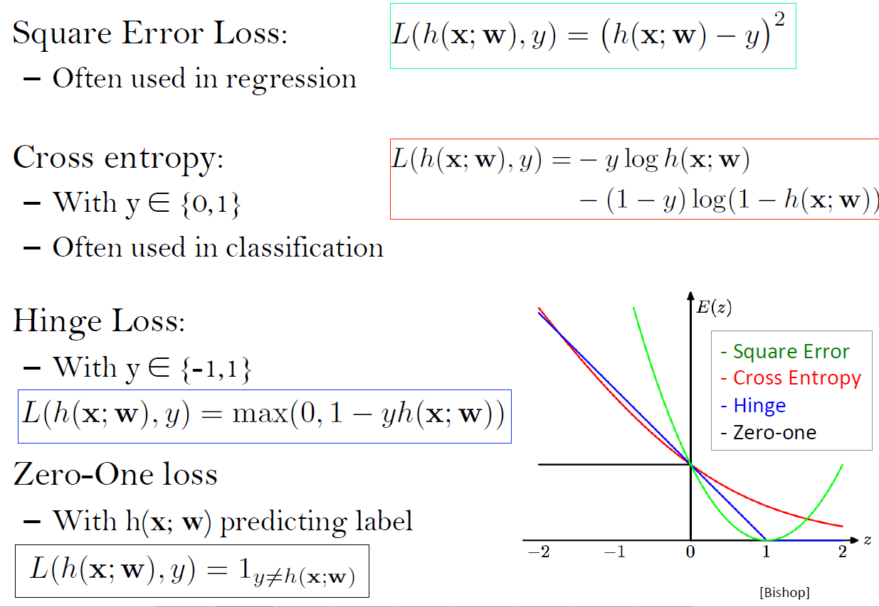
* A comparison of loss functions
Only penalizes values <1

Slide 64
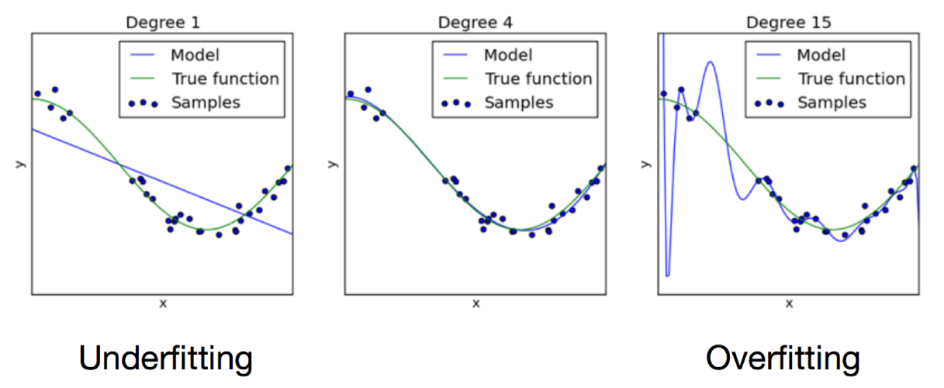
Underfitting and overfitting
Don't overfit!
We will discuss this issue further in the following.
As the complexity of your model increases, you manage to capture more and more of the features of the data. However, one needs to stop somewhere... Your task is to generalize, not to interpret just the data you were given.
Generalization fights against systematic uncertainties from the imperfections of the model (bias) and against the sensitivity of the prediction (variance)
Just about right

Slide 65
The pains of generalization
We can try to be a bit more formal, to investigate what is going on quantitatively. Suppose you have a model f(x) trained on data x, that approximates a random variable t. So this is a regression task.
In terms of expectation values you can write
$E\left[t\right]=\hat{t}$
$E\left[f\left(x\right)\right]=\hat{f}\left(x\right)$
One can study the generalization error on t at any value x by expanding
$E{[\left(f\left(x\right)−t\right)}^{2}]$=
$$E\left[{\left(t−\hat{t}\right)}^{2}\right]+$$
$${\left(\hat{t}−\hat{f}(x)\right)}^{2}+$$
$$E[{\left(f(x)−\hat{f}(x)\right)}^{2}]$$
Noise term – cannot be
improved with modeling
Squared bias: this can be reduced with a more complex model
Variance term: the more complex the model, the higher this term, as it tries to capture erratic behavior

Slide 66
Bias-Variance Tradeoff
Squared error
Optimal tradeoff
Total
squared
error
Variance
Bias²
Model complexity
With larger amounts of data the model can become more complex (smaller bias),
because the variance diminishes.

Slide 67
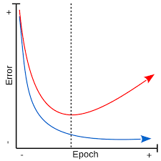
Training and testing
In order to construct and study a classifier built with a supervised algorithm – e.g. a decision tree, one needs labelled data from the two classes. The more data, the better!
One must decide how to use the available labeled data in the construction of the classifier or regressor. Can we use the same data for both training and testing?
Answer: No – the error estimated in the training phase ("resubstitution error") is optimistic: this is the phenomenon called over-training
During training, the model attempts to learn the features of the joint distribution p(x,y) of data x and labels (or values, in regression) y
But training data carries noise with it – and this component will be learned by a flexible model too, deteriorating the accuracy on data not seen in the training phase

Slide 68
Predictor variable 2
Predictor variable 1
Notes:
But with only the given data to work with, how can we evaluate a model’s likely performance on new observations?

Slide 69
Predictor variable 2
Training error:
7/42 = 16.7%
Predictor variable 1
Notes:
Using this approach with our example, applying the simple model to the training data would give a very similar model as before. This model misclassifies 17% of the observations used to train it,

Slide 70
Predictor variable 2
Testing (validation) error:
2/15 = 13.3%
Predictor variable 1
Notes:
but only 13% of the test data.

Slide 71
Predictor variable 2
Training error:
0/42 = 0%
Predictor variable 1
Notes:
In contrast, a complex model trained to perform perfectly on the training data,

Slide 72
Predictor variable 2
Testing (validation) error:
4/15 = 26.7%
Predictor variable 1
Notes:
performs worse than the simple model on the validation data.

Slide 73
One fitting example
Here we have training data (blue
crosses) and a few polynomial models
that try to capture their variation (y)
by minimizing the mean square error
Validation data (red points, call it test
data here for now) also shown
The problem cannot be "solved" by
training data alone, as a more complex
model would always seem to work
better than a simpler one
A graph of the MSE vs model complexity
is all that is needed to see what
model complexity is appropriate.
But we use test data for that!

Slide 74
Training, Validation, Testing
In order to construct and study a classifier built with a supervised algorithm – e.g. a BDT (see below), one needs labelled data from the two classes. The more data, the better!
Be given a sample of N_{S} signal events and N_{B} background events, one usually separates these sets in three parts:
Training set: events used to build the classifier. The algorithm employs them to estimate the prior densities of S and B, or directly the likelihood ratio or a monotonous function of it
Validation set: this is used to understand whether the training was too aggressive (overfitting), and to tune the algorithm parameters for best results
Test set: this sample is totally independent from the former two, and it is used to obtain a unbiased estimate of the final performance of the model, previously learned, validated and optimized.
The quality of the generalization can be further studied by more
advanced partitions and resampling techniques. A common one is k-fold cross validation (see below).

Slide 75
* Leave-one-out Cross Validation
Data is costly! So, often it is impractical to keep large holdout samples for validation.
Imagine you want to optimize a hyperparameter s affecting the precision of your model. How to proceed?
You can come up with the idea of removing just one event from the set. Train the learner on N-1 events, and test it on the N^{th} one:
MSE_{N} = (y_{N}-y*)²
That is a very rough estimate! But we can iterate on all N and take the mean:
<MSE> = 1/N Sum_{i} (MSE_{i})
You are using almost all data for training, so the returned answer is stable and has low variance; plus, the method is deterministic.
LOOCV is good, but can be very CPU consuming for large samples → use it only for very small data sizes.

Slide 76
k-Fold Cross Validation
Leave-one-out cross validation can be generalized by leaving out 1/k^{th} of the data
If k is >4, the training accuracy is not affected significantly, and we still get a reasonable estimate of the uncertainty.
Recipe:
Divide training data into N equally sized subsets (N=5-10 is typical)
For each k=1...N, train a classifier, or fit data with k-th sample as hold-out; apply to k-th subset and obtain error (or loss) E_{k}(s)
Obtain CV error by averaging:
CVE(s) = 1/N Sum(E_{k}(s))
Pick s such that CVE is minimum
Narsky advises N=10 for most problems.
Training sample
E₁(s)
T
T
T
T
V
E₂(s)
T
T
T
V
T
E₃(s)
T
T
V
T
T
E₄(s)
T
V
T
T
T
E₅(s)
V
T
T
T
T

Slide 77
LOSS MINIMIZATION

Slide 78
* Behind the scene of the picture
In the pictured situation, there are two possible outcomes:
the dealer has 21 (p=4/13) → you break even
the dealer does not (p=9/13) → you win 1.5 times your bet
E(win) = 1.5*9/13 = 1.038 (in initial bet units)
It's looking good! However, you might end up not winning anything... max loss = - min win = 0.
If you however place an insurance bet of X units (on the dealer having blackjack),
E(win) = (1.5-X)*9/13 +2X*4/13 = 1.038 - X/13;
So the insurance isn't doing any good to your expectation... But OTOH, now
max loss = -min [1.5-X,2*X]
by taking an insurance bet you decrease your expected win, but with X=0.5 you minimize your max loss (i.e. maximize your minimum win)
(at Casinos, max X allowed is 0.5 anyway)
Max loss
max loss with
no insurance
0
0.5 1.0 1.5
X
-1
minimal max loss

Slide 79
Gradient Descent
To minimize –log L and find optimal value of model parameters, in the absence of an analytical description, we "descend" toward the minimum by approximating the shortest route with local information:
find gradient of L w.r.t. parameters w: $\frac{∂L(w)}{∂w}$
update parameters:
$w^{′}←w−η\frac{∂L(w)}{∂w}$
and iterate.
Success depends on how fast you
descend, moduled by "learning rate" η.

Slide 80
Stochastic Gradient Descent
Computing the gradient over the whole training set at each step is sub-optimal:
CPU-intensive (must pass all dataset)
large memory use, intractable if too large datasets
does not allow updates on-the-fly (adding data online)
Also, it can become ineffective, as risk of getting stuck in local minima is large in multi-D
Most modern deep ML methods employ "stochastic" techniques to find the optimal working point / parameter values
This relies on the possibility to decompose the loss function into the sum of per-example losses.
SGD updates parameters on a per-event basis → objective function becomes noisy, but this has merits (can jump out of local minima)

Slide 81
Mini-batch SGD
One may improve on per-event SGD updating by computing the gradient over small batches of training data
get the best of both worlds:
fast
no memory issues
scales well with data size
still can jump out of local minima
noise averages out a bit
Recipe:
$$w ←w−η∙∇_{w}L(w;x^{i:i+M},y^{i:i+M})$$

Slide 82
Advanced descent strategies
Finding the real, absolute minimum of a function with many parameters in a multi-D space can be very tricky, and take a lot of time
A number of variants of mini-batch SGD exist on the market:
momentum descent
ADA gradient
ADAM
Nesterov accelerated gradient (NAG)
and others
Their performance depends on the specific problem, the data size, sparsity, etcetera
Take-home bit: don't just pick the first off the shelf. Experiment with different methods, try to understand what is best for your case
http://danielnouri.org/notes/category/deep-learning/#changing-learning-rate-and-momentum-over-time

Slide 83
Escaping saddles
It has been shown that the most challenging issue of SDG is that it tends to get trapped in saddle points, rather than local minima
Also, saddles are way more common!
Easy to understand: as number of dimensions grow, probability that a point which has zero local gradient is a minimum in all directions goes to zero
Variants of SGD try to address this in creative ways
decrease η according to some schedule
emulate physical rolling down
etcetera
E.g. Momentum: leverages "memory" of which gradient component consistently show decrease in loss to increase shift in relative direction

Slide 84
Escaping the saddle/2
Another nice animation shows how different SGD strategies perform on a complex surface
Methods that adapt the learning rate to the situation at hand, and explore the gradient components (ADA, RMSprop, ADAM) are faster in escaping saddles and progressing toward the real minimum
Funny to see how their trajectories look longer and less meaningful – their strength is in the speed here
http://ruder.io/optimizing-gradient-descent/

Slide 85
Escaping the saddle / 3
In this example one may more clearly see the risk SGD runs in saddle points

Slide 86
Escaping the saddle / 4
Here the oscillation of the SGD solution is not perfectly aligned with the direction of zero gradient, so it also ultimately escapes, but computationally the shortcomings are evident with respect to more advanced methods

Slide 87
DECISION TREES

Slide 88
Decision Trees
A "decision tree" is a tree constructed by "leaves" that are rules to split the data in
the different classes, based on the data features.
If each event to be classified has variables x₁, x₂, x₃, x₄ ...., I may create a tree by posing
conditions on each variable, in a chain
A decision tree is not generally
restricted to two possible decisions,
but the most simple problems lend
themselves to this form
What the tree does for you is to partition
the multi-D space describing the possible
states of an observation (right: atmospheric
weather used to decide whether to play
Tennis) in hypercubes where the decision
optimizes some quantity of our interest
(in this case the satisfaction of playing)

Slide 89
Two-Variable Example
The graph shows how the decision space of two variables could be partitioned
by a decision tree with a large number of "splits".
The tree operates "linear cuts" (such as x<x* or similar). Yet, due to the branching
nature of the structure, very complex decision boundaries may be created
Due to their simplicity, and the absence of variable transformations,
DTs were among the first
MVA algorithms adopted for
HEP S/B discrimination problems.

Slide 90
Training a tree
Splits are obtained by conditions on a single feature (j) of the data at a time,
x^{(j)} < > t*
The probability of a class at each split is evaluated by the number of examples of that class in the partitioned set N_{m} from training data,
p(c_{i}) = N_{im}/N_{m}
We take the N_{m} events of the parent node m and for each split criterion θ = (x^{(j)}, t*_{m}) we get two subset Q_{left}, Q_{right} of size n_{left}, n_{right}. We then compute the function
H() is an impurity measure (see below). We may now compute the best split:
(elsewhere one equivalently finds this described
as "maximizing the impurity gain", defining
ΔΙ=I₀-I_{L}-I_{R}, and choosing max ΔI)

Slide 91
Three measures of node impurity
To grow effective trees, we need nodes to be as pure as possible. On the other hand we also need nodes to not have too small probability, or we will be overfitting the training data.
The two criteria are conflicting for classes that overlap. So we need to first of all define a measure of impurity of each node.
It is common to define this as a symmetrical function I(t)=φ(p,q), when p, q are the relative frequencies of the two classes in node t, and with φ(0,1) = φ(1,0) = 0, and φ(½,½)= ½
If we just look at the classification error for one class as a measure of impurity, then we have
φ(p,q) = 1 – max (p,q).
This obliges the above definitions, but being linear it does not lend itself as an attractive way to optimize the tree construction.
A better (and non-linear) rule is the cross-entropy, defined as
φ(p,q) = –p log₂p –q log₂q
The third impurity measure is the Gini impurity index (see next slide).
q
p

Slide 92
The Gini diversity index
The Gini index or Gini coefficient is a statistical measure of distribution developed by the Italian statistician Corrado Gini in 1912. It is very well known as a gauge of economic inequality, but it has much broader applications.
If a population includes two classes of elements, with relative frequencies p and q (i.e. defined so that p+q=1), the Gini index is the symmetric function φ(p,q) = 1–p²–q²
As before, φ(0,1) = φ(1,0) = 0 indicates that the population is pure (only contains elements of one type), while φ(½,½)=½ indicates maximum entropy.
Clearly an equivalent definition is φ(p,q) = 2pq
q
p

Slide 93
Comparison
The Gini index and the cross-entropy both provide the necessary non-linearity to find optimal compromises between the two requests (high purity, low variance) for effective tree growth.

Slide 94
* One example
Let us consider the following proposed splits for a binary tree (example from I.Narsky). Do you see the problem?
the metric all linear impurity
measures are proportional to

Slide 95
* The Gini index decides for us...

Slide 96
* Classification vs Regression
The two "standard" problems usually addressed by supervised learning methods are apparently quite different
In classification tasks, the target is an indicator function assigning elements to one of two or more classes
In regression tasks, the target is continuous
Consider a binary tree used for classification of events of type S and B: a node will have relative frequencies p, q and a measure of impurity is the associated Gini index, for s and b events in a node:
φ(p,q) = 2pq = 2sb/(s+b)²
If taken as a regression problem, the target is y_{n}=+1 for S, y_{n}= -1 for B. One may choose the measure to be minimized as a mean-square error:
MSE = Sum_{n=1,...,N} (y_{n}-<y>)² / N
X
S
B
= 0 → pure of one class
=1/2 → completely mixed

Slide 97
* Classification == regression ?
We may write the mean response in a node with s and b events as
<y> = s/(s+b)*[+1] + b/(s+b)*[-1] =
= (s-b)/(s+b)
Hence, since N = s+b, the MSE results in
MSE = Sum_{n=1,...,N} (y_{n}-<y>)²/N = Sum_{n=1,...,N} (y_{n}-<y>)²/(s+b) =
(s[1-<y>]² + b[-1-<y>]² )/ (s+b) =
[s(1-(s-b)/(s+b))² + b(-1-(s-b)/(s+b))²] / (s+b) =
2sb / (s+b) = φ(p,q)
→ MSE = φ(p,q) !
So regression based on minimizing the MSE is equivalent to classification using the Gini index as criterion for the best split!
This is not a general result (change the minimization recipe and the result does not hold) but shows the tight connection of the two problems.
NB the Gini
index is discussed
in more detail
below, in the
context of
decision trees

Slide 98
DT: the perfect classifier?
If you allow your tree to grow indefinitely, it will continue to split impure nodes, ending up classifying events in "pure" leaves
Of course this has huge variance, and in fact it is a blatant example of overfitting the training data

Slide 99
When to stop?
As the leaf size decreases, leaves increasingly contain only events of one class
But this is true only for training data!
Validation is crucial to decide where to stop
The graph on the right, showing classification error versus leaf size, is quite typical of decision trees
Decrease leaf size

Slide 100
Pros and cons
Decision trees are an attractive choice for applications where performance is not the culprit:
they are extremely simple to interpret (in low D!)
they demand no preprocessing (scaling, standardization) and handle categorical data easily
they work well regardless of number of dimensions of feature space
But DTs have shortcomings, too:
overfitting is under no control → a careful validation is required
they are not stable WRT perturbations of the input data: change the training by a little, and the tree can grow very differently
The local optimization of tree splits does not guarantee reaching a global optimum (a NP complete problem)
There are ways to overcome the above shortcomings. They rely on early stopping, and ensemble methods.

Slide 101
Early stopping criteria
To mitigate the overfitting, one can adopt a fixed rule, such as:
set a minimum number of events per leaf
set a max number of leaves
set a max tree depth
These recipes all work, although it is not easy to decide what is best for each case
[Rogozhnikov]

Slide 102
* Pruning
Pruning means what it sounds: cut branches, replacing each with the node at their root. It is a form of regularization: we reduce the model complexity, hoping that the variance gain is not offset by a bias loss.
One may treat pruning by defining a risk function for each node t as the classification error of the node weighted by its probability,
$$r\left(t\right)=p(t)ε(t)$$
and for a tree as the sum over all leaves of the tree:
$$r\left(T\right)=\sum_{t∈L(t)}{r(t)}$$
When using training data, r(T) will tend to zero; one can however try to penalize the overtraining by adding to r(T) a term proportional to the number of leaves of the tree.

Slide 103
Ensemble methods
Here we take the case of decision trees to illustrate the power of ensemble methods, which are however applicable to any supervised learning tool
The idea is that we can reduce the variance of a prediction without increasing the bias, a "holy grail" in statistics. How can we do that?
By training slightly different models and taking a majority vote (for classification; for regression one would average the scores).
The bias does not increase because the result behaves similarly to any one of the inputs: the average ensemble performance is equal to the average performance of its members.
The variance does decrease because fluctuations and noisy predictions are averaged out: a spurious pattern picked up by one model will be damped in the pool

Slide 104
Combining weak learners
A combination of the prediction of several weak learners (small correlation with target value) with high variance can be a powerful model!
For decision trees the benefit is also the control of overfitting, as the "perfect classification" issue of growing pure leaves is solved automatically

Slide 105
Bagging and Boosting
Bagging ("Bootstrap aggregating") is a very effective ensemble technique employing bootstrap to leverage the replica of training sets
The training dataset is sampled with replacement, and every time a new classifier is trained with the resulting set
The prediction is obtained by a majority vote of the pool of classifiers, or by an average (in case of regression)
The Random Forest algorithm uses bagging to stabilize the response (see below)
The idea of Boosting is instead to train a sequence of models, each of which gives more weight to events not classified correctly by the previous ones.
At the heart of boosted decision trees

Slide 106
The ADABoost algorithm
Similar schemes are used by other algorithms (Gradient Boosting, XGBoost, ...)

Slide 107
Example: averaging trees
Trees grown on bootstrapped training data learn different decision boundaries; the averaging does better than any of the inputs

Slide 108
* Random Forests
The Random Forest algorithm was first proposed by Breiman (2001), but is based on a 1995 idea of Tim Kan Ho.
RF employs two ensemble techniques. The first is bagging of the training sample, to grow a forest of different trees based on different training data. The second is the subsampling of the feature space.
If I choose a subset of the variables (e.g. x₁, x₃, x₇) to create a split in a node of a decision tree, and another subset (x₂, x₄, , x₅, x₇) to create a different one, there will be events that get classified in a different way by the two nodes.
Often there is a dominant variables that is used to decide the split, offsetting the power of the subdominant ones. RF avoids that problem by reducing the correlation of different tres.
RF grows trees where at each node a subset (typically of size D^{0.5}, where D is the
dimensionality of the feature space) of the features is used to find the best split.

Slide 109
* Ensembles of trees: RF
Tree ensembles (like the Random
Forest algorithm) have a number
of attractive properties
they usually do not overfit
they are powerful learners
In addition they retain the advantages of DTs:
they are simple to understand and interpret
easy to train
They work equally well with continuous as well as categorical data types
no need to pre-process the data (e.g. invariant to standardization)

Slide 110
Take away bits for part 2
Classification is a rich subject, and solutions depend on the specific needs of the problem
metrics for optimality vary a lot
The loss function contains the recipe to give you the answer you want – pay attention to put it together (adding regularization where useful)
Overfitting / overtraining must be avoided by careful testing; optimization handled with independent dataset. Apply cross validation when data is scarce, k=5-10 typically good
Random Forests / boosted trees are a very flexible, interpretable, powerful learner. Often hard to beat

Slide 111
Part 3 Neural networks and HEP examples

Slide 112
NEURAL NETWORKS

Slide 113
Neural Networks - introduction
An artificial neural network (ANN) is a program that simulates the behaviour of a series of neurons and their connections
ANNs are capable of producing very flexible functions of the feature space variables
At the heart of the ANN there is an architecture of nodes organized in layers. Every "neuron" of a layer receives inputs from some of (or all) the neurons of the previous layer
Neural networks are extremely powerful tools for supervised learning tasks, such as classification and regression.

Slide 114
Looking inside
Each neuron may emit a strong or weak signal, in response to the combined stimulus coming from its inputs → activation functions parametrize the response signal.
The signal is transmitted to the neurons connected to it in the next layer.
Mathematically, the behaviour of every neuron is described by two parameters (a bias and a weight). The training phase of the ANN (learning) consists in finding parameter values which minimize a loss function
For binary classification problems, the loss function may be simply the fraction of misclassified events. From that one can construct a binary cross entropy.
The crucial step in the minimization phase is "back-propagation".
Training events are used to compute the loss function. During back-propagation the contribution of each neuron (with associated weight and bias) to the loss is computed. This way one may estimate how the loss would change if those parameters were changed. The iteration of the procedure allows to obtain optimal values, with different convergence strategies possible (e.g. "gradient descent").

Slide 115
* The Perceptron
The perceptron is the simplest NN
The idea is to try to create a mathematical model of a single neuron, as a "node" which receives several inputs, sums them, and gets "activated" if the sum surpasses a fixed threshold
The perceptron task is to select between two classes based in the inputs it receives. The inputs are combined linearly:
$$u=w^{T}x+b$$
Above, x is a vector of inputs, and w is a "weight vector", b is a constant bias. The output is calculated as
$$o\left(u\right)=\left\{\begin{matrix}+1 if u≥0 \\ −1 if u<0\end{matrix}\right\}$$
The predicted class here depends on the sign of u. As w and b define a hyperplane in the feature space:
$w^{T}x+b=0$,
by adjusting their values one can achieve ideal classification if the classes are linearly separable
o(u)
u

Slide 116
* Learning w and b
Suppose we have training data {x_{i}}, i=1...N for the two classes, labeled as such:
y_{i} = +1 for i in C₁
y_{i} = -1 for i in C₂
To simplify the math, we include b in the weight vector, adding a 0th component to x=[1,x₁,...,x_{m}] and w={b,w₁,...w_{m}}.
If for an event i we write $u_{i}=w^{T}x_{i}$, then (due to how we defined y) $u_{i}y_{i}$ is >0 (<0) if the event is classified correctly (incorrectly). We can then write an error function, if we define M(w) the set of misclassified events:
$$e\left(w\right)=−\sum_{i∈M}{w^{T}x_{i}y_{i}}$$
We can minimize this function to find the optimal weights. This is done by iteratively stepping in the right direction:
$$w\left(k+1\right)=w\left(k\right)−∇e\left(w\left(k\right)\right)=\left\{\begin{matrix}w\left(k\right) if i∉M \\ w\left(k\right)+x_{i}y_{i} if i∈M\end{matrix}\right\}$$
This way, the weights get adjusted to reduce the misclassification error.

Slide 117
* The smooth output: logistic sigmoid
In neural networks, rather than a discontinuous score as in the perceptron, the response of a neuron is modeled by a continuous, differentiable function
The simplest of these is the sigmoid.
In logistic regression, one assigns a probability to events based on the distance from the boundary, using the logistic sigmoid function:
[M.Kagan]

Slide 118
* Meaning of the sigmoid
If we express the posterior probability of x to be in class C₁ as a sigmoid,
$$p\left(C_{1} | x\right)=\frac{p\left(x | C_{1}\right)p\left(C_{1}\right)}{p\left(x | C_{1}∪C_{2}\right)}=σ\left(u\right)=\frac{1}{1+e^{−u}}$$
we can compute the inverse of σ as
$$u=\log{\frac{σ}{1−σ}=\log{\frac{p(C_{1}|x)}{p(C_{2}|x)}}}$$
This is called logit function, and corresponds to the log of the relative posterior odds.

Slide 119
The feed-forward neural network
We can put together these elements to create a non-linear function of the inputs, which can learn much more complex separation boundaries than a hyperplane
A feed-forward NN is composed of nodes connected by forward links. There is >=1 hidden layer, and one output layer
for binary classification, all you need is one node in it
The nodes need not all be connected, but there must be no circular reference – the value of a node must be a deterministic function of what comes before
z₁
a₁₁
z₂
o₁
a₂₁
z₃
1
1
bias terms
L0 (input) L1 (hidden) L2 (output)

Slide 120
* Calculation of the function
The FFNN is a complex, differentiable function of the inputs, and it offers a simple solution to the problem of optimizing its parameters.
For a formal treatment let us define:
z_{i} be the inputs to node i (i=1,...Z, where Z is the number of inputs for that node; z₀=1). For layer 0 (input layer), z_{i}=x_{i} is the vector of inputs.
[When we need to specify it, we add an index j for the node and an index m for the layer, so z_{ijm} is the i^{th} input to the j^{th} node of the m^{th} layer]
w_{ijm} be the vector of weights for that node (with w_{0jm}=b_{jm} the bias term).
The rule is that at each node the inputs are summed with a linear weighting, to obtain the activation of that node, a (a_{jm} when needed):
$$a=\sum_{i=0}^{Z}{w_{i}z_{i}}$$
i=1...Z inputs for a node
j=1...J nodes of a layer
m=1...M layers

Slide 121
* Adding nonlinearity
Nonlinearity is introduced by choosing a suitable continuous differentiable function of a to model the behaviour of the node. A common choice for inner layers is
$h\left(a\right)=\tanh{(a)}$
whose derivative is
$h^{′}\left(a\right)=1−{h(a)}^{2}$
For the output layer, as we saw, the sigmoid is the common choice for binary classification (one output). For K classes, one uses the soft-max generalization, which retains the interpretability of outputs as posterior probabilities:
$$o_{k}=σ\left(a_{k}\right)=\frac{e^{ak}}{\sum_{i=1}^{K}{e^{ai}}}$$

Slide 122
* Calculation/2
Let us consider a 3/2/1 architecture, and compute
activations in the hidden layer as
$$a_{j1}=\sum_{i=0}^{3}{w_{ij1}x_{i}}$$
The output layer receives as inputs the sum of j=1, j=2 activation functions
$$z_{j}=h\left(a_{j1}\right)=\tanh{a_{j1}}$$
The activation in the output layer is then
$$a=\sum_{i=0}^{2}{w_{i12}z_{i}}$$
and the output is the activation function (a sigmoid) of the above:
$$o=σ\left(a\right)={\left\{1+exp⁡\left[−w_{012}−\sum_{j=1}^{2}{w_{j12}\tanh\left(w_{0j1}+\sum_{i=1}^{3}{w_{ij1}x_{i}}\right)}\right]\right\}}^{−1}$$
(for each node j:)
(node 1 of layer 2)

Slide 123
* Backpropagation: where the magic happens
Consider the two-class case, with binary output y₁₂=1/0 for signal and background, and the 3/2/1 2-layer network of the previous slides. If a(x,w) is the activation on the output node, the output is
$$o\left(x,w\right)=\frac{1}{1+e^{−a(x,w)}}$$
This means that p(C₁|x)=o(x,w), and p(C₂|x)=1-o(x,w) so we can write syntetically
p(y|x) = o(x,w)^{y} [1-o(x,w)]^{1-y}
We have a differentiable model of the class probabilities, so we may write the –log(L) for a training dataset {x₍₁₎...x_{(N)}} as
$e\left(w\right)=−\sum_{n=1}^{N}{\left[y_{n}\log{o_{n}\left(x_{n},w\right)+(1−y_{n})\log{(1−o_{n}\left(x_{n},w\right))}}\right]}$
This is called (binary) cross entropy; it is the most commonly used loss for classification.

Slide 124
* Finding the weights
To find the optimal weights, we need to minimize the BCE loss. We are helped by noting that the loss is decomposable in per-event contributions e_{n}, which are a function of the weights. We need to only find the gradient of the error function with respect to each weight:
$$e_{n}\left(w\right)=−\left\{y_{n}\log{o_{n}}(x_{n},w)+\left(1−y_{n}\right)log\left[1−o_{n}(x_{n},w)\right]\right\}$$
We take the derivative of e_{n} WRT the weight for the i^{th} input to node j in layer m, w_{ijm}:
$$\frac{∂e_{n}}{∂w_{ijm}}=\frac{∂e_{n}}{∂a_{jm}}\frac{∂a_{jm}}{∂w_{ijm}}=e_{njm}z_{ijm}$$
where $e_{njm}=\frac{∂e_{n}}{∂a_{jm}}$and we have used the activation
$$a_{jm}=\sum_{i=0}^{n_{m−1}}{w_{ijm}z_{ijm}}$$

Slide 125
* Finding the weights/2
We work our way from the output layer M to the previous ones. While for the output layer the error caused by event n is e_{n1M}=o_{n}-y_{n}, for nodes at layer m=M-1 we should write
$$e_{njm}=\frac{∂e_{n}}{∂a_{jm}}=\sum_{q=1}^{n_{m+1}}{\frac{∂e_{n}}{∂a_{q,m+1}}\frac{∂a_{q,m+1}}{∂a_{jm}}}=\sum_{q=1}^{n_{m+1}}{e_{nq,m+1}\frac{∂a_{q,m+1}}{∂a_{jm}}}$$
To evaluate derivatives we proceed thus:
$$\frac{∂a_{q,m+1}}{∂a_{jm}}==\sum_{i=1}^{n_{m}}{w_{iq,m+1}\frac{∂z_{iq,m+1}}{∂a_{jm}}= \sum_{i=1}^{n_{m}}{w_{iq,m+1}\frac{∂h(a_{im})}{∂a_{jm}}}=}w_{iq,m+1}h′(a_{jm})$$
Hence we find
$$e_{njm}=h′(a_{jm})\sum_{q=1}^{n_{m+1}}{w_{qj,m+1}e_{nq,m+1}}$$
(At layer m+1=M there is only one node, but this formula works for any layer)
Remember:

Slide 126
* Finding the weights/3
The formulas of the previous slide allow us to work our way back recursively through the NN, using the chain rule.
For tanh() activation in inner layers the error contribution of event n due to weights in node j of layer m is written
$$e_{njm}=\left[1−{h(a_{jm})}^{2}\right]\sum_{q=1}^{n_{m+1}}{w_{qj,m+1}e_{nq,m+1}}$$
The weight updating process is iterative, and modulated by a learning rate η:
$$w^{(k+1)}=w^{k}−η∇e(w^{k})$$
One may choose to use the whole training set to evaluate the gradient (batch learning), or to update weights at each new event evaluation (online learning). They have different applications and properties.
Online learning is better fit to jump out of minima, but the learning may take longer.

Slide 127
* Choices of Activation function
We want it non-linear, otherwise hidden layers do nothing; it must be monotonic to ensure convergence of the optimization problem; and smooth. Often also preferable to have rapidly changing for input close to zero, slowly changing for large input

Slide 128
Learning rate
Above we mentioned the learning rate – the parameter η controlling how fast the parameters of the learner are updated
In a NN the weights, on which depend the strength of the response of an activated node, are adjourned by back-propagation
For NNs η is one of the crucial parameters in the search of optimality
Advanced techniques have been devised to overcome the difficulty. These include slowly decreasing η, scheduled modulations in η, momentum, etcetera.

Slide 129
* Regularization
In ANNs, regularization may be applied by adding to the loss a penalty term
L1 loss:
L2 loss: (AKA "weight decay")
A different method is called "dropout": during training, a random set of nodes is removed at each pass.
prevents collective effects conditioning the training
[M.Kagan; see
arxiv:1207.0580]

Slide 130
ADVANCED TECHNIQUES

Slide 131
NNs everywhere
The ascent of deep learning in the XXI century has brought to the design and development of many specialized architectures optimized to different tasks
We can give only a peek, as it is more fruitful to make sure you have gotten the gist of the basic concepts

Slide 132
The multi-body problem
The more one works on a NN, the better results can be achieved (up to a limit given by the NP lemma, which is however not usually achieved)
So is the message "take a problem and work at it very hard"? Not necessarily...
Take e.g. a HEP analysis where e.g. we want to measure the mass of a particle (e.g. top quark). There are multi-variate problems everywhere:
It makes little sense to spend all
your time on one of these... That is
poor analysis design!
Better to try and optimize everything
together if you can... Or get some
robust tool for each task
independent dataset
selected control sample
classification
background regression
M_{top}
unfiltered data
mass regression
Systematics
selected events
energy calibration

Slide 133
INFERNO
One common problem of many analyses searching for a signal: the classification of S vs N is normally "optimized" without accounting for systematic effects, which are assessed later.
The INFERNO algorithm (from "Inference-aware Neural Optimization") proposes a NN
architecture that incorporates the evaluation of systematic effects on the estimate of the parameter of interest (signal strength) in the definition of the loss.
The loss can be formulated as the expected sqrt(variance) of the likelihood fit that extracts the signal from the classifier output
→ the classification becomes robust WRT systematics and strongly reduces their impact

Slide 134
* Results on synthetic example
In a 3-D dataset of background plus small (50/1000) signal, where there are three nuisance parameters affecting the shape of the PDFs, the INFERNO classifier vastly outperforms the NN classifier on the quantity of interest
See for details https://doi.org/10.1016/j.cpc.2019.06.007 Computer Physics Communications 244 (2019) 170

Slide 135
Deep neural networks
What is "deep"? Arguable, but already a network with >2 hidden layers can be enormously complex
DNNs are appropriate for very complex data. While a single hidden layer should suffice to produce arbitrarily complex functions, to do so the number of neurons has to grow exponentially → better to increase the number of layers, essentially factorizing the learning process
DNNs can be powerful but are usually difficult to train

Slide 136
Convolutional neural networks
CNNs are a specialized form of DNNs
A very important commercial application is image recognition → used to drive cars, recognize faces, interpret content
The challenge in those cases is that the dimensionality of the input data is very large, but the required output is simple → dimensionality reduction problem
A convolution can be applied to reduce the dimensionality of the input (e.g. a high-res image), trying to grasp the essential information that can produce a meaningful output
Each output neuron shares weights from former layer with the others, so the classification acquires location-invariance

Slide 137
Convolutional neural networks
A convolution can be applied to reduce the dimensionality of the input (e.g. a high-res image), retaining the important information for later more effective processing
A number of "filters" can be used
to reduce the input data
http://danielnouri.org

Slide 138
Example of 3x3 filter

Slide 139
Example of a blurring 5x5 filter

Slide 140
A 5x5 sharpening filter

Slide 141
Example of a 3x3 edge detector

Slide 142
A 3x3 all-edge detector

Slide 143
Max pooling
A different reduction of dimensionality is achieved by the method of "max pooling", which retains the most interesting information from the inputs, producing in the output a more compact map of the image

Slide 144
New ways to detect particles: boosted jets
The W boson (1983) and the top quark (1995) were discovered using decays involving electrons and muons, as the more frequent quark decays are difficult to distinguish from QCD-induced backgrounds
We realized at the LHC that if top, W, Z, H particles have high energy, the jets of hadrons they produce in their quark decays are distinguishable from QCD through their inner structure – something which requires highly granular calorimeters which ATLAS and CMS do posssess.
Today the most sensitive searches for new massive particles benefit from CNN-powered imaging techniques [Kasieczka 2019]
Left: true pattern of particles in a top quark jet. Center: observed average distribution for top quark decays. Right: average shape of QCD jets.

Slide 145
PRACTICAL TIPS

Slide 146
Step 0: γνῶθι σεαυτόν
First of all, you should understand the specific needs of your problem. Name it!, e.g.
Classification? Multi-class classification? Regression? Clustering? Density estimation? Hypothesis test? Goodness of fit? Optimization? ...
Is it supervised or not supervised?
If classification, do you need to estimate densities or can you directly create a discriminator?
What dimensionality do your data have? High/low/can be reduced/cannot ...
Are your data tall, wide, do they miss entries... ? Does it look like you need to work on preprocessing / data augmentation?
Do you aim for a robust result or a performant one?

Slide 147
Step 1: choosing what fits
Want something simple? kNN may do very well for low-D (or if you can reduce D)
Want insight in algorithm choices? Prefer decision trees
Need high performance, aren't scared of complex optimization? A (D)NN can be your best friend (for a long time ☺)
In general, you should know that there is no free lunch (Wolpert, 1996)! It was shown that there is no a priori method that outperforms others if no prior specification of the problem is given.
[This is analogue to the issue "what GOF measure is best?" → there is no answer, it depends on the specific density]
This is why many different algorithms exist, and more are coming in...
But some general empirical observations have been made

Slide 148
Empirical analysis
A survey of 179 methods (not including DNNs) was made testing them on 121 datasets
RF was the best performer in 84% of cases (see
http://jmlr.csail.mit.edu/papers/volume15/delgado14a/delgado14a.pdf)
Kaggle competitions also allow to draw some conclusions (M.Kagan):
When high-level features informative of the system are present, winners are often RF
When you have lots of unstructured, low-level information per event, DNN outperform all others
CNNs typically work best in image classification, RNN excel in text/speech recognition

Slide 149
Random bits
Check what others have done in similar problems, even outside your domain – study the literature if you at all can!
Try simple things first – they may be all you need (and they might even be best)
Don't avoid preprocessing! Study your data to see if there are degeneracies that allow you to augment your training set
Always set up a robust validation scheme; divide your data accordingly; do not use validation data for testing.
Check for overtraining using cross-validation, but don't forget to avoid undertraining!
Use CV also to tune all the hyperparameters that may affect your results

Slide 150
MACHINE LEARNING IN HEP

Slide 151
Statistical learning techniques for HEP
In HEP the commonest problem is extracting a small signal from large set of background-dominated data → classification (sometimes multi-class)
Regression also widely used, e.g. to improve the estimate of an important feature (sometimes as an input to classification)
Almost always we deal with supervised learning tasks, but anomaly detection (unsupervised or semi-supervised) is starting to get attention. Resistance due to insufficient trust in models out of the bulk of the phase space.
Clustering is used as a tool (e.g. jet reconstruction); at high level rarely. Will see an example later (Higgs pair benchmarks).
Recently interest has boomed in more cutting-edge techniques:
Generative Adversarial Networks (e.g. to create better models)
Convolutional networks (image processing for e.g. jet substructure)

Slide 152
Some example ML applications in HEP
Online and DAQ:
Fast identification of patterns for triggering
Data quality monitoring
Event reconstruction:
Sort out hard interaction vertex, handle pile-up
Pattern recognition for tracking
Reconstruct b-tags, boosted hadronic systems, neutrino interactions
Classify to perform particle identification
Data analysis, hypothesis testing, signal extraction:
Classify signal from background events
Model backgrounds
Regress to improve energy/mass resolution, calibrate energy measurements
Find structures, detect anomalies, identify benchmarks
Computing tasks:
Estimate dataset popularity
Optimisation of resources

Slide 153
Two ubiquitous HEP problems
1) Improve the energy resolution of jet pairs, or photon pairs
Pre-2012, a lot of emphasis was given to this problem in connection to H searches. Still at the focus for high-mass particles.
A narrower M_{jj} or M_{γγ} peak improves observability proportionally to 1/σ
regression: achieve the best estimate of m_{H} given m₁₂ and other observables
2) Classify to obtain an effective "summary statistic", discriminating signal from backgrounds
Often, rather than selecting data with high value of a discriminant (BDT, NN, ...) one fits the full distribution → tough modeling issues

Slide 154
For instance, in Higgs searches...
In the Nature review article "Machine learning at the energy and intensity frontiers of particle physics" by A.Radovic et al. was offered a summary of the effect of ML techniques employed by ATLAS and CMS on Higgs sensitivity
The improvement over non-ML techniques is quite significant
More "aggressive" methods could certainly achieve still more

Slide 155
The rise of deep learning in particle physics
Deep neural networks use skyrocketed in particle physics after 2012, when they were used for the Higgs boson discovery (2012 is also the turning point in the imagenet challenge). A true paradigm change!
Further evidence of the benefit of ML tools for this area of science was given by the Kaggle Higgs challenge [Kaggle 2014], with 1800 teams participating (physicists, statisticians, computer scientists).
Task: separate Higgs boson decays from backgrounds
The score was an estimate of
significance of the signal which
could be obtained in a dataset
equivalent to the real one
The most effective solution was based on a pool of DNNs, with emphasis on cross-validation
Alternative methods commonly used in HEP (xgboost, Bayesian NN, etc.) were beaten soundly
Solution | Score
Gabor Melis (DNN pooling) | 3.806
MultiBoost | 3.405
TMVA boosted trees | 3.200
Naive Bayesian classifier | 2.060
1D cut-based selection | 1.535
equiv. to 6 times more data!

Slide 156
The Higgs Kaggle Challenge
https://www.kaggle.com/c/higgs-boson#description

Slide 157
The problem
The gluon-fusion production process pp→H→ττ is not easy to distinguish from large backgrounds in LHC data. CMS and ATLAS competed to "observe" the decay long after the 2012 discovery in the easier H→ZZ, H→γγ channels.
In 2014 ATLAS loaded on Kaggle high-level features of signal and background processes (30 per event), challenging users to tell signal and background apart
In practice the request was to optimize an "approximate median significance" measure on data surviving a selection decided by the user with a discriminant of their craft and tuning

Slide 158
AMS

Slide 159
Leaderboard

Slide 160
Looking deeper into the best solution
In a recent study[Strong 2020], Giles C. Strong reproduced Gabor Melis’ performance with a similar but much more GPU-efficient setup.
He could thus study the ingredients which were the most useful to improve the solution: Data augmentation + Swish activation + Densely connected layers = more performant model
Require fewer models in ensemble to achieve same performance (10 versus 70)
Ensemble much quicker to apply at inference time
Fewer models + 1-cycle schedule = quicker to train
Accounting for difference in GPU (Titan → 1080 Ti) processing power, new solution:
13x quicker to train on GPU, 7x quicker on laptop CPU
33x quicker to apply on GPU, 3x quicker on laptop CPU

Slide 161
Searching for new physics
The LHC experiments are very active in new physics searches. Physicists dream of finding new phenomena! However, we have not found any yet. As a justification I can offer the following:
it is quite hard to find a black cat
in a dark room,
especially if there is no cat
The problem is that we have models of possible new physics signatures, but the cat might be hiding elsewhere...

Slide 162
So we search in many places... An example: a general search in CMS data
Fearless of the multiple-testing problem, physicists have devised a search strategy that systematically looks at a large number of possible regions of interest in their data, extracting p-values from each, and then focusing on the smallest of those.
The trials factor can be computed, and the overall significance of the observed effects assessed safely
Below, a histogram of some observed quantity can
be scanned by identifying all possible contiguous
regions of its support, assessing the p-value of the
observed data in each, and deriving the smallest of
these.
Later, a correction accounts for the multiple testing

Slide 163
Search results
The global search strategy is demonstrated to be able to spot signals of new physics in simulated data, in the form of an excess of classes of search regions with small p-values (red crosses, see top right)
Results of a global scan of possible signals in real data are also reported as a distribution of observed (black points) and expected frequency of classes (green dashed line with 1- and 2-sigma bands) as a function of the p-value they correspond to (bottom right)

Slide 164
Going unsupervised
The one shown above is an anomaly detection search, but it was not performed with unsupervised learning tools
In principle in particle physics we have a very precise model of what we should observe, so one could cast the problem as a semi-supervised one (look for data not conforming to background-only hypothesis)
But today we can also search in a fully model independent, unsupervised way with ML tools
One example is RanBox, an algorithm I wrote that scans the copula space of observable features of collision events, in search for overdense regions

Slide 165
Example of multi-dimensional search with RanBox
On the right are shown two-dimensional distributions of simulated data in the multi-dimensional copula space, where RanBox is capable of spotting an overdense region populated by a new physics signal.
The full data (blue) does not betray the presence of a signal until a multi-dimensional cut is applied (green), identified by the ML tool

Slide 166
Unsupervised learning example: Cluster analysis of HH production
After the 2012 discovery, one questioned if its characteristics were those predicted by the SM
In particular its couplings to massive bosons and fermions are predicted precisely → production and decay measurement can test this
But H can couple to itself, too → how strongly ? The SM predicts a value, but new physics might change that value. To test it one should study processes sensitive to the self coupling: HH pair production
p
h
Self-coupling allows HH production
through this diagram
regardless of
what goes on
here
h
we want to measure
this
p
h

Slide 167
BSM HH production
If the Higgs Lagrangian contains differences with SM predictions, these can be explicitated by anomalous terms in an "effective Lagrangian" that considers terms up to dimension-6
In general one may think at 5 classes of diagrams contributing to HH pairs at the LHC. For each one may define a coupling modifier, multiplying the SM value (for (a) and (b) below) or plain generating a non-SM-existing process (in (c), (d), (e)).
By measuring HH production one can thus exclude these theories.
and (b)
exist in SM
(c), (d), (e)
do not exist in SM
related couplings
are =0; >0 in BSM

Slide 169
BSM parameter space
We are dealing with a 5-dimensional parameter space; each point corresponds to a different phenomenology of HH production
Indeed, the frequency of production varies drastically, and also the kinematics in the final state changes quickly
How can experiments test such a vast parameter space? One cannot do hypothesis testing with, e.g., 10⁵ theories (imagining a grid of 10 values per parameter)
We are helped by the fact that varying the five couplings, the final state (HH) is the same) → an experimental search looking for HH pairs can be sensitive to many theories at once; but not optimally!
it is advantageous to define "benchmarks", theory points that are "representative" as they describe situations that are maximally different and separately searchable
The idea is then to find points of parameter space on which to optimize the experimental searches, such that the optimized search remains sensitive to the largest possible range of parameter space points

Slide 170
Parameter space scan
k_{t}
Are the blue and red PDF different ?
Of course
Should we do two different
analyses (with differently optimized
MVA tools etc.) for these two points?
Or should we pick two different
points?
k_{λ}
In other words, if we can only train two MVA, the question is whether we should
teach them to distinguish background from the blue and red signals, or from
the blue and green, e.g.
our choice impacts the sensitivity we have to a BSM hh signal in the full parameter
space... so we have to take it wisely!

Slide 171
Dimensionality Reduction!
We are interested in distinguishing different production mechanisms, so we can focus on
what really tells apart different BSM models that produce HH pairs before any decay
/ hadronization / detector / reconstruction effect

Slide 172
Construction of a Test Statistic

Slide 173
In fact: a two-sample test produces in general a number (KS distance, AD distance, chi-square, etc) whose PDF is not distribution-independent; being distribution independent is a big advantage for a TS

Slide 176
CONCLUSIONS

Slide 177
Conclusions
I do hope this lecture brought you a bit closer to the world of Machine Learning
As with any field in rapid development, you do not need to become all-knowledgeable before you can become a practicioner: on the contrary! The best advice I can give you is - Jump in wherever you see fit and start swimming!
You will be surprised to see how fun it is to play with these tools – not to mention the fun you may have by coding your own methods (although clearly that's not everybody's definition of "fun"...)

Slide 178
Some final take-away bits
Don't look for complex solutions when simple ones work well
Hastie: often kNN performs best !
Useful to understand easy tools before you can exploit hard ones
As powerful as individual tools are, they aren't the answer to the question "what is best"
the mastery of the data analyzer is to optimally combine the proper ingredients to achieve their task, and then add the killing bit that is only useful in the particular application at hand
In NN design, the loss function is where the money is
improvements in the inputs have also large impact in results (see tutorials)
smart scanning for absolute minimum is important
attempts to improve on already reasonably flexible designs likely to not give as big gains

Slide 179
Thank you!

Slide 180
* A more complete list of ML tasks /2
Structured output:
Transcription: e.g. transform unstructured representation of data into discrete textual form; e.g. images of handwriting or numbers (Google Street view does it with DNN for street addresses), or speech recognition from audio stream
Machine translation
parsing sentences into grammatical structures
image segmentation, e.g. aerial pictures → road positions or land usage
image captioning
Synthesis, sampling: e.g. speech synthesis (structured output with no single correct output for each input); GANs can be used for e.g. generating artificial data
Missing values inputation: this can be a very complex task – Netflix ran a challenge on it to understand customer preferences
Denoising: obtain the clean example from a corrupt one x*, get p(x|x*)

Slide 181
Example: the Netflix challenge

Slide 182
* A parenthesis: Generalities on Hypothesis Testing
We are often concerned with proving or disproving a theory, or comparing and
choosing between different hypotheses.
In general this is a different problem from that of estimating a parameter, but the two
are tightly connected.
If nothing is known a priori about a parameter, naturally one uses the data to estimate it;
if however a theoretical prediction exists of a particular value, the problem is more
proficuously formulated as a test of hypothesis.
A hypothesis is simple if it is completely
specified; otherwise (e.g. if it depends on
the unknown value of a parameter, H(θ)) it is
called composite.

Slide 183
* Nuts and bolts of HT
Be given
- i.i.d. (Identical and Independently Distributed) data X={x_{i}}_{i=1,...,N}, assumed without loss of generality multi-dimensional: x_{i}=(x_{i,1},x_{i,2},...,x_{i,D})
- Two fully specified PDFs:
H₀: null hypothesis P(X|H₀)
H₁: alternate hypothesis P(X|H₁)
Three main parameters in the game:
α: type-I error rate; probability that H₀ is true although you allow yourself to accept the alternative hypothesis
β: type-II error rate; probability that you fail to claim a discovery (accept H₀) when in fact H₁ is true
θ, parameter of interest (describes a continuous hypothesis, for which H₀ is a particular value).
E.g. θ=0 might be a zero cross section for a new particle
Common for H₀ to be nested in H₁
Above, a smaller α is paid for
with a larger type-II error
rate (yellow area)
→ smaller power 1-β
if one specifies p(H0), p(H1),
and α the problem is solved...

Slide 184
* Alpha vs Beta and power graphs
Choice of α and β is conflicting: where to stay in the curve provided by your analysis method highly depends on habits in your field
What makes a difference is the test statistic: note how the N-P likelihood-ratio test outperforms others in the figure [James 2006] – reason is N-P lemma
As data size increases, power curve becomes closer to step function
The power of a test usually also
depends on the parameter of interest: different methods may have better performance in different parameter space points
UMP (uniformly most powerful):
has the highest power for any θ

Slide 185
* Statistical significance
Statistical significance reports the probability that an experiment obtains data at least as discrepant as those actually observed, under a given "null hypothesis“ H₀
In physics H₀ usually describes the currently accepted and established theory
Given data X and a test statistic T (a function of X), one may obtain a p-value as the probability of obtaining a value of T at least as extreme as the one observed, if H₀ is true.
p can then be converted into the corresponding number of "sigma," i.e. standard deviation units from a Gaussian mean. This is done by finding x such that the integral from x to infinity of a unit Gaussian equals p:
According to the above recipe, a 15.9% probability is a one-standard-deviation effect; a 0.135% probability is a three-standard-deviation effect; and a 0.0000285% probability corresponds to five standard deviations - "five sigma" in jargon.

Slide 186
* Notes
The convention is to use a “one-tailed” Gaussian: we do not care about departures of x from the mean in the un-interesting direction
The conversion of p into σ is independent of experimental detail. Using Νσ rather than p is just a shortcut, nothing more !
In particular, using “sigma” units does in no way mean
we are operating some kind of Gaussian approximation
anywhere in the problem
Empirical PDF of p|H₀
BAD – don't even
think of converting
ill-defined p into Z !!
The whole construction rests on a proper definition of the p-value. Any shortcoming of the properties of p (e.g. a tiny non-flatness of its PDF under the null hypothesis) totally invalidates the meaning of the derived Nσ
GOOD
0 1 p

Slide 187
* A note on the notes: How a non-flat p-value arises
The graph in the previous page is probably cryptic unless we consider how we could construct it
Take a model of the data (a PDF).
Then consider observations allegedly sampled from that model
If the model is not correct, the data will populate certain regions differently from what the model predicts
If for each data point you do a test of hypothesis, asking how probable it is that it does come from the supposed PDF (as a tail probability!), you can plot the resulting p-values
→ the incorrect model is spotted by a non-flat distribution of p
PDF(x)
x
Empirical PDF of p|H₀
BAD – don't even
think of converting
ill-defined p into Z !!
GOOD
0 1 p

Slide 188
* Diversion: Choose The Model
Suppose you are given some data (x, y+-σ_{y}) and the task of finding a suitable model y=f(x). The σ are standard error estimates. What model do you choose: a constant, a linear, or a quadratic one?
A first note to make is that this question involves a set of two tests of hypotheses (P0 vs P1 or P1 vs P2), and as such it is ill-posed until one specifies a type-1 error rate.
The other thing one might realize is that there is a thing solving this problem for you – it is called F-test.
Without diverging, the solution for the data shown (for α=0.1) is that you should pick the linear model.
If you chose the quadratic one you were too greedy: the model overfits the data (it goes through every uncertainty bar)!

Slide 189
The test between constant and line yields p=0.0146: there is evidence (according to our choice of α) against the null hypothesis (that the additional parameter is useless), so we reject the constant pdf and take the linear fit
The test between linear and quadratic fit yields p=0.1020: there is no evidence against the null hypothesis (that the additional parameter is useless). We therefore keep the linear model.

Slide 190
* A small diversion: parametric density estimators
Given an empirical density estimate p(x) obtained by N i.i.d. data points {x_{i}}, we might want/need to formulate our problem as that of finding parameters of a function q(θ) such that it gets "closer" to p(x).
The focus is what "closer" means!
The density estimation problem can be
summarized formally as follows:
What we need is to construct a probability divergence D(Q; P) between two smooth probability densities Q:R^{d}→R⁺ and P:R^{d}→R⁺, where Q is defined by a parametric generative model with parameters θ, and P is a target density.
If H is a space of densities ($H=\left\{p:R^{d}→R^{+},\left\|p\right\|=1\right\}$), we can define a probability divergence D(P;Q) as a map D:H²→R⁺ that enjoys some properties (next slide)
The goal is to have a consistent interpretation of D(Q; P) as well as use it to modify the parameters so that Q approaches P.

Slide 191
* Divergence measures
In general, one could argue that all we need is to find some D which guarantees
D(Q,P) = 0 ←→ Q=P
D(Q,P) >= 0
There are additional properties we might want D to have; e.g., be a metric. A metric also has the properties that
D(Q,P) = D(P,Q)
D(A,C) < D(A,B) + D(B,C) (triangle inequality)
The improved interpretability of distance between densities that is offered by these added properties is an important property.
But we might rather prefer our divergence to have other properties. In particular, we wish to make our D a measure of relative information.
This is what makes the Kullbach-Leibler divergence KL so useful.

Slide 192
* The Kullback-Leibler divergence
The KL divergence has its origins in information theory, where one wishes to quantify the amount of information contained in data.
One defines Entropy H for a probability distribution as
In base 2, H is the minimum number of bits that encode the available information of p. If we know this, we have a way to quantify the information in our data.
Given that, we can extract the information loss we incur in, if we substitute the data p with a model q of it. This is given by the KL divergence, defined as (for discrete datasets)

Slide 193
* KL / continued
What the KL divergence provides is the expectation of the log difference between the probability of data in the original distribution with the approximating distribution. So we could write it as
The value of D_{KL} gives us a measure of the number of bits we lose if we approximate p with q. As such, it does not possess one of the properties of a true metric, as
D_{KL}(p;q) != D_{KL}(q;p).
But its importance cannot be underestimated in ML, as it provides exactly what we need in our attempts to estimate densities by successive approximations.
→ often used in the definition of loss functions
Another way to see D_{KL}: expected number of bits that we have to transmit to a receiver in order to communicate the density Q given that the receiver already knows the density P

Slide 194
* Example: comparison of divergences
Below are some formulations of different choices for probability divergence measures; p is the data and q is the model
The minimization of different divergence measures for a Gaussian model of the data provides quite different answers →
This shows that it is important to know what we are using in our minimization problem!

Slide 195
* Genetic algorithms
The first idea of algorithms that would evolve toward optimality is from Alan Turing (1950).
Genetic algorithms are a subclass of evolutionary algorithms. These employ the concepts of natural selection and pooling, to allow the best models (those maximizing a "fitness function) to "evolve" from a random initial choice.
Commonly used in computer science to solve complex optimization problems
Can be powerful solvers, but have high CPU demand in repeated evaluations of fitness
Do not scale well with complexity (exponential space of mutations to investigate)
No guarantee that full space is explored; behavior hard to understand/assess

Slide 196
* Example: Neuroevolution for data certification in CMS
Optimization of hyperparameters of neural networks trained to classify CMS data events
study ROC AUC as figure of merit
Start with random choice of hyperparameter, create pool of classifiers, train them
let them breed (crossover), insert mutations
Re-seed periodically picking best-performing 50%, other part fished randomly to avoid getting stuck in local minima, if evolution stops or in case of bad mutations
Pool evolves to best choice of hyperparameters

Slide 197
* Result of genetic evolution
The networks "evolve" to higher AUC values, as designed.

Slide 198
Two words about me
I work for INFN – Istituto Nazionale di Fisica Nucleare, in Padova
Am a member of the CMS collaboration at CERN (2001-)
formerly (1992-2012) also a member of CDF @ Tevatron
Long-time interest in statistics; member of CMS Statistics Committee, 2009-, and chair, 2012-2015
Developed several MVA algorithms for data analysis in HEP (Hyperball, MuScleFit, Inverse bagging, Hemisphere mixing, INFERNO, RanBox)
Current interest: end-to-end optimization of experiments, scientific coordinator of MODE collaboration - see https://mode-collaboration.github.io
Have been blogging about physics since 2005 - www.science20.com , formerly at http://dorigo.wordpress.com and http://qd.typepad.com/6/
In 2016 I wrote a book on searches for signals in CDF →

Slide 199
* THE DATA

Slide 200
* The data
A set of multi-dimensional data is made of N individual events (AKA cases or examples), made up each of D variables (or features, or attributes, or predictors)
We can think of our data as a table, where each column is an observed feature, each line a different event: we can organize them in a NxD matrix
In physics and astrophysics, typically N is large and D is small: these data are called "tall"
In other disciplines one instead frequently encounters "wide" data, with few examples and many features: e.g. in DNA testing one may have thousands of gene sequences
The distinction is useful as different ML algorithms apply more successfully to the analysis of data depending on their shape; wide data is often problematic
BDTs can handle wide data just as well as tall data
resampling techniques may help with wide data
but kNN and other simple methods do not work well with wide data
also, linear discriminant analysis encounters difficulties with wide data as inversion matrix gets singular for N<D

Slide 201
* Data preprocessing
An important part of data analysis concerns its preprocessing – a sometimes annoying chore, which forces you to fiddle with non-high-tech tools
You have to preprocess your data if
some of the features are missing in a few of the events
there are outliers that spoil the accuracy of your model
some of the features are categorical
A preprocessing is not mandatory:
you can remove incomplete events (but see below)
you may decide to ignore the effect of outliers
you may split the data in subsets with homogeneous categories and proceed with each, or use methods that are robust to their existence
In general, the proper handling of missing data, outliers, and categorical features can significantly improve your model
A common mistake to be avoided: ignore preprocessing, rush to build the most performant super-duper classifier or regressor. Later, find out that the performance loss you took by ignoring the former step is not made up by the care you put on the latter

Slide 202
* Categories of missing values
There are three categories of data with missing values. Understanding to which case your data belongs is important
MCAR: missing completely at random
e.g. you are combining energy and timing observations of GRBs from two telescopes T1 and T2, and T2 is inactive on Sundays → there is no correlation between the lack of T2-related features of GRB candidate events and the GRB-related parameters of interest
MAR: missing at random
e.g. T2 is overall less sensitive to GRBs in a specific area of the sky, so we can predict with a probabilistic model the lack of T2 data from T1 readings
In general, for MCAR and MAR the mechanism that produces missing data can be ignorable, if it does not interact with the mechanism by which data are generated
MNR: missing not at random
e.g. T2 is less sensitive in a certain energy range, where it may fail to read a signal above instrumental noise: the lack of data depends on the properties (detectable energy) of the missing data themselves
→ the mechanism producing incomplete data affects the observed population!

Slide 203
* Should I worry about missing values?
You should apply hypothesis testing to determine what is the situation of your missing values
may compare the marginal distribution of each non-missing feature in data that has/lacks values of each one of features at a time
but beware of multiple testing: you will likely find that there is a significant difference in marginals for one feature, if you had many to test → apply usual Bonferroni-type corrections to handle this
or may do some global MVA test (e.g. assuming multivariate normality) between complete and incomplete data in the considered feature
In general, insight in the way the feature went missing is very important to understand whether you are in MCAR/MAR or MNAR. You can often ignore the issue of missing data in the former case, you must address it in the latter.

Slide 204
* When it matters and why
Narsky 2014 describes the formal argument defining why we can ignore the presence of missing values in training data, in the case of MCAR or MAR.
The probability to observe data X with missing values described by an indicator function I can be written p(x,i|θ,φ). x is D-dimensional and i_{n} is zero if the n-th component x_{n} is missing; θ are the parameters of interest and φ track the mechanism whereby values are missing
We can factorize p if the θ are distinct from the φ:
$p\left(x\left|i\right)=p(x | θ\right)p(i|x,φ)$
An observation x belonging to X can have missing or non missing data, $x∈\left\{X_{obs},X_{mis}\right\}$; the probability of observing it can then be written
$p\left(x_{obs},i;θ,φ\right)=\int{p\left(x_{obs},x_{mis};θ\right)p\left(i | x_{obs},x_{mis};φ\right)dx_{mis}}$

Slide 205
* MCAR and MAR probability densities
(From the previous slide):
$$p\left(x_{obs},i;θ,φ\right)=\int{p\left(x_{obs},x_{mis};θ\right)p\left(i | x_{obs},x_{mis};φ\right)dx_{mis}}$$
For MCAR data the mechanism of missing data is independent on observed and missed values, in which case $p\left(i | x_{obs},x_{mis};φ\right)=p(i,φ)$
so the integral simplifies to $p\left(x_{obs},i;θ,φ\right)=p\left(x_{obs},θ\right)p(i;φ)$
For MAR data the missing data mechanism is explained by the observed data,
$p\left(i | x_{obs},x_{mis};φ\right)=p(i|x_{obs},φ)$
so we find
$p\left(x_{obs},i;θ,φ\right)=p\left(x_{obs},θ\right)p(i|x_{obs},φ)$
→ In both MCAR and MAR, we see that the observed data carries sufficient information on the parameter of interest.
This is not the case of MNAR, when the pattern of missing data may affect the estimates one produces with the unprocessed data.

Slide 206
* Listwise deletion and imputation
If your data are MCAR or MAR, you may (or should, depending on what you will do next) manipulate them
Listwise deletion is the removal of events containing missing features. Excluding MNR, this introduces no bias, but reduces power
Inputation is the procedure of inserting values for the missing features. This avoids the defaulting result of elimination of an event from the data set (commonly applied by statistical packages).
The value is usually an estimate of the missing entry dependent (by regression, e.g. using a fit) or not (e.g. in mean substitution, by averaging the available entries) on the other features of the same event. Each choice has drawbacks.
Another common practice is to use the so-called hot deck imputation: one sorts the data using some of the features, then replaces the missing entry with that of the event that precedes it. A better idea (similar to regression) may be to use some form of kNN, averaging elements close to the one with the missing entry

Slide 207
* More preprocessing: Centering, scaling, reflections
Some ML algorithms benefit from preprocessing of the features by standardization procedures, operated with univariate transforms
Centering:
Centering consists in subtracting means off the marginals.
If X = {x₁,..,x_{N}} are the relevant coordinates of your N data examples, centering produces
X' = {x₁-μ*,...,x_{N}-μ*},
where μ* is the observed mean.
Note that since μ* != μ, E[X]!=0 in general.

Slide 208
* Scaling and reflections
Scaling: Multiplying each feature by a positive constant
Reflection: multiplication by negative constant
The main application of scaling is to force all features to have the same variance (usually chosen to be 1.0 → standardization).
By scaling one can "remove" the dimensional character of different features, to facilitate the interpretation of the resulting Euclidean distance
When should you use these preprocessing steps?
Centering is useless for decision trees, random forests, BDTs
Centering can instead improve training stability for neural networks (when applied with scaling)
Scaling is useful in kNN applications, which are instead insensitive to centering or reflection. The same is true for distance-based methods

Slide 209
* Data with unbalanced classes
In classification applications, it is usually the case that the amount of training data for each class differs. Most algorithms confronted with unbalanced training samples will learn more about one class than the other → smaller classification error for the oversampled class
To handle this, one can use Bayes theorem, obtaining from the learned p(x|c_{i}) a posterior probability p(c_{i}|x) by accounting for the class population in the training:
$p\left(c_{1} | x\right)=\frac{p\left(x | c_{1}\right)p(c_{1})}{p\left(x | c_{1}\right)p\left(c_{1}\right)+p\left(x | c_{2}\right)p(c_{2})}$
This procedure is also known as "weighting" the training data.
If one wants to mix data in equal proportions, one may undersample the majority class or oversample the minority class. The former reduces CPU but also information; the latter is effective IF one does it by synthetizing new observations. This can be done e.g. using local density estimates (e.g. kNN)

Slide 210
* Going forward or backward
In most applications of interest to fundamental science we observe natural phenomena
and try to decrypt them by constructing a model, then doing inference on its parameters
We are helped by simulations that, based on the model, allow to artificially generate
observations based on chosen parameter values.
Problem: the generative process is usually affected by stochasticity → cannot be reversed trivially, as same θ lead to different x at random
We have no analytic likelihood!
The inference process becomes intractable, forcing
us to use work-arounds.

Slide 211
* Cases when we can only go forward / 1

Slide 212
* Cases when we can only go forward / 2

Slide 213
* Cases when we can only go forward / 3

Slide 214
* How to deal with intractability?
We resort to the construction of proper summary statistics, which have a much lower dimensionality than the observed data.
This in general throws away information («T is not a sufficient statistic»)
Statistical sufficiency: the definition stems from the factorization theorem of Fisher-Neyman.
T is sufficient for X if
f(X|θ) = h(X) g(T(X)|θ)
in other words, all the information on the unknown parameters θ provided by data X is accessible through the function T
The problem is that finding sufficient statistics is very hard, when at all possible. Machine learning methods are however capable of extracting summaries from the data that offer useful surrogates

Slide 215
* Classification: Generative and Discriminative models
In the light of the ill-defined nature of the PDFs we deal with in our physics problems, and bearing in mind the Neyman-Pearson lemma, the goal then becomes: estimate p(x|S) and p(x|B), and then construct their ratio r(x)
Many MVA algorithms do precisely that: they approximate multivariate densities. Among them are kernel density estimators, nearest neighbors...
→ generative algorithms
or one may directly approximate the “likelihood ratio”, or a monotonous function of it: finding hyperplanes in the observation space where r(x) is constant allows then to separate S from B pseudo-optimally
There are many ways to learn a monotonous function of the LR: linear discriminators, BDTs, neural networks. These are globally called
→ discriminative algorithms

Slide 216
* 0-1 loss and Bayes error
The predicted response of a classifier can be a hard label (e.g. y*=0,1), or a soft score f(x). The latter provides a "level of confidence" in the prediction
In the case of a hard label y*, the loss can only be formulated as a "0-1 loss", the classification error
l(y,y*) = 0 if y=y*
l(y,y*) = 1 if y!=y*
One then minimizes the expected loss L(X,Y) by choosing y* such that it maximizes the probability of the corresponding class:
y*(x) = arg max_{y} P(y|x).
The 0-1 loss equates to the probability of observing one of the less probable classes,
$$ε^{∗}=1−\int_{X}{P\left(y^{∗} | x\right)P\left(x\right)dx}$$
The minimal classification error thus obtained is also known as the Bayes error.
← pick y which maximizes p!

Slide 217
* Finding the best parameters
We can treat a supervised learning problem by using the general strategy for parameter estimation: cast the problem as a likelihood maximization.
Using data X, write L as
L(w) = p(y|X;w) = Π_{i} p(y_{i}|x_{i},w)
and select the parameters w that make the observed data the most likely,
L(w) = arg min_{w} (-log L(w)) =
= arg min_{w} [-Sum_{i} log p(y_{i}|x_{i},w)]
E.g. 1: if the targets have a Normal distribution of mean μ=f(x) and width σ, given data X, compute
log p(y|x) = log [N(y|μ,σ)] ~ [y-f(x)]².
E.g. 2: if probability of data X being signal is p, one has a Bernoulli trials distribution of p(x)
log p(y|x) = log (B(y;p=f(x)) = log [p^{y} (1-p)^{1-y}] =
= y log f(x) + (1-y) log (1-f(x))

Slide 218
* Parameter estimates for a linear model
Let us assume that
y_{i} = f(x_{i}) + e_{i}
with a Gaussian random error
p(e_{i}) = exp (-e_{i}²/2σ²)
The model for y_{i} is then
p(y_{i}|x_{i},w) = exp ((wx_{i}-y_{i})²/2σ²)
The likelihood can then be written:
$$L\left(w\right)=p\left(y | x,w\right)=\prod_{i=1}^{n}{p(y_{i}|x_{i},w)}$$
→ $−\log{L\left(w\right)=\sum_{i=1}^{n}{{(y_{i}−w_{i}x_{i})}^{2}}}$
Thus the negative log-likelihood is equivalent to the least-square loss.
This yields a probabilistic interpretation of the regression operated by a ML tools using the LS loss.

Slide 219
* Regularizing the loss
The parameters of a model, learned through loss minimization, can sometimes diverge / be unstable
Often one wishes to regularize the loss by adding some constraining term, e.g.
The function Ω, moderated by a strength parameter λ, penalize some values of the parameters w

Slide 220
* Ridge and Lasso
The regularization of the loss is often done with a L2 or a L1 norm on the parameters. The behavior one obtains is different.
A L2 norm
$$Ω\left(w\right)=\sum{{w_{i}}^{2}}$$
is equivalent to having a Gaussian prior in the PDF of the parameters
A L1 norm
$$Ω\left(w\right)=\sum{{|w}_{i}|}$$
corresponds instead to a prior having a Laplace distribution
RIDGE LASSO

Slide 221
* What it means

Slide 222
* Fisher Linear discriminant
The Fisher discriminant constructs a linear boundary between two classes by finding a projection of the data that maximizes their separation
The idea is similar to linear discriminant analysis (not discussed here), however there is no assumption of normality or equal variance of the classes
There are two measures of relevance: the separation of the means along the chosen projection, and the spread of each distribution
If two classes have means μ₁, μ₂,
and covariances C₁, C₂ we can define:
The between-class variation
$$S_{B}={\left(μ_{2}−μ_{1}\right)}^{T}(μ_{2}−μ_{1})$$
The within-class variation
$$S_{W}=\sum_{j=1,2}{\sum_{i∈cl j}{{\left(x_{i}^{}−μ_{j}^{}\right)}^{T}(x_{i}^{}−μ_{j}^{})}}$$

Slide 223
* Fisher linear discriminant /2
Fisher criterion tries to maximize SB and minimize SW, so it is in fact written as a ratio of the two. One finds the vector w (orthogonal to the separating plane) which maximizes the function
$$S\left(w\right)=\frac{{(w∙(μ_{2}−μ_{1}))}^{2}}{(w^{T}\left(C_{1}+C_{2}\right)w) }$$
The solution is found for w proportional to
$w∝{(C_{1}+C_{2})}^{−1}(μ_{2}−μ_{1}$)
This is easy to compute.
The Fisher discriminant is optimal for normal MV distributed data of different means and same covariance; performance deteriorates with complexity

Slide 224
* Support vector machines
A SVM is a binary linear classifier that tries to find the best separation between two classes of data
The basic concept can be again explained with linear separation between the classes (a hyperplane in the feature space)
Non-linear separation is possible by extending the technique to additional dimensions → we do not make the discrimination surface more complex, but we make the data more complex (see below)

Slide 225
* Which hyperplane?
Besides the obviously bad solutions, there can be an infinity of good solutions that work perfectly with linearly-separable training data
However, there is only one "best" solution
→ need to discuss a proper recipe to find it

Slide 226
* A bad idea
Can we learn a decision boundary between two classes by using a least square loss ?
→not a good idea. Too sensitive to outliers...

Slide 227
* Linear SVM
Take two classes of i.i.d. training data {(x_{i},c_{i})} where c is the class label, either +1 or -1, and x is D-dimensional. For now let us consider linear separable classes.
SVM find the hyperplane that maximizes the distance of each class from the plane separating them. The decision score can be set as the value of
$$f\left(x\right)=β^{T}x+β_{0}$$
and we can define the separating hyperplane as the one for which f(x)=0; examples with f(x)>0 are then classified in class c=1, and those with f(x)<0 are in class c=-1.
One can always rescale the coefficients such that f(x)=+1 at the plane that intercepts the edge of the positive class, and f(x)=-1 at the plane supported by the edge points of the negative one:
$$c\left(β^{T}x+β_{0}\right)=±1$$
The classification margin is cf(x), and the loss function appropriate for training a SVM is called hinge loss:
$$\sum_{i=1}^{N}{{[1−c_{n}f\left(x_{n}\right)]}_{+} }$$
The loss is zero in a linearly separable training sample.

Slide 228
* Finding the optimal hyperplane
We write the linear classifier as $h\left(x;β\right)=β^{T}x+β_{0}$
To find the distance of each data point to the decision boundary we calculate, with c_{i}=+-1,
$$\frac{c_{i}(β^{T}x_{i}+β_{0})}{\sqrt{β^{T}β}}$$
The best boundary will have β such that
$$\arg{\max_{β}\left\{\frac{1}{\sqrt{β^{T}β}}\min_{i}\left[c_{i}(β^{T}x+β_{0})\right]\right\}}$$
We can equivalently write our optimization problem as the one of
minimizing $L=\sqrt{β^{T}β}$
with the condition that $c_{i}\left(β^{T}x_{i}+β_{0}\right)≥1 ∀i$
This corresponds to finding the separating hyperplane that offers the widest margin between the points of the two classes

Slide 229
* If distributions are not separable
[M. Kagan]

Slide 230
* Loss for SVM
The loss function for a SVM can be defined as
$$L\left(β\right)=c\sum_{i}{max⁡\left[0,1−c_{i}(β^{T}x+β_{0})\right]}+\frac{1}{2}\sum_{i}{{β_{i}}^{2}}$$
c is a hyperparameter that controls the regularization: how "hard" is the boundary.

Slide 231
* Non-separability: increase dimensions
[M. Kagan]
The map increases the data dimensionality, R^{m}→R^{k}
$$h\left(x;a,β\right)=\sum_{i}{a_{i}y_{i}{φ\left(x\right)}^{T}φ\left(x\right)+β_{0}}$$
If k large, CPU problems... but we can rely to the Kernel trick (see next slide)

Slide 232
* Kernel trick
By transforming the data with a map φ(x), we may find a hyperplane in the larger dimensions space where the classes are linearly separable
We do not need to compute the full transformation of the data: we just need to compute the "kernel" K(x,x') = φ(x)φ(x')
Some valid (semi-positive-definite) Kernels:
Gaussian: $K\left(x,x^{′}\right)=exp⁡(−\frac{{\left(x−x^{′}\right)}^{2}}{2σ^{2}})$
Polynomial: $K\left(x,x^{′}\right)={\left[1+x^{T}x′\right] }^{q}$
Inner product (linear kernel): ${K\left(x,x^{′}\right)=x}^{T}x′$

