Slide 1



Engineering
single and N-photon emission from frequency resolved correlations
Elena del Valle

Slide 2

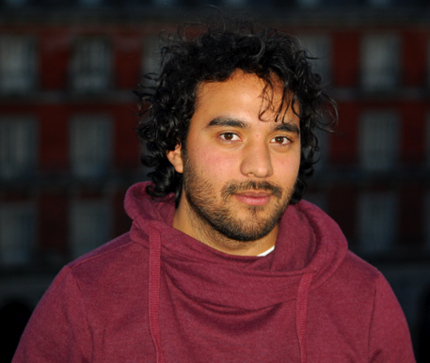
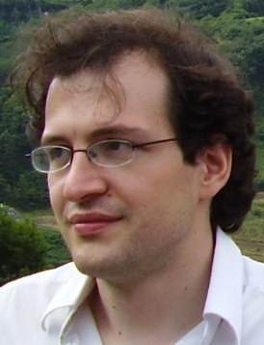
My theory group
Eduardo
Zubizarreta
Casalengua
Dr. Juan Camilo
López
Carreño
Prof. Fabrice
Laussy

Slide 3

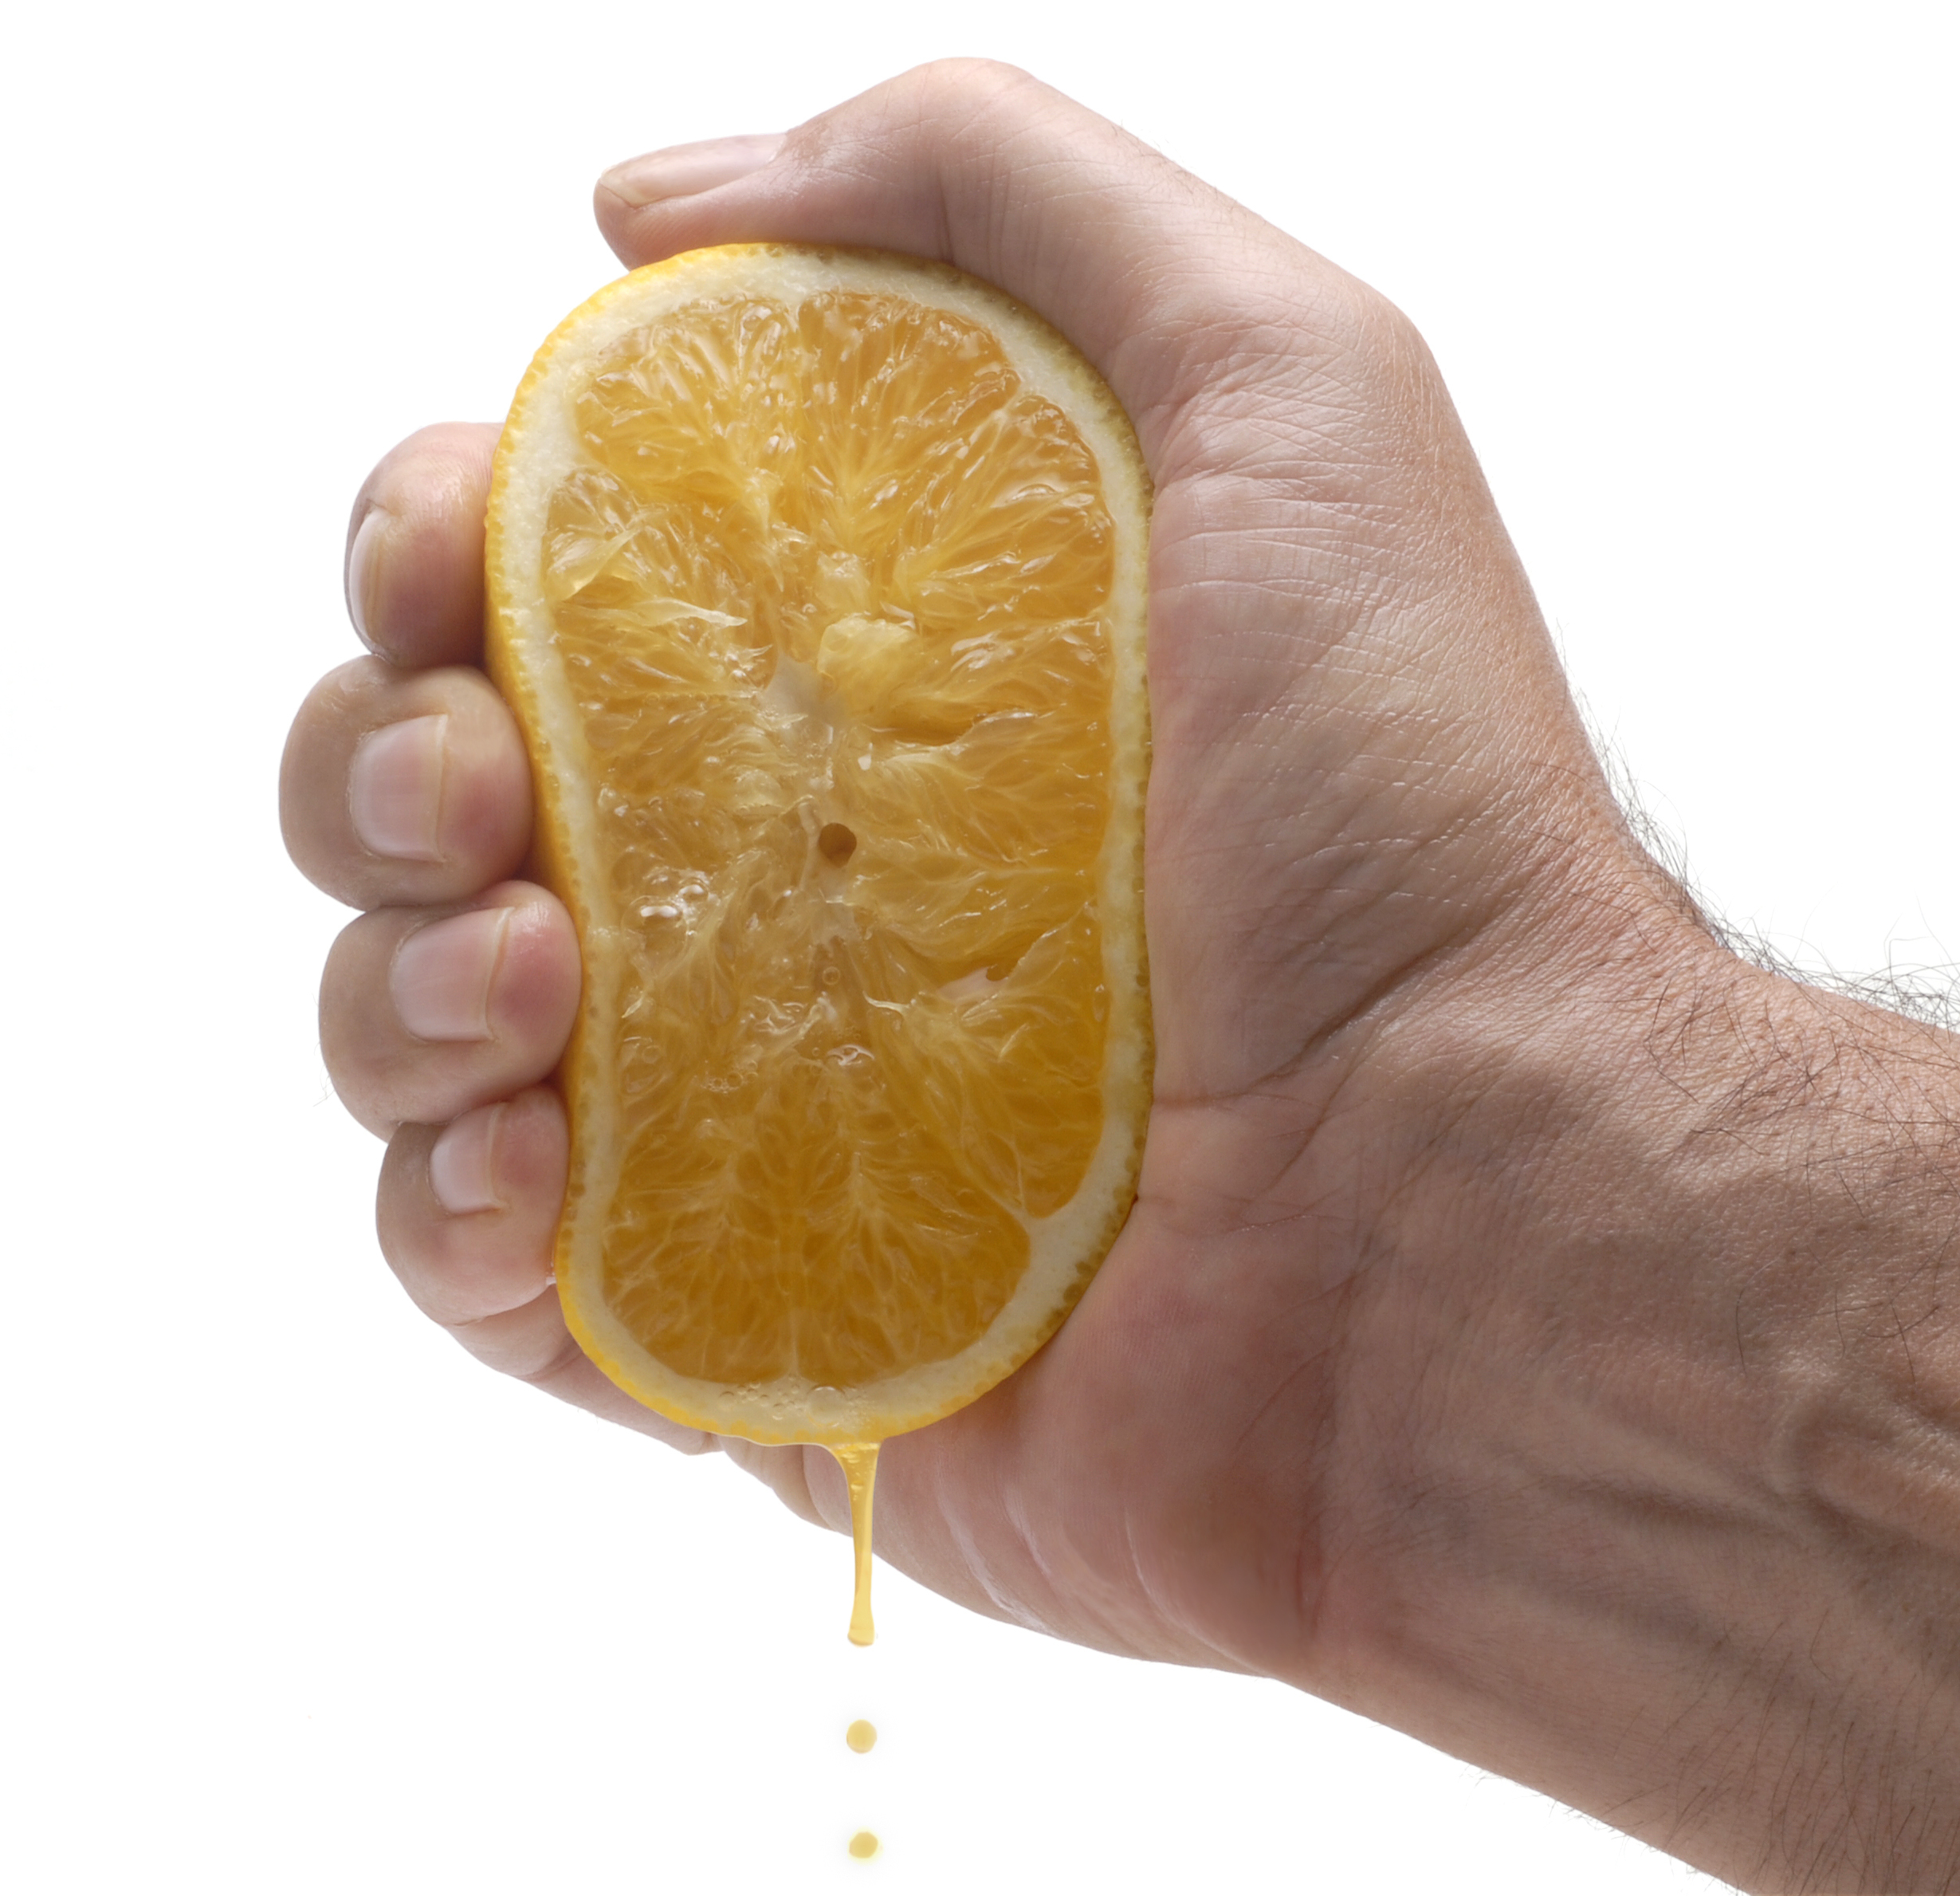
Outline
TOOL: Frequency and time resolved correlations
Temporal correlations (relationship between photons) where photons are defined by their colour
→ How to measure, compute & interpret them
APPLICATIONS in Resonance Fluorescence:
N-photon emitter or bundler (high driving)
Single photon emitter with subnatural linewidth (low driving)

Slide 4
Outline
TOOL: Frequency and time resolved correlations
Temporal correlations (relationship between photons) where photons are defined by their colour
→ How to measure, compute & interpret them

Slide 5
One-photon spectrum or PL spectrum
photon counting
&
detection
probability to emit
one photon at frequency ω ?
= frequency detector resolution
or filtering window

Slide 6
One-photon spectrum or PL spectrum
photon counting
&
detection
probability to emit
one photon at frequency ω ?
= frequency detector resolution
or filtering window
Two-photon correlations or second order coherence function
coincidence
counting
&
detection
probability to emit
two photons delayed by τ ?
Hanbury-Brown and Twiss setup:
Are photons introverts or extroverts?

Slide 7
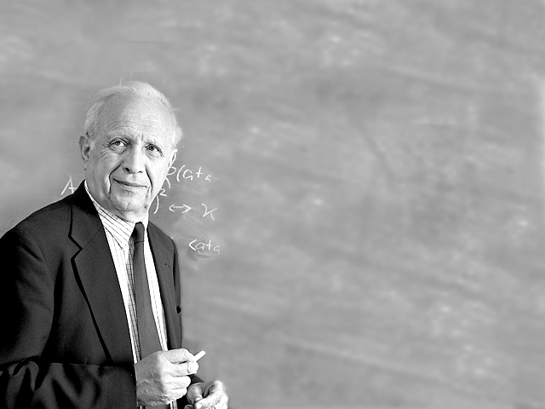

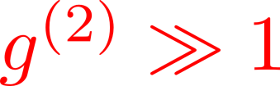
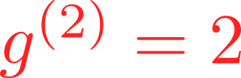



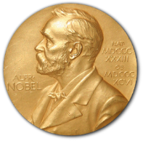
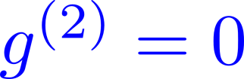
Second order coherence function
At zero delay between the photons…
Roy Glauber
Nobel Prize 2005

Slide 8
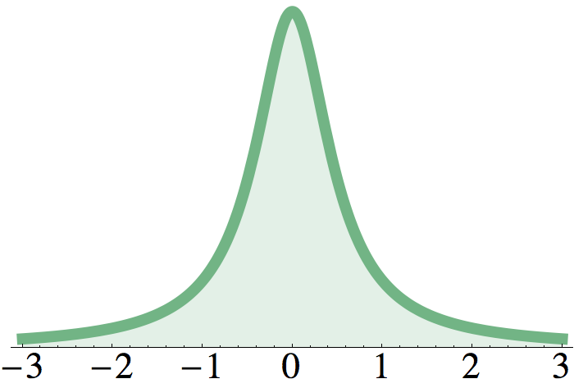
Two-photon correlations, time and frequency resolved
filters
coincidence
counting
&
detection
probability to detect
two photons
delayed by τ at ω₁ and ω₂ ?
= time detector resolution
Frequency-resolved second order coherence function:
Intensity-intensity correlations
between two windows of the PL spectrum
What is the role/effect of detection?
How to compute them?

Slide 9
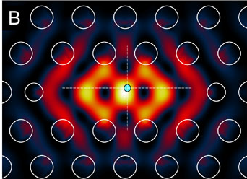
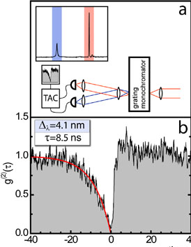
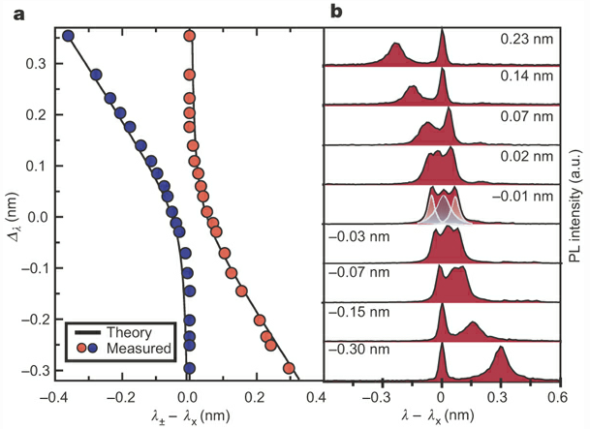
Experimental filtering & cross-correlations in cavity-QED
Quantum nature of a strongly coupled single quantum dot–cavity system
K. Hennessy et al., Nature 445, 896 (2007)

Slide 10
Theory
Theoretically challenging:
L. Knöll and G. Weber, J. Phys. B 19, 2817 (1986)
K. Joosten and G. Nienhuis, J. Opt. B 2, 158 (2000)
G. Bel and F. L. H. Brown, Phys. Rev. Lett. 102, 018303 (2009)
Via input-output formalism, convolution with detectors:
4!/2 = 12 independent correlators (time orders) with their specific integrating regions
Each requires Quantum Regression Theorem 3 times
Very difficult to generalise to N photon correlations

Slide 11
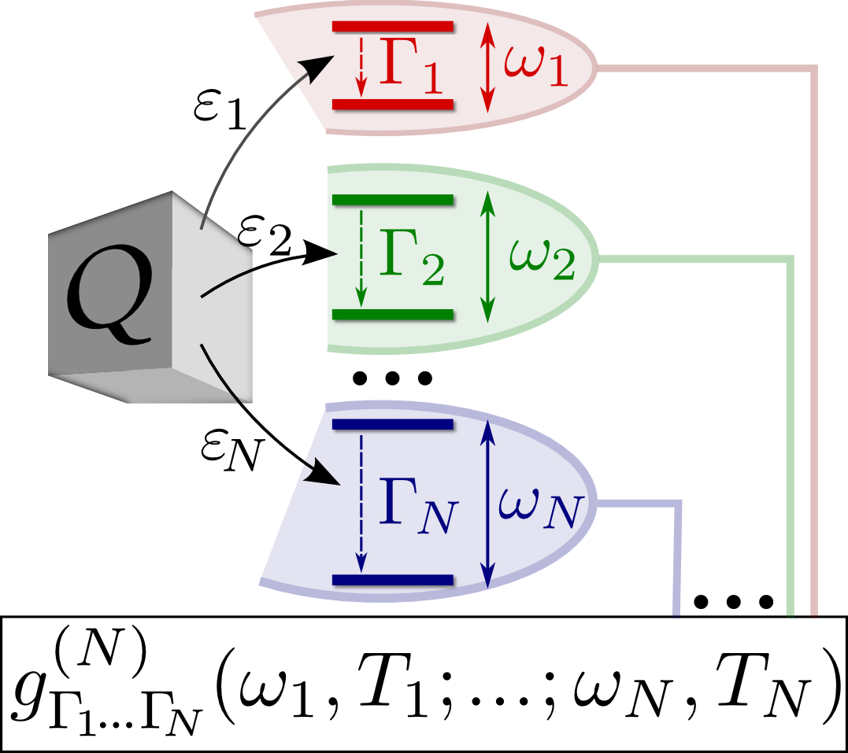
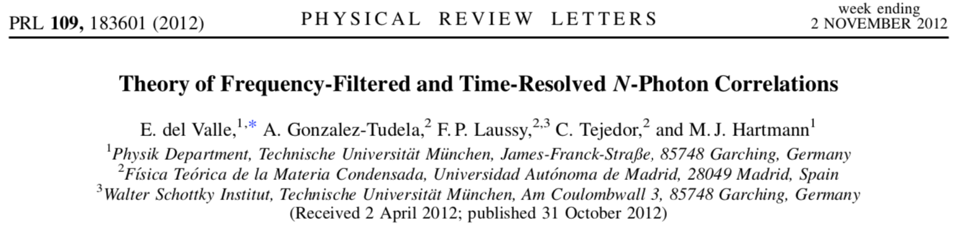
Theory
We propose a general theory including filter/detectors (= “sensors”) in the dynamics:
We solve the full system in the weak coupling limit with the sensors → the system dynamics is unperturbed
We apply the quantum regression theorem only once & no integrals to make!
For τ = 0 we only need to look at one-time correlations
We recover exactly the integral result & the proof provides a perturbation approach and formulas
Simple, general and escalable method!

Slide 12
Theory
General theory valid for
Any number of photons (not only two as in previous studies)
Any quantum open system (not only simple limiting cases)
Steady-state situations under continuous excitation or time dynamics
Computationally powerful and efficient
Includes self-consistently the fundamental detector uncertainty or filtering resolution
(in time/frequency according to Heisenberg uncertainty principle)

Slide 13
Outline
TOOL: Frequency and time resolved correlations
Temporal correlations (relationship between photons) where photons are defined by their colour
→ How to measure, compute & interpret them
APPLICATIONS in Resonance Fluorescence:
N-photon emitter or bundler (high driving)

Slide 14


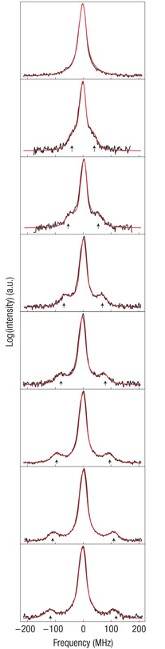
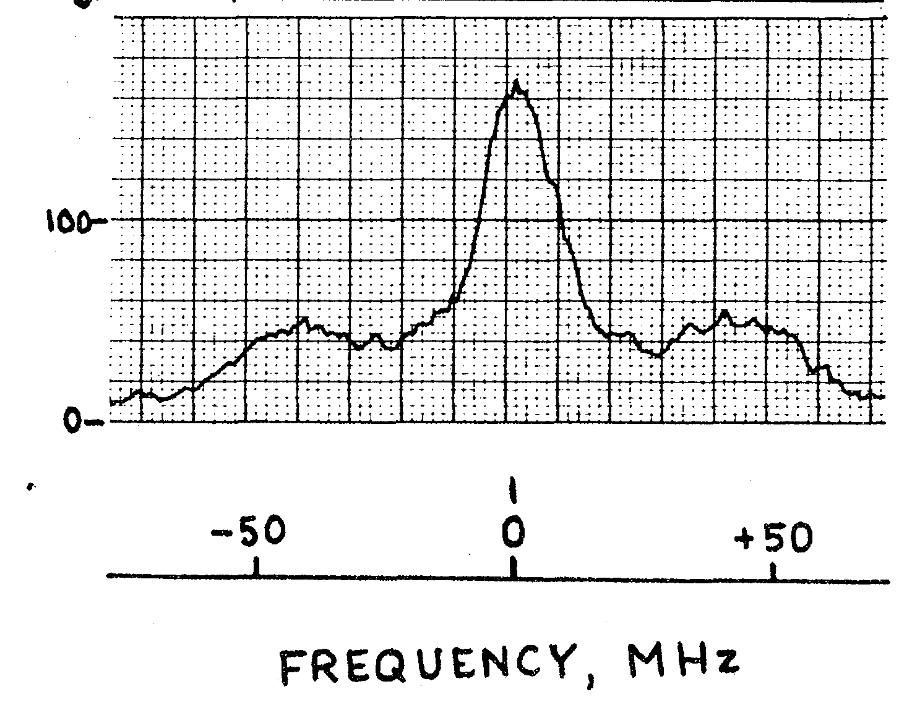
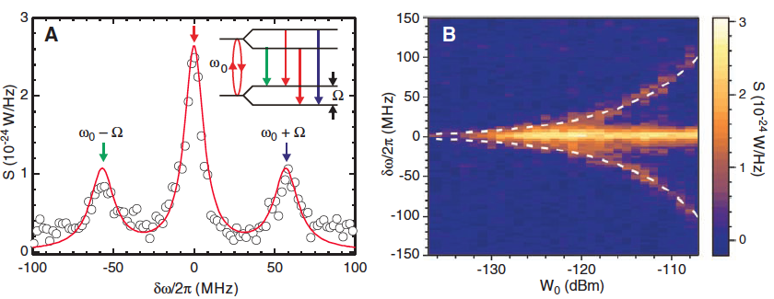
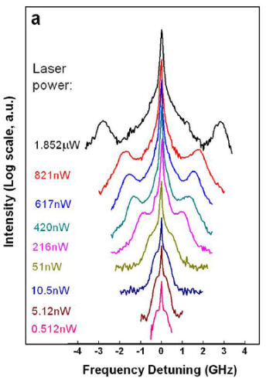
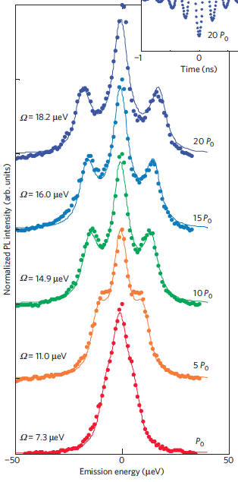
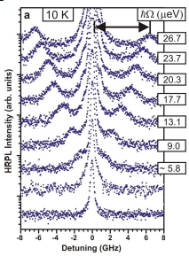
Driving the qubit with a laser (light-matter strong-coupling)
qubit
Atoms:
Superconducting qubits:
Wu et al.
Phys. Rev. Lett. 35,
1426 (1975)
The Mollow Triplet
A molecule:
Wrigge et al.
Nature Phys. 4,
60 (2008)
With a
quantum dot:
Astafiev et al.
Science 12, 840 (2010)
Flagg et al.
Nature Phys. 5,
203 (2009)
Vamivakas et al.
Nature Phys. 5, 198 (2009)
Ates et al.
Phys. Rev. Lett. 103,
167402 (2009)

Slide 15
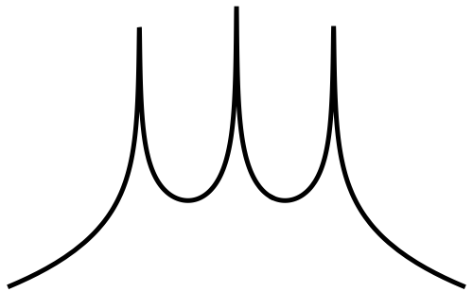
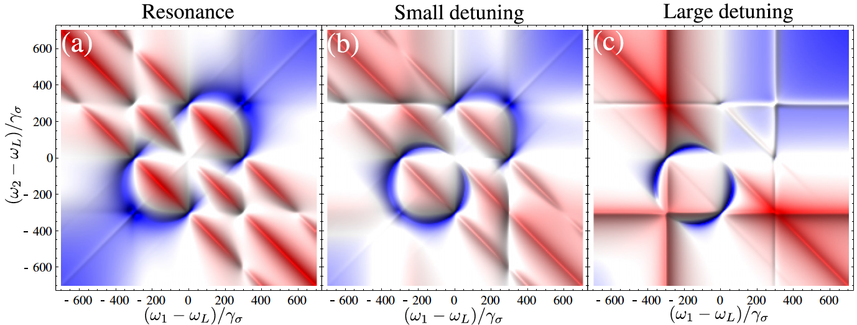
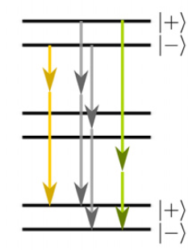
Filtering & cross-correlations of the Mollow triplet
2-photon processes
(also form a triplet!)
Notes:
15

Slide 16
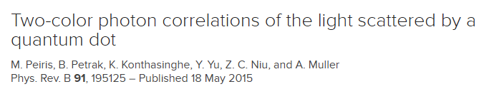
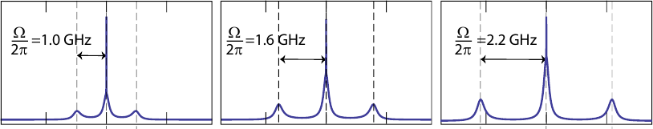
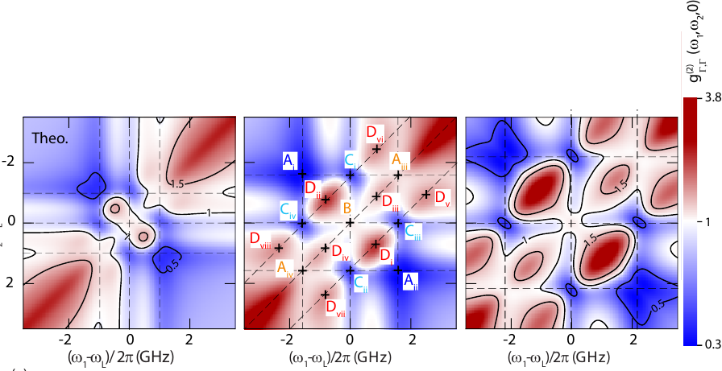
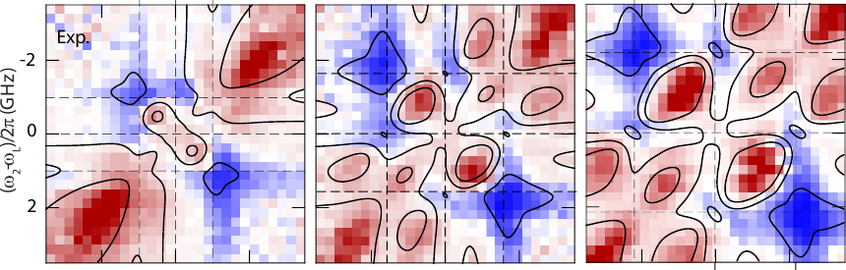
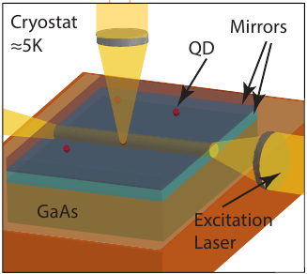
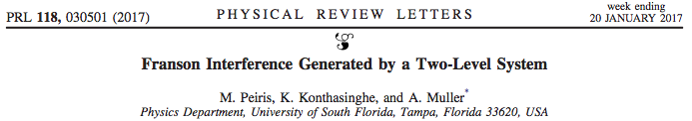
The experiments…

Slide 17
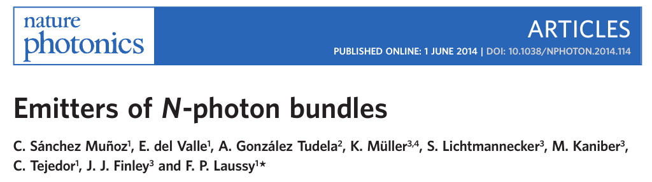
Filtering of the Mollow triplet with a cavity
A cavity to Purcell enchance & gather
the two-photon emission
qubit
Notes:
17

Slide 18
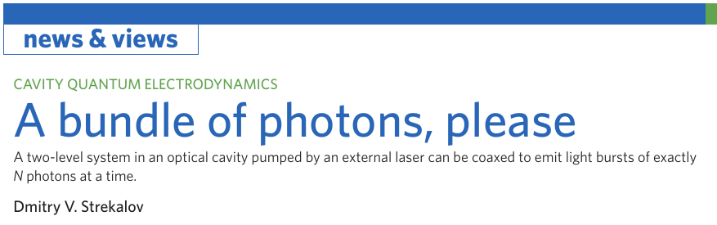
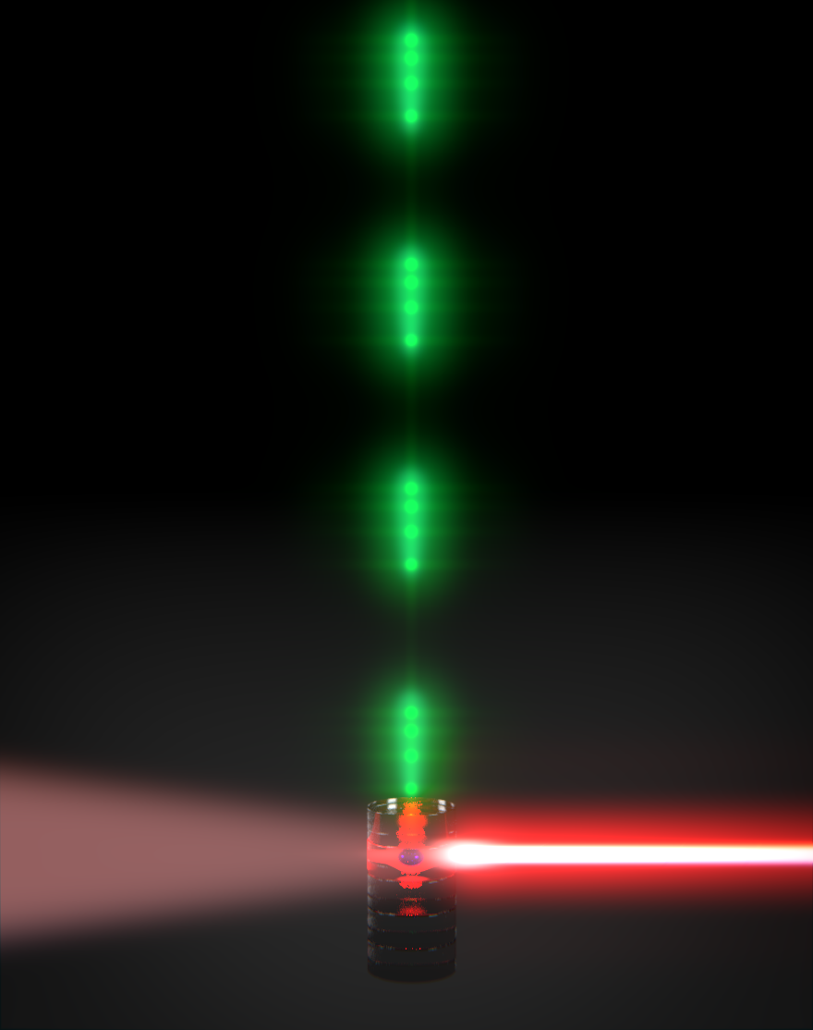
Notes:
18

Slide 19
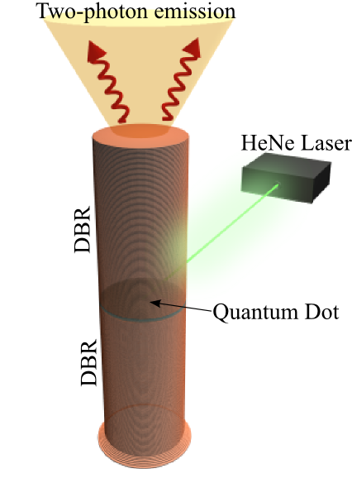
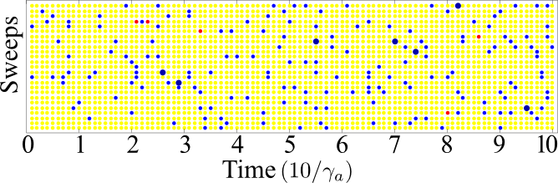
Cavity emission of N-photon states
No emission
Montecarlo simulation
Photon pairs
Single photons
Trajectories

Slide 20
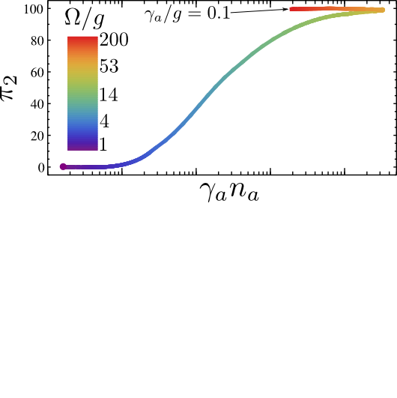
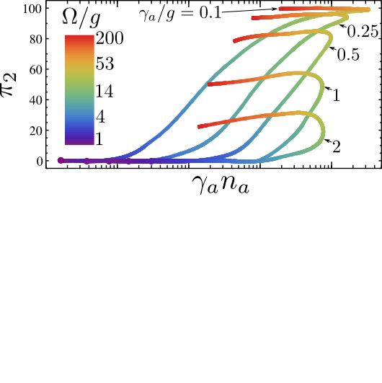
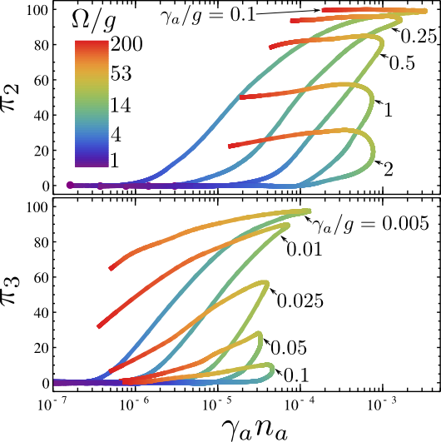
Cavity emission of N-photon states
(purity)
% of N-photon states
in the emission

Slide 21
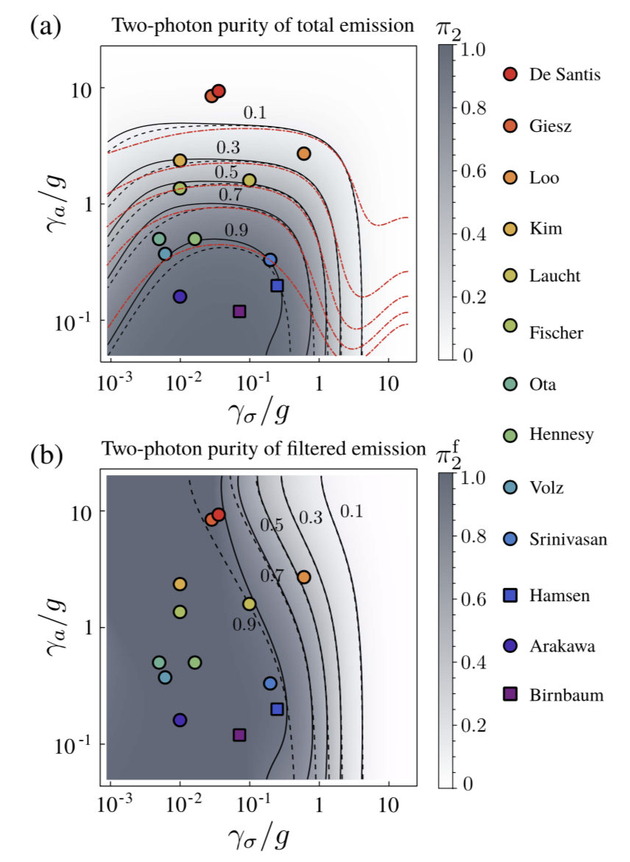
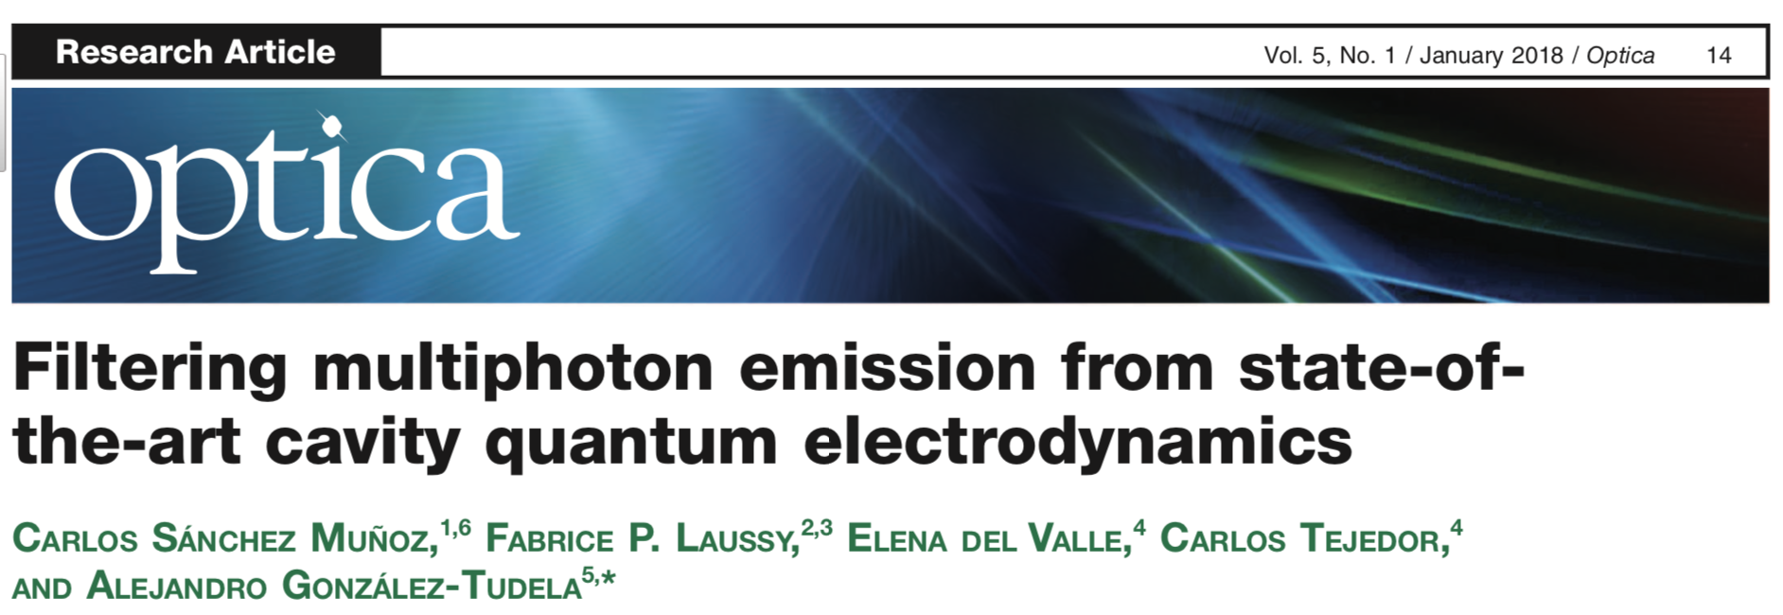
Filtering the cavity emission
to increase 2-photon purity

Slide 22
Outline
TOOL: Frequency and time resolved correlations
Temporal correlations (relationship between photons) where photons are defined by their colour
→ How to measure, compute & interpret them
APPLICATIONS in Resonance Fluorescence:
N-photon emitter or bundler (high driving)
Single photon emitter with subnatural linewidth (low driving)

Slide 23



Resonance fluorescence in the Heitler regime
All calculations to leading order in
Analytical and beautiful!

Slide 24
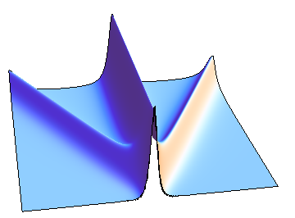
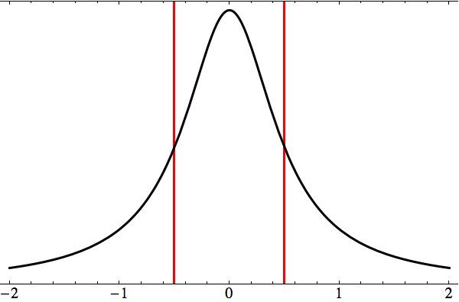
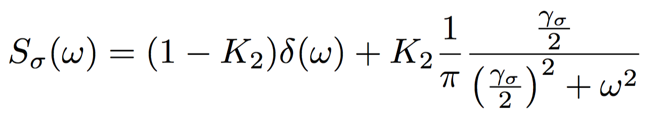
Resonance fluorescence in the Heitler regime
photon counting
&
detection
Spectrum of emission (selecting frequency – single photon detection)
Most classical regime
Delta peak (laser broadening)
Rayleigh scattering
Laser
intensity
emitted frequency
But with detection (very important!)…
Lorentizan peak (detector broadening)
Very precise detection in frequency
→
Monochromatic
Small

Slide 25
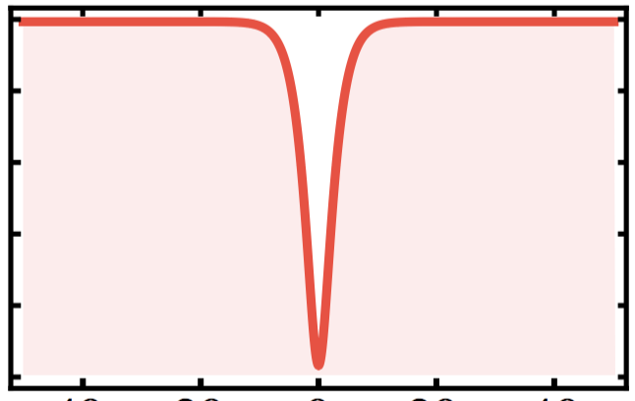

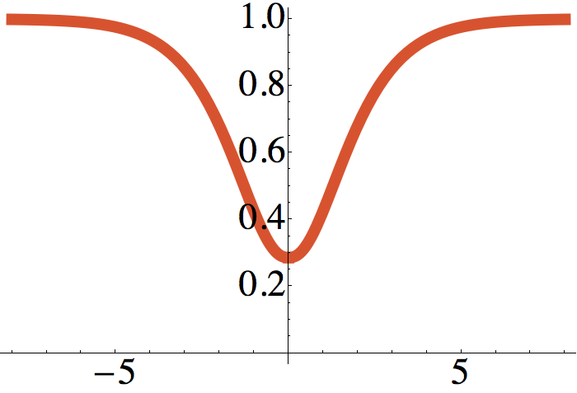

Resonance fluorescence in the Heitler regime
coincidence
counting
&
detection
2. Statistics of the total emission (selecting time – several photons)
Perfect dip (zero) at all drivings
Two-level system → reloading time even under coherent excitation
But with detection…
Dip is spoilt (detector time uncertainty)
Very precise detection in time
→
Single photon source
Large

Slide 26
The ideal single photon emitter!
coincidence
counting
&
detection
Spectrum = Delta peak (inherited from the laser) → inditinguishable photons
Statistics = Perfect antibunching (inherited from the qubit) → emitted one by one
Bright
These properties were confirmed
in separate experiments:
Direct observation of fluorescence narrower than the natural linewidth,
Gibbs et al., Opt. Commun. 17, 87 (1976)
Heterodyne measurement of the fluorescent radiation of a single trapped ion,
Höffges et al., Opt. Commun. 133, 170 (1997)
Ultra-coherent single photon source,
Nguyen et al., Appl. Phys. Lett. 99, 261904 (2011)
Subnatural linewidth single photons from a quantum dot, Matthiesen et al., Rev. Lett. 108, 093602 (2012)

Slide 27
Two-photon spectra of quantum emitters,
A. Gonzalez-Tudela, et al.
New J. Phys. 15, 033036 (2013)
The ideal single photon emitter!... Or is it?...
coincidence
counting
&
detection
Spectrum = Delta peak (inherited from the laser) → inditinguishable photons
Statistics = Perfect antibunching (inherited from the qubit) → emitted one by one
Bright
These properties were confirmed
in separate experiments:
Direct observation of fluorescence narrower than the natural linewidth,
Gibbs et al., Opt. Commun. 17, 87 (1976)
Heterodyne measurement of the fluorescent radiation of a single trapped ion,
Höffges et al., Opt. Commun. 133, 170 (1997)
Ultra-coherent single photon source,
Nguyen et al., Appl. Phys. Lett. 99, 261904 (2011)
Subnatural linewidth single photons from a quantum dot, Matthiesen et al., Rev. Lett. 108, 093602 (2012)
Incompatible in the same experiment!
Very precise detection in frequency,
not to increase the linewidth
Small Γ
Very precise detection in time,
not to spoil the antibunching
Large Γ

Slide 28
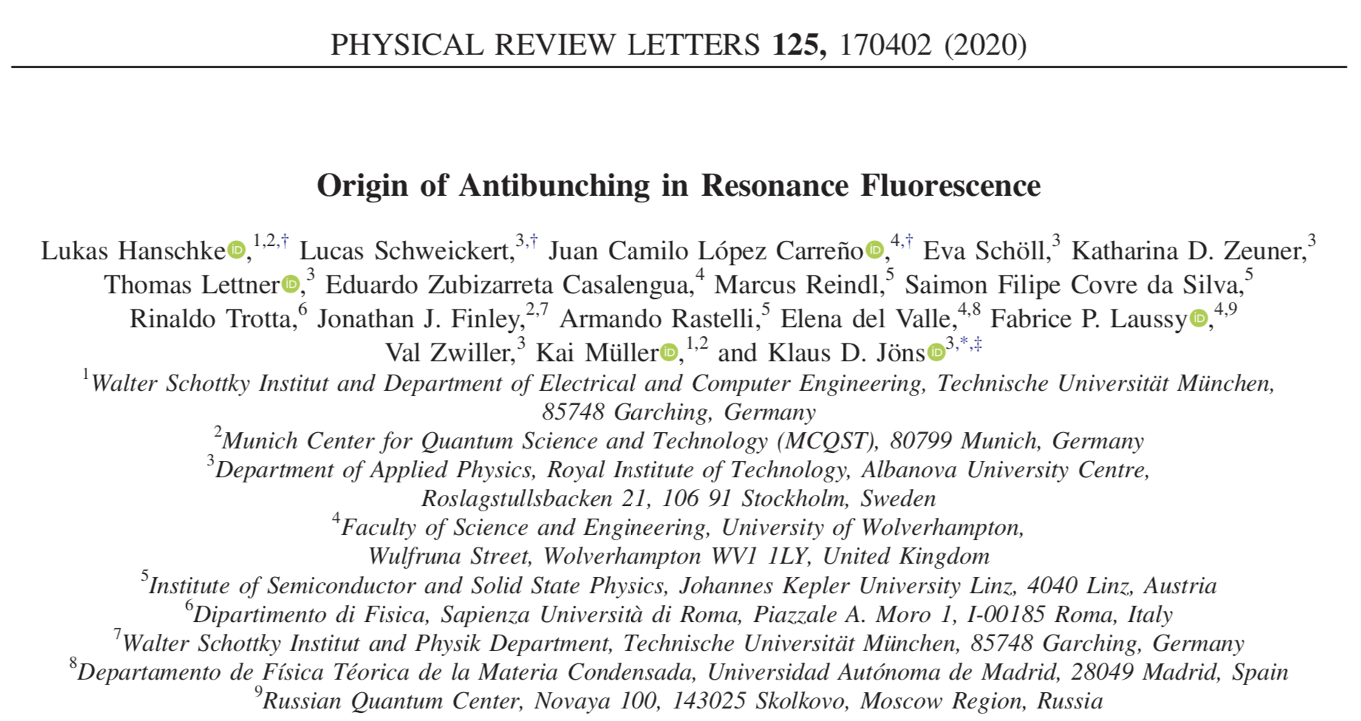
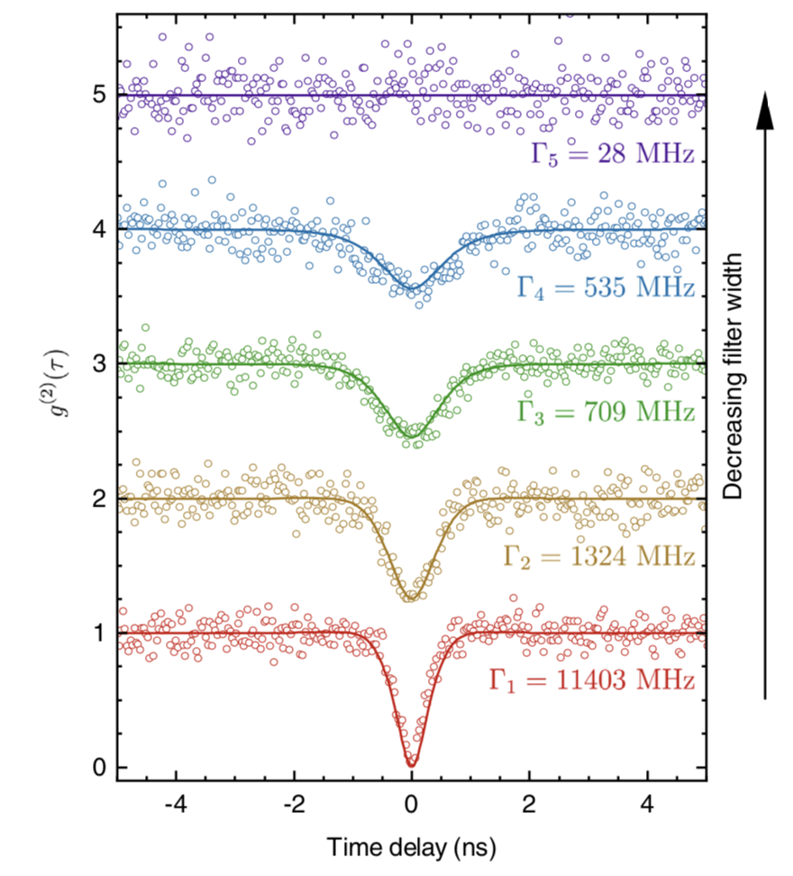
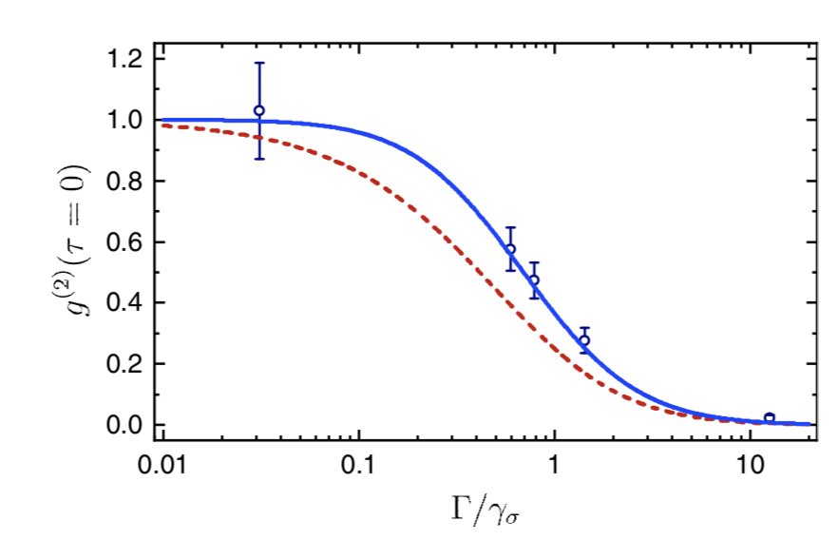
The ideal single photon emitter!... Or is it?...

Slide 29
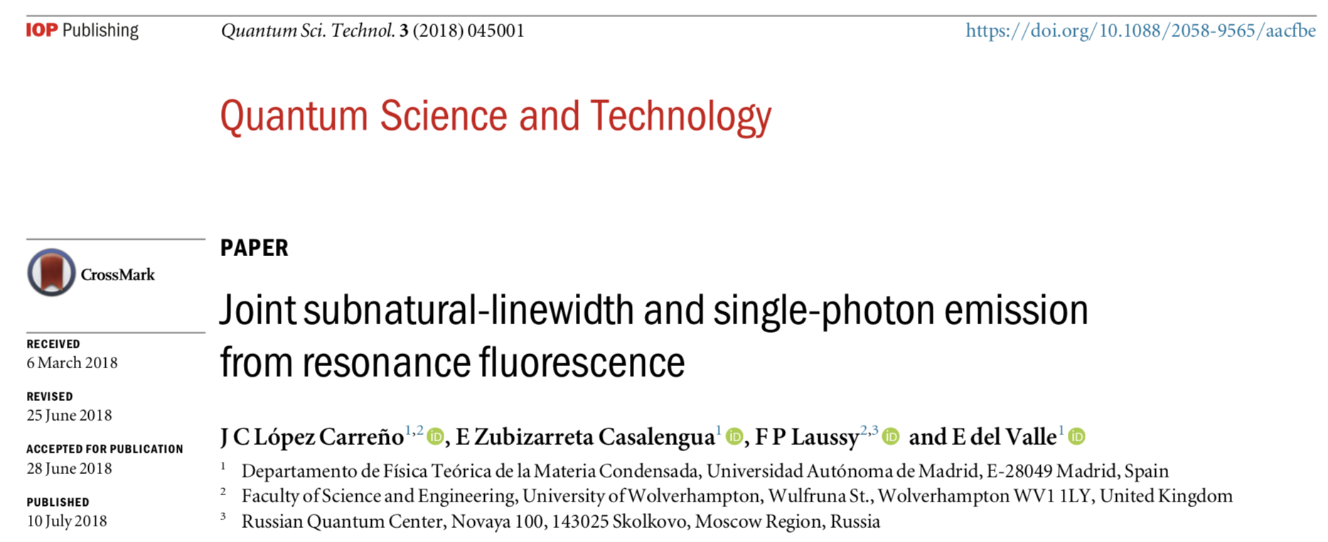
The ideal single photon emitter!... Or is it?...
Can we solve this problem??
Is it possible to do it without coupling to more elements?

Slide 30


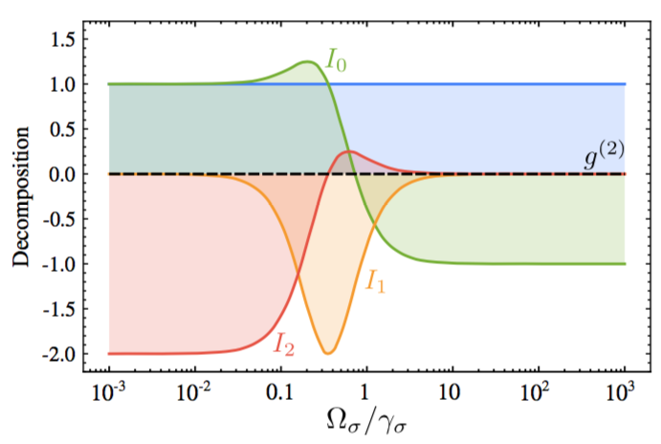
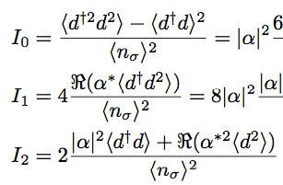
Understanding the Heitler regime…
A way to look at the perfect antibunching under coherent excitation:
Mean field decomposition:
Homodyne terms (Vogel, Carmichael):
Fluctuation
statistics
1 = Laser statistics
Anomalous
moments
Fluctuationquadrature squeezing

Slide 31

Understanding the Heitler regime…
Why is single photons emission spoilt
when detection or frequency filtering beyond the linewidth????
Because we are breaking a perfect interference at the level of N (>1) photons…
Mean field decomposition:
1 = Laser statistics
Coherent photons
Rayleigh scattering
Incoherent-squeezed-photons
Two-photon processes
Always
detected
Breaking the interference!
Not fully detected if

Slide 32


Restauring the interference: homodyne setup
Superposition with a coherent field:
Attenuation factor = parametrization:

Slide 33


First, just the interference → Beautiful!
Perfect time detection:
We compute the statistics at the N-photon level for the total signal
We find interference points at the N-photon level:

Slide 34
First, just the interference → Beautiful!
Perfect time detection:
Conventional statistics:
CA: Conventional Antibunching (no extra laser)
Already explained: due to the 2LS structure
Perfect blockade (N-photon interference) for N > 1

Slide 35
First, just the interference → Beautiful!
Perfect time detection:
Unconventional statistics: not directly related to the level structure
UA: Unconventional Antibunching (requires extra laser)
The same coherence fraction than CA but with a π phase-shift
Perfect blockade for N =2 (2-photon interference) but not for N > 2
one at a time → not as interesting for single-photon emission

Slide 36

First, just the interference → Beautiful!
Perfect time detection:
Unconventional statistics: not directly related to the level structure
UB: Unconventional Bunching (with some extra laser)
Classical destructive interference of the coherent fraction
Perfect blockade for N =1 (population) →
Not useful for N-photon emission (chaotic & squeezed fluctuations, not bundles)

Slide 37

Back to business, restauring the interference:
Good ω-detection:
1
Conventional statistics:
CA: Conventional Antibunching
Gets spoilt
Restored thanks to the extra laser

Slide 38




Restauring the interference: homodyne setup
Perfect second order antibunching
Low higher order functions (no longer zero)
Compatible with a thin spectral width (subnatural linewidth)
Downside: signal loss
Long second order coherence time (plateau)

Slide 39


Light-matter coupling under weak laser driving
without extra laser!!!
self-homodyne
Eduardo Zubizarreta’s talk (yesterday)

Slide 40



Self-homodyne proposals with Jaynes-Cummings:
Using for the interference with the cavity, instead of an external laser
→ light coherently scattered from the continuum above-the-light-line modes.
Optimizing self-homodyne interference to enhance quantum features
→ Mollow triplet, QD single-photon emission, tunable statistics

Slide 41



Unconventional photon blockade for photonic molecules:
A relevant problem to optimize!

Slide 42




Light-matter coupling under weak laser driving
Jaynes-Cummings model: 2LS
Microcavity polaritons: Kerr
(maps for cavity driving only)

Slide 43


Conventional statistics:
Jaynes-Cummings model
Microcavity polaritons

Slide 44


Unconventional statistics:
Jaynes-Cummings model
Microcavity polaritons
without extra laser!!! self-homodyne

Slide 45


Playing & optimize statistics with the driving:
Many parameters to optimise: cavity-exciton driving fractions, phase, detuning, decay rates, coupling.

Slide 46
Conclusions
Time and frequency-filtered correlations
Hanbury Brown-Twiss effect → colour domain
Spectrum of emission → 2-photon spectrum
1-photon transitions → N-photon transitions
Resonance fluorescence
N-photon emitter
Correlations enhanced
by a cavity
Subnatural linewidth single photon emitter
Correlations corrected by a laser

Slide 47
Thanks!

