Slide 1
Identity and Access Management with KEYCLOAK
Sagar S. Mungse 25th July, 2025 CCCF, TIFR

Slide 2
Outline
Legacy authentication methods
World of Single Sign On (SSO)!
World of Single Sign On (SSO)…
Why Keycloak?
Keycloak Flow
Keycloak Flow dynamics
Installation, configuration and live use cases
Customised authentication flow
Authentication flow dynamics
Securing Keycloak (SSO)
Stressed vs Unstressed System Administrators
Reference and Acknowledgment
Q & A

Slide 3
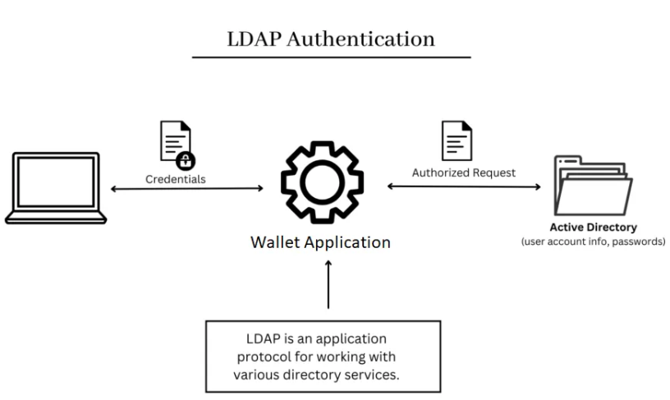
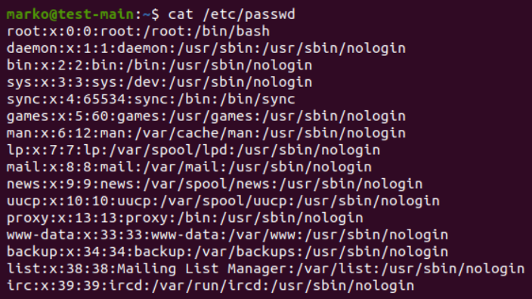
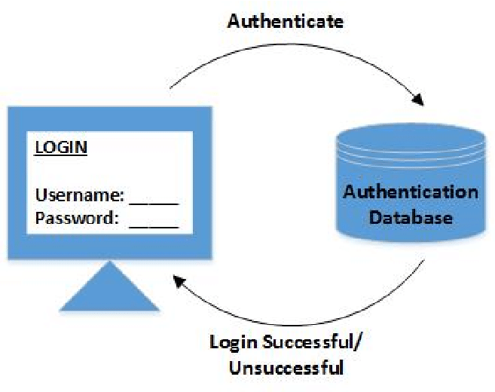
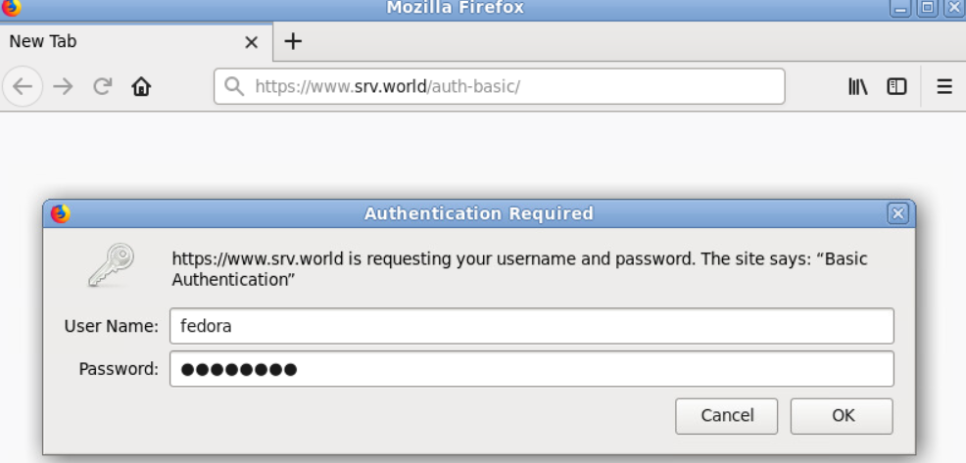
Legacy authentication methods
AD or openLDAP
Local user account
Apache htpasswd
Database

Slide 4
Security flaw for legacy auth methods
Weak authentication mechanism.
Multiple systems and multiple passwords for users.
A lot of hardship to manage the accounts especially while using htpasswd.
Multiple systems and multiple passwords for users.
System’s Internal database is in use for user authentication.
Application directly integrated with authentication server.
Difficult to upgrade the auth systems (AD or openLDAP).
Common Flaws
No multi-factor authentication (MFA).
Phishing and Social Engineering
Lateral Movement.

Slide 5

Any solution to overcome these issues???

Slide 6
World of Single Sign On (SSO)!
Opensource SSO Solutions
Feature / Platform | Keycloak | Authelia | Gluu Server / Flex | ORY Hydra + Kratos | Authentik
SSO (Single Sign-On) | ✅ OIDC, SAML | ✅ (via reverse proxy) | ✅ OIDC, SAML, UMA | ✅ OIDC (Hydra) | ✅ OIDC, SAML
Multi-Factor Auth (MFA) | ✅ TOTP, WebAuthn, SMS | ✅ TOTP, Duo, WebAuthn | ✅ OTP, Duo, WebAuthn | 🔶 (Requires integration) | ✅ TOTP, WebAuthn
OAuth2 / OIDC | ✅ Full support | 🔶 Limited (via proxy) | ✅ Full support | ✅ Advanced (Hydra) | ✅ Full support
SAML | ✅ Yes | 🔶 No native support | ✅ Yes | ❌ Not supported | ✅ Yes
LDAP / AD Integration | ✅ Yes | ✅ Yes | ✅ Yes | 🔶 Partial (Kratos) | ✅ Yes
User Management (UI) | ✅ Full Admin UI | ❌ Config-based | ✅ Admin UI (Flex) | ❌ CLI/API only | ✅ Admin UI
User Self-Service | ✅ Password reset, registration | ❌ Not built-in | ✅ Yes | ✅ (Kratos) | ✅ Yes
Cross Domain IAM | 🔶 Planned / Partial | ❌ No | ✅ Yes | 🔶Limited (Custom Dev) | 🔶 Planned
Access Policies / RBAC | ✅ Fine-grained | 🔶 Basic | ✅ Fine-grained | 🔶 Custom logic | ✅ Built-in
Deployment | Docker, K8s, bare metal | Docker, K8s | Docker, K8s | Modular (Hydra/Kratos separately) | Docker, K8s
Ease of Setup | Moderate | Easy | Complex (Flex easier) | Complex (Dev-heavy) | Easy
Best For | Enterprises, microservices, hybrid cloud | Self-hosted SSO/MFA | High-security, enterprise use | Dev teams, custom workflows | SMEs, devs, modern cloud apps
Enterprice SSO Solutions
Microsoft Entra ID (Azure AD)
Ping Identity
ForgeRock
OneLogin (by One Identity)
CyberArk Identity
Okta

Slide 7

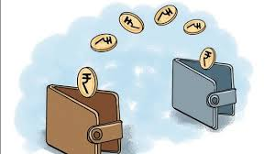



Opensource or Enterprise??? On-prem or Cloud???

Slide 8
World of Single Sign On (SSO)…
Category | Keycloak (Self-Hosted) | Commercial IAM (e.g., Okta, Azure, onelogin etc)
License Fees | ✅ Free (Apache 2.0 open-source) | ❌ Subscription-based (monthly/yearly per user/app)
Hosting Costs | 💸 You pay (e.g., VMs, Kubernetes) | ✅ Included in pricing (SaaS)
Scaling Costs | 💸 Pay for compute/storage/network | 💸 Pay per MAU or per API call — scales fast
Maintenance & Patching | 🛠️ Your team handles it | ✅ Vendor handles it
Support | 🟡 Community or paid Red Hat support | ✅ Professional 24/7 support included
Customization Flexibility | ✅ Full access to internals | ❌ Often limited or costs extra
Security/Compliance | 🛡️ You must implement | ✅ Compliance usually included
Uptime/SLAs | 🟡 You must monitor and ensure | ✅ SLAs (e.g., 99.99% uptime)
Developer Speed | ❌ Slower without IAM experience | ✅ Faster with hosted SDKs, prebuilt flows
Vendor Lock-in | ✅ No | ❌ Usually high

Slide 9

So, we decided to deploy KEYCLOAK…..

Slide 10
Why Keycloak?
TOTP (Time-based One-Time Password) support using any authenticator (E.g Google authenticator, FreeOTP etc).
Full document is available to deploy the system.
Free of cost and deployment is easy.
All types of deployment is available e.g. Docker, K8s, bare metal.
In-house support is available.
Multiple LDAP servers can be integrated
Many more cases to consider.
Use Case | Keycloak Suitability
Microservice authentication | ✅ Excellent
SSO for internal & external apps | ✅ Strong
Social login support | ✅ Built-in
OIDC/SAML identity federation | ✅ Robust
LDAP/AD integration | ✅ Easy
Highly customizable auth flows | ✅ Fully extensible
Lightweight SSO with minimal setup | ✅ Easy (LDAP Integration, customise auth flow, reverse proxy and few other security parameters deployment makes keycloak moderate)

Slide 11
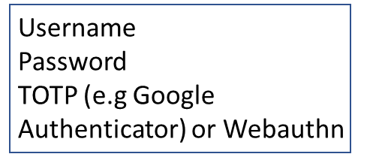




Keycloak Flow
Web App - 3
Web App - 2
Web App -1
TIFR LDAP
Reverse Proxy
NCBS LDAP
NCBS LDAP
ICTS LDAP
Keycloak Server
TOTP and Webauthn Auth flow
Internal MySQL DB

Slide 12
Keycloak Flow dynamics
Username Password TOTP (e.g Google Authenticator) or Webauthn
Web-App-3
Web-App-2
Web-App-1
TIFR LDAP
Reverse Proxy
NCBS LDAP
Check Username and Cont…
ICTS LDAP
Webauthn (passwordless)
Keycloak Server (auth)
Password + 2FA
Auth Success or Fail
TOTP Auth flow
Internal MySQL DB
Auth Success or Fail
Webauthn Auth flow

Slide 13
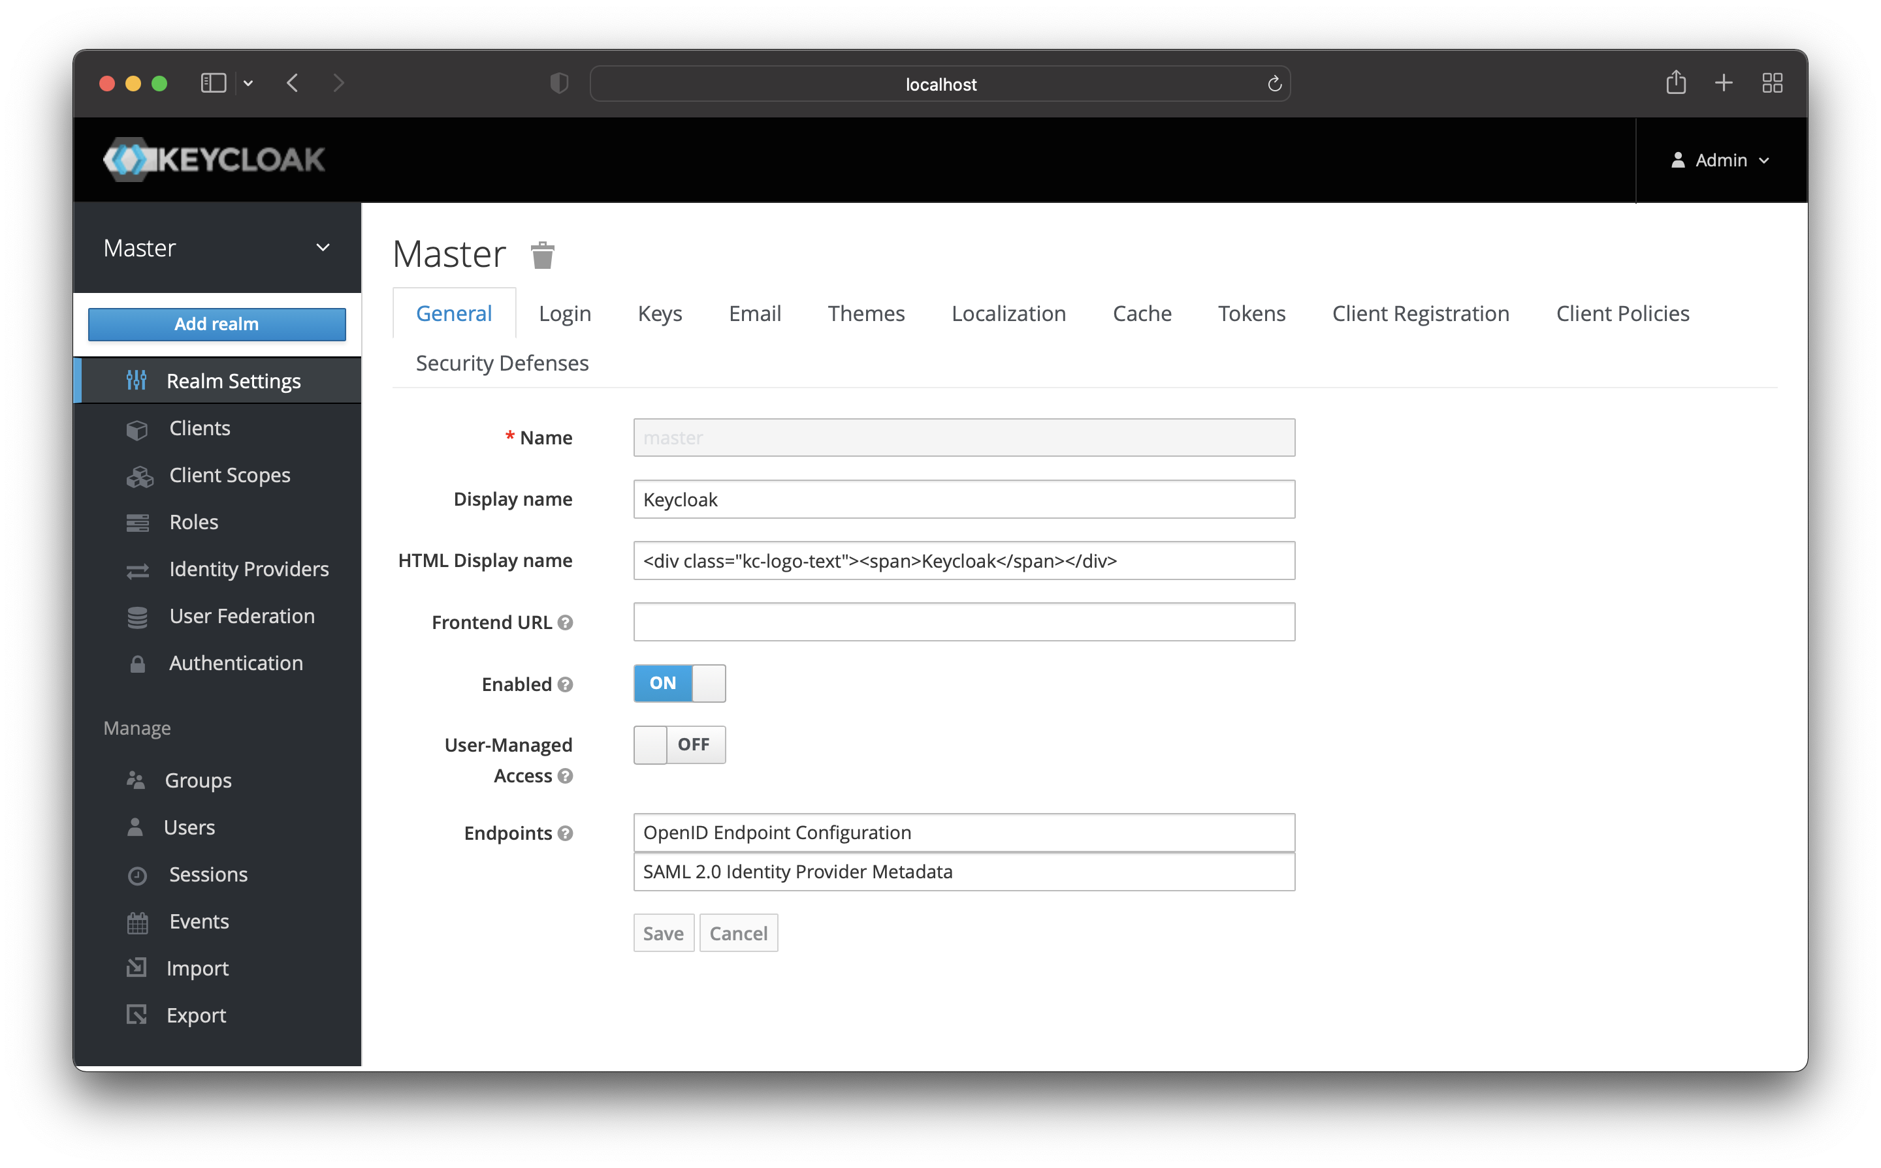
Installation, configuration and live use cases.
Complete Installation and configuration document available on https://zerobyte.notion.site/Zerobyte-knowledge-Base-241bc95018e48058bdfdc2b61294ce9f
Core Concepts of Keycloak
Realm
Logical, isolated namespace for managing users, roles, groups, clients and identity settings.
Provision to create multiple realms.
Do not create any clients inside master realm. As master realm is only for administration purpose.
Clients
An Application or service registered with realm for login.
Client Scope
A client scope is bundle of protocol-specific settings (like roles, claims, mappers) that define what gets sent to a client during login.
Mapper
Helps to fetch the attribute values from the LDAP/AD for further authorization purpose.
User Federation
Integration of LDAP/AD with keycloak.

Slide 14
Customised authentication flow.
Basic authentication flow provides only username and password form which is less secure.
Keycloak provide customisation in authentication flow.
This enables 2nd factor of authentication using TOTP (Time based OTP) and also provides password-less login using webauthn (fingerprint) feature.
Authentication flow maps to the realm therefore all the clients under the realm will use the same flow.
Customisation enables you to add various forms, sub flows and conditions which helps for authentication and authorisation at the same time.
Block the access based on Ipaddress, Geolocation and login time etc.
This makes difficult for an attacker to get the access.

Slide 15
Customised authentication flow
Step - Cookie (Alternative)
OTP Form (Required)
Step - Identity Provide Redirector (Alternative)
Sub Flow – Username/Passwd/OTP (Alternative)
Step - Deny Access (Required)
Step – Username Form (Required)
Condition – IP Range (Required)
Sub Flow – Auth Method (Required)
Sub Flow – Deny By IPaddress (Conditional)
Sub Flow – Passwordless (Alternative)
Sub Flow – 2FA Registration (Alternative)
Step – Webauthn Passwordless (Required)
Step – OTP FORM (Alternative)
Sub Flow – Passwd and 2FA (Alternative)
Step – Webauthn Authenticator (Alternative)
Step – Passwd Form (Required)
Condition – User Configured (Required)
Sub Flow – 2FA-SKIP-Check (Conditional)
Sub Flow – 2FA Authentication (Alternative)
Condition User Attribute – 2FA-BYPASS (Required)
Sub Flow – 2Factor (Required)

Slide 16
Authentication flow dynamics
Step - Cookie (Alternative)
OTP Form (Required)
Step - Identity Provide Redirector (Alternative)
Sub Flow – Username/Passwd/OTP (Alternative)
Step - Deny Access (Required)
Step – Username Form (Required)
Condition – IP Range (Required)
Sub Flow – Auth Method (Required)
Sub Flow – Deny By IPaddress (Conditional)
Sub Flow – Passwordless (Alternative)
Sub Flow – 2FA Registration (Alternative)
Step – Webauthn Passwordless (Required)
Step – OTP FORM (Alternative)
Sub Flow – Passwd and 2FA (Alternative)
Step – Webauthn Authenticator (Alternative)
Step – Passwd Form (Required)
Condition – User Configured (Required)
Sub Flow – 2FA-SKIP-Check (Conditional)
Sub Flow – 2FA Authentication (Alternative)
Condition User Attribute – 2FA-BYPASS (Required)
Sub Flow – 2Factor (Required)

Slide 17
Securing Keycloak (SSO).
Authentication and authorization for all the applications are served by keycloak.
Use SSL certificate on keycloak server.
Do not configure LDAP/AD, new client, authentication flow in master realm.
Admin access should be enabled over internal network or through specific IPs.
Safeguard your keycloak with any reverse proxy (Apache, Caddy or Nginx).
Enable high security on reverse proxy.
Enable WAF (Web application firewall – i.e. Modsecurity) on reverse proxy and keep the WAF rules up-to-date.
Users should register their 2FA parameters over internal network and strictly not allowed over internet.
Enable captcha to control brute force attack, email verification and account lockout after “n” failed attempts.
Cut down time-to-live to 1 minute only to avoid man in middle attack (TOTP configuration).
Backup of keycloak database as webauthn and TOTP data are stored in it.
System should be upgraded periodically for fixing vulnerabilities.

Slide 18
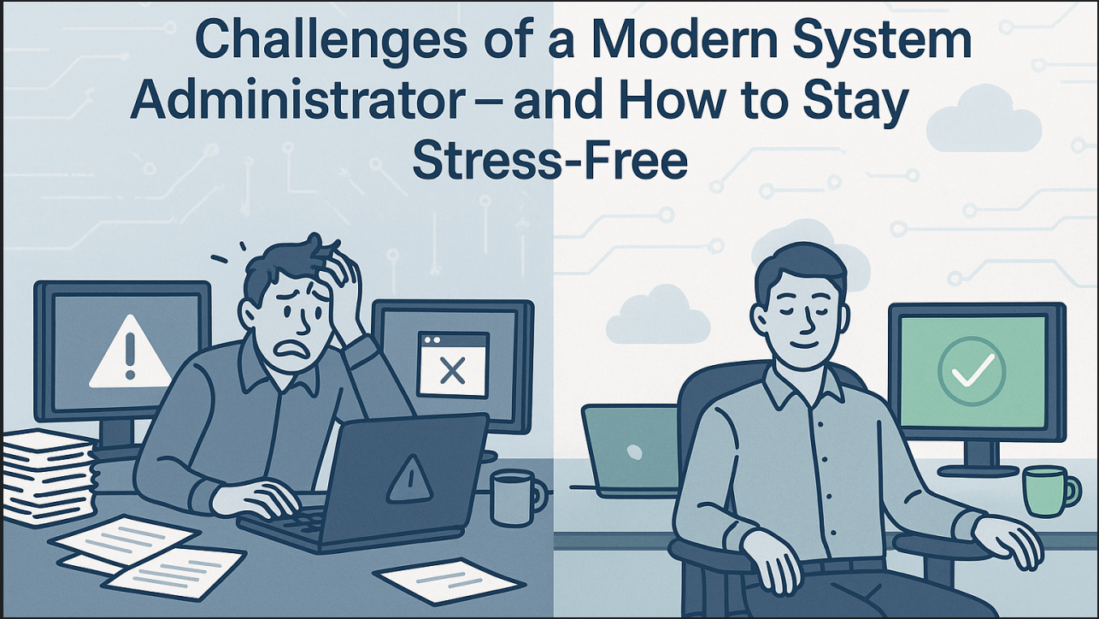

Stressed vs Unstressed System Administrators

Slide 19
References
Keycloak official website:
https://www.keycloak.org/
Keycloak installation and configuration:
https://zerobyte.notion.site/Keycloak-198bc95018e4807ba1baeb8e86fef4c9
Keycloak Authentication flow:
https://zerobyte.notion.site/Keycloak-Authentication-Flow-and-Theme-Customization-19ebc95018e480768411fde3c044f26d
Keycloak LDAP integration:
https://zerobyte.notion.site/Keycloak-and-LDAP-AD-19abc95018e480c4a837c65514ad2c1a
Apache Reverse Proxy:
https://zerobyte.notion.site/Reverse-Proxy-Apache-20fbc95018e480ed814fe7c95984bbc4
For quarkus properties:
https://quarkus.io/guides/all-config

Slide 20
Acknowledgment
Prof. Ramprasad Saptharishi, Associate Professor (G), STCS
Smt. Kausalya Srinivas, SO (F), CCCF
Shri. Santosh Kyadari, SO (E), CCCF
Shri. Siraj Momin, SO (D), CCCF

Slide 21


Q & A

