Slide 1
Restricted Boltzmann Machines: Statistical Physics and applications to protein sequence data.
Rémi Monasson, Jérôme Tubiana, Simona Cocco
Physics, Ecole Normale Superieure & CNRS, Paris
Statistical Physics of Machine Learning, ICTS, Bangalaore, January 7, 2020

Slide 2
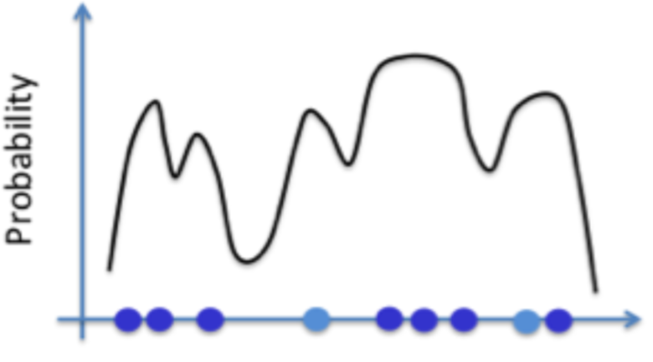
Learn a probability distribution from (relatively few) data.
Many applications, in particular to model « complex » systems where first-principle approaches have limited success, e.g. sequence to structure/function mapping in proteins
Can be done by unsupervised neural nets, such as restricted Boltzmann machines (RBM)
The probability distribution inferred from data can be used to generate new configurations of the system

Slide 3
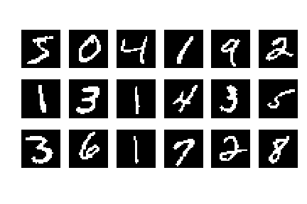

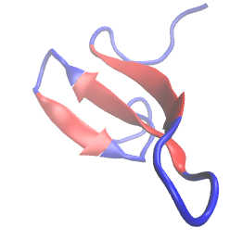
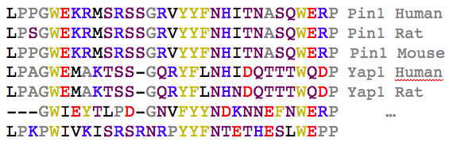
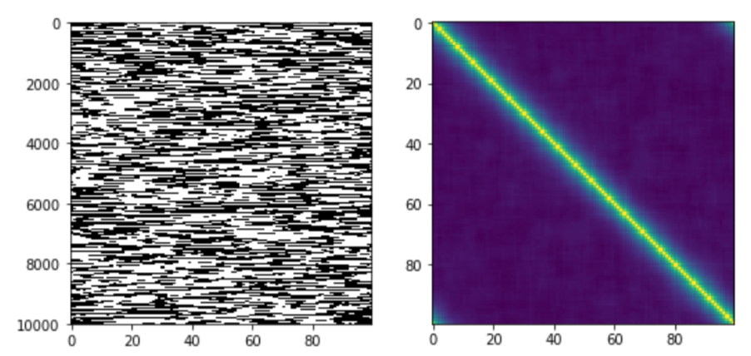
Data studied
MNIST digit data set
60000 Binary images 28x28 pixels of handwritten digits
WW protein domain
8000 sequences
Artificial data from1D-Ising model
N=256 digits
Le Cun, Cortes,Burges, (1998)
Russ et al. Nature 2005
N=31 sites
Potts variables
N=100 spins
Notes:
from the MNIST digit database (1998)
Popular Machine Learning benchmark:
195/1009 of NIPS2018 papers use MNIST
Mettere mano con in mano una penna che scrive
Say here that this are like potts models

Slide 4
Why learning a probability distribution from data?
To understand the structure of the data
To make prediction (score) new data
To produce (generate) new artificial samples: eg. design new protein sequences which can be experimentally synthetized and tested.

Slide 5
Network Architecture
Restricted Boltzmann Machine
Hidden layer
h₁
h₂
M
V₁
V₂
V₃
Visible layer (binary r.v.)
RBM explains data through their common features
Combinations of features can, in turn, generate new data
Notes:
Features are the weigths or couplings between the visible layer and the hidden layer
Weignts are prototype of good sequences

Slide 6
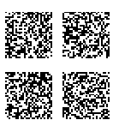
What distinguishes both images ?
Samples from MNIST
Random binary images

Slide 7
What distinguishes both images ?
1/ Fewer white pixels
Random binary images

Slide 8
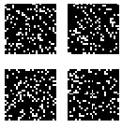
What distinguishes both images ?
1/ Fewer white pixels
Random sparse binary images

Slide 9
What distinguishes both images ?
2/ White pixels are grouped in strokes
Random sparse binary images

Slide 10
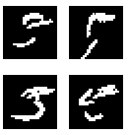
What distinguishes both images ?
Samples from MNIST
Random strokes images

Slide 11
What distinguishes both images ?
3/ Strokes are arranged specifically
Random strokes images

Slide 12
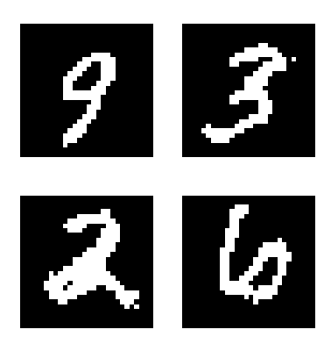
Can we produce artificial samples ?
Samples from MNIST
Four artificial samples

Slide 13
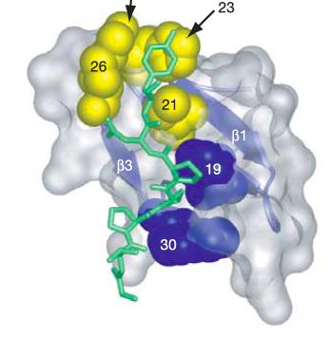
Proteins: from sequence to function
Function
Sequence
Structure
R
P
P
L
E
Folding
Docking
K
R
M
S
R
S
S
G
R
V
Y
F
Y
N
WW domain
[Russ et al. 2005]
Notes:
We are interested, in understanding the relationship between a sequence and its biological function. Called the genotype to phenotype mapping. After its biosynthesis, a sequence fold into a 3D structure which allows it e.g. to bind to a target ligand. As you know well, modeling these folding and docking process is very hard from first principles such as Molecular Dynamics, because exact treatment of this many-body quantum problem is infeasible; instead people use effective potentials that may lead to uncontrolled errors.
One way around this issue is to leverage evolution. The sequence determines the function, and the function has constrained the sequences during their evolutions as well; a sequence cannot mutate arbitrarily and keep its desired function.
For a given sequence, we now have access to hundred or thousand of homologous sequences that presumably perform the same function. Studying this ensemble allows to find out what are the key ingredients that account for what makesa sequence good or bad.

Slide 14
Proteins: from sequence to function
Function
Sequence
Structure
R
P
P
L
E
Folding
Docking
K
R
M
S
R
S
S
G
R
V
Y
F
Y
N
WW domain
[Russ et al. 2005]
VERY HARD FROM
FIRST PRINCIPLE METHODS
(Molecular Dynamics, Ab Initio…)
Notes:
We are interested, as many other people in understanding the relationship between a sequence and its biological function. After its biosynthesis, a sequence fold into a 3D structure which allows it e.g. to bind to a target ligand. As you know well, modeling these folding and docking process is very hard from first principles such as Molecular Dynamics, because exact treatment of this many-body quantum problem is infeasible; instead people use effective potentials that may lead to uncontrolled errors.
Correct level of description is the atomic levels between the atoms on the amino acids but this is a many body quantum problem which is infeasible at least for normal size protein. Many efforts have been done on such Protein folding little success, since the 80.
One way around this issue is to leverage evolution. The sequence determines the function, but in turn, the function constrains the sequence as well; a sequence cannot mutate arbitrarily and keep its desired function.
For a given sequence, we now have access to hundred or thousand of homologous sequences that presumably perform the same function. Studying this ensemble allows to find out what are the key ingredients that account for what makesa sequence good or bad.

Slide 15
Constraints on protein sequences
Function
Sequence
Structure
R
P
P
L
E
Folding
Docking
K
R
M
S
R
S
S
G
R
V
Y
F
Y
N
WW domain
[Russ et al. 2005]
Stability: Must fold, and only in the native(s) fold(s)
Affinity: Must bind to target ligand
Specificity: Must preferentially bind a specific ligands…
Catalytic Activity: Must promote reaction within the target ligand
Allostery: Must change conformation upon partner binding…
Notes:
We are interested, as many other people in understanding the relationship between a sequence and its biological function. After its biosynthesis, a sequence fold into a 3D structure which allows it e.g. to bind to a target ligand. As you know well, modeling these folding and docking process is very hard from first principles such as Molecular Dynamics, because exact treatment of this many-body quantum problem is infeasible; instead people use effective potentials that may lead to uncontrolled errors.
One way around this issue is to leverage evolution. The sequence determines the function, but in turn, the function constrains the sequence as well; a sequence cannot mutate arbitrarily and keep its desired function.
For a given sequence, we now have access to hundred or thousand of homologous sequences that presumably perform the same function. Studying this ensemble allows to find out what are the key ingredients that account for what makesa sequence good or bad.

Slide 16
Proteins: from sequence to function
Multiple Sequence Alignment of
Functional WW-domain sequences from diverse organism and genes
(Source: PFAM)

Slide 17
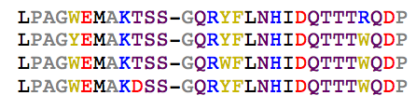
Proteins: from sequence to function
Functional WW-domain sequences from diverse organism and genes
(Source: PFAM)
Examples of non-functional WW sequences
obtained by mutagenesis
(Fowler et al. Nature Methods 2011)

Slide 18
Proteins: from sequence to function
Functional WW-domain sequences from diverse organism and genes
(Source: PFAM)
Examples of non-functional WW sequences
obtained by mutagenesis
(Fowler et al. Nature Methods 2011)
<50% Sequence identity.
Same activity in vitro
(Otte et al. Protein Science 2003)

Slide 19
Proteins: from sequence to function
Multiple Sequence Alignment of
Functional WW-domain sequences from diverse organism and genes
(Source: PFAM)
Examples of non-functional WW sequences
obtained by mutagenesis
(Fowler et al. Nature Methods 2011)
<50% Sequence identity.
Same activity in vitro
(Otte et al. Protein Science 2003)
Differ by a single
amino-acid

Slide 20
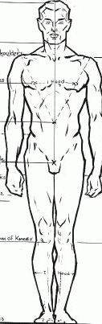

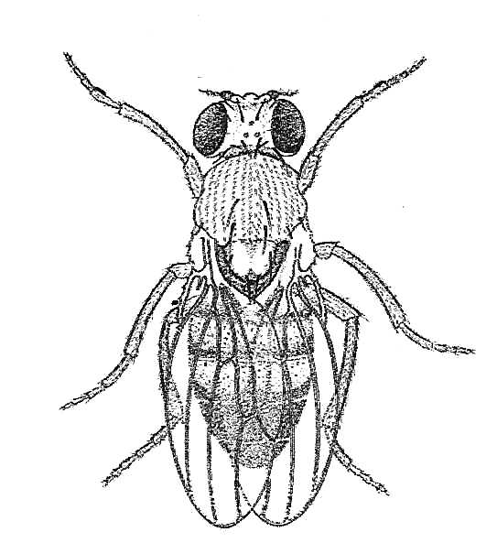
Feature Extraction from data:
Principal Component analysis
Σ_{i} w_{i}(v_{i})
PCA, Sparse PCA, and Sector Analysis :
From correlation matrix extract principal components: features w(v_{i})
Project sequences on them to characterize the maxima of the probability landscape
[ A Raussel.. A Valencia 2010, N Halabi,…R.Ranganathan 2009 ]
But they are not generative …
Notes:
Occurrence of different aminoacids on different sites
Occurrence, presence

Slide 21
Feature Extraction from data
Data space
(binary images)
(protein sequences)
Notes:
Riprendere slides di jerome

Slide 22
Feature Extraction from data
Set of all images of digits / functional sequences
Data space
(binary images)
(protein sequences)

Slide 23
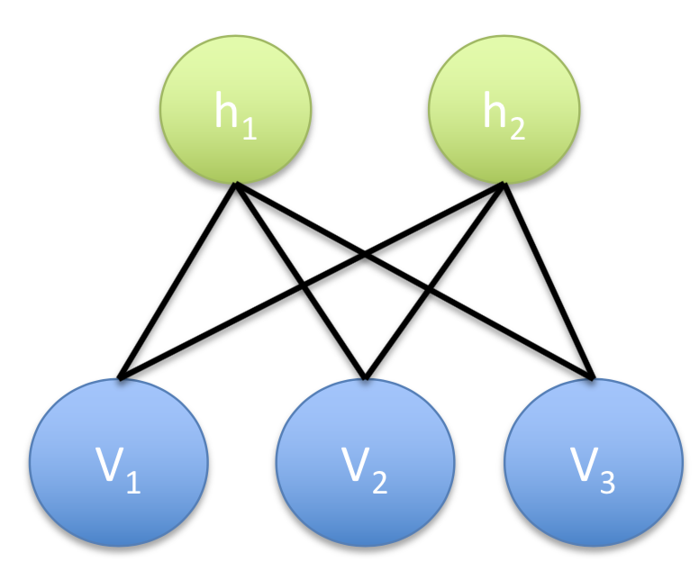
Feature Extraction from data
Set of all images of digits / functional sequences
h₂
h
h₁
Data space
Representation space
(binary images)
{h}^{M} (features)
(protein sequences)

Slide 24


Feature Extraction from data
Set of all images of digits / functional sequences
[Strokes]
[Protein bio-chemical properties]
h₁
specificity
Data space
-> Genotype
Representation space
->Phenotype
(binary images)
{h}^{M} (features)
(protein sequences)

Slide 25
Feature Extraction from data
Set of all images of digits / functional sequences
[Strokes]
[Protein bio-chemical properties]
Data space
Representation space
(binary images)
{h}^{M} (features)
(protein sequences)

Slide 26
Feature Extraction from data
Set of all images of digits / functional sequences
[Strokes]
[Protein bio-chemical properties]
Data space
Representation space
(binary images)
{h}^{M} (features)
(protein sequences)

Slide 27
Feature Extraction from data
Set of all images of digits / functional sequences
[Strokes]
[Protein bio-chemical properties]
Data space
Representation space
(binary images)
(protein sequences)

Slide 28



Restricted Boltzmann Machines
Graphical model constituted by two sets of random variables that are coupled together.
.
Hidden layer
h₁
h₂
M
V₁
V₂
V₃
N
Visible layer (binary/potts r.v.)
Notes:
like Boltzmann Machine Update weigths byStocastic gradient descent, mini batch to calulate ‘noisy version’ (Carlo Lucebello), contrastive divergence

Slide 29
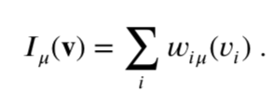

Restricted Boltzmann Machines
Graphical model constituted by two sets of random variables that are coupled together.
.
Hidden layer
h₁
h₂
M
V₁
V₂
V₃
Given an input configuration, the hidden unit μ
Receives an input:
N
Visible layer (binary/potts r.v.)
Which determines the probability of its activity:
Notes:
like Boltzmann Machine Update weigths byStocastic gradient descent, mini batch to calulate ‘noisy version’ (Carlo Lucebello), contrastive divergence

Slide 30
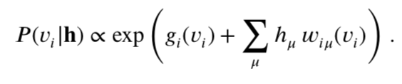
Restricted Boltzmann Machines
Graphical model constituted by two sets of random variables that are coupled together.
.
Hidden layer
h₁
h₂
M
V₁
V₂
V₃
Given an hidden unit configuration the visible unit
takes the value v_{i} with probability
N
Visible layer (binary/potts r.v.)
Notes:
like Boltzmann Machine Update weigths byStocastic gradient descent, mini batch to calulate ‘noisy version’ (Carlo Lucebello), contrastive divergence

Slide 31
Restricted Boltzmann Machines
Graphical model constituted by two sets of random variables that are coupled together.
RBM learns a probability distribution over the visible layer.
Hidden layer
h₁
h₂
M
V₁
V₂
V₃
N
Visible layer (binary/potts r.v.)
RBM are generative models, trained through unsupervised learning
Learning is done by finding parameters maximizing the Likelihood
Notes:
like Boltzmann Machine Update weigths byStocastic gradient descent, mini batch to calulate ‘noisy version’ (Carlo Lucebello), contrastive divergence

Slide 32
Restricted Boltzmann Machines
Restricted Boltzmann Machine
M
Difficulties
Large number of fields g_{i}(v_{i}) and of weight parameters w_{iμ}(v)
Hard Computational Problem : Main technieque Boltzmann Machine Learning, with stochastic gradient ascent of the log-likelihood … not guarantee to converge to an unique solution.
Limited sampling (sequences in protein database form small and biased samples
Fixing the hyperparameter of the network: number of hidden units M, potential on hidden units, sparsity:
Notes:
Explain names: Graphical model Ising, Potts, Boltzmann Machine
Explain inverse Tehnique: Gaussian Approximations, Pseudo-Likelihood, Clusters Expansions, Boltzmann Mahine Learning
moment matching of emprical distribution and the model distribution

Slide 33
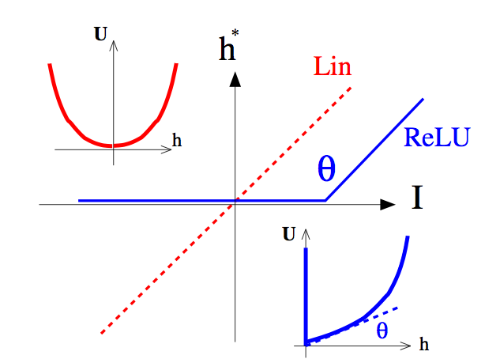
Hidden Unit Potential Shape
Hidden layer
h₁
h₂
Compute hidden units inputs
Sample hidden units :
V₁
V₂
V₃
Visible layer (binary/Potts r.v.)
Linear RBM: Gaussian Potential
P(v) is analytically obtained by integrating over hidden variables
H
Boltzmann machine, i.e. Hopfield model with M patterns!
[Barra, Bernacchia,Santucci, Contucci,Neural Network 2012]
[Mézard PRE(2016)] [J.Tubiana,R.Monasson,PRL (2017)]
Notes:
Network model with a M low rank (M) couplings matrix , Hopfiel had shown that each model is a maximal probability peak

Slide 34
Hidden Unit Potential Shape
Hidden layer
h₁
h₂
Compute hidden units inputs
Sample hidden units :
V₁
V₂
V₃
Visible layer (binary r.v.)
Rectified Linear Ulit (Relu) RBM
H
Non quadratic potentials generate multi-body interactions between v_{i} ...

Slide 35
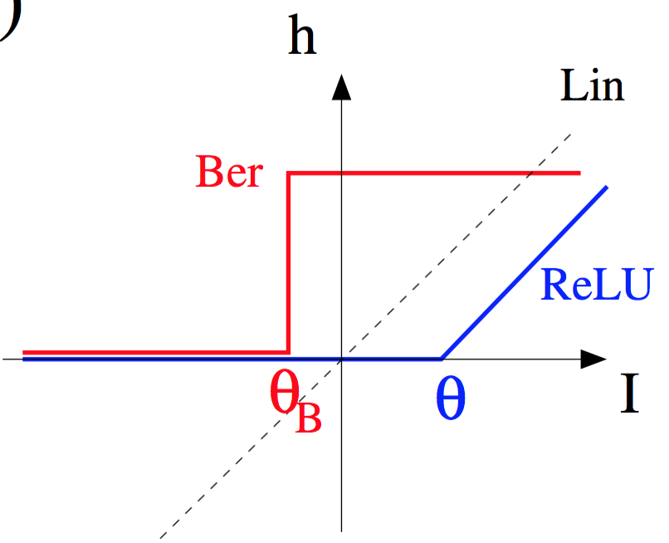
Hidden Unit Potential Shape
Hidden layer
h₁
h₂
Compute hidden units inputs
Sample hidden units :
V₁
V₂
V₃
Visible layer (binary/Potts r.v.)
U
U
*
Bernulli Hidden Unit RBM
h
H
Binary value of the Hidden Units

Slide 36
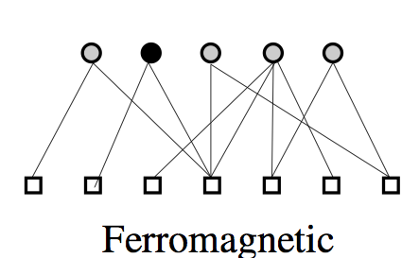
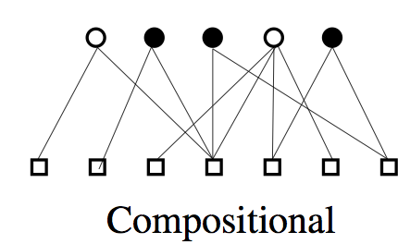
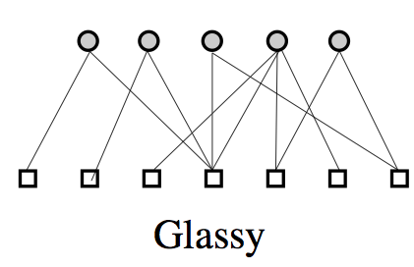
Ferromagnetic, Compositional, and Glassy phases
Mother Cell
representation
Relu RBM
5
5
5
5
w
w
ferromagnetic
5
5
spin glass
spin glass
Prototype-like
distributed
Entangled/
g
Depending on hyper-parameters there are different data-representational phases,
separated by phase transitions
RBM working in the Compositional phase give better results: training and sampling are easier
Compositional phase can be enforced by chosing a non-quadratic potential on the hidden units ,
have a large number of hidden variables M, imposing sparsity on the weight vectors…
[J. Tubiana, R.Monasson,PRL (2017)]
Notes:
Qui si puo’ aggiungere il filmino (magari si’)

Slide 37

MNIST synthetic digits: Linear vs. ReLU RBMs
MNIST 60,000 image of digits of size 28x28
Linear RBM
M = 400
LogLikelihood : -0.15 bits/pixel
ReLU RBM
M = 400
LogLikelihood : -0.11 bits/pixel
(digits are less noisy, more accurate, and MCMC are mixing faster)

Slide 38
Hidden Unit Potential Shape
Hidden layer
h₁
h₂
Compute hidden units inputs
Sample hidden units :
V₁
V₂
V₃
Visible layer (binary/Potts r.v.)
U
To have compositional phase In protein sequence data
We introduce adaptive non linearity :
Double Relu Units, and fit slope and curvature
parameters.
And impose sparsity on the weights.
h
H
Notes:
Sparsity penality

Slide 39
Weights
Hidden layer
h₁
h₂
In the Compositional phase
weights are interpretable !!!
Coming next: 3 exemples from
- MNIST
-1-D Ising Model
-Protein Data
V₁
V₂
V₃

Slide 40
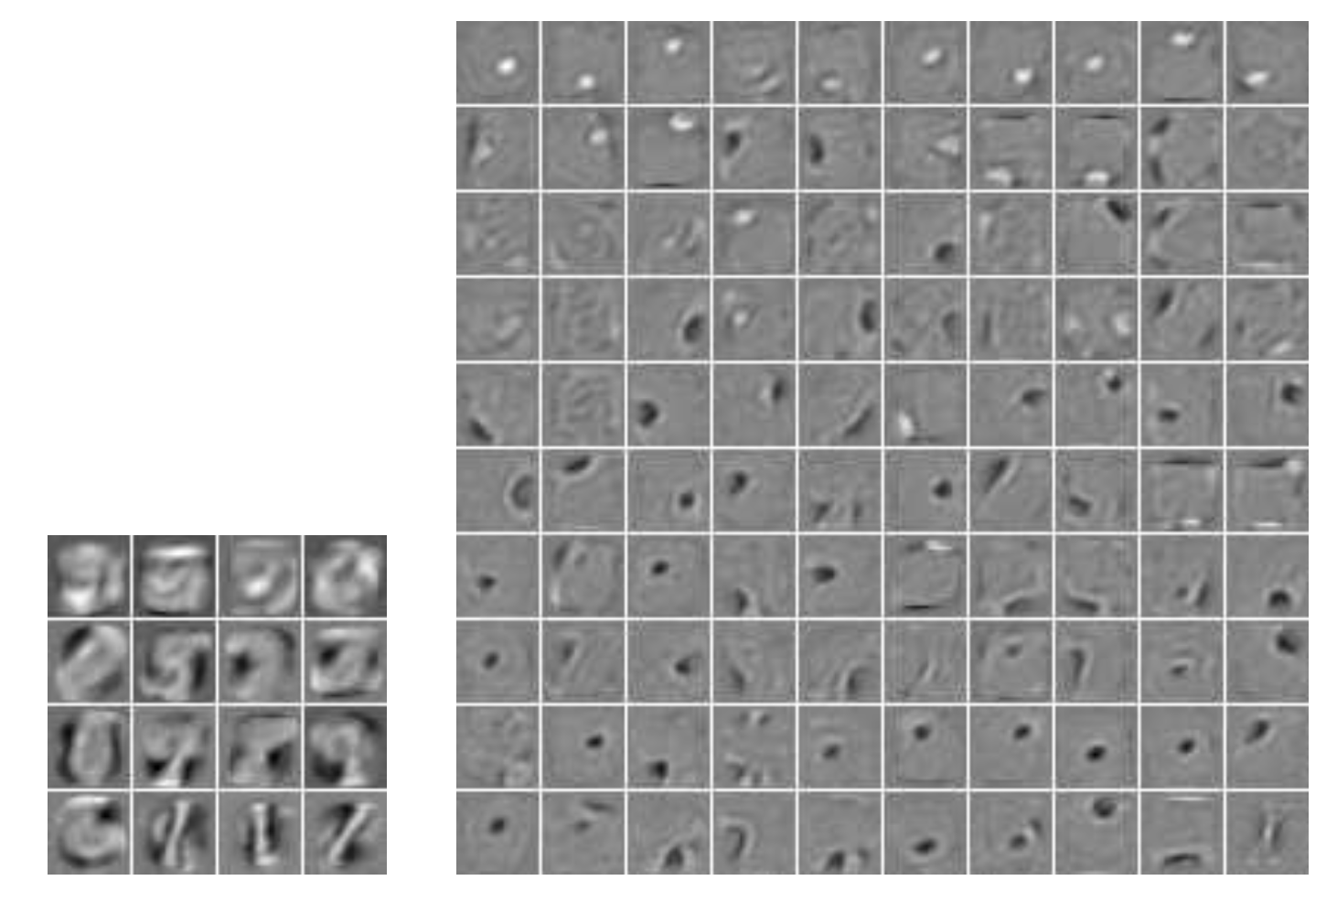
Compositional phase how weights look like?
Relu RBM
5
5
5
5
w
w
ferromagnetic
5
5
spin glass
spin glass
Prototype-like
distributed
Entangled/
g
[J. Tubiana, R.Monasson,PRL (2017)]
M=16 hidden
units
Fischer & Igel. Training Restricted Boltzmann Machines: An Introduction, 2014.
N=28x28=784 digits

Slide 41
Learning with RBM an invariant distribution
Goal: try to learn invariant distribution with simple (few hidden units) RBM
Here, 1D Ising model configurations over 100 sites:
10,000 configurations over 100-site rings; β=1
M. Harsh,, J. Tubiana, S. C. R. Monasson (2000 Arxiv 1912.12941)

Slide 42
Learning with RBM
Log-likelihood
Learning time

Slide 43
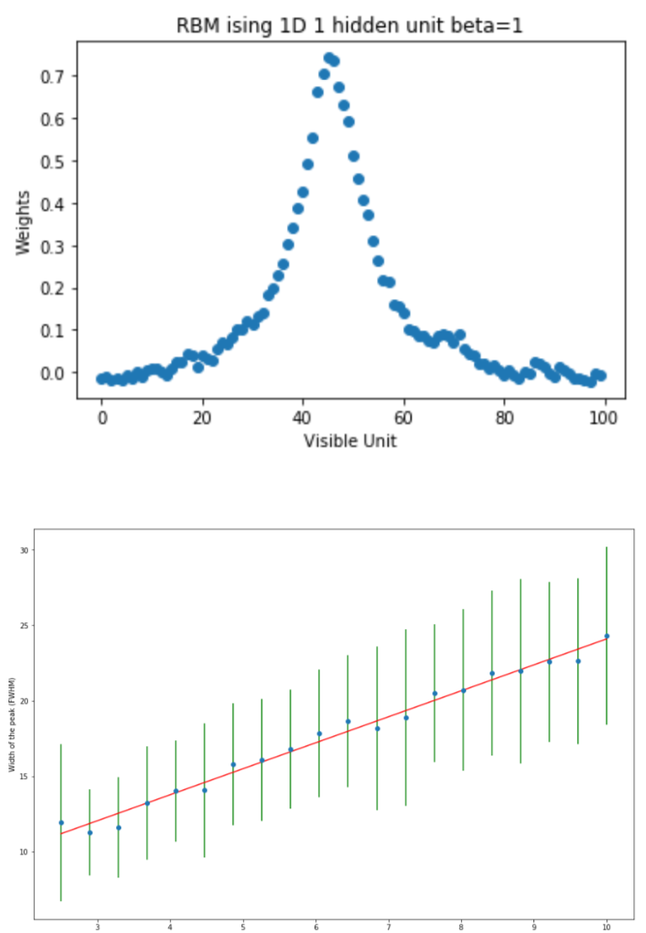
Learning with RBM:
dynamical symmetry breaking
W_{i}
Site index i
Bump width
L(β)
Notes:
On this length RBM will be able to extract relevant non zero magnetization…
Good sequences are up or down on the correlation length pf the system

Slide 44
Learning with RBM
Log-likelihood
Learning time

Slide 45
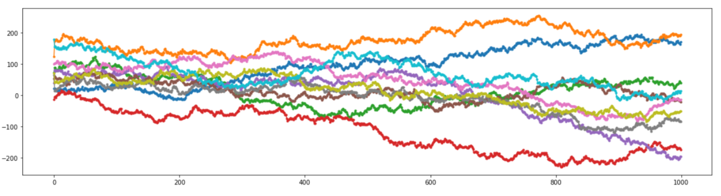
Learning with RBM:
dynamical symmetry restoration
location
time

Slide 46
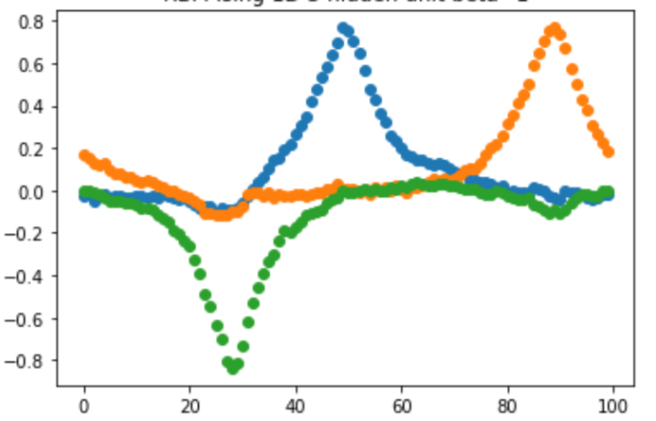
Learning with RBM:
Multiple hidden units
W_{i}
Site index i
time
Locking of bumps (relative distances are maintained through time), compositional
Phase and expression power is restored
Similar to brain cells responding to a stimulation in a precise region: place field, eg. Place cells
and grid cells in Hippocampus, retinal ganglion cells

Slide 47
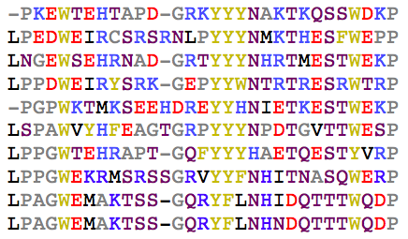
MSA statistics reflect constraints

Slide 48
MSA statistics reflect constraints

Slide 49
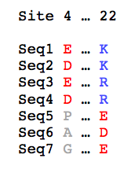
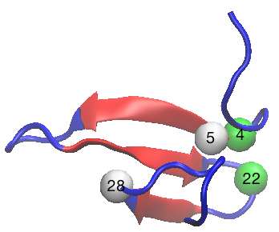
MSA statistics reflect constraints

Slide 50
From coevolution to structure:
Direct Coupling Analysis
Visualization of the largest
couplings inferred for the WW domain
Weigt et al. PNAS 2009
Morcos et al., PNAS 2011
S.C, M. Figliuzzi, .. Weigt ROPP 2017

Slide 51
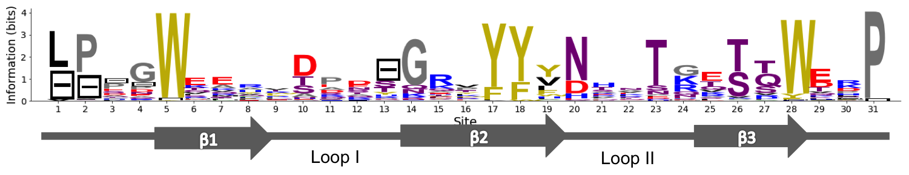
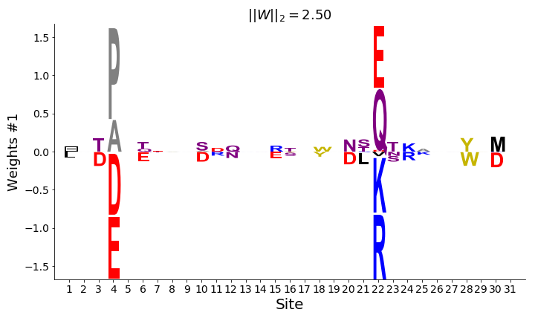
RBM Weights reflect structural constraints
h₁
A contact mode

Slide 52
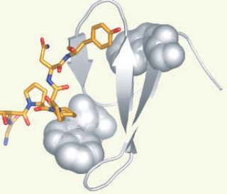
WW Binding Specificities
Sequences have
different binding affinity:
★
★
★
★
★
★
★
Sequence
Ligand
group I PPxY
group II PPLP
group III PPR
group IV PS/PT
PCA-based Analysis: 8 positions, very correlated & relevant for specificity
[W.P. Russ…R. Ranganathan, Nature 2005
N Halabi,…R.Ranganathan 2009 ]
Notes:
Y
L : Leucin
R Arginine
Y:Tyrosyn
phosphorylated serine/threonine-proline sites

Slide 53
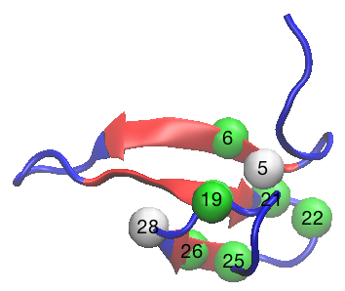
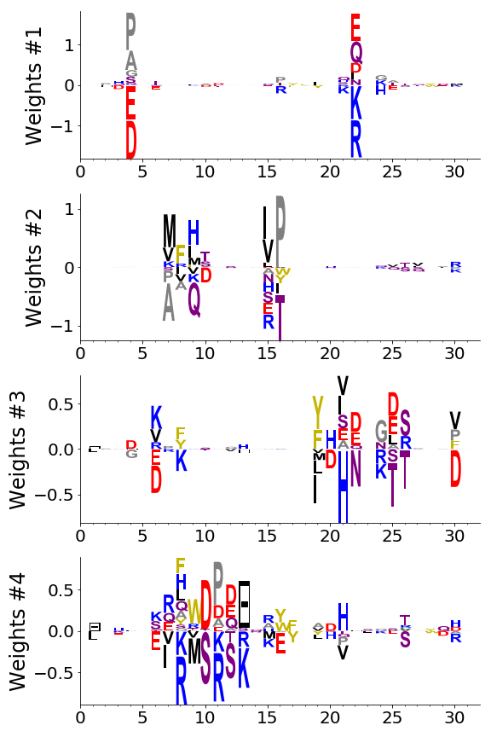
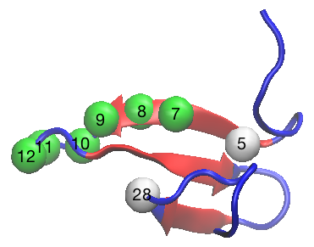
RBM weights reflect specificity
h₃
h₄
Tubiana SC Monasson , elife, 2019

Slide 54

RBM weights reflect specificity
Type I : PPXY
Type II : PPLP
Type III: PR
Type IV: [p(S/T)P]
★
★
★
★
★
★
★
Type II/III/IV
Type I
Type I
★
★
★
★
Type I/II/III
Type IV:
The longer loop allows the ligand to bind there !
Tubiana SC Monasson , elife, 2019,

Slide 55
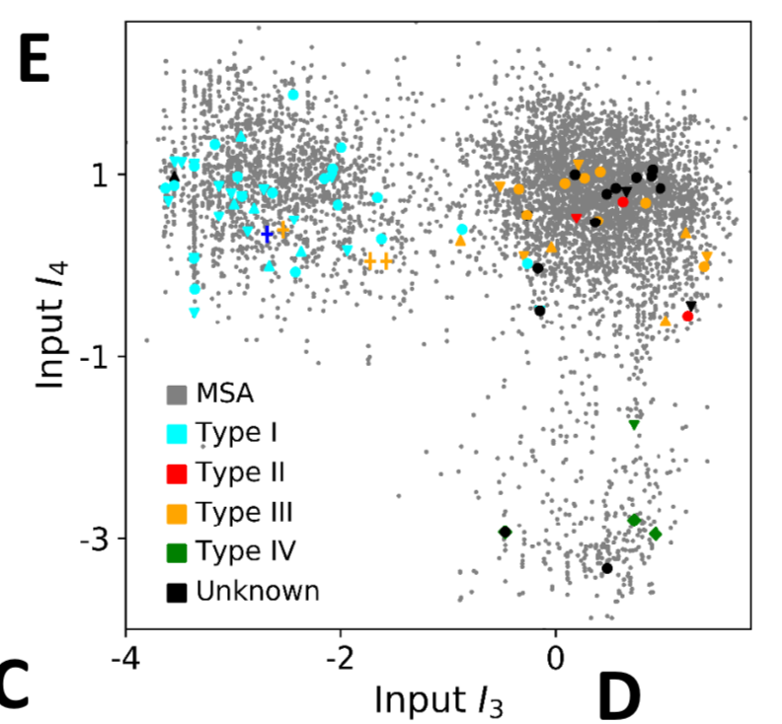
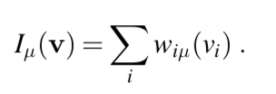
Natural Sequence Space
Tubiana SC, Monasson , elife, 2019,

Slide 56
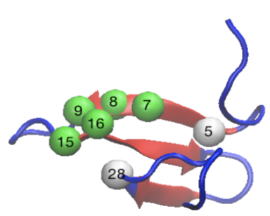
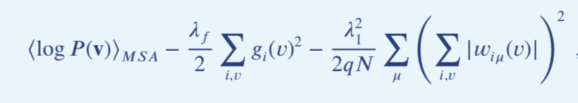
The interpretability-performance trade-off

Slide 57
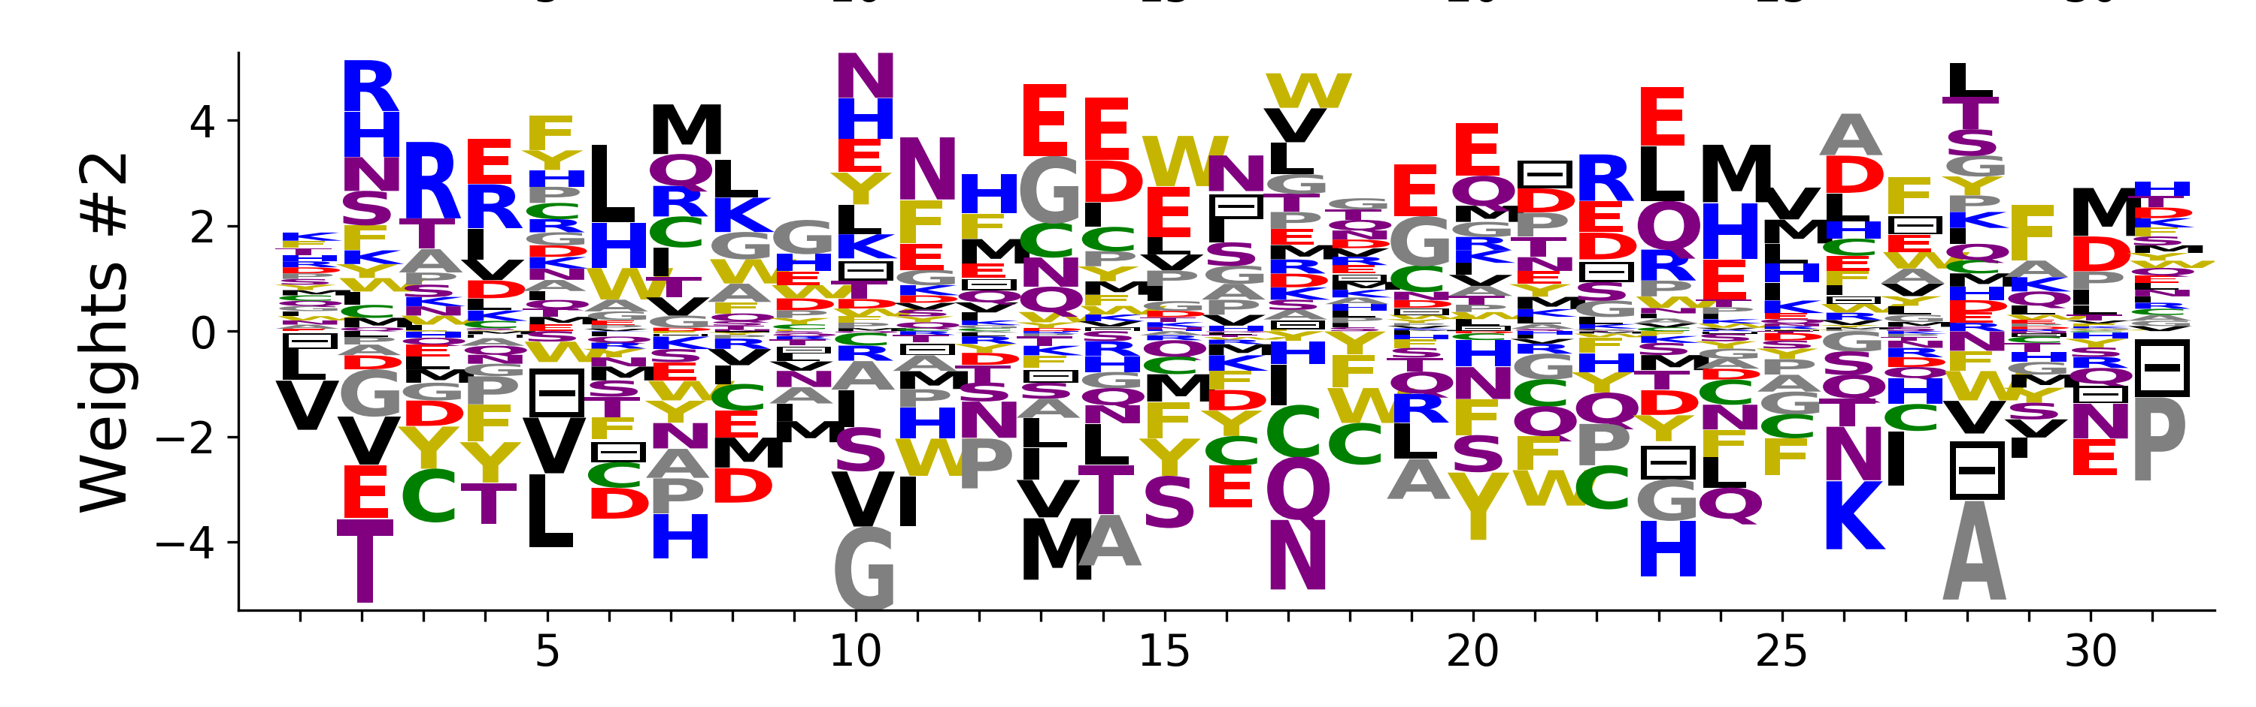
The interpretability-performance trade-off

Slide 58
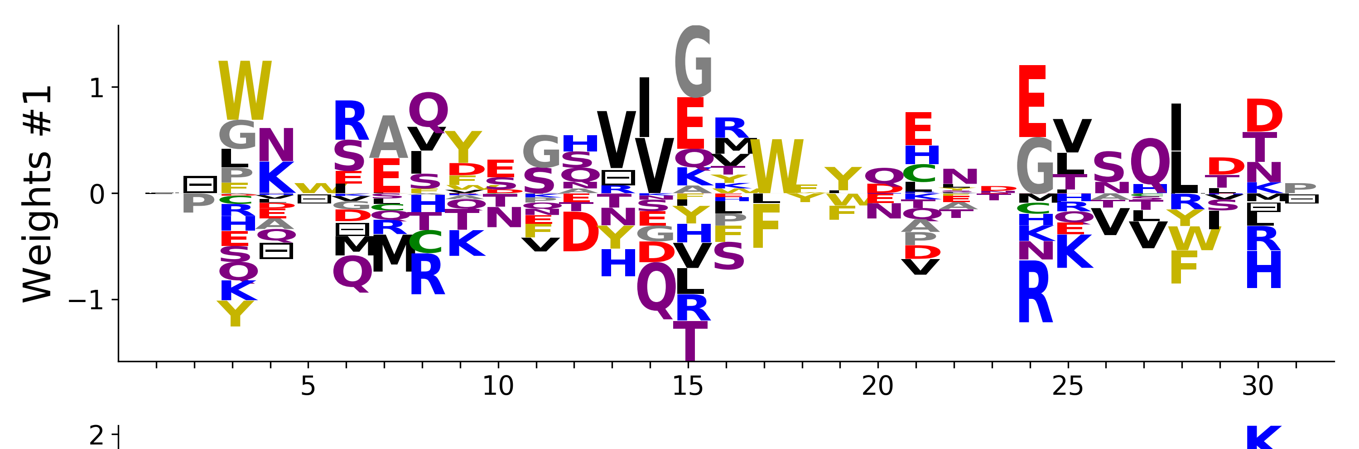
The interpretability-performance trade-off
Tubiana Cocco Monasson , elife, 2019,

Slide 59
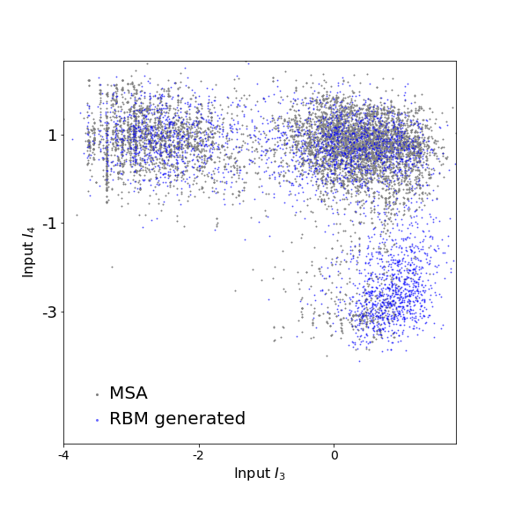
Artificial Sequence Generation
with RBM
Artificial Sequences
Tubiana SC, Monasson , elife, 2019,

Slide 60
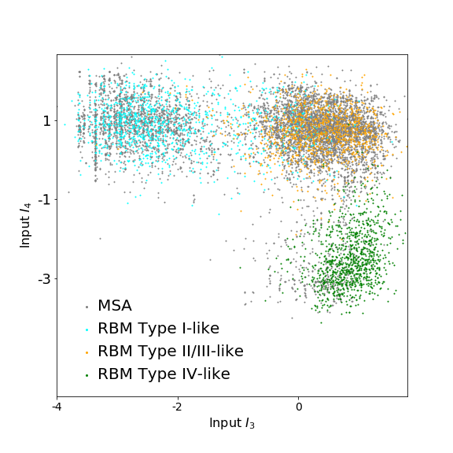
Artificial Sequence Generation with RBM
Type I-like
binding specificity +
Short loop
Type II/III/IV-like
binding specificity +
Short loop → Type II/III
h₃
h₄
h₃
h₄
Type II/III/IV-like
binding pocket +
Long loop → Type IV
Artificial Sequences
h₃
h₄

Slide 61
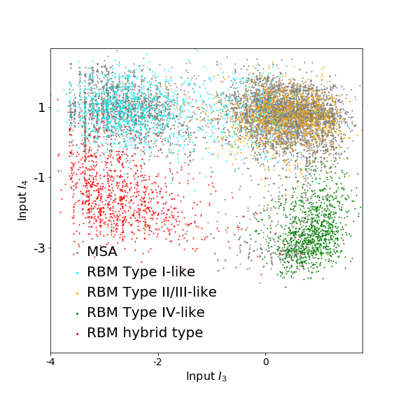
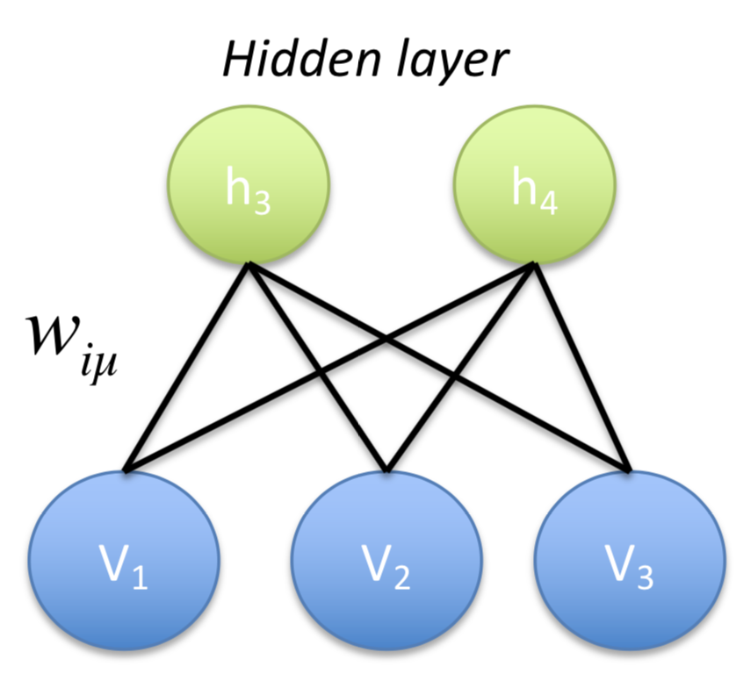
Artificial Sequence Generation with RBM
Type I-like
binding specificity +
Short loop
Type II/III/IV-like
binding specificity +
Short loop → Type II/III
h₃
h₄
h₃
h₄
Type II/III/IV-like
binding pocket +
Long loop → Type IV
Type II/III/IV-like
binding pocket +
Long loop → Type IV
h₃
h₄
h₃
h₄

Slide 62
Conclusion
Summary:
  Under specific conditions (weight sparsity, non-linearity), RBM learn compositional representations of data.
  They achieve a good trade-off between interpretability and performance
  RBM can extract meaningful features from sequence
  RBM can Generate sequences with specific properties (eg.specificity)
But:
-RBM less well known and studied Model than BM. Training not guarantee to work well: Log-Likelihood is not a convex function …
Outlook:
  Experimental validation of designed sequences
  (for Inverse Potts model(BM) :[Figliuzzi et al 2020] )

