Slide 1
Numerical Implementation of the Overlap Operator
Michael Lujan
The George Washington University
Asian School on Lattice Field Theory
March 18, 2011

Slide 2
Outline
Approximating the Overlap Operator
  Polynomial Approximation
Low Mode Projection for Sign Function
Smearing effects
Inverting Overlap
Timings

Slide 3
Compute Correlation Functions
Propagator
Cannot store the inverse matrix
Solve the point to all problem
Iterative methods: e.g. Conjugant Gradient

Slide 4
function [x] = conjgrad(A,b,x)
r=b-A*x;
p=r;
rsold=r'*r;
for i=1:size(A)(1)
Ap=A*p;
alpha=rsold/(p'*Ap);
x=x+alpha*p;
r=r-alpha*Ap;
rsnew=r'*r;
if sqrt(rsnew)<1e-10
break;
end
p=r+rsnew/rsold*p;
rsold=rsnew;
end
end
Need a fast and optimal overlap construction

Slide 5
Matrix sign function. Cannot be computed exactly
Polynomial Approximation

Slide 6
Polynomial Approximation:
* We use Chebyshev Polynomials as a basis.
Larger n, better approximation

Slide 7
Low Mode Projection

Slide 8
The larger the max eigenvalue in the small space the smaller n
→ Leading to smaller order of the polynomial needed to give a certain approximations
So more eigenvectors of H is always better ??

Slide 9
Good enough?
-> Half the memory storage and only 15 % slow down in computation.
Notes:
Plot of the small space eigenvalues. Certain question needs to be addressed. Because of memory requirements on the gpu’s if we don’t see a substantial decrease in polynomial order then it might not be worth the effort to read them in.

Slide 10
Memory Issues
GPU CPU
~ 64 GB Unlimited
32³x64 for 200 vectors → 80 G.B.
So? Just do Everything on CPU?
GPUs are faster
Matrix Vector Multiplication
3.1 ms
54.8 ms

Slide 11
Improve speed up with smearing
Lattice and 60 eigenvectors
n = 130
n = 42
Overall factor of 3 speedup in this case

Slide 12
To construct overlap
    Smear links
    Compute eigenvectors and eigenvalues of the small space.
    Approximate the remaining large space via Chebyshev polynomials.
Another Approximation Scheme is the Zolotarev (Rational) Approximation
-> Needs larger memory ~ 15 additional vectors
-> Overall slower than Polynomial approximation
-> Can’t estimate how many Hwilson eigenvectors are “necessary”

Slide 13
rational
polynomial

Slide 14
Inversion of Overlap
Allows us to use multi-shifter cg
In this form there are two overlap multiplications per cg iteration
We can reduce to one if we use milc (chiral) basis in our calculations.

Slide 15
Construct Chiral Source Vectors
In cg algorithm iterate until convergence ~ 10² ~ 10⁴ iteartions
If source vector is not chiral:
If source vector is chiral:

Slide 16
Deflation
Compute Exactly
use C.G.
 | Total Overlap Iterations
Without Deflation | ~ 30,000
With Deflation | ~ 2,700

Slide 17
Deflation cont.
Very expensive to compute
Cost depends on: Lattice size, precision, zero modes.
Spend more iterations on eigenvectors than on a propagator calculation.
Multiple sources, you’ll usually always win by using deflation.
Again storing vectors is not trivial.
using 100 eigenvectors maybe just as good as 200 eigenvectors?

Slide 18
Sum It Up
We want to compute propagators with overlap
Use a Polynomial approximation to get D_ov
Use a C.G. to get the inverse times vector
Use low mode projection and deflation to speed up the calculations

Slide 19
Projects
Putting Overlap onto the GPU. We’ve faced memory challenges and data storage issues.
I use overlap for my research project, which is computing electric polarizabilities in lattice QCD
I’ve used it for computing Delta Mix on DWF and Overlap.

Slide 20
Extra Slides

Slide 21
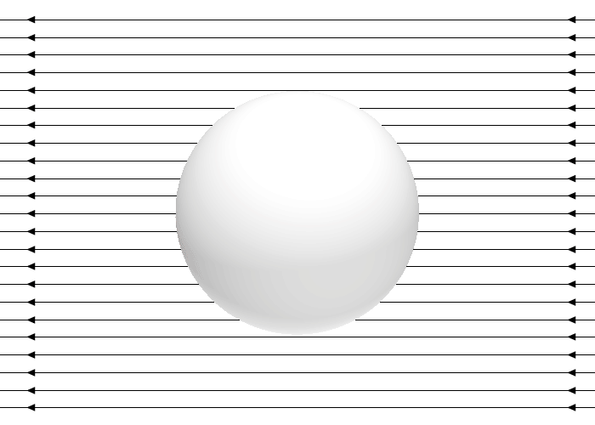
Quantum Mechanical Example
Ground state
1st order
2nd order
An external electric field changes the energy. We want to calculate this energy or mass shift.
Notes:
Neutral particle. Say H-atom.
Polarizability is only one parmetirization there are others which is

Slide 22
Some Results For Polarizability
Polarizability = 0.62(5)* 10⁻⁴ fm³

