Slide 1


Understanding polygenic adaptation with experimental evolution
Christian Schlötterer

Slide 2
Different approaches to study polygenic adaptation

Slide 3
Temperature adaptation is polygenic

Slide 4

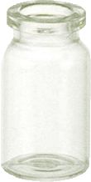
Experimental design
Replicate 1: 1000 flies
Replicate 2: 1000 flies
(base population)
200
isofemale
lines
Replicate 3: 1000 flies
Incubation at hot temperature: 18-28°C
natural
population
Pool-Seq
Replicate 1: 1000 flies
Replicate 2: 1000 flies
Replicate 3: 1000 flies
Incubation at cold temperature: 10-20°C

Slide 5
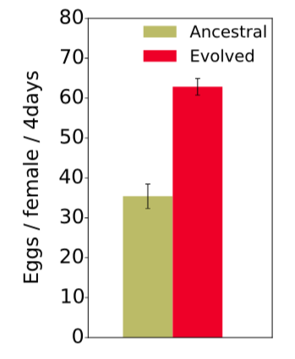
Fitness increase

Slide 6
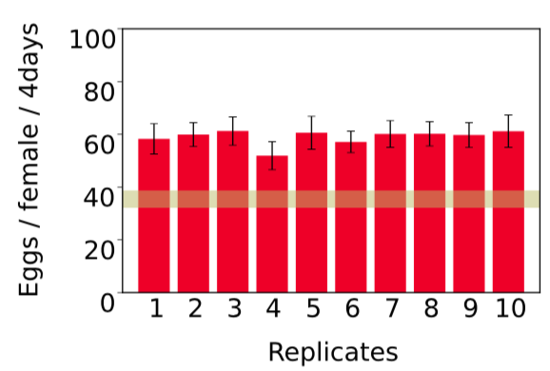
Parallel fitness increase across replicates

Slide 7
Parallel response for high-level phenotypes

Slide 8
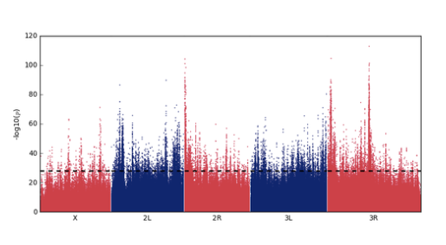
Complex selection response, with many putative targets
CMH test: 10 replicates, comparison generation 0 vs. 60

Slide 9
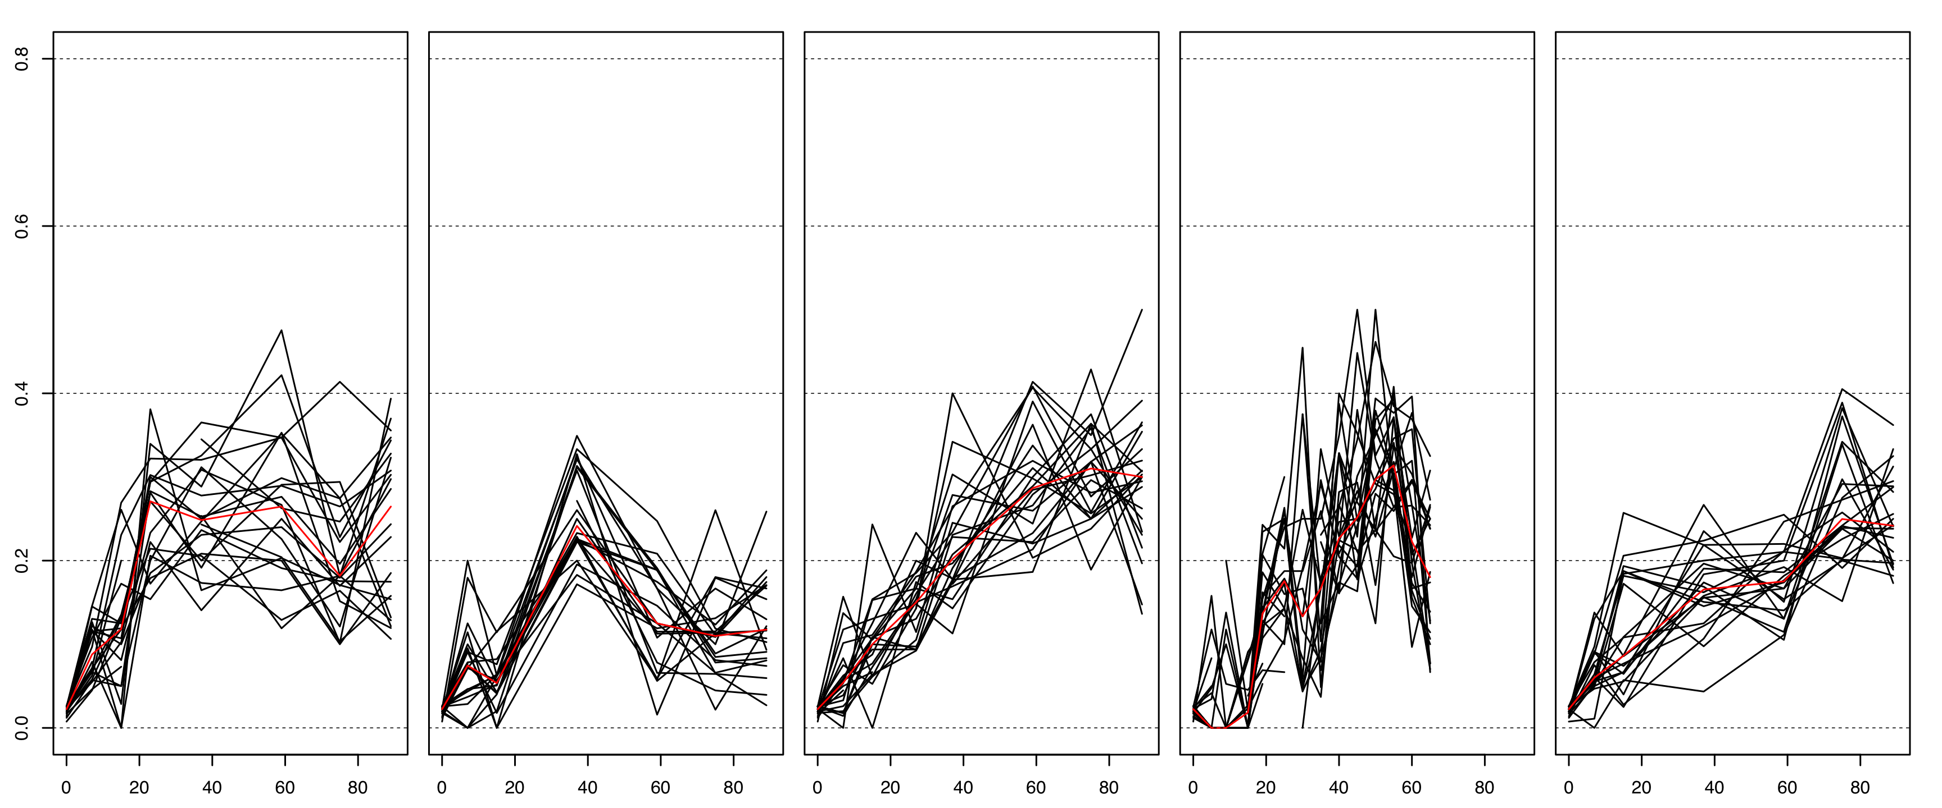
Reconstruction of selected haplotype blocks from Pool-Seq
Idea: linked alleles have correlated frequency trajectories
R1 R2 R3 R4 R5
Marker frequency
Generation
Frequency SNP2
→ 99 selected haplotype blocks
Frequency SNP1
Franssen et al., MBE, 2016

Slide 10
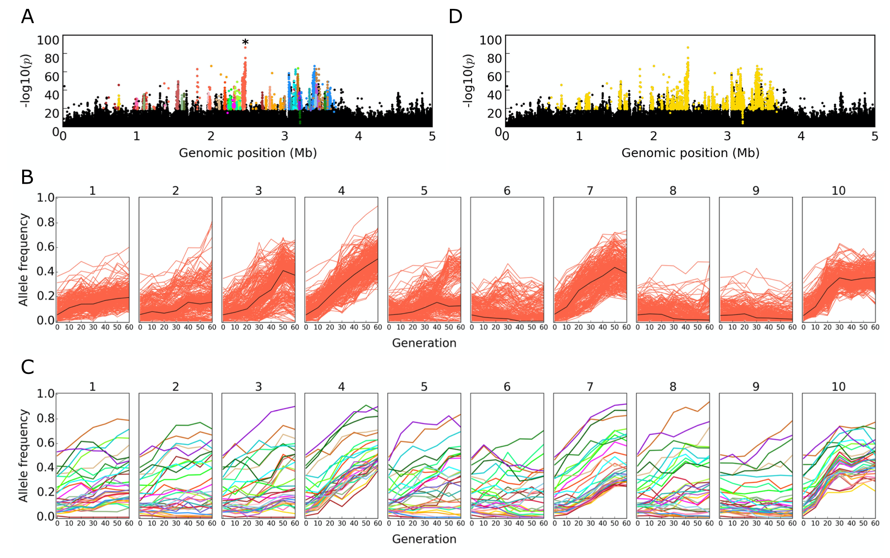
Clustering

Slide 11
Frequency and s of selected loci

Slide 12
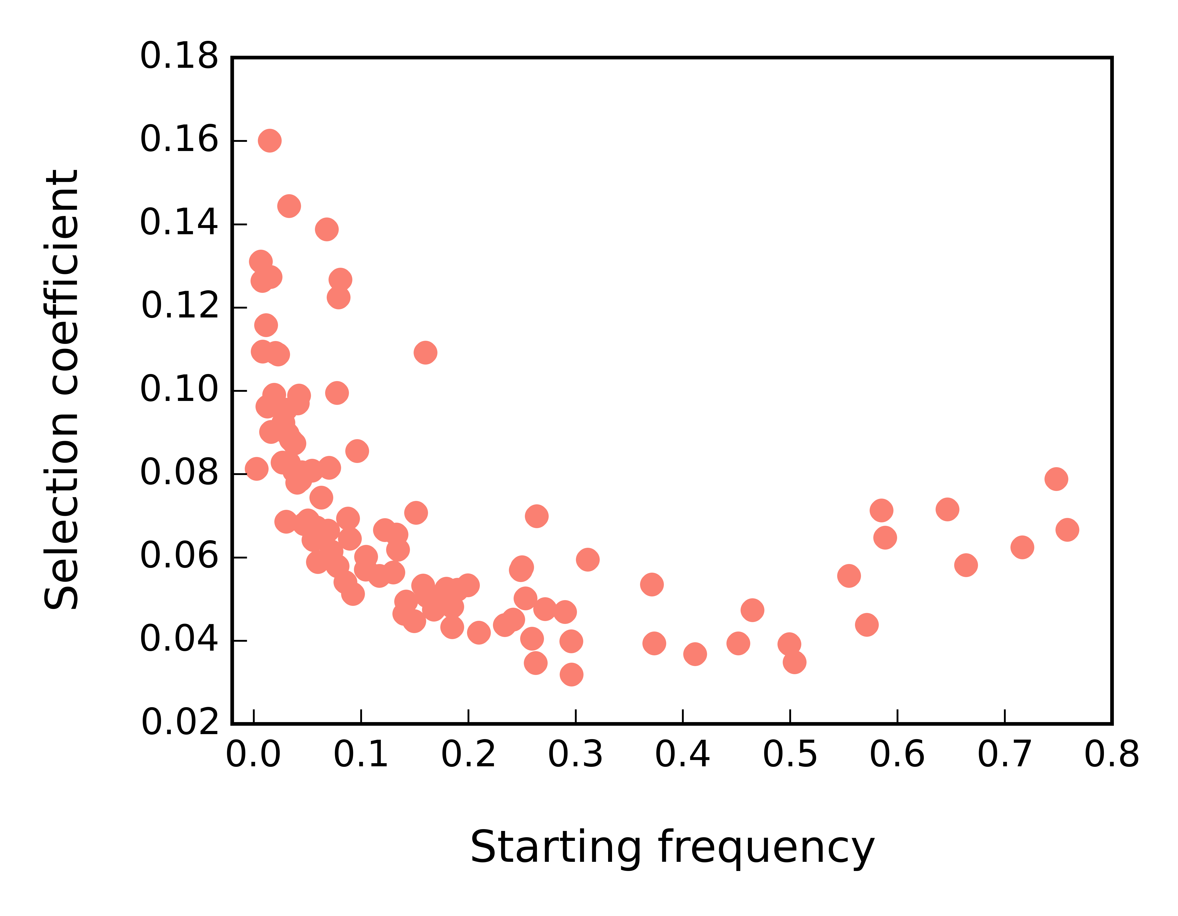
Inverse relationship between s and starting frequency

Slide 13
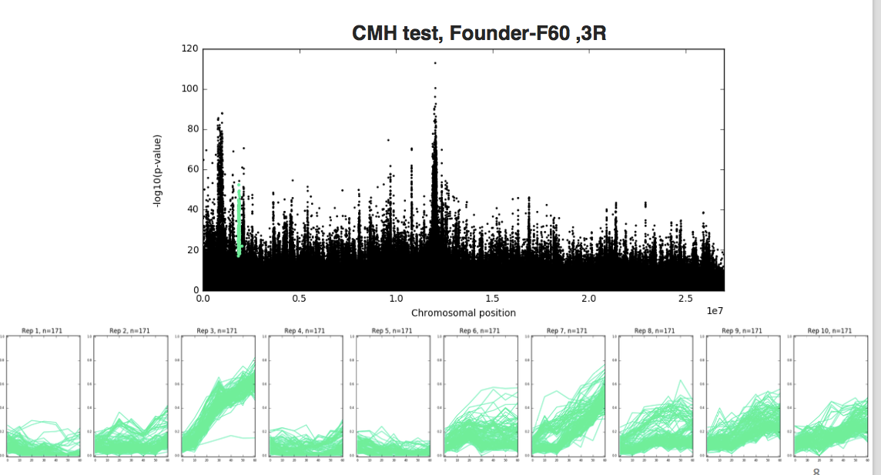
No convergence on the gene level

Slide 14
How to reconcile phenotypic convergence with no genetic convergence?
Many targets of selection
  99 candidate loci
Small effective population size
  about 300
Low starting frequency
  median: 0.1

Slide 15
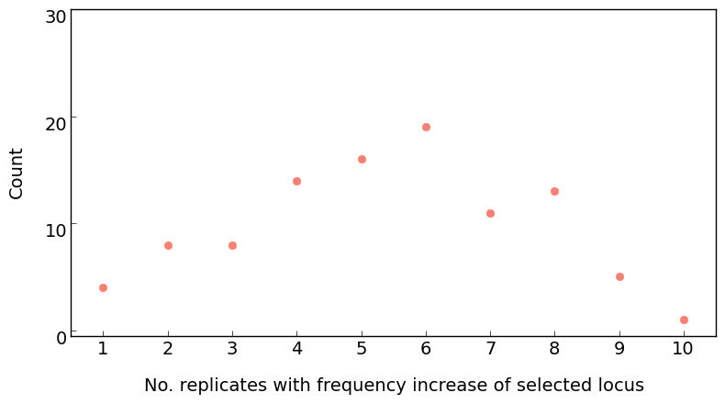
Replicate frequency spectrum

Slide 16
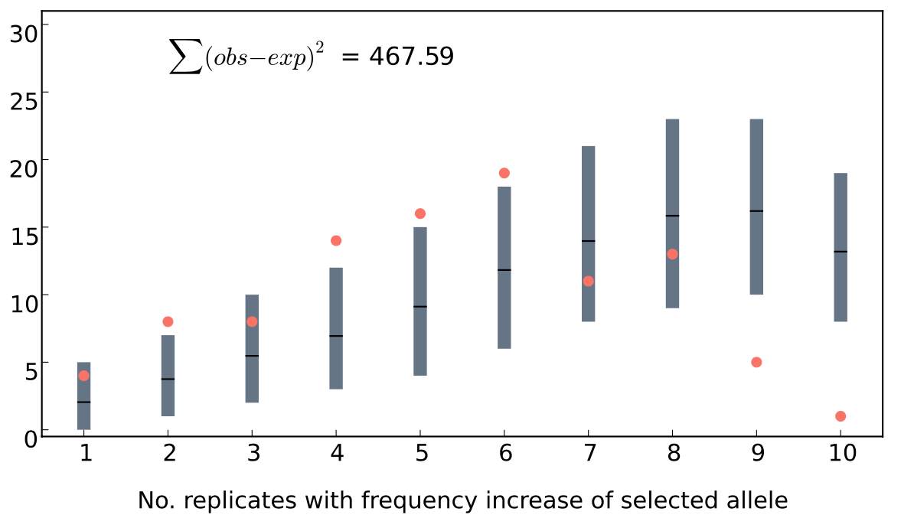
No fit to sweep model
linked loci

Slide 17
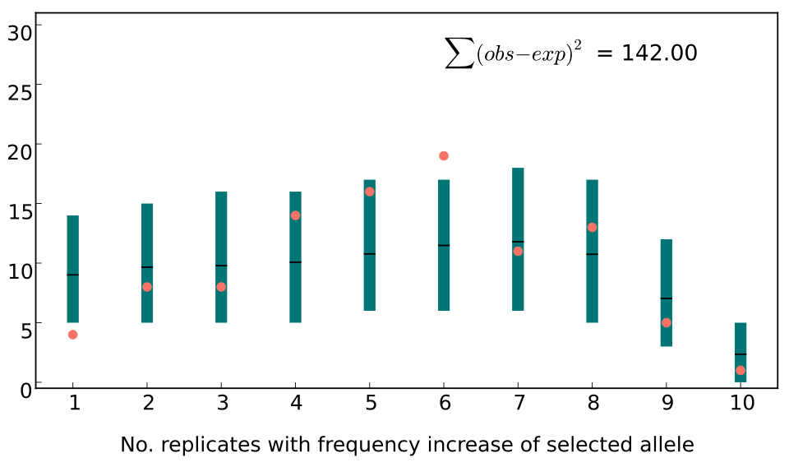
Good fit to a QTL model
linkage

Slide 18
Jaccard index

Slide 19
The infinitesimal model is not sufficient to explain E&R data

Slide 20
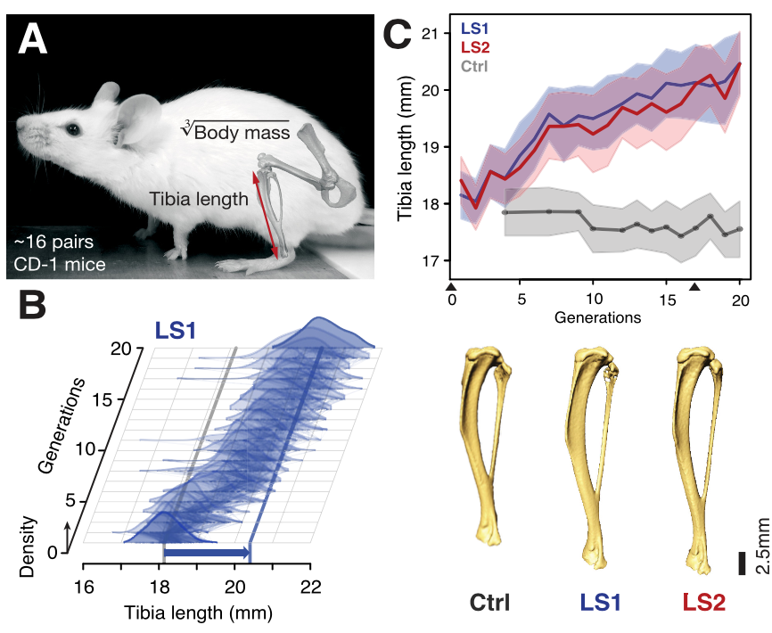
Mice: selection for tibia length
    Castro et al. 2018

Slide 21
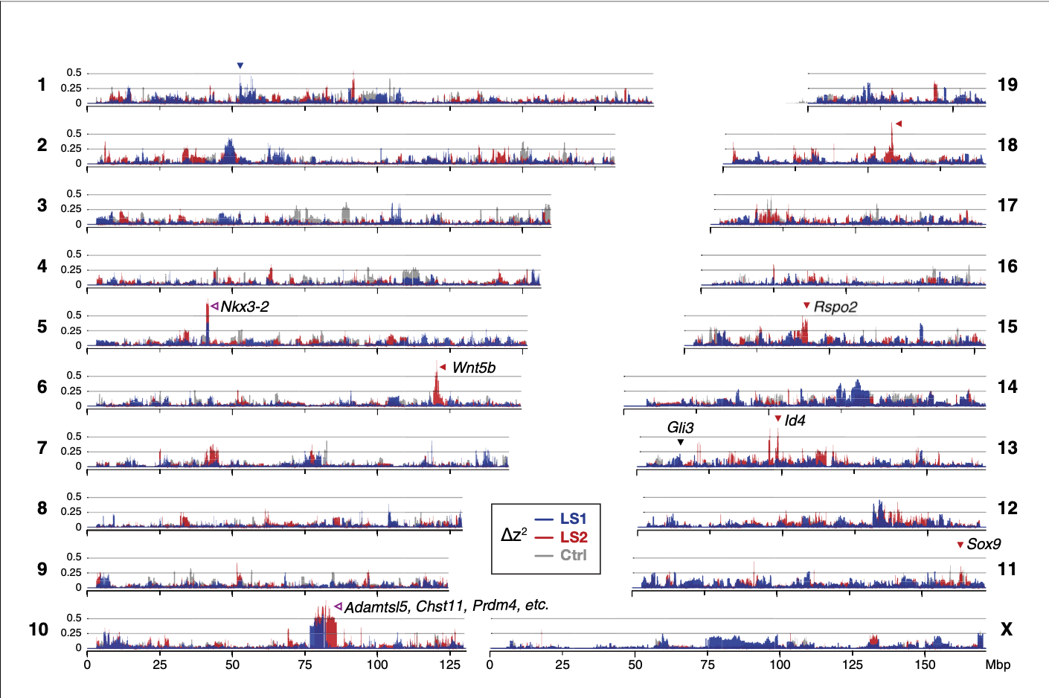
Mice: selection for tibia length
Loci with strong, parallel response
    Castro et al. 2018

Slide 22
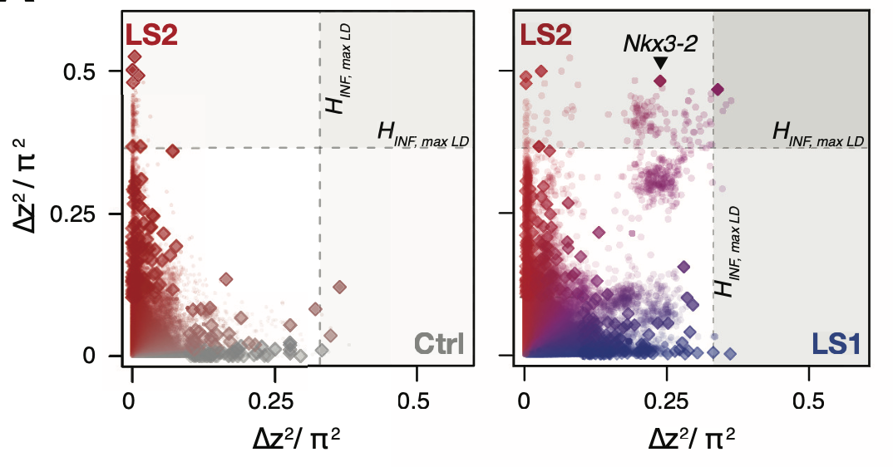
Mice: selection for tibia length
Most selection signatures are lineage specific
    Castro et al. 2018

Slide 23
Many selection targets

Slide 24
Distinguishing haplotype blocks from single targets
Idea
  Reducing the number of founder haplotypes
  Recombination breaks haplotypes of beneficial and deleterious alleles
  The pattern of recombination events sheds some light on the number of selection targets

Slide 25
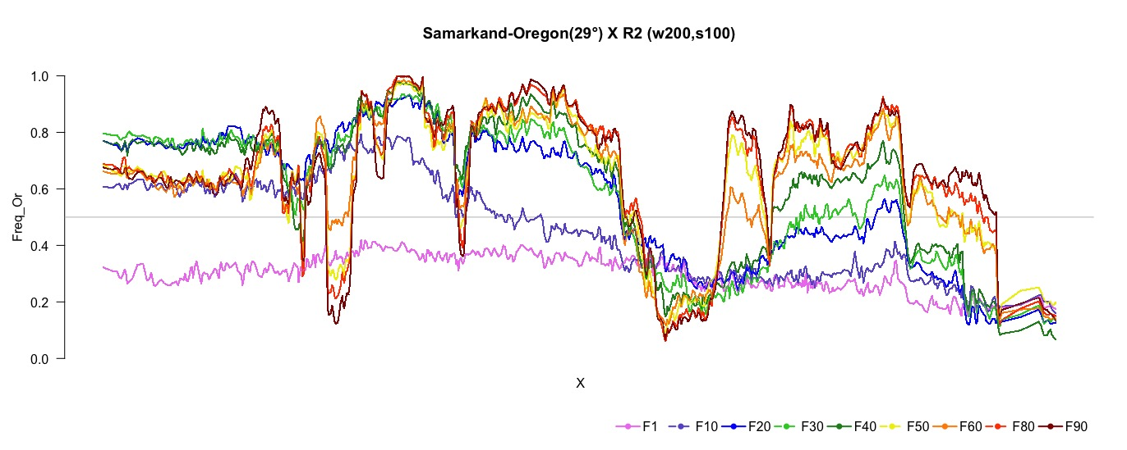
Temperature adaptation of 2 genotypes
Samarkand vs. Oregon
Recombination separates alleles

Slide 26
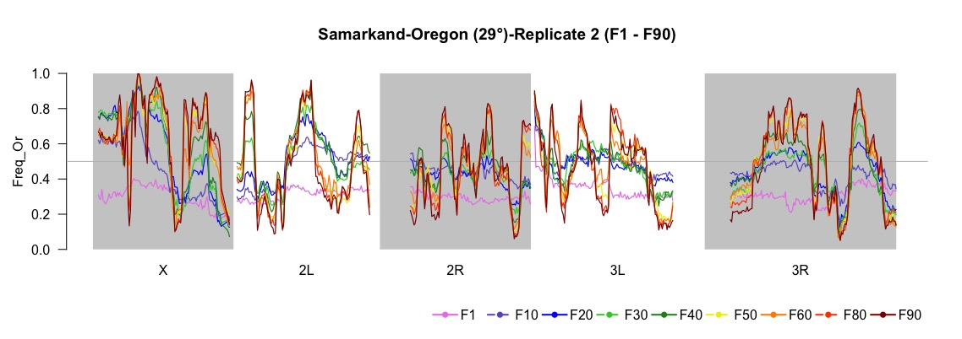
Temperature adaptation of 2 genotypes
Samarkand vs. Oregon
Recombination separates alleles

Slide 27
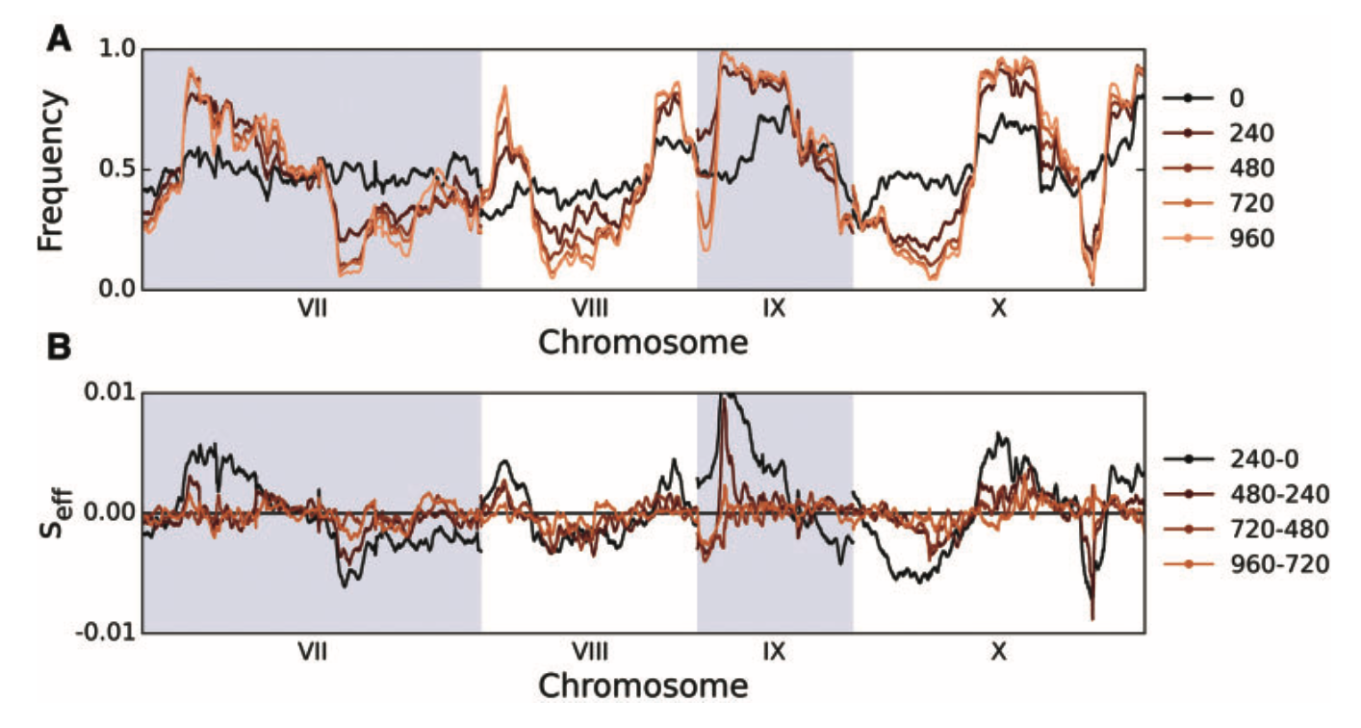
yeast
Haploid, frequent recombination
      Kosheleva & Desai 2017

Slide 28
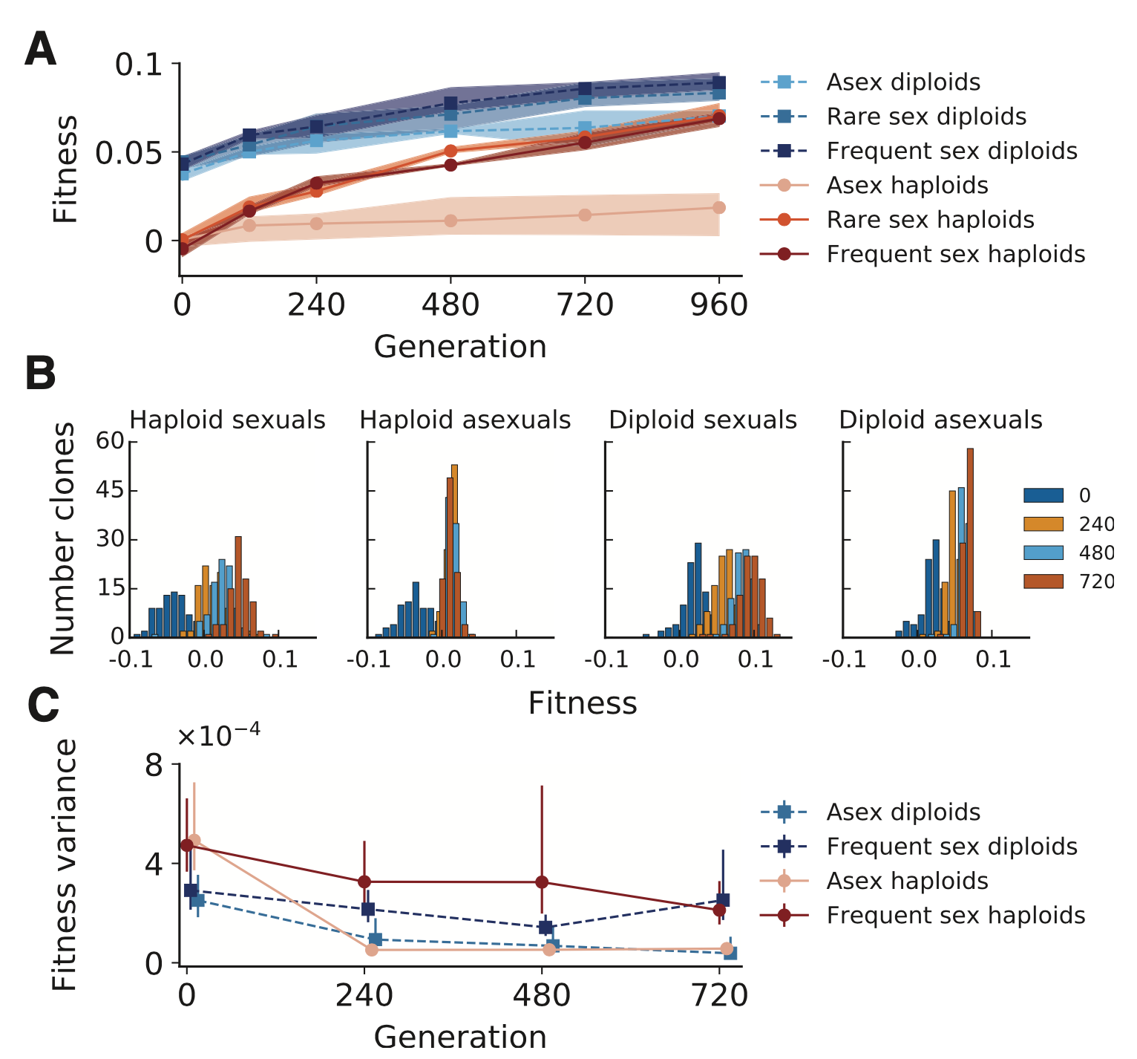
yeast
      Kosheleva & Desai 2017

Slide 29
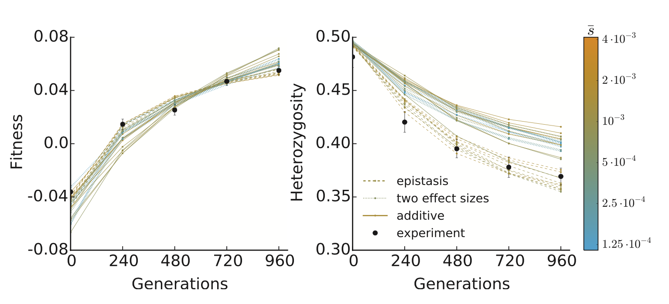
yeast
Simulations suggest a model of diminishing returns
300-1200 loci with s between 0.075 and 0.15%
      Kosheleva & Desai 2017

Slide 30
Gene expression as a polygenic trait

Slide 31
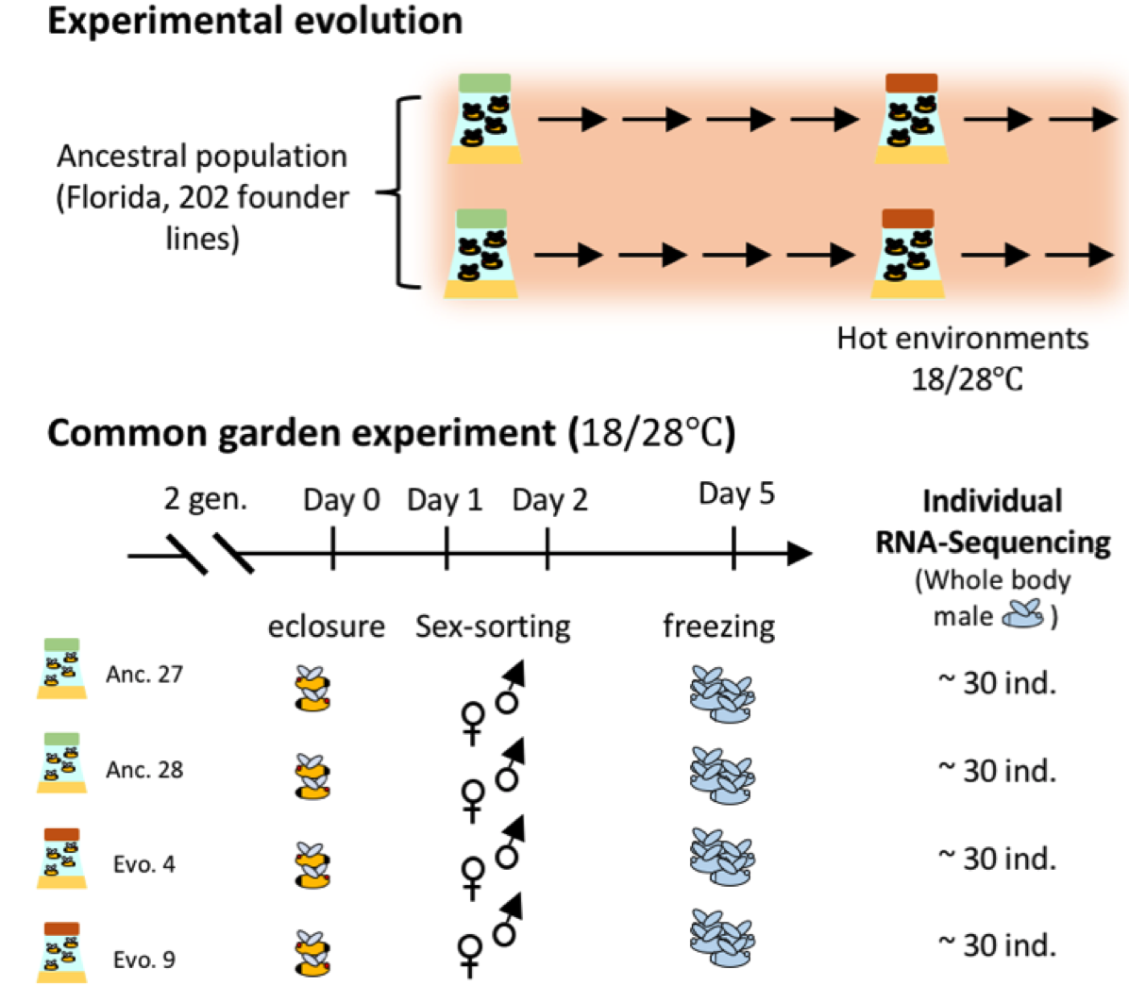
Evolution of variance

Slide 32
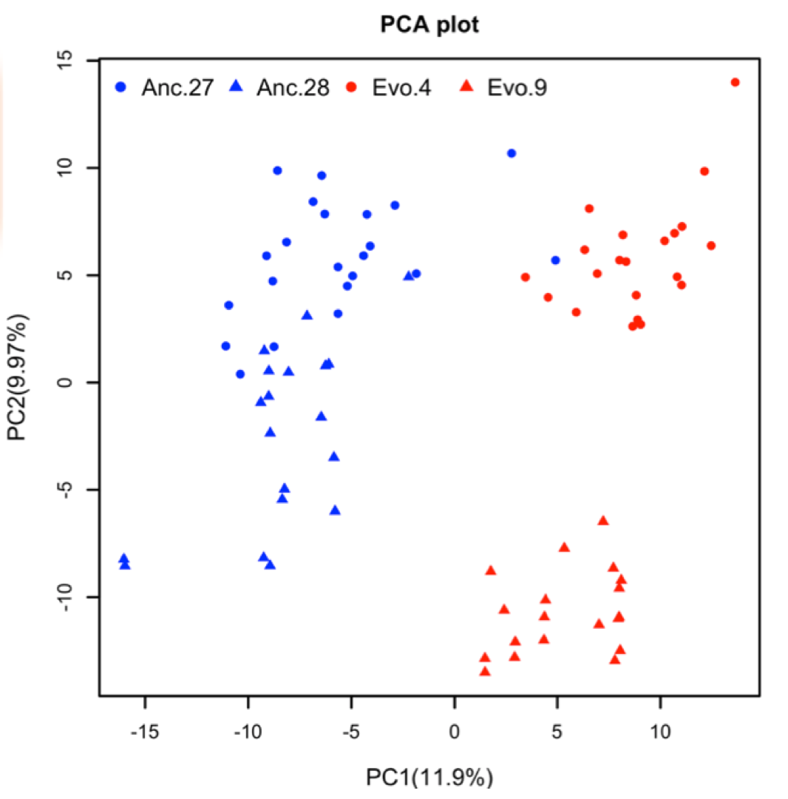
Evolution of variance

Slide 33
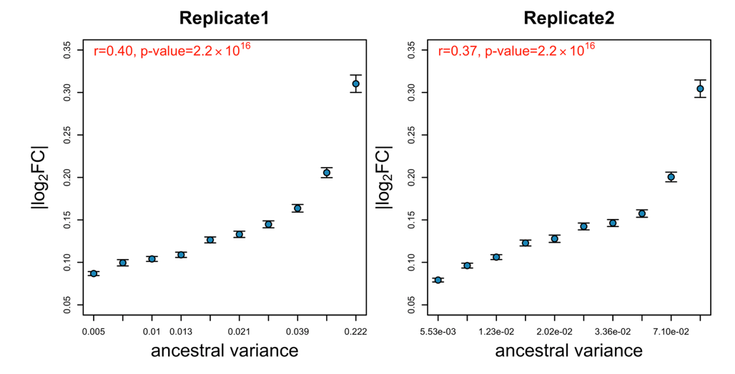
Variance evolution
Genes with higher variance change more in expression

Slide 34
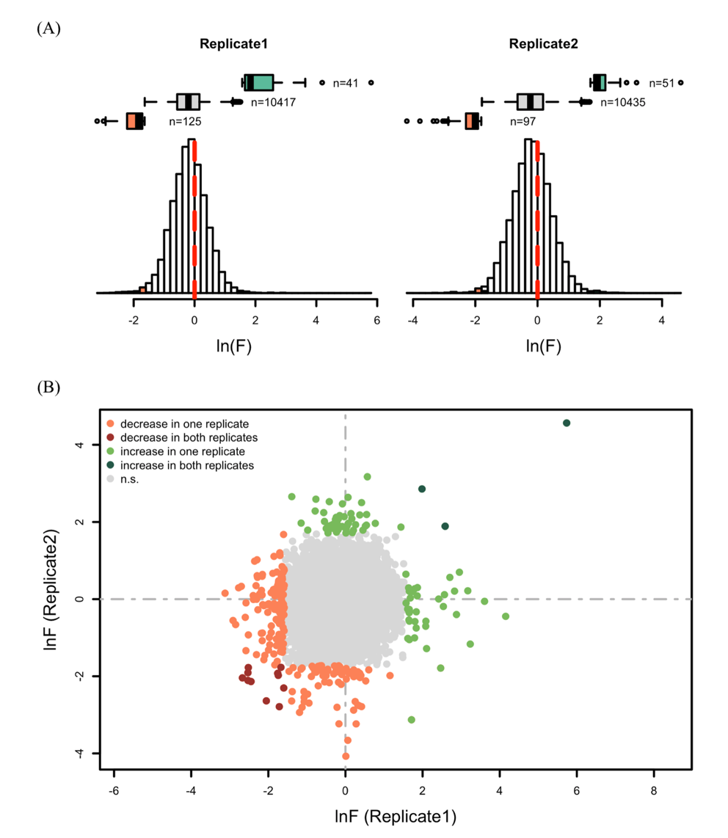
Variance evolution
Only in a small set of genes variance evolves

Slide 35
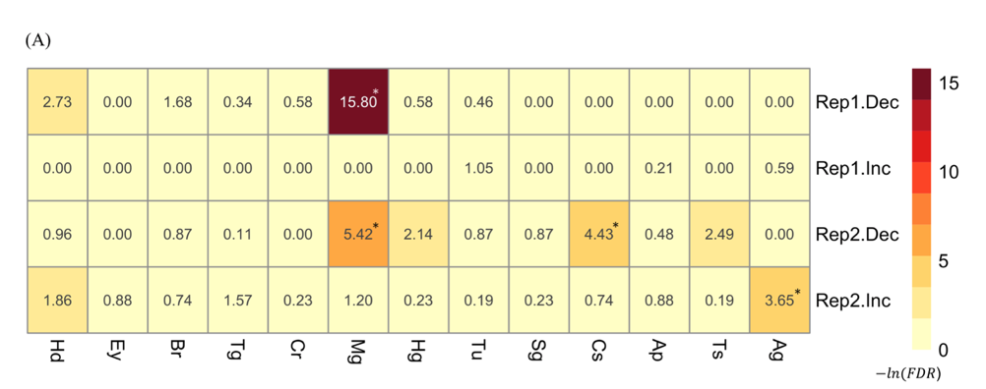
Variance evolution
Down regulated genes are enriched in midgut

Slide 36
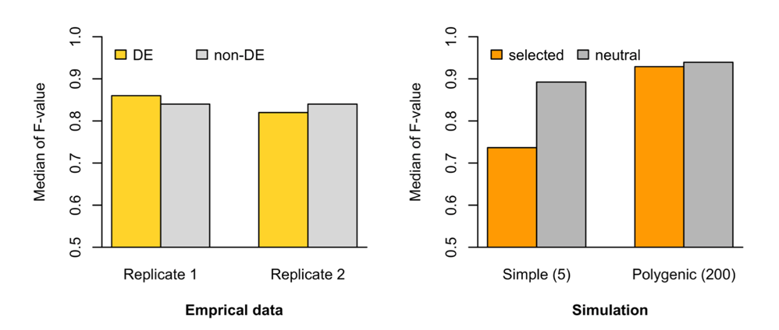
Variance evolution
For a simple genetic architecture changes in variance are expected for selected genes
Differentially and non-differentially expressed genes have similar changes in variance
→ Gene expression is polygenic

Slide 37
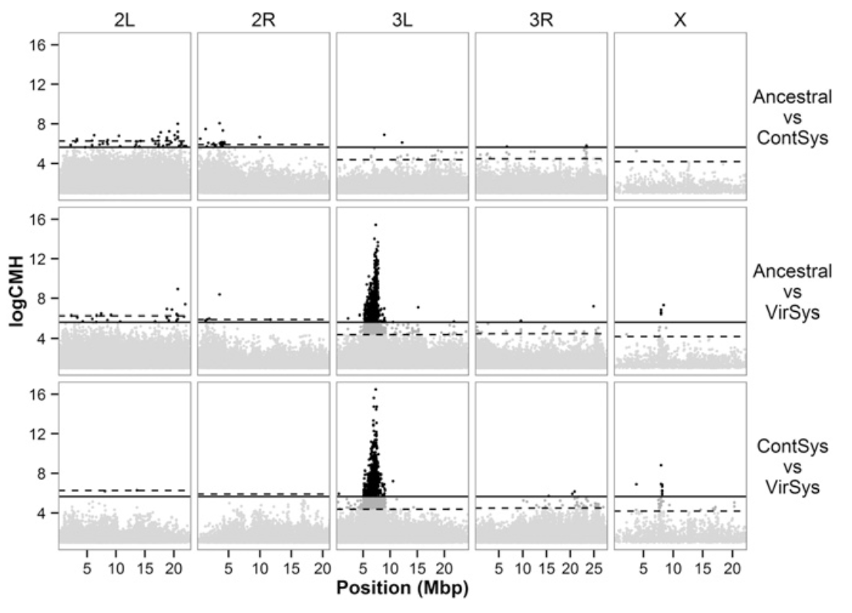
Wolbachia resistance
    Martins et al. 2014
pastrel
Ubc-E2H

Slide 38
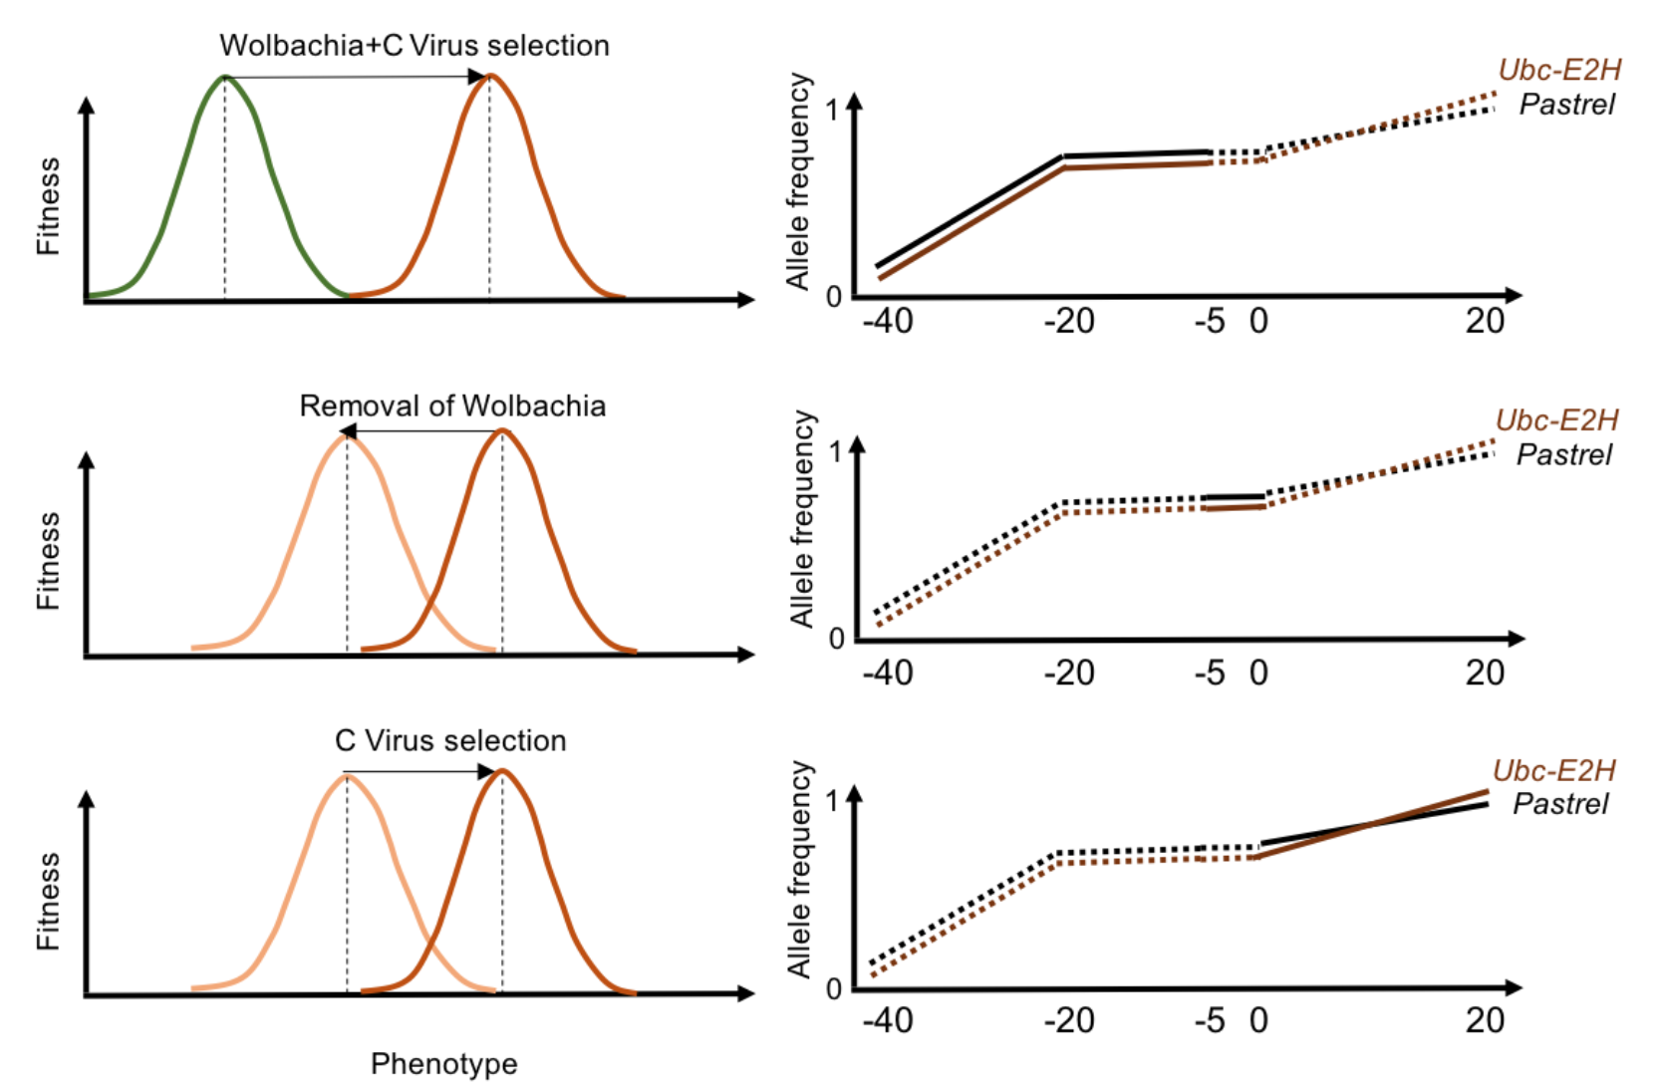
Wolbachia resistance is polygenic
    Faria et al. 2018

Slide 39
