Slide 1
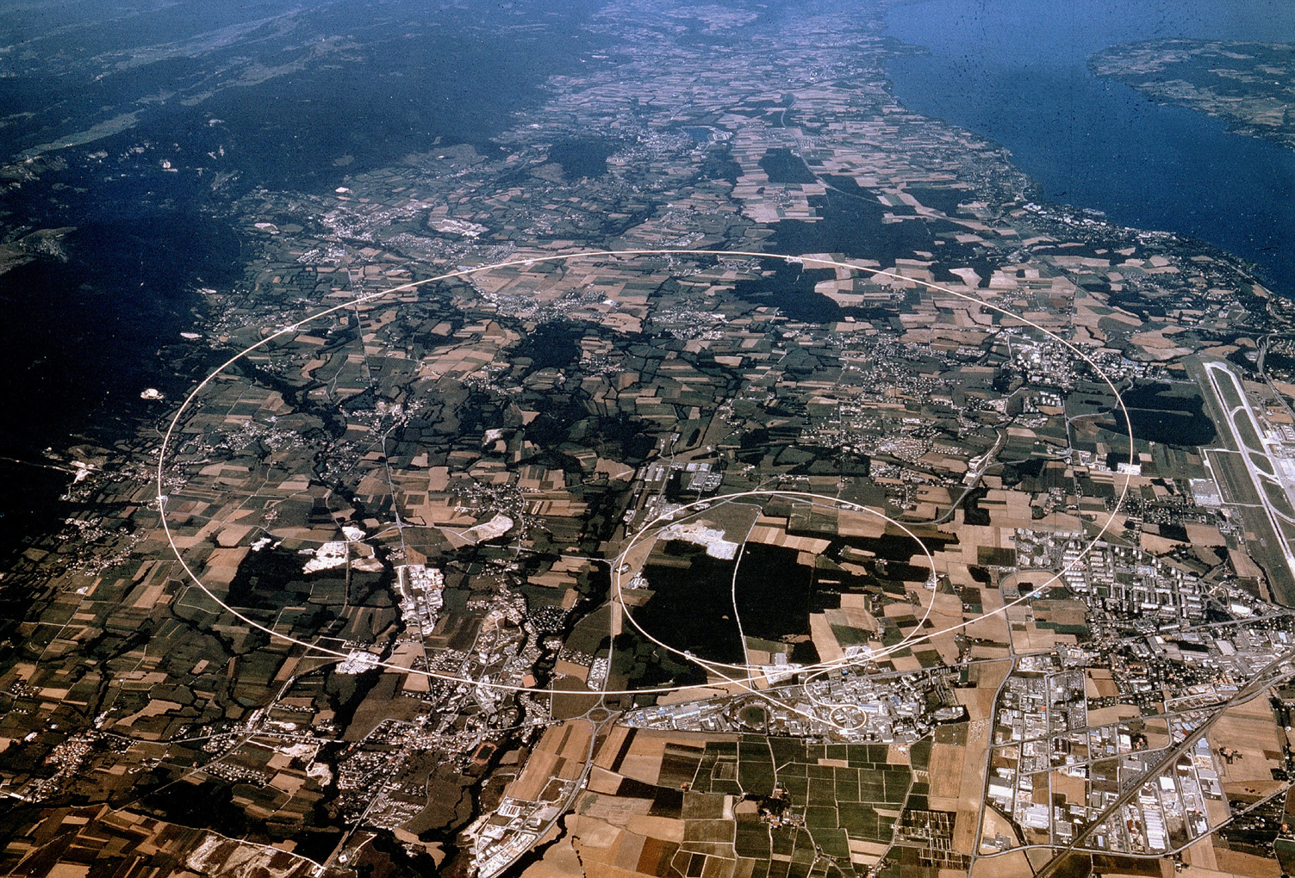
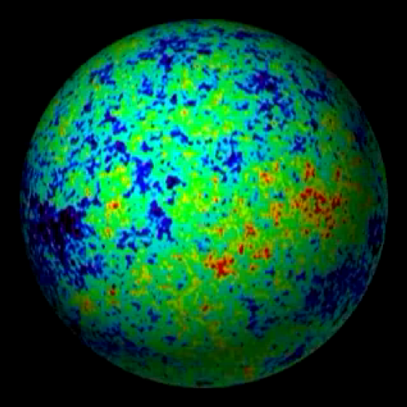
Particle Physics & Cosmology in Light of the LHC
John Ellis
King’s College London & CERN

Slide 2
The ‘Standard Model’
= Cosmic DNA
The matter particles
The fundamental interactions
Gravitation electromagnetism weak nuclear force strong nuclear force

Slide 3
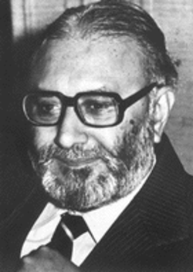
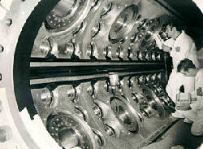
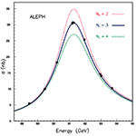
The ‘Standard Model’ of Particle Physics
Proposed byAbdus Salam,
Glashow and Weinberg
Tested by experiments
at CERN
Perfect agreement between
theory and experiments
in all laboratories

Slide 4
Open Questions beyond the Standard Model
Why do particles have mass?
Higgs boson? Supersymmetry?
Why so many types of matter particles?
Are the fundamental forces unified?
Supersymmetry?
Quantum theory of gravity?
String theory?
All ➔ Cosmology
LHC project @ CERN

Slide 5
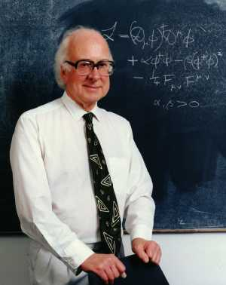
Why do Things Weigh?
Newton:
Weight proportional to Mass
Einstein:
Energy related to Mass
Neither explained origin of Mass
0
Where
do
the
masses
come from
?
Are masses due to Higgs boson?
(the physicists’ Holy Grail)

Slide 6
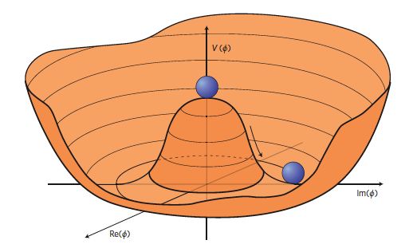
Mysterious Higgs Potential
Vertical scale ~ 10⁶⁰ × dark energy
Mass² of Higgs ~ curvature of potential at minimum

Slide 7
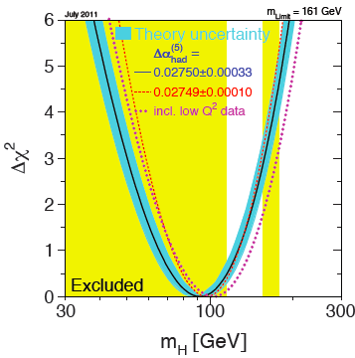
The State of the Higgs Earlier in 2011
High-energy search:
Limit from LEP:
m_{H} > 114.4 GeV
High-precision electroweak data:
Sensitive to Higgs mass:
m_{H} = 96⁺³⁰_{–24} GeV
Combined upper limit:
m_{H} < 161 GeV, or 190 GeV including direct limit
Exclusion from high-energy search at Tevatron:
m_{H} < 158 GeV or > 173 GeV

Slide 8
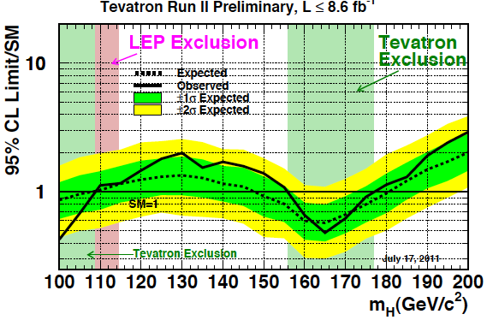
Latest Higgs Searches @ Tevatron
Experimental
upper limit
Standard Model
prediction
Exclude (100,109); (156,177) GeV
Notes:
8

Slide 9
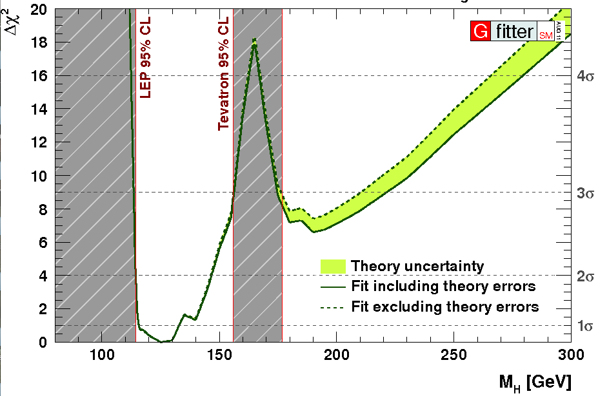
Combining the Information from Previous Direct Searches and Indirect Data
m_{H} = 125 ± 10 GeV
Gfitter collaboration

Slide 10
The Higgs Boson and Cosmology
Changed the state of the Universe when it was about 10⁻¹² seconds old
May have generated then the matter in the Universe
Contributes (too much) to today’s dark energy
A related inflaton might have expanded the Universe when it was about 10⁻³⁵ seconds old

Slide 11
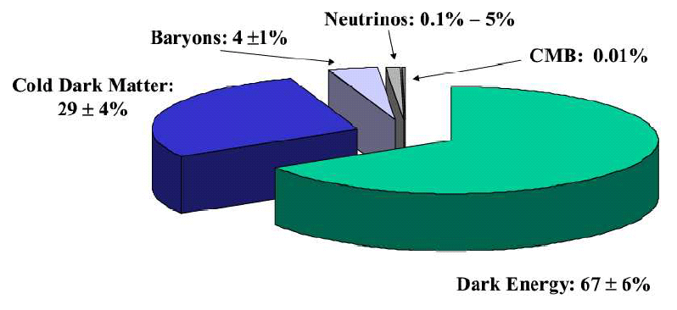
A Strange Recipe for a Universe
The ‘Concordance Model’
prompted by astrophysics & cosmology

Slide 12
Open Cosmological Questions
Where did the matter come from?
1 proton for every 1,000,000,000 photons
What is the dark matter?
Much more than the normal matter
What is the dark energy?
Even more than the dark matter
Why is the Universe so big and old?
Mechanism for cosmological inflation
Need particle physics to answer these questions

Slide 13
The Very Early Universe
Size: a → zero
Age: t → zero
Temperature: T → large
T ~ 1/a, t ~ 1/T²
Energies: E ~ T
Rough magnitudes:
T ~ 10,000,000,000 degrees
E ~ 1 MeV ~ mass of electron
t ~ 1 second
Need particle physics to describe earlier history
LHC physics @ TeV: t ~ 1 picosecond

Slide 14
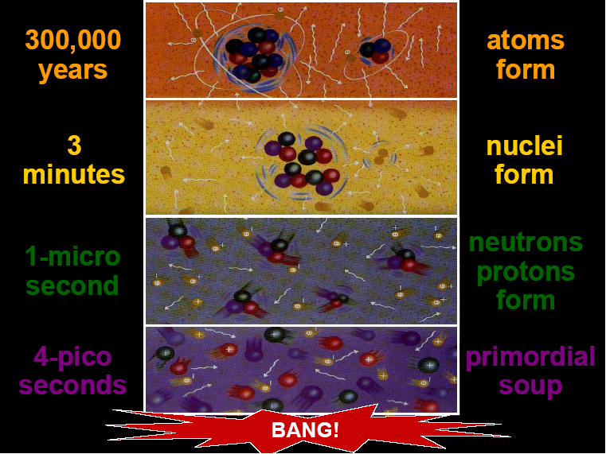
380,000
years
Formation
of atoms
3
minutes
Formation
of nuclei
Formation
of protons
& neutrons
1 micro-
second
Freeze-out
of dark matter?
1 pico-
second
Appearance
of mass?
Matter-antimatter
asymmetry?

Slide 15
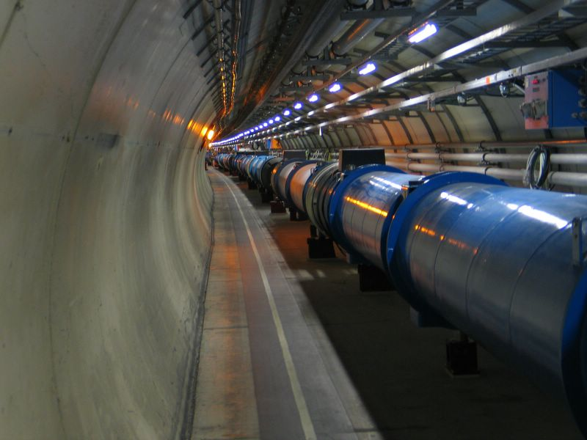
The Large Hadron Collider (LHC)
To answer these questions:
Proton- Proton Collider
Total energy 7 to 14 TeV
Primary targets:
Origin of mass
Nature of Dark Matter
Primordial Plasma
Matter vs Antimatter
7 TeV +
7 TeV
Up to 1,000,000,000 collisions/second

Slide 16
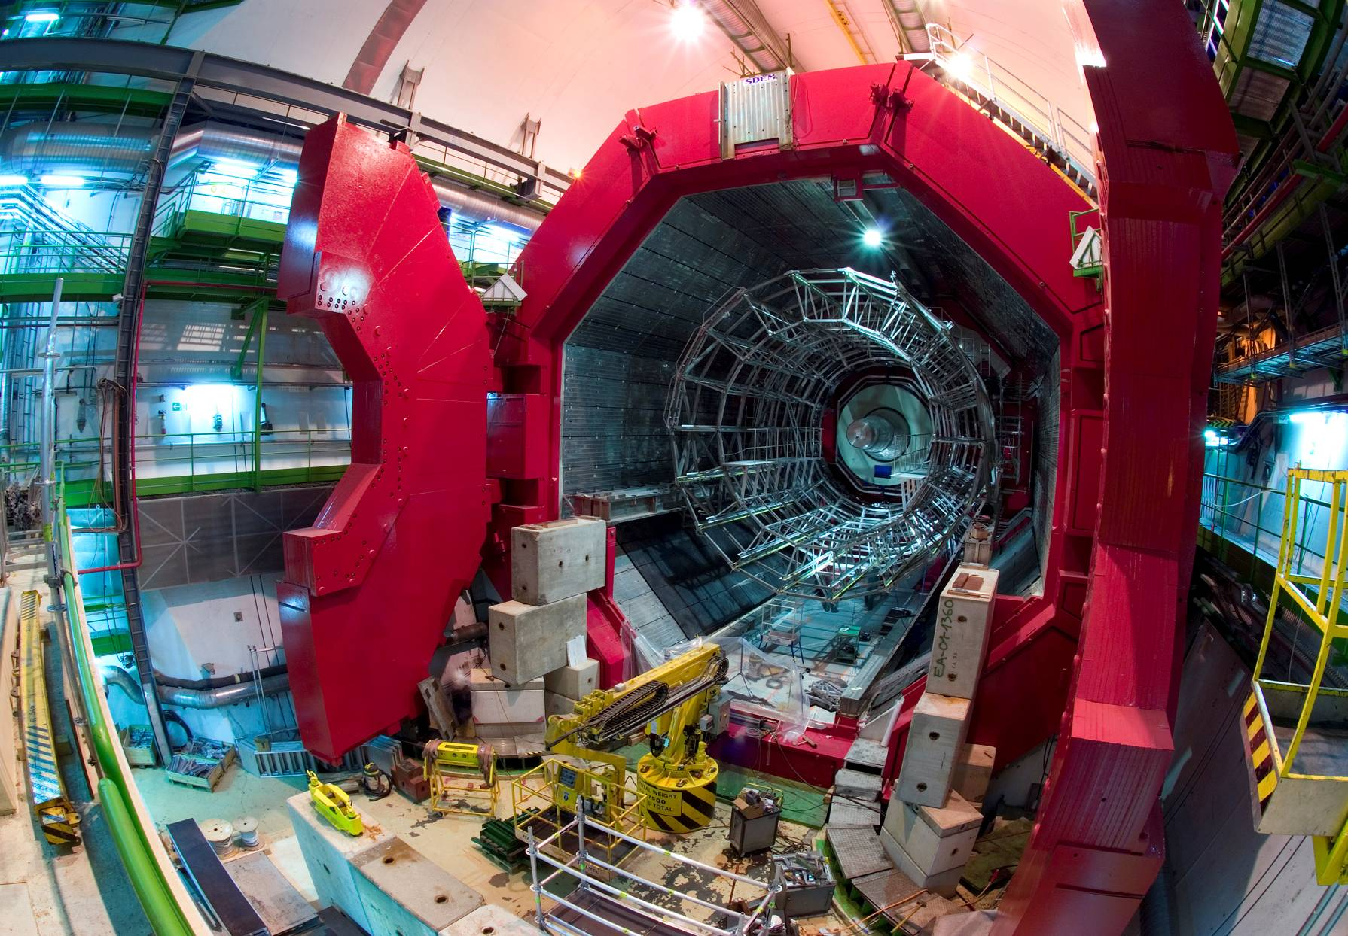
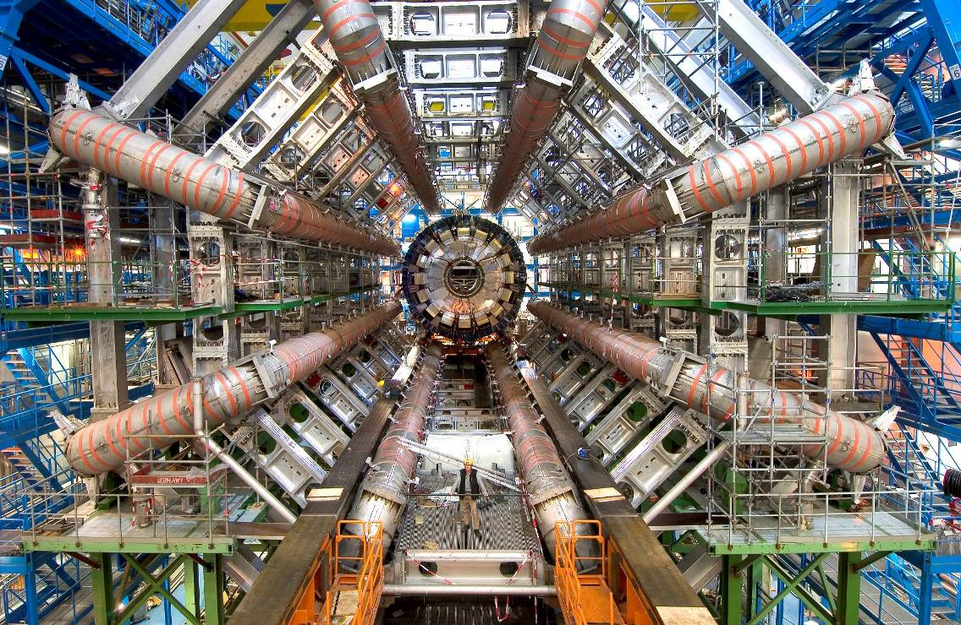
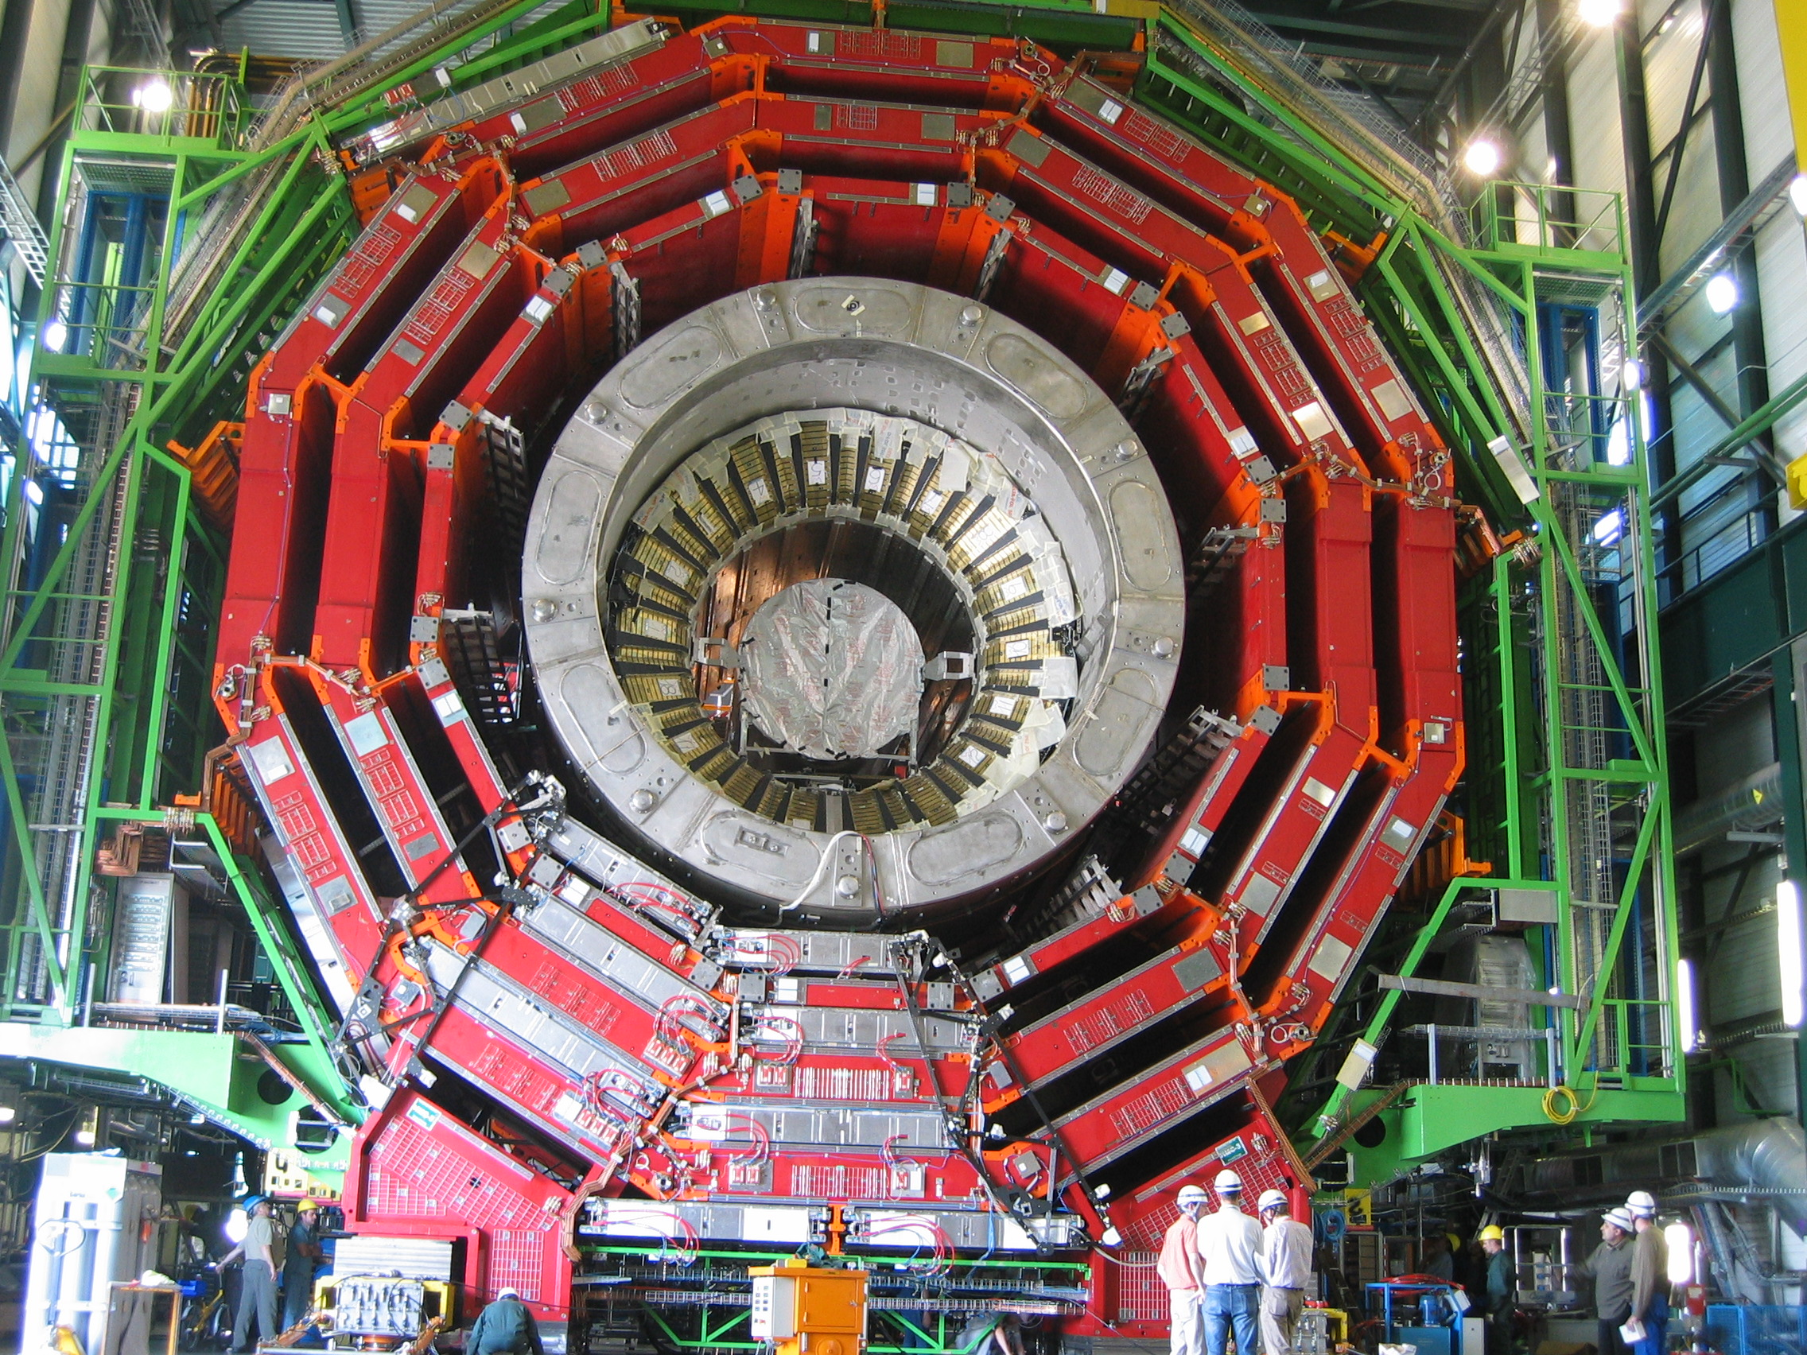
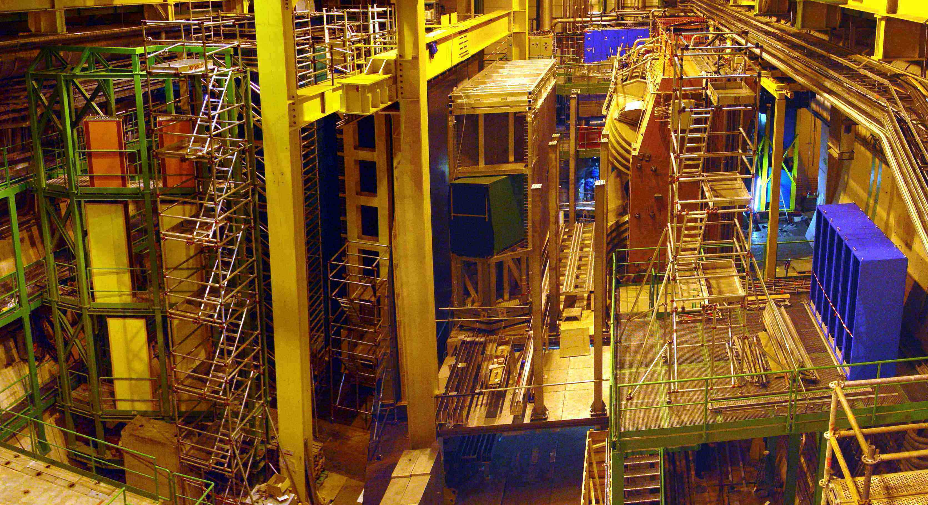
ALICE: Primordial cosmic plasma
ATLAS: Higgs and supersymmetry
CMS: Higgs and supersymmetry
LHCb: Matter-antimatter difference

Slide 17
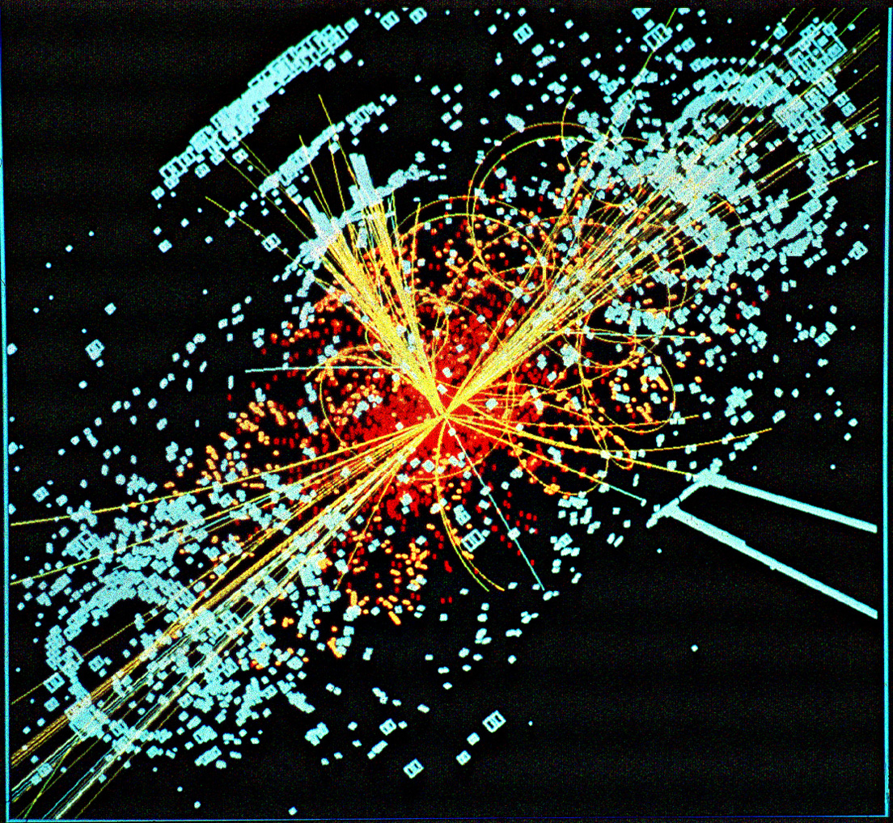
Simulated Production of a Higgs Boson

Slide 18
Interesting Events
Notes:
18

Slide 19
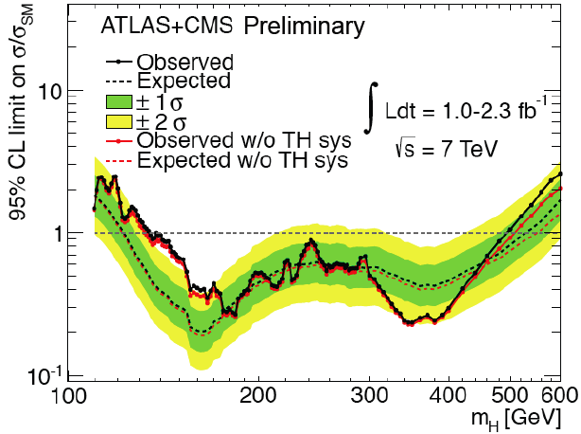
Compilation from Friday Nov. 18th
There must be New Physics beyond the Higgs Boson
No Higgs Boson yet:
only upper limits on its production
Higgs
potential
collapses
Precision
Electroweak
data?
Higgs
coupling
blows up
Higgs coupling less
than in Standard Model

Slide 20
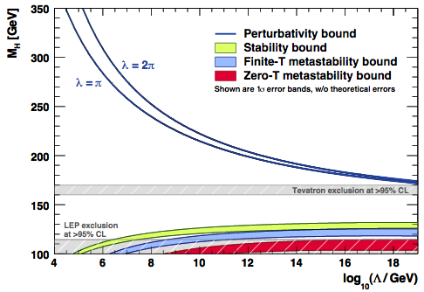
Theoretical Constraints on Higgs Mass
Large M_{h} → large self-coupling → blow up at low-energy scale Λ due to
renormalization
Small: renormalization
due to t quark drives
quartic coupling < 0
at some scale Λ
→ vacuum unstable
Bounds on Λ depend on Higgs mass
LHC 90%
exclusion
Espinosa, JE, Giudice, Hoecker, Riotto, arXiv0906.0954

Slide 21
Astronomers say
that most of the
matter in the
Universe is
invisible
Dark Matter
‘Supersymmetric’ particles ?
We shall look for
them with the
LHC

Slide 22
Supersymmetry?
Would unify matter particles and force particles
Related particles spinning at different rates
0 - ½ - 1 - 3/2 - 2
Higgs - Electron - Photon - Gravitino - Graviton
(Every particle is a ‘ballet dancer’)
Would stabilize vacuum
Would help fix particle masses
Would help unify forces
Predicts light Higgs boson
Could provide dark matter for the
astrophysicists and cosmologists

Slide 23
Lightest Supersymmetric Particle
Stable in many models because of conservation of R parity:
R = (-1) ^{2S –L + 3B}
where S = spin, L = lepton #, B = baryon #
Particles have R = +1, sparticles R = -1:
Sparticles produced in pairs
Heavier sparticles → lighter sparticles
Lightest supersymmetric particle (LSP) stable
Fayet

Slide 24
Possible Nature of LSP
No strong or electromagnetic interactions
Otherwise would bind to matter
Detectable as anomalous heavy nucleus
Possible weakly-interacting scandidates
Sneutrino
(Excluded by LEP, direct searches)
Lightest neutralino χ (partner of Z, H, γ)
Gravitino
(nightmare for astrophysical detection)

Slide 25
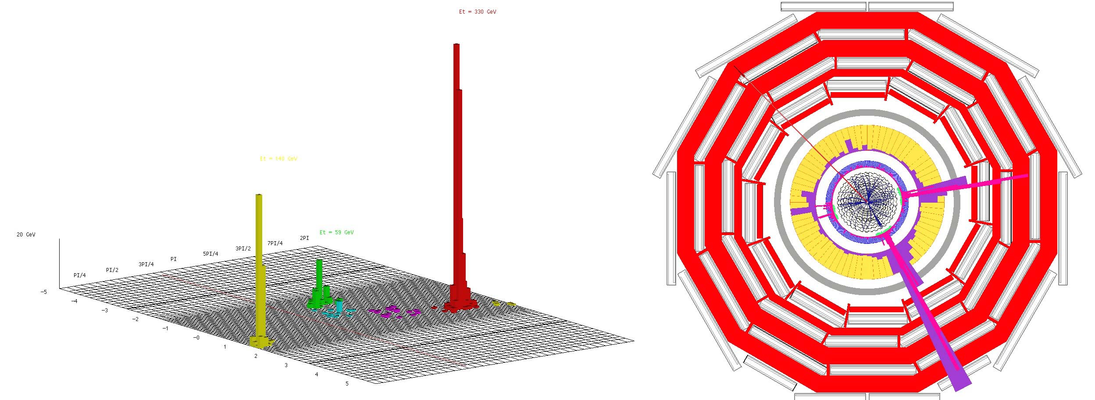
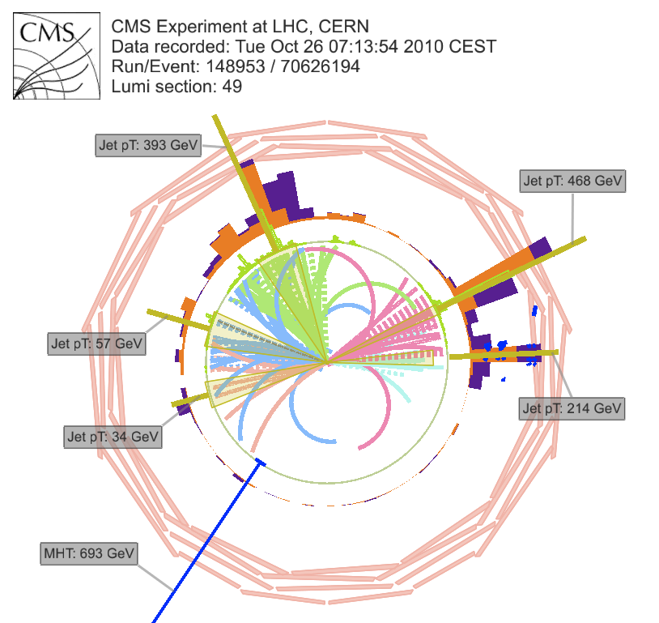
Supersymmetric Signature @ LHC
Missing transverse energy
carried away by dark matter particles
Notes:
25

Slide 26
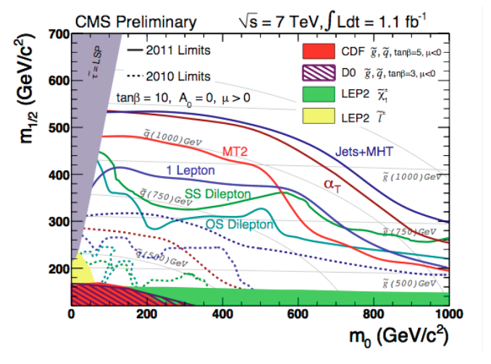
Supersymmetry Searches in CMS
Jets + missing energy (+ lepton(s))
Notes:
26

Slide 27
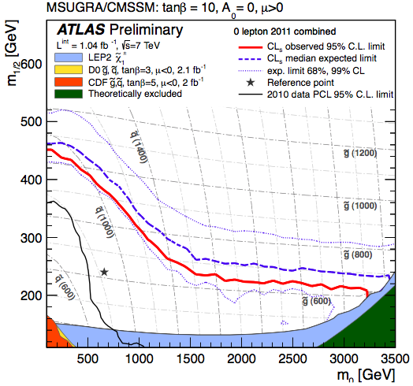
Supersymmetry Searches in ATLAS
Jets + missing energy + 0 lepton
Notes:
27

Slide 28
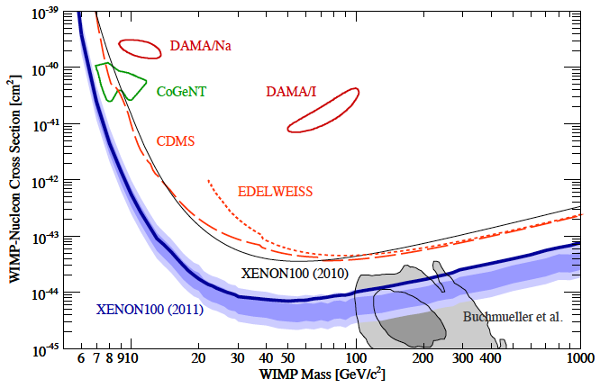
XENON100 Experiment
Aprile et al: arXiv:1104.2549
Notes:
28

Slide 30
68% & 95%
CL contours
….. pre-LHC
___ LHC 1/fb

Slide 31
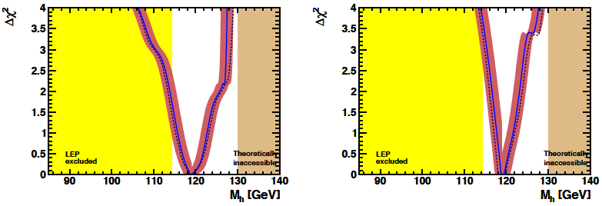
Higgs mass
χ² price to pay if M_{h} = 125 GeV is < 2
Buchmueller, JE et al: arXiv:1112.3564
Favoured values of M_{h} ~ 119 GeV:
Range consistent with evidence from LHC !

Slide 32
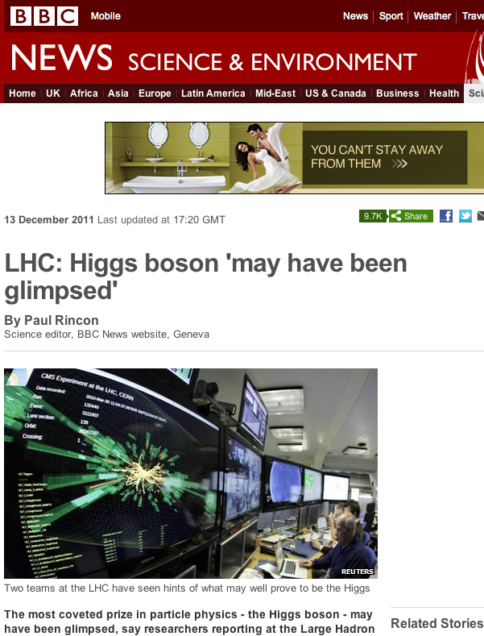

Slide 33
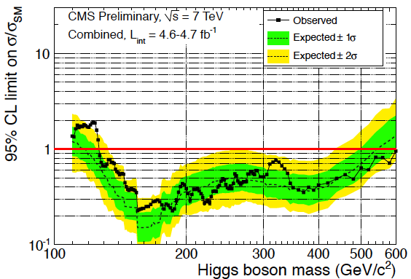
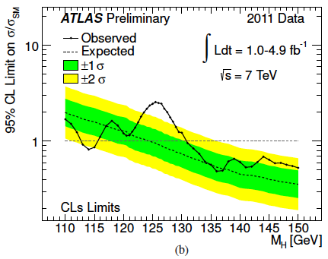
Has the Higgs Boson been Discovered?
Interesting hints around M_{h} = 125 GeV ?
CMS sees broad
enhancement
ATLAS prefers
125 GeV

Slide 34
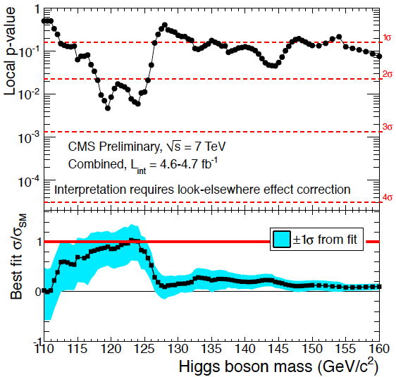
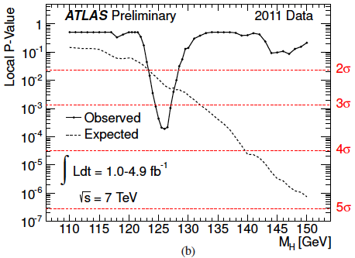
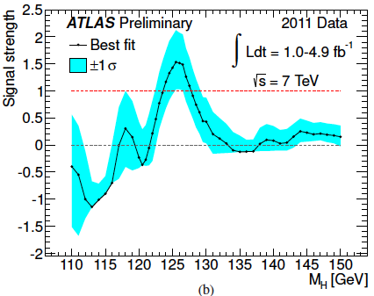
Has the Higgs Boson been Discovered?
Interesting hints around 125 GeV in both experiments
- but could also be 119 GeV ?

Slide 35
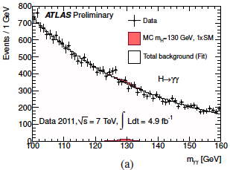
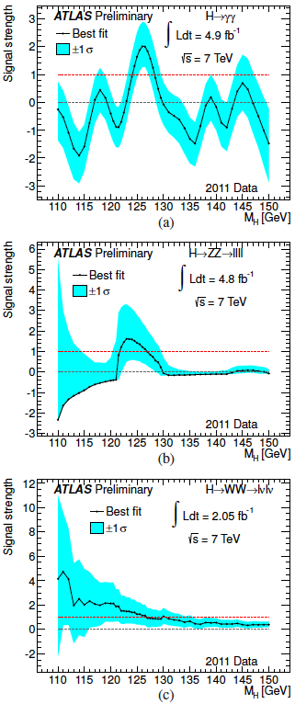
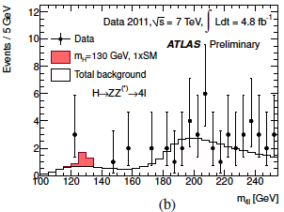
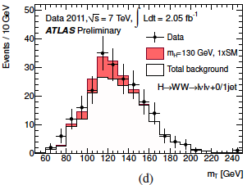
ATLAS Signals
γγ: 2.8σ
ZZ: 2.1σ
WW: 1.4σ
Combined: 3.6σ

Slide 36
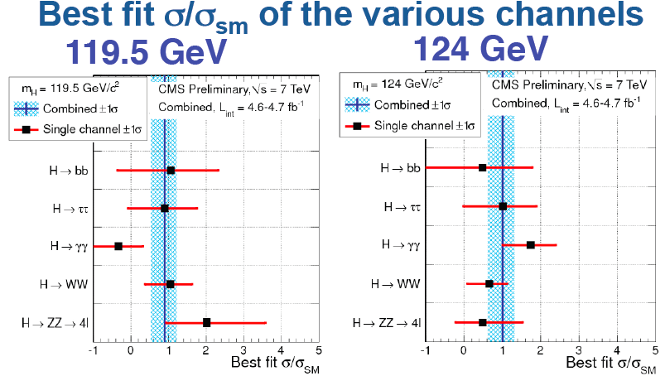
CMS Signals
Combined: 2.6σ

Slide 37
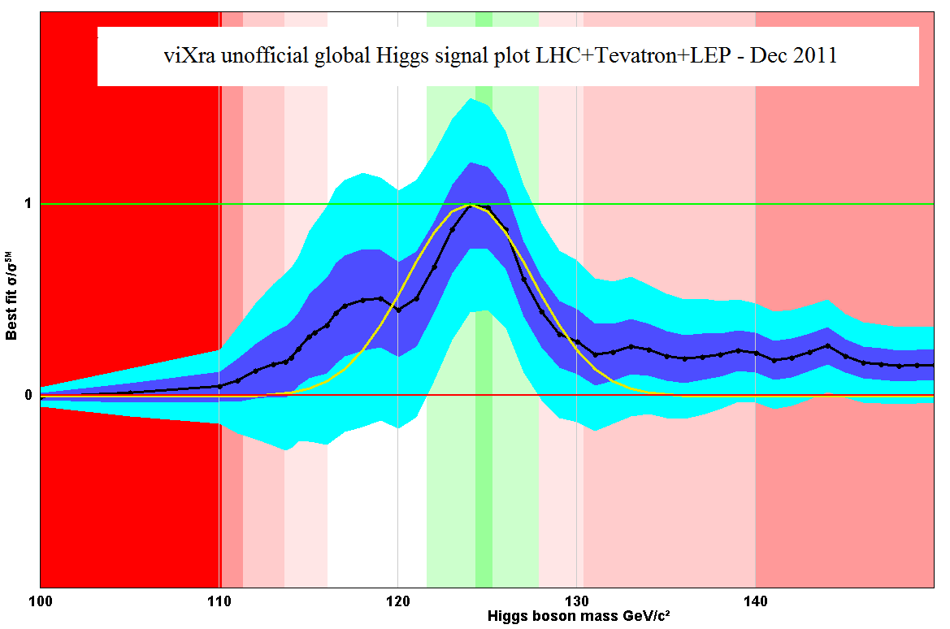
Has the Higgs Boson been Discovered?
Unofficial blogger’s combination
NOT ENDORSED BY EXPERIMENTS
but he was right last time !

Slide 38
68% & 95%
CL contours
….. pre-Higgs
___ Higgs @ 125
Buchmueller, JE et al: arXiv:1112.3564

Slide 39
Gluino mass
--- pre-Higgs
___ Higgs @ 125
… H@125, no g-2
Buchmueller, JE et al: arXiv:1112.3564
Favoured values of gluino mass significantly
above pre-LHC, > 2 TeV

Slide 40
Spin-independent
dark matter scattering
….. pre-Higgs
___ Higgs @ 125
Buchmueller, JE et al: arXiv:1112.3564
Higgs @ 125 GeV reduces
prospects for coming years ?

Slide 41
68% & 95%
CL contours
….. pre-Higgs
___ Higgs @ 119
Buchmueller, JE et al: arXiv:1112.3564
Higgs @ 119 GeV would enhance
prospects for coming years ?

Slide 42
Spin-independent
dark matter scattering
….. pre-Higgs
___ Higgs @ 119
Buchmueller, JE et al: arXiv:1112.3564
Significant impact on dark matter experiments:
Better prospects for coming years !

Slide 43
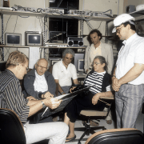
How to Create the Matter in the Universe?
Sakharov
Need a difference between matter and antimatter
observed in the laboratory
Need interactions able to create matter
present in unified theories
not yet seen by experiment
Must break thermal equilibrium
Possible in the decays of heavy
particles
Will we be able to calculate using laboratory data?
Notes:
43

Slide 44
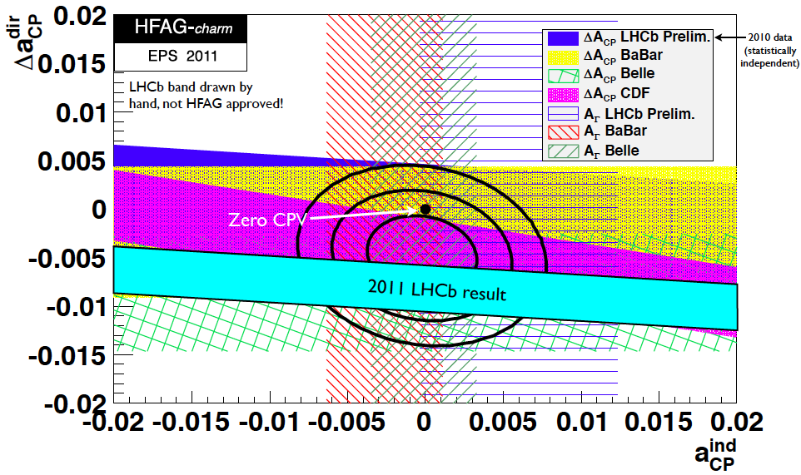
Observations of Matter-Antimatter Diffferences
Observed in strange particle decays in 1964
Also measured in decays of b quarks
Described within the Standard Model
Insufficient to explain matter in Universe
Matter-antimatter asymmetry now seen by LHCb in charm decays @ 3.5 σ level
10 × larger than SM estimate?
A new frontier opened up

Slide 45
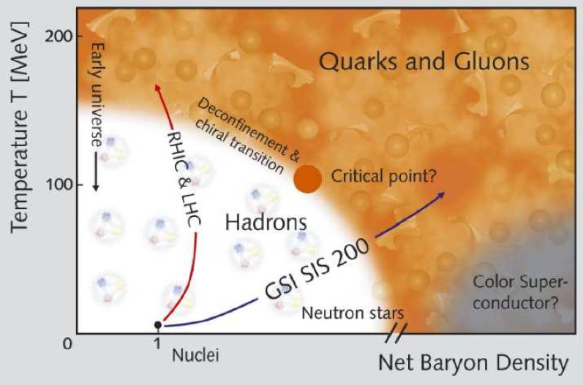
Hot and Dense Hadronic Matter
Collide heavy nuclei at high energies to create …
Recreate the first 10⁻⁶ seconds …
Properties described by
AdS/CFT correspondence
suggested by string theory:
Viscosity, jet quenching, …?
… and probe the quark-hadron
phase transition

Slide 46
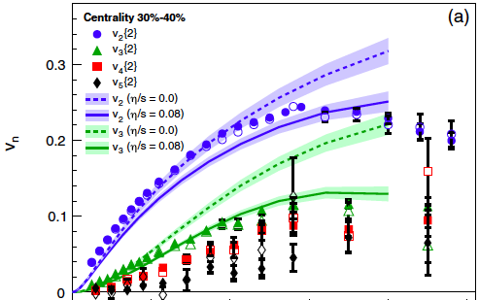
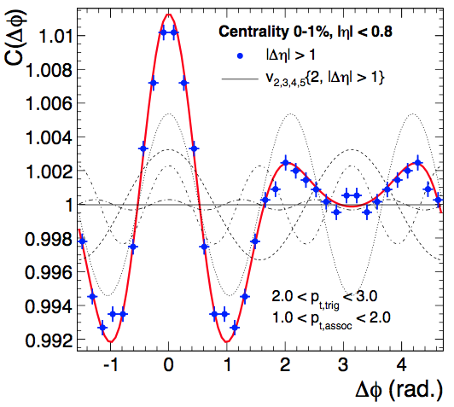
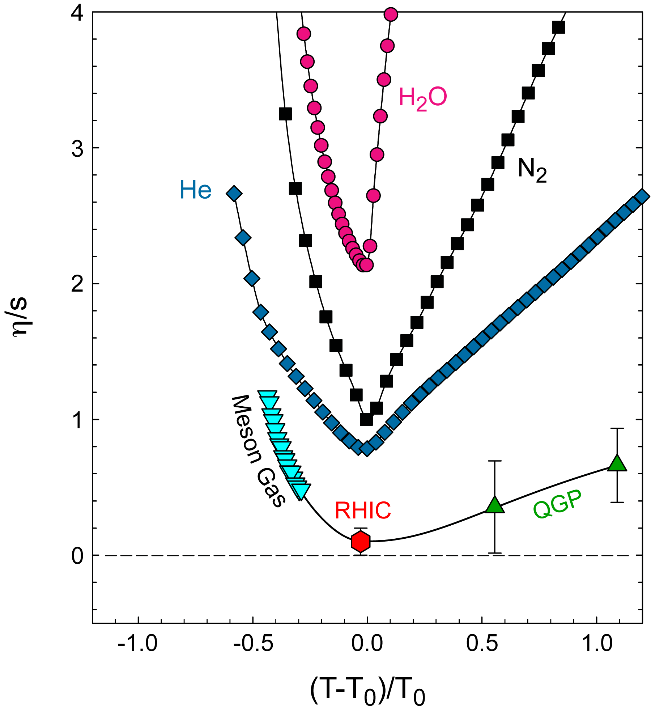
An Almost Perfect Fluid
Collide heavy nuclei at high energies to create …
Anisotropic flow with
very low viscosity
Flow pattern explained
by initial conditions:
CMB redux ?
Challenge: measure viscosity before/after
minimum: Hard probes for high T?

Slide 47
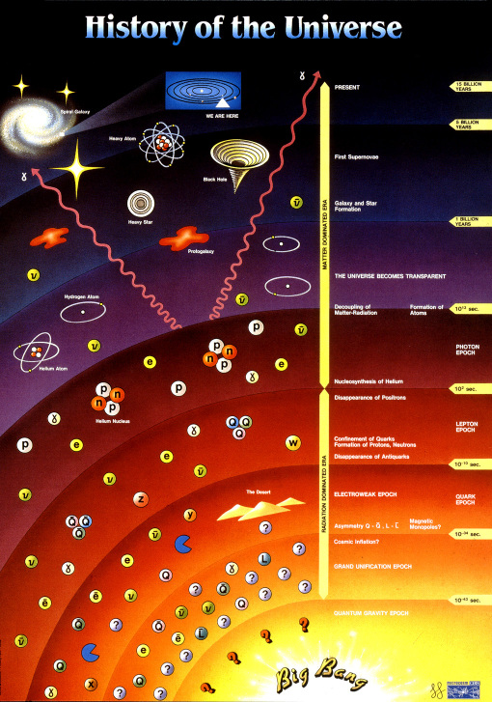
Big Bang ↔ Little Bangs
The content of the Universe
Dark energy
Dark matter
Origin of matter
Particle experiments
Higgs boson
Supersymmetry
Matter-antimattter
Learn particle physics from the Universe
Use particle physics to understand the Universe

