Slide 1
Server Security Guidelines
for
HPC, Mail, DNS, Web, DB, and Web Applications
Kausalya S, CCCF, TIFR Mumbai

Slide 2
Common Security Practices
Use minimal OS installations and harden kernel parameters
Enforce time sync (NTP/chrony), disable unused services
Implement firewalls with default deny policies
Mandatory SSH key authentication
Disable direct SSH root login
Centralized log collection & Regular audits
As per CERT-In, 180 days of logging is required for incident forensics.

Slide 3
HPC Server Security
Isolate management and compute networks
Restrict direct internet access for worker nodes
Patch management as and when warranted
Forward proxy to be enabled for internet access for upgrade/update or patch as and when required.
Implement job scheduler based access control
Monitor for misuse or unauthorized long-running jobs
User-specific software should be installed in user home directory

Slide 4
Mail Server Security
Enforce SPF, DKIM, and DMARC policies
Use anti-spam and anti-virus filtering tools
Enable TLS for mail transport and authentication
Limit relay access to trusted networks
Regularly audit mail logs for misuse and
Filter unrealistic geo locations

Slide 5
DNS Server Security
Disable recursion for external clients
Run on minimal privileges (chroot/jail)
Rate-limit responses to prevent amplification attacks
Enable DNSSEC for zone signing and validation
Use allow-transfer for zone transfers

Slide 6
Web Server Security
Disable directory listing, enable HTTPS with strong ciphers
Use security headers (HSTS, CSP, X-Content-Type-Options)
Run with least privileges and restrict file access
Enable logging and watch for anomalies
Separate websites rendering static and dynamic content
Use reverse proxy for minimal exposure
https://geekflare.com/cybersecurity/apache-web-server-hardening-security/

Slide 7
Web Application Hosting
Keep application stack updated regularly
Harden PHP/Python/Node/Java environments
Implement secure session handling
Input validation
Log and alert on suspicious application behavior
Use docker for web applications for better isolation and maintenance
Thoroughly inspect vendor developed applications for security compliance
Use WAF (Web Application Firewall) to detect threats

Slide 8
Database Server Security
Use encrypted connections (SSL/TLS) for client access
Disable remote root/admin access
Enforce least privileged roles and strong authentication and authorization
Harden DB config files (e.g., no password reuse, bind to localhost)
Enable query logging and audit trails
Backup the database regularly online and offline.
Use docker for DB servers for better security, isolation and maintenance

Slide 9
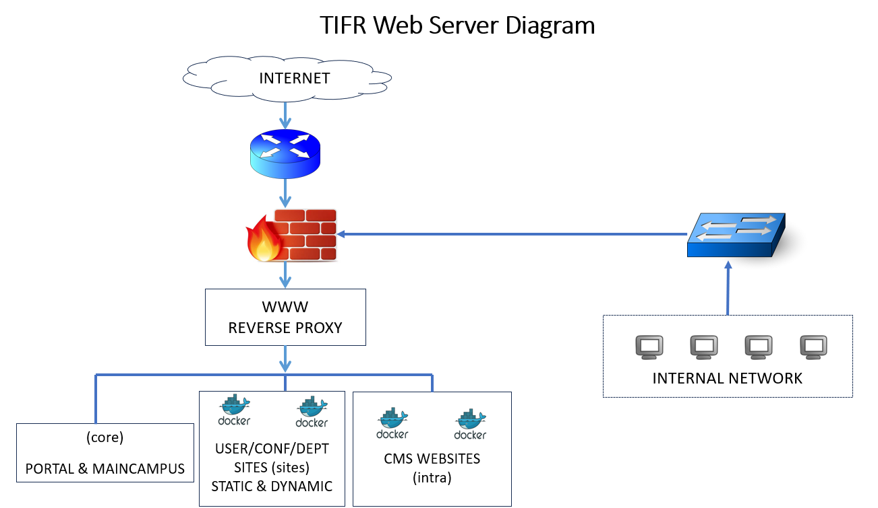

Slide 10
Network & Firewall Security
Segment traffic using VLANs or subnets
Implement host and network firewalls
Use reverse proxies and load balancers securely
Isolate attack surfaces using zones.
Monitor and control traffic in data centers
Log and analyze network traffic patterns

Slide 11
Common Network Security Threats
Malware (viruses, worms, ransomware)
Phishing and social engineering
Denial-of-Service (DoS) attacks
Man-in-the-middle attacks
Insider threats
Exploits of software vulnerabilities

Slide 12
Best Practices for Network Security
Use strong, unique passwords and change regularly
Regularly update & upgrade & document changes
Patch all software for flagged vulnerabilities
Train users to recognize phishing and social engineering
Limit user privileges to the minimum necessary
Deploy multi-factor authentication
Monitor network traffic and maintain logs
Schedule regular vulnerability assessments and penetration testing
Audit firewall regularly
Document and file incident reports - online / offline

Slide 13
Logging, Monitoring & SIEM Integration
Centralize logs using syslog/rsyslog/ELK stack
Use file integrity monitoring tools (AIDE, Tripwire)
Integrate with an SIEM (Security Information and Event Management) for correlation and alerting (Wazuh)
Monitor admin and authentication logs closely
Define incident response workflows

Slide 14
Backup, DR & Business Continuity
Segregate critical and non critical services.
Critical services to have redundancy and backup
Implement pull strategy for backup
Onsite and offsite backup strategy
Encrypt backup data in transit and at rest
Test recovery regularly via mock drills
Automate and document backup routines
Separate backup infrastructure from production

Slide 15
Access Control & Identity Management
Use Single Sign On (SSO) for centralized identity management
Enforce multi-factor authentication MFA for administrative access
Use role-based access control (RBAC)
Regularly review user roles and permissions
Log all access events and privilege escalations

Slide 16
Patch Management & Vulnerability Scanning
Automated security updates enabled for OS
Application stack updates where required
Use vulnerability scanners like OpenVAS, Nessus, Lynis
Track and prioritize CVEs based on risk category
Maintain update logs and audit trails
Monitor software lifecycle and EOL notices

Slide 17
Wrap-Up: Defense in Depth & Compliance
Use layered security: network, OS, app, and data layers
Ensure alignment with NCIIPC, CISAG, CERT-In guidelines
Conduct periodic risk assessments and pen tests
Document security policies and user training programs
Continuously evaluate and improve security posture
Create security alertness and awareness in users.
CISAG Security guidelines
TIFR Server security Guidelines
Web application development guidelines

Slide 18
Thank You
Q & A

Slide 19
Http Headers
Header set X-Frame-Options: "SAMEORIGIN"
Header set X-XSS-Protection "1; mode=block"
Header set X-Content-Type-Options: "nosniff“
Header set X-Robots-Tag "noindex, nofollow“ ( Enable no indexing on search engines)
#Header set X-Robots-Tag "noindex, nofollow“ ( Disable then indexing is allowed)
Header set X-Permitted-Cross-Domain-Policies "none"
Header always set Clear-Site-Data "cache"
Header set Cache-Control "no-cache, no-store, max-age=0 must-revalidate, post-check=0, pre-check=0"
Header always set Strict-Transport-Security "max-age=31536000; preload" env=HTTPS
Header edit Set-Cookie ^(.*)$ $1;HttpOnly;Secure (Allow cookie on both)
Header edit Set-Cookie ^(.*)$ $1;Secure (When developer ask no cookie on HttpOnly)
FileETag None

