Slide 1
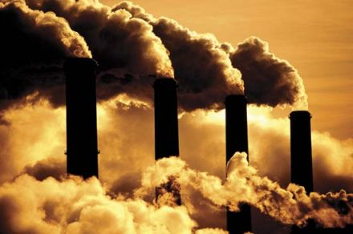
G. Bala, Caos Indian institute of Science
The global carbon cycle 101
3 April 2017
ICTS, Bengaluru

Slide 2

Who am I? A climate Modeller
Jack of All Trades but master of none
Climate modeling
Climate change
Carbon cycle
LULCC
Feedbacks
Geoengineering

Slide 3
Take home message
Mean surface temperature has increased by ~1ºC and could increase by additional 2-5ºC in this century
“Anthropogenic” CO₂ is the main driver
Climate change is irreversible on human timescale.
Natural carbon cycle processes would take millions of years to remove the “Anthropogenic” CO₂ from the atmosphere-ocean-land system

Slide 4
Evidence: Oceans have soaked up 100s of zeta (10²¹) joules of heat in recent decades
Cheng et al. 2017, Sci. Adv.

Slide 5
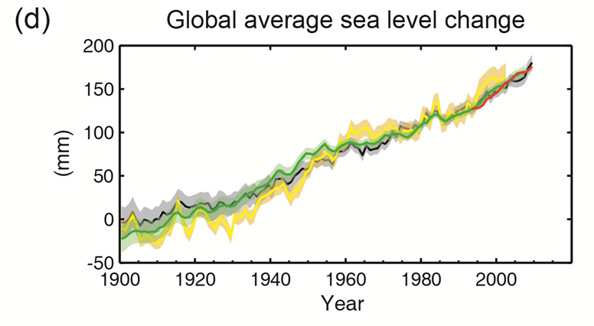
Sea level has increased by 20 cm since 1900
Mainly because of ocean expansion
IPCC, 2013

Slide 6
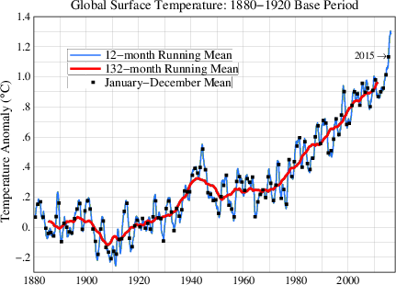
Global temperatures in 2016 were 1.1ºC above pre-industrial levels
2016 is 3rd year in row to set new record T

Slide 7
What is driving the temperatures upward?

Slide 8
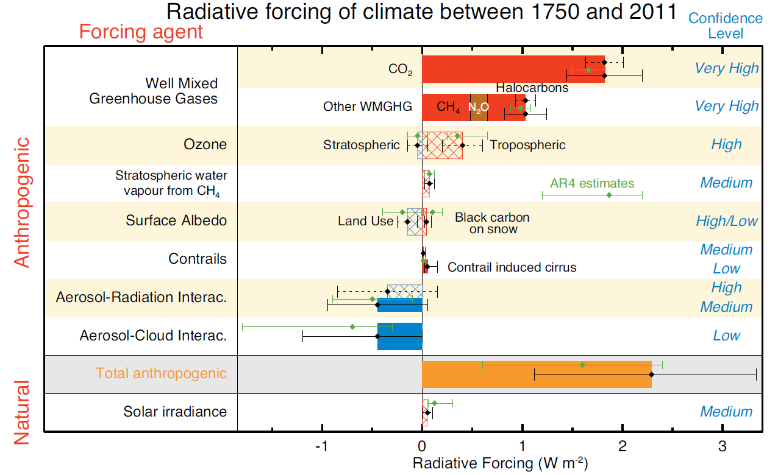
Drivers of Recent Climate Change
Dominant Driver
Enhanced Heating Rate ~ 2 Wm⁻²
≈ 1 PW
IPCC 2013

Slide 9
What is the change in CO₂ in recent decades?

Slide 10
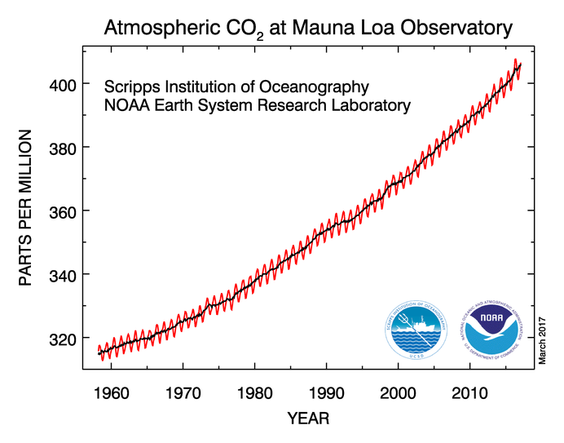
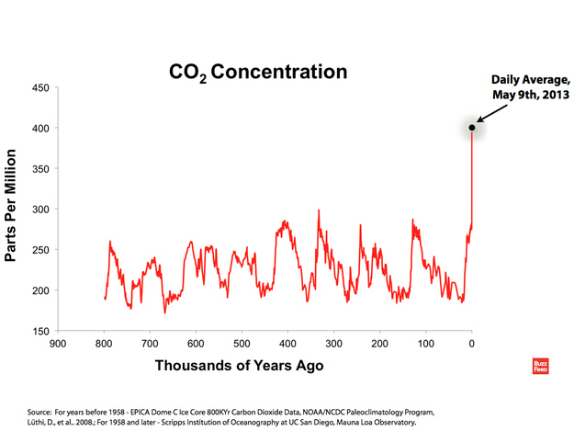

Atmospheric CO₂ is now over 400 ppm : 120 ppm above the pre-industrial level
~100 ppm increase in last 60 years
Unprecedented in the last 1 million years and possibly in the last 20 M years.

Slide 11
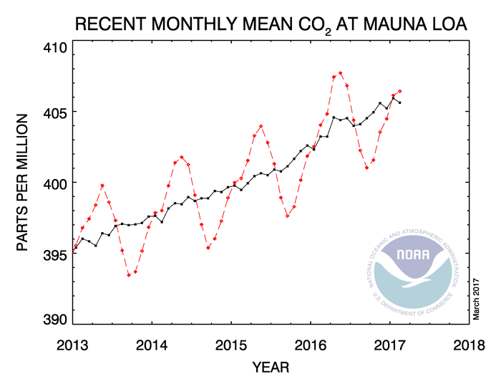
CO₂ in the last 5 years
Amplitude of the Oscillation ~ 7 ppm
May
Sept.
The rhythm comes from the “breathing” by NH vegetation

Slide 12
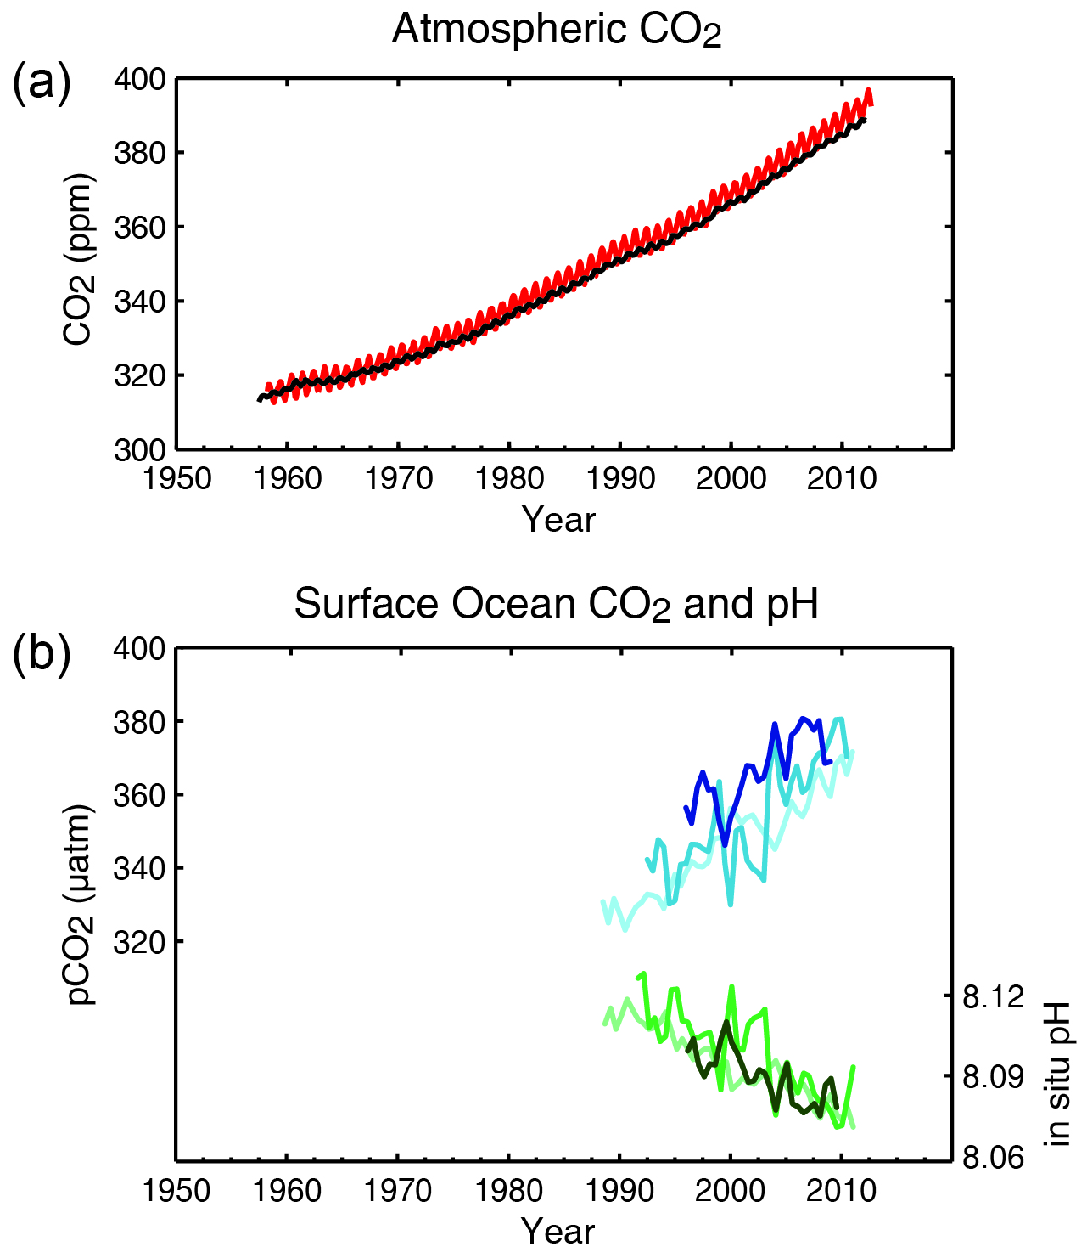
One definite consequence of CO₂ increase: Ocean Acidification
Ocean CO₂
pH

Slide 13
Reason for CO₂ increase?

Slide 14
Kaya Identity for CO₂ emission
CO₂ emission = population x (GDP/person) X (Energy Production/GDP) x (CO₂ emission/Energy Production)
CO₂ emission = population x (GDP/person) X Energy Intensity x Carbon Intensity

Slide 15
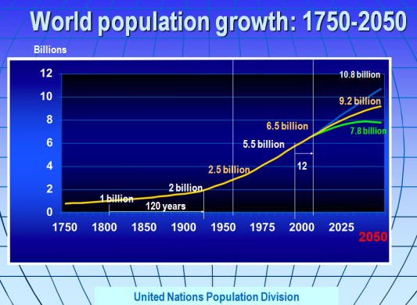
It took just 12 years to add 100 crore people on this planet recently
While it took 120 years in the pre-industrial era for the same increase

Slide 16
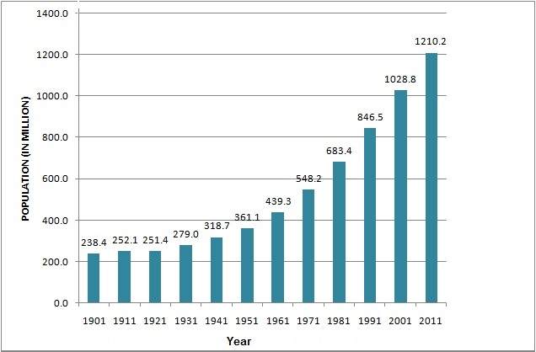
India’s population increased 5 fold in a century

Slide 17
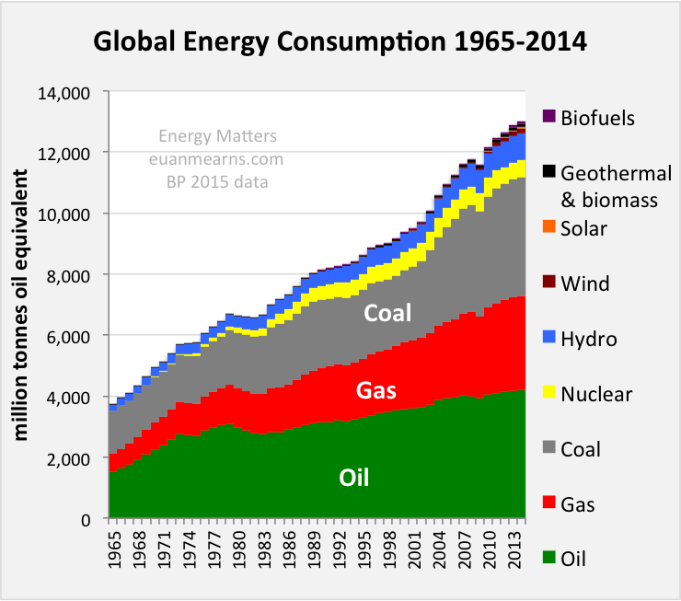
Global Energy consumption tripled in 50 years

Slide 18
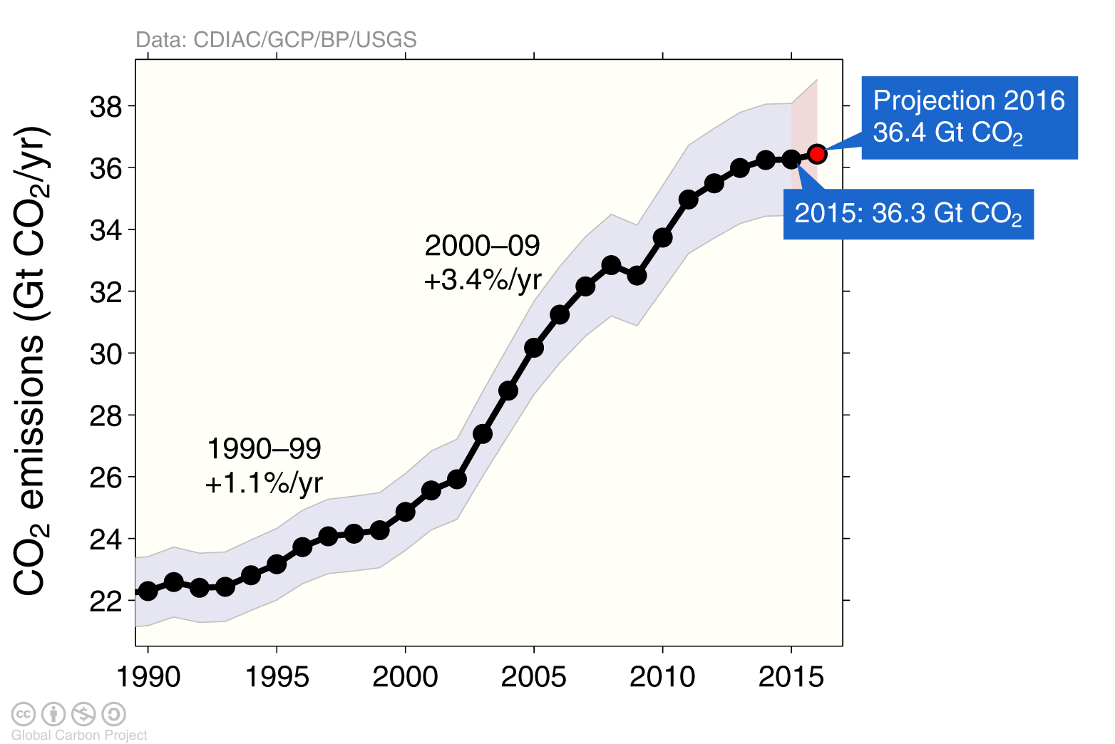
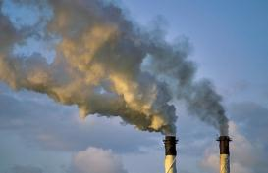
Fossil Fuel CO₂ Emission has increased by 63 % since 1990
Uncertainty is ±5% for one standard deviation (IPCC “likely” range)

Slide 19
Carbon in the context of Climate change
CO₂ is the Main driver for 20th and 21st century climate change.
Projection of future climate change requires a good understanding of “the Fate of atmos. CO₂”
How CO₂ is exchanged between land, ocean and the atmosphere?

Slide 20
Units for carbon for this talk
Atmospheric CO₂ is in ppm
Carbon stocks and fluxes are quoted in either Gt-C (giga tons of C) or PgC (peta grams) of C
1 ppm ~ 2 Gt-C = 2 PgC
1 mole of C ⬄1 mole of CO₂
=> 12 g C ⬄ 44 g CO₂
=> 1 Gt-C ⬄3.67 Gt-CO₂

Slide 21
What is the short term fate of our current CO₂ emissions?

Slide 22

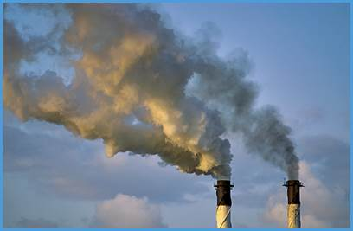
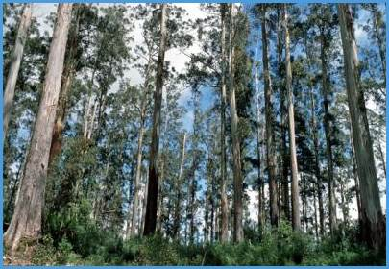
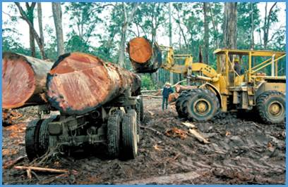

Fate of anthropogenic CO₂ emissions (2006-2015)
16.4 GtCO₂/yr
44%
34.1 GtCO₂/yr
91%
Sources = Sinks
31%
11.6 GtCO₂/yr
9%
3.5 GtCO₂/yr
26%
9.7 GtCO₂/yr
Source: CDIAC; NOAA-ESRL; Houghton et al 2012; Giglio et al 2013; Le Quéré et al 2016; Global Carbon Budget 2016

Slide 23
Carbon
Exists in oxidized (e.g. CO₂), intermediate (e.g. CH₂O), or reduced (e.g. CH₄) forms
Oxidized form is called inorganic carbon
Intermediate form is called carbohydrates
Reduced carbon is called hydrocarbons
Carbon in intermediate oxidation states (glucose (CH₂O)₆) and reduced forms are called organic carbon.

Slide 24
Carbon in 3 forms
 | Oxidized | Intermediate | Reduced
Example | CO₂ | CH₂O | CH₄
C oxidation state | +4 | 0 | -4
General Category | Inorganic Carbon | Carbohydrates | Hydrocarbons
Organic Carbon

Slide 25
Quiz
On earth, do we have more organic or inorganic carbon?

Slide 26
Quiz
On earth, do we have more of inorganic carbon or organic carbon?
Answer: Inorganic carbon
The largest reservoir is limestone (Calcium carbonate CaCO3)
Over land: limestone
Over ocean: Bicarbonate iron, HCO₃⁻

Slide 27
Carbon stocks on earth
Land
Atm
Archer 2007
Ocn
Rocks

Slide 28
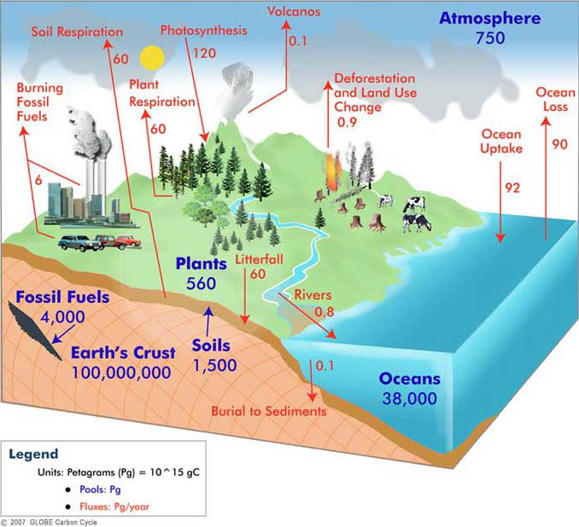
The Global carbon cycle
1. Atmos – Land exchange
2. Atmos – Ocean exchange
3. Weathering

Slide 29

Carbon interaction over land
Photosynthesis and respiration
6CO₂ + 6H₂O + sunlight (heat) ↔ (CH₂O)₆ + 6O₂
Production ↔ destruction
Plants do both
We perform only the backward reaction (respiration)

Slide 30
Carbon interaction in the Ocean
CO₂ (atmospheric) ↔ CO₂ (dissolved)
CO₂ (dissolved) + H₂O ↔ H₂CO₃ (carbonic acid)
H₂CO₃ ↔ H⁺ + HCO₃⁻ (bicarbonate iron)
HCO₃⁻ ↔ H⁺ + CO₃²⁻ (carbonate iron)
Today, ~ 90 % of carbon in the ocean is in bicarbonate form and ~8% in carbonate form

Slide 31
Simple story of C Chemistry
The Net reaction is
CO₂ + H₂O + CO₃²⁻ ↔ 2HCO₃⁻
CO₂ invasion into ocean will deplete CO₃²⁻
Reduced CO₃²⁻ is detrimental to organisms that need CO₃²⁻ for making shells and skeletons
Addition of CO₂ will deplete CO₃²⁻ and
the buffering capacity (CO₂ uptake capacity
of seawater) will decline.

Slide 32
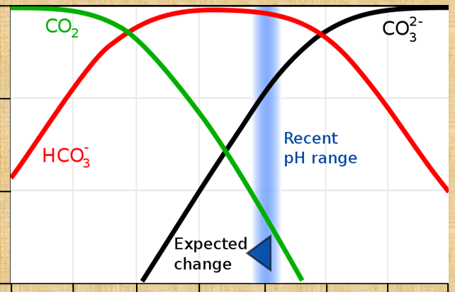
DIC ratios (Bjerrum plot)
1
0.1
0.01
0.001
Ratios of concentrations
Today
CO2 invasion depletes CO₃ ²⁻
4 5 6 7 8 9 10 11
Acidic pH Basic

Slide 33
Carbon interaction with Rocks
Carbonate mineral weathering
CaCO₃ + CO₂ + H₂O → Ca²⁺ + 2HCO3⁻
Silicate mineral weathering
CaSiO₃ + 2CO₂ + H₂O → Ca²⁺ + 2HCO3⁻ + SiO₂
Rivers carry the ions to the ocean
Weathering rates are larger in warm and wet climates

Slide 34
Carbonate weathering helps to transfer CO₂ from atmosphere to oceans
Carbonate mineral weathering
CaCO₃ + CO₂ + H₂O ↔ Ca²⁺ + 2HCO3⁻
When marine organisms form CaCO3, the reverse reaction releases CO₂ back and hence carbonate weathering does not lead to net removal from the atm-ocn system. But it helps to transfer CO₂ from atmosphere to Ocean

Slide 35
But Silicate weathering removes CO₂ permanently
Silicate mineral weathering
CaSiO₃ + 2CO₂ + H₂O → Ca²⁺ + 2HCO3⁻ + SiO₂
→CaCO₃ + SiO₂ + CO₂ + H₂O
Each molecule of Silicate can sequester one CO₂ molecule into CaCO₃ which could settle on the ocean floor

Slide 36
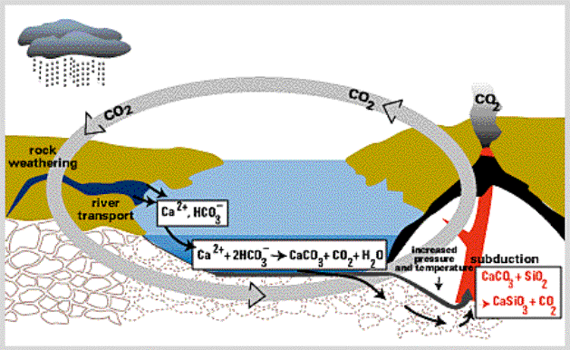
The long-term global carbon cycle
~0.1 PgC/yr
~0.1 PgC/yr
Carbonate deposition rate~0.1 PgC/yr

Slide 37
Can Silicate weathering remove anthropogenic CO₂ emissions?

Slide 38

Can Silicate weathering remove anthropogenic CO₂ emissions?
CO₂ emissions from human activities
≈ 10 PgC/ yr
PgC/yr
CO₂ consumption by silicate weathering ≈ 0.1 PgC/ yr

Slide 39
Can Silicate weathering remove anthropogenic CO₂ emissions?
It would take 10,000 years to remove a century of CO₂ emissions from human activities (provided CaCO₃ deposition on the ocean floor is unchanged) …… but

Slide 40
The Perturbed Carbon Cycle

Slide 41

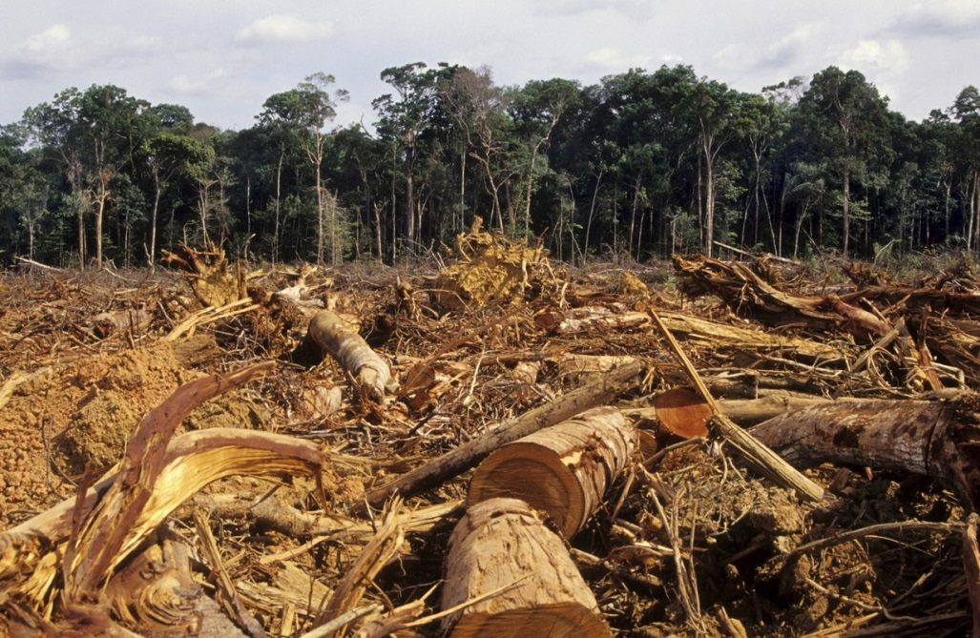
The Major Perturbations in the Industrial Era
Fossil Fuel Emissions
Land cover change

Slide 42
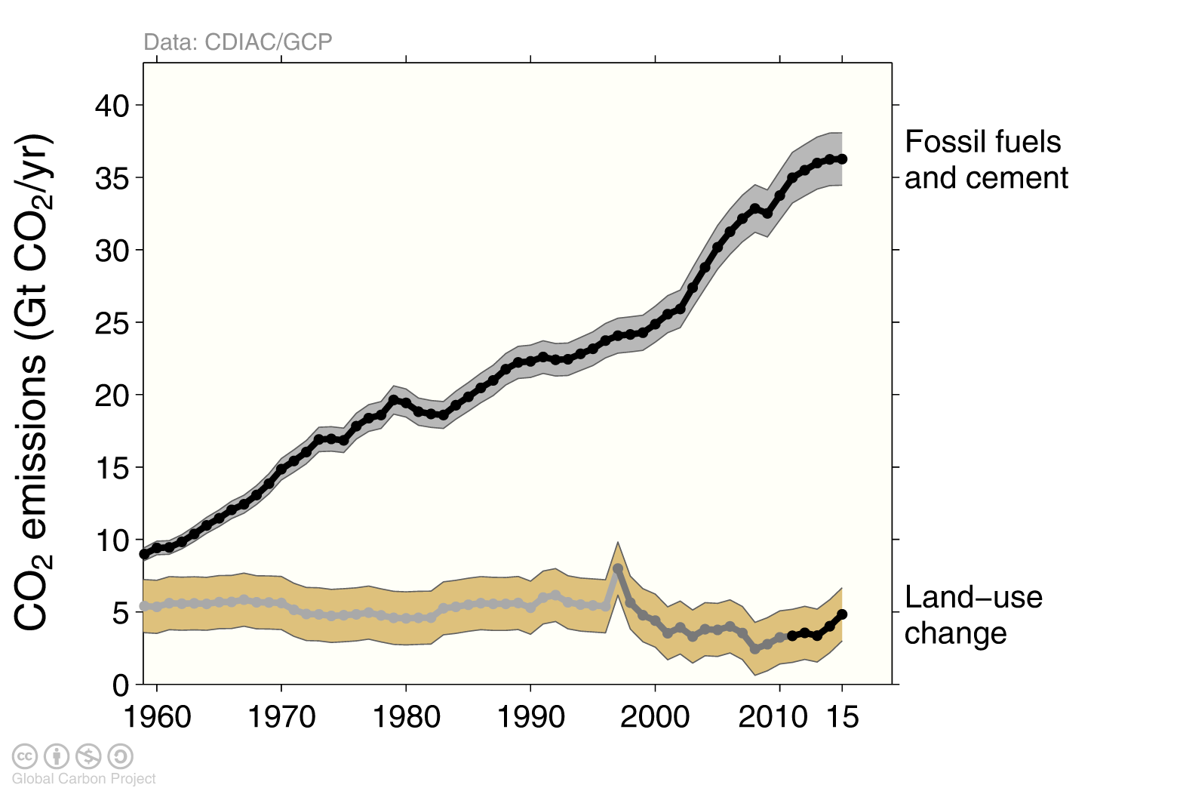
Total global emissions
Total global emissions: 41.9 ± 2.8 GtCO₂ in 2015, 49% over 1990 Percentage land-use change: 36% in 1960, 9% averaged 2006-2015
Fossil Fuel
Land Use
Three different methods have been used to estimate
land-use change emissions, indicated here by different shades of grey Source: CDIAC; Houghton et al 2012; Giglio et al 2013; Le Quéré et al 2016; Global Carbon Budget 2016

Slide 43
Fate of anthropogenic CO₂ emissions (2006-2015)
16.4 GtCO₂/yr
44%
34.1 GtCO₂/yr
91%
Sources = Sinks
31%
11.6 GtCO₂/yr
9%
3.5 GtCO₂/yr
26%
9.7 GtCO₂/yr
Source: CDIAC; NOAA-ESRL; Houghton et al 2012; Giglio et al 2013; Le Quéré et al 2016; Global Carbon Budget 2016

Slide 44
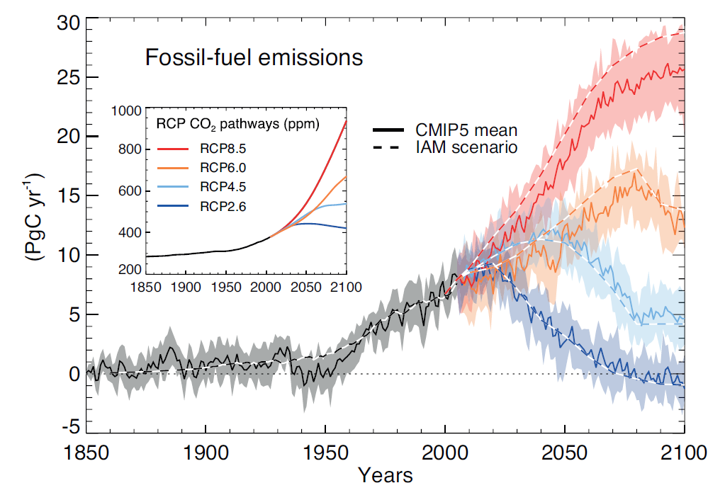
Projected CO₂ levels be more than double by 2100
IPCC 2013
Present day

Slide 45
Long term fate of fossil fuel emissions
What if all the conventional fossil fuels (~ 4000 Gt-C) are emitted into the atmosphere
Where will it go?
Ridgwell and Edwards, 2006
Year

Slide 46
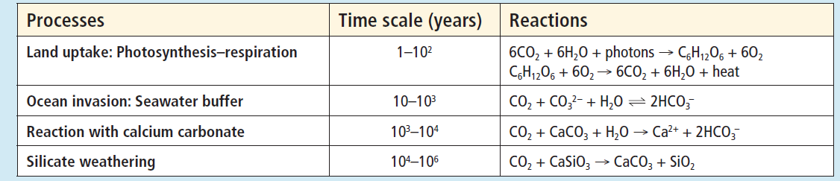
CO₂ removal from atm-land-ocean system
Climate Change is irreversible on human timescales
IPCC, 2013

Slide 47
CO₂ removal on 1-10 year timescale
Ridgwell & Edwards 2007
Uptake by land and surface ocean

Slide 48
CO₂ removal on 10-100 year timescale
Ridgwell & Edwards 2007
CO₂ invades the deep ocean

Slide 49
CO₂ removal on 1000 year timescale (~65% gone)
Ridgwell & Edwards 2007
Ocean Invasion
Climate change
No
Climate change
Year
Atm. CO₂ equilibrates with ocean

Slide 50
CO₂ removal on 10,000 year timescale (~80% gone)
Ridgwell & Edwards 2007
Climate change
Ocean Invasion only
No
Climate change
Sea floor CaCO3dissolution
Year
Dissolution of CaCO₃ on ocean floor

Slide 51
CO₂ removal on 100,000 year timescale (~90% gone)
Ridgwell & Edwards 2007
Ocean Invasion only
No
Climate change
Sea floor CaCO3 dissolution+ land CaCO3 weathering
Year
CaCO₃ weathering on land pulls atm. CO₂ further down

Slide 52
So far, CO₂ has not been removed from atm-ocn system: It has been only transferred from atmosphere to ocean
CaCO₃ + CO₂ + H₂O ↔ Ca²⁺ + 2HCO3⁻
Weathering or CaCO₃ dissolution
Calcification
Calcification releases CO₂ to the ocean

Slide 53
CO₂ removal on 1,000,000 year timescale
Lenton &
Britton 2006
Ridgwell & Edwards 2007
Climate change
No
Climate change
Silicate weathering on land pulls down atm. CO₂ to pre-industrial levels

Slide 54
Summary: CO₂ removal timescale in the Climate System
Climate Change is irreversible on human timescales
IPCC, 2013

Slide 55
Take Home message
On time scales of 100,000 to million years , the silicate weathering would clean up our mess & pull down the CO₂ to pre-industrial levels.
Ultimately, all “Fossil Fuel CO₂” would be converted to carbonate deposits on the ocean floor.

Slide 56


Slide 57
Long term fate of fossil fuel emissions
CO₂ invasion will acidify the oceans (lower pH)
Carbonate ion concentration will decrease
Acidification will dissolve shells of certain
marine organisms.
It could even dissolve CaCO₃ on the ocean floor.
Dissolution of CaCO₃ helps to remove CO₂

Slide 58
Long term fate of fossil
fuel emissions
The lower concentration of carbonate iron will favor the reverse reaction:
Ca₂⁺+ 2HCO₃⁻ CO₂+ H₂O + CaCO₃
CO₂ will be released to the atmosphere and pH will increase.
Increase in atmospheric CO₂ would lead to again cause a decline in pH.
Back and forth of increase and decrease of pH
This process could take thousands of years

Slide 59
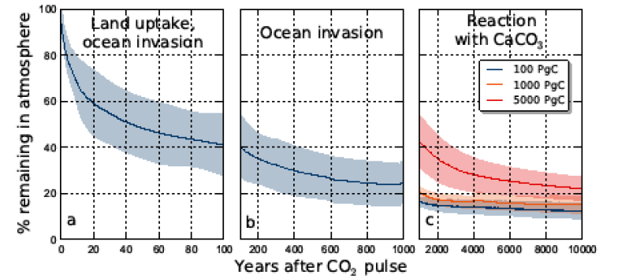
Long term fate of fossil
fuel emissions
IPCC 2013
~ 20 % of emissions may stay in the atmosphere for many thousands of years.

Slide 60
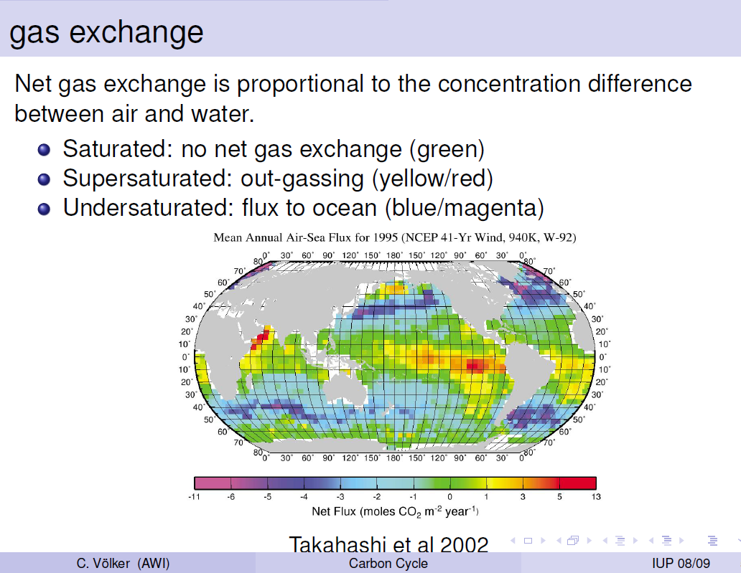

Slide 61
Precipitation increases with T
O’Gorman et al . 2010

